Slide 1
Energy Saving in West Bank- Palestine.
Prepared by:
Abdullah Qadomi
Ahmad Yassin
Yazan Rashed
Supervisor:
Dr. Adel Juaidi

Slide 2
Outline
Introduction
Methodology
Case Study
Results and Analysis
Conclusion and Recommendations

Slide 3
Introduction
Energy saving improved by:
Renewable energy
Lighting system improvement
HVAC system

Slide 4
Introduction
The most important issue facing the world in our time is
energy, which is the basis for most environmental,
sustainable and economic issues.
High electric energy consumption is one of the major issues in global use and can be a major problem for emerging countries.

Slide 5
Methodology
Analysis by Excel:
Before PV installation
After PV installation
Suggestions:
LED lighting
Adding 9 panels (PV)

Slide 6
Case study
Faqqua Association Cooperative Consumer building in Faqqua-Jenin, which supported a renewable energy building mechanism. The data collected on the basis of this building.

Slide 7
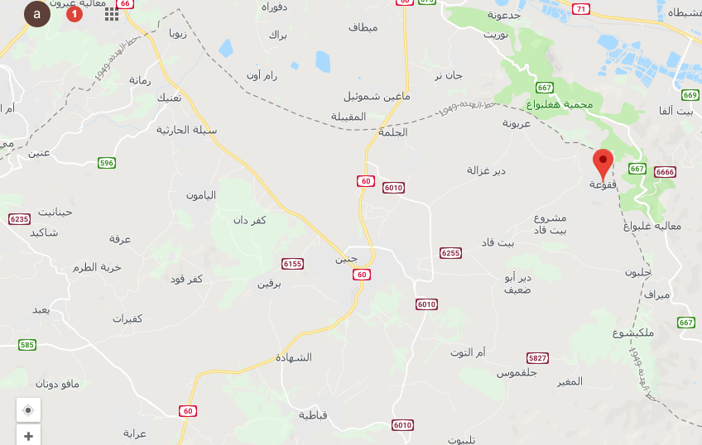
Case Study Location

Slide 8
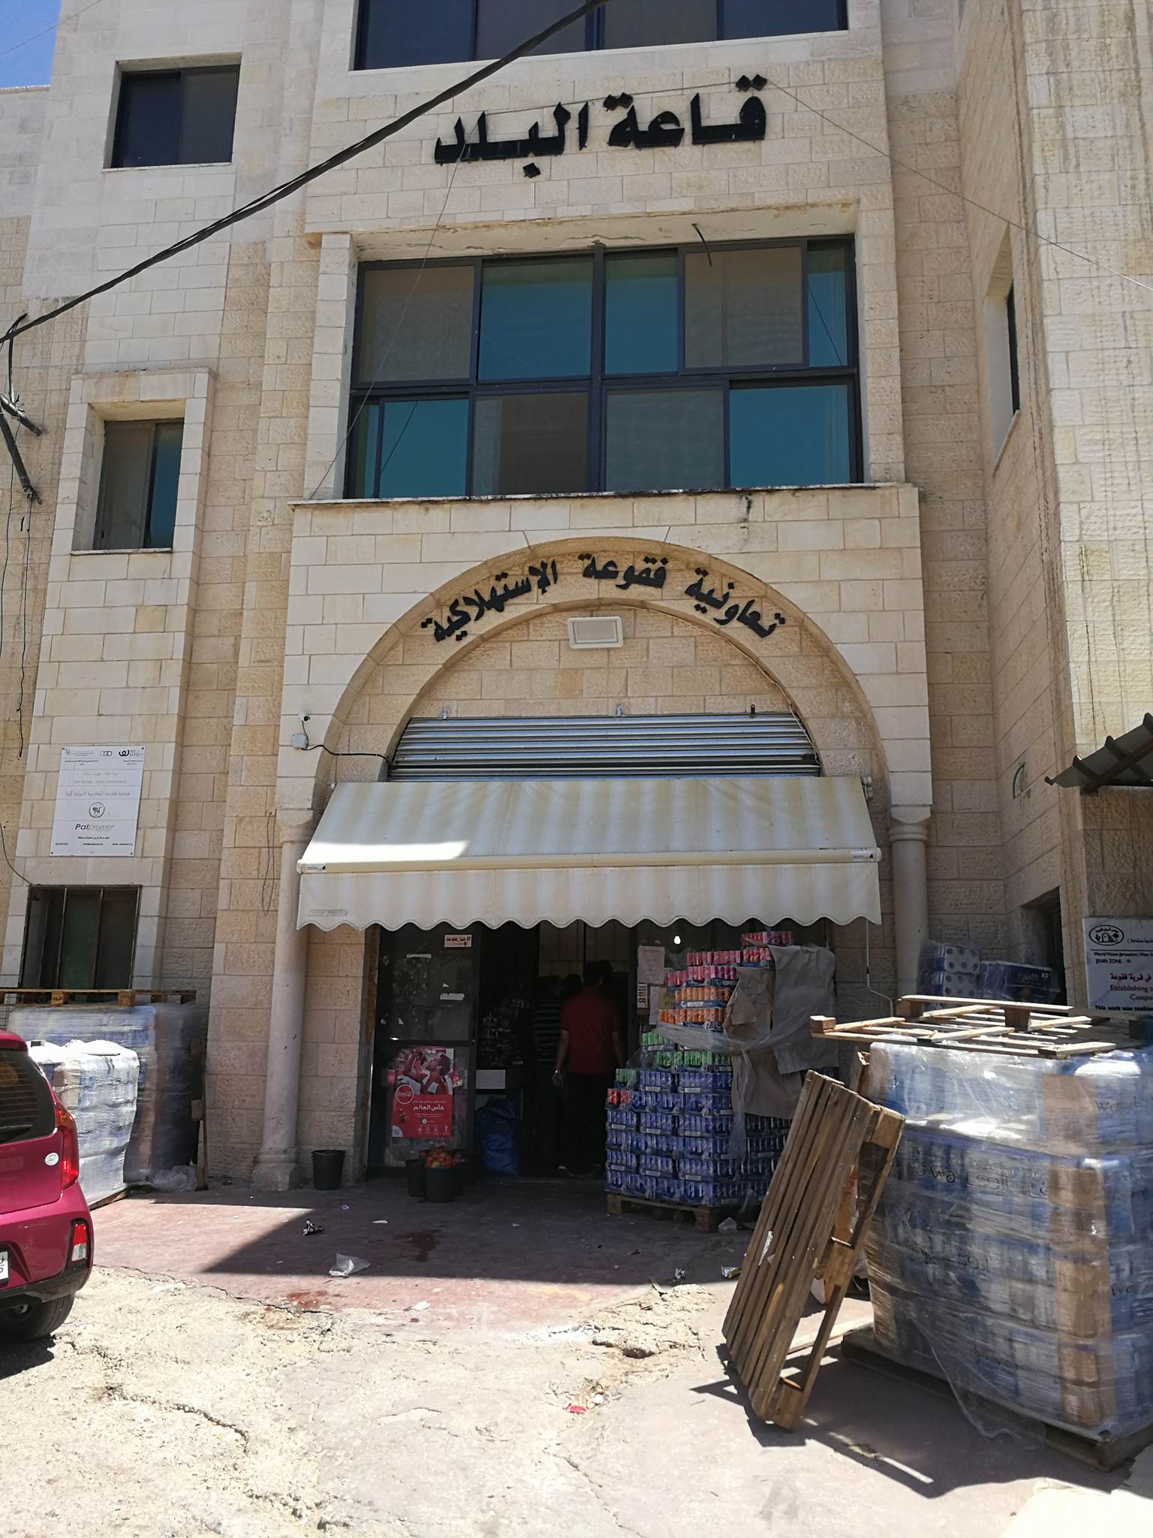

Slide 9
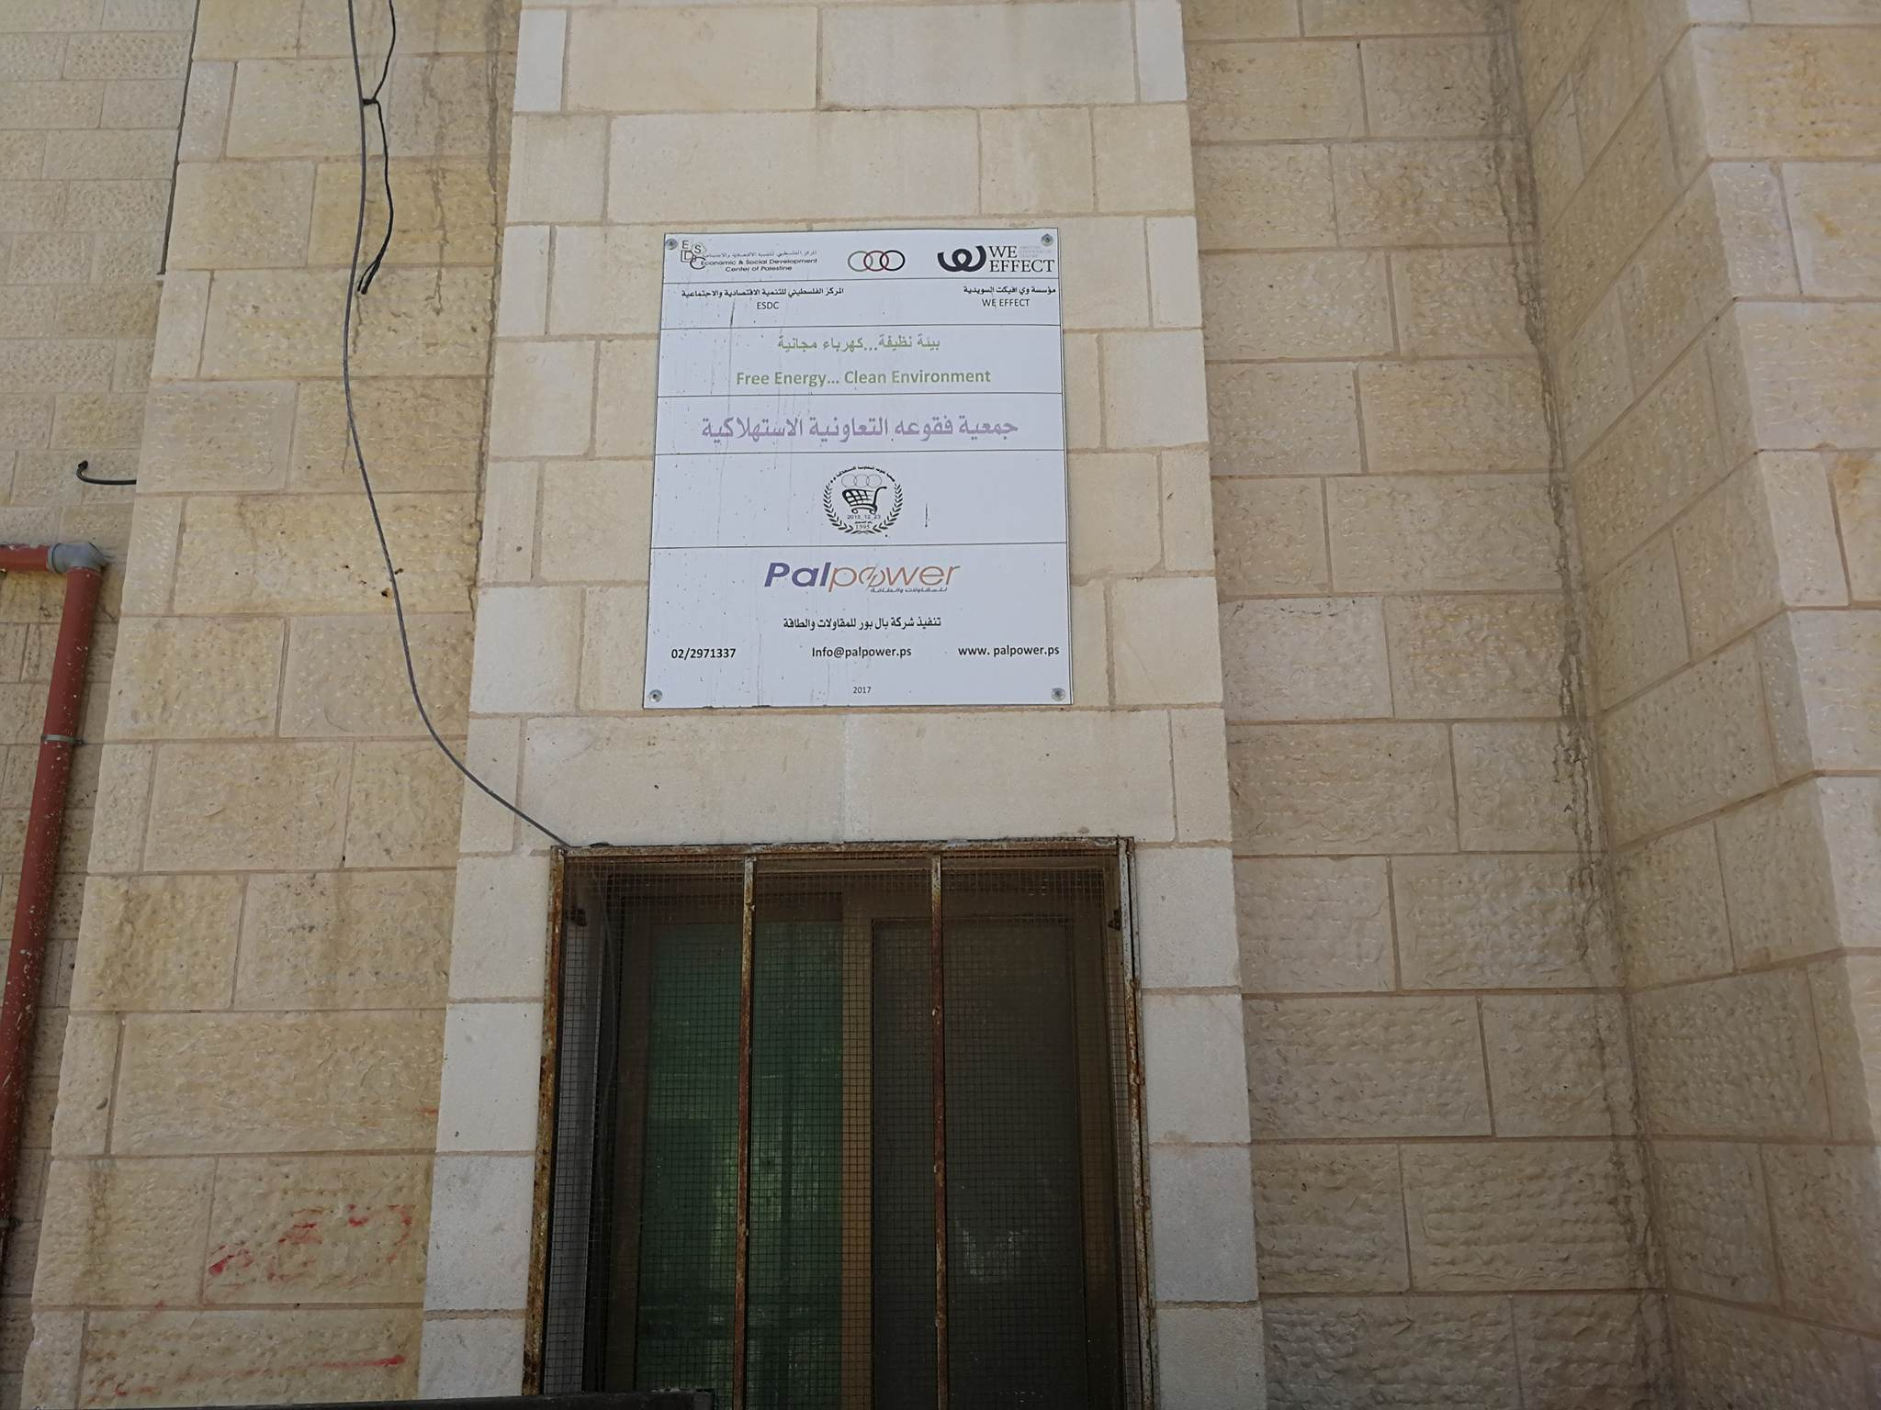

Slide 10
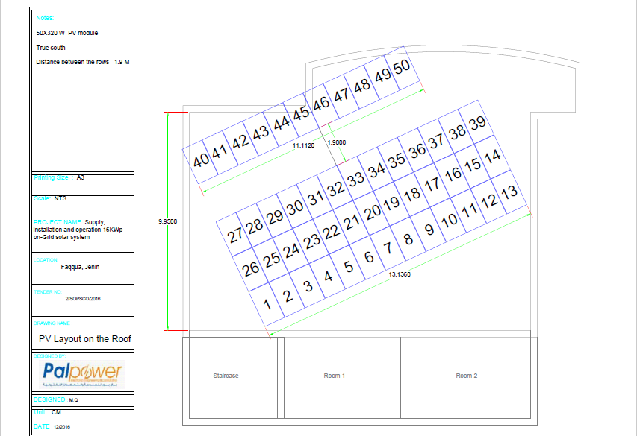
PV Layout on the Roof

Slide 11
Results and Analysis
Annual Energy Consumption and PV Supplied Energy of the Case Study

Slide 12
Results and Analysis
Annual Cost before and after PV System.

Slide 13
Results and Analysis
.

Slide 14
Results and Analysis
Economic Analysis for the System
Payback period is 7 years.
12,250
16,228
0
92,160
1 year
14,205.6
2 years
1,487

Slide 15
Results and Analysis
Comparison between Data Before and After PV System and the Suggestions.
System | Annual Consumption from Grid (KWh) | Annual Cost (NIS) | Initial Cost (NIS) | Energy Saving (KWh) | Energy Saving (%)
Before PV | 28,240 | 15,334 | 0 | 0 | 0
After PV | 7,655 | 3,827.5 | 92,160 | 2,0585 | 73
LED System | 1,663.2 | 831.6 | 504 | 2,772 | 10
Adding Nine Panels | 0 | 0 | 12,331.6 | 4,883 | 17

Slide 16
Conclusion and Recommendations
The initial cost is the main reason for increasing of payback period in PV system.
Energy star certified air conditioning is advised to install for saving the products outside the refrigerator such as flour.

Slide 17


