Slide 1
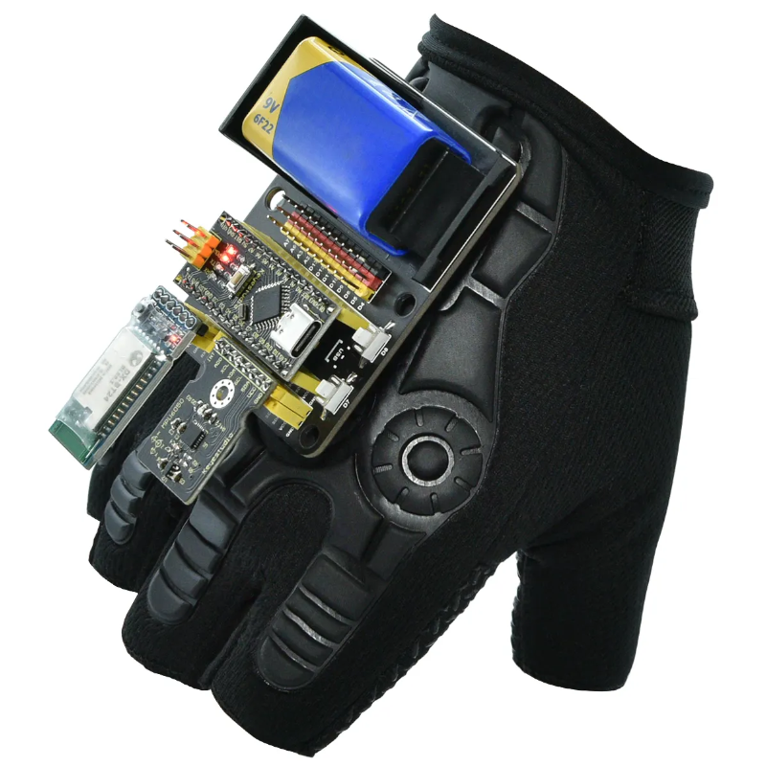
GRADUATION PROJECT II
Smart Glove
Controlled Wheelchair
Gesture-based mobility control using motion sensing,
wireless communication and obstacle detection.
PREPARED BY
Nagham Fraij • Akram Abu Aisheh
SUPERVISED BY
Dr. Aladdin Masri • Hanal Abu Zant
An-Najah National University — Computer Engineering Department — 2026

Slide 2



The Problem & Motivation
Why conventional wheelchair control falls short for many users
Limited hand strength
Reduced coordination
Need for independence
Joystick and manual controls demand continuous physical effort that not every user can sustain.
Mobility restrictions and limited motor coordination make precise joystick operation difficult.
Assistive technology must offer more natural, intuitive control to preserve user autonomy.

Slide 3





Project Objectives
Build a safe, low-cost, gesture-driven mobility system
Wearable sensing glove
Wireless link
Directional control
Detect hand movement & orientation with an MPU6050 motion sensor.
Establish reliable HC-05 Bluetooth communication between the two units.
Drive the chair forward, backward, left, right and stop on command.
Obstacle safety
Audible alerts
Low-cost & reliable
Use an HC-SR04 ultrasonic sensor to detect obstacles and prevent collisions.
Trigger a buzzer warning whenever a hazard is detected ahead.
Deliver an affordable assistive solution from widely available parts.

Slide 4
System Overview
Two cooperating units communicating over Bluetooth
GLOVE UNIT
WHEELCHAIR UNIT
Transmitter
Receiver
Arduino Nano (gesture processing)
MPU6050 motion sensor
HC-05 Bluetooth module
9V battery / power bank
Arduino Nano + HC-05 receiver
L298N driver + DC motors
HC-SR04 ultrasonic sensor
Buzzer + battery pack
Bluetooth

Slide 5
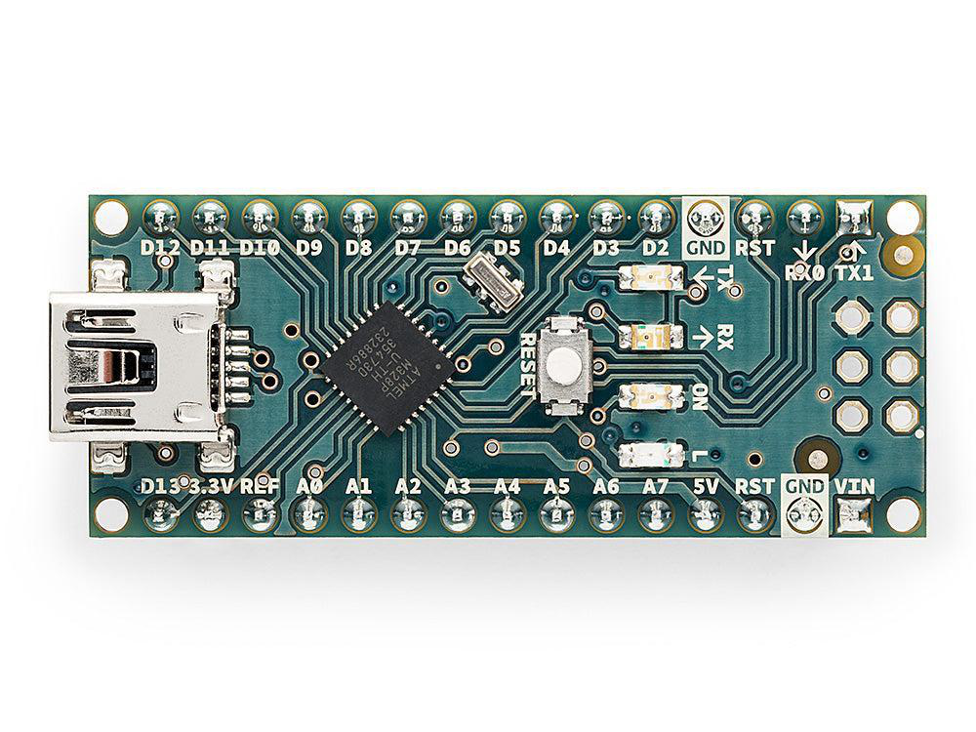
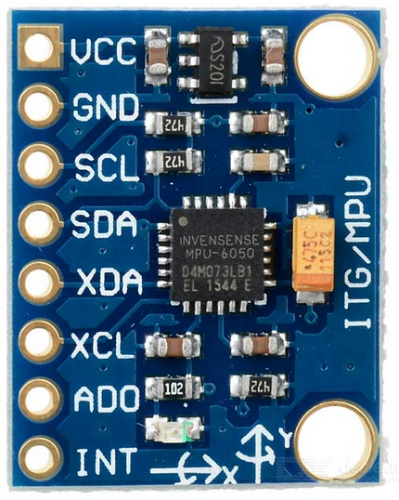
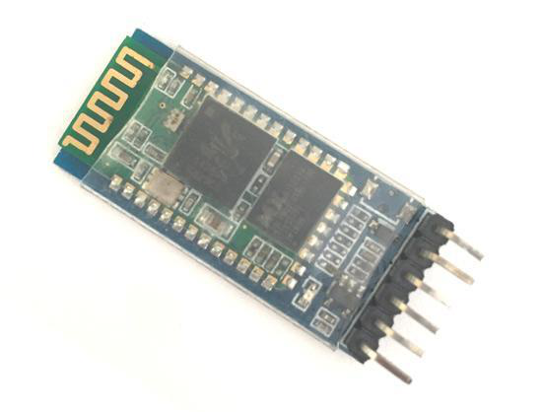
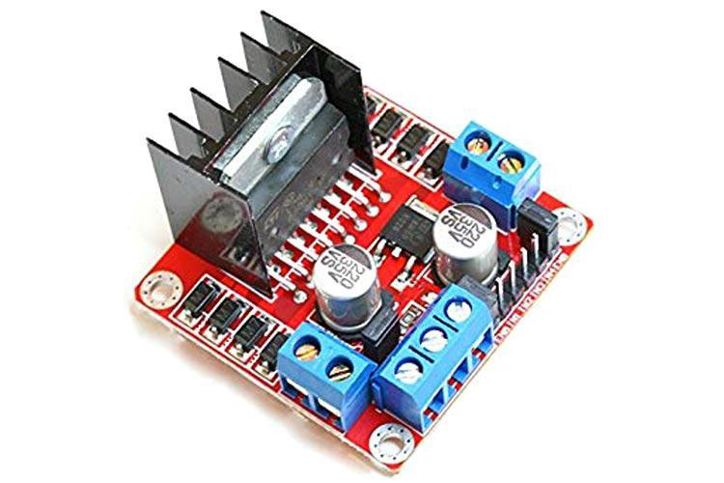
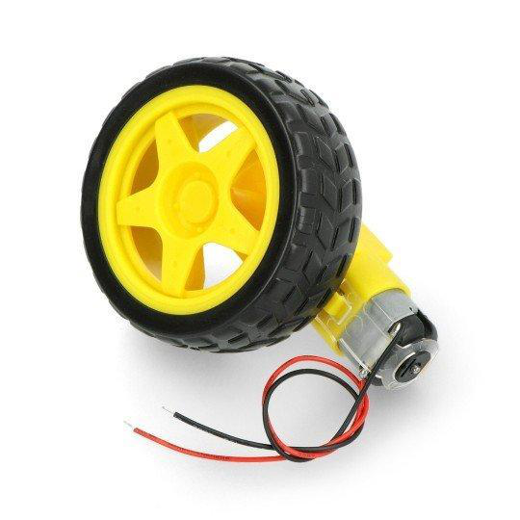
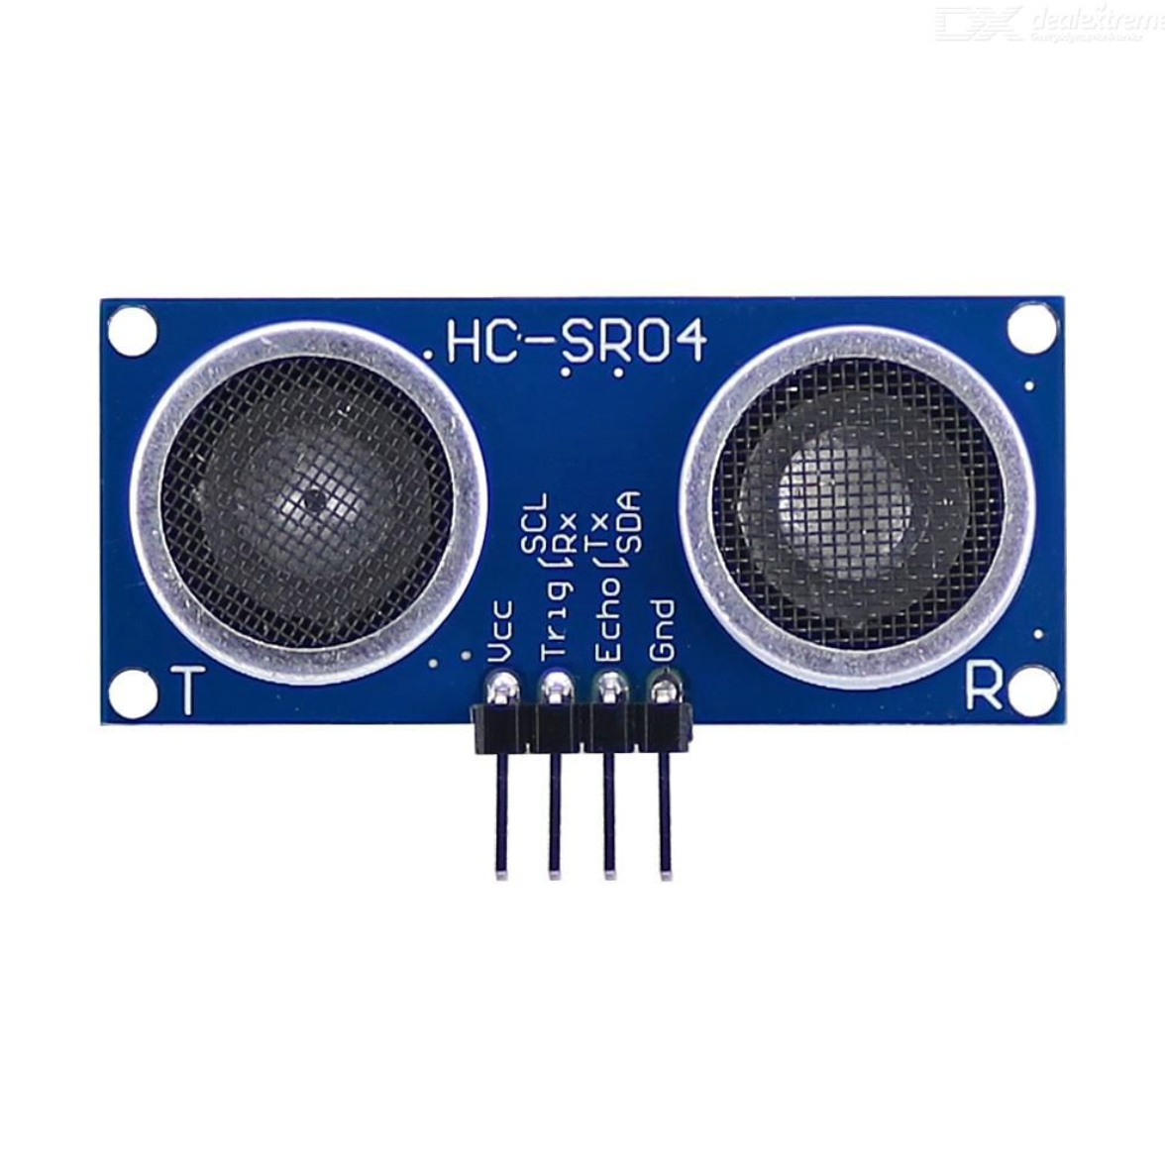
Hardware Components
Off-the-shelf, low-cost modules integrated into one system
Arduino Nano
MPU6050
HC-05
ATmega328P controller ×2
3-axis accel + gyro
Bluetooth serial ×2
L298N
DC Motors
HC-SR04
Dual H-bridge driver
Differential drive
Ultrasonic distance

Slide 6


How It Works
From a hand tilt to wheel motion — in real time
1 · Sense
2 · Interpret
3 · Transmit
4 · Check
5 · Move
MPU6050 reads hand tilt & orientation via I²C.
Arduino compares readings to thresholds → gesture.
Command character sent over HC-05 Bluetooth.
Receiver verifies the path is clear of obstacles.
L298N drives the DC motors in the right direction.
Returning the hand to a neutral position is treated as STOP — minimizing accidental movement.

Slide 7
Gesture Command Mapping
Each hand gesture maps to a single command character
Hand Gesture | Command | Wheelchair Response
Tilt Forward | F | Move Forward
Tilt Backward | B | Move Backward
Tilt Right | R | Turn Right
Tilt Left | L | Turn Left
Neutral Position | S | Stop Motors
Obstacle Detected | STOP | Stop + Activate Buzzer
Table 1 — gesture-to-command relationship used throughout testing.

Slide 8
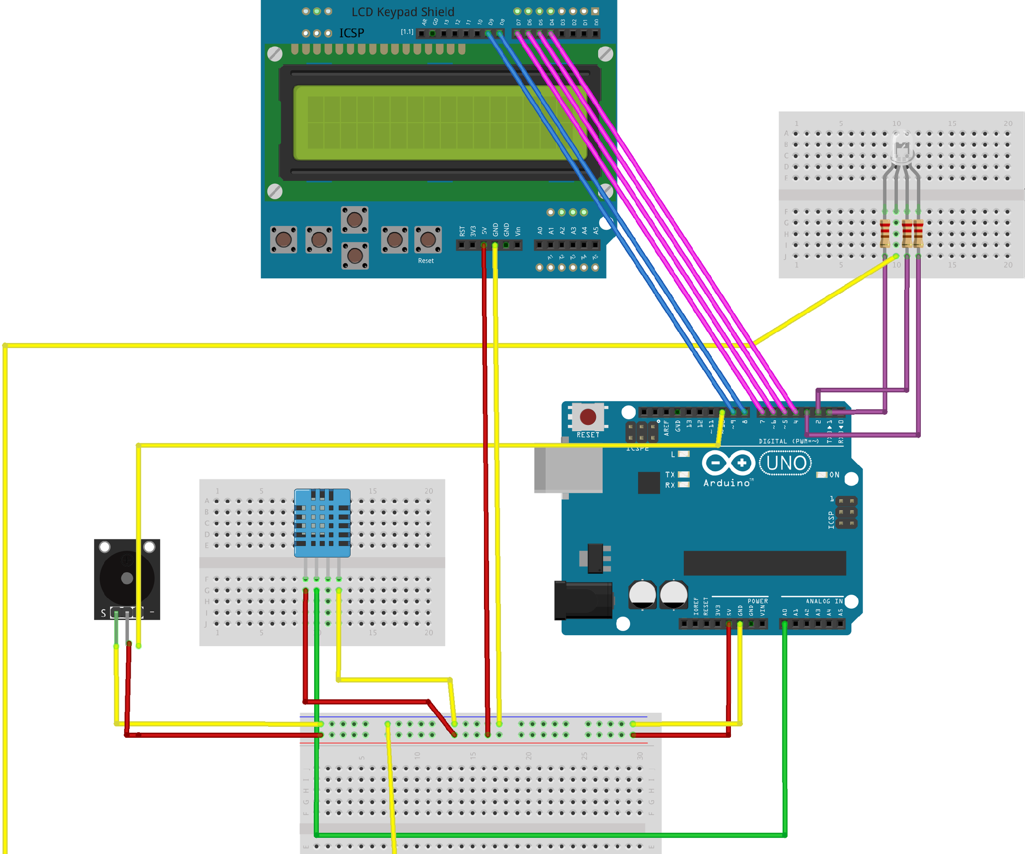

Safety: Obstacle Detection
An always-on layer that prevents collisions
Continuous sensing
HC-SR04 emits ultrasonic pulses and times the echo to measure distance to objects ahead.
Auto-stop threshold
If an obstacle enters the safety distance, the Arduino halts the motors instantly.
Audible warning
The buzzer sounds to alert the user the moment a hazard is detected.
Prototype wiring on the wheelchair unit

Slide 9
Results & Discussion
Tested indoors across all movement commands and obstacle scenarios
5
2-way
0
Movement commands
Bluetooth link
Missed stops
Key findings
The MPU6050 detected hand orientation accurately and gestures converted cleanly into commands.
The L298N delivered consistent motor response across repeated runs.
The HC-SR04 + buzzer reliably blocked forward motion when the safety threshold was crossed.

Slide 10

Limitations & Future Work
Honest constraints today — and where the project goes next
Current Limitations
Future Enhancements
Limited Bluetooth communication range.
Sensor accuracy depends on per-user calibration.
Single front sensor — no side/rear coverage.
Wooden chassis is for demonstration only.
PWM speed control for smoother motion.
Multiple sensors for full 360° coverage.
Emergency stop button & battery monitoring.
Mobile app, voice control & AI gestures.

Slide 11
Conclusion
A low-cost, gesture-controlled wheelchair
that works — and scales.
The prototype integrates motion sensing, wireless communication, motor control and obstacle detection into one functional assistive system — improving independence and safety for users with mobility impairments, while staying affordable and easy to extend.
Thank you • Questions welcome
Nagham Fraij & Akram Abu Aisheh — An-Najah National University, 2026

