Slide 1


CE BRIDGE
GRADUATION PROJECT 1
By: “Moahammad Omar” Tanbour
Supervisor: Eng. Khaled Daud

Slide 2

OVERVIEW
01
02
03
Introduction
Motivation
Technologies
04
05
06
Project Overview
Future Work
Constraint

Slide 3
Introduction
01
CE Bridge project aim to officialize the operations in department registration, organized it and digitalize it, replacing existing traditional in person methods. simplify and make a way to connect each other to reach and bridge the gap between them formally.

Slide 4

02
Motivation
what encourage to do the project ?

Slide 5
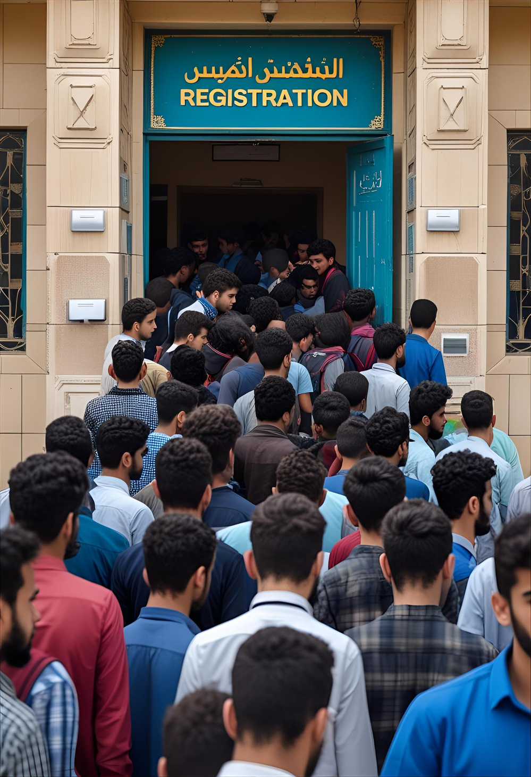
  Suffering of registration and long queuing at the registration office

Slide 6

2. the ambiguity of supervisors status and registration coordinator not aware of it

Slide 7


3. The longth of journey for seeking a suitable partner for the project

Slide 8
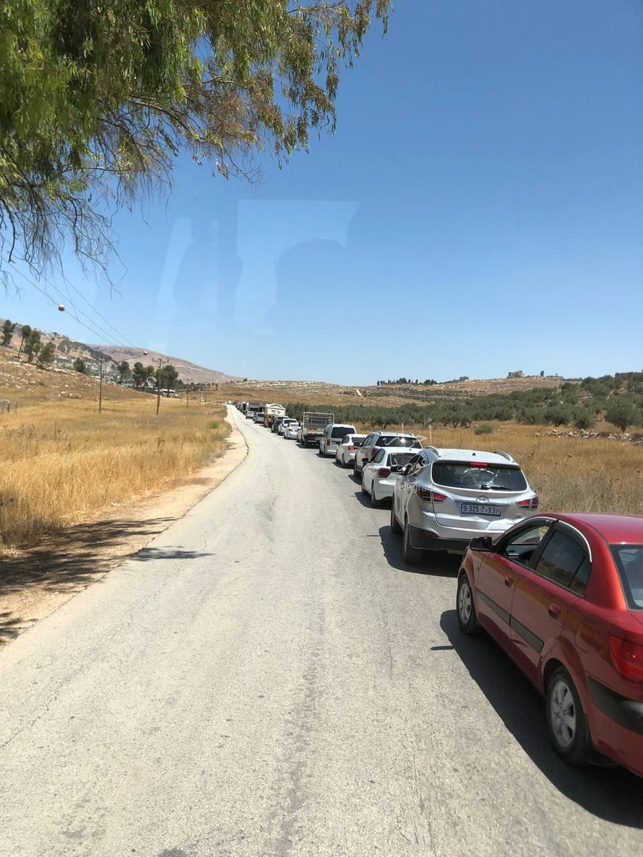
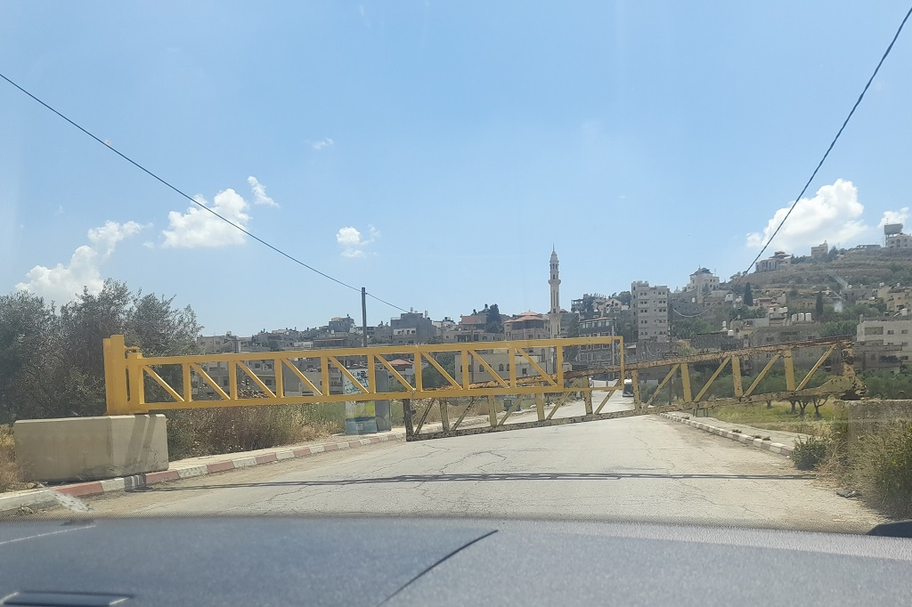
4. The traffic seige blockage of the roadways

Slide 9









03
TECHNOLOGIES AND FRAMEWORKS

Slide 10

04
Project Overview

Slide 11
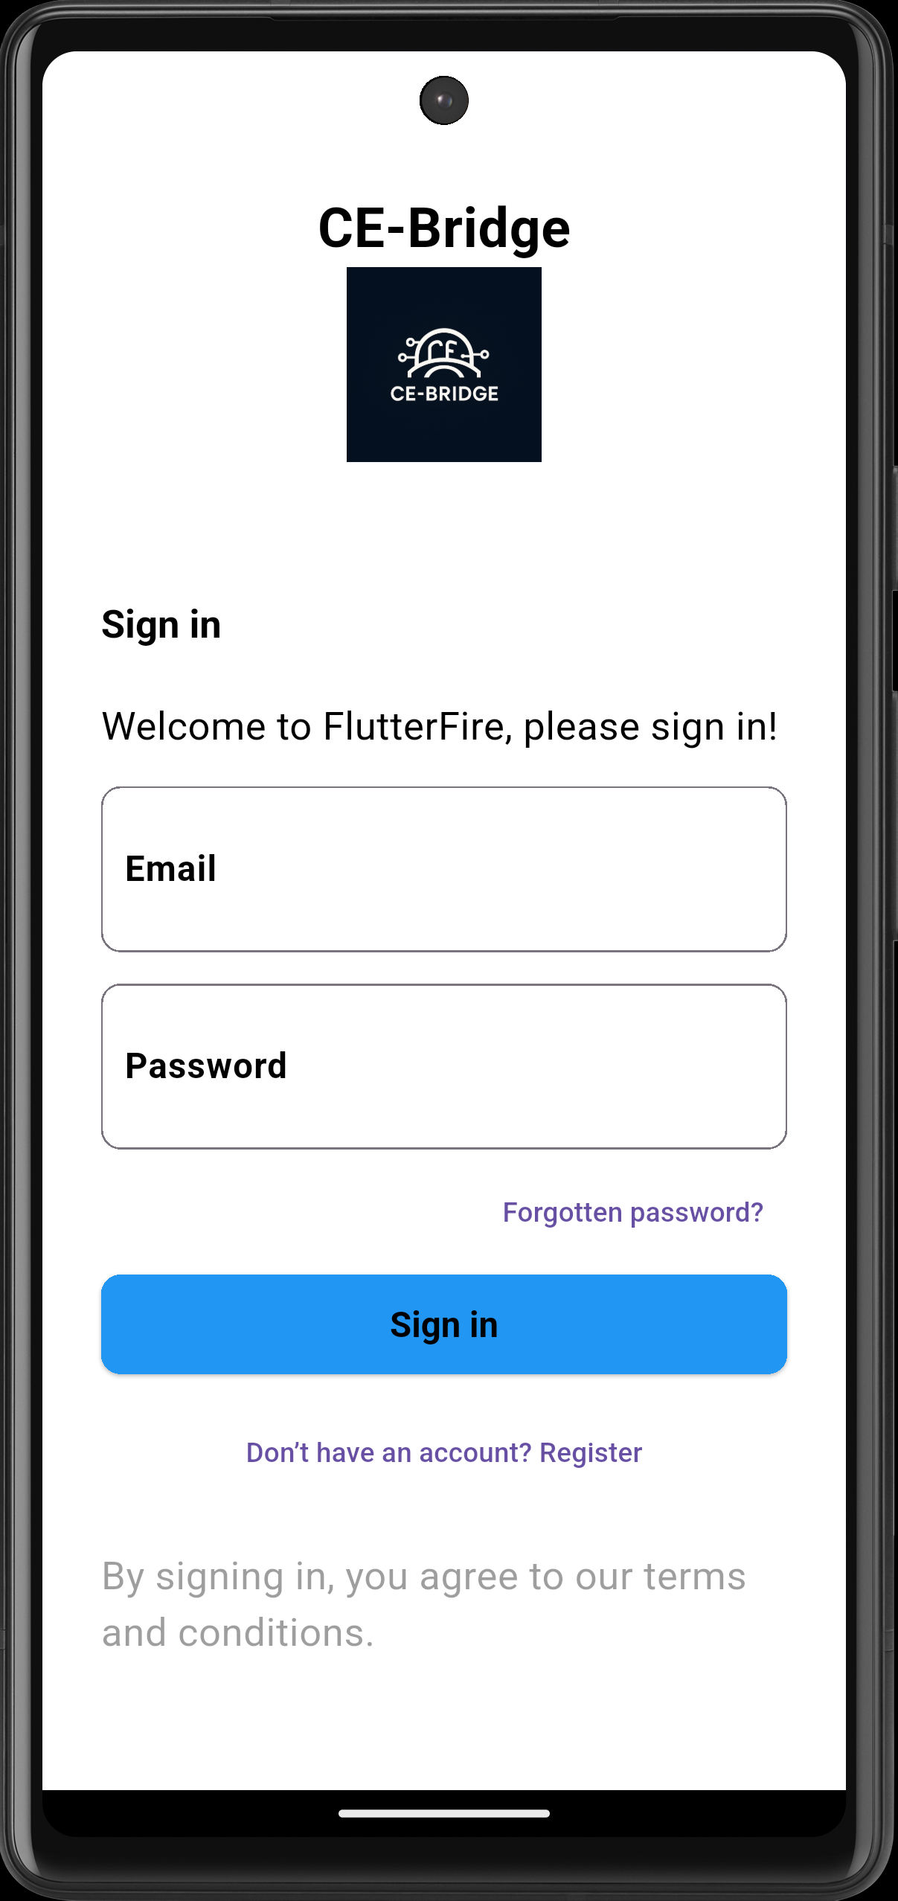
Login page

Slide 12
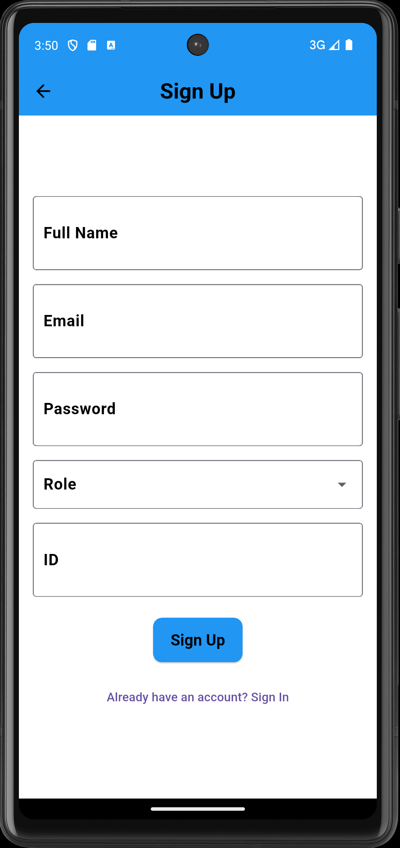
Sign up page
Users sign up by entering their name
Must use a university-affiliated email
Required to enter a strong password
Choose a role: student or admin
Enter their ID number during registration

Slide 13
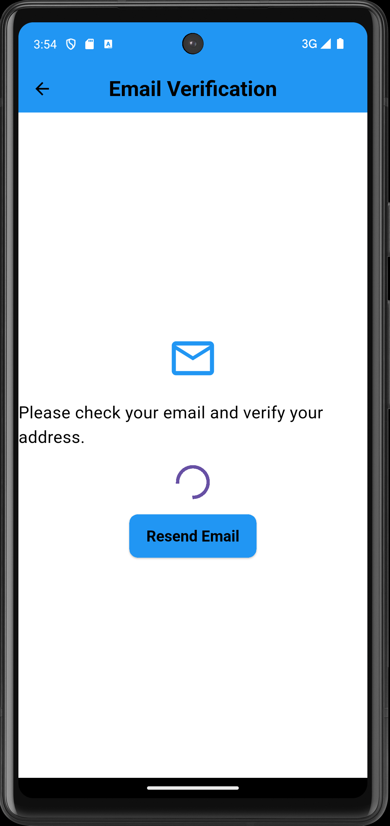
Wait for user action to proceed
Verify the user's email to continue
Verification page
Wait for user action to proceed
Verify the user's email to continue

Slide 14
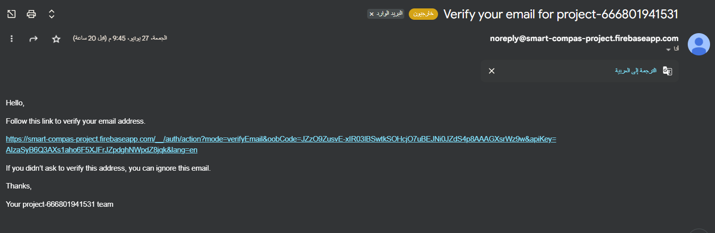
Wait for user action to proceed
Verify the user's email to continue
Verification Email
Wait for user action to proceed
Verify the user's email to continue

Slide 15
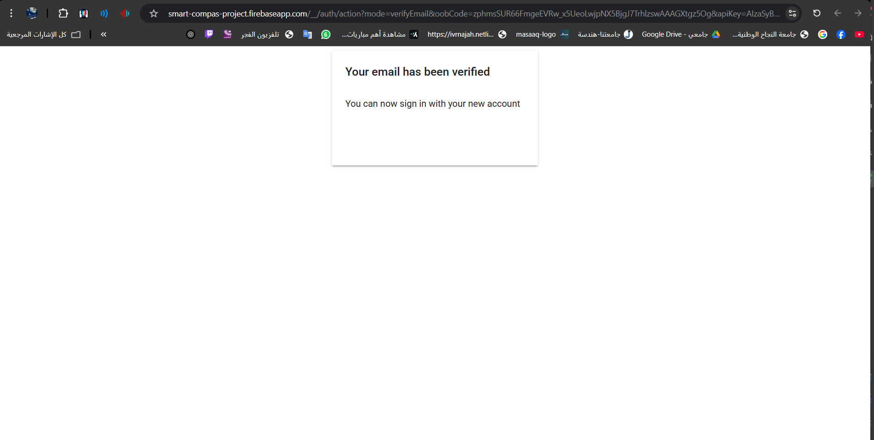
Wait for user action to proceed
Verify the user's email to continue
Verification Message
Congratulation your email verified!

Slide 16
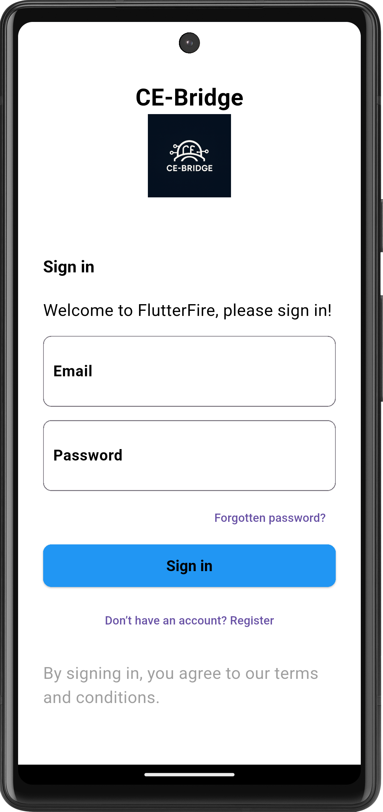
Wait for user action to proceed
Verify the user's email to continue
Forget Password
user can choose the option of forgotten password.

Slide 17
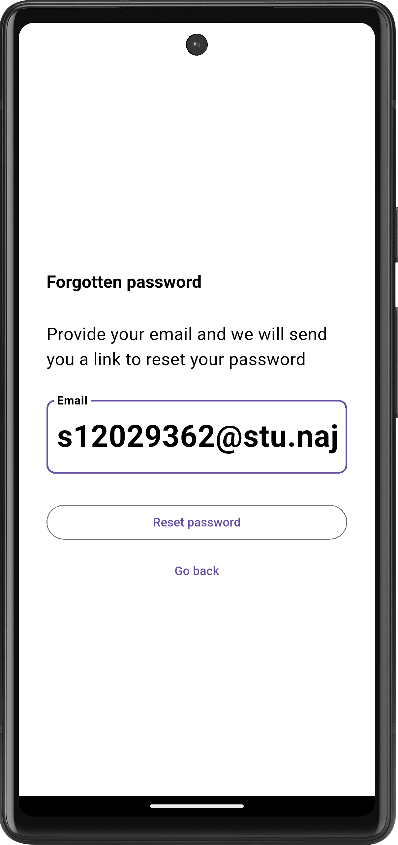
Wait for user action to proceed
Verify the user's email to continue
Forget Password
They enter their email

Slide 18
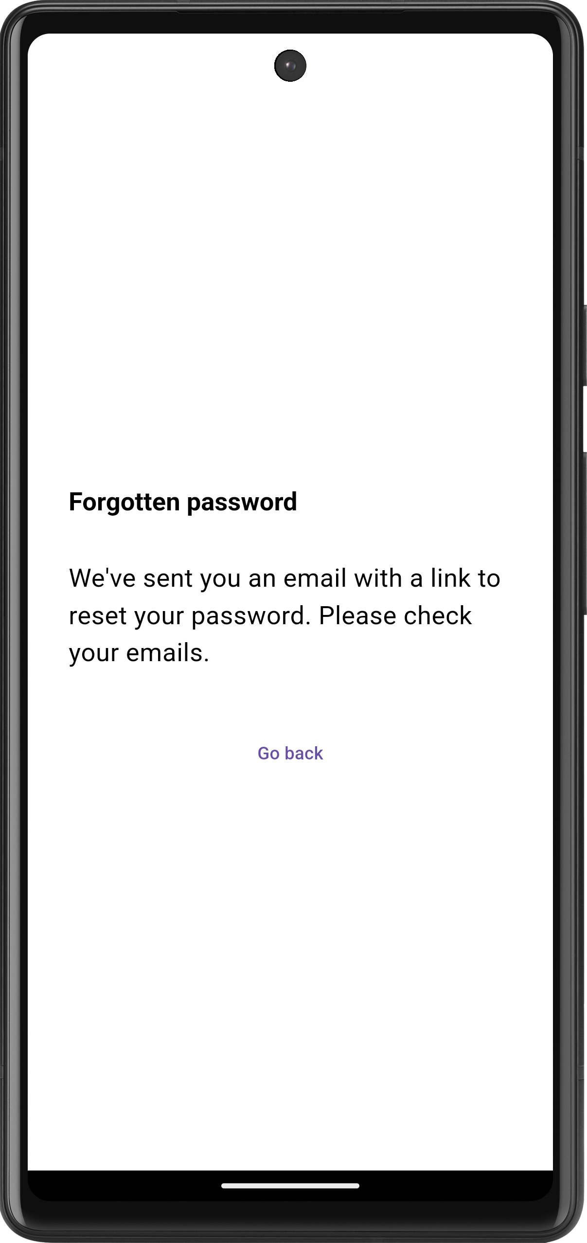
Wait for user action to proceed
Verify the user's email to continue
Forget Password
Reset email sent to user

Slide 19
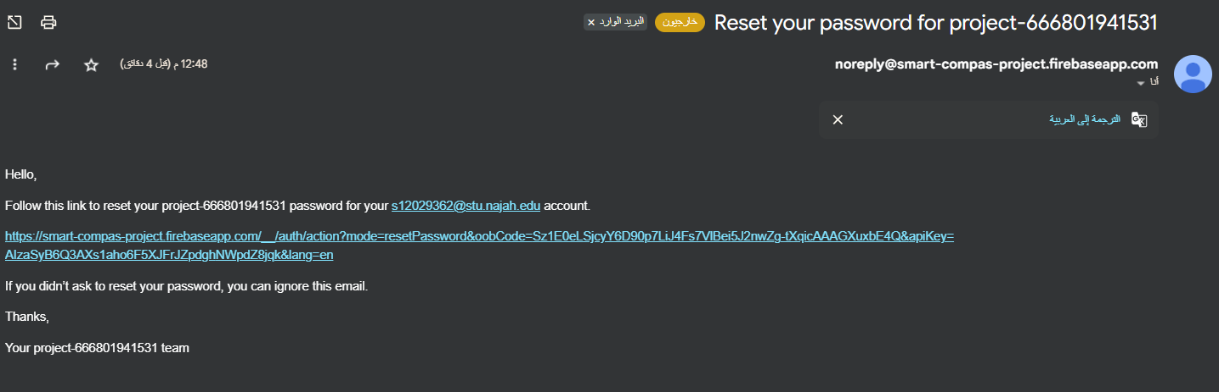
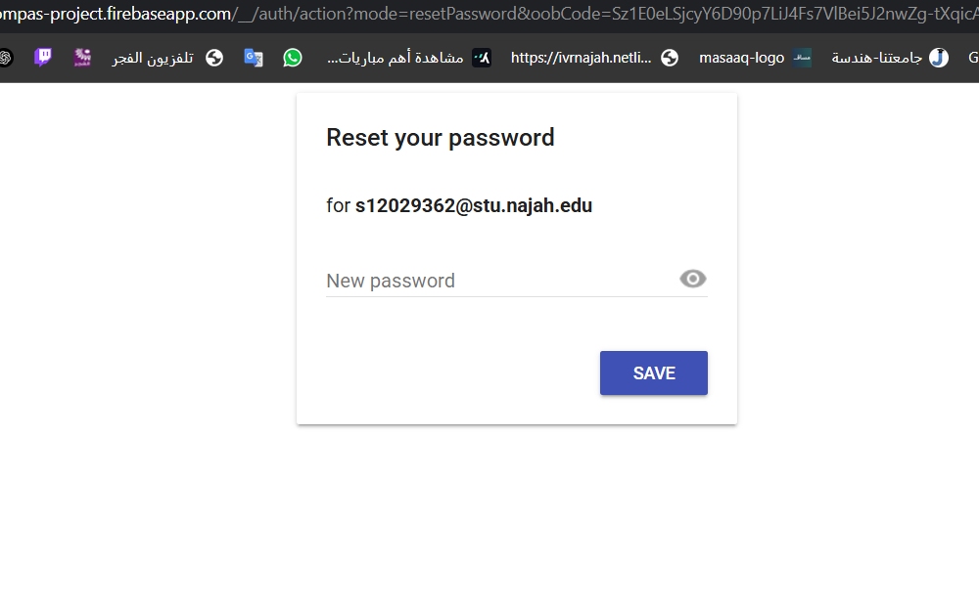
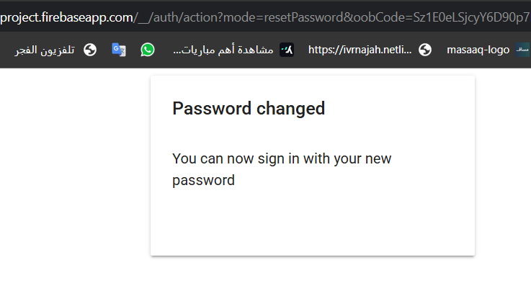
Wait for user action to proceed
Verify the user's email to continue
Forget Password
Reset email sent to user
User resets their password

Slide 20
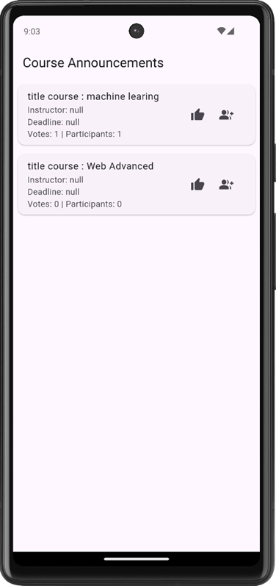
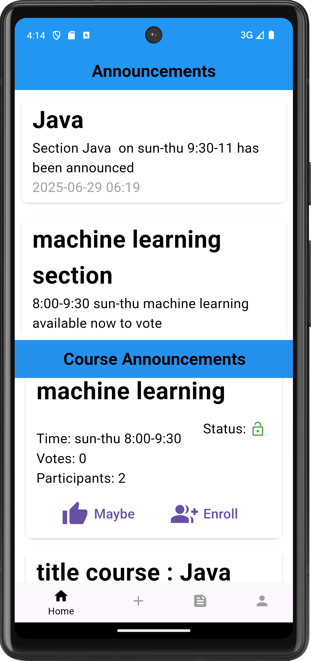
Homepage
  Displays department and sections announcements
  Students can browse available announcements
  Students can interact with course announcements
  Interaction includes voting for preferred sections
  Students can enroll in sections they like
  Enrollment reflects their participation or interest

Slide 21
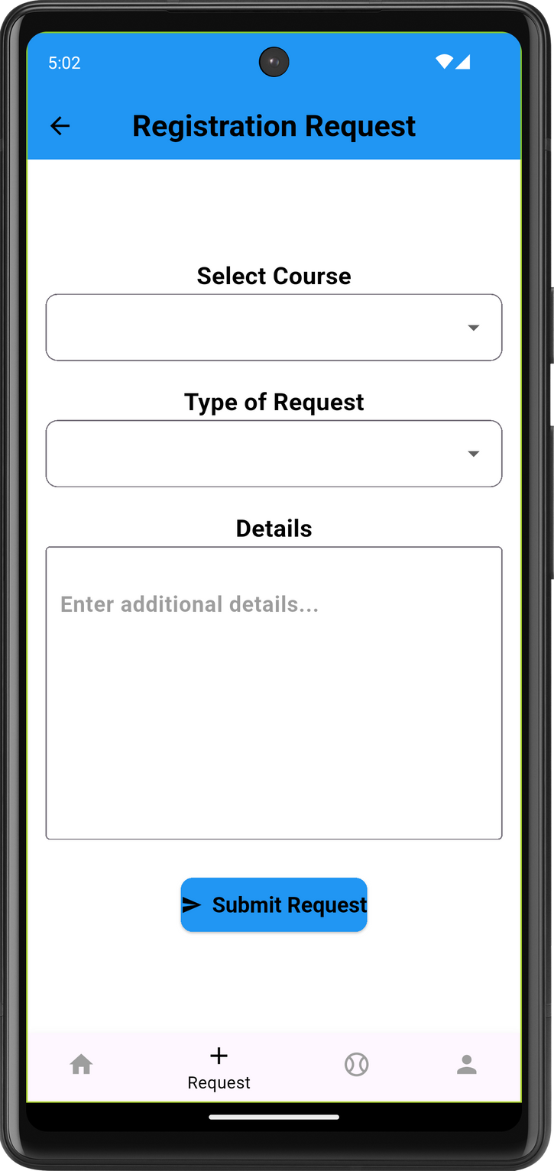
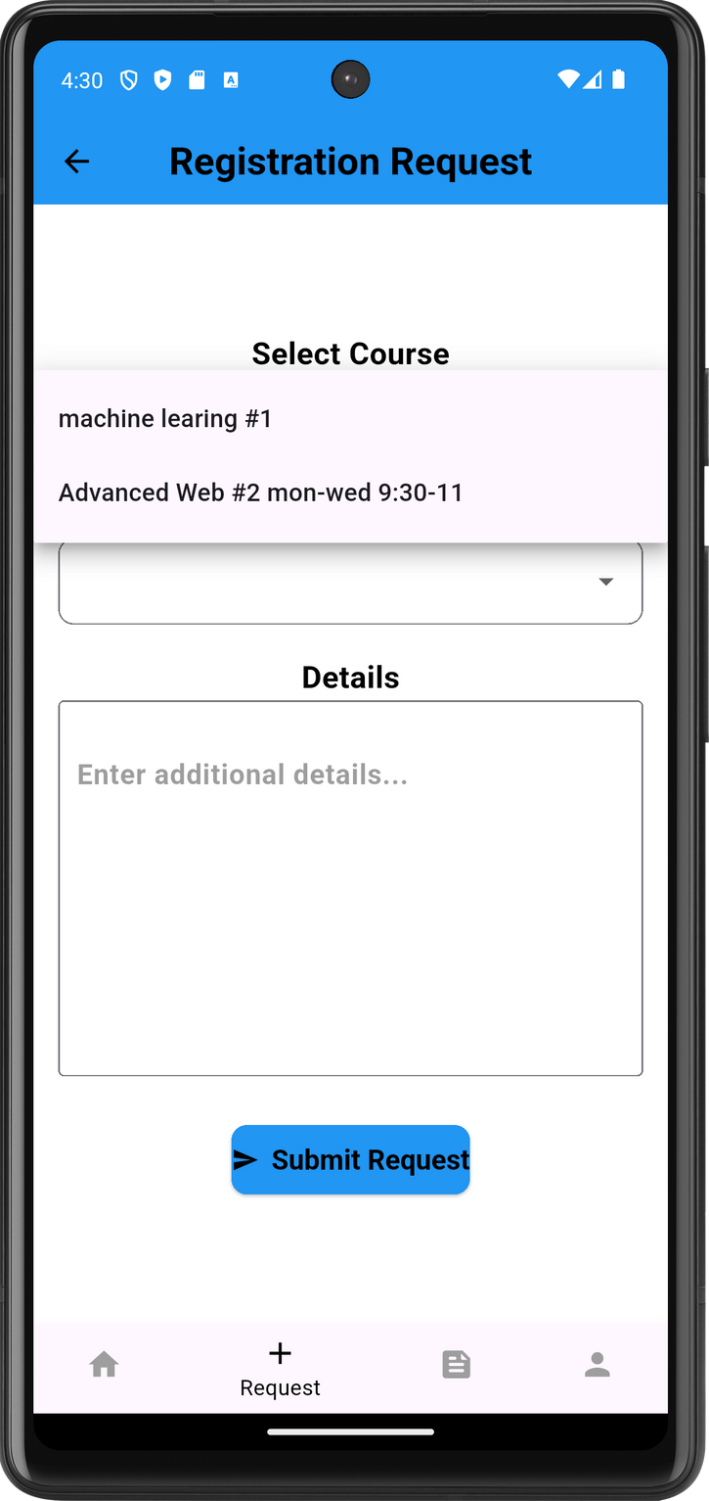
Homepage
  Students can choose a section
  Students can enroll in or withdraw from a section
  Students can provide details or a specific reason for their action

Slide 22
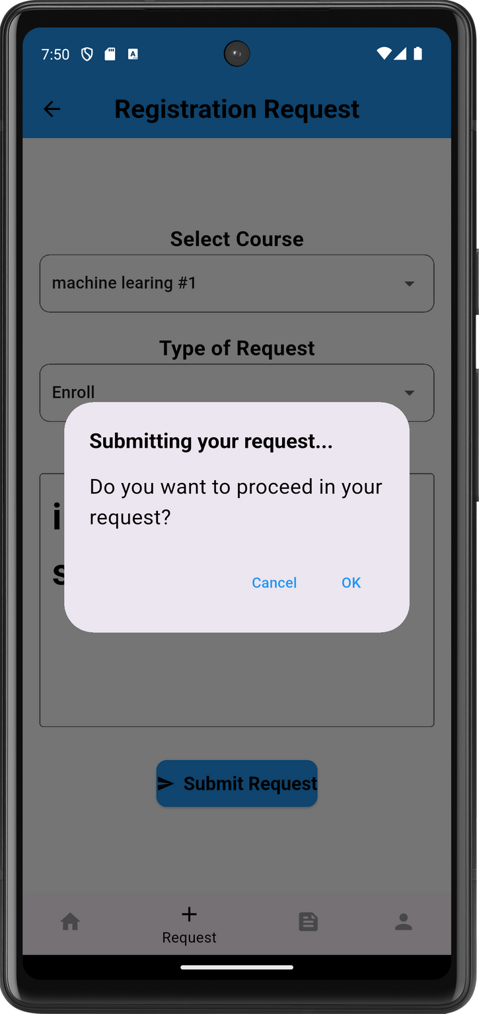

Slide 23
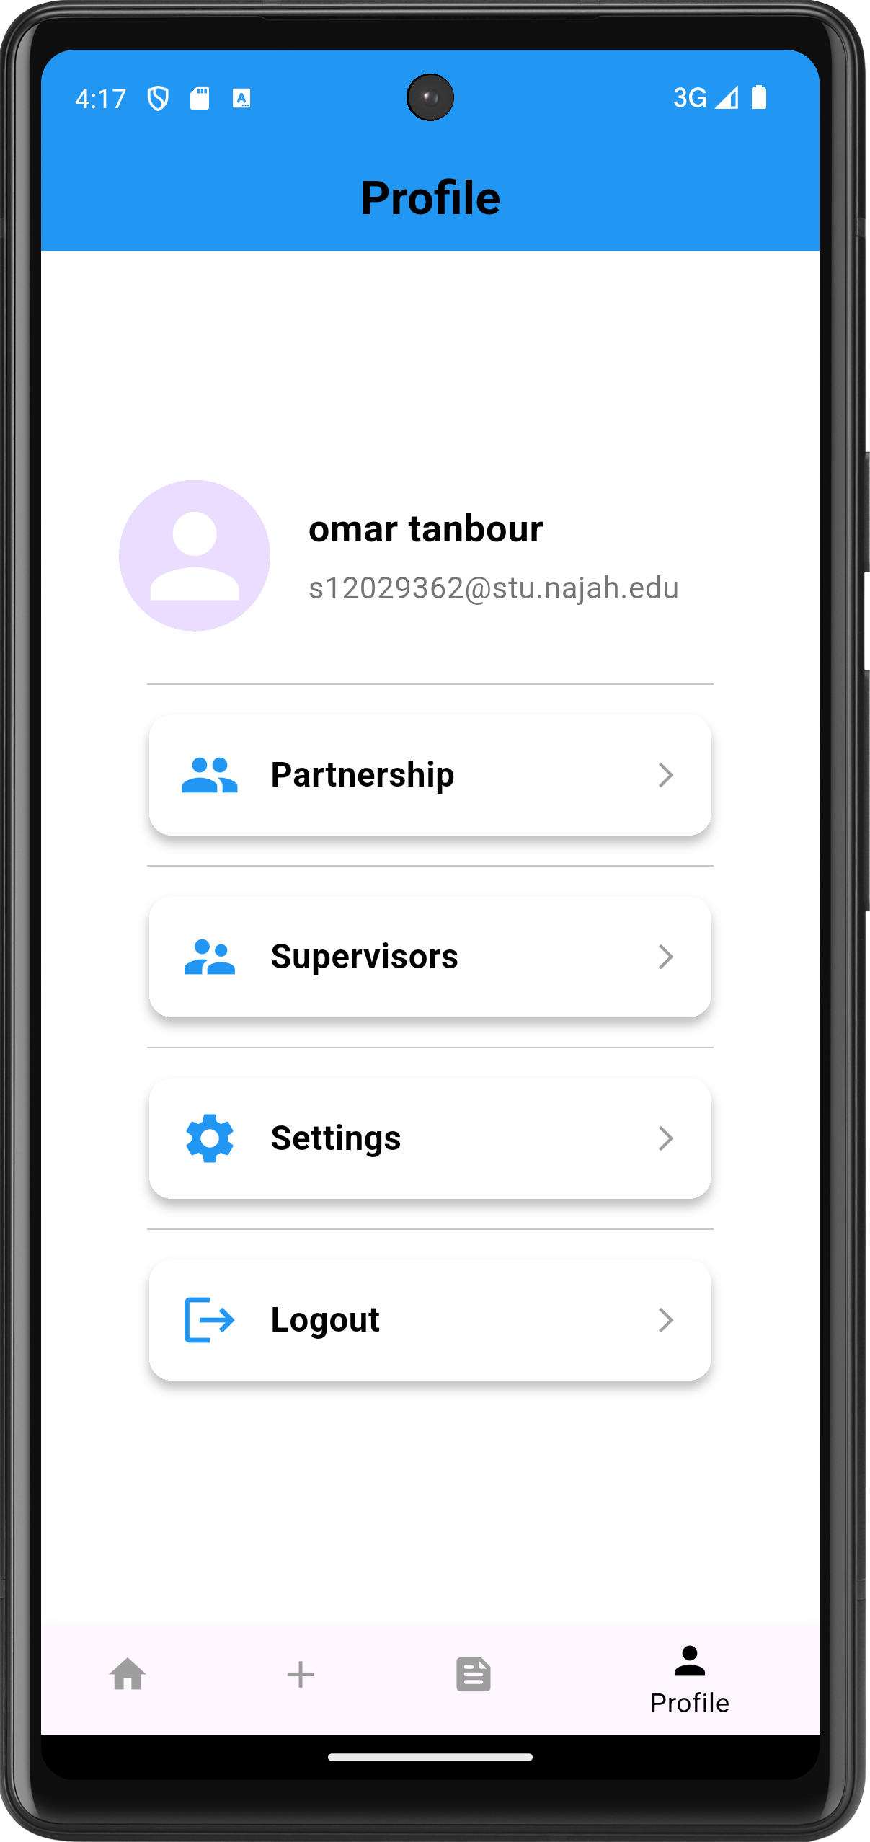
Profile
  Display student's name and email
  Include a partnership button
  Include supervisor section
  Include settings section
  Include log out option

Slide 24
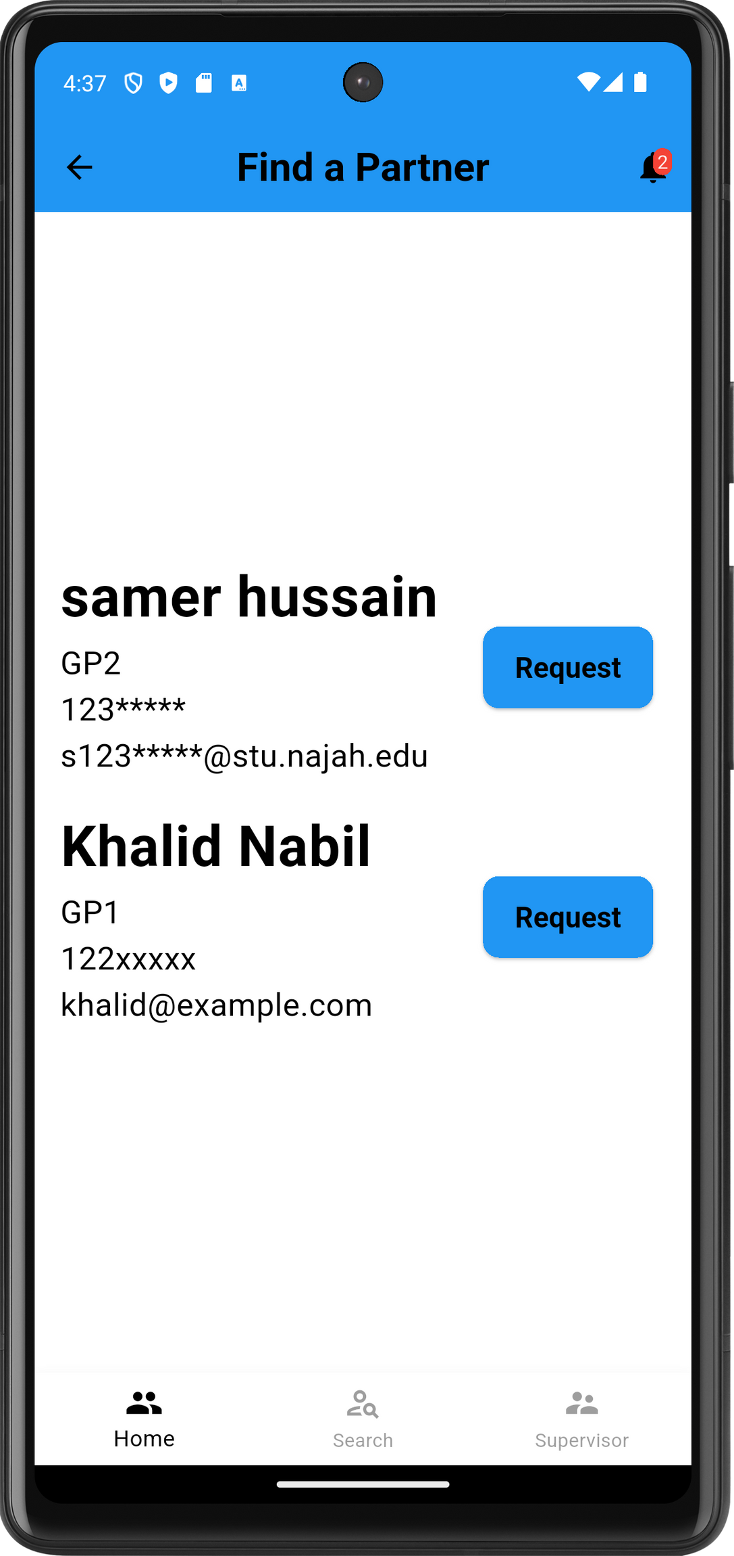
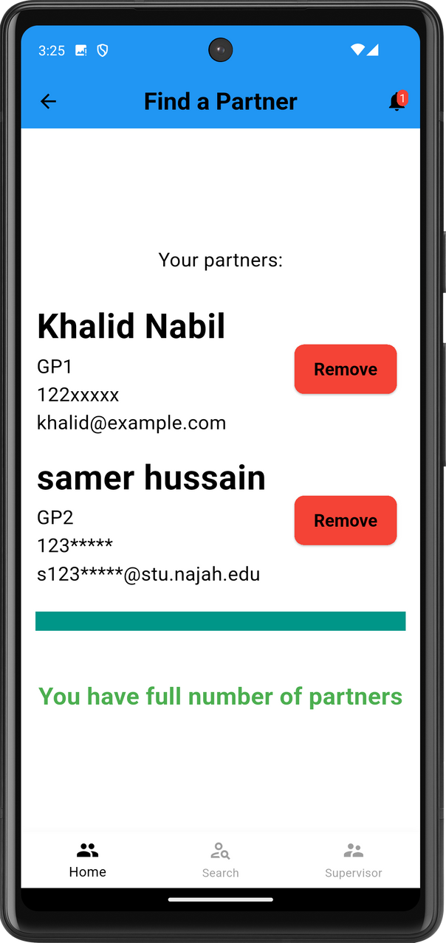
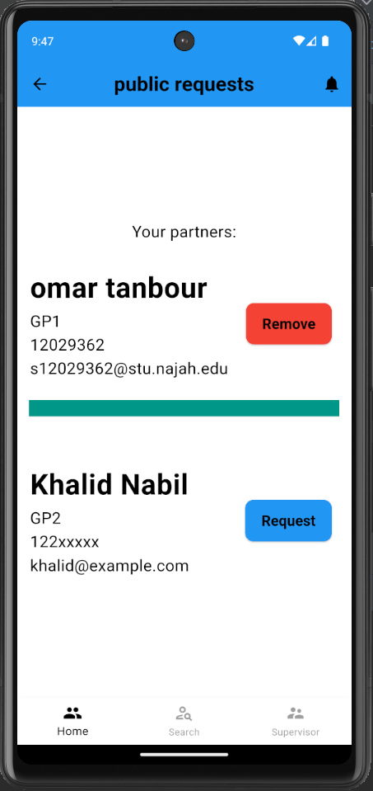
Partnership
  Displays the student's partners list
  Allows students to find partners and view their information
  Shows partner suggestions if space is available

Slide 25
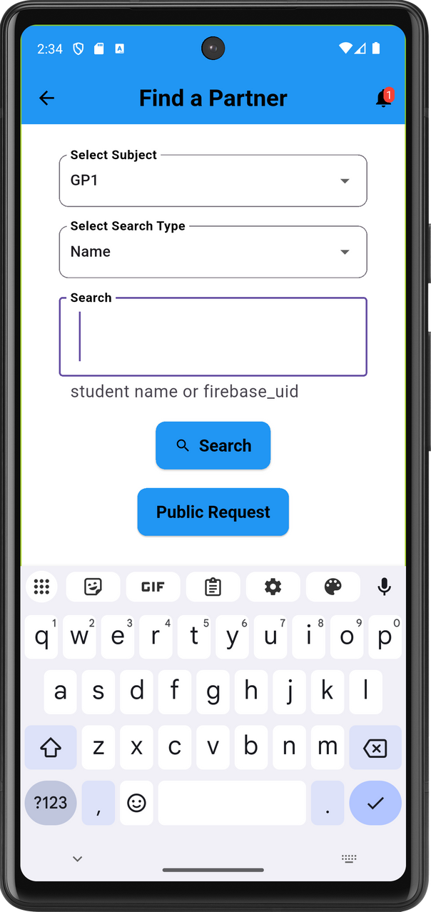
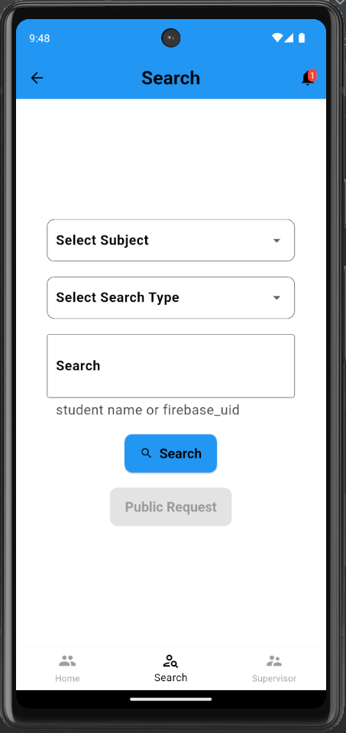
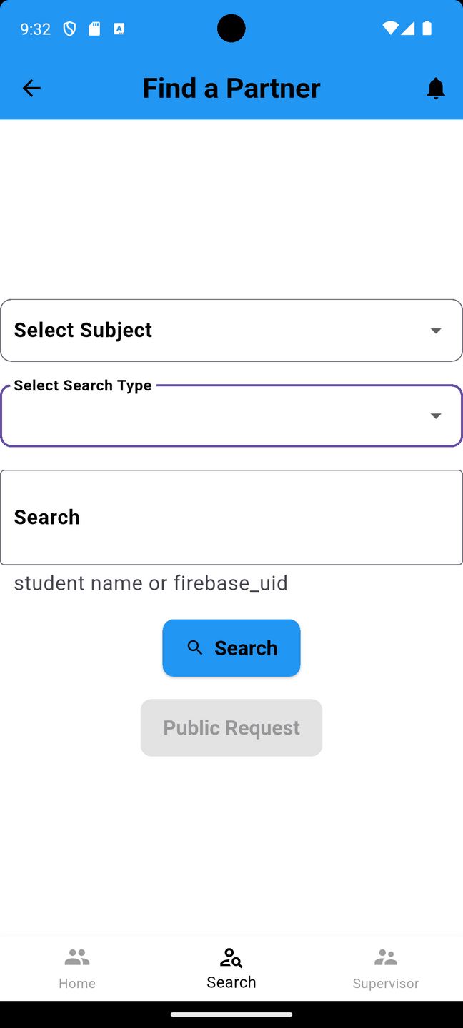
Partnership
  Students can search for a partner using various methods
  Students can send partnership requests to other students
  If no partner is found, students can post a public request
  Public requests require selecting a project
  Public requests are shown as suggestions to other students with available partner space

Slide 26
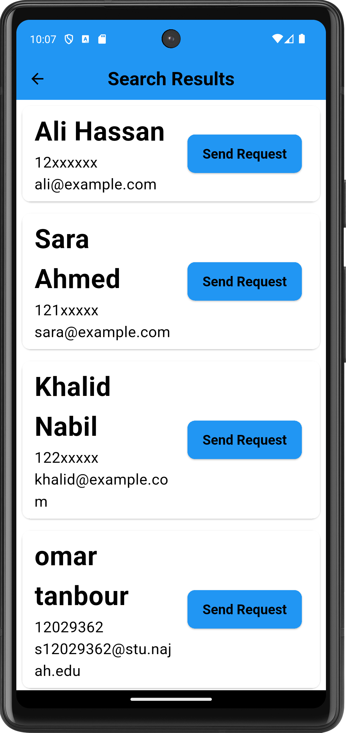
Partnership
  Students searched for partners
  Students can browse result partners and send request to them

Slide 27
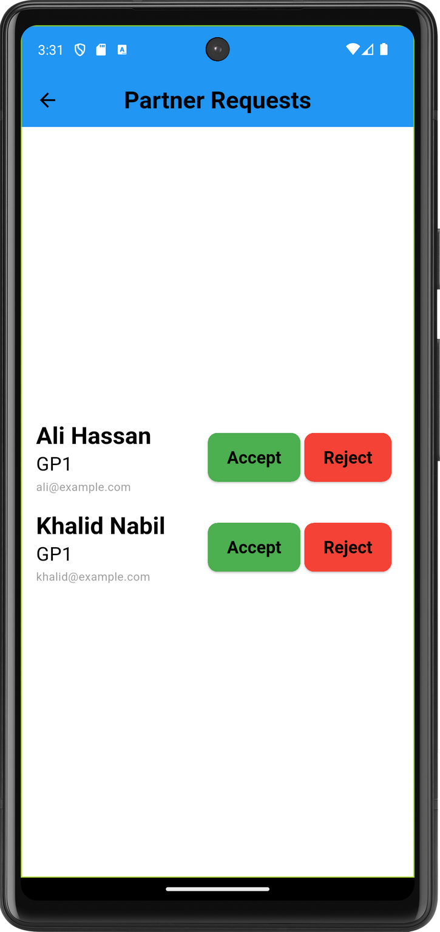

Partnership
  Incoming partnership requests are reflected as a count on the notification icon
  Notification icon is located at the top right
  Clicking the icon displays the list of incoming requests on the page

Slide 28
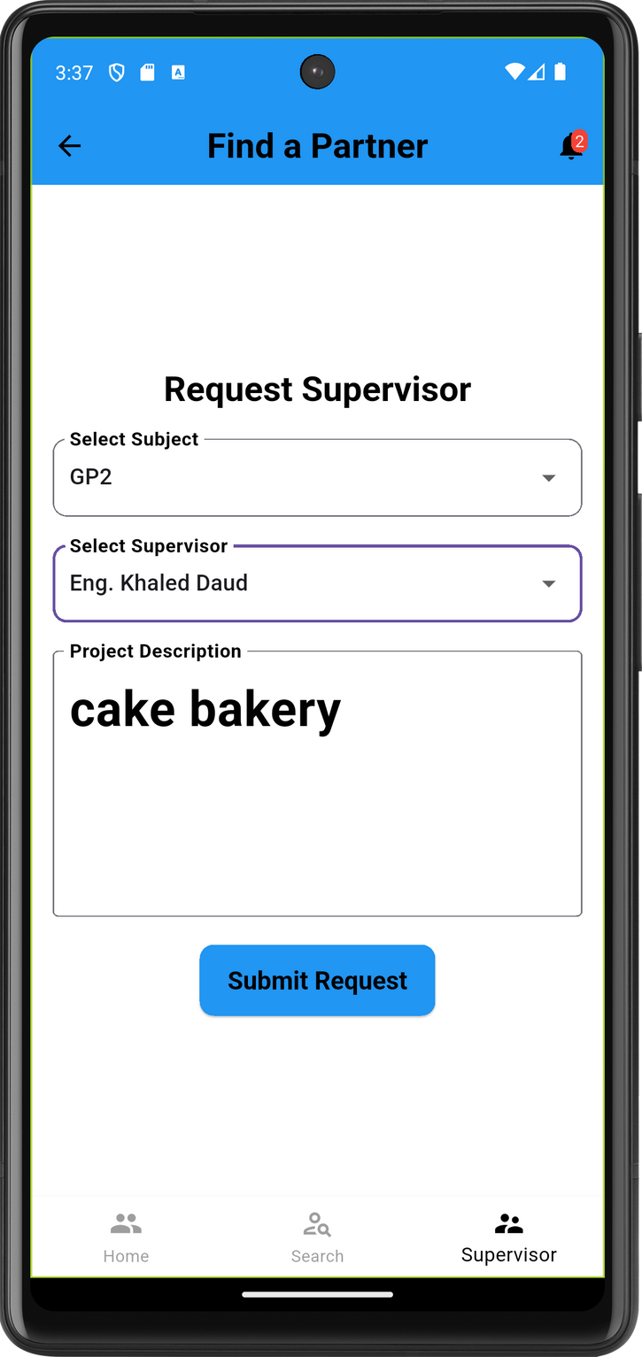
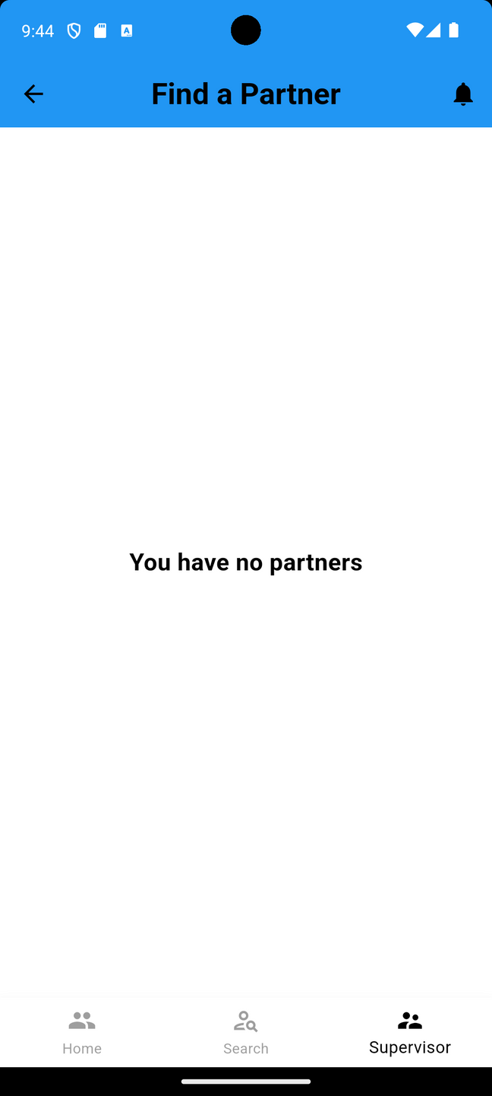
Partnership
  Students can submit a request to a supervisor
  This action is available after successfully forming a partnership

Slide 29
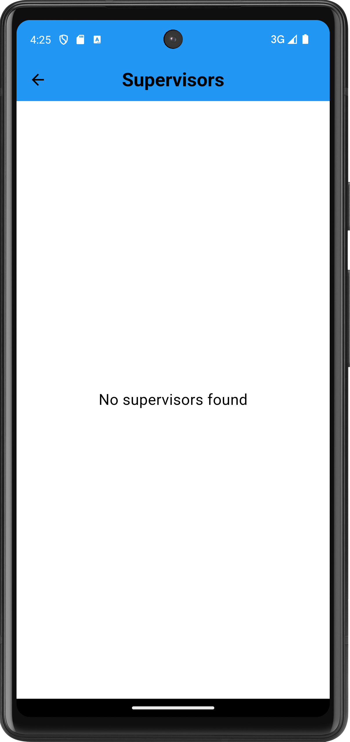
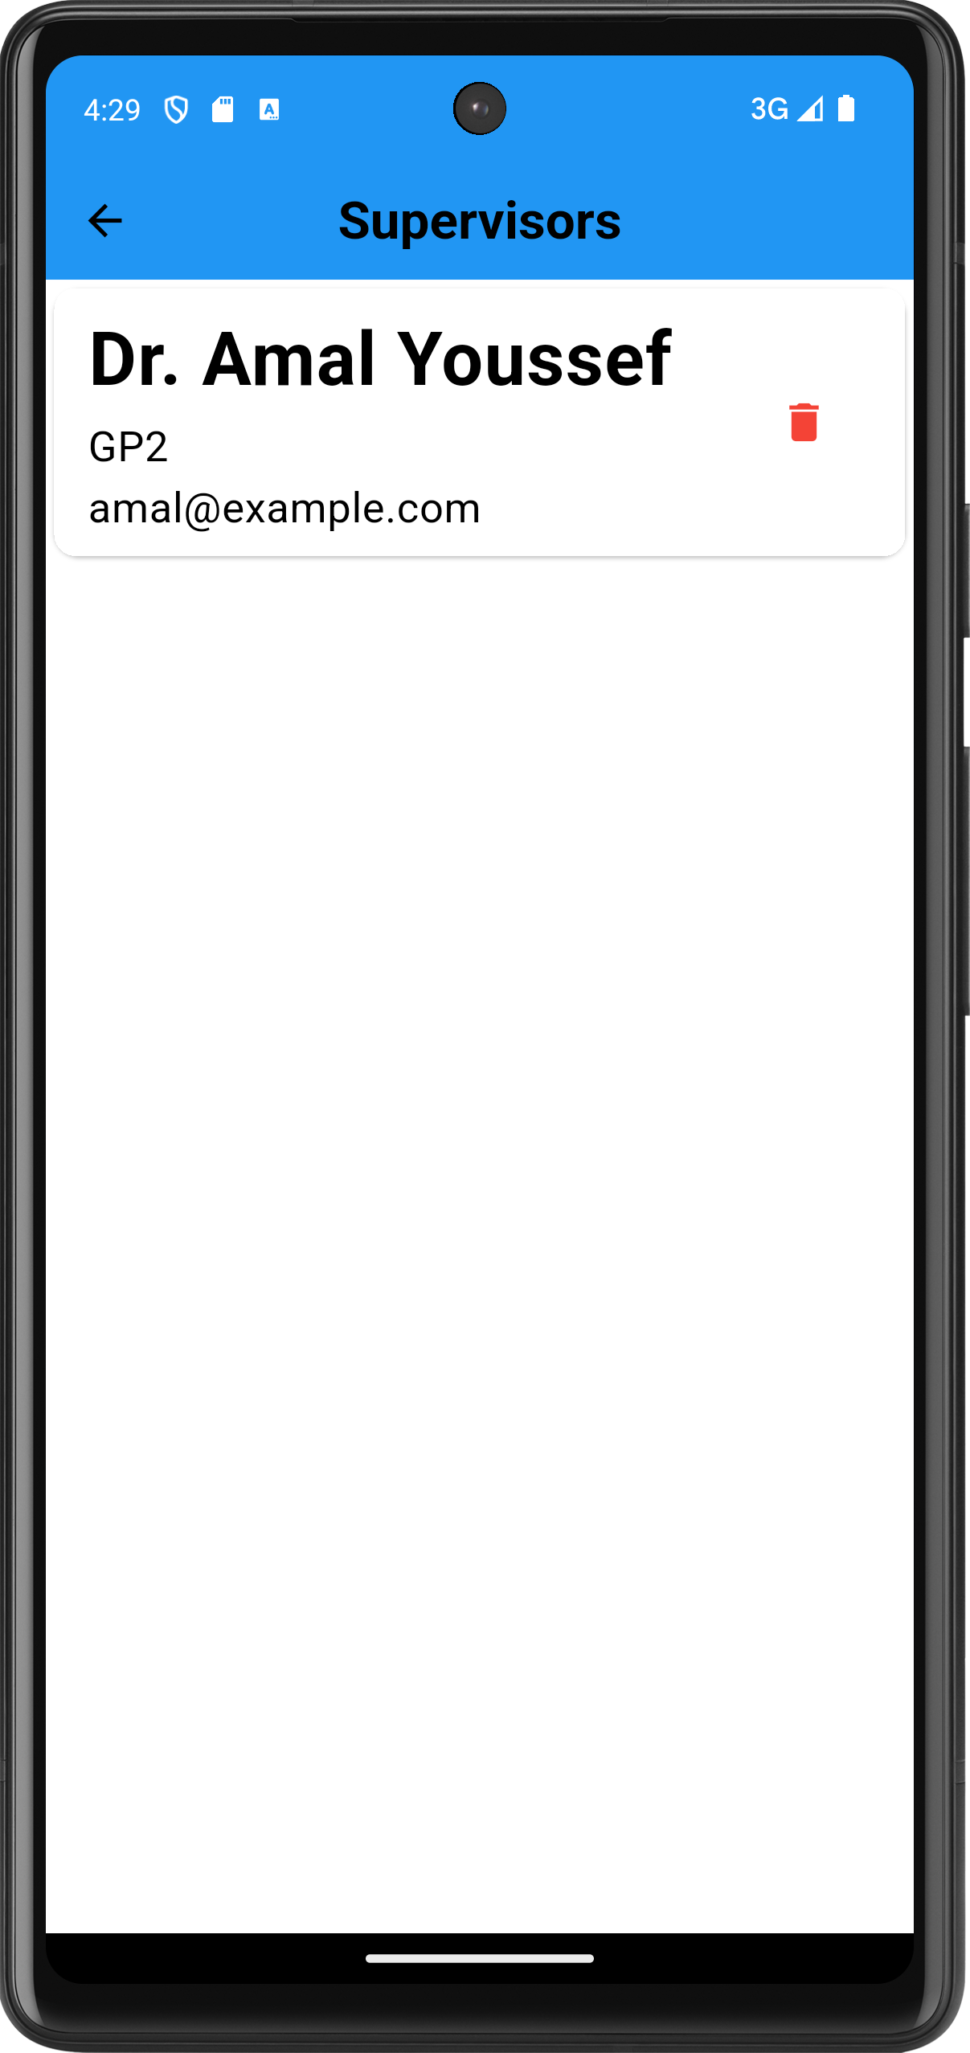
Supervisors
  approved supervisors for the user will list here

Slide 30
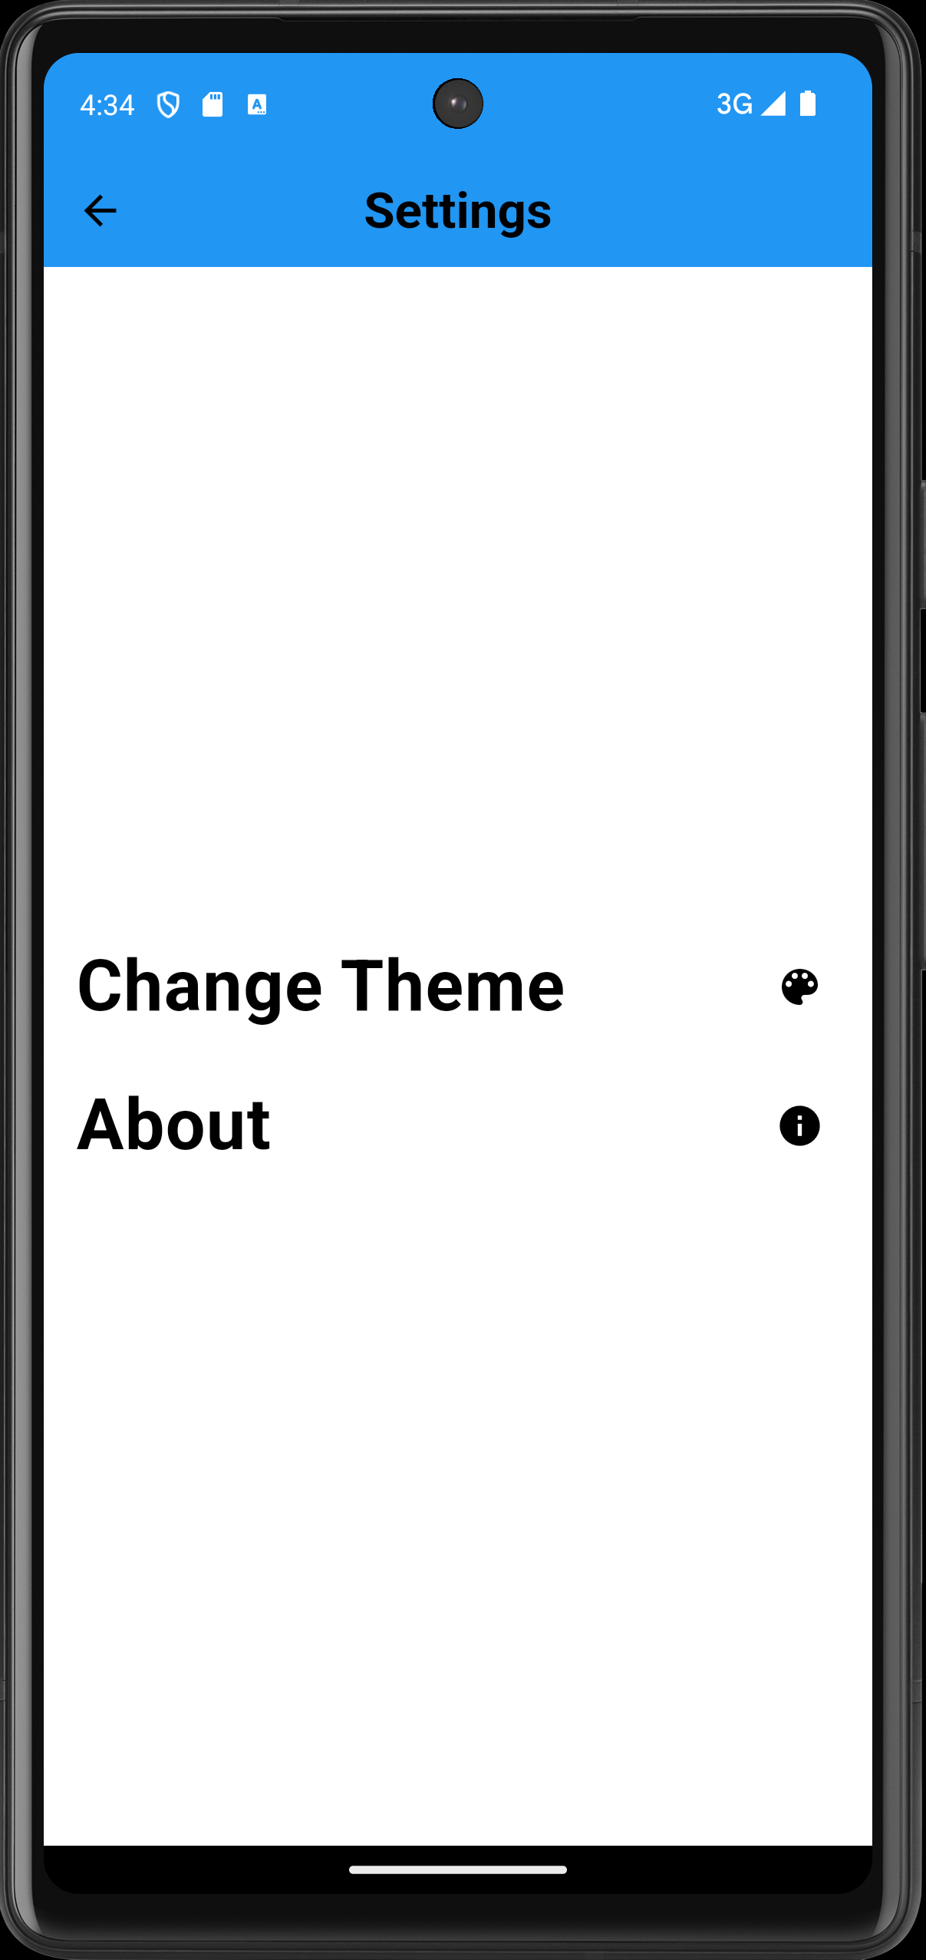
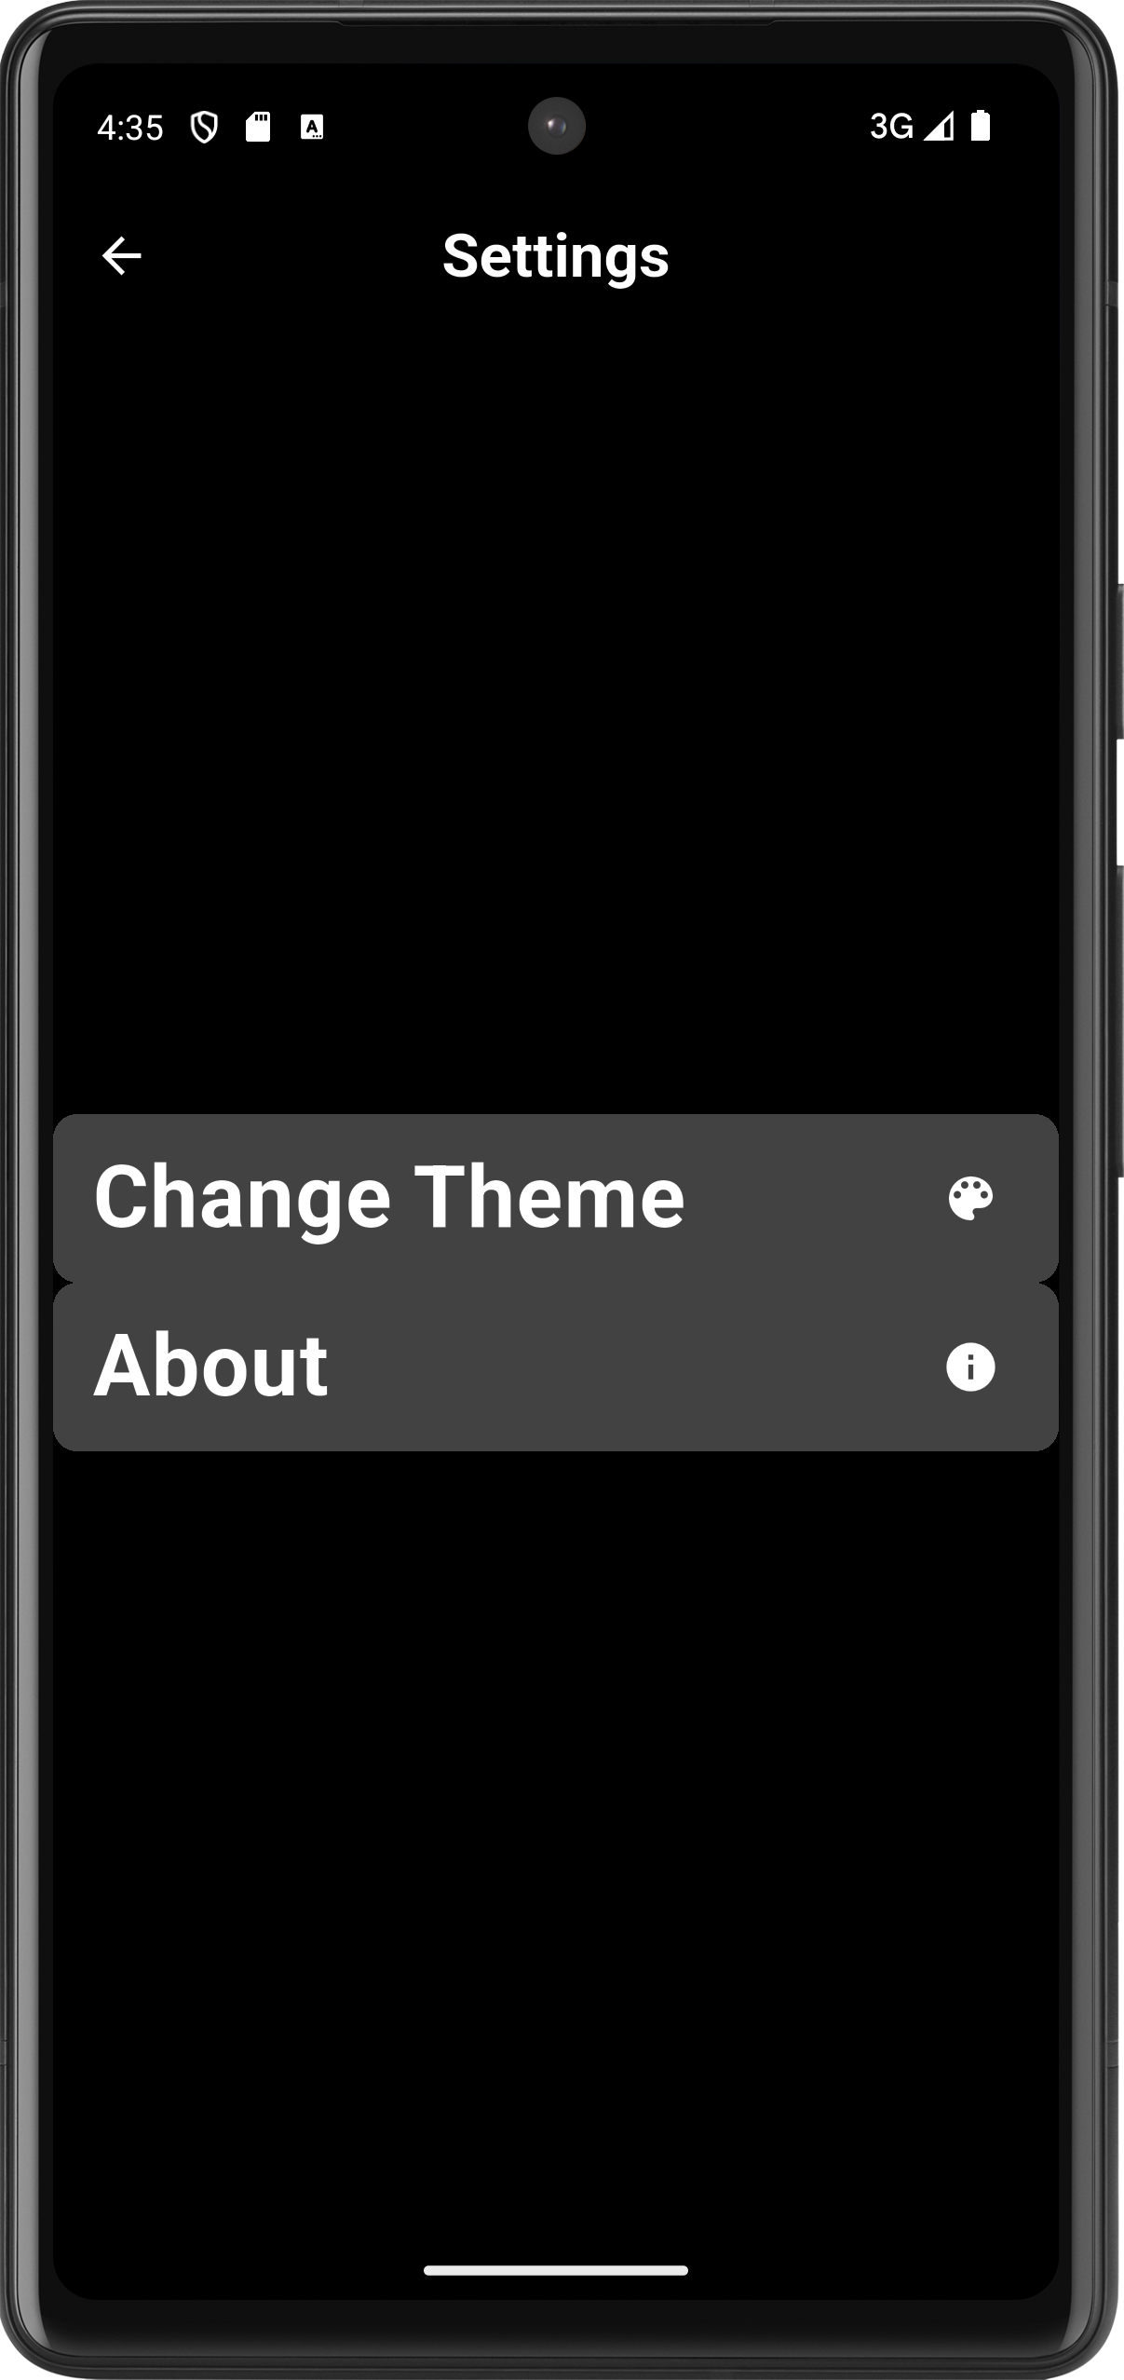
Settings
  here we can toggle the theme either light or dark mode for the app

Slide 31
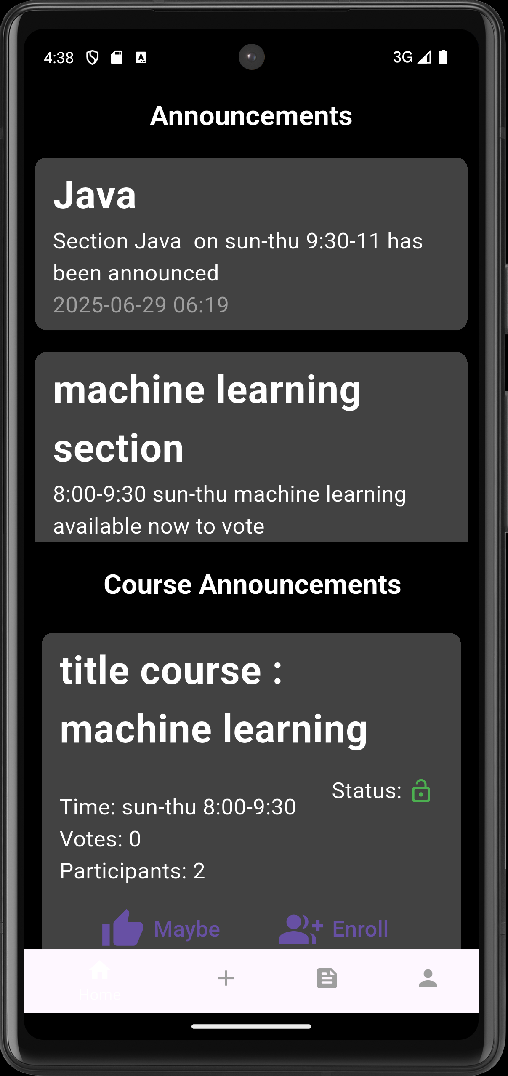
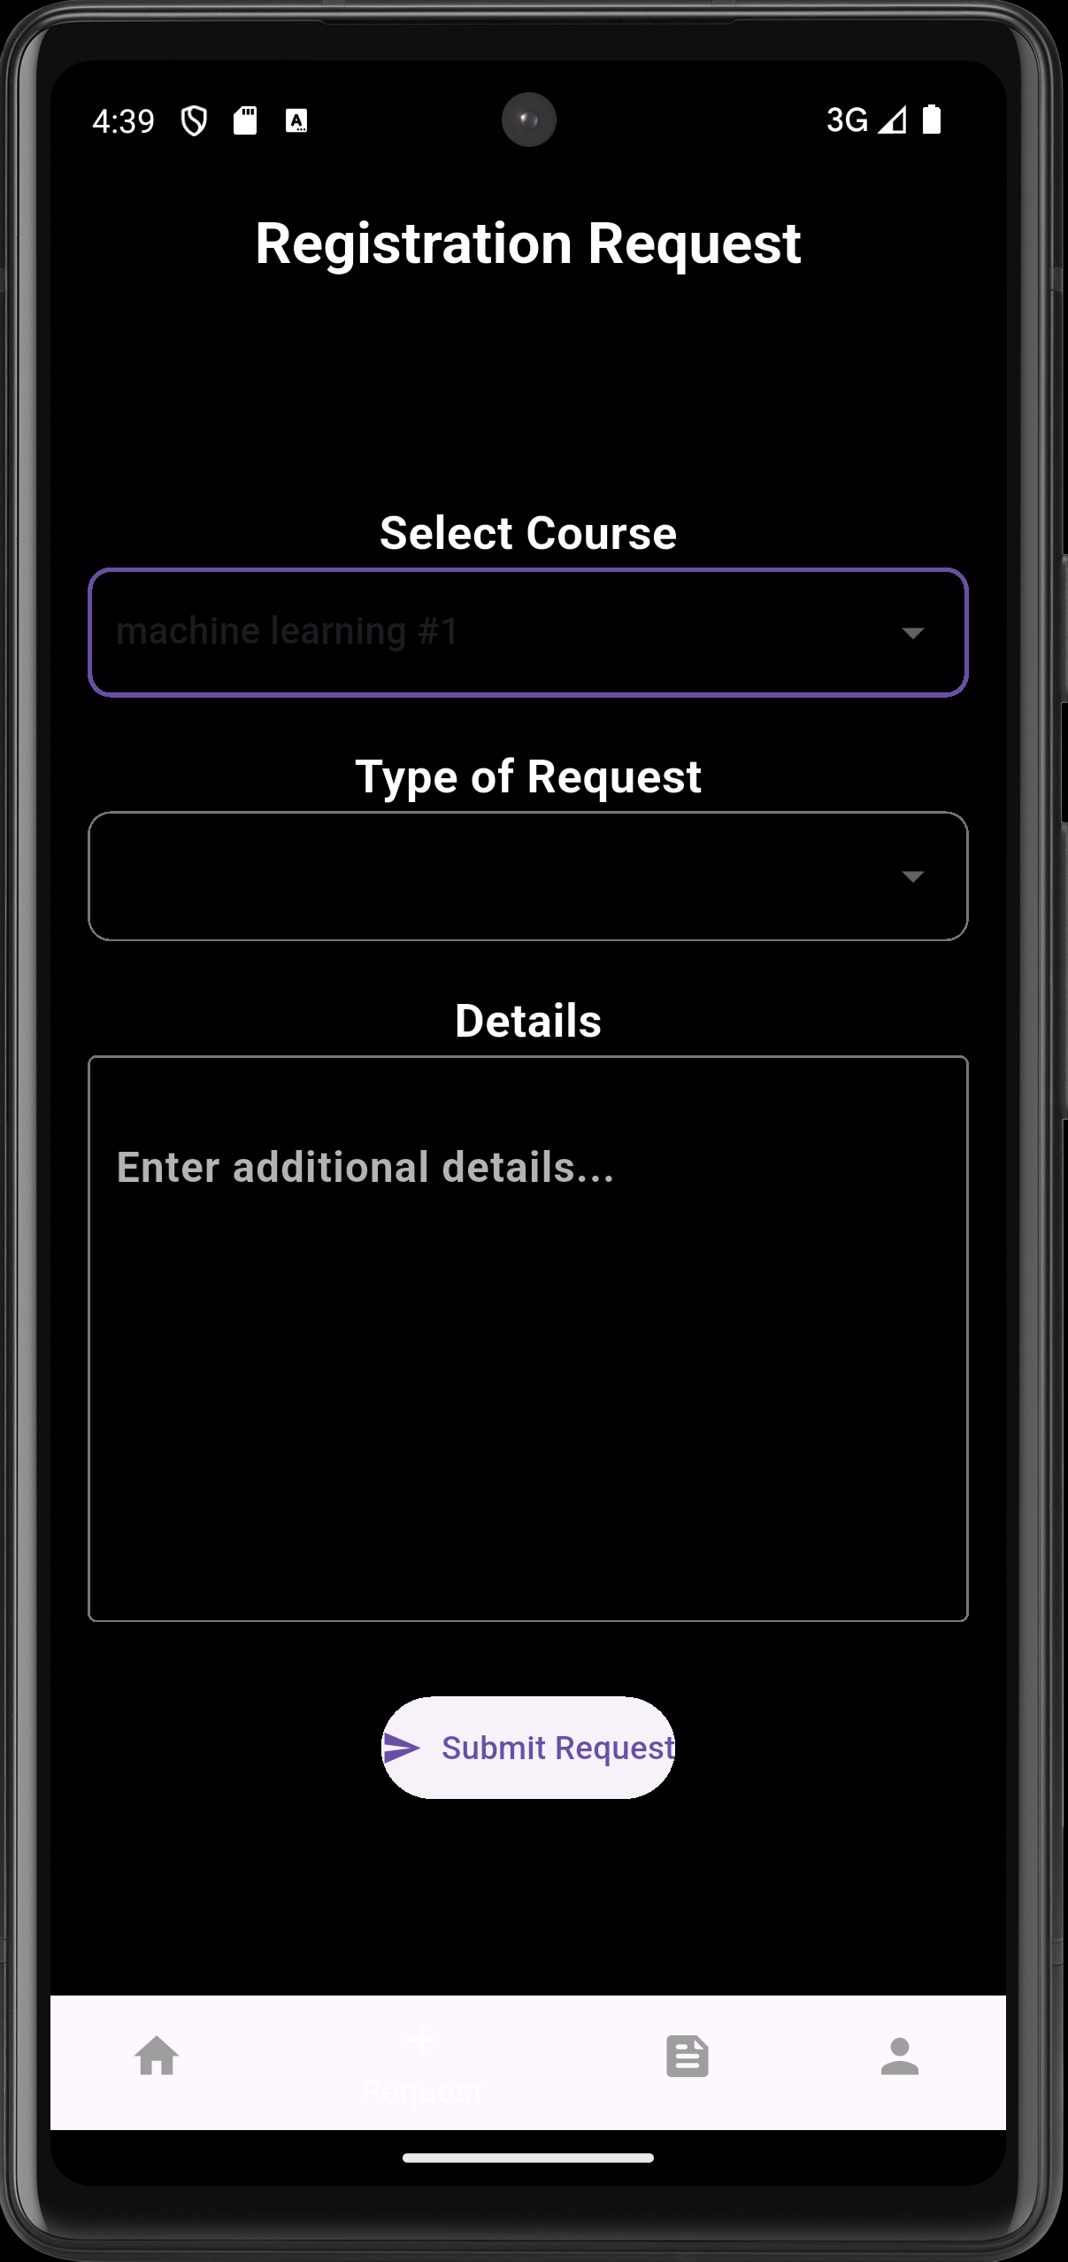
Dark Theme

Slide 32
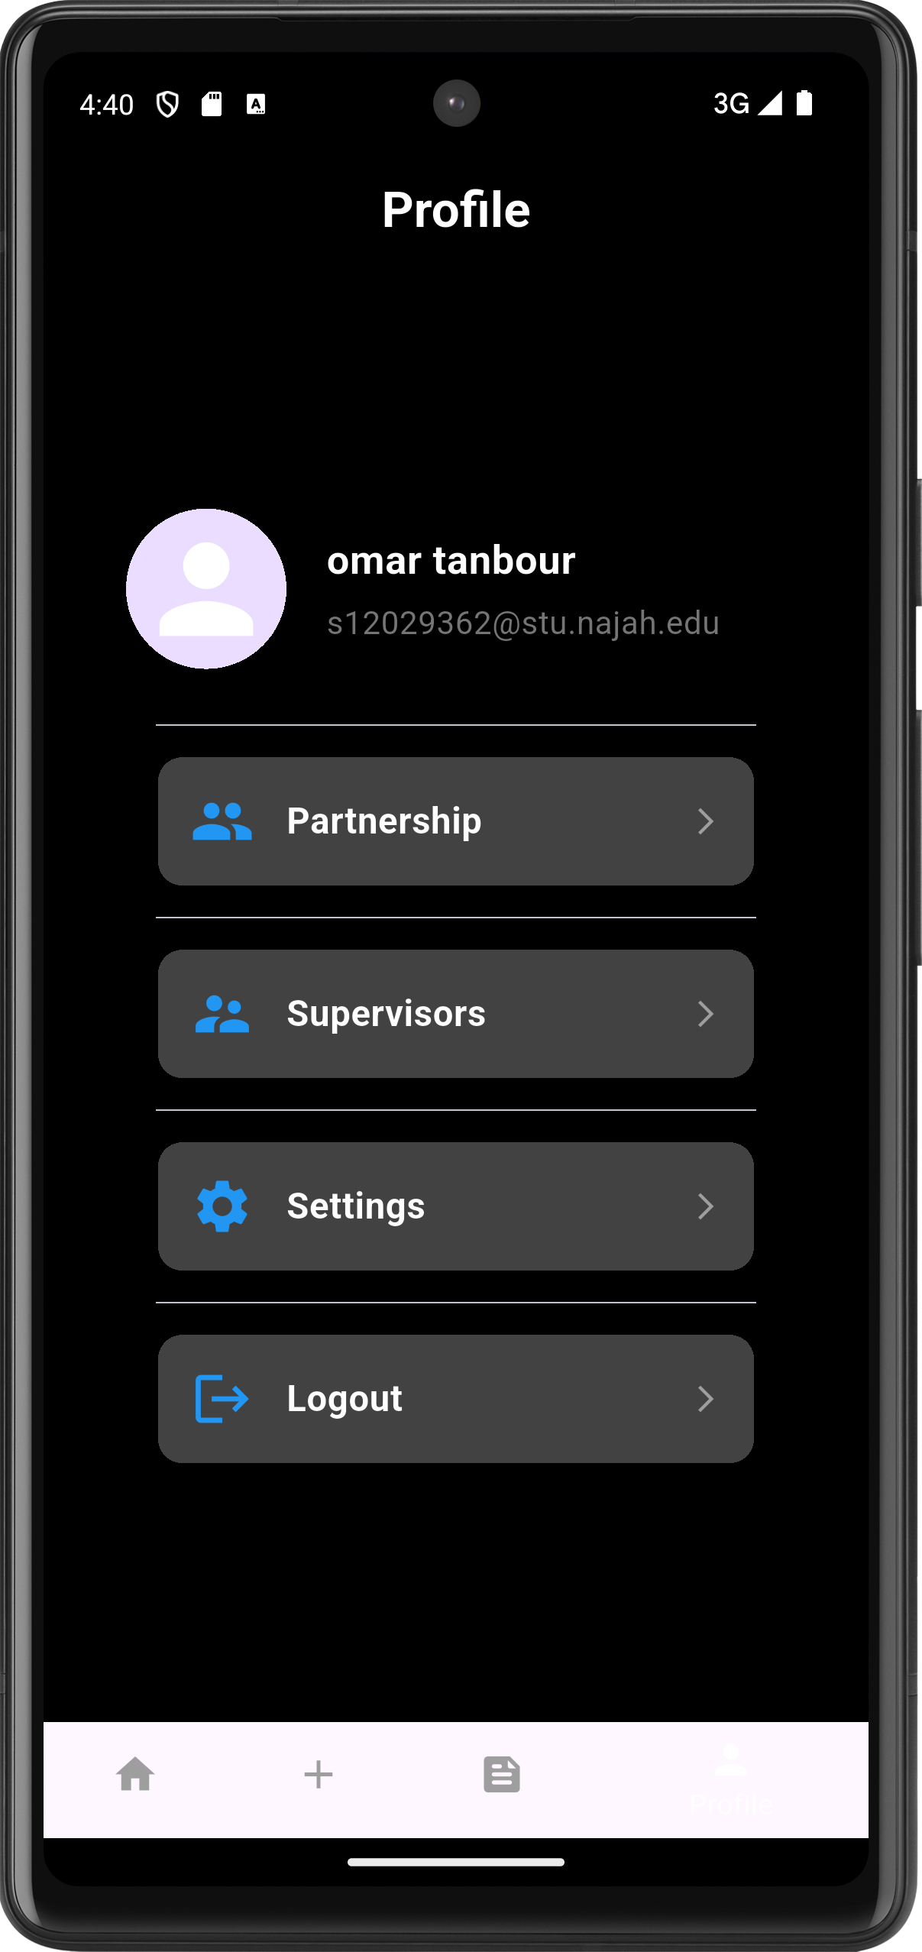
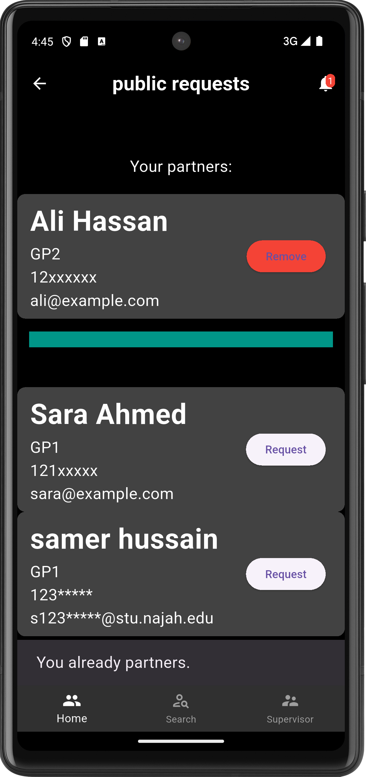
Dark Theme

Slide 33
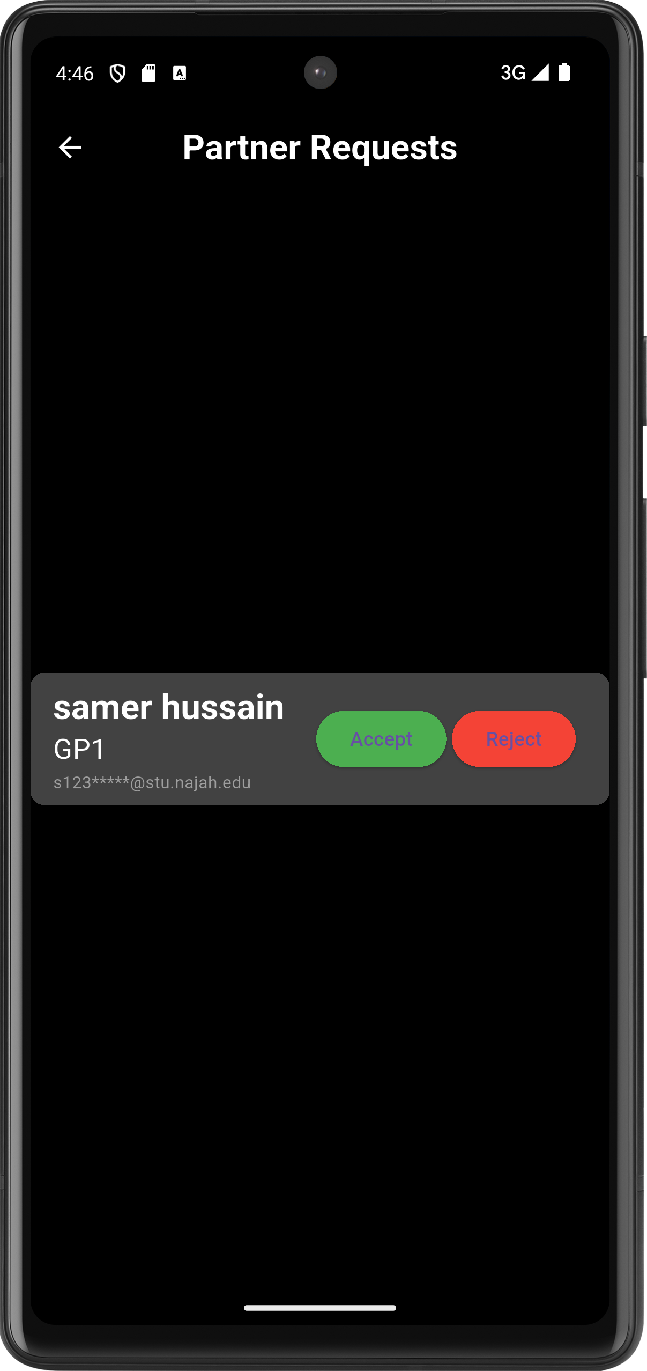
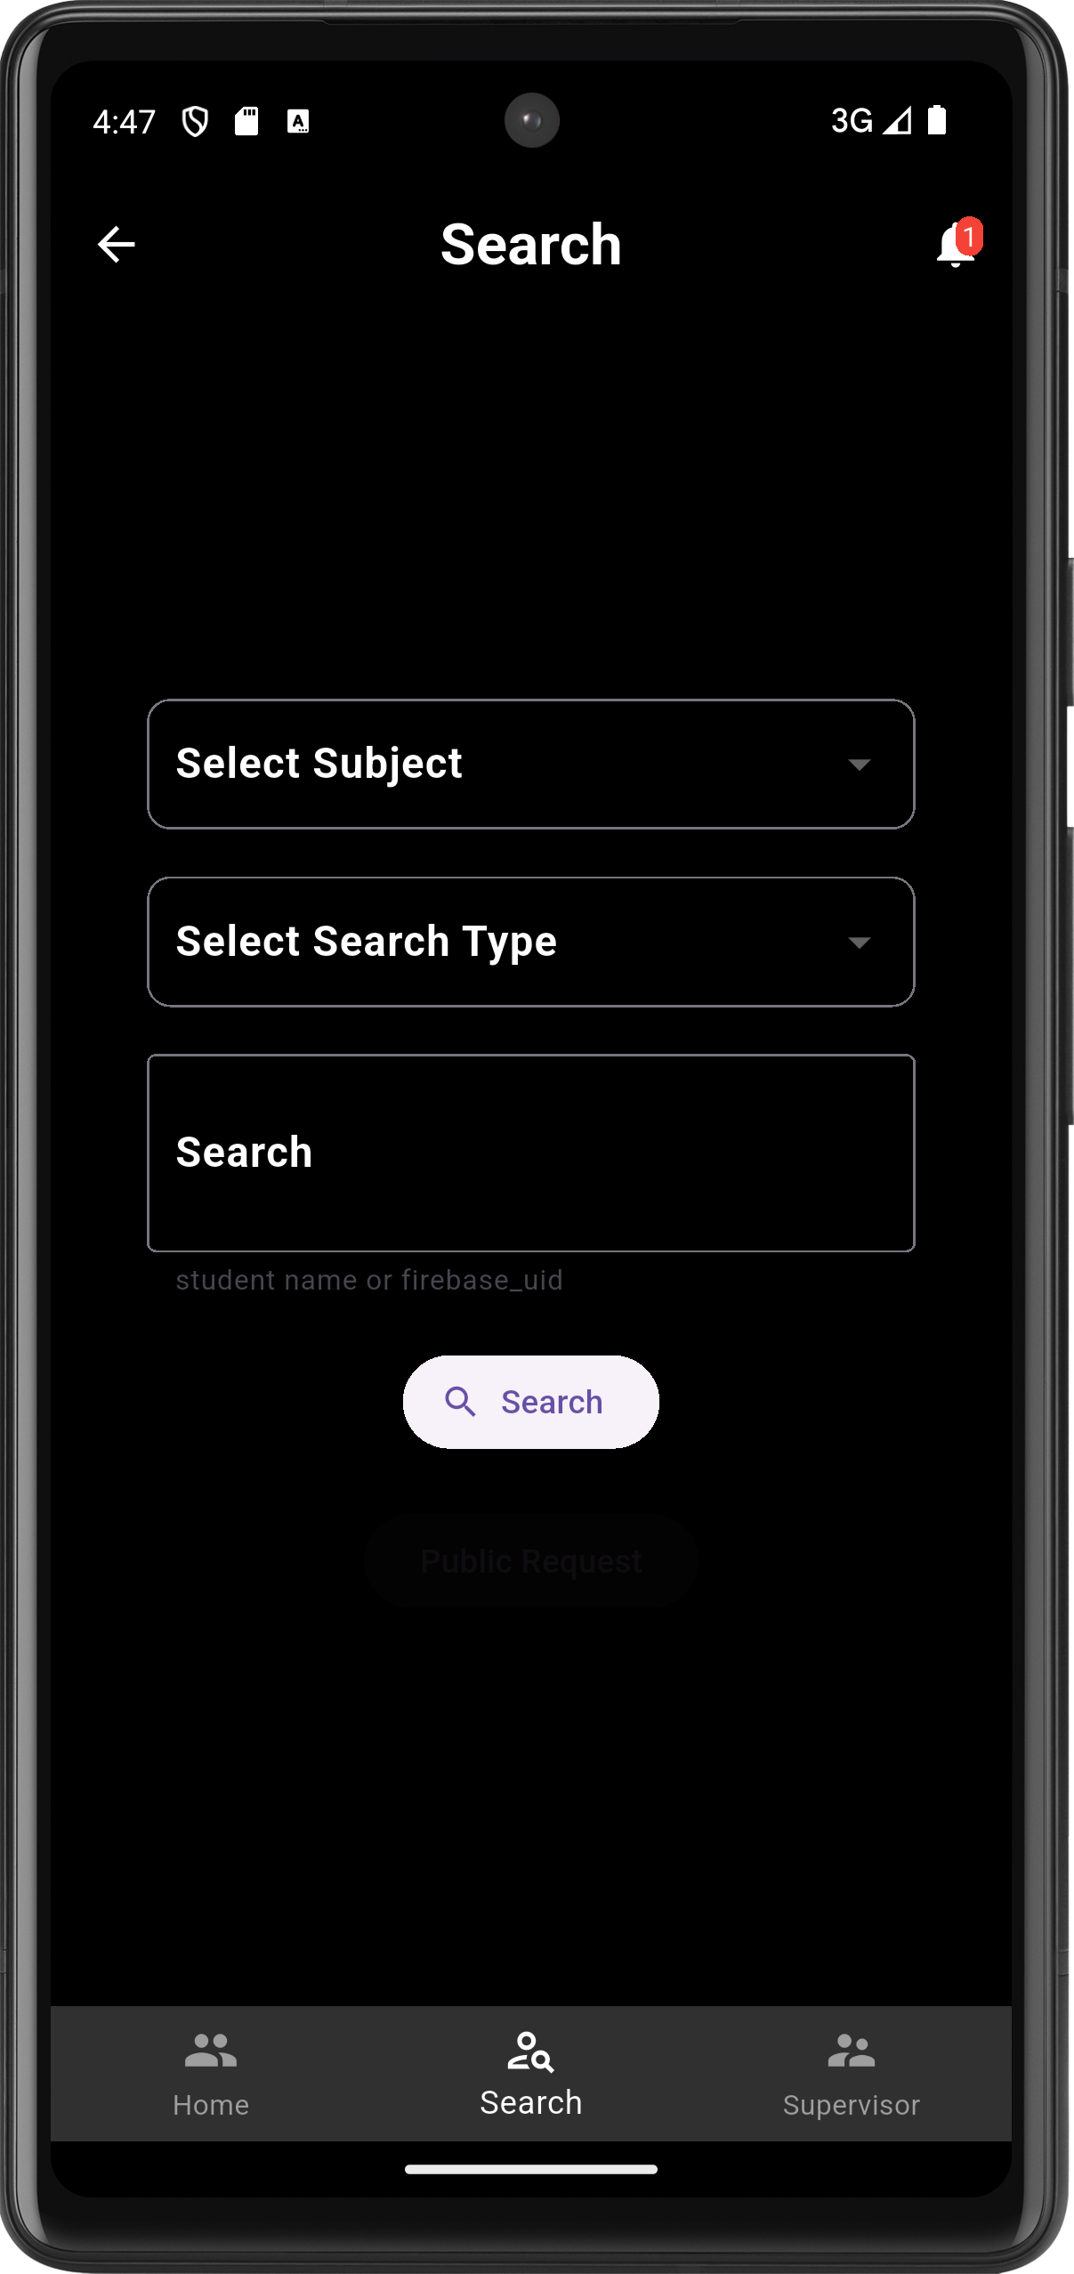
Dark Theme

Slide 34
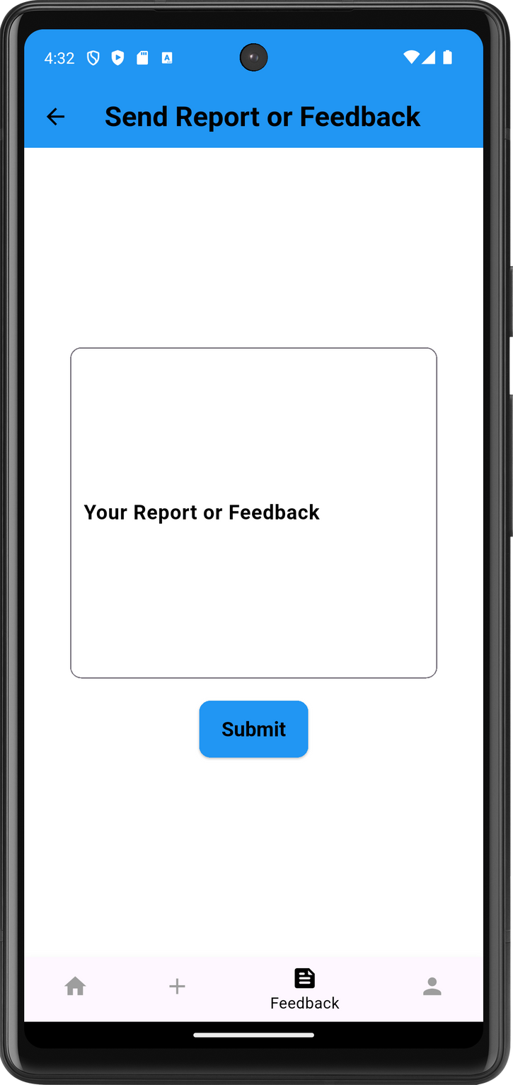
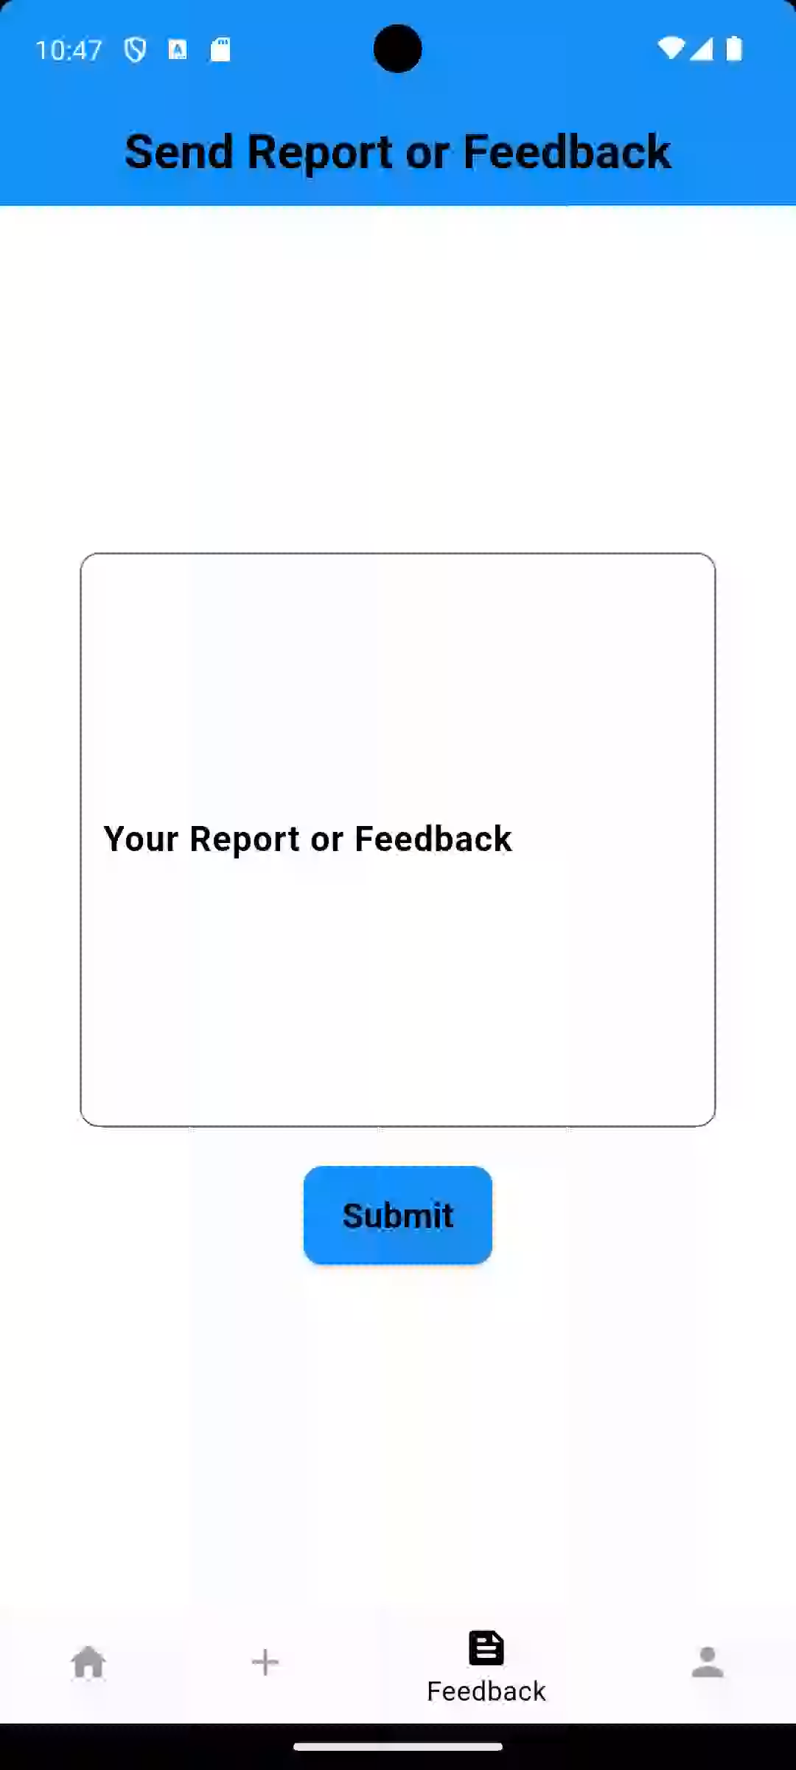
Reporting or Feedback

Slide 35

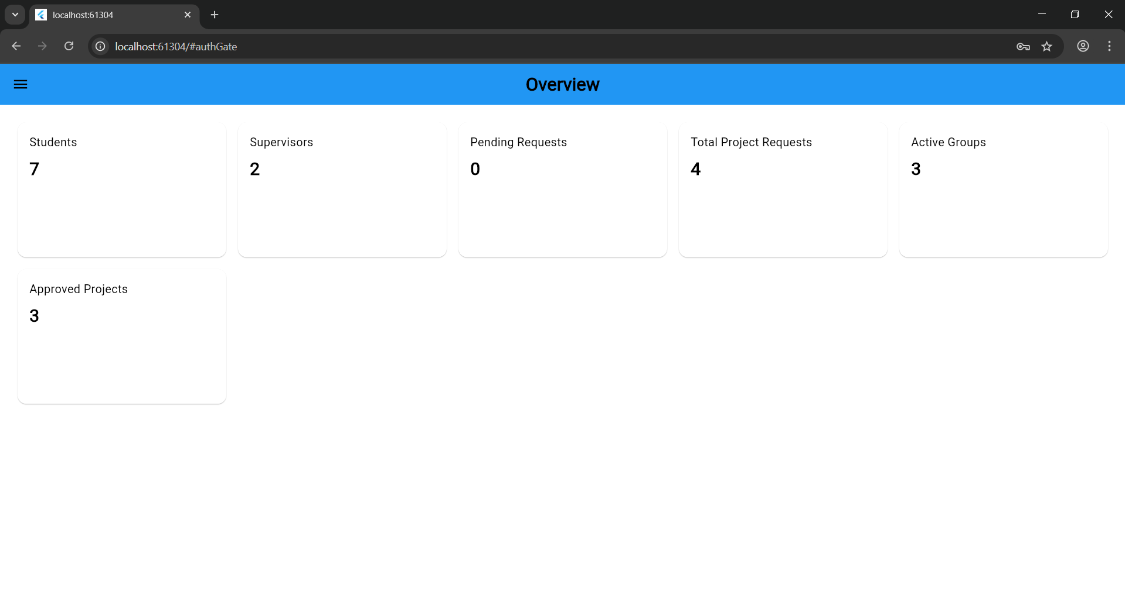
Admin Dashboard
Overview
Some numbers and figures of the system and its statistics for general data and

Slide 36
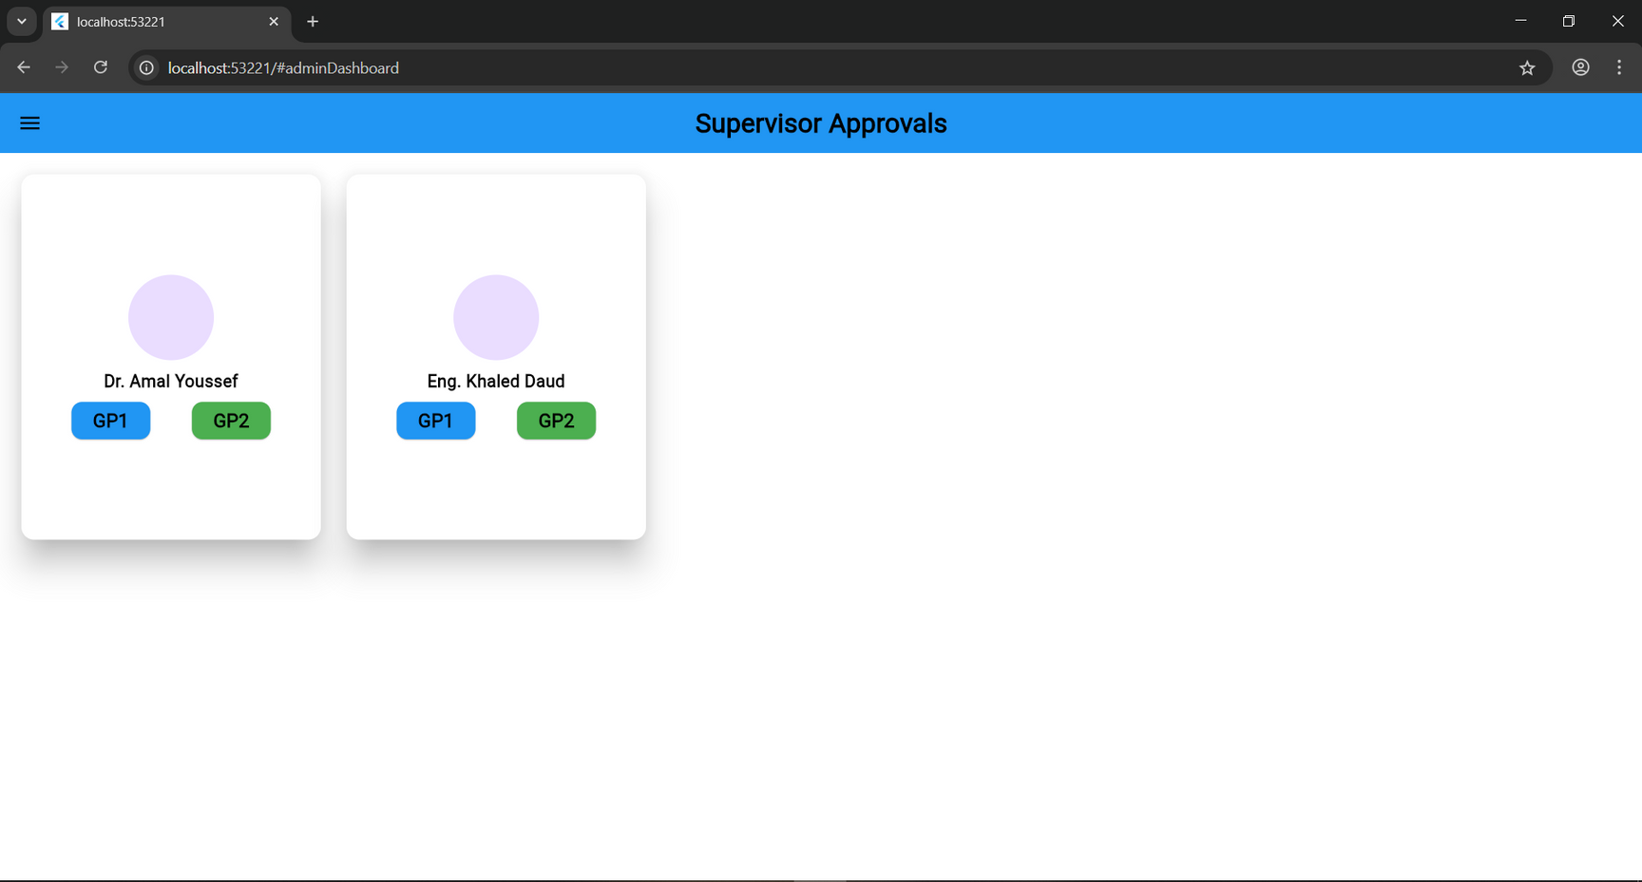
Admin Dashboard
Supervisor Projects
Here it lists the supervisors and for each the there both project subjects

Slide 37
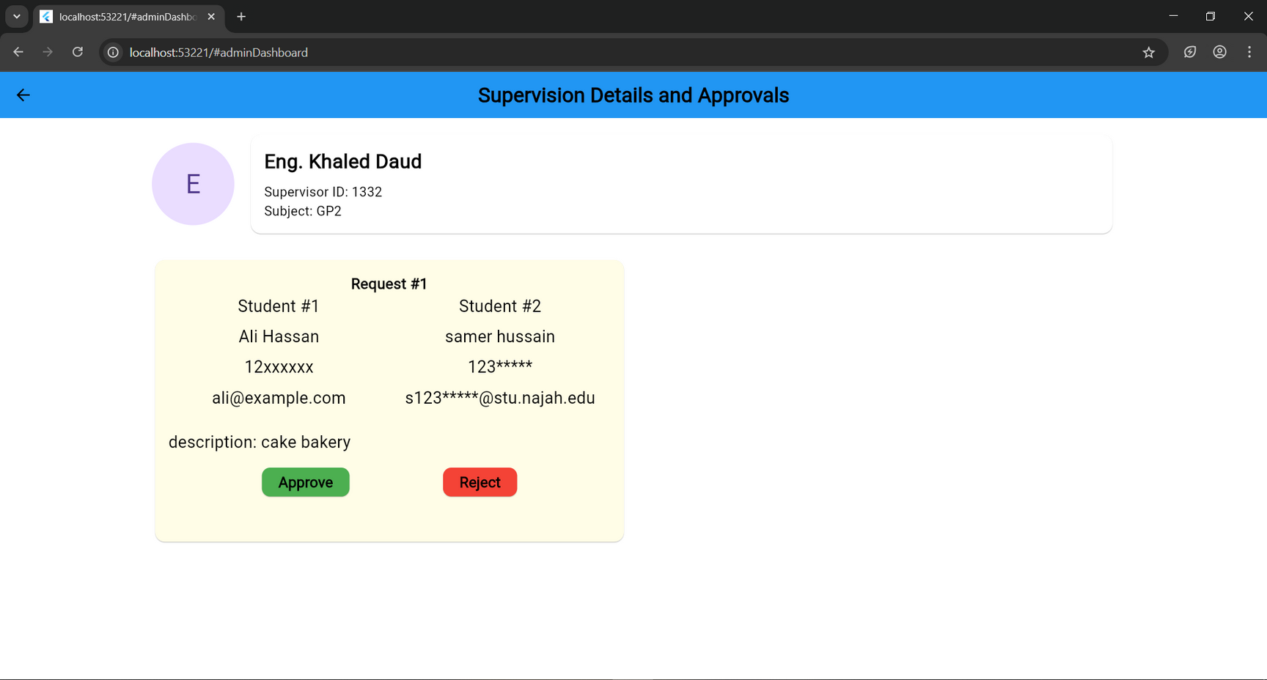
Admin Dashboard
Supervision details & approvals
After click on one of project subjects for a supervisor this page appear that shows the approved (if exist) and pending groups with details

Slide 38
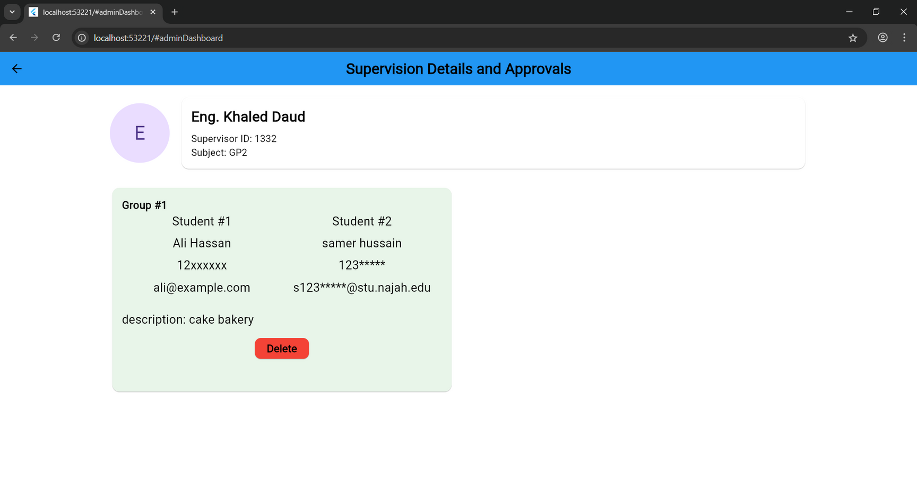
Admin Dashboard
Supervision details & approvals
After click on one of project subjects for a supervisor this page appear that shows the approved (if exist) and pending groups with details

Slide 39
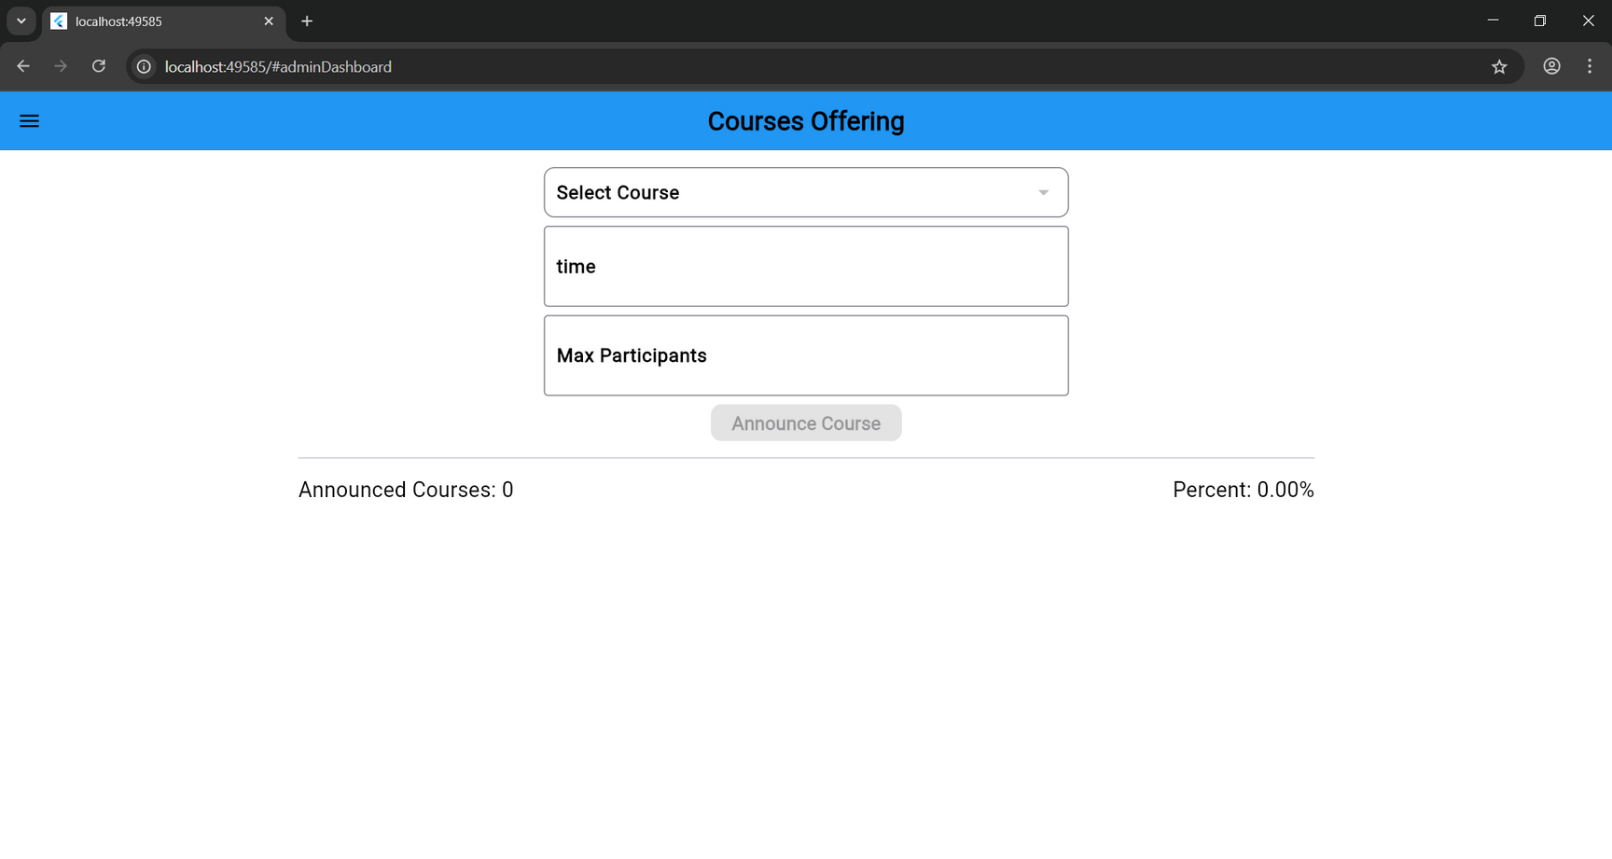
Admin Dashboard
Course offering
Announced and officialized courses(sections) are made and done here as the admin choose a course and the specify the weekly time and the max participants of this section and after submit it lists below with its current state and with an officialization ability at any time

Slide 40
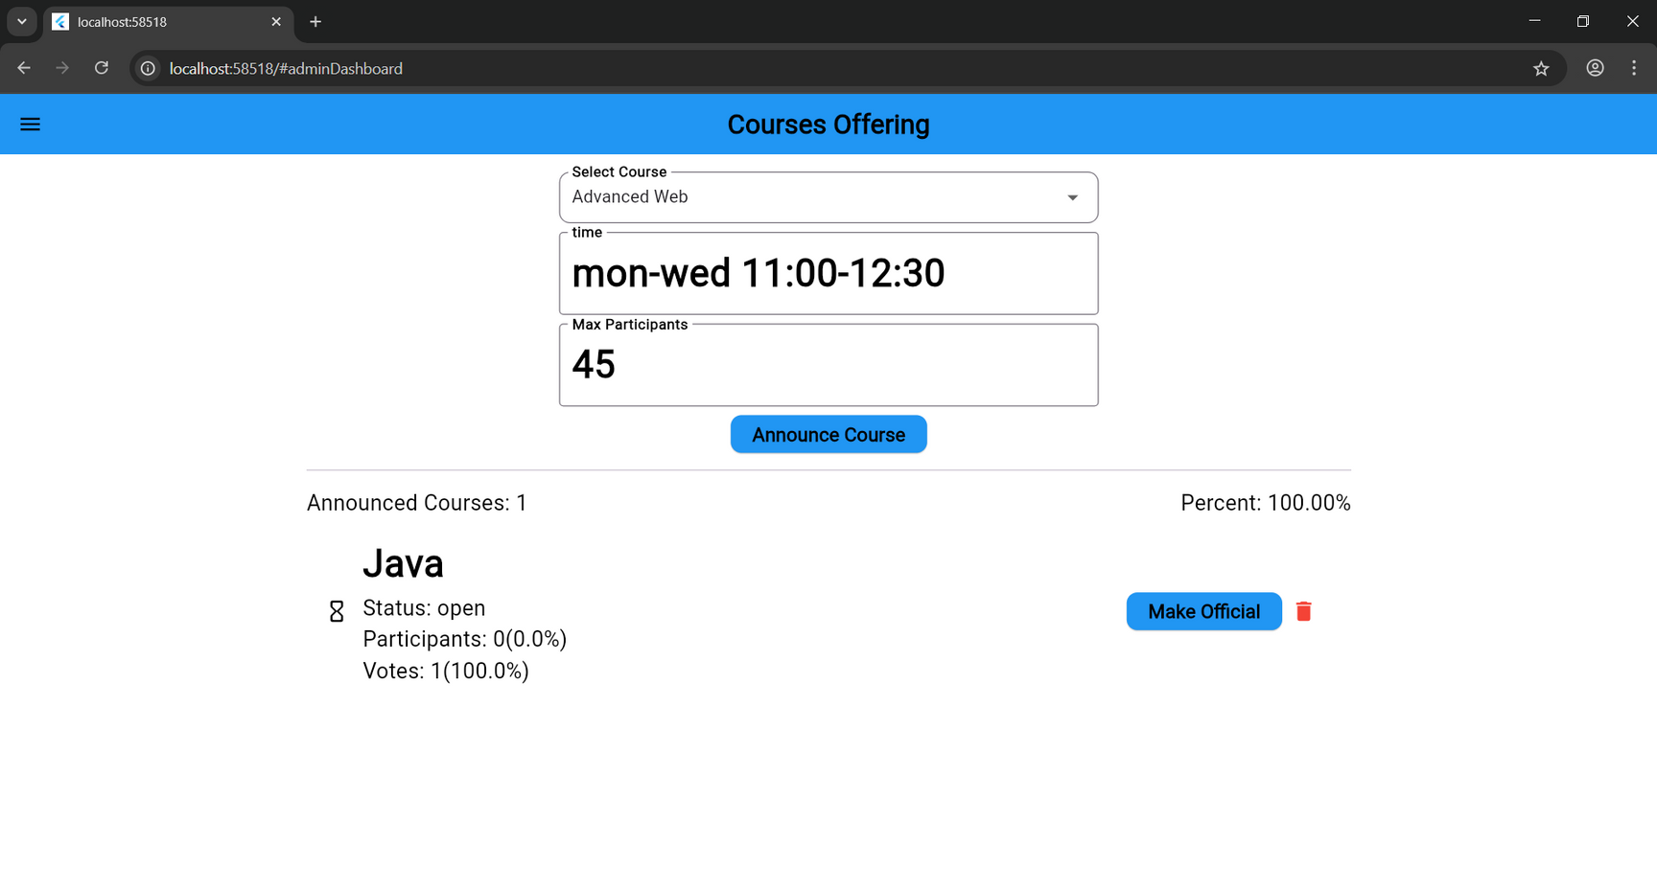
Admin Dashboard
Course offering
Announced and officialized courses(sections) are made and done here as the admin choose a course and the specify the weekly time and the max participants of this section and after submit it lists below with its current state and with an officialization ability at any time

Slide 41
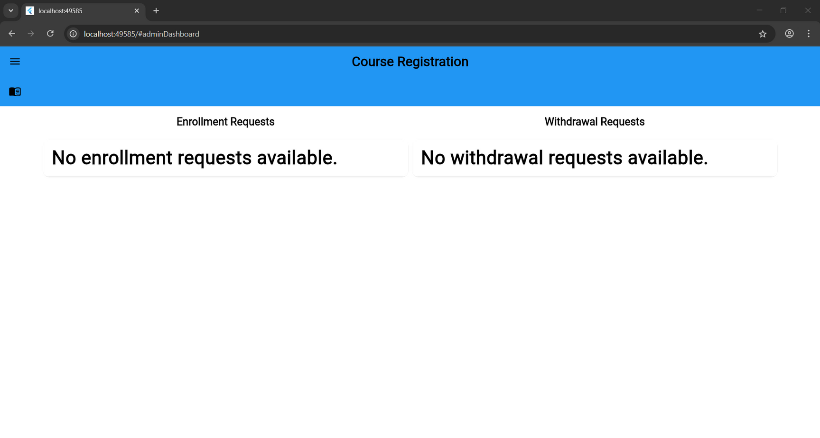
Admin Dashboard
Course Registration
The requests sent by the students will list in this page divided by its type, giving the ability to respond on them with the taken decision

Slide 42
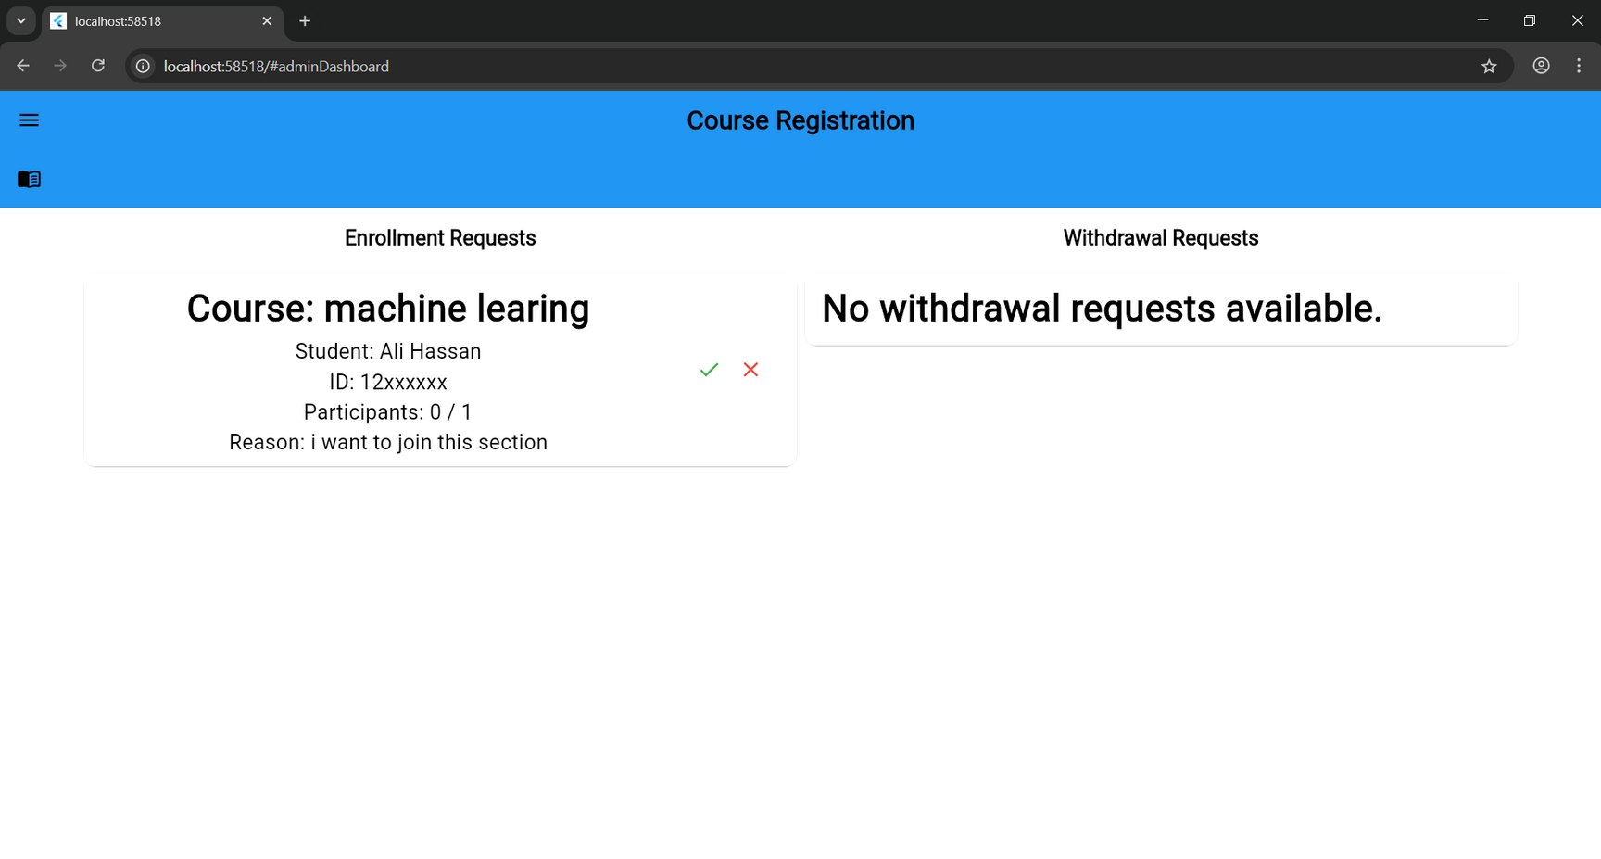
Admin Dashboard
Course Registration
The requests sent by the students will list in this page divided by its type, giving the ability to respond on them with the taken decision

Slide 43

Admin Dashboard
Announced Courses
The announced courses(sections) all listing here with its details and current state

Slide 44

Admin Dashboard
Announced Courses
The announced courses(sections) all listing here with its details and current state

Slide 45

Admin Dashboard
Course Students
After clicking on the specific section its enrolled students appear and list in this page

Slide 46

Admin Dashboard
Course Students
After clicking on the specific section its enrolled students appear and list in this page

Slide 47

Extra Web Pages

Slide 48

Extra Web Pages

Slide 49

Extra Web Pages

Slide 50

Extra Web Pages

Slide 51

Extra Web Pages

Slide 52

Extra Web Pages

Slide 53

Extra Web Pages

Slide 54

Extra Web Pages

Slide 55

Extra Web Pages

Slide 56





05
FUTURE WORK
01
Tighter integrating with Zajel.
02
Improve and extend the schema to deal with different Engineering departments.
03
Chat system between students.
04
Extend details and reason with file uploading

Slide 57






06
CONSTRAINS
Solo development
Lack of distributed load on team members as I obliged to make it alone with all its load and effort on my responsibility affects the progress and the organizing of it flow and delay it notably.
Data access
No direct access or API to use obtaining valid authentication or real case date from university database or the Zajel, mock data used instead of it.
Limited resources
development process of the project using limited and open-source tools and lacked of and limited financial resources and availability forced me to not reach the advanced and premium tools, framework and services that facilitate and enhance the development process
Time limitation
  The project must be completed within one semester
  Faced to working alone after losing a partner and agreed idea
long stages defining - studying new technologies, development, and reporting
  Focus on core features, no time for minor ones
  Significant time debugging, and testing
  Required redefinition and replanning from the beginning

Slide 58


Any Question❓

Slide 59

Thanks For Watching

