Slide 1
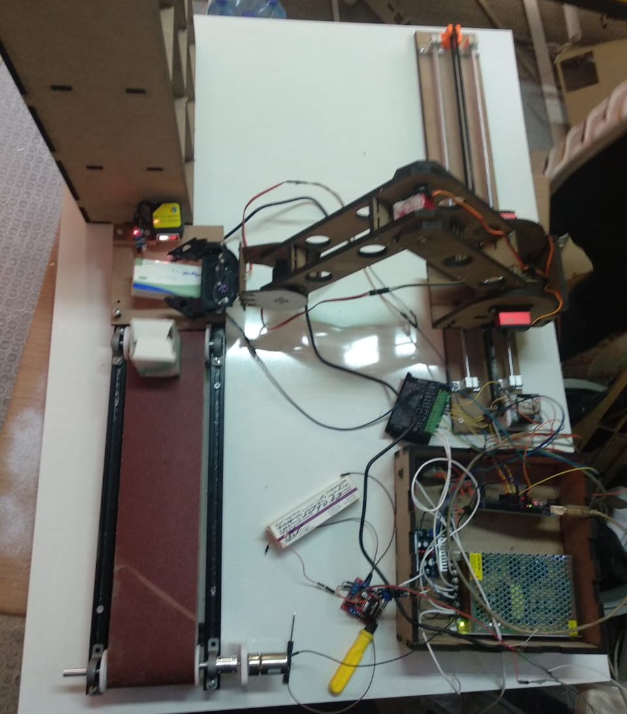
Pharmacy Robot
By: Siham Abu Baker & Maysa AbuBaker
Supervisor: Ashraf Armoush

Slide 2
Outlines:
Problem Statement
What’s Pharmacy Robot and how it works
Tools
Demo
Constraints
Future work

Slide 3
Problem statement
All the pharmacies in Palestine face lots of difficulties in arranging the medicine boxes.The pharmacists arrange medicines in a traditional way where
they spend more than one day doing this. In addition, they may put them in the wrong places. Moreover, the height of some shelves is high for the pharmacists to reach.

Slide 4
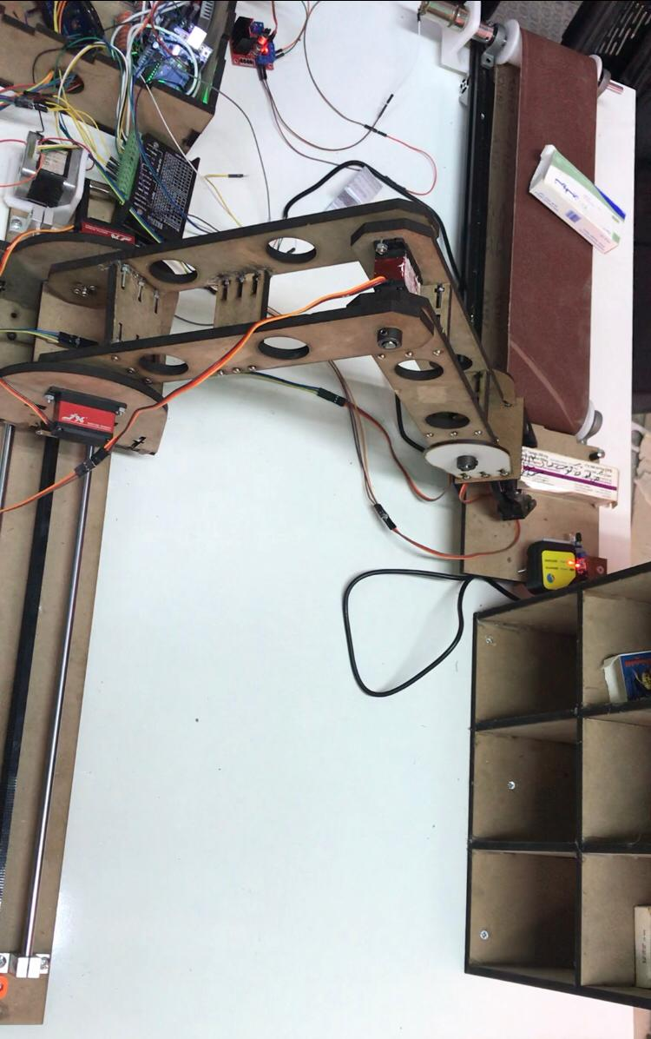
What’s Pharmacy Robot

Slide 5
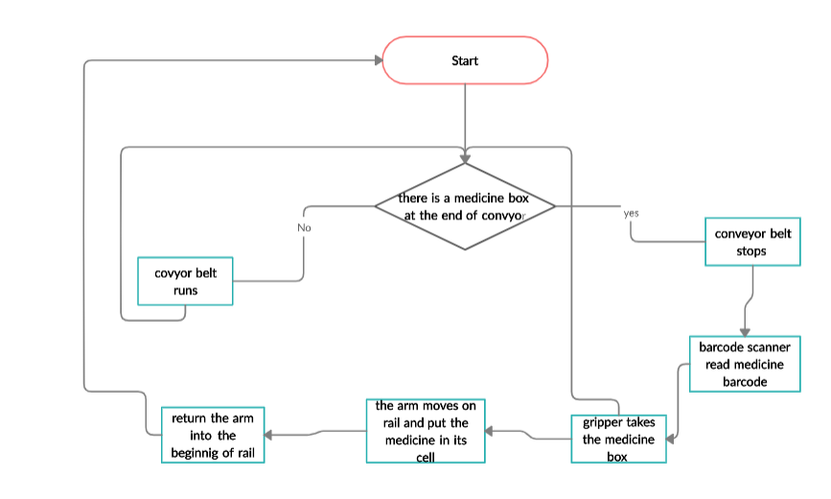
How it works

Slide 6
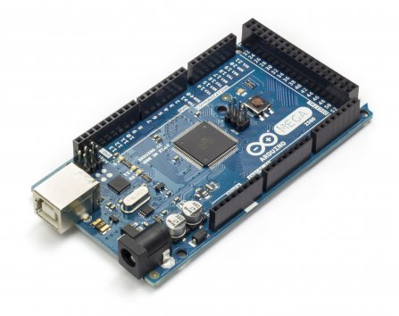
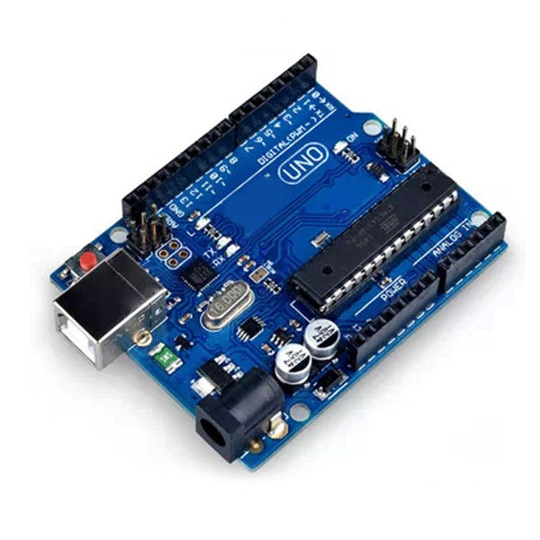
Tools
Arduino Mega – 2560
The main controller of the project.
It controls stepper ,Dc and servo motors .
It reads sensors data and process them.
It reads barcode scanner data and process it.

Slide 7
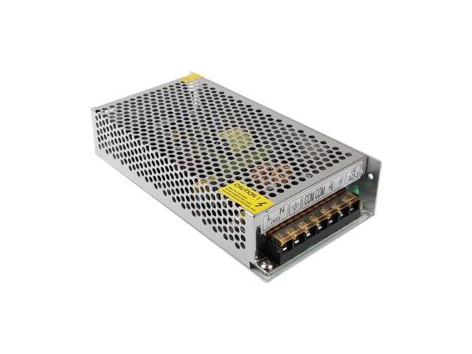
Tools (cont)
Power Supply 12V,10A

Slide 8
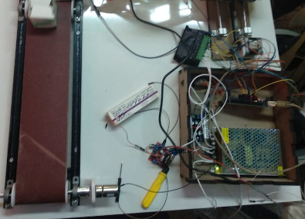
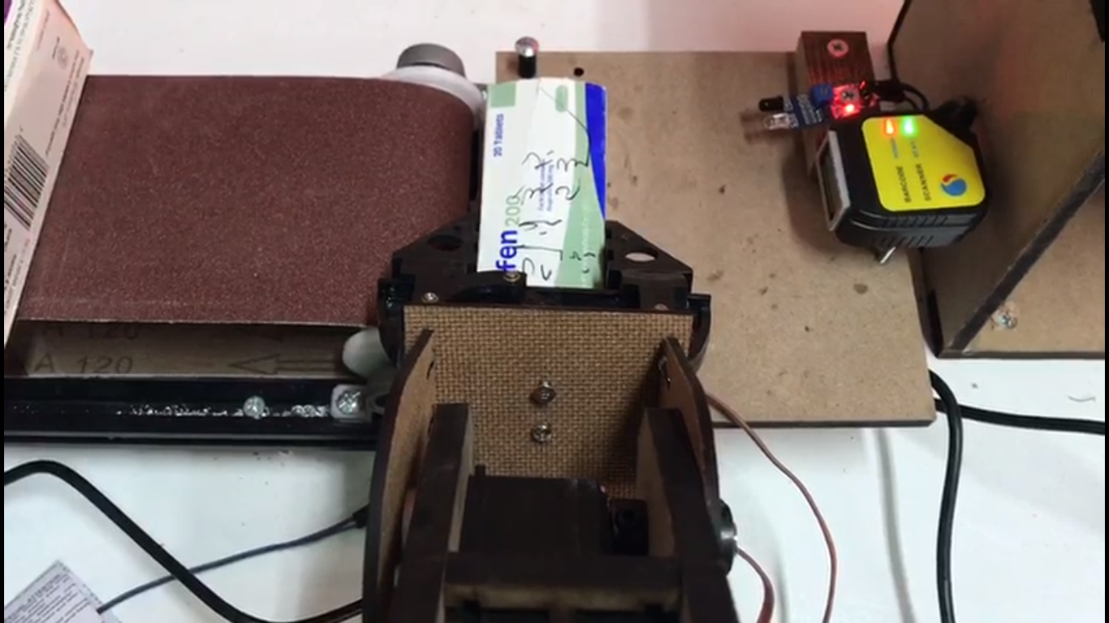
Conveyor belt Tools

Slide 9
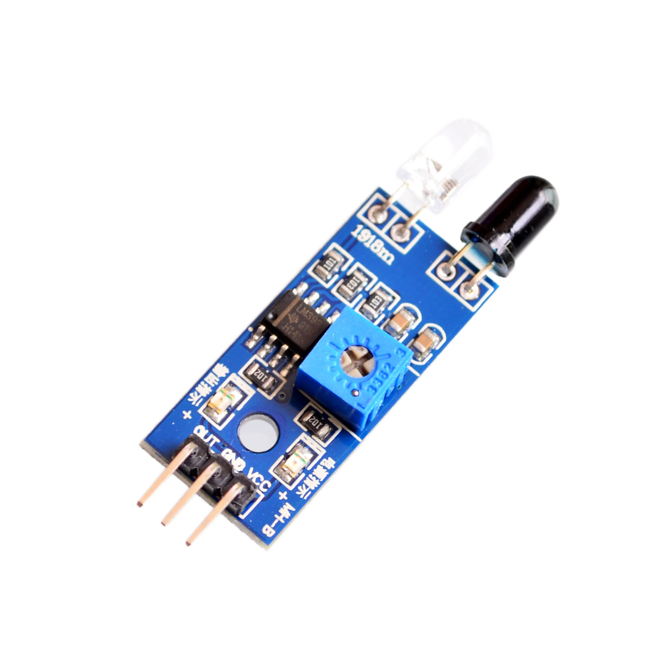
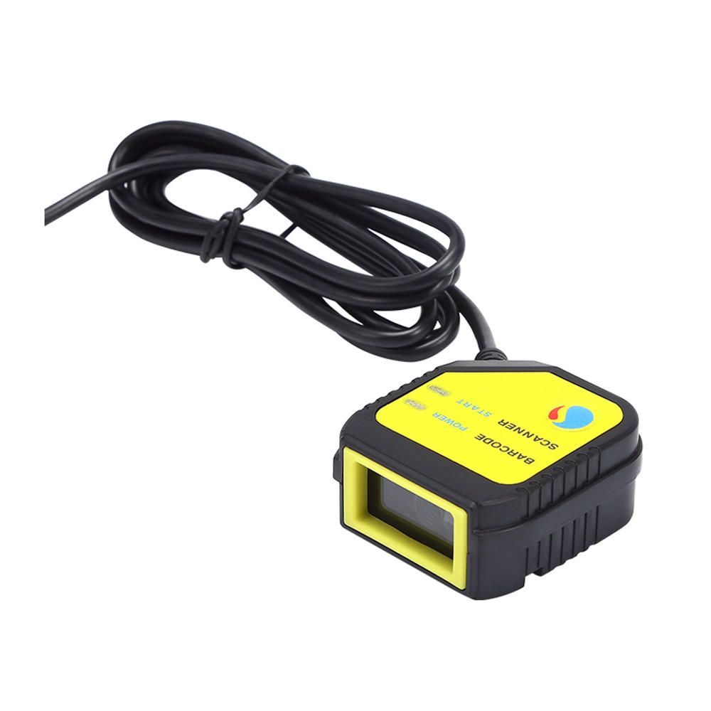
Tools (cont)
IR Obstacle Avoidance Sensor Module
Barcode Scanner 2D

Slide 10
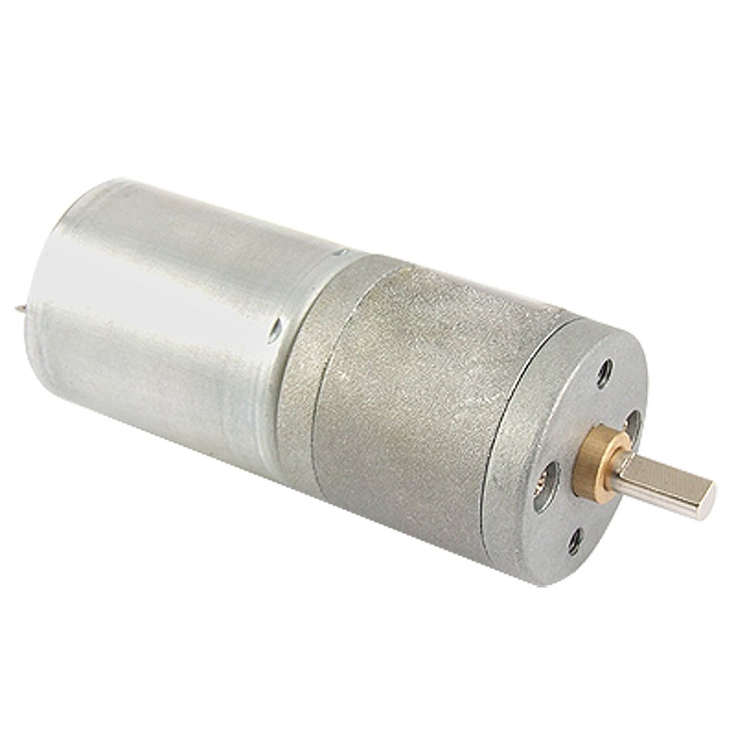
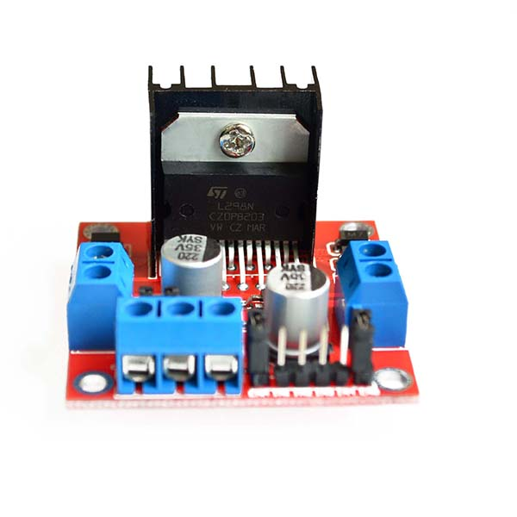
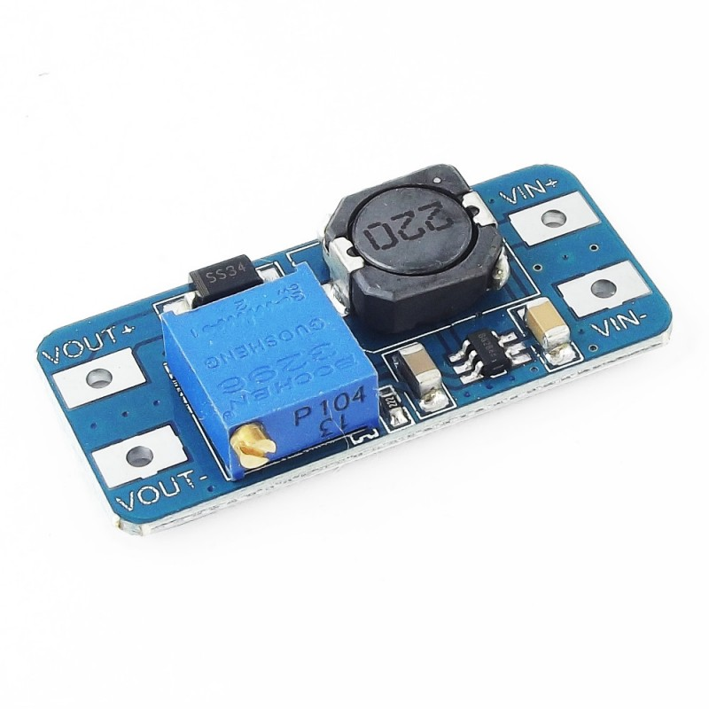
Tools (cont)
DC motor 12 V
L298N Dual H-Bridge Motor Drive
MT3608 Step Up Power Supply

Slide 11
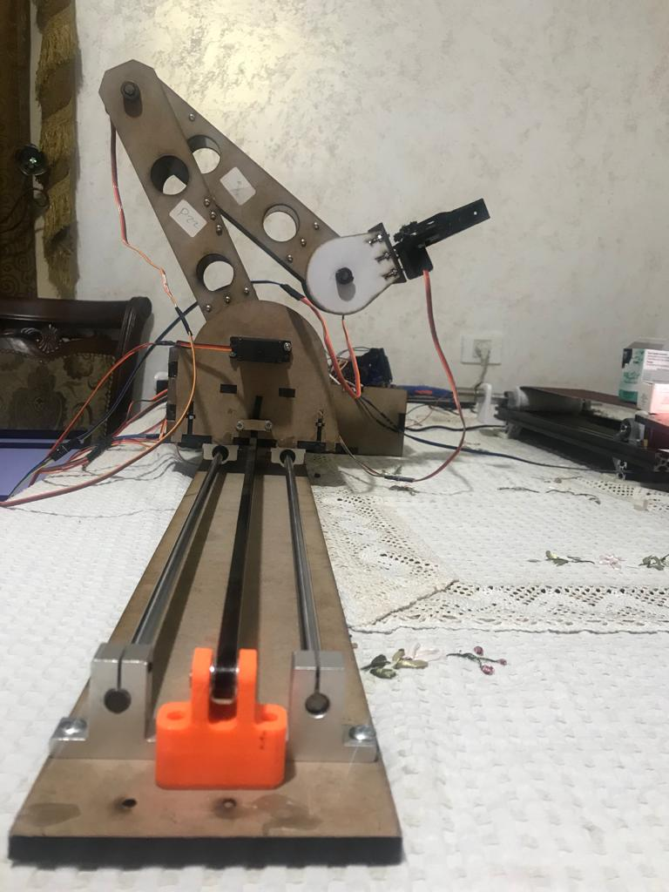
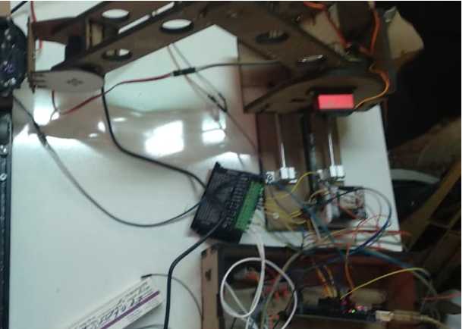
Rail tools

Slide 12
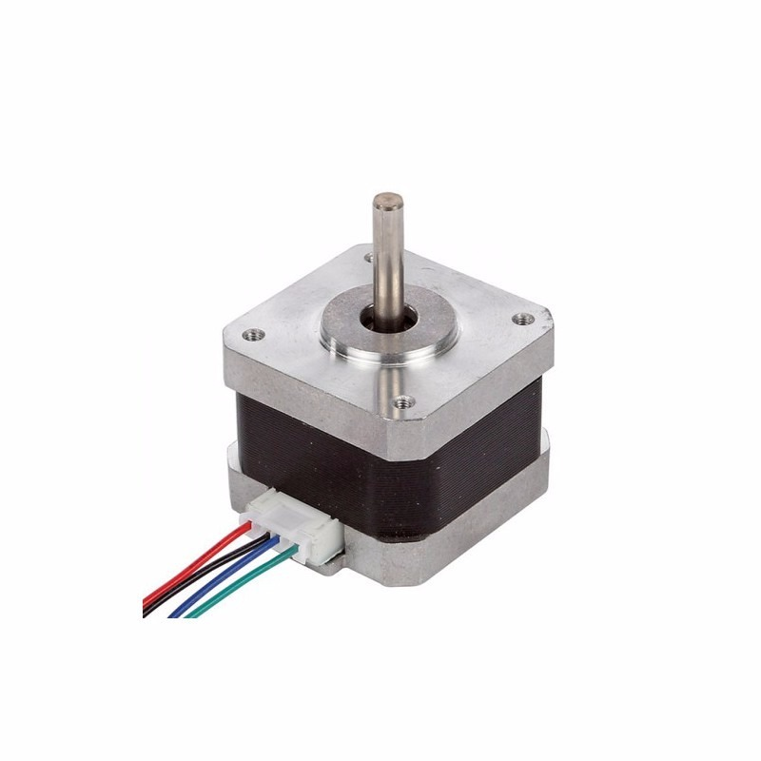
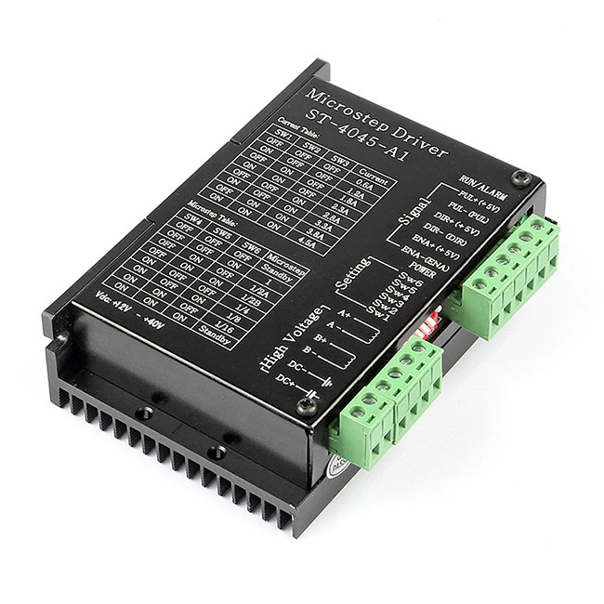
Tools (cont)
Stepper Motor
Stepper Motor Driver

Slide 13
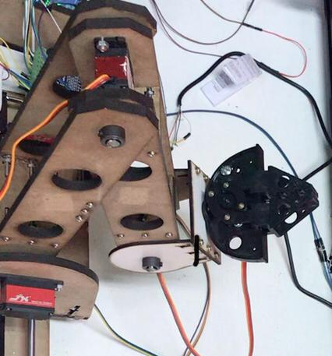
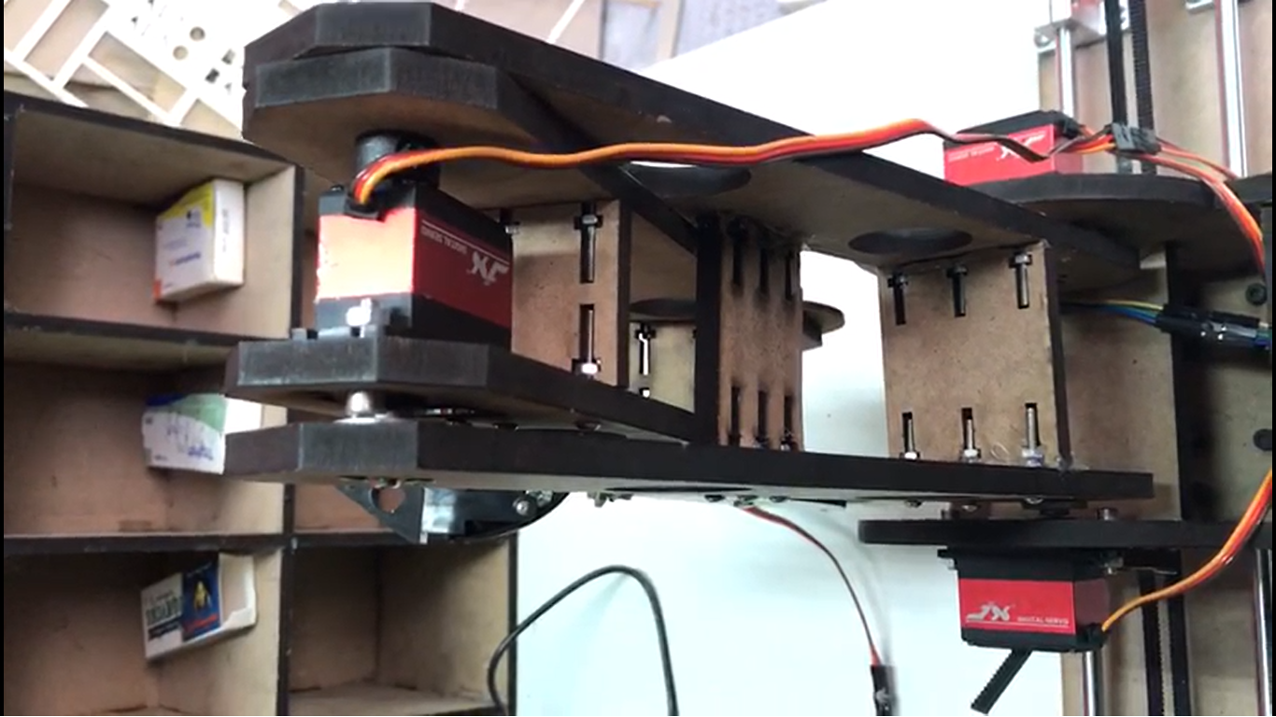
Arm tools

Slide 14
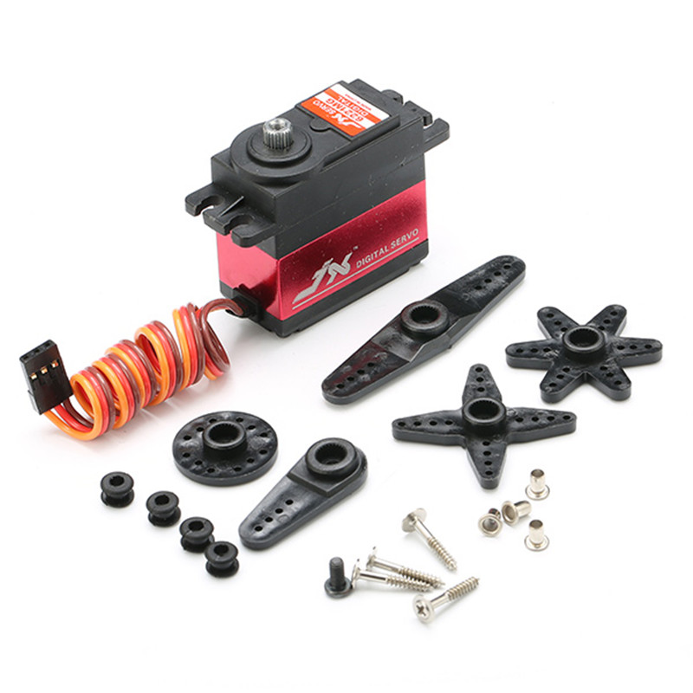
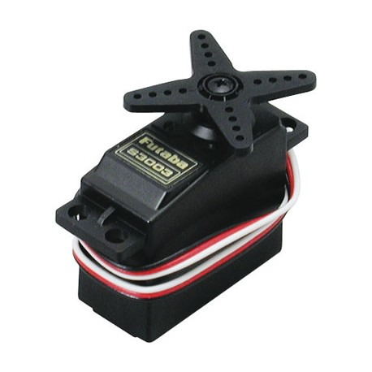
Tools (cont)
Servo motor 20kg.cm
Servo motor 9kg.cm

Slide 15
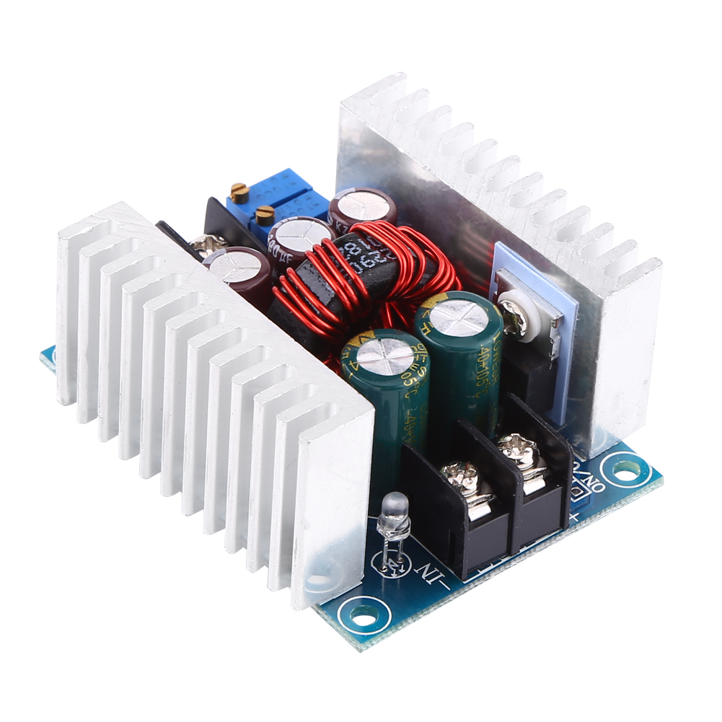
Tools(cont)
Buck Converter Module

Slide 16
Demo

Slide 17
Constraints
power problem
Servo motors problem
Measurements problem

Slide 18
Future Work
We wish to make the robot itself to be able to rotate the medicine box into the barcode side.

Slide 19
Questions?!!

