Slide 1
Stair Climbing Robot “Yazur”
(Ibraheem + Mostafa) * Taha
Dr.Read Qadi Dr.Luai Malhis

Slide 2
Outline
Idea and Introduction
Design
Control:
  Car
  Mobile
  Flex and Hand
Future Work
Demo
Conclusion
Question

Slide 3
Outline
Idea and Introduction
Design
Control:
  Car
  Mobile
  Flex and Hand
Future Work
Demo
Conclusion
Question

Slide 4
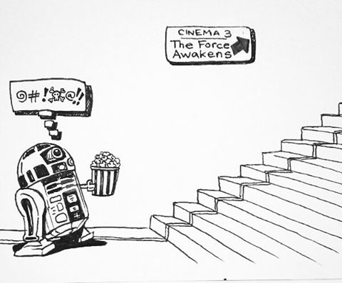
Idea and Introduction
Problems
  Rescue Duties
  Hard Terrains
  Stairs
  …. and Robotic World
  Solution → Stair Climbing Robot

Slide 5

Idea and Introduction
Plug and Play (Dr.Luai Malhis) ^^”
Very tough & undoable – Dr.Raed Qadi >.<

Slide 6
Outline
Idea and Introduction
Design
Control:
  Car
  Mobile
  Flex and Hand
Future Work
Demo
Conclusion
Question

Slide 7

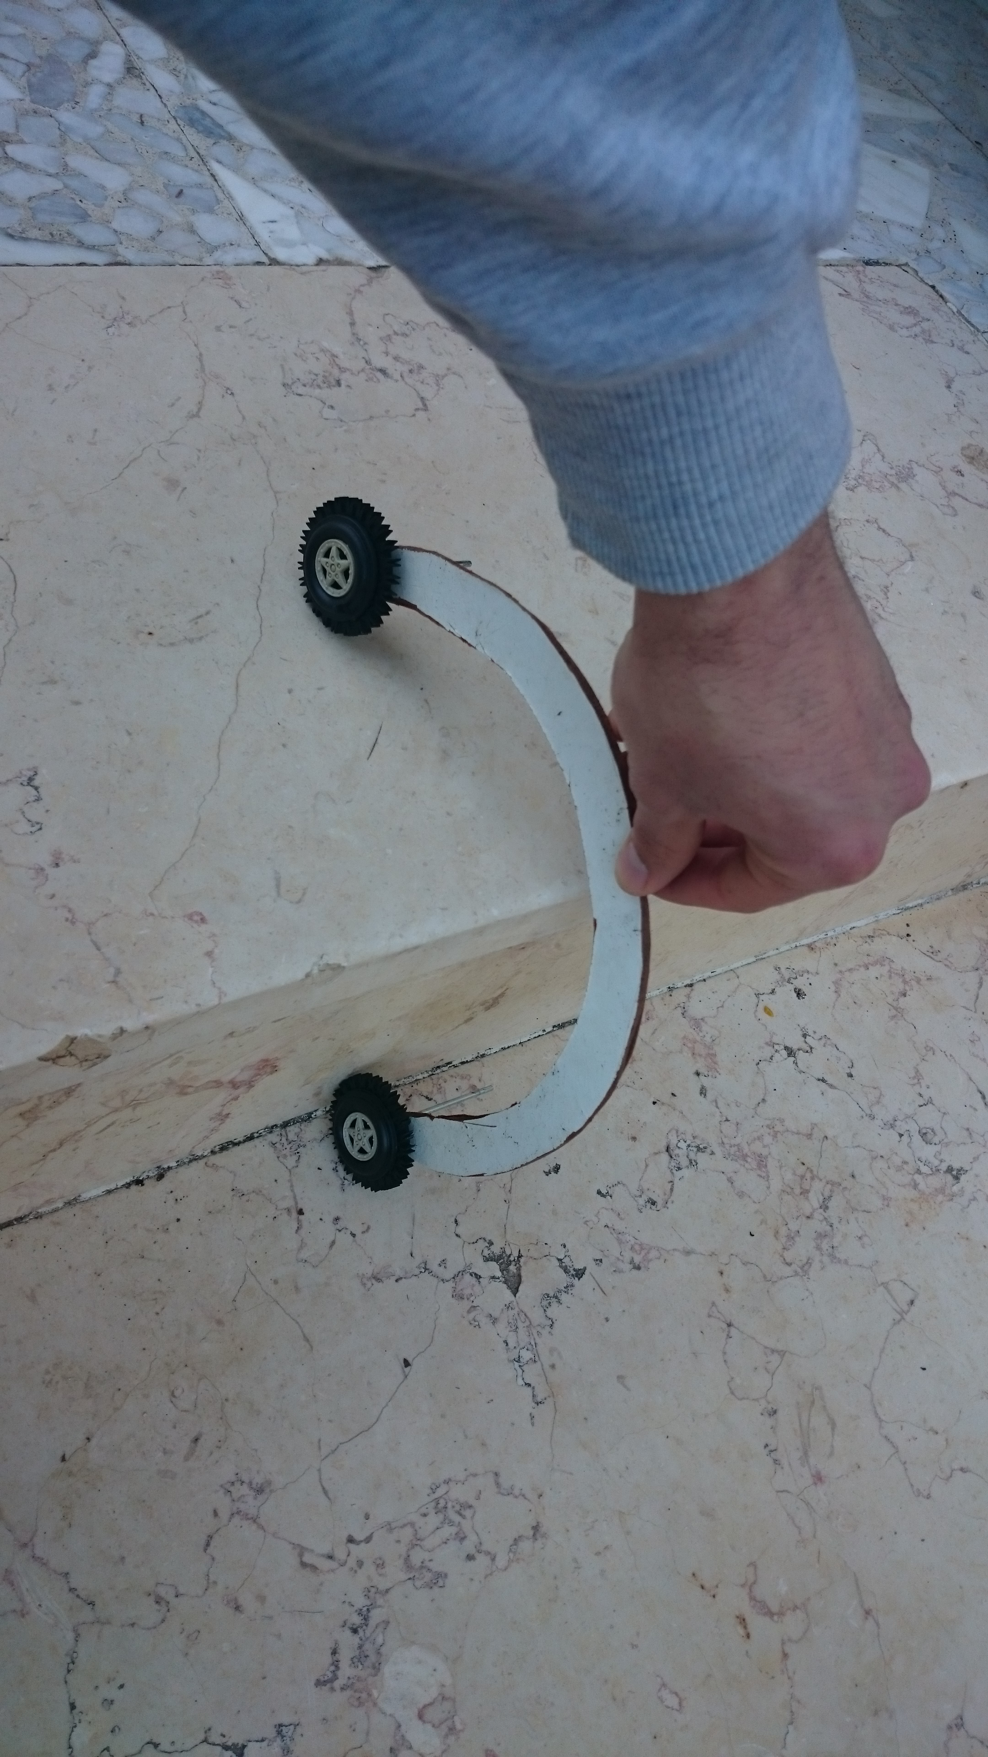
Design
Look and search
Chosen Design → Arc Design

Slide 8
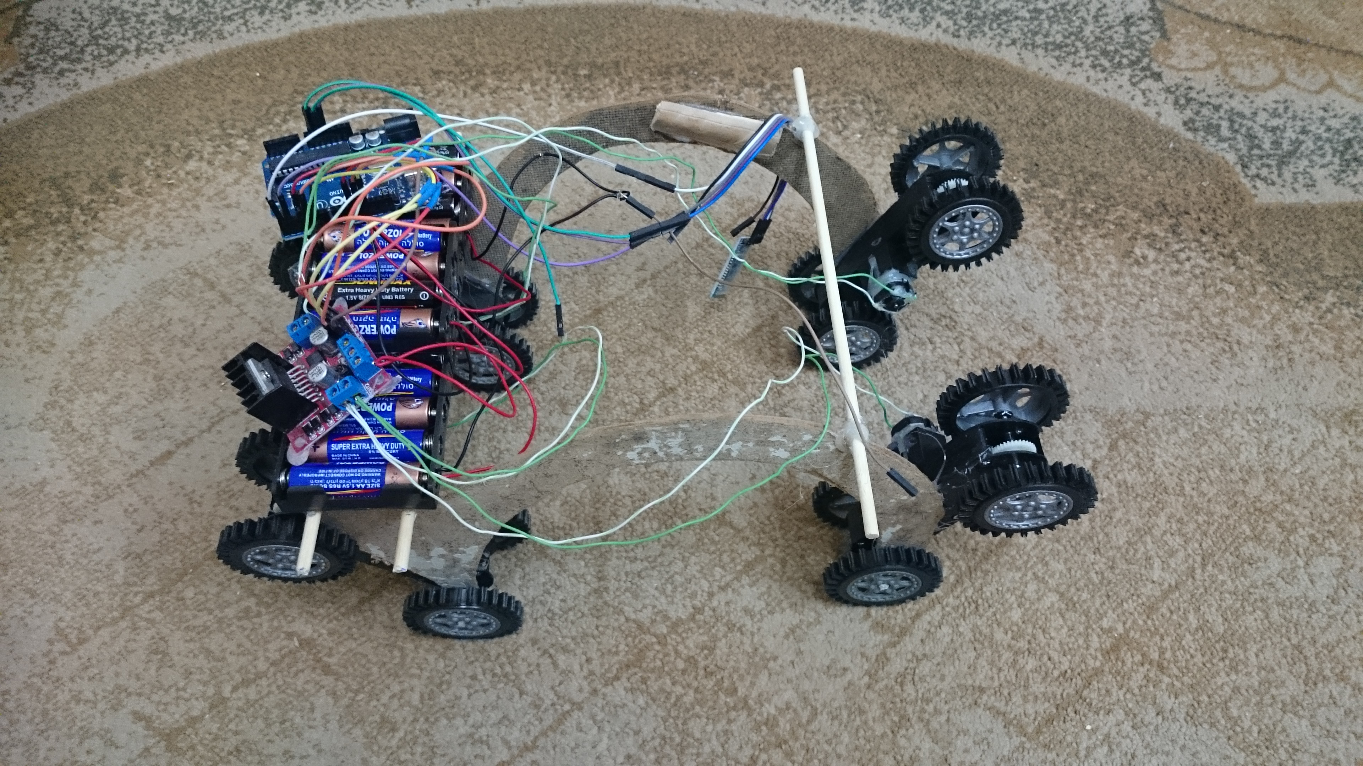
Design
First Design

Slide 9
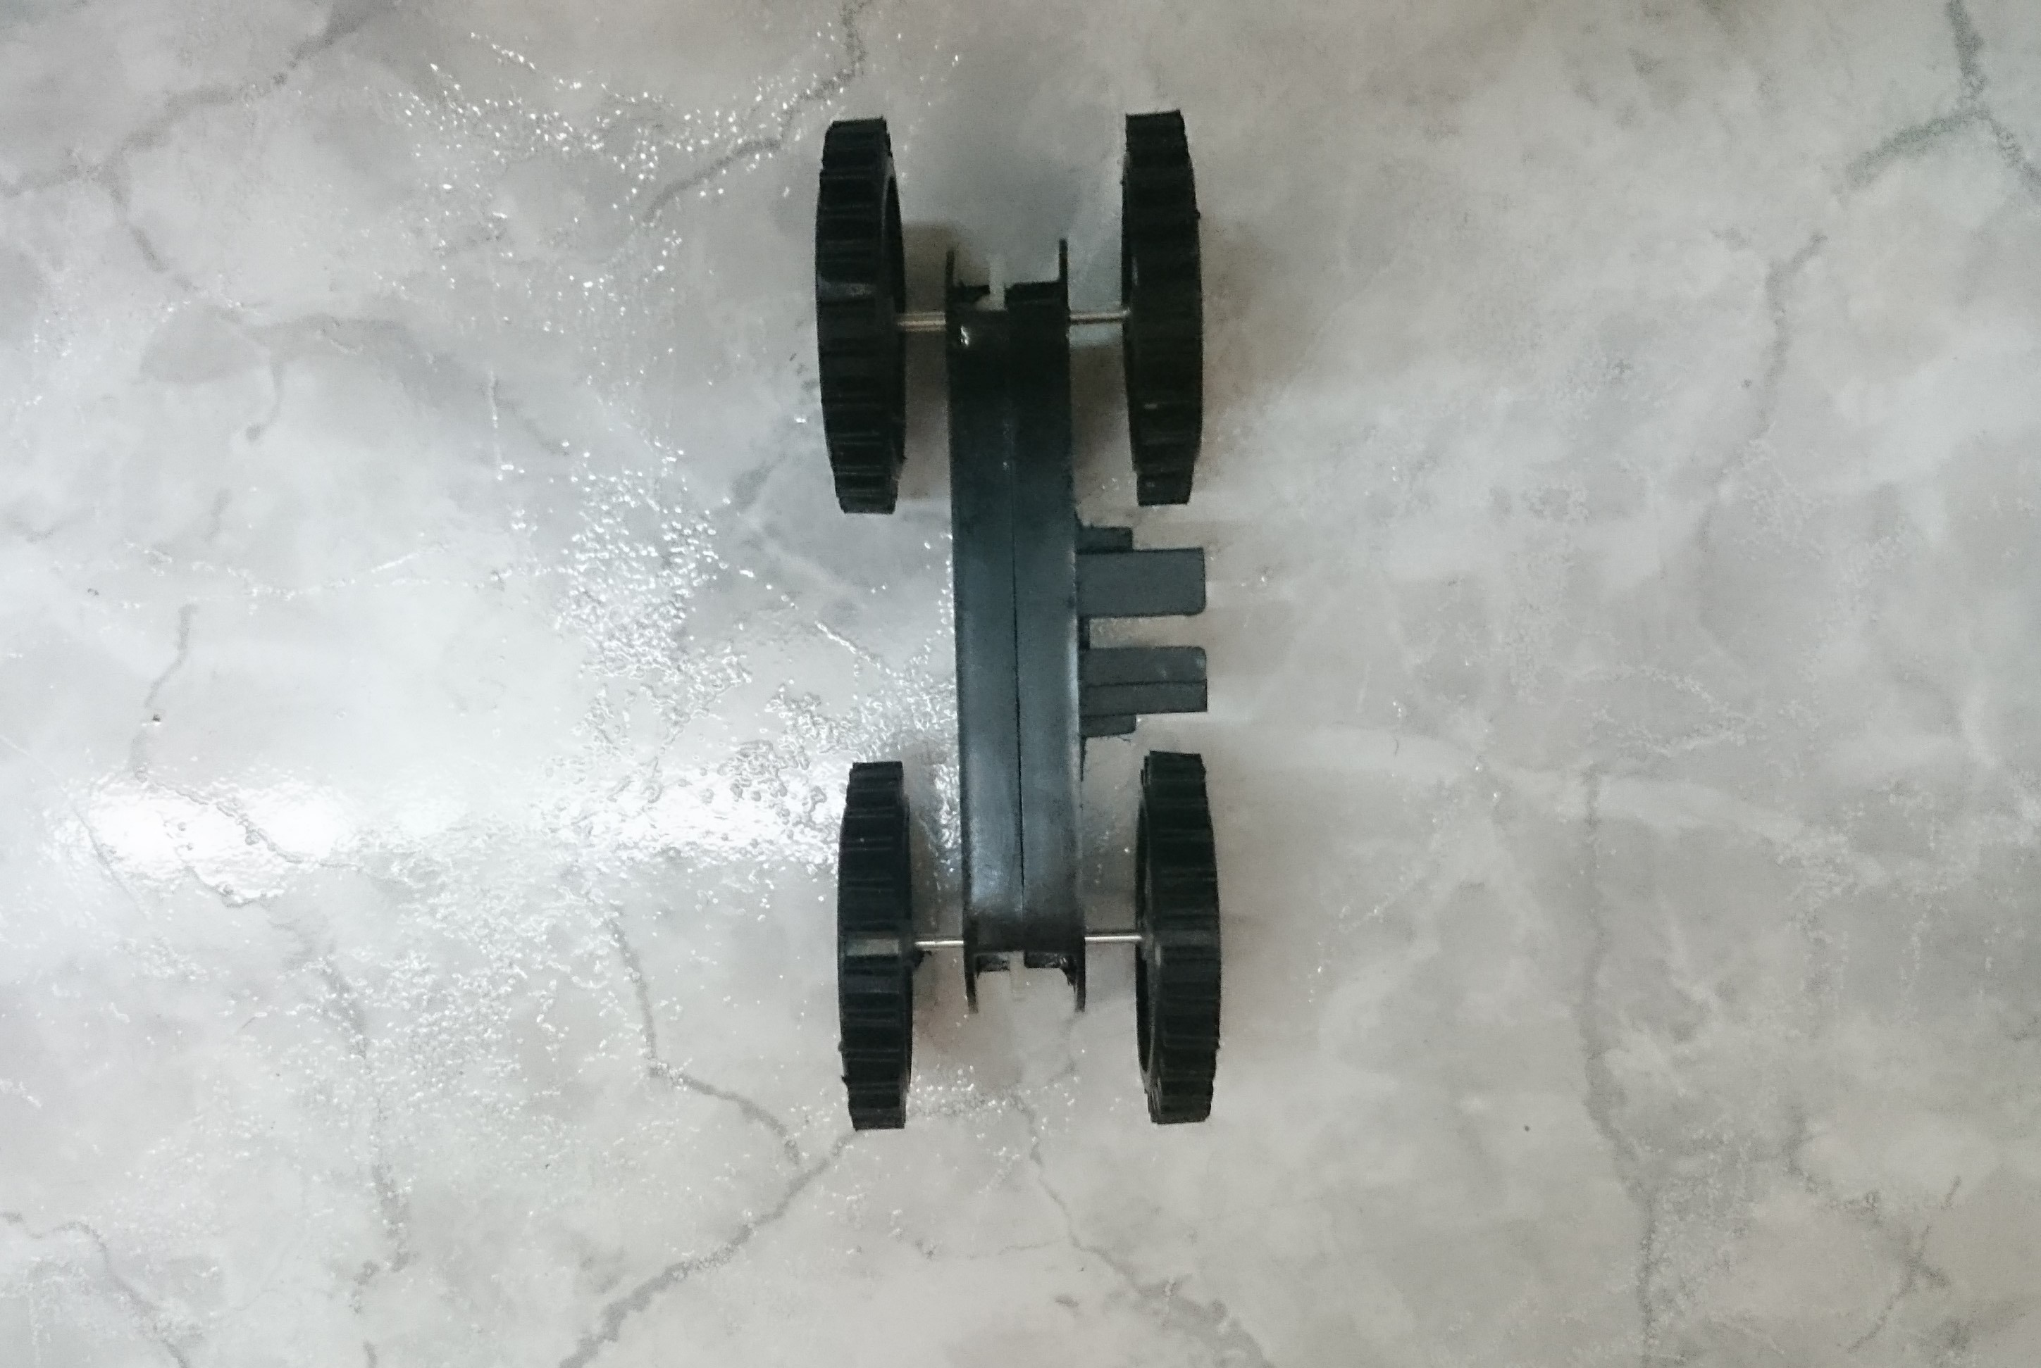
Design
Problem with the design
  Friction
  Weight – front and back
  Angles

Slide 10
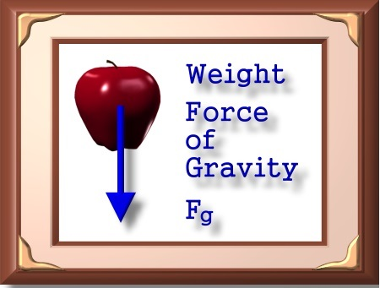
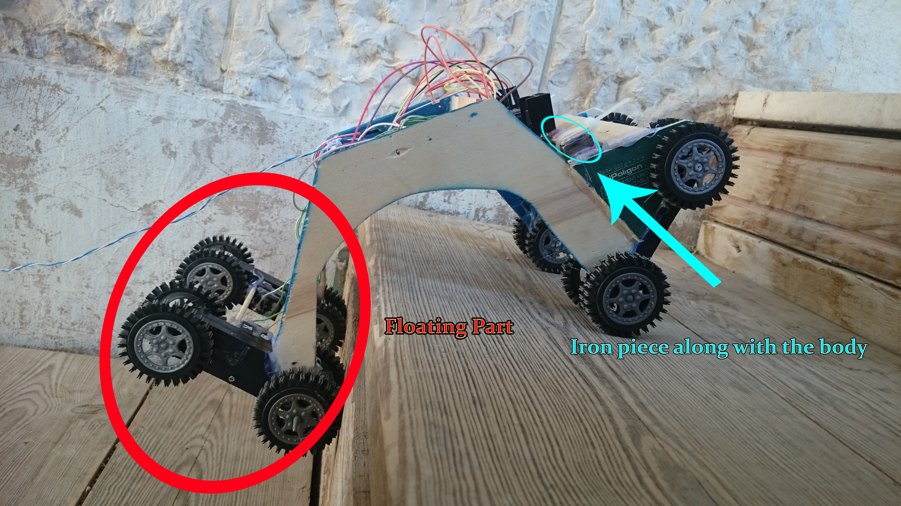
Design
Problem with the design
  Friction
  Weight – front and back
  Angles

Slide 11
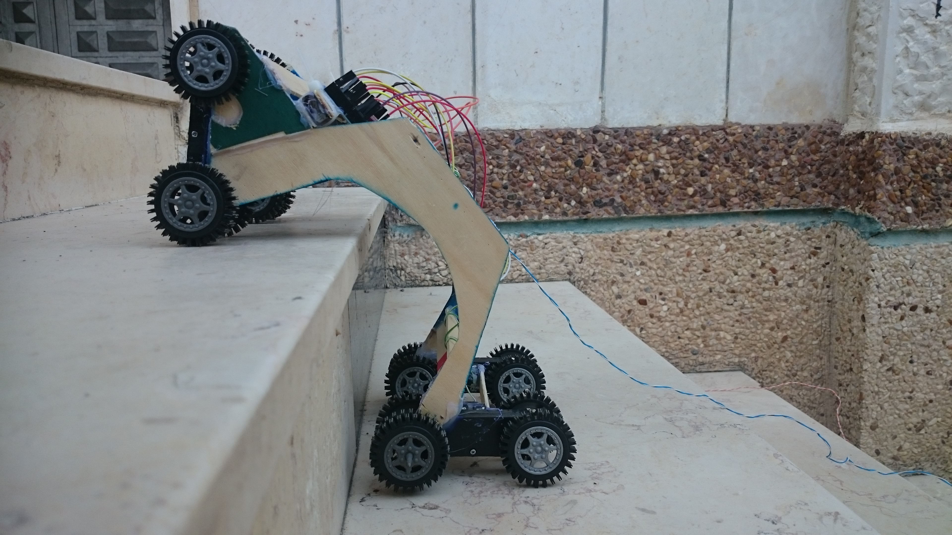
Design
Problem with the design
  Friction
  Weight – front and back
  Angles

Slide 12
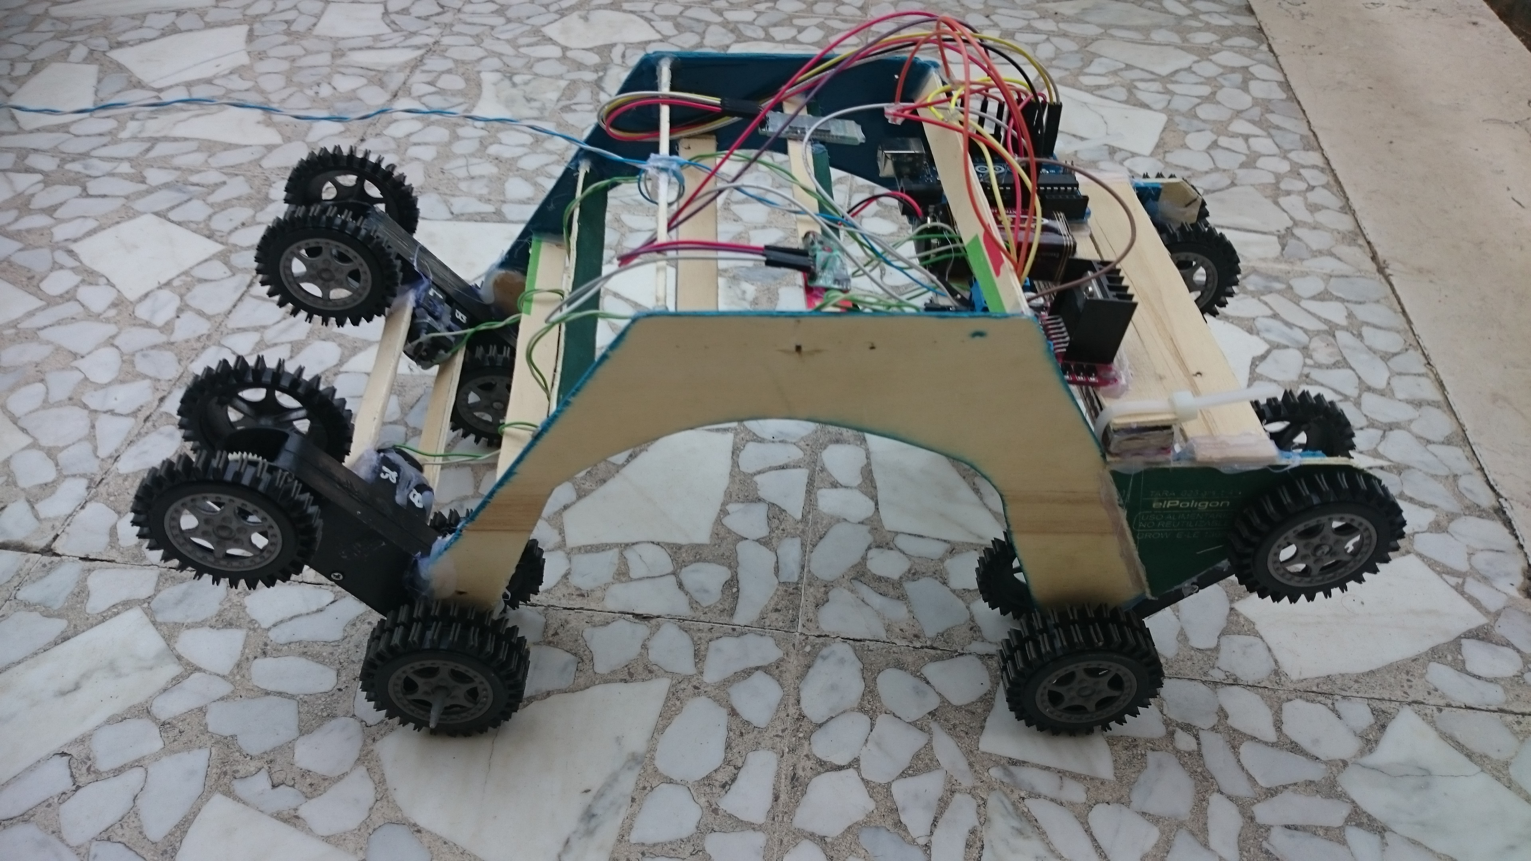
Design
Final Design

Slide 13
Outline
Idea and Overview
Design
Control:
  Car
  Mobile
  Flex and Hand
Future Work
Demo
Conclusion
Question

Slide 14
Control
Car

Slide 15
Outline
Idea and Overview
Design
Control:
  Car
  Mobile
  Flex and Hand
Future Work
Demo
Conclusion
Question

Slide 16
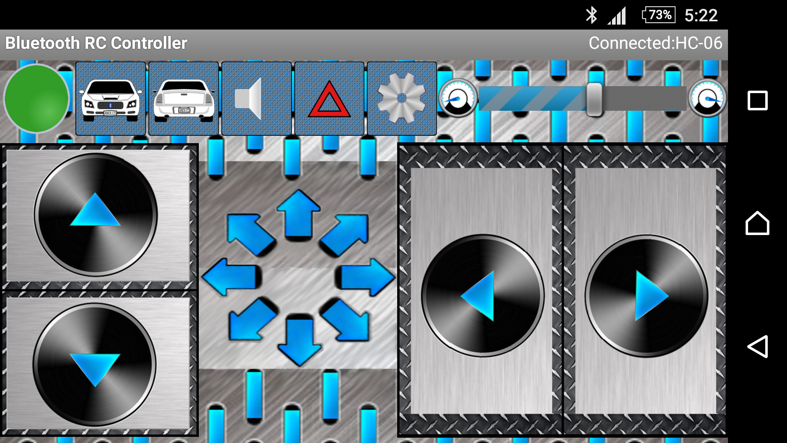
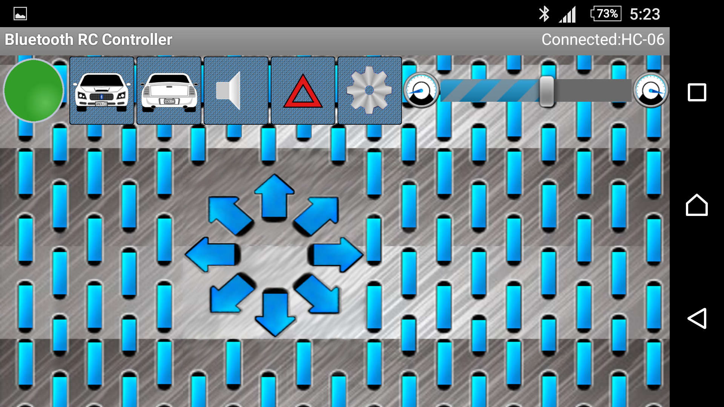
Control: Mobile
Characters to send (F-B-R-L-S…)
Data Stream problem
Solution → One bit for an action

Slide 17
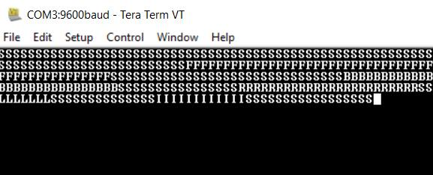
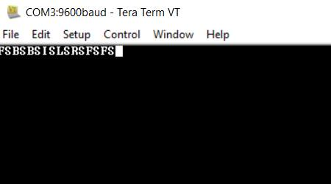
Streaming problem
Streaming every 50MS
One character for each action

Slide 18
Outline
Idea and Overview
Design
Control:
  Car
  Mobile
  Flex and Hand
Future Work
Demo
Conclusion
Question

Slide 19
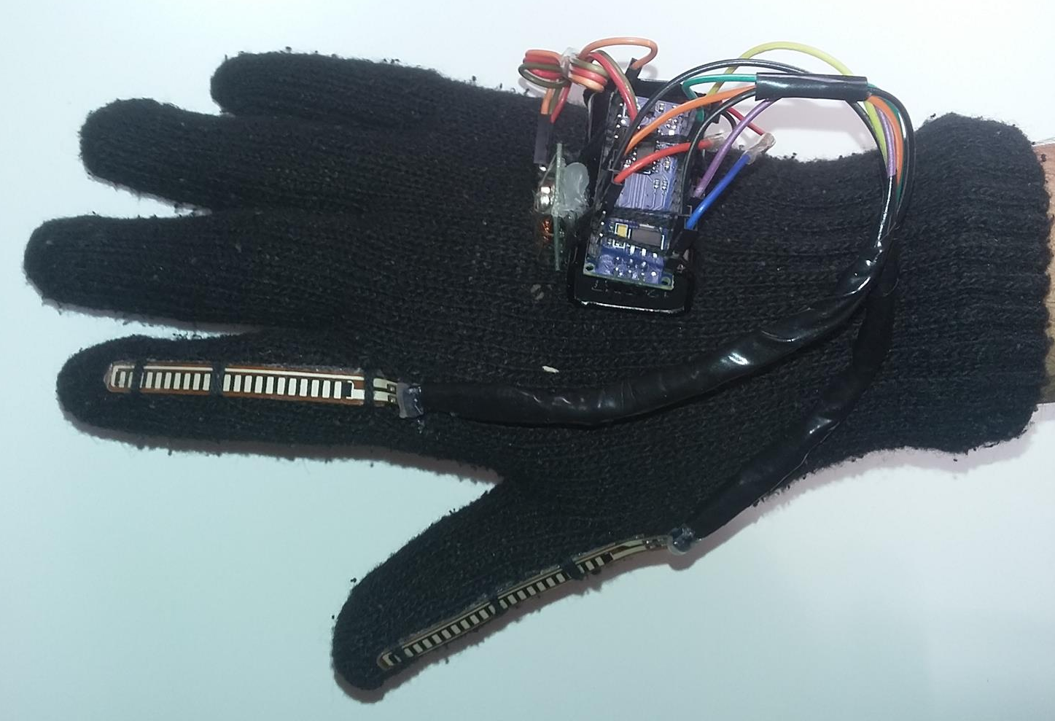
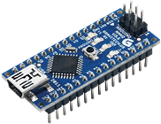
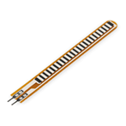
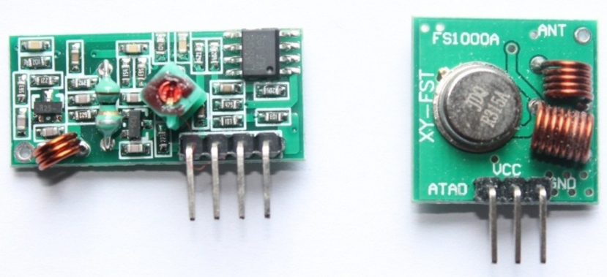
Control: Flex and Hand
Main movements (F-B-R-L-S) ()V
Main Components:
  Sensor: Flex Sensor
  Controller: Nano Arduino
  Communication: RF Transmitter & Receiver

Slide 20
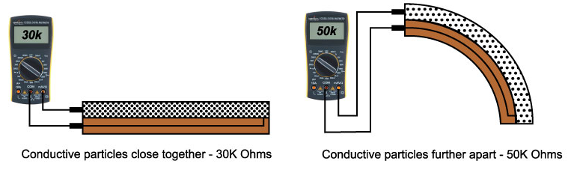
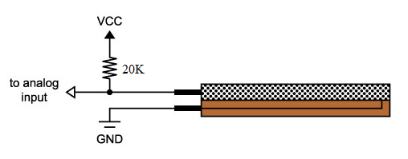
Flex and Hand cont..
Flex sensor:
Voltage divider circuit

Slide 21
Flowchart

Slide 22
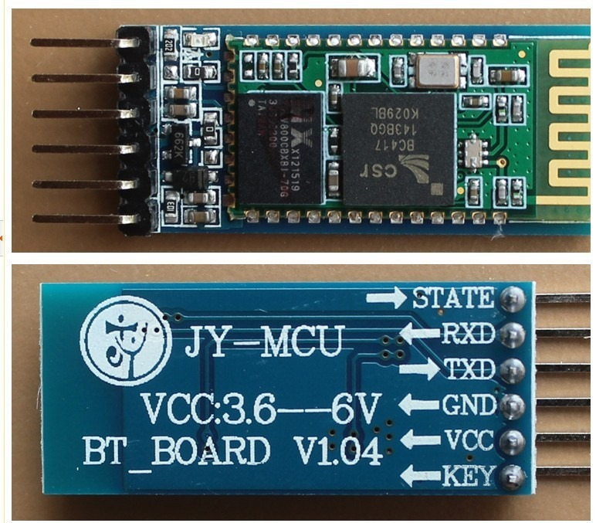
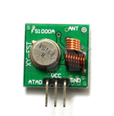
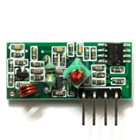
Flex and Hand cont..
Problem with Bluetooth HC-05 & HC-06 (Master)
Solution: RF transmitter and receiver
Bluetooth HC-05
transmitter
receiver

Slide 23
Outline
Idea and Overview
Design
Control:
  Car
  Mobile
  Flex and Hand
Future Work
Demo
Conclusion
Question

Slide 24
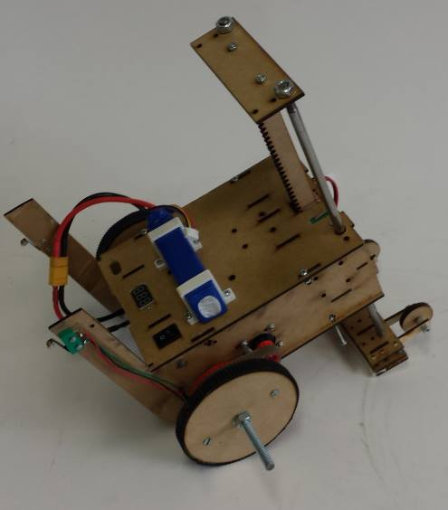
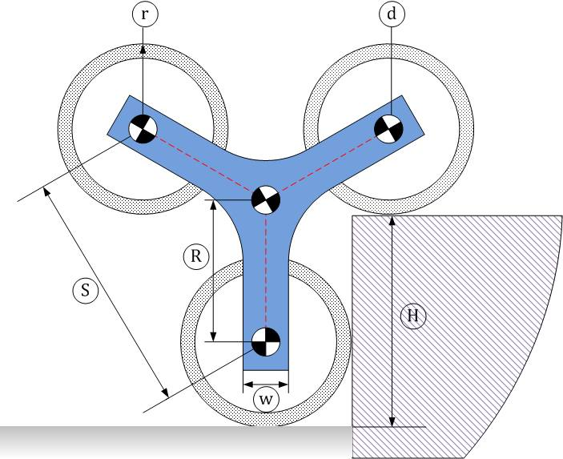
Future work
Adding new actions to the robotic glove
Although the robot can climb the stairs and can be controlled easily, the more friction is needed.
Shift loads such as the following image
Another aspect that could be improved is wheels’ design

Slide 25
Outline
Idea and Overview
Design
Control:
  Car
  Mobile
  Flex and Hand
Future Work
Demo
Conclusion
Question

Slide 26
Outline
Idea and Overview
Design
Control:
  Car
  Mobile
  Flex and Hand
Future Work
Demo
Conclusion
Question

Slide 27
Conclusion
Robotic World is so wide
Accomplished 95%
Low cost (50$ more-less) → Good for business

Slide 28
Outline
Idea and Overview
Design
Control:
  Car
  Mobile
  Flex and Hand
Future Work
Demo
Conclusion
Question

Slide 29
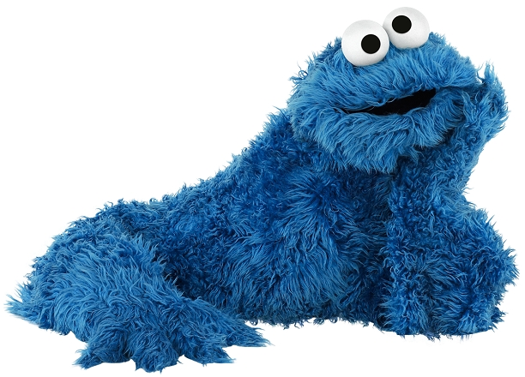
Thank You ☺
Any Cookies ?

