Slide 1
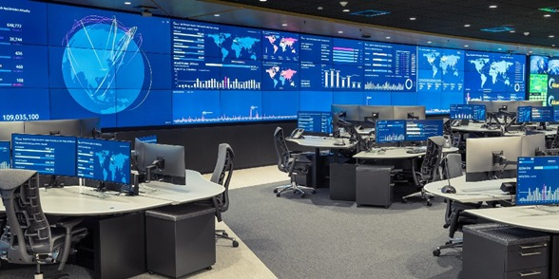

An-Najah National University Faculty of Engineering
Telecommunication Engineering Department
GRADUATION PROJECT 2
Virtual Network Operations Center (VNOC)
Supervisor:
Prof. Allam Mousa
Eng. Ahmad Qashoo
Students Name:
Ranin Sharawneh
Laila Omer
Roua Daghameen

Slide 2



Table of contents
1.Introduction
5.Monthly Report
2.The Role of VR in the NOC
6.Alarms
3.The Role of AI in the NOC
7.Tables Comparison
4.VNOC Environment in Unity
8.Real-Time Report
9.Future Work

Slide 3

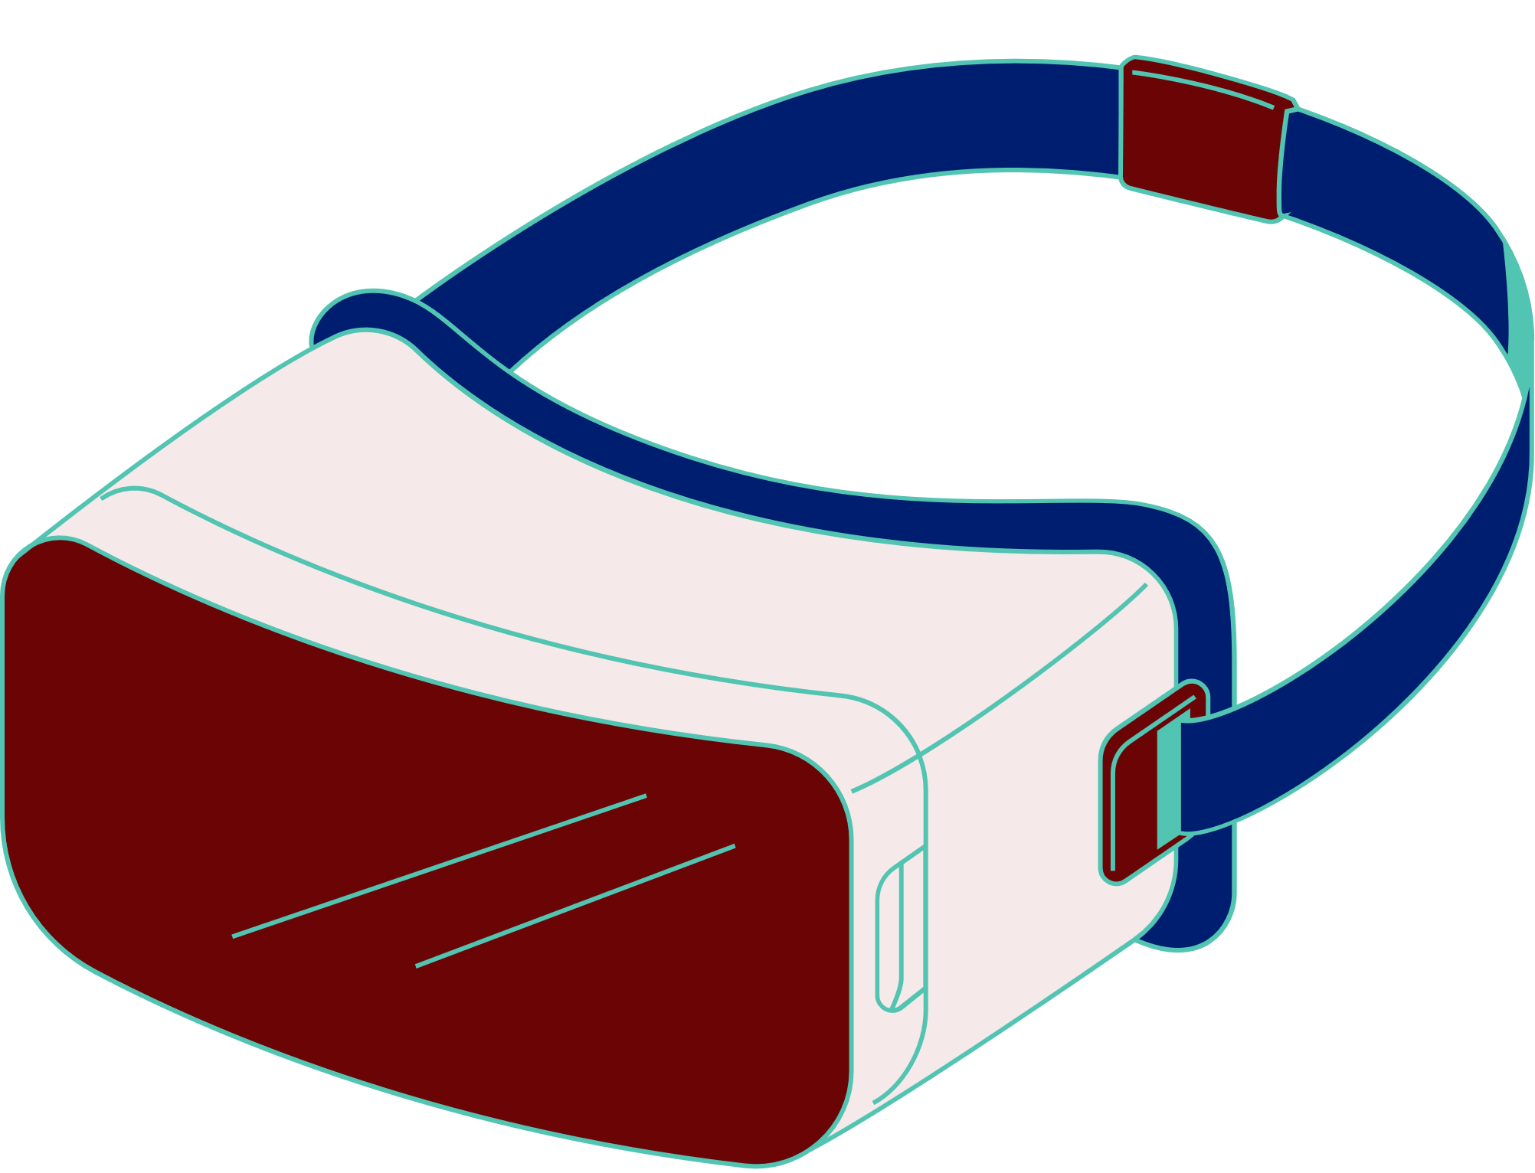
Introduction
Our VNOC project is an intelligent, AI-powered system designed to simulate a traditional Network Operations Center within a 3D virtual environment, built using Unity and VR technologies.
This system leverages artificial intelligence to:
  Analyze network data in real-time.
  Automatically detect faults.
  Generate smart engineering reports.
  Send immediate email alerts to the responsible teams.
Our VNOC integrates the power of AI directly into real-world network operations

Slide 4

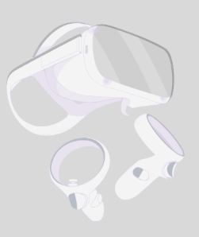
The Role of VR in the NOC
Virtual Reality (VR) is a cutting-edge technology that is rarely used in the telecom sector ,and we aim to change that .By integrating VR into our Virtual Network Operations Center (VNOC), we bring a new level of innovation that transforms how engineers interact with network data. This immersive experience enables:
    More intuitive and realistic network monitoring
    Hands-on virtual training for engineers
    Faster and smarter response to network issues
    A fully immersive environment that simulates real NOC operations.
    Greater engagement and learning for telecom professionals
Our goal is to introduce VR as a powerful tool in telecom operations, making our VNOC project not only functional — but futuristic.

Slide 5


The Role of AI in the NOC
Integrating AI into your Virtual Network Operations Center isn't just an upgrade ,it's a fundamental shift that brings powerful advantages:
Automated Monitoring & Analysis
Intelligent Incident Management
Enhanced Decision Support
Immersive Data Visualization
Operational Efficiency
Continuous Improvement

Slide 6

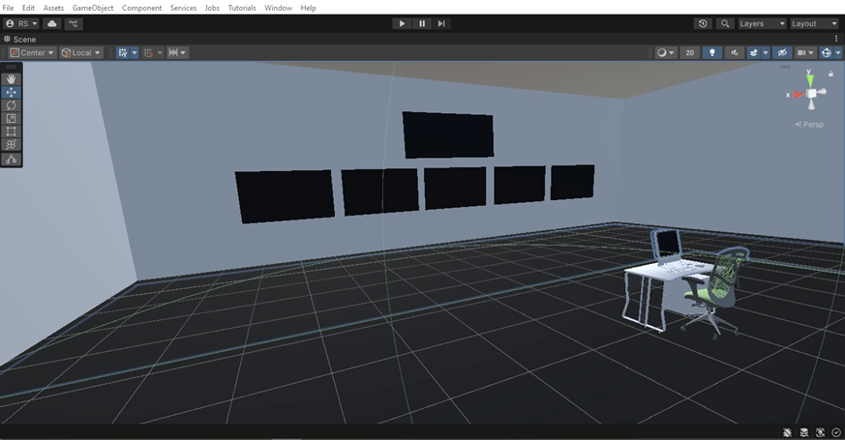
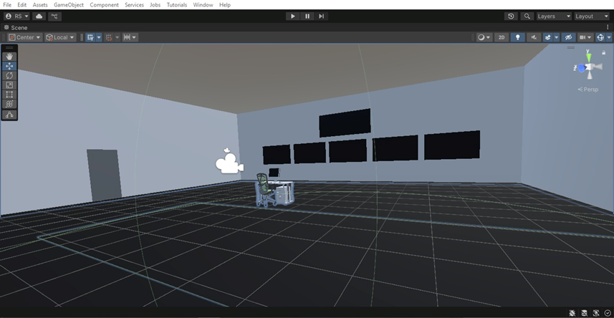
VNOC Environment in Unity

Slide 7
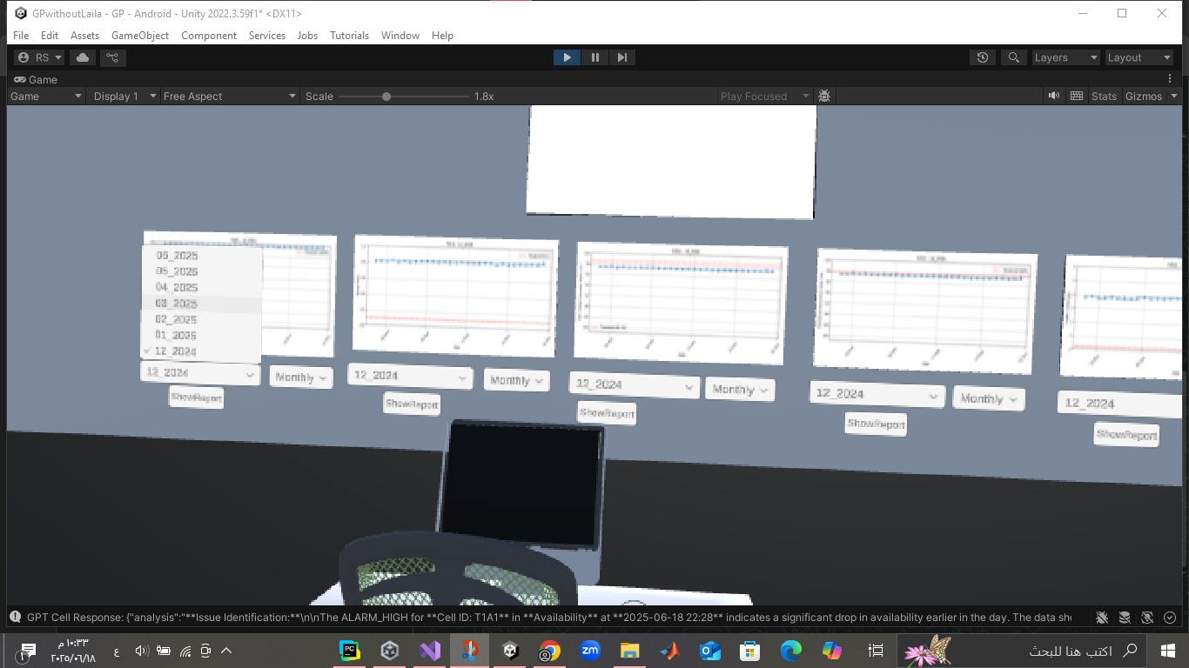
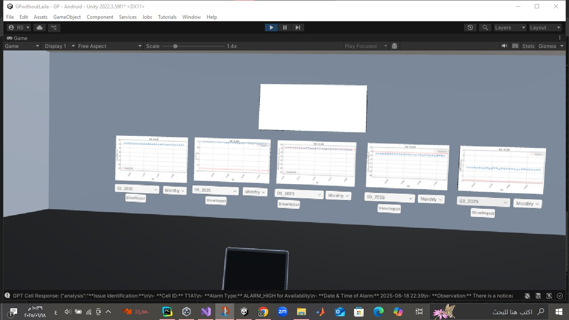
The process of displaying data on the screens

Slide 8
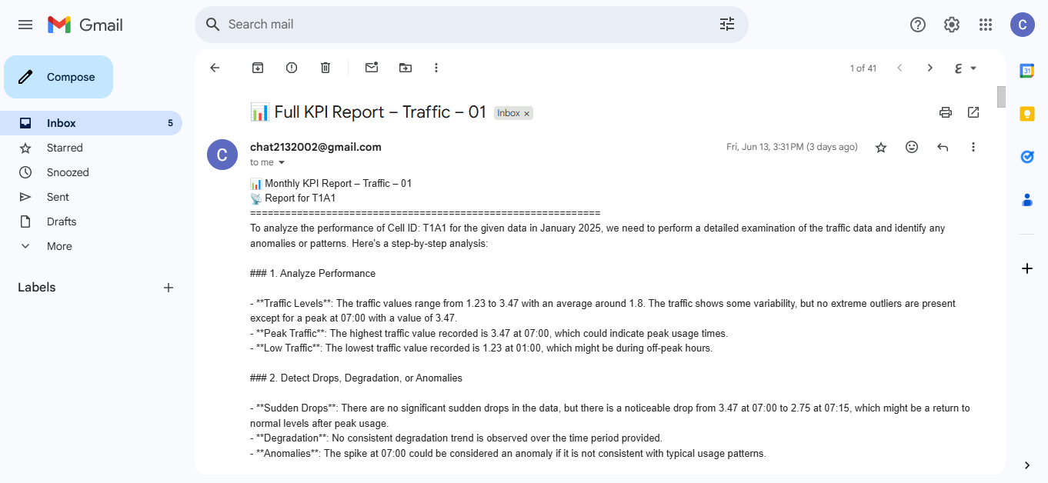


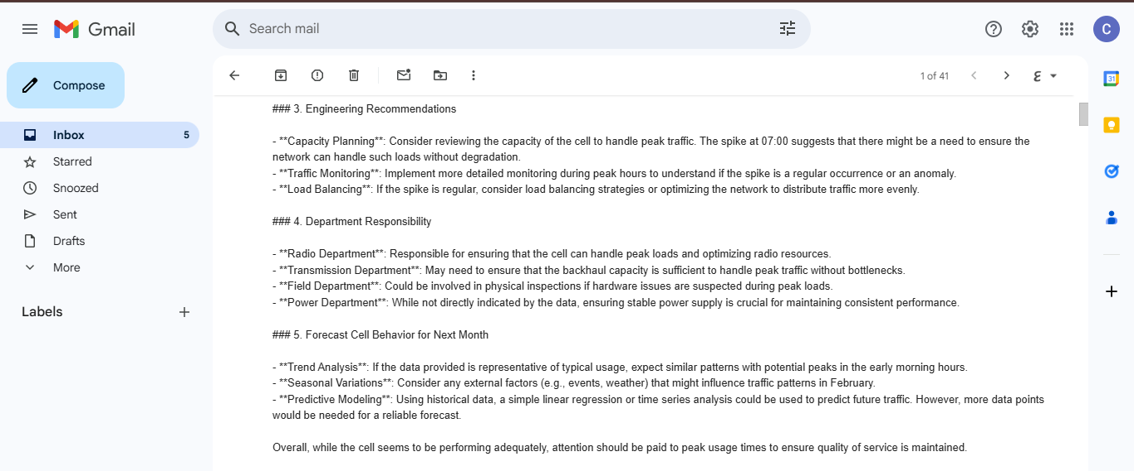


Monthly Report
Traffic

Slide 9
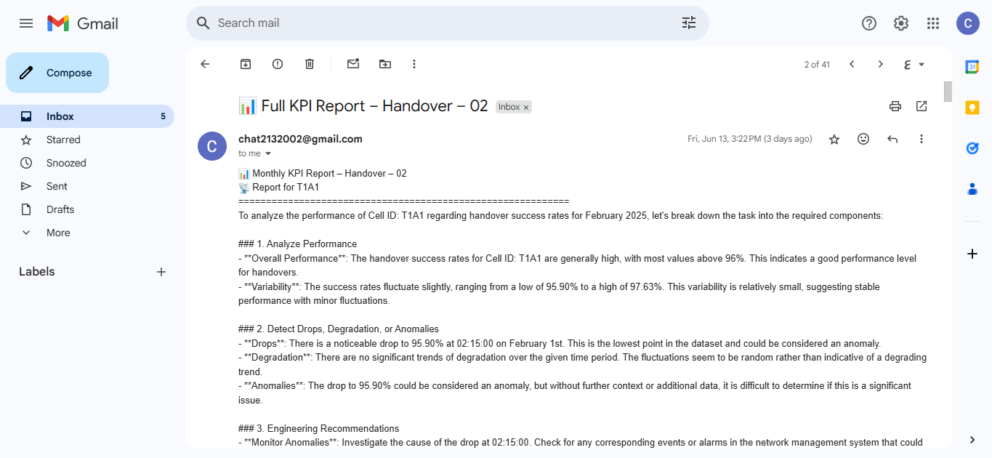
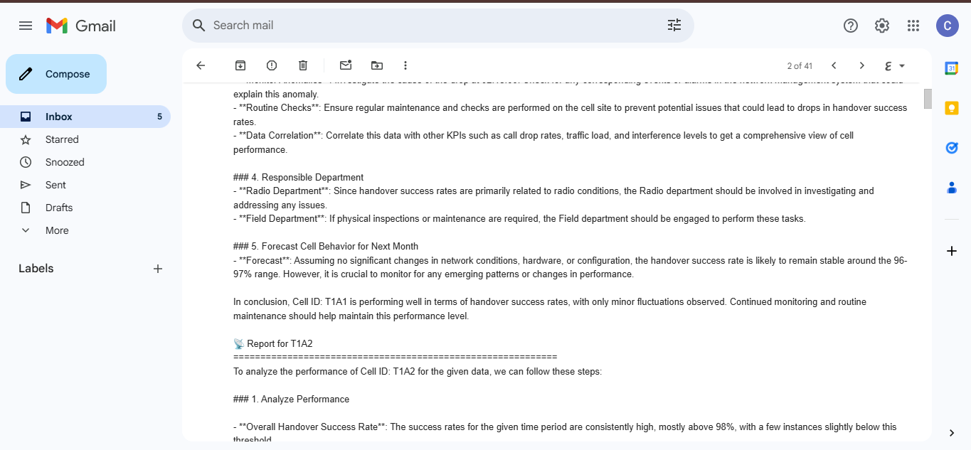
Handover

Slide 10
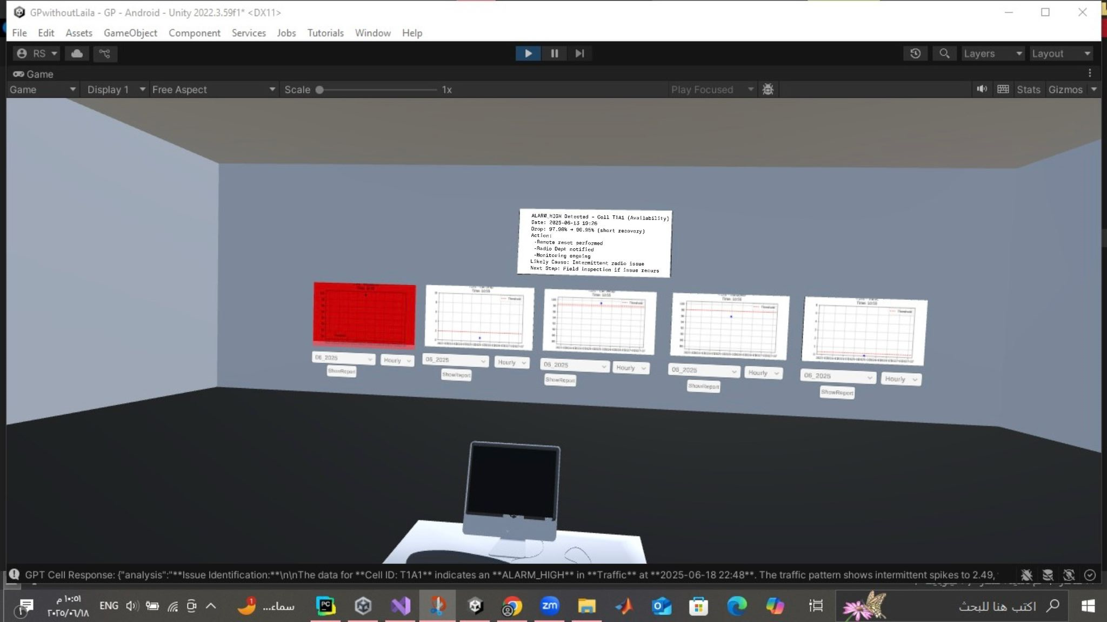
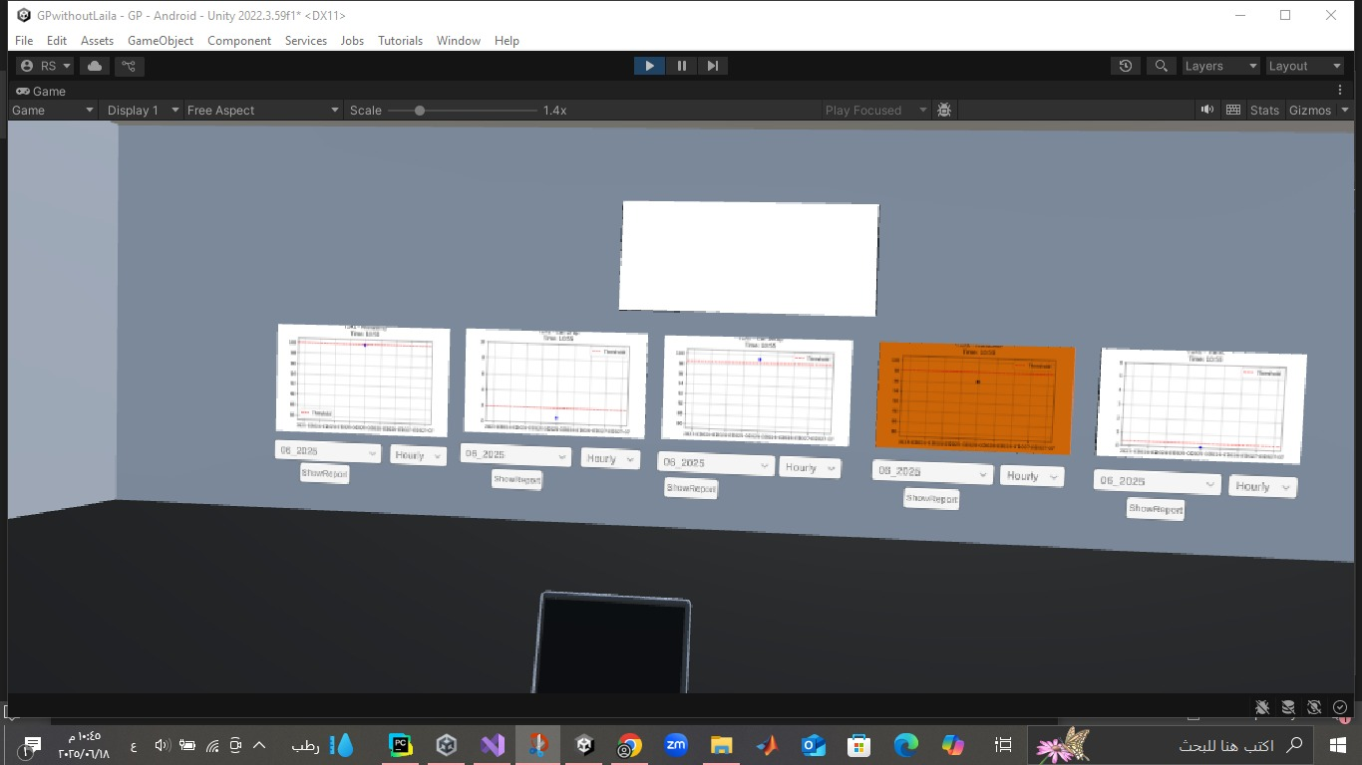
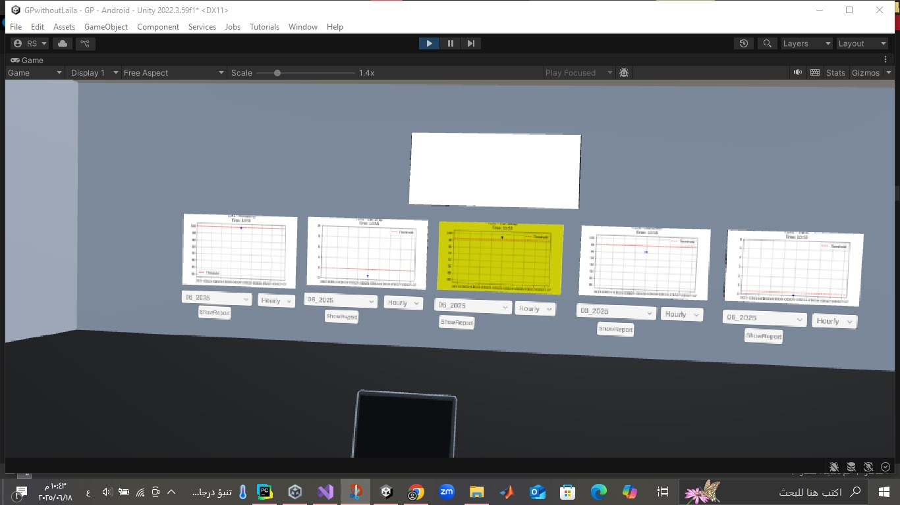
Alarms
Red
Yellow
orange
High Alarm
Minor ALARM
Medium Alarm

Slide 11
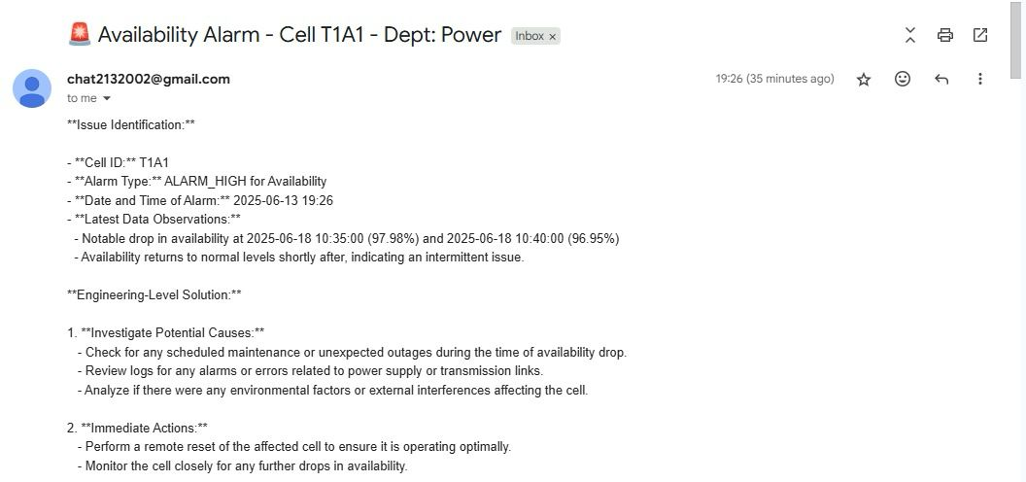
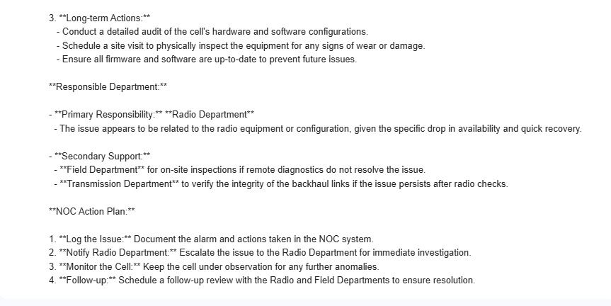
Real-Time Report
AVAILABILITY

Slide 12

Comparison Between Traditional NOC Engineer and AI
Aspect | Traditional NOC Engineer | VNOC AI System
Speed | Slower due to manual checks | Instant response with real-time analysis
Awareness | Affected by fatigue and multitasking | Fully aware, runs continuously
Detection Accuracy | May miss minor or time-sensitive issues | Highly accurate, checks KPIs every 15 mins
Comprehensiveness | Needs to review multiple reports | Correlates data instantly across cells
Exceptional Handling | Adapts well to rare, real-world cases | May misinterpret unusual cases
Recommendations | Proposes practical, field-tested solutions | Provides generic suggestions
Flexibility | Makes decisions based on experience | Limited to predefined logic

Slide 13
The difference between traditional and virtual NOC
Factor | NOC | VNOC
Costs | High (equipment, location, power, maintenance) | Lower due to reduced physical infrastructure
Location | Fixed, requires a physical center | Accessible from anywhere
Human Resources | It requires a number of workers and their presence 24 hours a day. | Can be operated remotely with AI support
Fault Management | Relies on manual monitoring and on-site decision-making | Provides fault simulations and proactive solutions using AI
Emergency Response | Slower due to reliance on field teams | Immediate interaction with issues via a virtual environment
Monitoring Efficiency | Uses 2D screens and traditional analytics | Provides deeper insights and dynamic 3D analysis

Slide 14
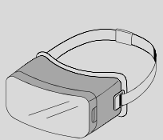


Future Work Supporting 2G, 3G, and 4G Networks
Our goal is to expand the VNOC system to comprehensively support 2G, 3G, and 4G networks.
This expansion will involve:
  Incorporating unique KPIs and analysis models for each network generation.
  Automatically processing all KPI logs for real-time monitoring, alarm generation, and reporting.
This scalable design will enable smarter, more comprehensive network operations within the metaverse, adapting to diverse network environments.

Slide 15
Future Work: Expanding Our AI Horizon: The Future of AI in VNOC
Our VNOC already uses AI for analysis, fault detection, and reporting. We're expanding our AI tools for even smarter, more autonomous network management.
Future AI integrations will focus on:
  Predictive Maintenance: predict equipment failures proactively.
  Proactive Security Automation: enable automated threat detection and response.
  Intelligent Capacity Planning: forecast traffic for optimal resource allocation and bottleneck prevention.
  Enhanced Root Cause Analysis: provide faster, more precise troubleshooting.
  Self-Optimizing Networks (SON): AI will autonomously optimize network configurations.
  AI-Powered Virtual Assistants: AI will offer on-demand insights for network professionals.
Expanding AI makes our VNOC more proactive, resilient, and intelligent, driving unparalleled efficiency in the metaverse's evolving network.

Slide 16
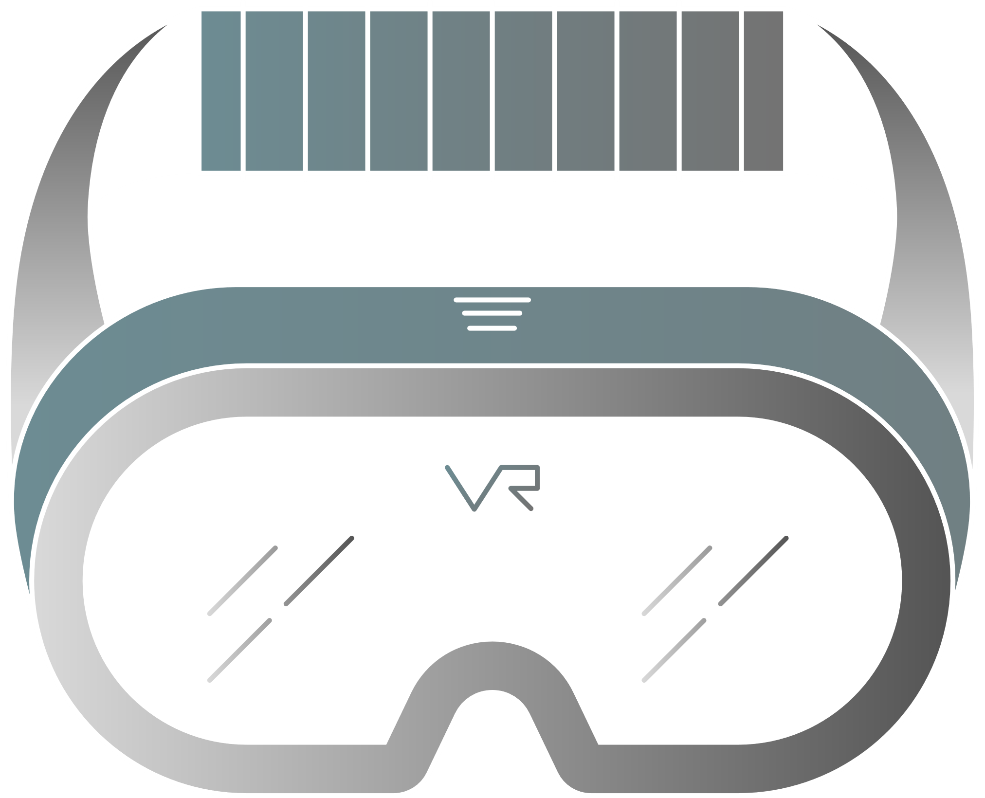

thank you

