Slide 1

Readers Club

Slide 2



The problem
There are many groups that discuss and rate books on Facebook, WhatsApp, and Telegram, in addition to that, there are sites that display books and sell them.... It seems that the world of readers is distributed, why not have a social site for readers. Provides these things through one site .....

Slide 3

This distribution distracts many readers.

Slide 4
Benefiting from discussion and evaluation will not be excellent.
Benefits
Costs

Slide 5

Sometimes it leads to wrong conclusions .

Slide 6

The solution

Slide 7
People's opinion
We asked people about the idea of this project through the following question: what do you think is the best way to discuss books?
Discussing books through a reader’s website equipped with discussion and evaluation tools .
OR
Discussing books through social networking sites such as Facebook and others .

Slide 8
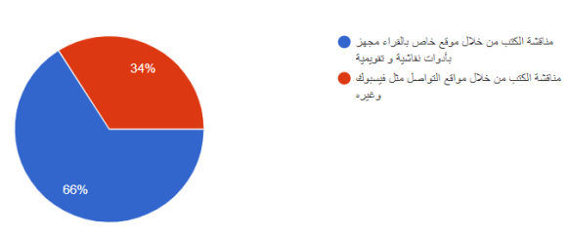

Slide 9
Readers Club

Slide 10
We believe that this site will be a suitable solution to this problem.

Slide 11
Readers Club :
It is a social site for readers, which allows them to discuss and rate books, create groups to read books, and take advantage of reviews to build conclusions.

Slide 12
Features of this site

Slide 13
Book Room
Each book on this site is linked to its own page. Through this page, the reader can discuss others, and evaluate this book through the composite evaluation.

Slide 14
Study Group
Through this site, you can build a private group to discuss a specific topic, and you can download the materials the group needs. Also, members can discuss ideas in this project.

Slide 15
Writing notes
Through this site, you can browse a book with the ability to write notes and comments, and save them. These notes are linked to user profile, if another user opens the same book, he does not see these notes .

Slide 16
صورة للنوت

Slide 17
Recommendation System
This site provides appropriate suggestions for user based on a recommendation system written in Python language, this system keeps track of user reviews on this site, then Based on the reviews, the system provides appropriate books to the user .

Slide 18
How it works ?

Slide 19
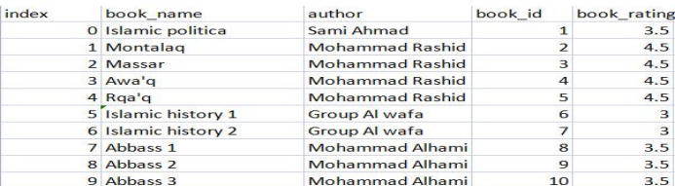

Slide 20
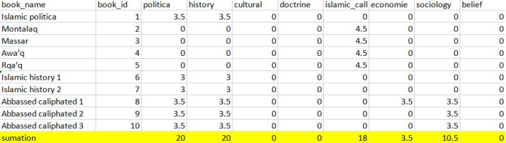

Slide 21
Paper Review
Through this site, you can upload a research paper, to discuss it with others and evaluate it .

Slide 22
Composite evaluation

Slide 23
Simple VS composite

Slide 24
Simple evaluation
Simple evaluation: It is an evaluation based on one dimension, such as the evaluation of stars.

Slide 25
Disadvantages of simple evaluation
Sometimes it is :
Not subjective .
Incorrect .

Slide 26
Composite evaluation
It is an evaluation based on several criteria.
Clarity
Objectivity
realism
Difficulty
language

Slide 27


Case Study
critic and novice

Slide 28
Tools and programming languages

Slide 29





Slide 30






PSPDFKIT

Slide 31
Difficulties
low cultural level .
Need Large team and.
Lack of Big database for arabic books .

Slide 32
Future work
Classification .
Forming a work team .
Big Data Base for arabic books .

Slide 33


Classification
In order to solve the problem of low user culture, in the future we will classify users
into two categories, the first category will include thinkers and intellectuals, the
second category will include normal users. The first category will be given 60
percent of the general vote, while normal users will be given 40 percent of the
general vote, in an attempt to reduce the impact of the problem of low level of
culture .

Slide 34


Team work
Form a small work team consisting of thinkers, programmers and critics in order to develop the project .

Slide 35
Big Data Base for arabic books .

Slide 36
Conclusion
At the end of this project, we learned a lot of things, software tools, frameworks, searching for information, how to get information, learning things quickly, connecting components, polling people's opinions, and working in a team . In fact, we tried to use skills we learned at university and apply them through this project .
In addition , we tried as much as possible to learn Full Stack skills to be ready for job market.

