Slide 1

Analysis of Water Distribution Network and design waste water collection network for Al-Zababida
An-Najah National University
Faculty Of Engineering
Civil Engineering Department
Graduation Project 2
Prepared by :
Ahmad Wael “Ali Hussein” Aysar Isbeih Mohammad Jamal Kmail
Supervisor:
Eng. Hamees Tubeileh

Slide 2
Contents: -
Objective
Methodology
Overview of Al-Zababida
Questionnaire analysis
Modeling & analyzing current WDN now and after 30 year
Result of analyze WDN
Design waste water collection network
Problems that was solved

Slide 3
Objectives : -
Analyze the exiting water distribution network.
Find the problems in WDN and suggest solution to solve these problems.
Redesign the water network in the town if it needs.
Design WWCN

Slide 4
Methodology : -
Visiting study area
Make a questionnaire
Prepare data
Analyze the existing conditions
Analyze after 30 year
Design WWCN

Slide 5
Overview of Al-Zababida : -
Location:
  Al-Zababida town is located 15 kilometers away southeast from Jenin city.
Population:
  The total population of the town was 4261 in addition to 1500 student coming from Arab Americana university in 2017.

Slide 6
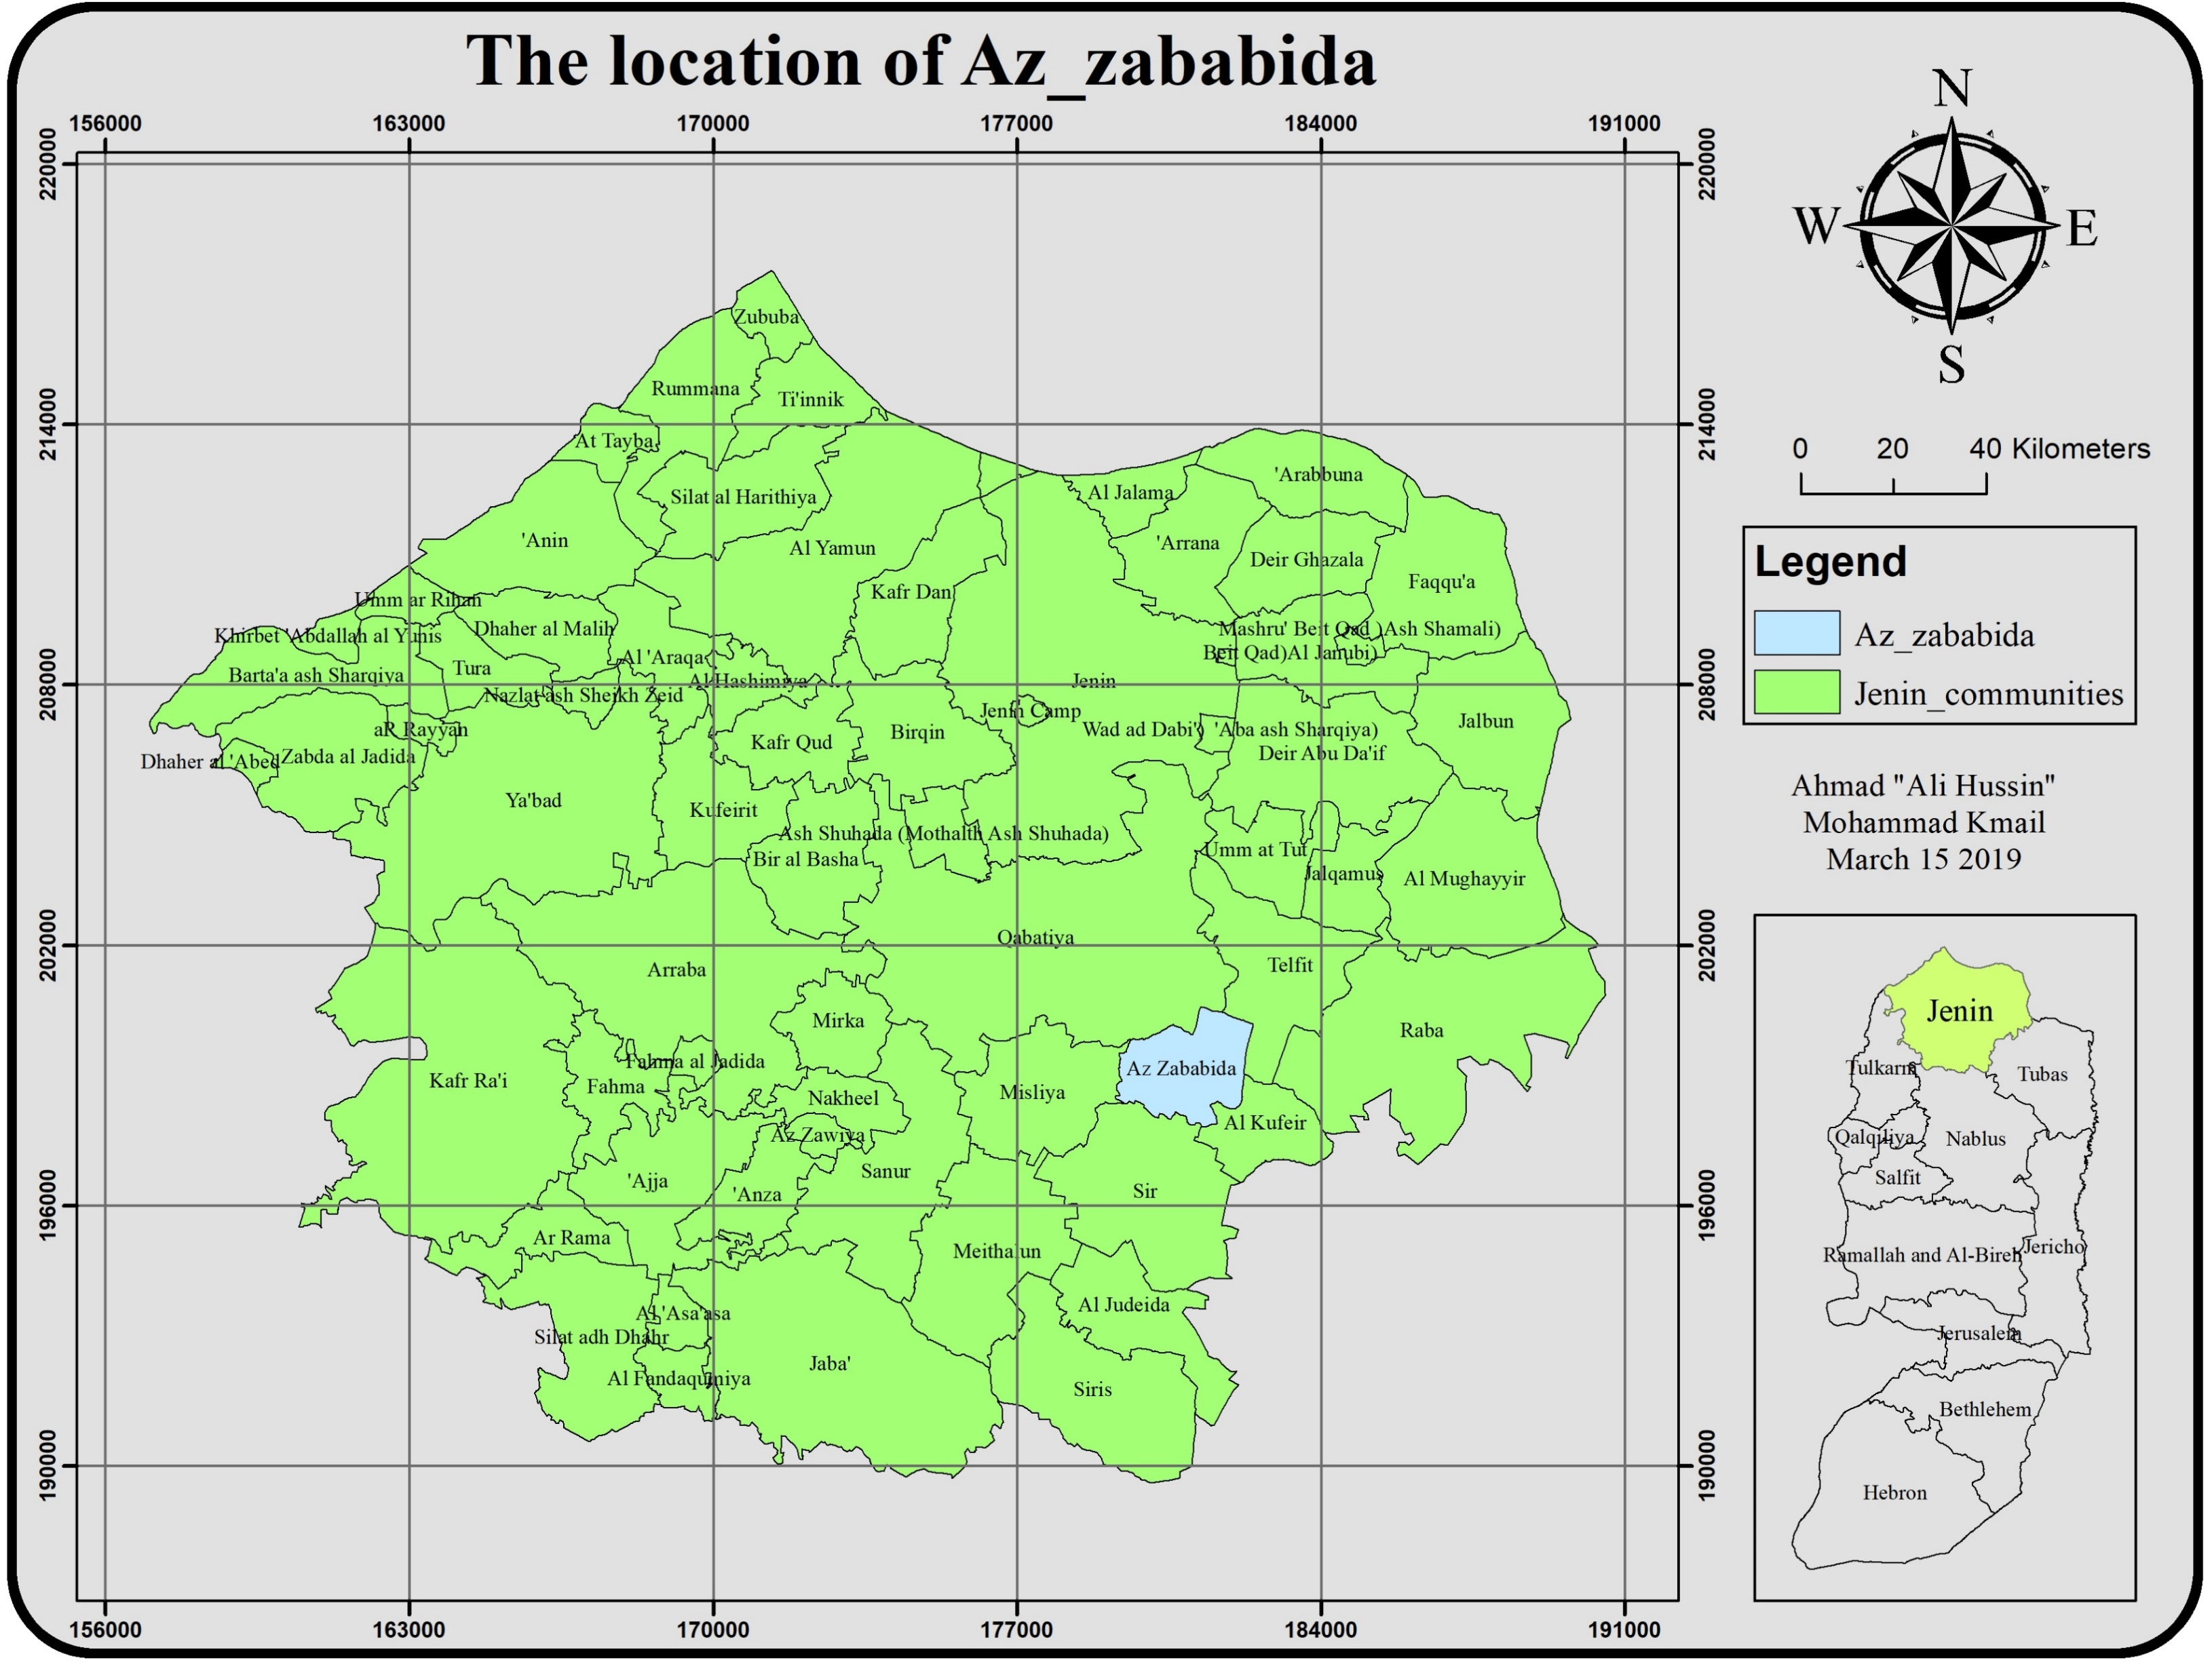
Overview of Al-Zababida : -

Slide 7
Overview of Al-Zababida : -
Topography:
  Al-Zababida is located at a hill and surrounded by two mountains from south and west and flat from other sides.
Land Use:
  Most people in Al-Zababida mainly works in jobs, commercial side, agricultural work and quarries.
Climate :
  The annual average maximum temperature is 25Cº and the annual average minimum is14Cº.

Slide 8
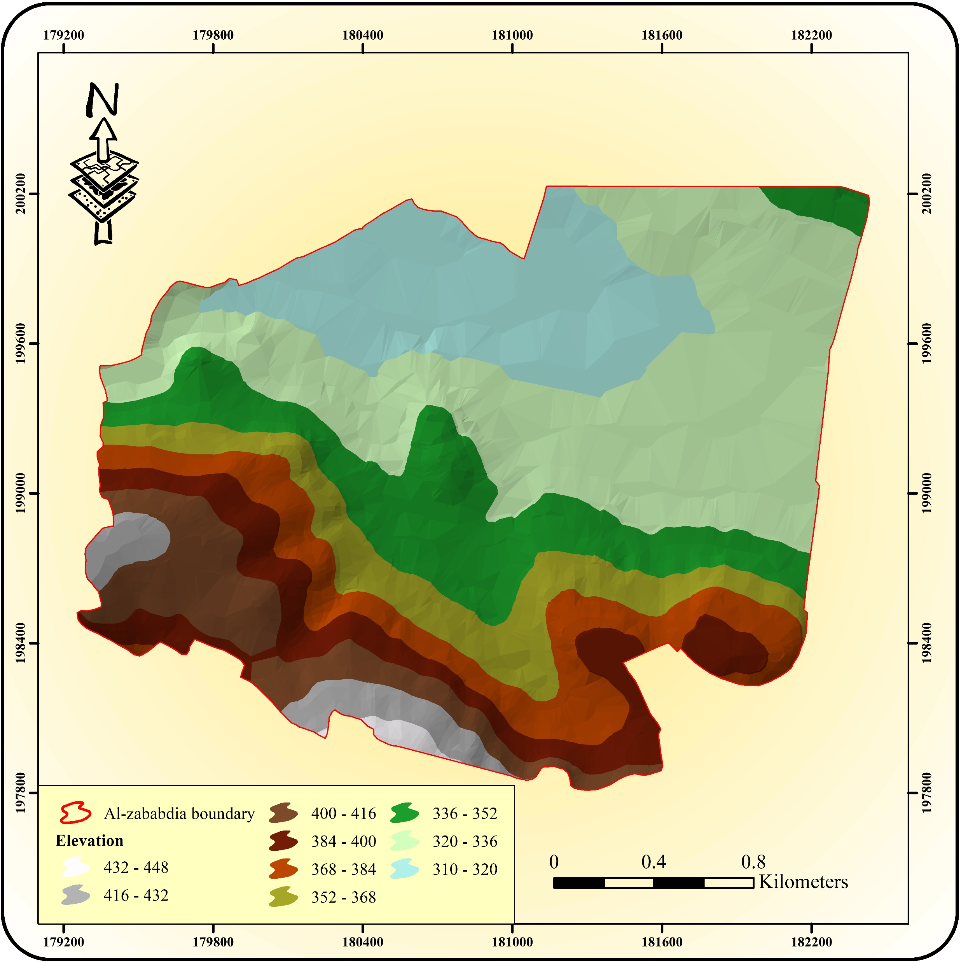
Overview of Al-Zababida : -

Slide 9
The Questionnaire: -

Slide 10
The Questionnaire: -

Slide 11
The Questionnaire: -

Slide 12
The Questionnaire: -

Slide 13
The Questionnaire: -

Slide 14
The Questionnaire: -

Slide 15
The Questionnaire: - for student :

Slide 16
The Questionnaire: -
for student :

Slide 17
The Questionnaire: -
for student :

Slide 18
Analysis of the exiting network

Slide 19
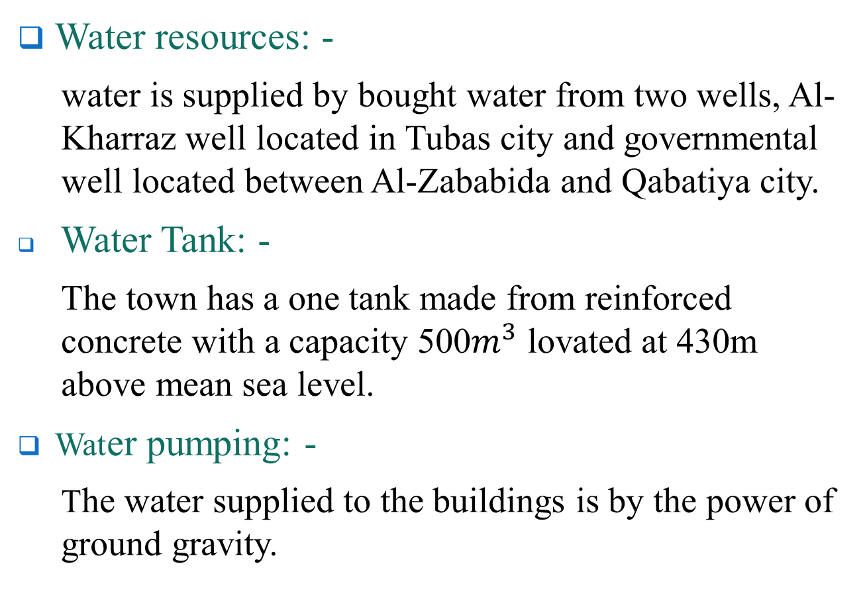
Modeling & analyzing of network : -
Water resources: -
  water is supplied by bought water from two wells, Al-Kharraz well located in Tubas city and governmental well located between Al-Zababida and Qabatiya city.
Water Tank: -
  The town has a one tank made from reinforced concrete with a capacity 500$m^{3}$ lovated at 430m above mean sea level.
Water pumping: -
  The water supplied to the buildings is by the power of ground gravity.

Slide 20
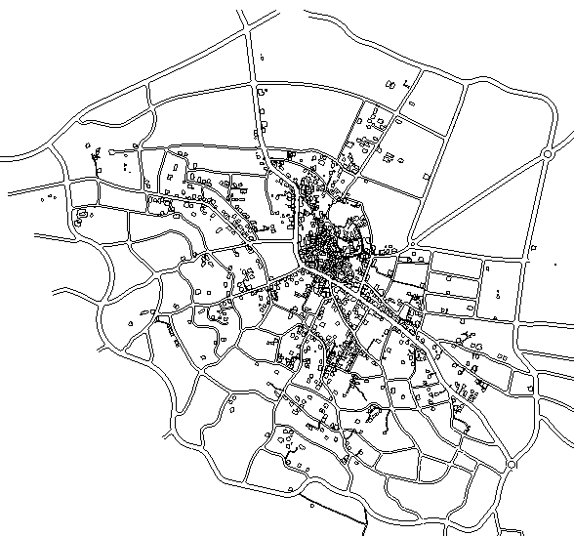
Collected Data :
Contour shape file from geomolge
Road network shape file
Building from the municipality as Auto CAD
Water consumption for the village from the municipality

Slide 21
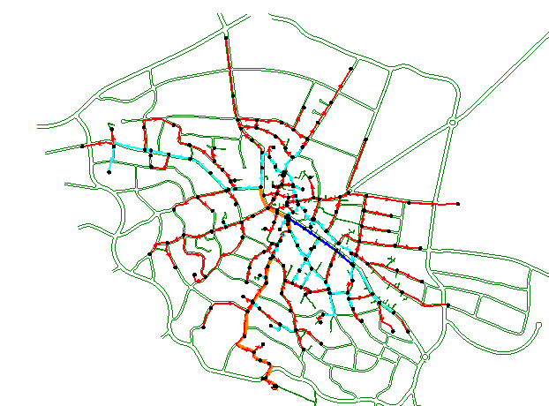
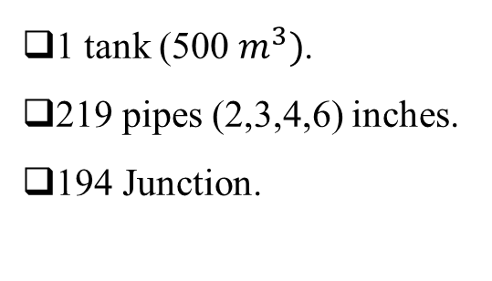
Modeling of network : -
Obtained the network by called the Network AutoCAD shape that was got from the municipality file then draw the network by distribution the junction and drawing the pipes .
1 tank (500 $m^{3})$.
219 pipes (2,3,4,6) inches.
194 Junction.

Slide 22
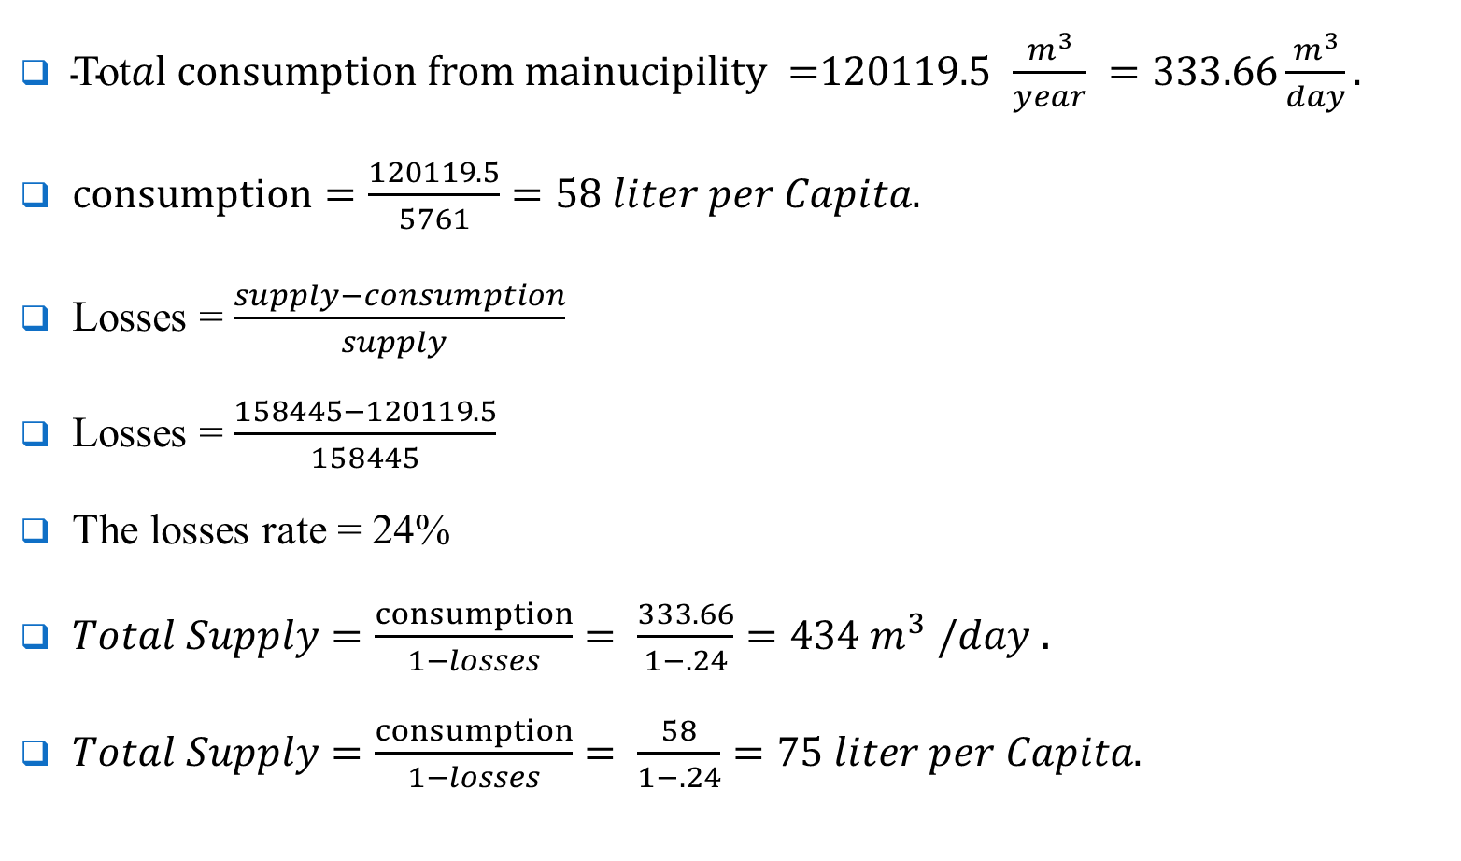
Demand calculations and distribution :
$\text{Tot}al consumption from mainucipility =$120119.5 $\frac{m^{3}}{year} =333.66\frac{m^{3}}{day}.$
$consumption=\frac{120119.5}{5761}=58 liter per Capita.$
Losses = $\frac{supply−consumption}{supply }$
Losses = $\frac{158445−120119.5}{158445}$
The losses rate = 24%
$Total Supply=\frac{consumption}{1−losses}= \frac{333.66}{1−.24}=434 m^{3} /day$ .
$Total Supply=\frac{consumption}{1−losses}= \frac{58}{1−.24}=75 liter per Capita.$

Slide 23
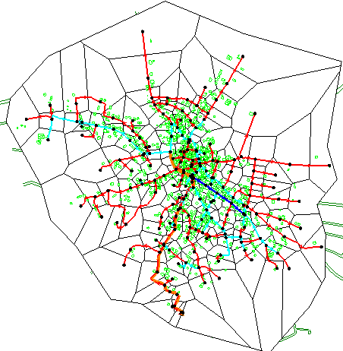
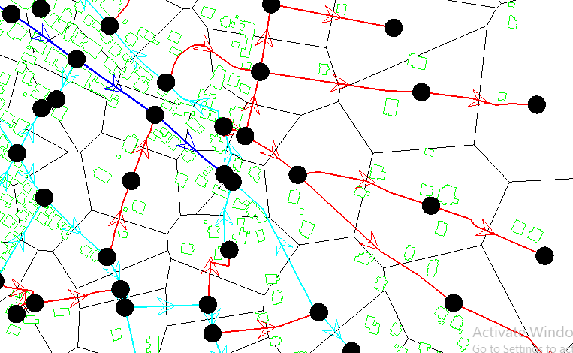
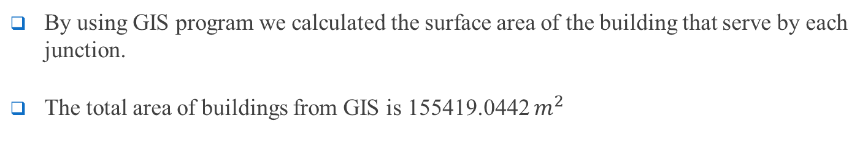
Demand calculations and distribution :
By using GIS program we calculated the surface area of the building that serve by each junction.
The total area of buildings from GIS is 155419.0442 $m^{2}$

Slide 24
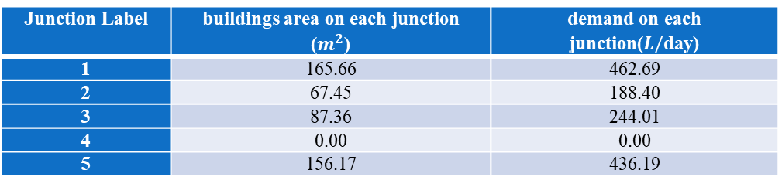
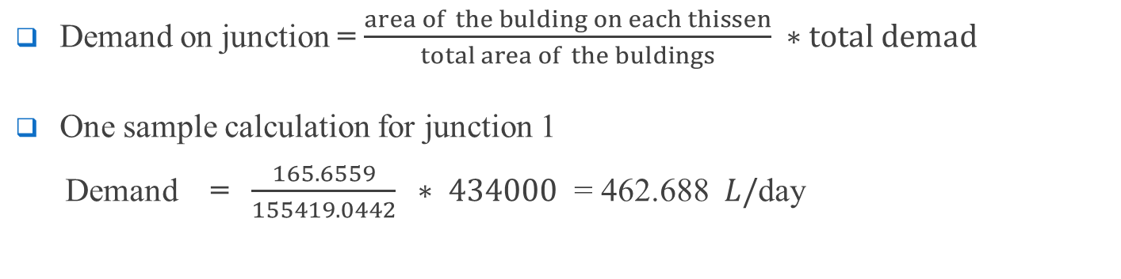
Demand calculations and distribution :
Demand on junction = $\frac{area of the bulding on each thissen}{total area of the buldings} ∗total demad$
One sample calculation for junction 1
Demand = $\frac{165.6559}{155419.0442} ∗ 434000$ = 462.688 $L/$day
Junction Label | buildings area on each junction ($m^{2}$) | demand on each junction($L/$day)
1 | 165.66 | 462.69
2 | 67.45 | 188.40
3 | 87.36 | 244.01
4 | 0.00 | 0.00
5 | 156.17 | 436.19

Slide 25
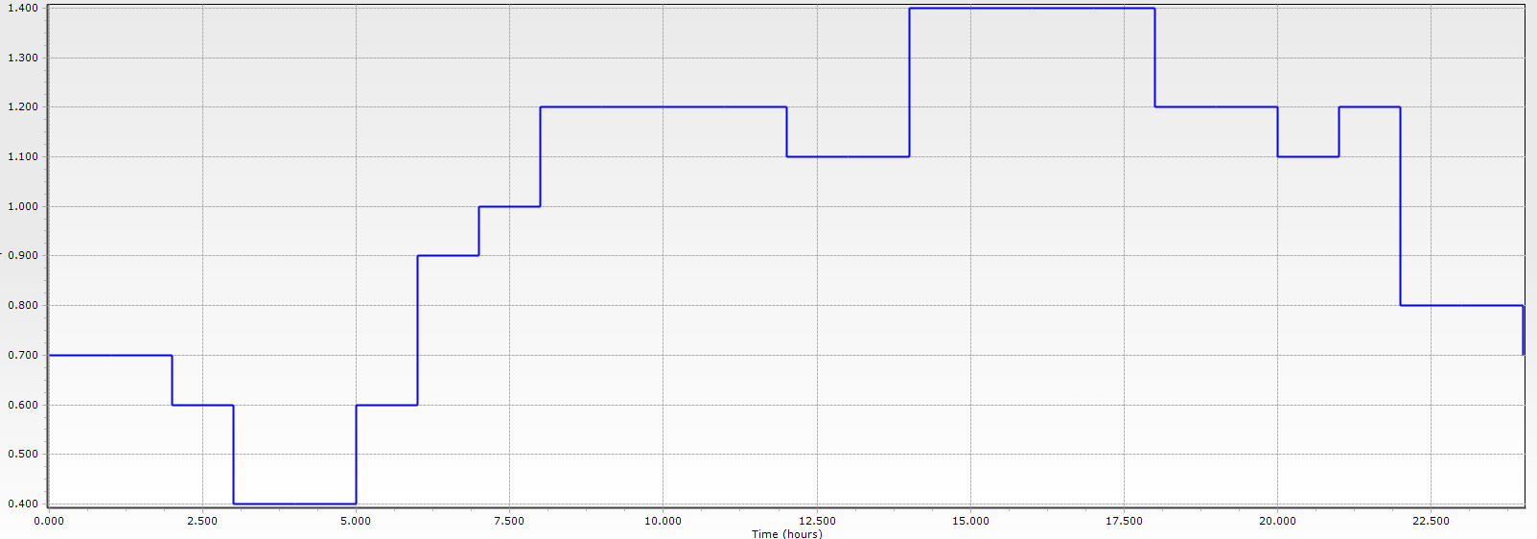
analyzing of network : -
Use this pattern which taken from Ammar Kokhon

Slide 26
Result : -
Velocity at 4:00 am Velocity at 2:00 pm

Slide 27
Result : -
After 30 year
Pressure at 4:00 am Pressure at 2:00 pm

Slide 28
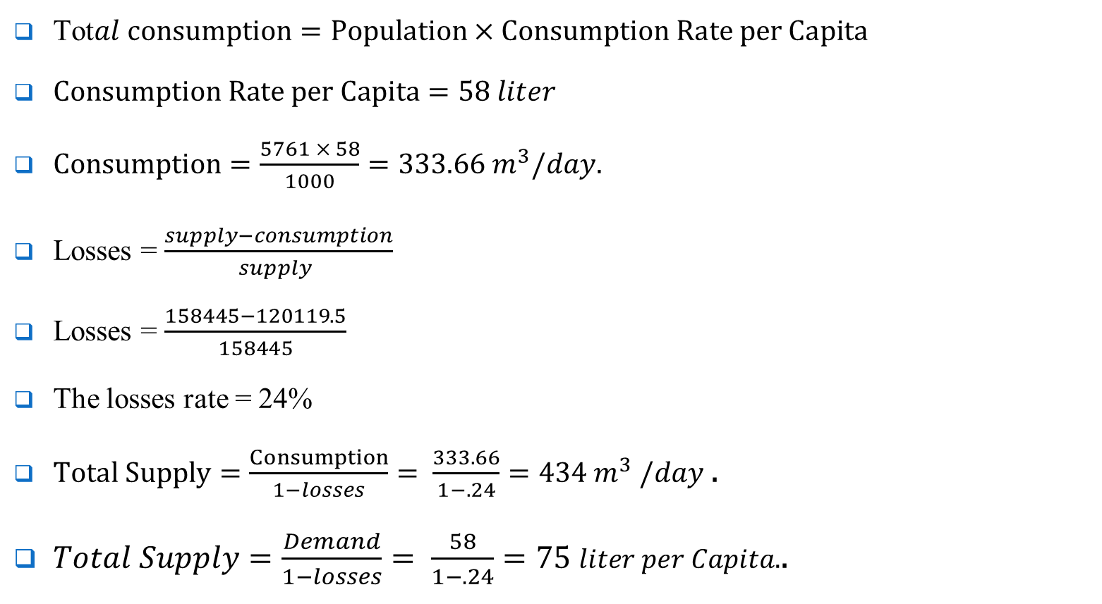
Modeling & analyzing of network : -
$\text{Tot}al consumption=Population×Consumption Rate per Capita$
$Consumption Rate per Capita=58 liter$
$Consumption=\frac{5761 × 58}{1000}=333.66 m^{3}/day.$
Losses = $\frac{supply−consumption}{supply }$
Losses = $\frac{158445−120119.5}{158445}$
The losses rate = 24%
$Total Supply=\frac{Consumption}{1−losses}= \frac{333.66}{1−.24}=434 m^{3} /day$ .
$Total Supply=\frac{Demand}{1−losses}= \frac{58}{1−.24}=75 liter per Capita.$.

Slide 29
Future analysis for the existing network

Slide 30
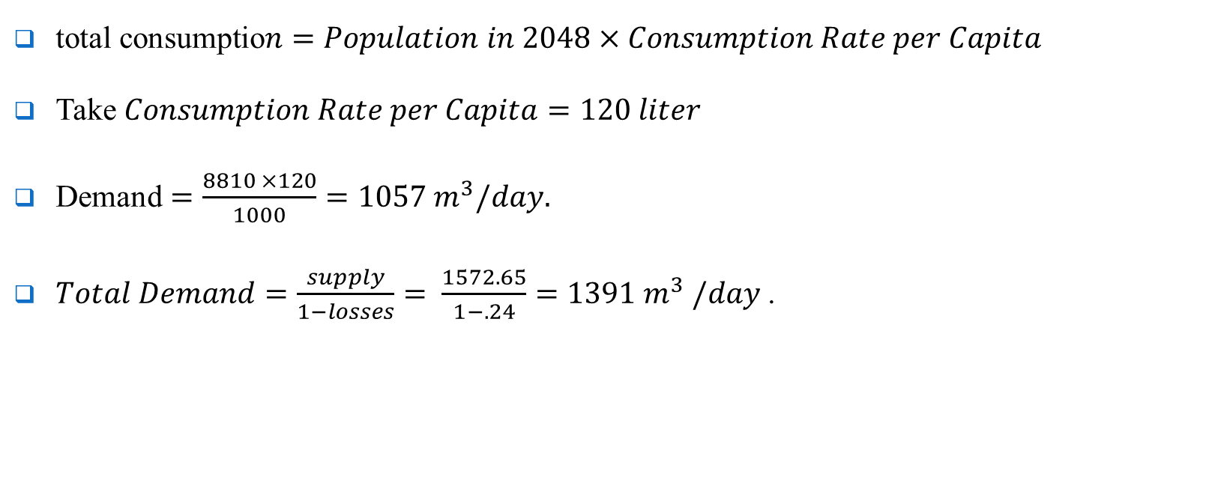
Data Collection :-
$\text{total} \text{consumptio}n=Population in 2048×Consumption Rate per Capita$
Take $Consumption Rate per Capita=120 liter$
$\text{Demand}=\frac{8810 ×120}{1000}=1057 m^{3}/day.$
$Total Demand=\frac{supply}{1−losses}= \frac{1572.65}{1−.24}=1391 m^{3} /day$ .

Slide 31
Modeling & analyzing of network after 30 year:-
For the distribution of the future population we assumed that the density of the building in middle areas ( main street area ) of the village will stay the same (fixed density areas)
the expansion in the building will be in the areas which its density is smaller than the middle areas (unfixed density areas)
the increased population will uniformly distribute in the unfixed density area

Slide 32
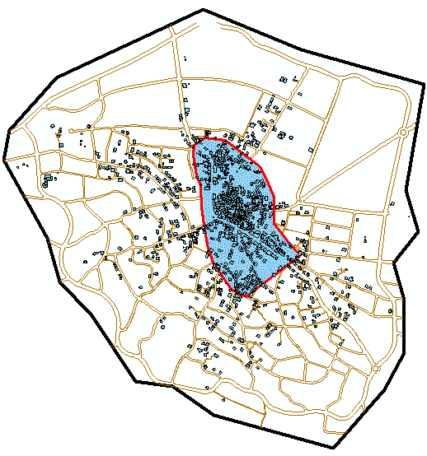
Modeling & analyzing of network after 30 year:-

Slide 33
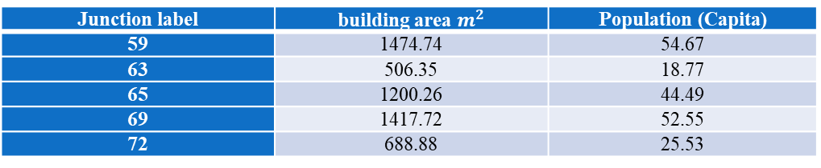
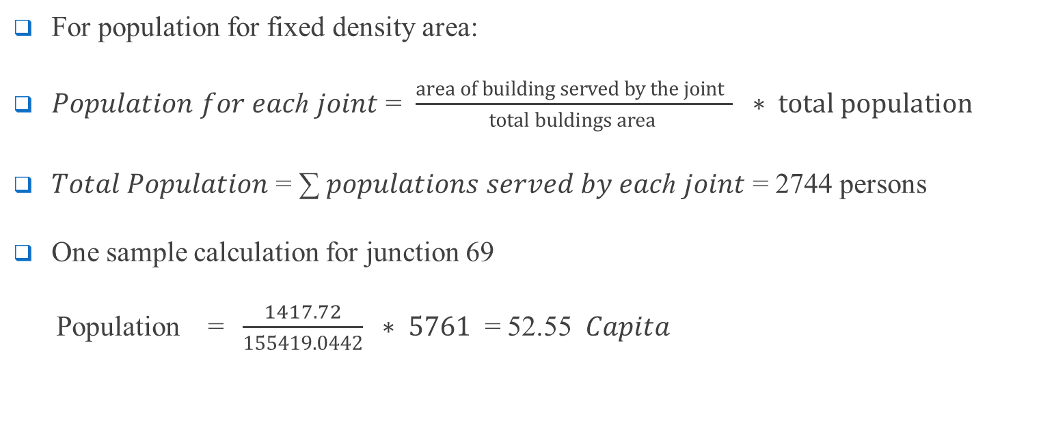
Demand calculation and distribution after 30 years:-
For population for fixed density area:
𝑃𝑜𝑝𝑢𝑙𝑎𝑡𝑖𝑜𝑛 𝑓𝑜𝑟 𝑒𝑎𝑐ℎ 𝑗𝑜𝑖𝑛𝑡 = $\frac{area of building served by the joint }{total buldings area } ∗ total population$
𝑇𝑜𝑡𝑎𝑙 𝑃𝑜𝑝𝑢𝑙𝑎𝑡𝑖𝑜𝑛 = ∑ 𝑝𝑜𝑝𝑢𝑙𝑎𝑡𝑖𝑜𝑛𝑠 𝑠𝑒𝑟𝑣𝑒𝑑 𝑏𝑦 𝑒𝑎𝑐ℎ 𝑗𝑜𝑖𝑛𝑡 = 2744 persons
One sample calculation for junction 69
Population = $\frac{1417.72}{155419.0442} ∗ 5761$ = 52.55 $Capita$
Junction label | building area $m^{2}$ | Population (Capita)
59 | 1474.74 | 54.67
63 | 506.35 | 18.77
65 | 1200.26 | 44.49
69 | 1417.72 | 52.55
72 | 688.88 | 25.53

Slide 34
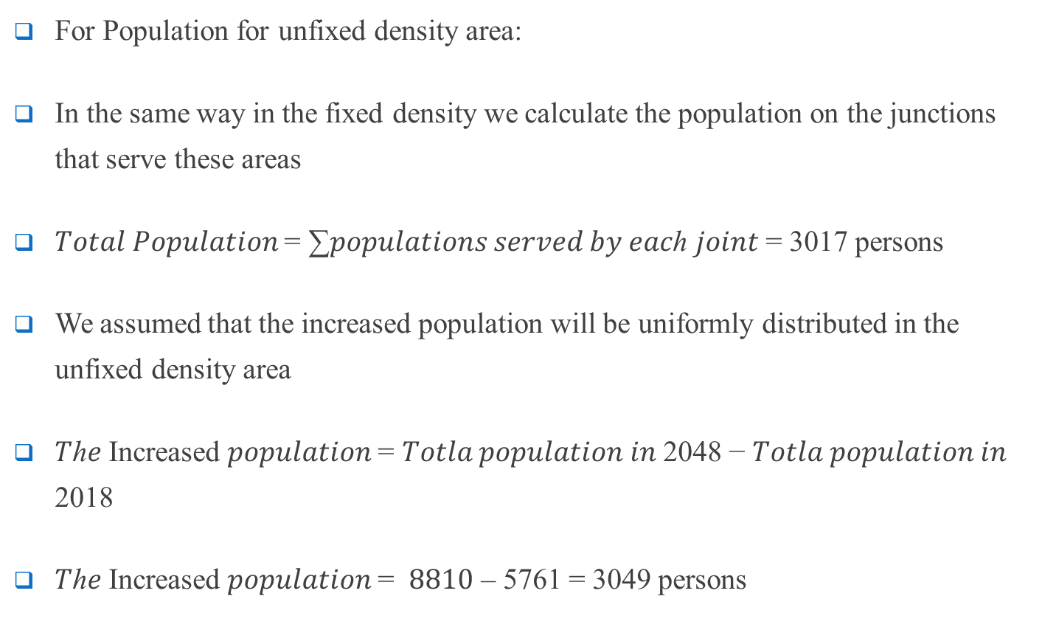
Demand calculation and distribution after 30 years:-
For Population for unfixed density area:
In the same way in the fixed density we calculate the population on the junctions that serve these areas
𝑇𝑜𝑡𝑎𝑙 𝑃𝑜𝑝𝑢𝑙𝑎𝑡𝑖𝑜𝑛 = ∑𝑝𝑜𝑝𝑢𝑙𝑎𝑡𝑖𝑜𝑛𝑠 𝑠𝑒𝑟𝑣𝑒𝑑 𝑏𝑦 𝑒𝑎𝑐ℎ 𝑗𝑜𝑖𝑛𝑡 = 3017 persons
We assumed that the increased population will be uniformly distributed in the unfixed density area
𝑇ℎ𝑒 Increased 𝑝𝑜𝑝𝑢𝑙𝑎𝑡𝑖𝑜𝑛 = 𝑇𝑜𝑡𝑙𝑎 𝑝𝑜𝑝𝑢𝑙𝑎𝑡𝑖𝑜𝑛 𝑖𝑛 2048 − 𝑇𝑜𝑡𝑙𝑎 𝑝𝑜𝑝𝑢𝑙𝑎𝑡𝑖𝑜𝑛 𝑖𝑛 2018
𝑇ℎ𝑒 Increased 𝑝𝑜𝑝𝑢𝑙𝑎𝑡𝑖𝑜𝑛 = $8810$ – 5761 = 3049 persons

Slide 35
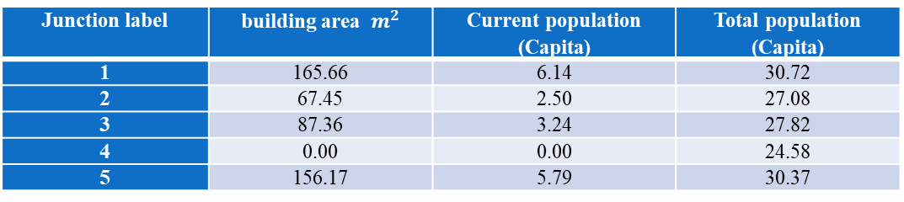
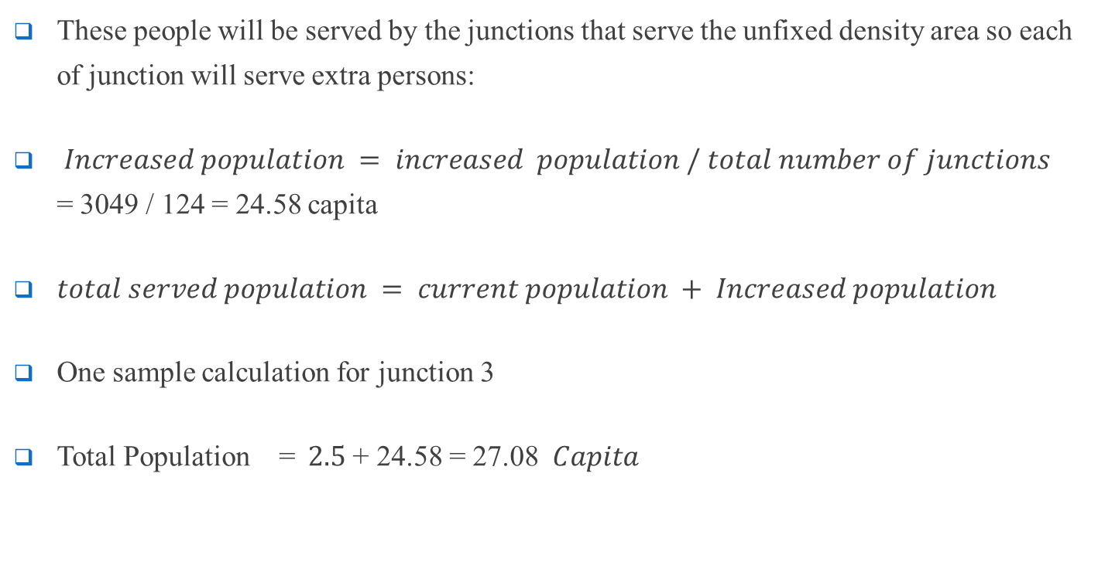
Modeling & analyzing of network after 30 year:-
These people will be served by the junctions that serve the unfixed density area so each of junction will serve extra persons:
$Increased population = increased population / total number of junctions$ = 3049 / 124 = 24.58 capita
$total served population = current population + Increased population$
One sample calculation for junction 3
Total Population = $2.5$+ 24.58 = 27.08 $Capita$
Junction label | building area $m^{2}$ | Current population (Capita) | Total population (Capita)
1 | 165.66 | 6.14 | 30.72
2 | 67.45 | 2.50 | 27.08
3 | 87.36 | 3.24 | 27.82
4 | 0.00 | 0.00 | 24.58
5 | 156.17 | 5.79 | 30.37

Slide 36
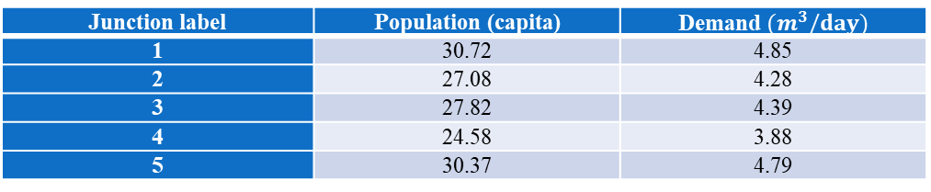
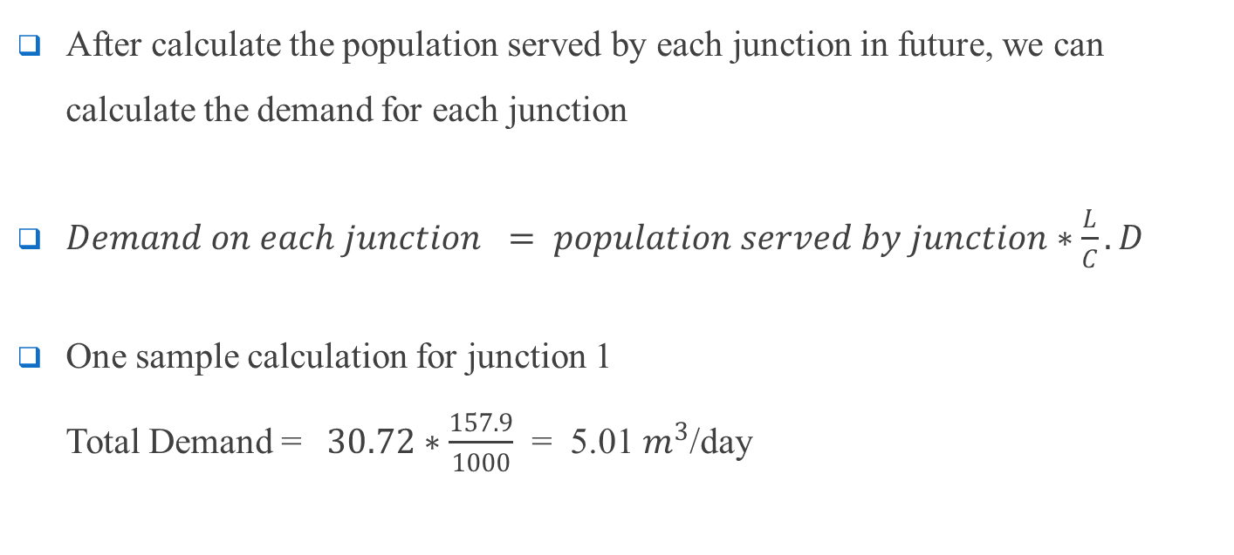
Modeling & analyzing of network after 30 year:-
After calculate the population served by each junction in future, we can calculate the demand for each junction
$Demand on each junction = population served by junction∗\frac{L}{C}.D$
One sample calculation for junction 1 Total Demand = $30.72∗\frac{157.9}{1000}$ = 5.01 $m^{3}$/day
Junction label | Population (capita) | Demand $(m^{3}/day)$
1 | 30.72 | 4.85
2 | 27.08 | 4.28
3 | 27.82 | 4.39
4 | 24.58 | 3.88
5 | 30.37 | 4.79

Slide 37
Result : -
After 30 year
Pressure at 4:00 am Pressure at 2:00 pm

Slide 38
Result : -
After 30 year
Velocity at 4:00 am Velocity at 2:00 pm

Slide 39
Design waste water collection network
Al-Zababida town doesn’t have a wastewater network
The terrain of the town allows to use gravity system, to let the wastewater goes downwards
The contour line of the town shows that the lowest point in the town located in north region.
SewerCAD software will be used to design the wastewater networks

Slide 40
Design waste water collection network
The assumption that will considered in the design is: -
Design period 30years.
Future Population = 8810 capita.
120 L/c.d water consumption
80% of produced waste water from consumed water.
20% infiltration.
The maximum distance between manholes is 30m.
PVC circular pipes.

Slide 41
Design waste water collection network
The constrains for the design of WWCN are:
Velocity between (0.6 – 3) m/s.
Cover between (1 – 5) m.
Slope between (1 – 4) %

Slide 42
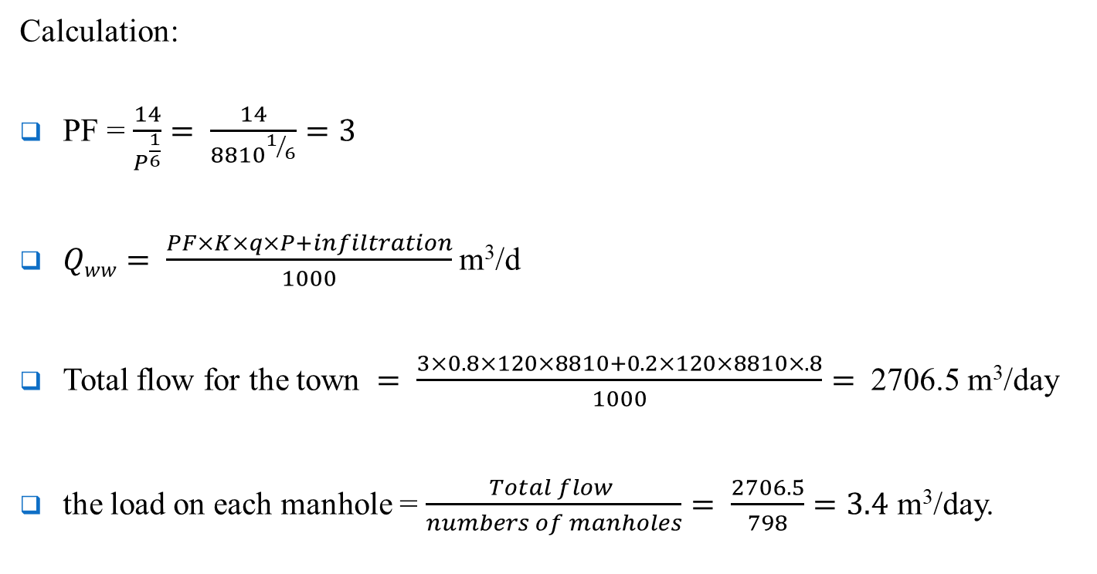
Design waste water collection network
Calculation:
PF = $\frac{14}{P^{\frac{1}{6}}}= \frac{14}{{8810}^{1/6}}=3$
$Qww= \frac{PF×K×q×P+infiltration}{1000}$m³/d
Total flow for the town $= \frac{3×0.8×120×8810+0.2×120×8810×.8}{1000}=$ 2706.5 m³/day
the load on each manhole = $\frac{Total flow }{numbers of manholes}= \frac{2706.5}{798}=3.4$ m³/day.

Slide 43
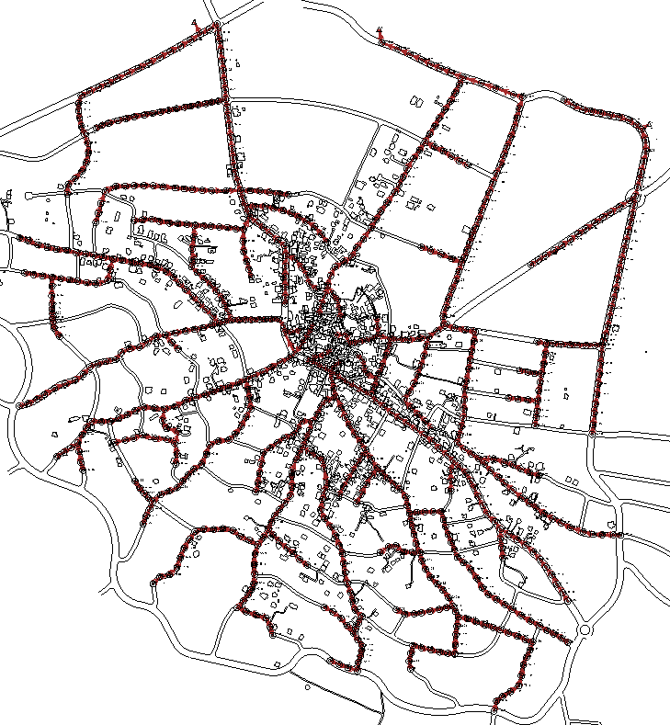
Design waste water collection network

Slide 44
Result of Design WWCN
Slope

Slide 45
Result of Design WWCN
Velocity

Slide 46
Cover
Cover start cover stop

Slide 47
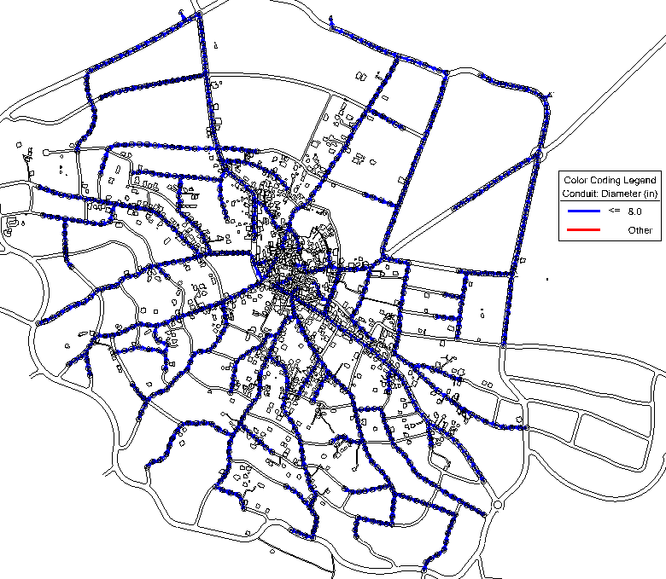
Result of Design WWCN
All the diameters in the network are 8 in

Slide 48
Cost estimate for WWCN
To estimate the total cost of network, 4 main parts should be considered:
Excavation and filling cost
Conduits cost
Manholes cost
Repaving cost

Slide 49
Cost estimate for WWCN
Conduits cost(8in) = 40 x 22780.9 = 911236 $
excavation of pipes tracks and filling = 30 x 22780.9 = 683427 $
Manholes = 650 x 798 = 518700 $
Total cost = 2113363 $

Slide 50
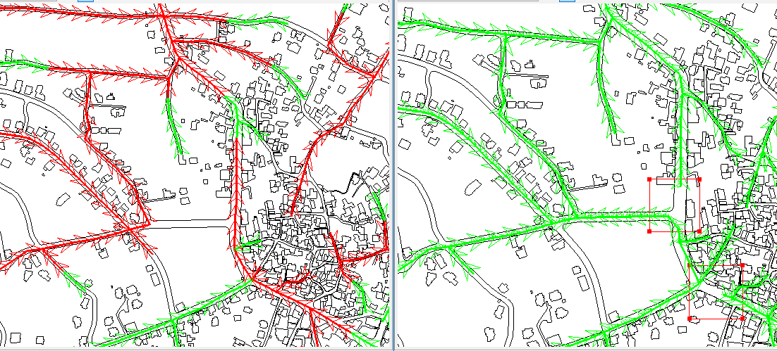
Problems that was solved
Problem of the Hard and the quick change in topography and slops.
solution:
Changing the direction of the flow and enlargement the distance between manholes

Slide 51
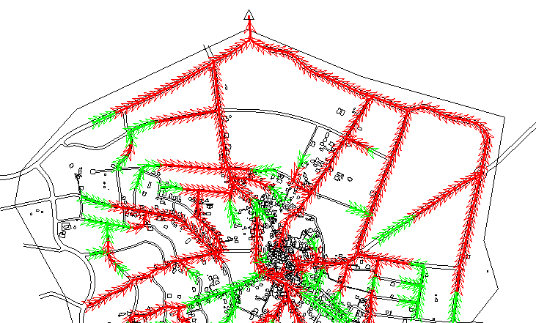
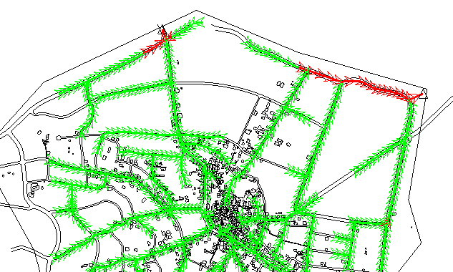
Problems that was solved
Adding more than one outfall
One outfall two outfall

Slide 52
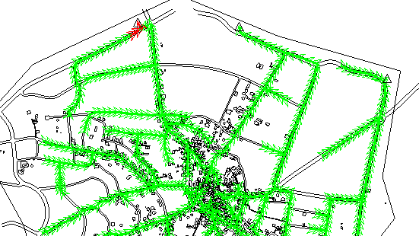
Problems that was solved
three outfall

Slide 53
Problems that was solved
Problem of minimum velocities and high cover.
After the Trying many cases, the velocities of the flow were very small in general because of the low population
This problem can solve by increase the cover constrain range but that affects to make a huge cover depth

Slide 54
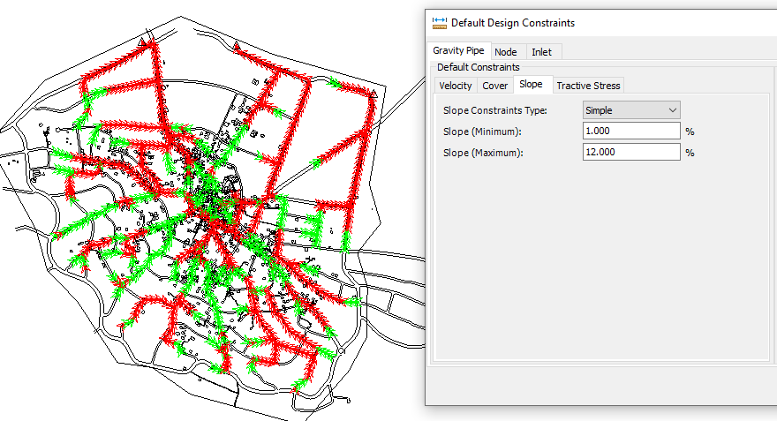
The cases of the slope rang and its effects on covers:
slope: 1% to 12%

Slide 55
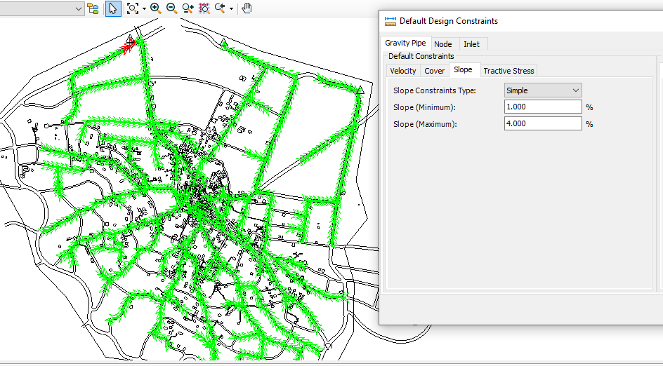
Problems that was solved
Slope: 1% to 4%

