Slide 1

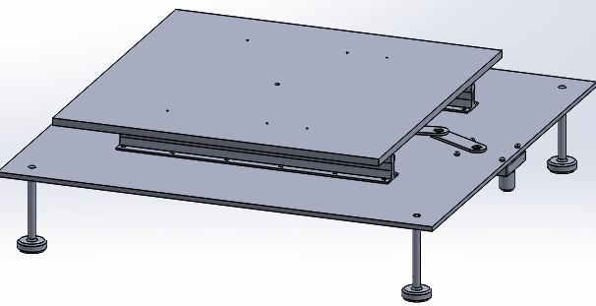
Shake table design test
Done by : Supervisor:
Fadi Abdallah Eng.Luqman
Khalid Zaher Herzallah
Amjad Abdullah

Slide 2
Outline
Introduction
Methodology
Result and Analysis
Conclusion
Future Work

Slide 3
Introduction
Objective
Specification and Description (table, model, mechanism)
Problem Statement
Problem Definition

Slide 4
Objectives
This project was designed for a study and educational purpose, where it can be used and applied in the laboratory or in the field of construction and buildings.
The study aims mainly to design a shaking table for measuring the response, natural frequencies, and mode shapes of multi-degree of freedom systems.

Slide 5
Problem Definition
One of the most important challenges designers face is the modeling of buildings and their simulation of external influences such as earthquakes

Slide 6
Problem Statement
This problem is specifically that may affect the design aspect of the buildings and the lack of correct prediction of the problem may lead to dire effects such as the collapse of the building and the occurrence of material and human losses.
The solution lies in the possibility of modeling laboratory buildings and facilities using a shake table and applying an external force that simulates earthquakes to obtain a model capable of resisting them.

Slide 7
Specification and Description
The Table is consists of a steel base, an aluminum top base, a rail, a linear bearing, and a link system connected with an electrical motor.
The structure is an aluminum model determined by the user according to the nature and size of the building.
The specific mechanism is the block slider system to transmit rotational motion from the motor to a linear in one dimension as one degree of freedom system

Slide 8
Methodology
Design Approach
Design Criteria
Data Collection

Slide 9
Data Collection
The information was collected on a global basis followed in advance by relying on previous designs such as (Quanser tables).
In addition to the average earthquake for recommended frequency range that the international designers rely upon 0.5 to 1 Hz and is estimated at 0.775 to get the best reading as much as possible.

Slide 10
Design Criteria
Maximum payload
30 kg for maximum model weight
Design options
Material property
Steel for the bottom base .
Aluminum for the top base and axillary parts.
Damping ratio Ɀ<1.
Column stiffness =26000 N/M.
Coefficient of fraction for block slider =1.35.

Slide 11
Design Approach
Stroke Distance
7.5cm in two ways
Dimensions
$For the table \left(60×60×50\right)cm$
$For the model\left(30×30×75\right)cm$
For the table" " (60×60×50)cm
For the model(30×30×75)cm
Operation Values
0.775 operation frequency.
0.5 hp motor power.
Motor speed
50 rpm converted to 0.5 m/s as recommended.

Slide 12
Result and Analysis
Simple Calculations
  Step 1
Mathematical model
  Step 2
Programing and Simulations
  Final Step

Slide 13
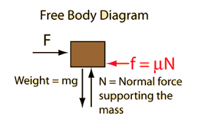
Simple Calculations
Some simple calculations were performed such as calculating the base mass and the linear force required to move at a recommended speed with which the motor power was inferred from that.

Slide 14
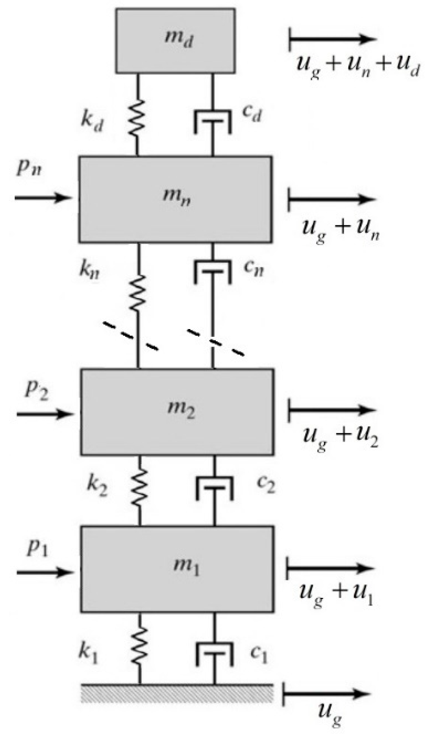
Mathematical model
The mechanical system was converted to an adjustable mathematical model and the necessary entries could be made by the user according to the program MATLAB code attached in Appendix, thus obtaining theoretical results.

Slide 15
Programing and Simulations
SolidWorks software was used as a system to extract data in a non-practical way instead of the practical device by entering the primary data and extracting the final results and the result was as the following:
Maximum acceleration possible
1.7830 m/$s^{2}$
1.7830 m/𝑠^2
Maximum speed possible
0.000935 m/s
000192 m/s
Maximum displacement

Slide 16
Conclusion
As a final result of this work, we can extract what was produced as a theoretical model applicable in the laboratory.
The device is a single degree shake table designed using the SolidWorks program according to the global system and previous devices.
The project also includes a complete program design for the table and the model and a somewhat logical results extraction system.

Slide 17
Future Work
Applying the system on the practical side
Developing the system to become multi-degree of freedom
Using practical and accurate control systems and a data mining system.
Work on the programs of LabVIEW and SAP, which allow to work better and achieve desired results
Create a system based on converting seismic signals into readings that can be applied to the device, thus facilitating the process of simulating earthquakes
We remain hopeful in the near future that we will develop on this research to keep pace with the needs of the market within several proposals:

Slide 18


