Slide 1

Kiddy
Supervisors:
Dr. Ashraf Armoush
Dr. Haya Samaana
Students:
Maysam Mousa
Abdelrahman Baba

Slide 2
Table of contents
01
02
Main Idea & Motivation
Technologies
03
04
Business Domain
Future Work
07
Similarity
App Structure
05
06
Features

Slide 3
01
Main Idea & Motivation

Slide 4

Main Idea & Motivation
International Platform for kindergartens.
Aims to:
  Making it easy for parents to choose better kindergartens
  Offering management system for kindergarten owners
  Exchange experiences and thoughts in one platform
  Taking children and learnin process further

Slide 5
Table of contents
01
02
Main Idea & Motivation
Technologies
03
04
Business Domain
Future Work
07
Similarity
App Structure
05
06
Features

Slide 6
02
Technologies

Slide 7









Technologies
Back-end
Database
Front-end
Mobile
ORM
Machine Learning

Slide 8
Table of contents
01
02
Main Idea & Motivation
Technologies
03
04
Business Domain
Future Work
07
Similarity
App Structure
05
06
Features

Slide 9
03
App Structure

Slide 10
RESTful Architectural Style
MVC Architectural Pattern
Security

Slide 11
Table of contents
01
02
Main Idea & Motivation
Technologies
03
04
Business Domain
Future Work
07
Similarity
App Structure
05
06
Features

Slide 12
Business Domain
Roles
Semesters
Children
Register Application life cycle

Slide 13
01
Roles

Slide 14
Roles
Admin
Kindergarten Owner
Parent

Slide 15
02
Semesters

Slide 16
Semesters
Constraints
Each kindergarten manages its own semesters
Starts and ends at specific chosen dates by the owner
Each semester have a final dead line (register expiration) date
Parents can apply their children to active semesters
Each kindergarten can have only one active semester at a time
All semesters are archived

Slide 17
03
Chidren

Slide 18
Children
Constraints
Parents can add children as they like
Only one application for single child per kindergarten for a semester
A parent can send multiple register applications for different kindergartens
A single child can belong to one kindergarten only per semester
A child can register in the same kindergarten but for different semesters

Slide 19
Children Status Types(Cont.)
Looking For Kindergarten
Enrolled
01
02
03
Graduated

Slide 20
04
Register Application Life Cycle

Slide 21
Register Application Life Cycle
UNDER_REVIEW
APPROVED
01
02
03
04
REJECTED
CONFIRMED

Slide 22
Table of contents
01
02
Main Idea & Motivation
Technologies
03
04
Business Domain
Future Work
07
Similarity
App Structure
05
06
Features

Slide 23
05
Features

Slide 24
Features
Matching
Chat system
Subscription System
HR Service
01
02
03
04
05
06
Statistics
Semester Management

Slide 25
01
Matching

Slide 26
Matching
Search
Find best suits
Parameters
Budget
Search feature for kindergartens
City
Country
Finding best kindergartens that suits parent
Open to apply?
Max Distance
Takes in consideration
Location

Slide 27
02
Chat System

Slide 28

Chat System
Cloud Based
Firebase Google
  Supports:
    Parent & owner

Slide 29
03
Subscription System

Slide 30
For whom?
Manage Services
Managing Plans For Services
Admin based service.
Consumed by kindergarten owners
Managing the available services
Creating different plans for a service, so kindergarten owners can choose the plans suit them

Slide 31
04
HR Service

Slide 32
HR Service
Jobs
Full Job Management per kindergarten
Employees
Monetoring and tracking Employees
Bonuses
Ability to give employees bonuses
TimeOffs
Ability to manage employees’ timeoffs
Ability to manage categories for timeoffs
TimeOff Categories

Slide 33
05
Statistics

Slide 34

Statistics
Admin
Owner
Tracking users joining
Tracking parents information
Tracking children joining and status
Tracking Register Applications
Tracking kindergartens owners
Tracking Children Applied to Kindergarten
Tracking Register Application
FOR A CHOSEN SEMESTER

Slide 35
06
Semster Management

Slide 36
Semester Management
Organaizing
Rules
Histroy
01
02
03

Slide 37
Table of contents
01
02
Main Idea & Motivation
Technologies
03
04
Business Domain
Future Work
07
Similarity
App Structure
05
06
Features

Slide 38
06
Future Work

Slide 39
Future Work
Roles For Employees
AI Features
Driving/stats services
Real time Timeline
01
02
03
04

Slide 40
Table of contents
01
02
Main Idea & Motivation
Technologies
03
04
Business Domain
Future Work
07
Similarity
App Structure
05
06
Features

Slide 41
07
Similarity

Slide 42
Similarity
Q: What is similarity?
    Finding how much two instances are similar to each other
    Q: What is the purpose of finding similarity btw two instances?
    Applicable in many fields in our lives, its main purpose if to identify how much similar the instances are
    Q: How to find similarity?
    Represent instances (kindergartens) as vectors
    Define what features are meaningful
    Measure distance between vectors using similarity metrics

Slide 43
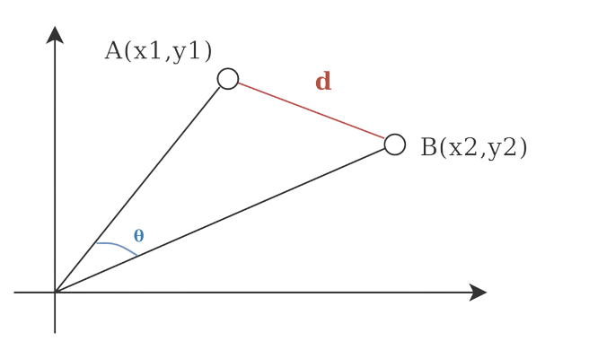
Similarity Metrics
Q1: What are similarity metrics?

Slide 44
Kindergartens as vectors
Q2: What features should be considered to measure similarity btw kindergartens?
Q3: How to represent Kindergartens as vectors?

Slide 45
Q2 Analysis
Q2: What features should be considered to measure similarity btw kindergartens?
We are concerned with each kindergarten individually with its active semester
To retrieve the data required, an Inner Join is applied to “kindergarten” and “semester” tables

Slide 46
Q2 Analysis Cont.
Q2.1: What features/columns are meaningful and will help to match kindergartens after the inner join?
Name
Location Formatted
Latitude
Longitude
Email
Phone
Country
City
Website
About
Created at
Start date
End date
Registration expiration
Name
Tuition
Created at

Slide 47
Q2 Analysis Cont.
Q2.1: What features/columns are meaningful and will help to match kindergartens after the inner join?
Name
Location Formatted
Latitude: numerical
Longitude: numerical
Email
Phone
Country: categorical
City: categorical
Website
About
Created at
Start date
End date
Registration expiration
Name
Tuition: numerical
Created at

Slide 48
Q3 Answer: Kindergarten as vectors
Latitude
Longitude
Country
City
Tuition
38.562342
32.568749
Palestine
Nablus
120
36.412635
31.598314
Jordan
Amman
200
.
.
.
.
.
.
.
.
.
.
.
.
.
.
.
19.561326
35.658743
Egypt
Cairo
165

Slide 49
Q3.1
Q3.1: How to process categorical features (Country & City)?
By representing features as One-Hot Encoded Vectors

Slide 50
Q3 Before OHE
Latitude
Longitude
Country
City
Tuition
38.562342
32.568749
Palestine
Nablus
120
36.412635
31.598314
Jordan
Amman
200
.
.
.
.
.
.
.
.
.
.
.
.
.
.
.
19.561326
35.658743
Egypt
Cairo
165

Slide 51
Q3 After OHE
Latitude
Longitude
Palestine
Jordan
.
Cairo
Tuition
38.562342
.
32.568749
1
0
0
120
36.412635
31.598314
0
1
.
0
200
.
.
.
.
.
.
.
.
.
.
.
.
.
.
.
.
.
.
.
.
.
.
19.561326
35.658743
0
0
1
165

Slide 52
Q3 Cont.
Q3.2: Are scale important?
Yes
Q3.3: Why?
To make sure there are no Dominant features.
Q3.4: How to apply that?
Scaling/Normalizing our features which makes sure that all features are between [0, 1] range

Slide 53
Q3 After Scaling
Latitude
Longitude
Palestine
Jordan
.
Cairo
Tuition
0.78
.
0.32
1
0
0
0.72
0.69
0.43
0
1
.
0
0.53
.
.
.
.
.
.
.
.
.
.
.
.
.
.
.
.
.
.
.
.
.
.
0.53
0.76
0
0
1
0.55

Slide 54
Q3 Cont.
Summary:
Representing kindergartens as vectors succeeded
All features are scaled and well processed
Finding similarity between any 2 vectors(kindergartens) is a piece of cake
We got reliable results
Q3.5: Is it really important the similarity between kindergartens already stored in a database?
((>> NOOOO <<))
What really matters is the similarity between already stored kindergartens in the database and the user input requirements

Slide 55
Q1 Cont.
Q3.6: How to get that done?
Get user input
OHE categorical features
Normalize features
Append it as a virtual kindergartens

Slide 56
Q3 Getting input data
Get user input and
Latitude
Longitude
Country
City
Tuition
31.236598
39.452168
Palestine
Nablus
210

Slide 57
Q3 OHE
OHE categorical features
Latitude
Longitude
Palestine
Jordan
.
Cairo
Tuition
.
31.236598
39.452168
1
0
0
210

Slide 58
Q3 Normalization
Normalize features
Latitude
Longitude
Palestine
Jordan
.
Cairo
Tuition
.
0.64
0.67
1
0
0
0.86

Slide 59
Q3 Append it
Latitude
Longitude
Palestine
Jordan
.
Cairo
Tuition
0.78
.
0.32
1
0
0
0.72
0.69
0.43
0
1
.
0
0.53
.
.
.
.
.
.
.
.
.
.
.
.
.
.
.
.
.
.
.
.
.
.
0.53
0.76
0
0
1
0.55
.
0.64
0.67
1
0
0
0.86

Slide 60
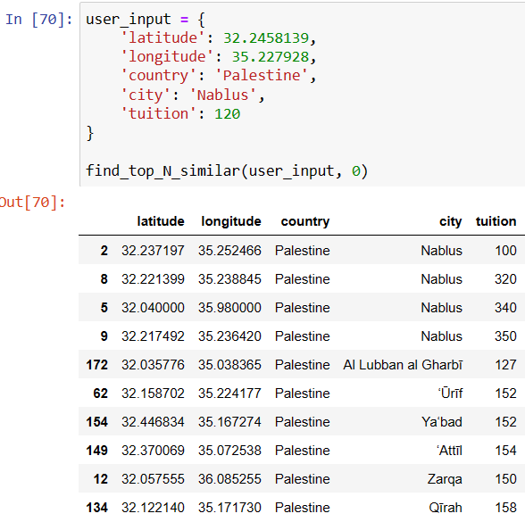
Testing model’s performance
Are those results satisfying?
Yes, Buttt ?…

Slide 61
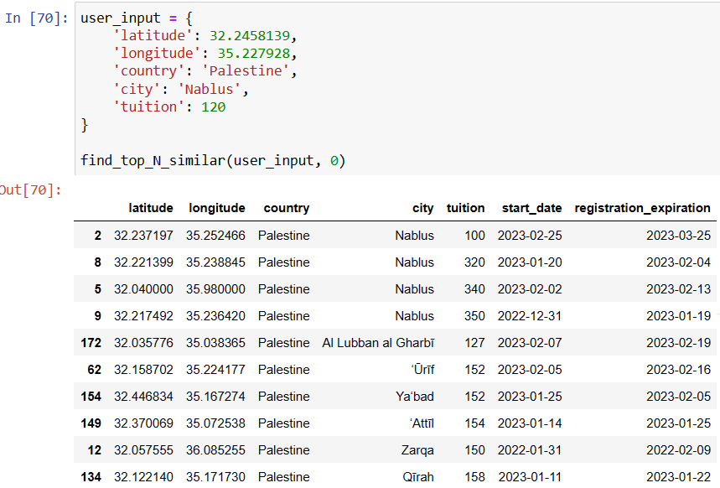
Testing model’s performance (Cont.)
V1
Today:
2023-01-21

Slide 62
Testing our model
As previously seen:
Our model suggests kindergartens that have already started their semesters.
Even suggested a kindergarten with an expired date of registration
WHAT TO DO?

Slide 63
Currently included features
Q2.1: What features/columns are meaningful and will help to match kindergartens after the inner join?
Name
Location Formatted
Latitude: numerical
Longitude: numerical
Email
Phone
Country: categorical
City: categorical
Website
About
Created at
Start date
End date
Registration expiration
Name
Tuition: numerical
Created at

Slide 64
Thinking …. Hmmmmm….
Qs:
What to do?
Should we include start_date and registration_expiration to our processed dataframe so it has an impact?
If yes, how can that be done?
How to represent those dates to be meaningful in our domain?

Slide 65
An Idea …. What if?
Maybe an Idea satisfies the following statement is our hint?
In simple terms:
Raise the rank of kindergartens which their semester did not start
Add a penalty to kindergartens whose semester has started

Slide 66
An Idea …. What if? (Cont.)
1. User input for those 2 features are always 1
2. Then filling those 2 features according to the following conditions:
If (today < start_date){
start_date = 1
} else{
start_date = 0
}
If (today < registration_expiration){
registration_expiration = 1
} else{
registration_expiration = 0
}

Slide 67
Applying our Idea
Q: What features/columns are meaningful and will help to match kindergartens after the inner join?
Name
Location Formatted
Latitude: numerical
Longitude: numerical
Email
Phone
Country: categorical
City: categorical
Website
About
Created at
Start date: date
End date
Registration expiration: date
Name
Tuition: numerical
Created at

Slide 68
Applying our Idea (Cont.)
Latitude
Longitude
Palestine
Jordan
.
Cairo
Tuition
Start
date
Registration
expiration
0.78
.
0.72
1
0
0.32
1
0
0
0.69
0.43
0
.
0
0.53
0
1
.
.
.
.
.
.
.
.
.
.
.
.
.
.
.
.
.
.
.
.
.
.
.
.
.
.
.
.
0.53
0.76
0
0
1
0.55
1
1
.
0.64
0.67
0
0
0.86
1
1

Slide 69
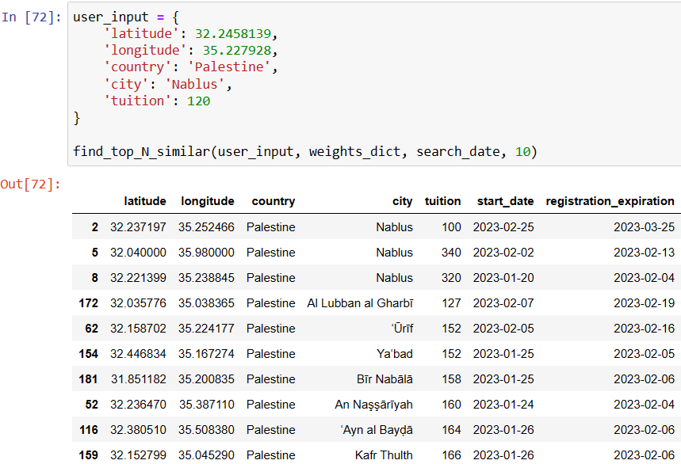
Testing after adding date features
V2
Today
2023-01-21
2023-01-21
2023-01-21
2023-01-21
2023-01-21
2023-01-21
2023-01-21
2023-01-21
2023-01-21
2023-01-21
2023-01-21
2023-01-21

Slide 70
Results
Our model has eliminated the kindergarten with expired registration date
Now our model operates with 6 features
provide neutral and balanced results for all features
But, in some use cases its performance will not be able to serve users

Slide 71
Use case #1 (u think life is easy?)
What if a user is extremely concerned with
Tuition
Start_date
Expiration_registration
Will the model be able to serve this user?
Mostly, our model will not be able to serve this need

Slide 72
Imagining if this could happen
What if a user is extremely concerned with
Tuition
Start_date
Registration_expiration
x1
x1
x1
x1
x4
x4
x4
Latitude: numerical
Longitude: numerical
Country: categorical
City: categorical
Tuition: numerical
Start_date: date
Registration_expiration: date

Slide 73
Thinking ….
Q: Is it even posibble?
Mmmm.. Maybe
Q: Can we raise the importance for some features?
Could be
Q: How?
By multiplying each features with a number?
Q: How to get that done?
Using Identity matrix

Slide 74
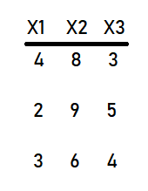
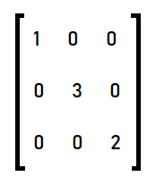
Changing features’ importance factors
Suppose we have the following 3 records with 3 features?
And we have the following Identity Matrix
1 is the importance of X1
3 is the importance of X2
2 is the importance of X3

Slide 75
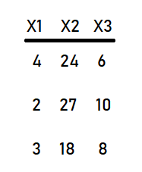
Changing features’ importance factors
Applying the following equation:
Matmul(Identity, features.T).T
Gets us the following result
X1 is multiplied by 1
X2 is multiplied by 3
X3 is multiplied by 2
→

Slide 76
Back to our problem
Same applied to our problem
We want some features to have more importance than other features
Get an Identity Matrix of size (#features, #features)
Fill the diagonal with the importance of each features as desired
Multiply the features by that matrix and we will get features more important than others

Slide 77
But !!? ..
Q: Does it matter if we apply the matrix multiplication before or after the normalization/scaling?
DEFINITELY …….
-> Before normalization:
We will get exactly the same result with features of scale [0, 1]
-> After normalization:
We will get the features of scale [0, 1] * N
Where N is the importance factor

Slide 78
Applying matrix mult. (Before) normalization
x1 x1 x2 x2 x2 x2 x2
Latitude
Longitude
Palestine
Jordan
.
Cairo
Tuition
0.78
.
0.32
1
0
0
0.72
0.69
0.43
0
1
.
0
0.53
.
.
.
.
.
.
.
.
.
.
.
.
.
.
.
.
.
.
.
.
.
.
0.53
0.76
0
0
1
0.55
.
0.64
0.67
1
0
0
0.86

Slide 79
Applying matrix mult. (After) normalization
x1 x1 x2 x2 x2 x2 x2
Latitude
Longitude
Palestine
Jordan
.
Cairo
Tuition
0.78
.
0.32
2
0
0
1.44
0.69
0.43
0
2
.
0
1.06
.
.
.
.
.
.
.
.
.
.
.
.
.
.
.
.
.
.
.
.
.
.
0.53
0.76
0
0
2
1.1
.
0.64
0.67
2
0
0
1.72

Slide 80
Use case #1 … It’s real
What if a user is extremely concerned with
Tuition
Start_date
Expiration_registration
x1
x1
x1
x1
x4
x4
x4
Latitude: numerical
Longitude: numerical
Country: categorical
City: categorical
Tuition: numerical
Start_date: date
Registration_expiration: date

Slide 81
Use case
x1 x1 x1 x1 x1 x1 x4 x4 x4
Latitude
Longitude
Palestine
Jordan
.
Cairo
Tuition
Start
date
Registration
expiration
0.78
.
2.88
4
0
0.32
1
0
0
0.69
0.43
0
1
.
0
2.12
0
4
.
.
.
.
.
.
.
.
.
.
.
.
.
.
.
.
.
.
.
.
.
.
.
.
.
.
.
.
0.53
0.76
0
0
1
2.2
4
4
.
4
0.64
0.67
1
0
0
3.44
4

Slide 82
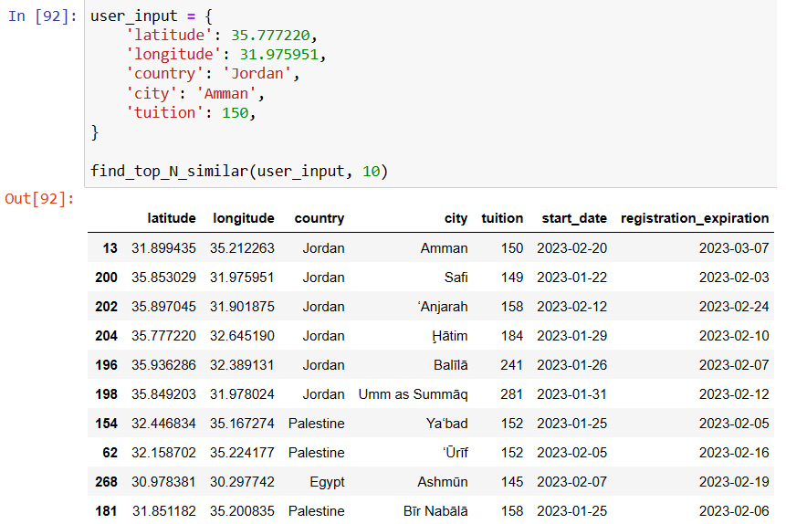
Testing model for the use case
Today
2023-01-21
2023-01-21
2023-01-21
2023-01-21
2023-01-21
2023-01-21
2023-01-21
2023-01-21
2023-01-21
2023-01-21
2023-01-21
2023-01-21

Slide 83
Result
We can observe that
All kindergartens have not started their semesters yet
Tuition is close to what user desired
A kindergarten from different country was also suggested
Our model served that specific use case and mostly will be able to serve similar cases

Slide 84
Use case #2
What if a user is extremely concerned with
Location
Should we build another model prioritizing (Location) feature to handle this use case and similar ones?

Slide 85
Use cases ….
What if a user is extremely concerned with …..
What if second user is extremely concerned with ….
What if third user is extremely concerned with ….
What if fourth user is extremely .. ….
What if fifth user is extre ….
What if sixth u…
What if …

Slide 86
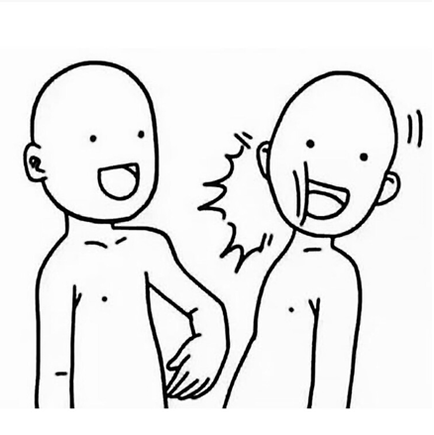
What if….??
Similarity feature
Users’ preferences never end!
Billions of preferences to handle and
We are heading to a DEAD END !!
My mind

Slide 87
Thinkiing …… Is there a solution?
Is there a general solution(set of weights/importance) that serves most of the population?
Different users, different preferences, different choices and circumstances.
It’s almost impossible to cover or satisfy all users with one general weights to be applied on features

Slide 88

Thinking .. Hmm ..
What if we let the user specify the weights/importance for features?
Hmm …
Is that possible?
Definitely, we can receive a dictionary with feature weights and multiply them by features.
Let’s assume that each feature weight/importance factor is between [0,5]
why?
Features are normalized [0,1], we would get the same results as if weights ranged from [0, 1000]

Slide 89































Birth of a new version ..
x{$P_{0}$} x{$P_{1}$} x{$P_{2}$} x{$P_{3}$} x{$P_{.}$} x{$P_{.}$} x{$P_{.}$} x{$P_{n−1}$} x{$P_{n}$}
Latitude
Longitude
Palestine
Jordan
.
Cairo
Tuition
Start
date
Registration
expiration
0.78 * $P_{0}$
.
0.72 * x{$P_{.}$}
1 * $P_{n−1}$
0 * $P_{n}$
0.32 * $P_{1}$
1 * $P_{2}$
0 * $P_{3}$
0 * x{$P_{.}$}
0.69 * $P_{0}$
0.43 * $P_{1}$
0 * $P_{2}$
1 * $P_{3}$
.
0 * x{$P_{.}$}
0.53 * x{$P_{.}$}
0 * $P_{n−1}$
1 * $P_{n}$
.
.
.
.
.
.
.
.
.
.
.
.
.
.
.
.
.
.
.
.
.
.
.
.
.
.
.
.
1 * $P_{n−1}$
0.53 * $P_{0}$
0.76 * $P_{1}$
0 * $P_{2}$
0 * $P_{3}$
1 * x{$P_{.}$}
0.55 * x{$P_{.}$}
1 * $P_{n}$
.
0.86 * x{$P_{.}$}
0.64 * $P_{0}$
0.67 * $P_{1}$
1 * $P_{2}$
0 * $P_{3}$
0 * x{$P_{.}$}
1 * $P_{n−1}$
1 * $P_{n}$

Slide 90
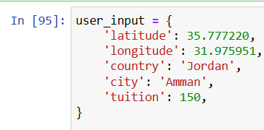
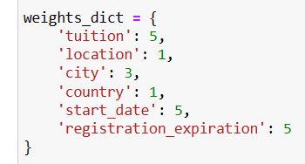
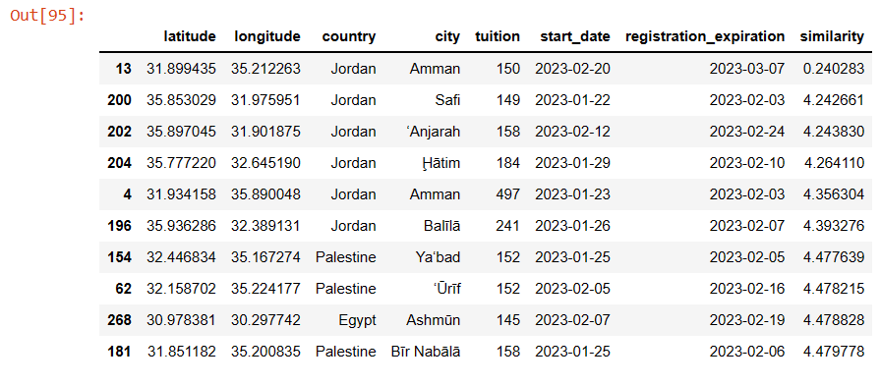
Trying our new model
Today
2023-01-21
2023-01-21
2023-01-21
2023-01-21
2023-01-21
2023-01-21
2023-01-21
2023-01-21
2023-01-21
2023-01-21
2023-01-21
2023-01-21

Slide 91
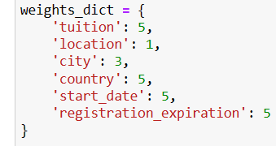
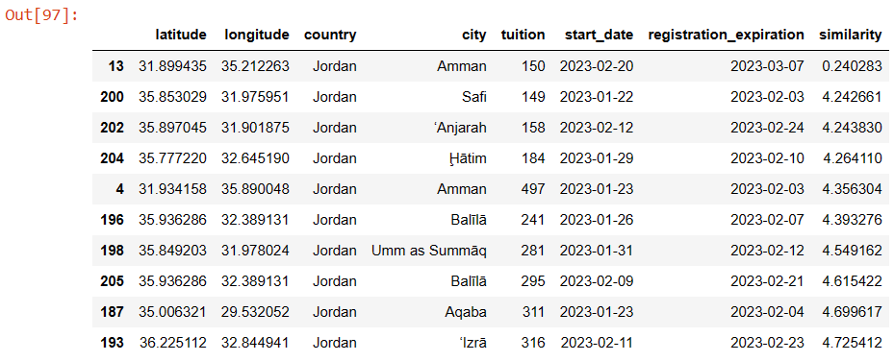
Raising country impotance factor
V3
Today
2023-01-21
2023-01-21
2023-01-21
2023-01-21
2023-01-21
2023-01-21
2023-01-21
2023-01-21
2023-01-21
2023-01-21
2023-01-21
2023-01-21

Slide 92
Summary
A model finds similarity according to the following features:
        location
        country
        city
        tuition
        start_date
        registration_expiration
        User can specify weights for each feature on a scale [0, 5]

Slide 93
Summary Cont.
        Ok …. Did the model cover all users’ preferences by providing users the ability to explicitly specify the weights for features?
        Almost Yes
        BUTTT ….. . !!?? ?!?!??!?!?! ?

Slide 94

BUT ???
        Similarity model

Slide 95
A user compliant
        User: “What if I am for some reason, concerned with the result of similarity model at some point in the future, can your model serve me?”
        For example: user and his family wants to travel after 1 month to Reyad in Saudi Arabia and wants to decide which kindergarten to put his child in once he arrives
        Can our model serve him?
        For the moment, NO

Slide 96
What to do?
        Let’s remember our condition for start_date and registration_expiration
If (today < start_date){
start_date = 1
} else{
start_date = 0
}
If (today < registration_expiration){
registration_expiration = 1
} else{
registration_expiration = 0
}
        What if we substituted today by the date the user specified?

Slide 97
What to do?
If (search_date < start_date){
start_date = 1
} else{
start_date = 0
}
If (search_date < registration_expiration){
registration_expiration = 1
} else{
registration_expiration = 0
}

Slide 98






Trying out our new solution
x{$P_{0}$} x{$P_{1}$} x{$P_{2}$} x{$P_{3}$} x{$P_{.}$} x{$P_{.}$} x{$P_{.}$} x{$P_{n−1}$} x{$P_{n}$}
Latitude
Longitude
Palestine
Jordan
.
Cairo
Tuition
Start
date
Registration
expiration
0.78 * $P_{0}$
.
0.72 * x{$P_{.}$}
? * $P_{n−1}$
? * $P_{n}$
0.32 * $P_{1}$
1 * $P_{2}$
0 * $P_{3}$
0 * x{$P_{.}$}
0.69 * $P_{0}$
0.43 * $P_{1}$
0 * $P_{2}$
1 * $P_{3}$
.
0 * x{$P_{.}$}
0.53 * x{$P_{.}$}
? * $P_{n−1}$
? * $P_{n}$
.
.
.
.
.
.
.
.
.
.
.
.
.
.
.
.
.
.
.
.
.
.
.
.
.
.
.
.
? * $P_{n−1}$
0.53 * $P_{0}$
0.76 * $P_{1}$
0 * $P_{2}$
0 * $P_{3}$
1 * x{$P_{.}$}
0.55 * x{$P_{.}$}
? * $P_{n}$
.
0.86 * x{$P_{.}$}
0.64 * $P_{0}$
0.67 * $P_{1}$
1 * $P_{2}$
0 * $P_{3}$
0 * x{$P_{.}$}
1 * $P_{n−1}$
1 * $P_{n}$

Slide 99
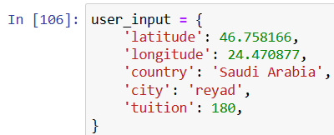
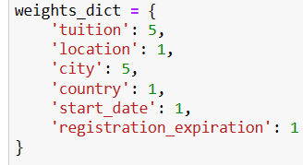
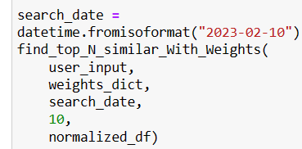
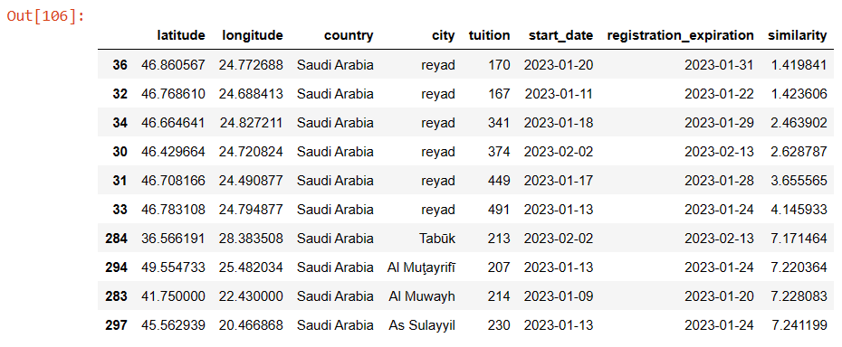
Use case(Trying model)
(2)
(1)
(3)
Today 2023-01-21
(4) Result:
Search_date
2023-02-10
2023-02-10
2023-02-10
2023-02-10
2023-02-10
2023-02-10
2023-02-10
2023-02-10
2023-02-10
2023-02-10
2023-02-10
2023-02-10

Slide 100
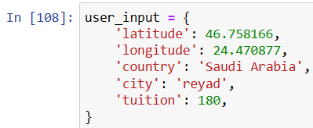
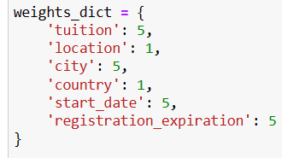
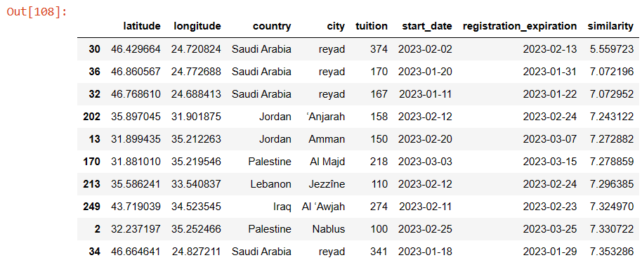
Use case raising importance
(2)
(1)
(3)
Today 2023-01-21
(4) Result:
Search_date
2023-02-10
2023-02-10
2023-02-10
2023-02-10
2023-02-10
2023-02-10
2023-02-10
2023-02-10
2023-02-10
2023-02-10
2023-02-10
2023-02-10

Slide 101
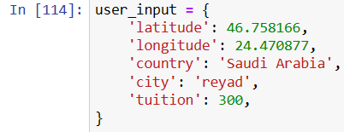
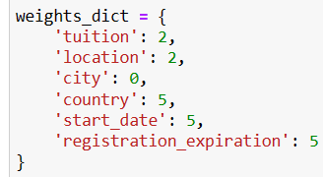
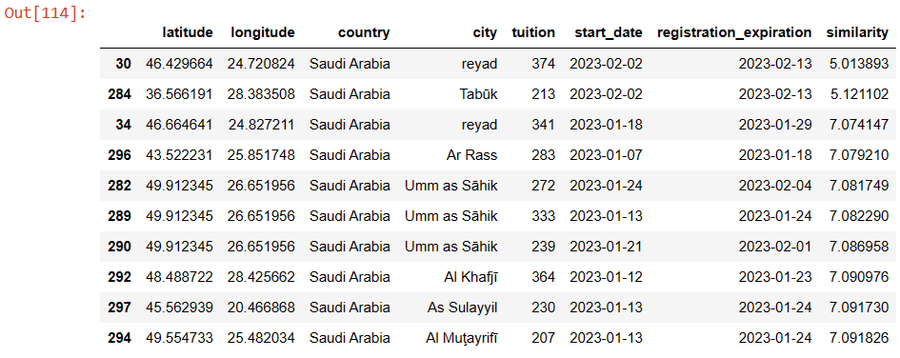
Use case Cont.
(2)
(1)
(3)
Today 2023-01-21
(4) Result:
Search_date
2023-02-10
2023-02-10
2023-02-10
2023-02-10
2023-02-10
2023-02-10
2023-02-10
2023-02-10
2023-02-10
2023-02-10
2023-02-10
2023-02-10
V5

Slide 102
SUMMARY
Highly OPTIMIZED, CUSTOMIZABLE Similarity Model with perfect results utilizing each available data detail that enables user to:
Specify importance factors (weights) for each feature freely
Choosing the date want the similarity model to apply at
Including any point
In the future
Adding dates features
V1
V2
V3
V4
Regular model
Ability of user to specify importance factors

Slide 103
Table of contents
01
02
Main Idea & Motivation
Technologies
03
04
Business Domain
Future Work
07
Similarity
App Structure
05
06
Features

Slide 104

Thank You!

