Slide 1

An-Najah National University
Engineering & IT Faculty
Civil Engineering Department
Structural Design and analysis of
International Palestinian Airport
By:
Majd M. Khader
Ahmad M. Halahla
Mohammad I. Hendi
Under supervision of : Dr. Mohammad Samaaneh

Slide 2
Outline:
Introduction.
Gravity and Lateral loads.
3D modeling using SAP.
Design of Slab.
Design of Beams.
Design of Columns and Shear walls.
Design of Footings and Ground Beams.

Slide 3
INTRODUCTION
Civil engineering is a major department of engineering, which is an applied science that deals with many branches such as design and analysis of any building type, environment, water, transportation facility, etc.
In this project, the knowledge of analysis and design of buildings is applied.

Slide 4
Objectives
This project applies concepts of structural engineering learned over last years.
Different types of analysis and design are done in this project in order to choose the safest and most economical type and method for the design.

Slide 5

Project information
Location
The project under study is the proposal of the international Palestinian Airport building, which is Located 10 km south of Jericho, and 7 km west of Dead Sea, in Al-baqee'a area.

Slide 6
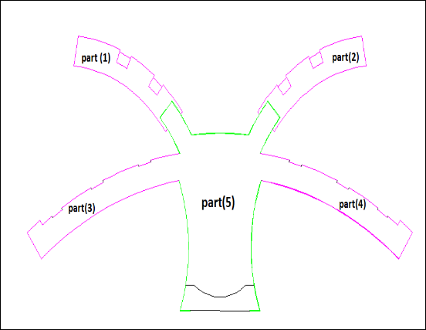
Project information
Structure Components
Our structure composed of five parts
as shown in the figure below:
Parts one, two, three, and four are
consist of two floors.
which are departures, arrivals,
and waiting hales, etc.…
Part five is a hole for reception,
check offices, shopping centres,
etc.…

Slide 7

International Palestinian Airport Building

Slide 8
Project information
Site And Geology
Based on soil investigation report tests, soil in this project has 250 KN/m^2 bearing capacity, this will be illustrated when the footing designed.
based on this tests the design of foundations system and earthwork can be done.

Slide 9
Methodology
At first the architectural drawings are studied, and the structural challenges are understood.
After that the most compatible structural system selected depending on strength, serviceability, safety and economy constrains.
So Set the locations of the columns and bearing walls.
the materials used and the materials strengths are selected.
preliminary sizing and design of the structural members
Design the buildings to resist gravity and lateral loads

Slide 10
Design criteria
  Structural Materials
  1) Concrete:
  Used Compressive Strength (f_{c}’) for Slabs, Beams, Columns and Footings is 35 MPa.
  Modulus of Elasticity = 27806 Mpa
  Unit Weight for used Concrete is 25 kN/m³

Slide 11
Design criteria
Structural Materials
2) Reinforcing Steel
Yielding Stress for used Steel is 420 Mpa
Modulus of Elasticity is 200,000 MPa
3) Steel for structure
Yielding Stress for used Steel is 350 Mpa
Modulus of Elasticity is 200,000 MPa

Slide 12
Design criteria
Non-structural material
Material | Density kN/m³
Mortar | 23
Tile | 25
Filling material | 18
insulation | 0.4

Slide 13
Design criteria
Load assumption
Gravity loads:
Dead load
Live load
Super dead load
Load assumption
Lateral Loads
Earthquake
Wind load

Slide 14
Codes
ACI 318-11 (American Concrete Institute)
UBC-97 (Uniform Building Code)
ASCE-2010 (American Society of Civil Engineers).

Slide 15
Load Combination
U = 1.4D
U = 1.2D + 1.6L + 0.5(Lr or S or R)
U = 1.2D + 1.6(Lr or S or R) + (1.0L or 0.5W)
U = 1.2D + 1.0W + 1.0L + 0.5(Lr or S or R)
U = 1.2D + 1.0E + 1.0L + 0.2S
U = 0.9D + 1.0W
U = 0.9D + 1.0E

Slide 16
Computer Programs
SAP2000
E-tabs
SAFE
RAM-connection
AutoCAD

Slide 17
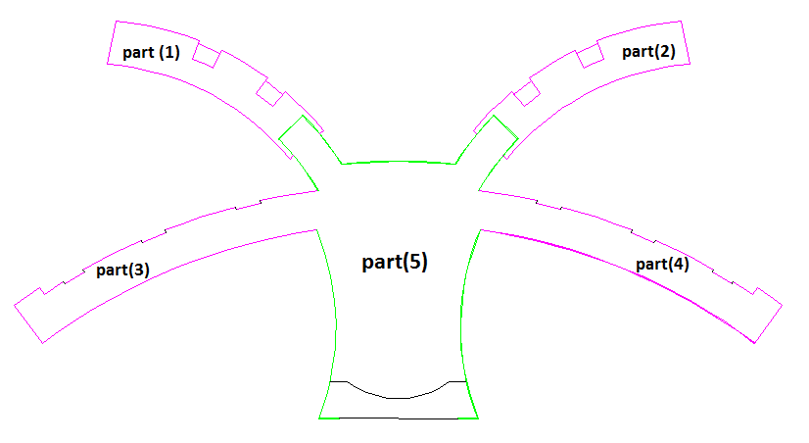
Structural system (analysis and design)
Structure dividing

Slide 18
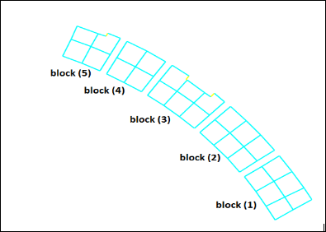
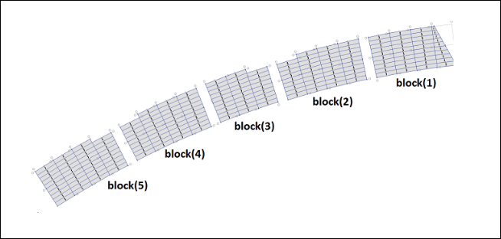
Structural system (analysis and design)
To improve and simplified the design the structure is divided into blocks, as shown:
blocks of concrete parts blocks of steel parts

Slide 19
Structural system (analysis and design)
The parts on eand two are designed as a concrete structure, they are similar in all properties so they are have the same design.
The parts three and four are designed as a steel structure, they are similar in all properties so they are have the same design.
Part five is a concrete and steel trusses used to cover it.

Slide 20
Preliminary Design
The choice of the system for slab in the building is very important to resist the internal forces and stability.
Comparison | Solid Slab | Ribbed Slab
Weight | Heavier than ribbed | Light
Area of steel | More | Less
Beams | Bigger | Smaller
framework | Approximately the same
Cost | Bigger | smaller
International Journal of Current Engineering and Technology

Slide 21
Loads
Loads
Gravity
Lateral
Seismic
Dead
live
Superimposed
wind

Slide 22
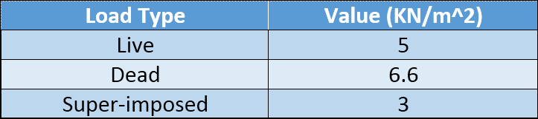
Gravity Loades
Lateral Loades
Lateral load taken in this project is seismic load(earthquake)

Slide 23
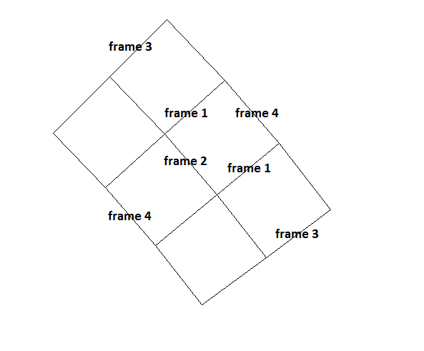
Preliminary Design
Concrete parts
Frame equivalent method (FEM)
Divide the system into frames in each direction(transform the building from 3d to 2d)by taking the effect of lateral stiffness

Slide 24

Preliminary Design
Concrete parts
Main idea of EFM
Calculating the stiffness for column ,and slab beam member
K_{c}= 104.6*10⁴ KN.m
K_{SB} = 107.84*10⁴ KN.m
K_{t . edge} = $\frac{Kt∗Isb}{Is}$ =57.122 *10⁴ * $\frac{1.6∗10ˆ11}{15000∗(400ˆ3)/12}$ =114.244*10⁴ KN.m
K_{t . interior} =76.82 *10⁴ *$\frac{1.6∗10ˆ11}{8∗10ˆ10}$= 153.64 * 10⁴ KN.m
Then calculate d_{f}
Then use moment distribution method to find moment on frame
Then we have this results

Slide 25
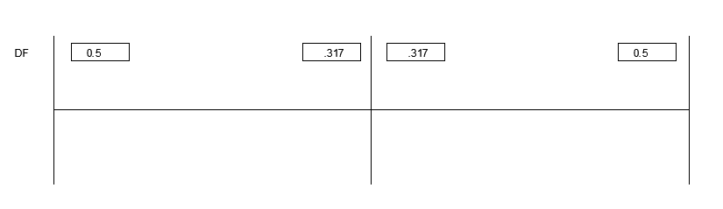
Preliminary Design
Concrete parts
Table moment distribution on first floor-frame one
joint | A | B |  | C
member | ab | ba | bc | cb
df | 0.5 | 0.317 | 0.317 | 0.5
FEM | -5602.5 | 5602.5 | -5602.5 | 5602.5
cof | 0.505 | 0.505 | 0.505 | 0.505
balance | 2801.25 | 0 | 0 | -2801.25
cof | 0 | 1414.631 | -1414.63 | 0
balance
cof
total | -2801.25 | 7017.131 | -7017.13 | 2801.25

Slide 26


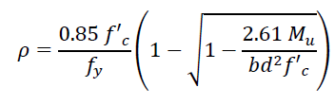
Preliminary Design
slab design
1.laods:
2. shear check:
3.Flexure design:

Slide 27
Preliminary Design slab design

Slide 28
Preliminary Design
Beam design
1.laods:
2. shear check:
3.Flexure design:

Slide 29
Preliminary Design
For flexure
Beam design

Slide 30
Preliminary Design
Beam design
Shear reinforcement
A_{v}= 226.2 mm²
use double stirrup φ12 (2 φ12/110mm)

Slide 31
Preliminary Design
Column design
Pu = 0.8 Ф [ 0.85 f’c (Ag - As) + Fy * As ]
As = ρ * Ag
ρ = 0.01 (economical percentage of steel)

Slide 32
Preliminary Design
Column design
Longitudinal reinforcement
As = 0.01 * 785398 =7854 mm²
Use 12 Ф32 mm

Slide 33
Preliminary Design
Column design
shear reinforcement
A_{v}=226mm²
Use 1 Ф12mm/26cm

Slide 34
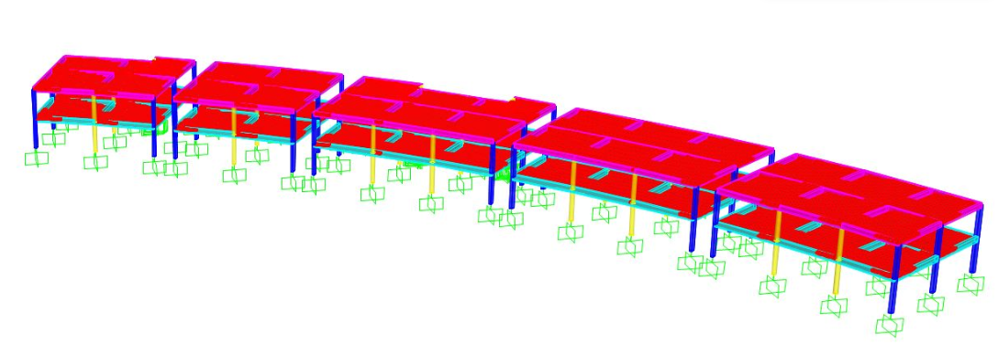
Three Dimensional Structural model and check
The structure is modeled using SAP2000 program

Slide 35
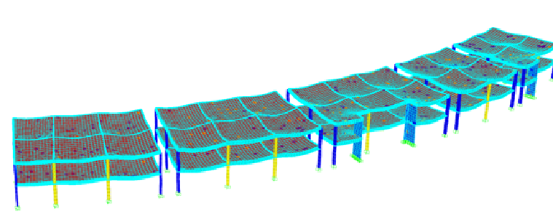
Three Dimensional Structural model and check
    Checks
Compatibility Check
  The following figure proves the compatibility of the model

Slide 36
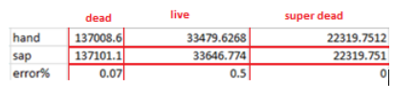
Three Dimensional Structural model and check
    Checks
2) Equilibrium Verification

Slide 37
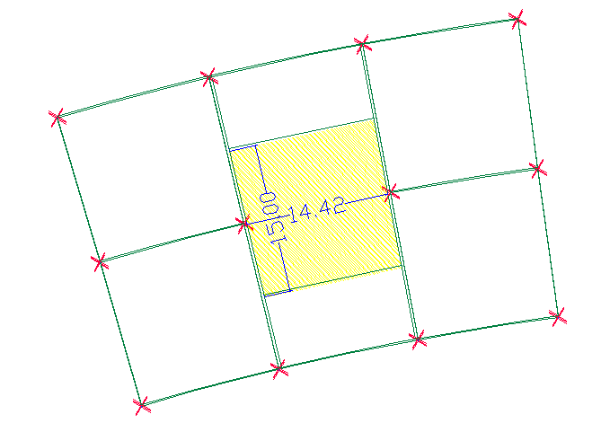
Three Dimensional Structural model and check
    Checks
    3) Stress strain relationship check
    Take the block shown to make verification
    The total factored moment will be compared on
    interior span for its live load applied on it

Slide 38

Three Dimensional Structural model and check
    Checks
    3) Stress strain relationship check
m₁= 1353KN.m
m₂ =685KN.m
m3 =1363KN.m
So by SAP2000
M₀=$\frac{m1+m3}{2}$ + m2 = $\frac{1363+1353}{2}$+685 =2016KN.m
Total factored moment on span assume it simple
=W_{L}*l_{n}² /8 =5*15*14.42²/8=1950
Error% =3.27% < 10% so the stress strain check is acceptable

Slide 39
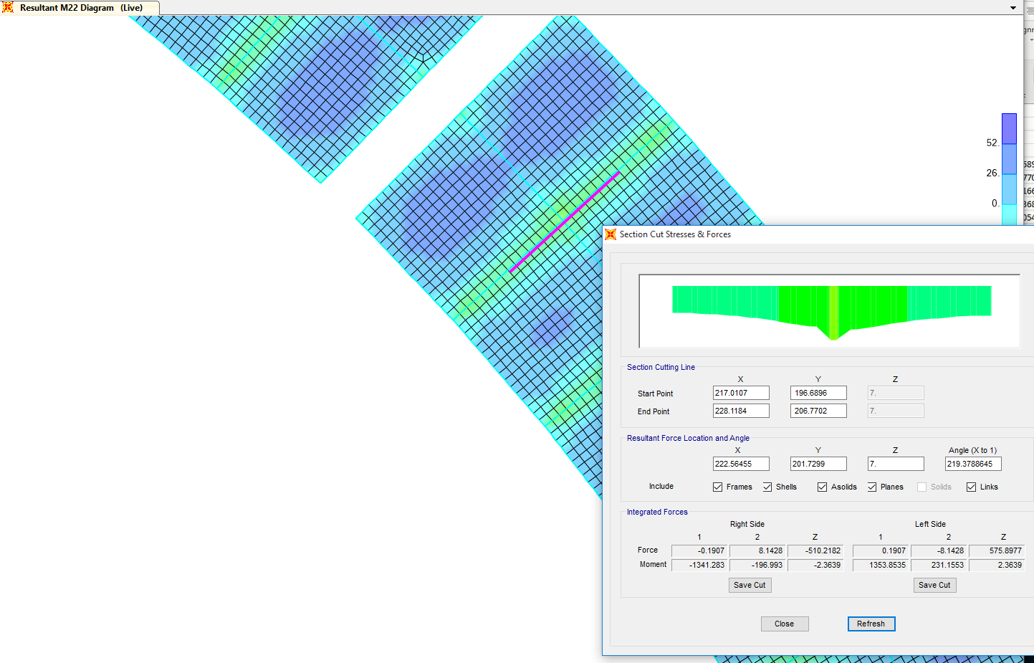
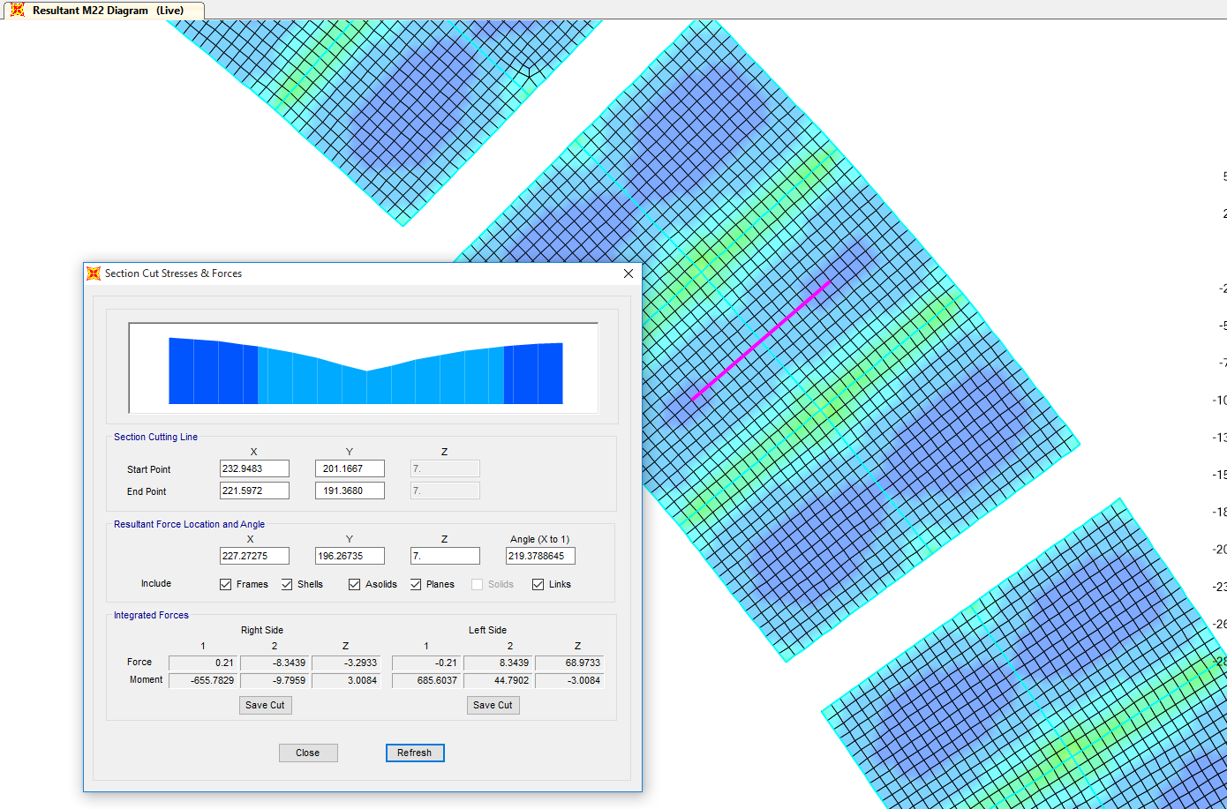
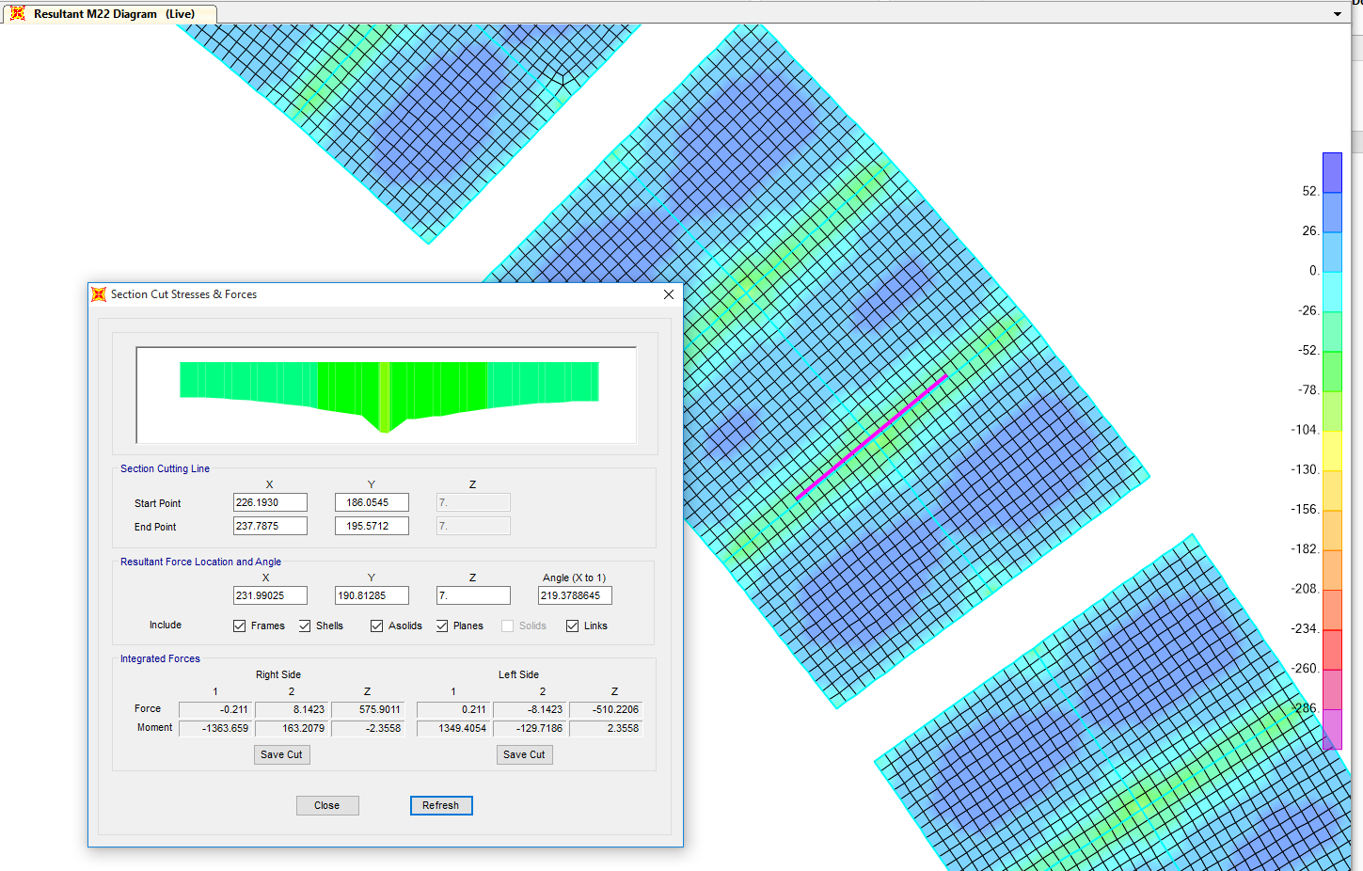
m1
m2
m3

Slide 40
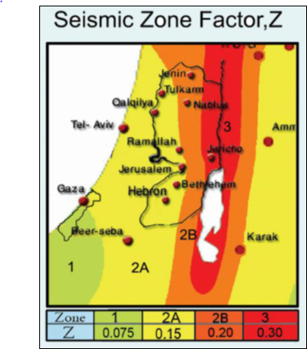
Seismic Design And Analysis
Detailing requirements:
The seismic map of Palestine is shown, our
project is located in zone with red colour
which is equals to (Z=0.3, i.e. Zone 3)

Slide 41
Seismic Design And Analysis
Detailing requirements:
so the SDC founded by Z-factor, according to table R1.1.9.1 in code of ACI-18.
According to table R21.1.1 in ACI 318-11, the detailing requirements for structure should be special moment frames.

Slide 42
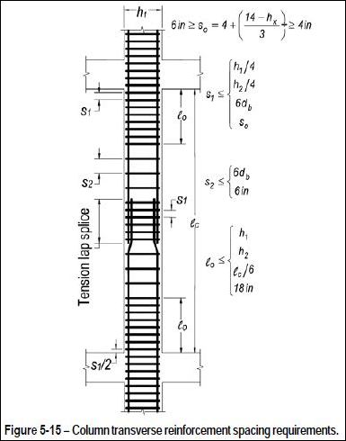
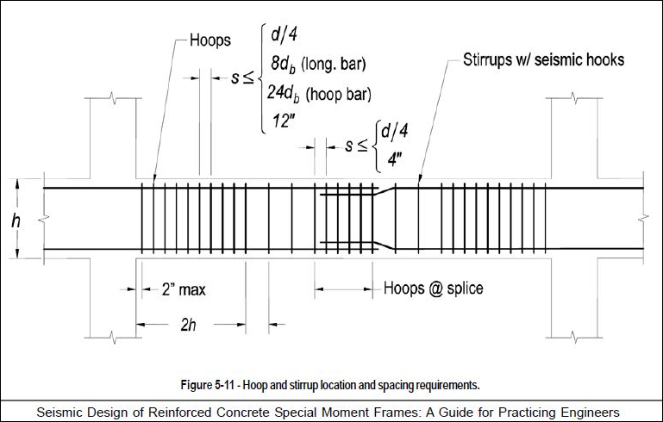
Seismic Design And Analysis
Detailing requirements:
Beam detailing
Column detailing

Slide 43
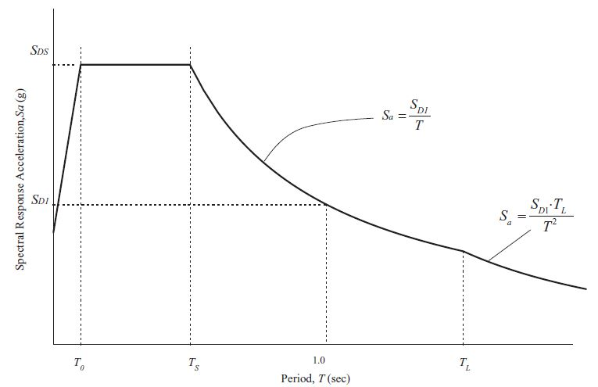
Seismic Design And Analysis
Response spectrum analysis
  define and analyze a response spectrum function using SAP2000 on both blocks. Then, the results from response spectrum will be verified using Equivalent static
  method.

Slide 44
Seismic Design And Analysis
Response spectrum analysis
Factors:
Z-factor: Z=0.3 for Jericho
Site Soil Classification Stiff soil profile → Soil type D.
find Ca and Cv based on site Soil Classification so so C_{a}=0.36
and Cv=0.54
Importance Factor (I):
the structure is considered as special occupancy structure, so from table From table 16-K—occupancy category in UBC-97 the factor I=1.
response modification factor (R): R=8.5 for special moment resisting frame, but it reduced to (6.5) to increase the seismic load on building.

Slide 45
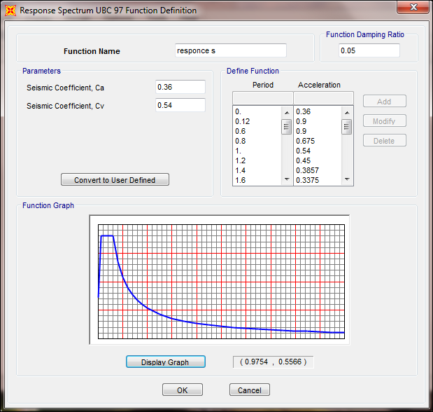
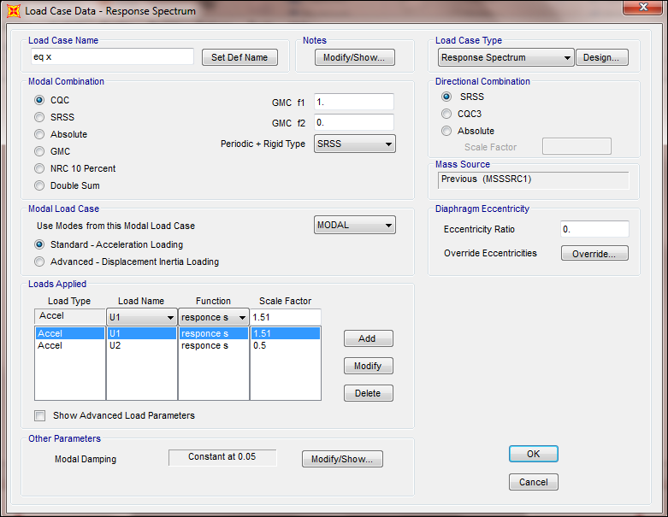
Seismic Design And Analysis
Response spectrum analysis
Definition of response spectrum function

Slide 46
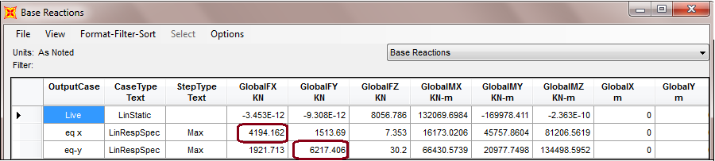
Seismic Design And Analysis
Response spectrum analysis
  Base Reactions:

Slide 47
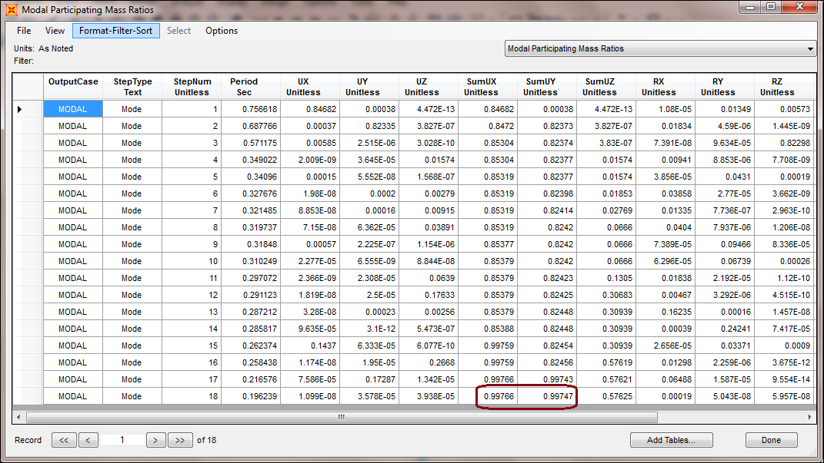
Seismic Design And Analysis
Response spectrum analysis
Modal Case (For modal mass participation ratio)

Slide 48



Seismic Design And Analysis equivalent lateral force method
Total base shear can be calculated manually by this equation:
V(max)
V(min)

Slide 49
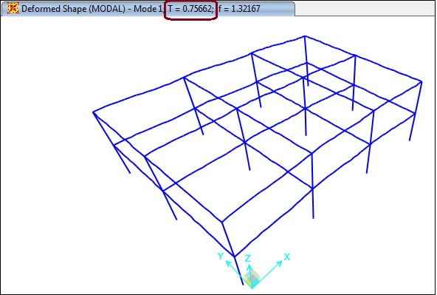


Seismic Design And Analysis
    Period (T)Check:
T (Rayleigh) =$2π\sqrt{\frac{\sum{(mass×∆^{2})}}{\sum{(F×∆)}}}$
= 0.852 sec
%Difference = $\frac{0.85−0.76}{0.85}$ ×100%
= 0.001 % →0.001 %<<20% →OK

Slide 50
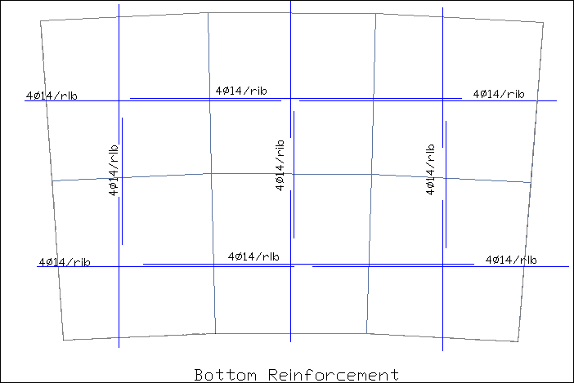
Seismic Design And Analysis
Final Design
Slab design:
Bottom and top reinforcement are the same

Slide 51
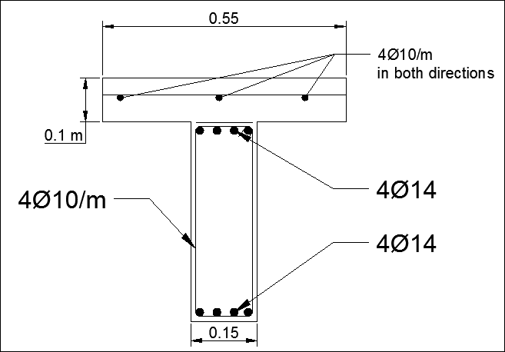
Seismic Design And Analysis
Final Design of slab
Rib Details

Slide 52
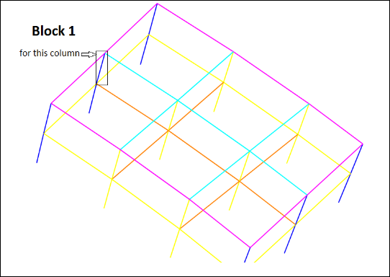
Seismic Design And Analysis
Final Design of columns
An example taken is the column shown
Ultimate axial load from SAP (Pu) = 1981 KN
Ultimate moment Mu2 =2796KN.m
Ultimate moment Mu1 =2995 KN.m

Slide 53

Seismic Design And Analysis
Final Design of columns
Check if column is short or long
[(K*Lu)/r] < [34 – 12(M1/M2)] ………… for short column
K = 0.81 , Lu =7 m, r = 0.3h = 0.3*0.81 = 0.243
M1/M2 negative then double curvature
34 - 12(M1/M2) = 34 + 12 * (2796/2995) = 45.2
$\frac{KLu}{r}$ = (0.81 * 7000) / 225 = 25.2
So , [(K*Lu)/r] < [34 – 12(M1/M2)] ………………… short

Slide 54
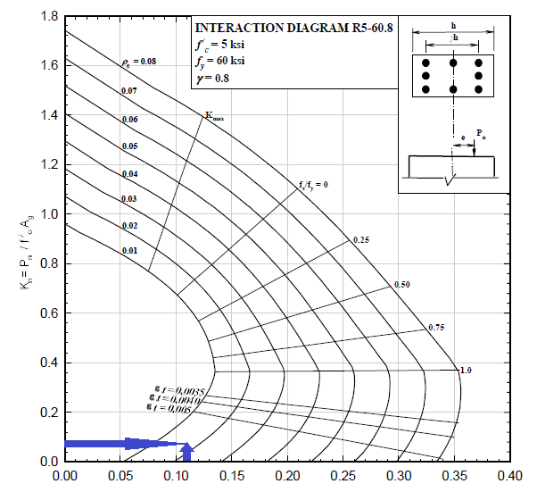


Seismic Design And Analysis
Final Design of columns
K_{n} = $\frac{3048(1000)}{35∗1600∗750}$ = 0.073
R_{n} = $\frac{4608(1,000,000)}{35∗1600∗750∗750}$ = 0.146
ϒ = (750 – (100 + 24 + 32)) / 750 = 0.8
ρ = 1.9 %
Then As= 0.019 * 1600 * 750 = 22800 mm2
Using bars of φ32 then:
Then use 28 φ32

Slide 55
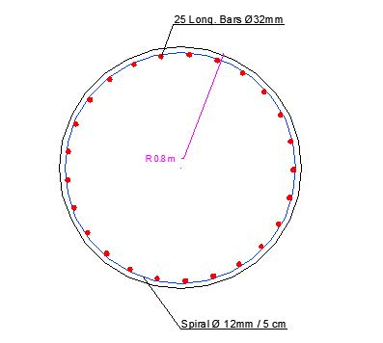
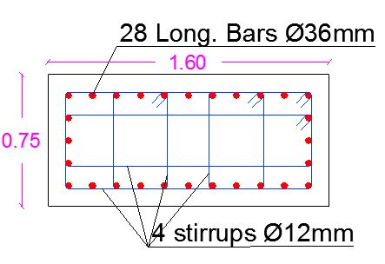
Seismic Design And Analysis
Final Design of columns
Column ID | Dimensions (mm) | ρ (SAP) | As (used) | No. of Bars | Av/s | S | S_{used}
C1 | 1600X 750 | 1.50% | 18000 | 24Ø32 | 3.635 | 124 | 120
C2 | 1600X 750 | 1.80% | 21600 | 28Ø32 | 4.919 | 91 | 90
C3 | D = 1600 | 1.28% | 25735.92702 | 32Ø32 | 3.951 | 60 | Spiral with 60
C4 | D = 1600 | 1% | 20106.19298 | 25Ø32 | 4.542 | 50 | Spiral with 50

Slide 56


Seismic Design And Analysis
Final Design of beams
For maximum negative moment:
$ρ$ =$\frac{0.85∗35}{420}$ (1- $\sqrt{1− \frac{2.61∗3145∗\left({10}^{6}\right)}{0.85∗600∗\left({1290}^{2}\right)∗35}}$ ) =0.0105 > p _{min} = $\frac{1.4}{Fy}$= 0.0033→ Ok
$ρ$_{max} =0.0225 > p= 0.0105 → Ok
Cover of 110 mm so d= 1290 mm
As = $ρ$*b*d =0.0105*600*1290 = 8127 mm²
For maximum positive moment:
$ρ$ =$\frac{0.85∗35}{420}$ (1- $\sqrt{1− \frac{2.61∗1160∗\left({10}^{6}\right)}{0.85∗600∗\left({1290}^{2}\right)∗35}}$ ) =0.0037 > p _{min} = $\frac{1.4}{Fy}$= 0.0033→ Ok
$ρ$_{max} =0.0225 > p= 0.0037 → Ok
Cover of 110 mm so d= 1290 mm
As = $ρ$*b*d =0.0037*600*1290 =2864 mm²

Slide 57

Seismic Design And Analysis
Final Design of beams
Design beam for shear:
Vu = 1290 KN at distance d from the face of the column
S_{max} = min. {$\frac{ d}{ 2}$ , 600 mm } → S_{max} = 600 mm
$\frac{Av}{s}$=$\frac{Vs}{Fy∗ d }$ =1.4 mm²/mm
($\frac{Av}{s}$)_{min} = max. {0.062*$\sqrt{fc}$ *$\frac{b}{Fy}$ ,$\frac{0.35∗b}{Fy}$ } → 0.5 <$\frac{Av}{s}$→ Ok
Assume stirrups diameter (12 mm ), so Av = 226 mm²
$\frac{226}{s}$ = 1.4 → s = 162 mm <S_{max}
Use s = 170 mm→1 φ 12 /17 cm

Slide 58



Seismic Design And Analysis
Final Design of beams
$\frac{At}{S}= \frac{Tn}{\begin{aligned}2\left(Ao\right)\left(Fyt\right) \\ \end{aligned}}$ = $0.34$ mm²/mm
Using two leg stirrups $\frac{Av+t}{s}=\frac{Av}{S}+2∗\frac{At}{S}$ = 2.08 mm²/mm
Spacing = 100 mm
So, A_{l} = 1237.6 mm²
So, A_{l(min)} = 3692.5 mm²
A_{L}<A _{L..min} , then use Al min. = 3692.5 mm²

Slide 59
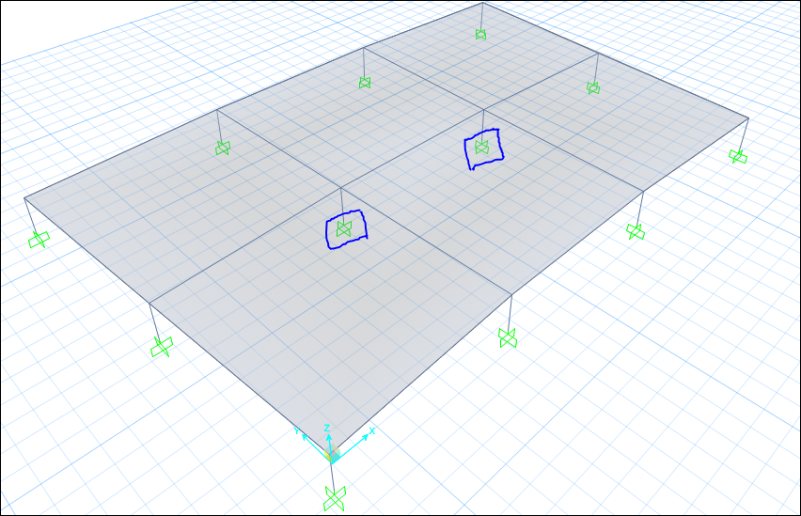

Seismic Design And Analysis
Final Design of footings
in operation of design of footing, the SAFE program is used.
P_{n} = 8500 KN
P_{u} = 10800 KN
A= $\frac{Pn}{σall}$ = $\frac{8500}{250}=$34 m²
so, take L = 6m, and B = 6m
Shear failure:
Punching Shear:
.$∅Vc= 0.75∗ \frac{1}{3}∗fc∗b∗d$
= 0.75 * (1/3) * 35 * ( 2 $π$ (1500+d))* d = 10800
then d= 900 mm

Slide 60
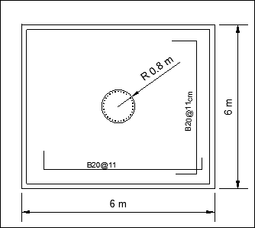
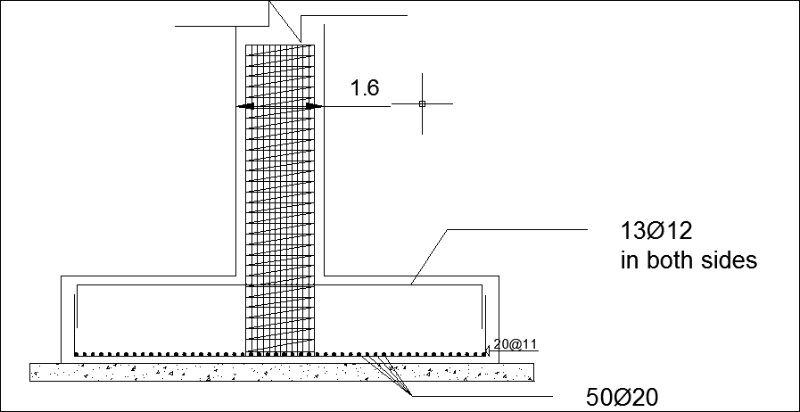
Seismic Design And Analysis
Final Design of footings(single)

Slide 61
Seismic Design And Analysis
Final Design of footings
 |  |  |  | reinforcement
 | B | L | Depth | parallel to B | parallel to L
F1 | 6 | 6 | 0.9 | 1φ20/11cm | 1φ20/11cm
F2 | 4.3 | 7 | 0.55 | 8φ16/m | 7φ25/m
F3 | 5 | 3.6 | 0.6 | 5φ25/m | 5φ25/m

Slide 62


Seismic Design And Analysis
Final Design of tie beams
M_{u}=2775.5 KN.m
ρ=0.0136
A_{s} = 7480 mm²
so use 10$∅$32
for shear reinforcement:
V_{u}=352.85 KN
$∅$V_{c} = 1.1 * 0.75 * $\frac{\sqrt{35}}{8}$ * 500 then $∅$V_{c} > V_{u}
(A_{v}/S)_{min} = (0.436 , 0.416)
use (A_{v}/S) = 0.436
A_{v} = 2 * 10 * ($π/4)$ = 157 so S = 360 mm

Slide 63
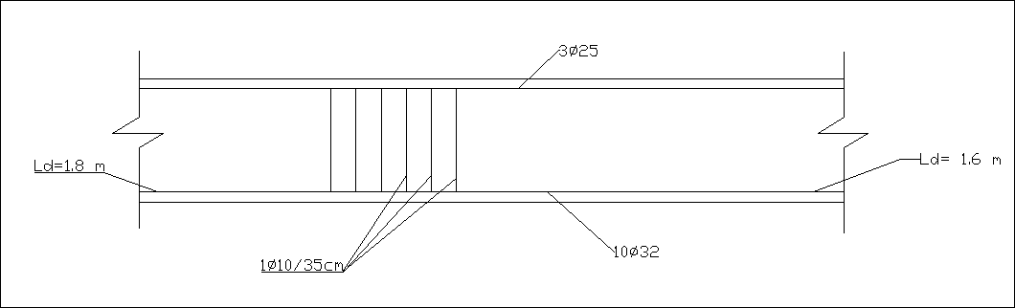
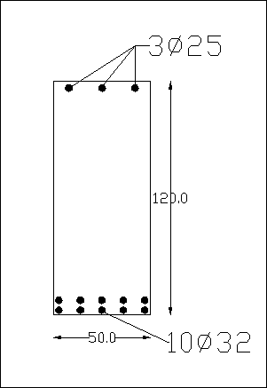
Seismic Design And Analysis
Final Design of tie beams

Slide 64


