Slide 1
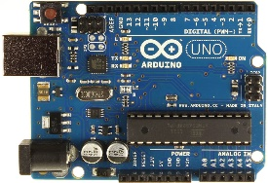
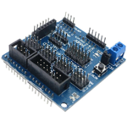
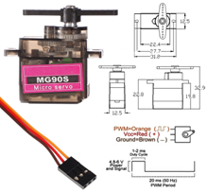
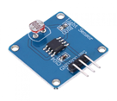
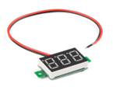
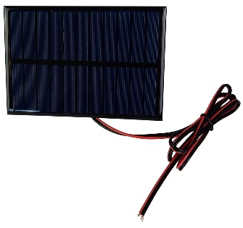
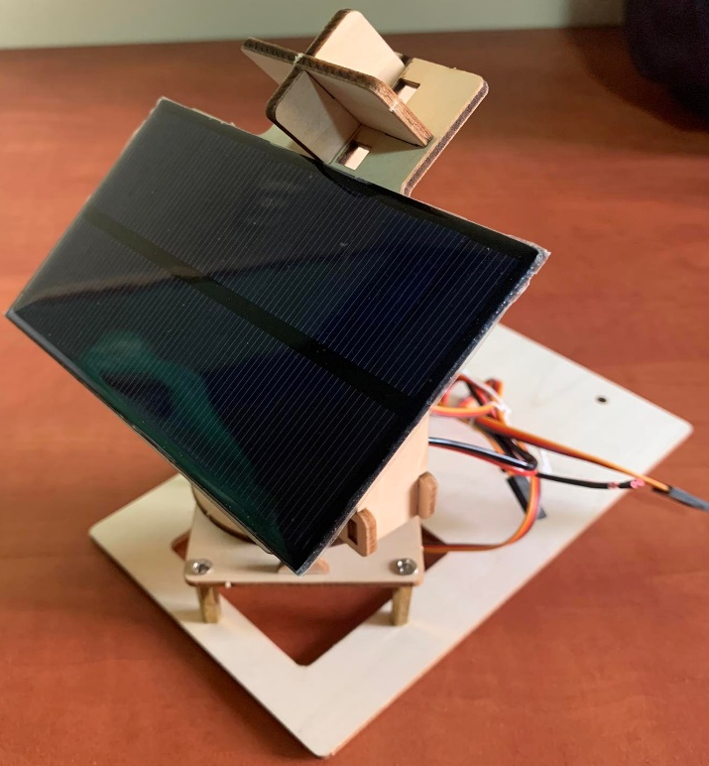
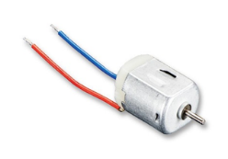
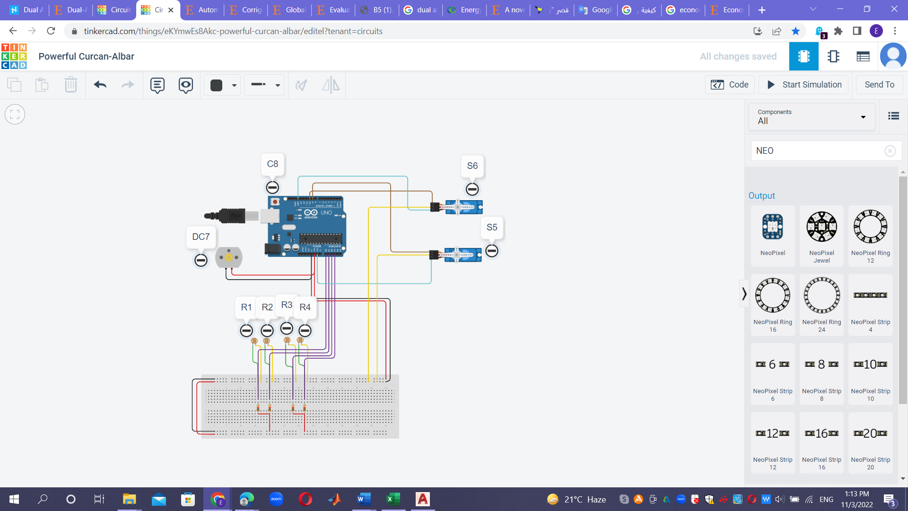
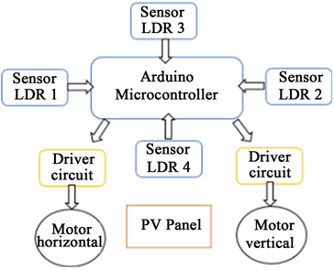
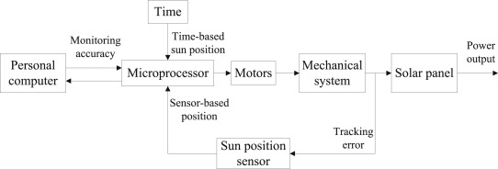
DUAL AXIS SOLAR TRACKER
PEMD 2023 – 23 – 1 January 2023
Objectives
A solar tracker is a system that follows the sun as it moves across the sky ; When paired with solar panels, the panels can follow the path of the sun and produce more renewable energy for you to use.
In this project, Dual Axis Solar Tracker, we've developed a demo model of solar tracker to track the maximum intensity point of light source so that the voltage given at that point by the solar panel is maximum. The dual-axis solar tracking system has greater efficiency than the single-axis system as well as the fixed system.
where this type of system is designed to increase the collection of solar energy throughout the year to rotate in all directionsand track the sun's rays to obtain and store the largest possible amount of sun ; Also, these trackers generate 45-50% higher power output per year, compared to a fixed plant of the same installed capacity.
How DOES DUAL AXIS SOLAR TRACKER WORK?
Components
When sunlight incident on the solar cells. it starts calculating and comparing that from which direction the maximum intensity sunlight is coming.
after comparing the panel above the system start to move toward the maximum intensity so that the solar panel has the maximum intensity and makes the maximum power. The proposed tracking system tracks sunlight more effectively by providing PV panel rotation along two different axis.
The tracker is composed of four LDR sensors, two stepper motors and PIC microcontroller. A pair of sensors and one motor is used to tilt the tracker in suns east-west direction and the other pair of Sensors and the motor which is fixed at the bottom of the tracker is used to tilt the tracker in the suns north-south direction. Two stepper motors are all in use in this system. Upper panel holder stepper motor tracks the sun linearly and base stepper motor tracks the parabolic displacement of the sun. These stepper motors and sensors are interfaced with a microcontroller. The microcontroller gives the command to the motors on the basis of sensors input. LDR sensors sense the light and sends signal to microcontroller.
and the other pair of sensors and the motor which is fixed at the bottom of the tracker is used to tilt the tracker in the suns north-south direction
These stepper motors and sensors are interfaced with a microcontroller. The microcontroller gives the command to the motors on the basis of sensors input. LDR sensors sense the light and sends signal to microcontroller.
Arduino Uno R3
Arduino Sensor Shield
2 x 9g Metal Gear Servos
LDR (resistance sensor)
Digital LED Voltmeter
Solar Panel
DC motor
The Project Model
Block diagram system
Hardware System
Figure 1 shows the block diagram of a dual axis solar tracker. 4 LDR sensors are placed adjacent to the solar panel and will be activated when light is detected. An activate signal will be sent to the microcontroller and when the signal is received, the Arduino microcontroller will trigger the 2 drivers and activate the 2 motors.
The sun tracking system is designed in Tinker cad online environment which is shown in Figure :
The Best Results
Methodology Work
After designing and implementing a prototype solar tracker for Tubas Turkish Governmental Hospital, we also discussed the economic study, we adopted the methodology of the project to calculate the solar radiation as well as the power calculations for all months of the year.
And also one of the contributions of this paper is to present the engineering economics analysis related to the project investment proposal IRR (0.60% < market interest rate 5.57%), NPV (less than zero). These results show that the project (i.e. the installation of a photoelectric biaxial tracking system) is not economically justified. However, installing this photovoltaic system may be a good decision for other important reasons such as academic, environmental, societal and political. The system is most useful for academic purposes through the solar system.
The electricity cost of electricity will increase by 10% every year, the interest rate is 5.57%, and the panel efficiency will be reduced by 3% every year.
Control method of normal tracking :
As is shown in Fig , the microprocessor can calculate the sun's position based on the solar time.
Besides, the microprocessor can also receive signals from the sun position sensor. The motors for the primary axis and the secondary axis are controlled by the microprocessor, which realizes the motion of the mechanical system. The personal computer is connected to the microprocessor to monitor the tracking accuracy in real-time.
Conclusion
In this paper, all the objectives have been achieved which are, firstly, to design a model of dual axis solar tracker by using software. The design has been showed and
analyzed. Secondly, to program the micro-controller on Arduino (ATmega328p) so that rotation of DC motor can be controlled by microcontroller and H-bridge. The
programming part consists of 5 cases which has been stated and analyzed. Thirdly, to investigate the voltage differences from the sensor (light depending resistor LDR)
based on intensity of light received by the sensor. The output has been plotted into a graph and has been analyzed.
After that, we conducted an economic feasibility study to design a Dual axis solar tracker system for Tubas Turkish Hospital. After doing the study, we interpreted the
results and summarized the work.

