Slide 1


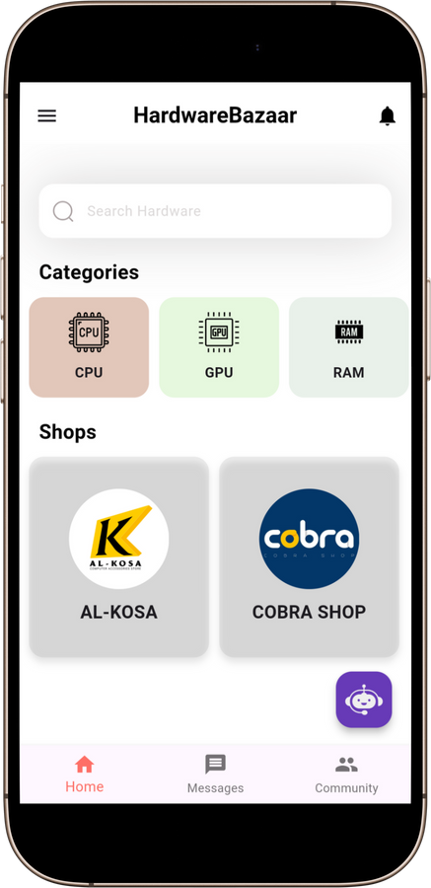
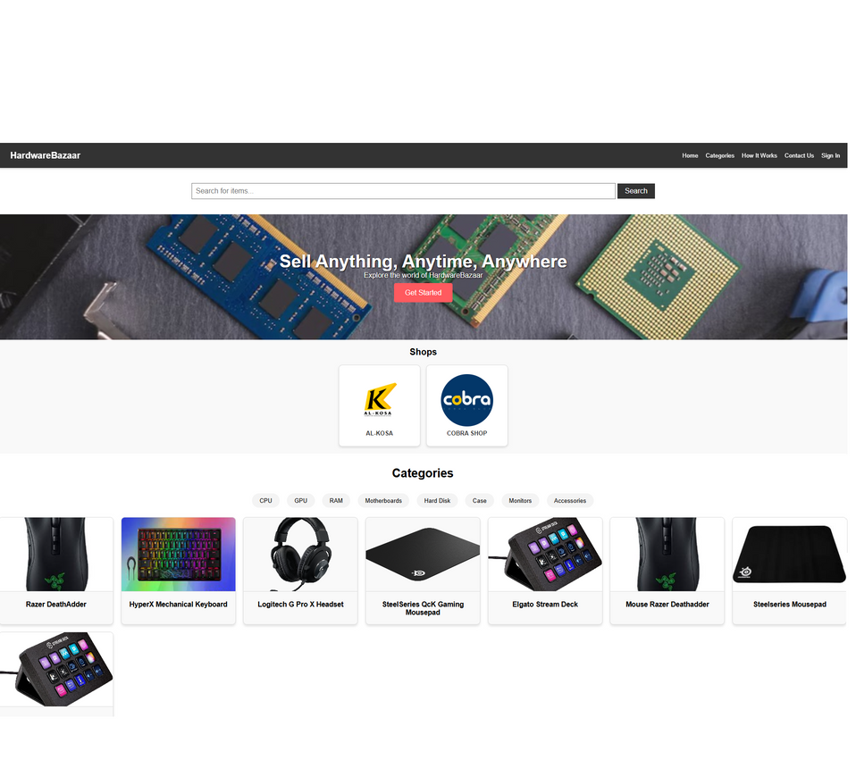
HardwareBazaar
Home
Service
About Us
Contact
HardwareBazaar

Slide 2
HardwareBazaar
Home
Service
About Us
Contact
Table Of
Content
1
Intoduction
4
Future Work
2
Motivation, Goals, and Objectives
5
Constraints
3
6
Demo
Project Details

Slide 3

HardwareBazaar
Home
Service
About Us
Contact
Introduction
HardwareBazaar is a revolutionary platform for buying and selling hardware components such as RAMs, CPUs, and GPUs. It promotes environmental sustainability by encouraging reuse and reducing electronic waste.
The platform encourages the reuse of hardware components, extending their lifecycle and reducing electronic waste. By supporting a circular economy and encouraging thoughtful, responsible use of resources

Slide 4

HardwareBazaar
Home
Service
About Us
Contact
Motivations
Due to the fragmented market and lack of
trustworthy platforms, HardwareBazaar aims
to provide a unified, secure, and user-friendly
solution tailored for hardware enthusiasts and businesses.

Slide 5
HardwareBazaar
Home
Service
About Us
Contact
Goals And Objectives
Build a platform where people can easily find or sell the hardware they need, all in one safe and convenient place.
Encourage people to reuse hardware instead of throwing it away, reducing electronic waste and supporting a more sustainable future.
1
2
Create a vibrant community where users can chat, share advice, and get help with building their dream setups using tools like the Virtual Build Assistant.
Ensure every interaction is secure, from verifying users to offering trusted payment methods, so people can buy and sell with confidence.
3
4

Slide 6
HardwareBazaar
Home
Service
About Us
Contact
Project Details
1
Programming Languages and Tools.
2
User Side and Admin Side.
  Guest User
  Logged User
  Shop Owner
3
Features.

Slide 7

HardwareBazaar
Home
Service
About Us
Contact
Programming Languages and Tools
BACKEND
Node.js & Express
Flutter, HTML, CSS & JS
FRONTEND
DATABASE
MongoDB
Firebase
Real-Time Features
External APIs
OpenCage, OpenAI

Slide 8





HardwareBazaar
Home
Service
About Us
Contact
Application Features
1
ByteBuddy
2
Real-Time Chat
3
Community
4
Own a Shop

Slide 9
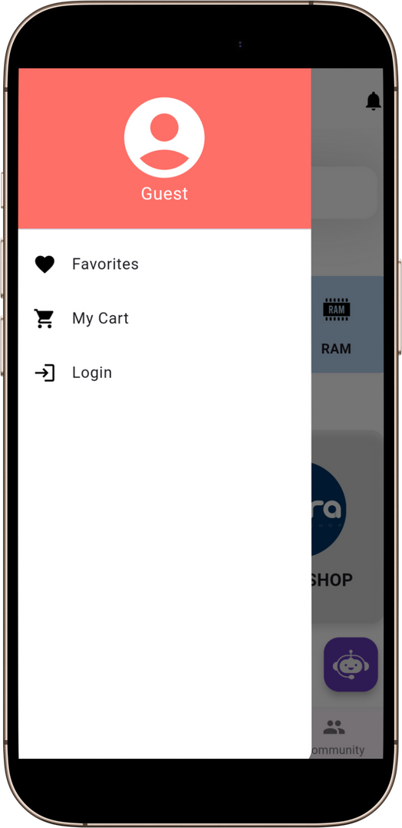

HardwareBazaar
Home
Service
About Us
Contact
Menu Display
1
Guest User
2
Logged User

Slide 10
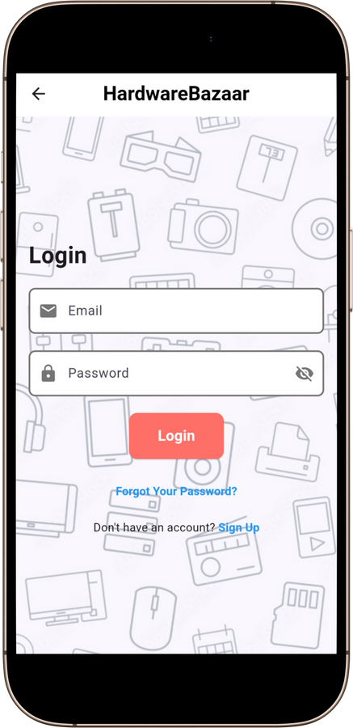
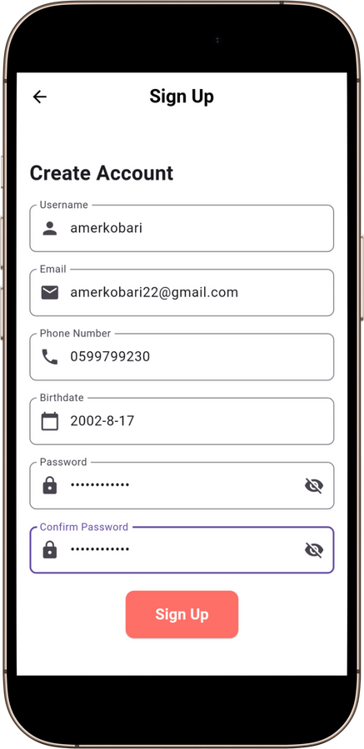
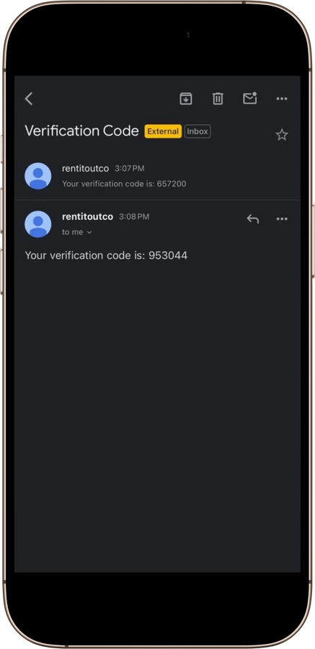
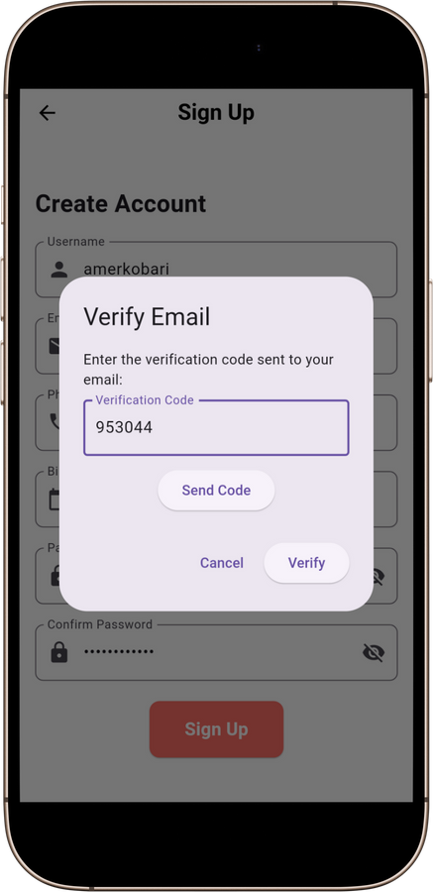
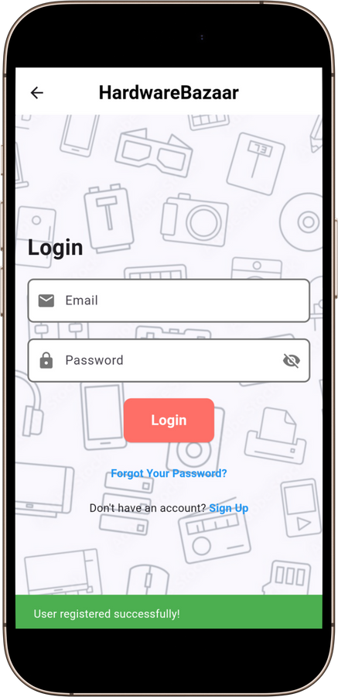
HardwareBazaar
Home
Service
About Us
Contact
SignUp Process

Slide 11
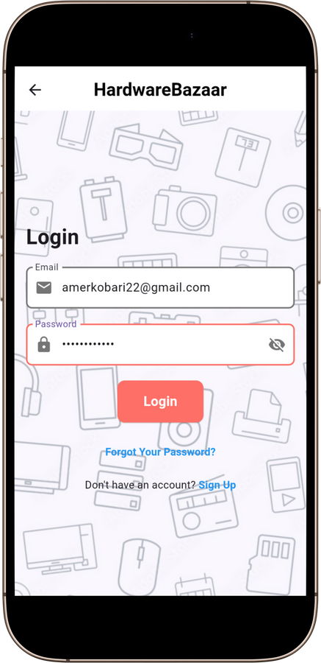
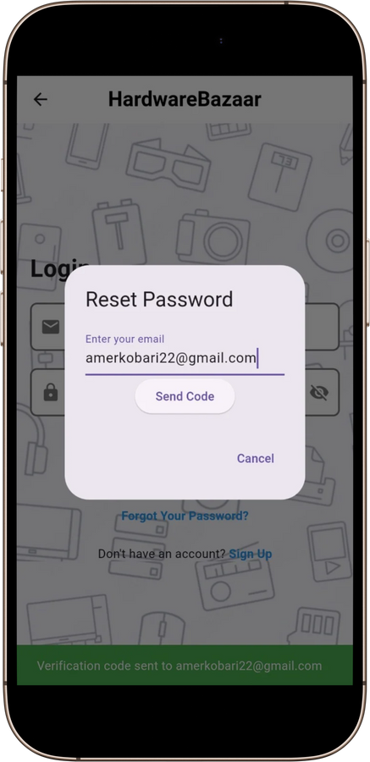
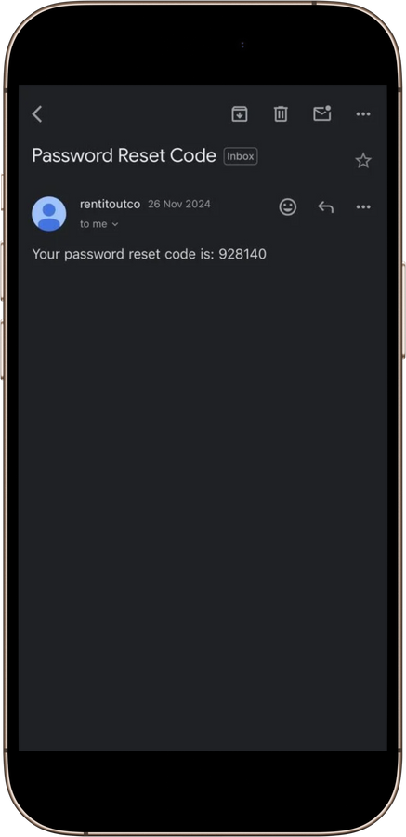
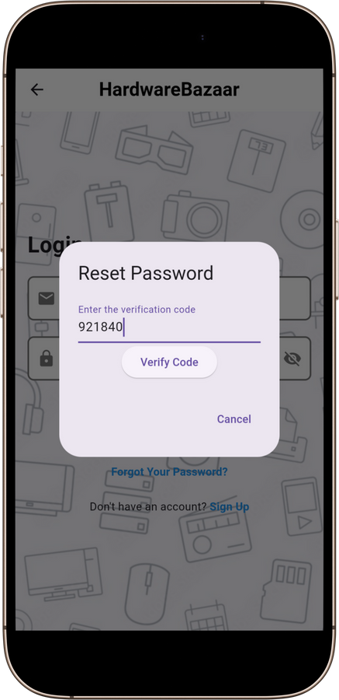
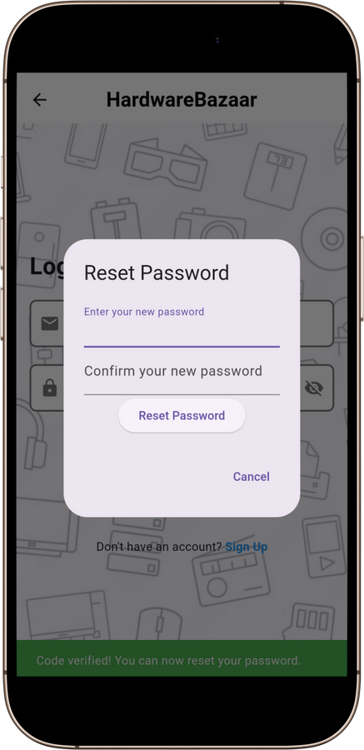
HardwareBazaar
Home
Service
About Us
Contact
Login Process

Slide 12
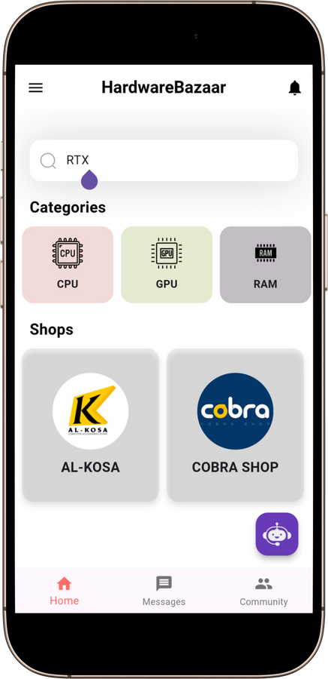
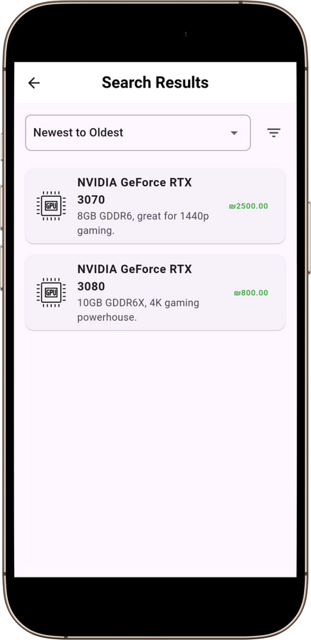
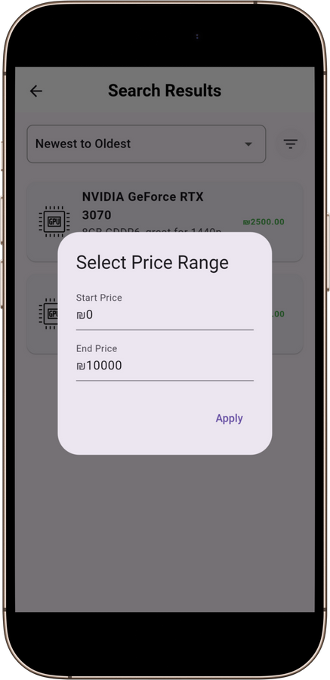
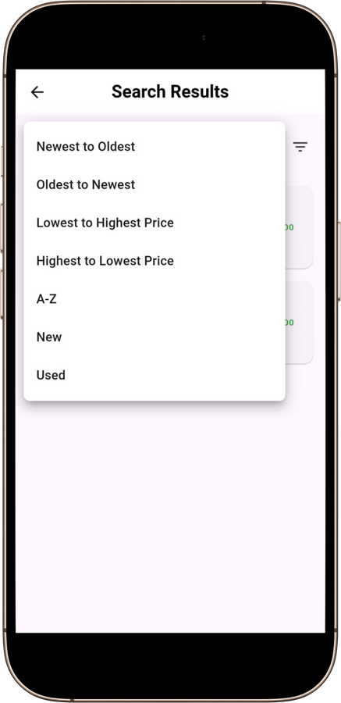
HardwareBazaar
Home
Service
About Us
Contact
Home Features

Slide 13
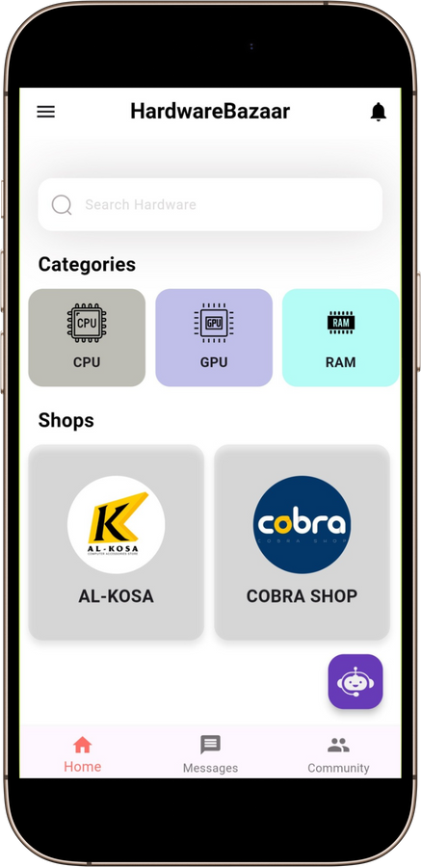
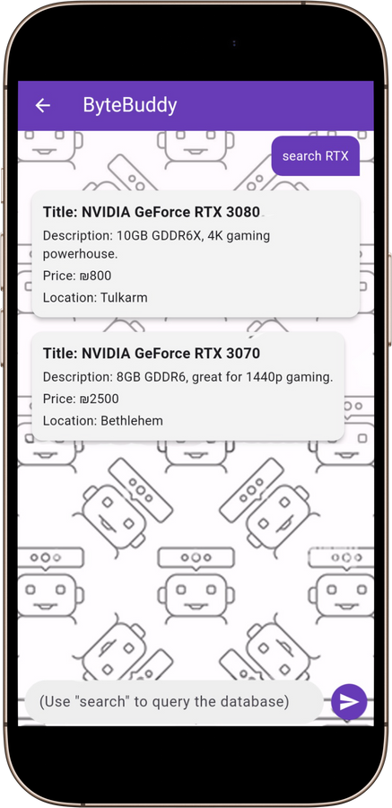
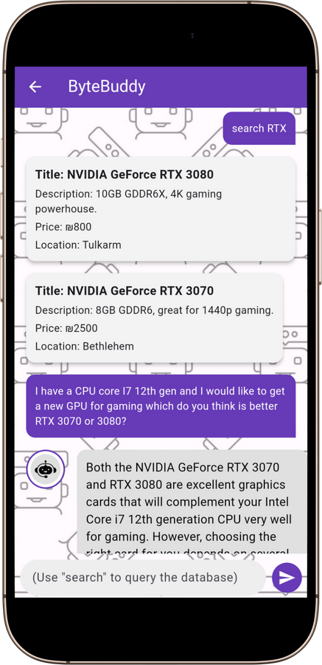
HardwareBazaar
Home
Service
About Us
Contact
ByteBuddy

Slide 14
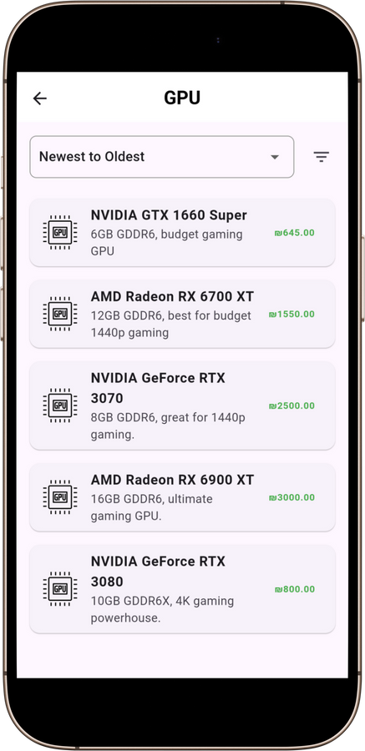
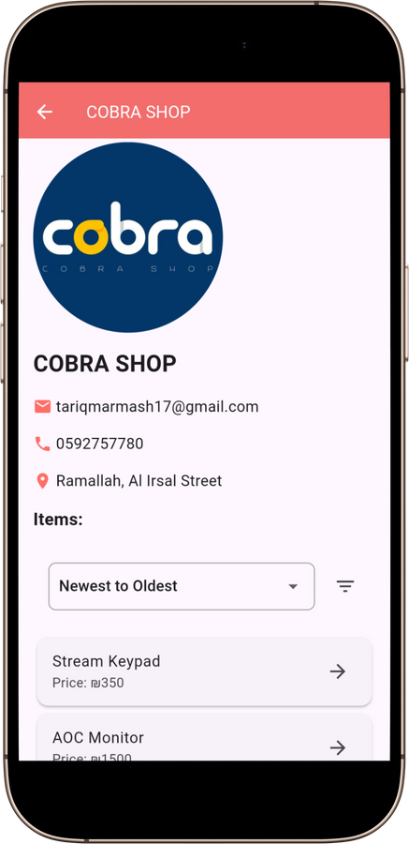
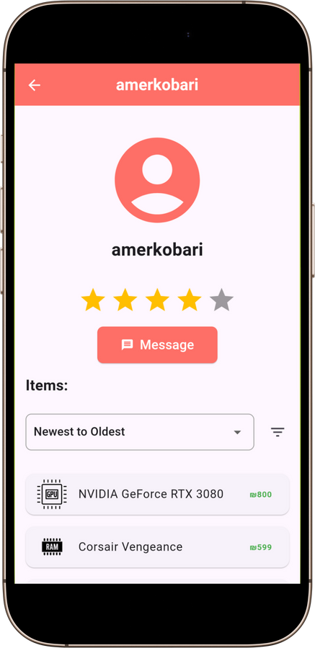
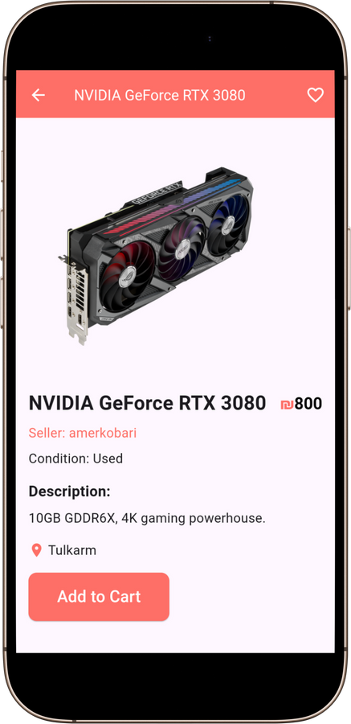
HardwareBazaar
Home
Service
About Us
Contact
Item Features

Slide 15
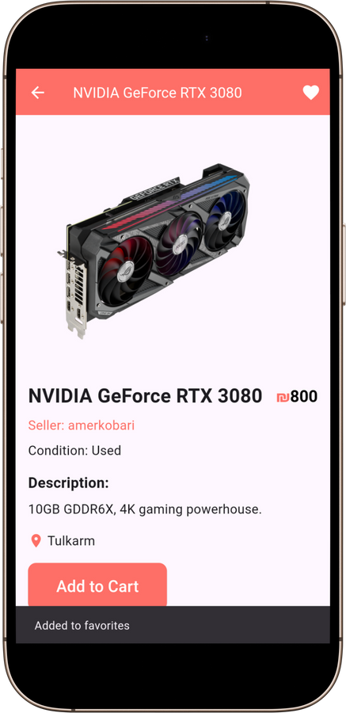

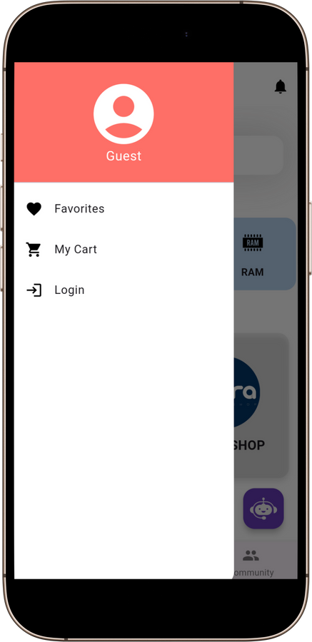
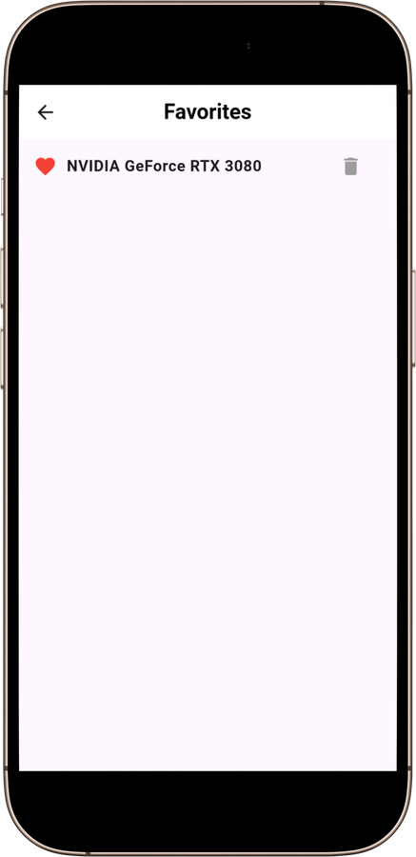
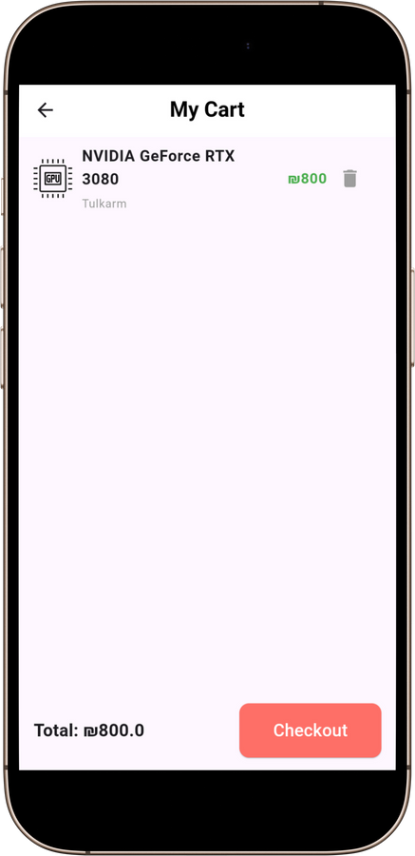
HardwareBazaar
Home
Service
About Us
Contact
Cart & Favorite

Slide 16
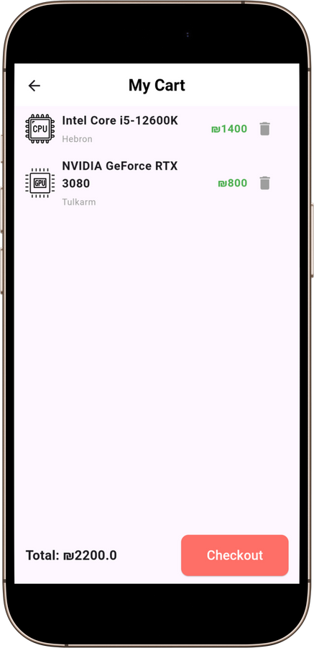
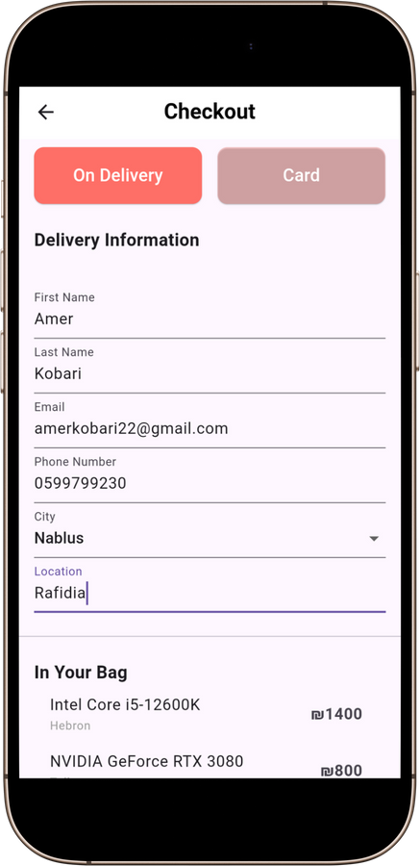
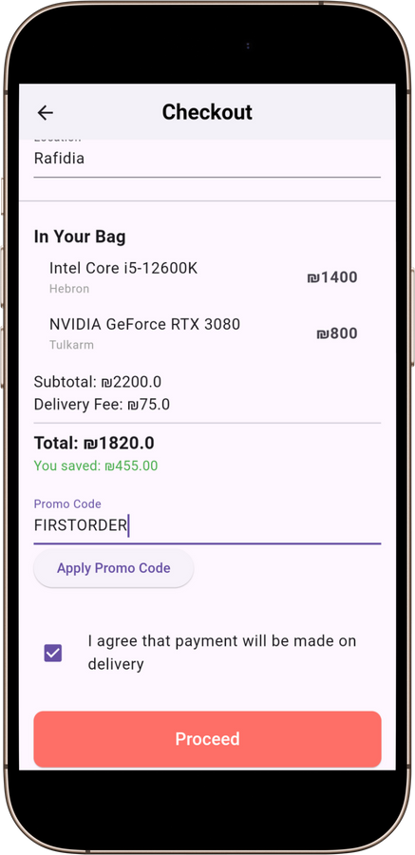
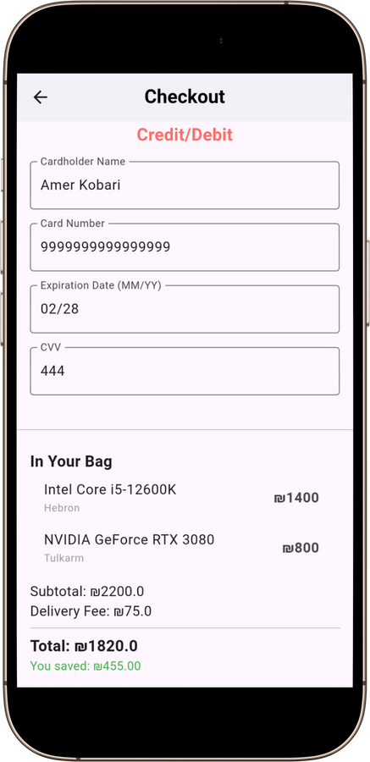
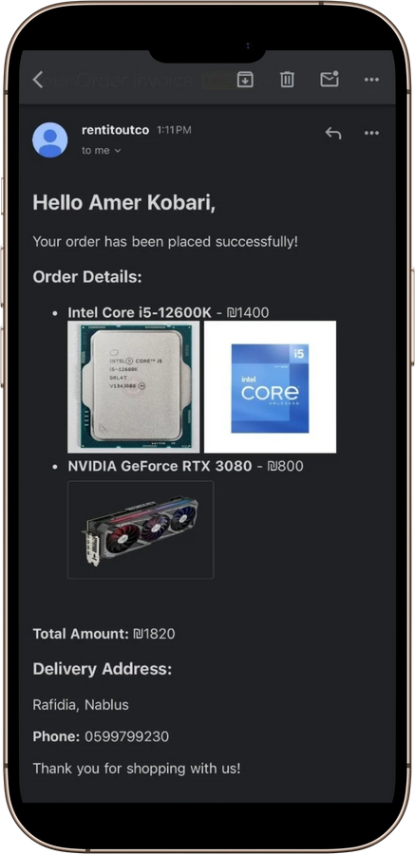
HardwareBazaar
Home
Service
About Us
Contact
Checkout Process

Slide 17

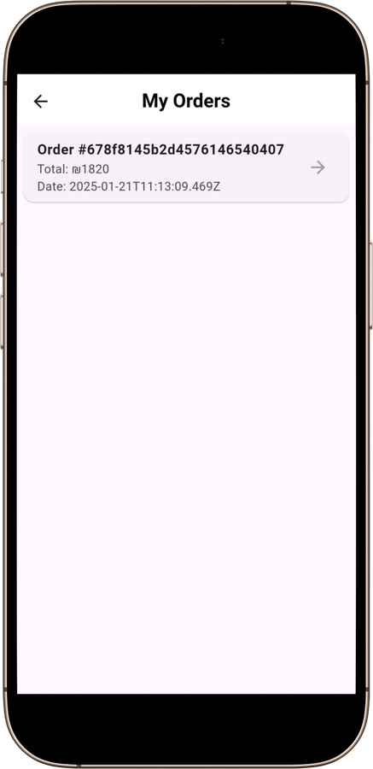
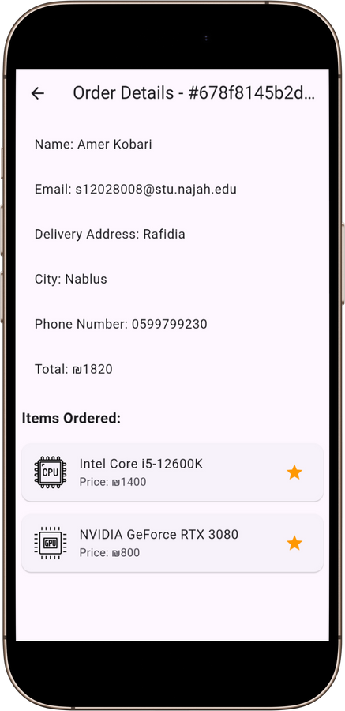
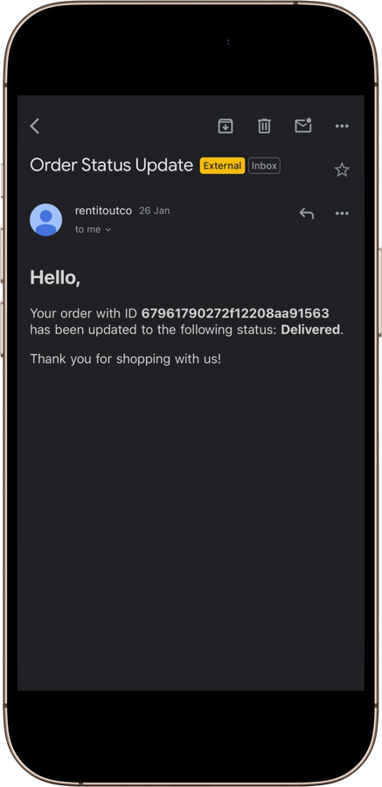
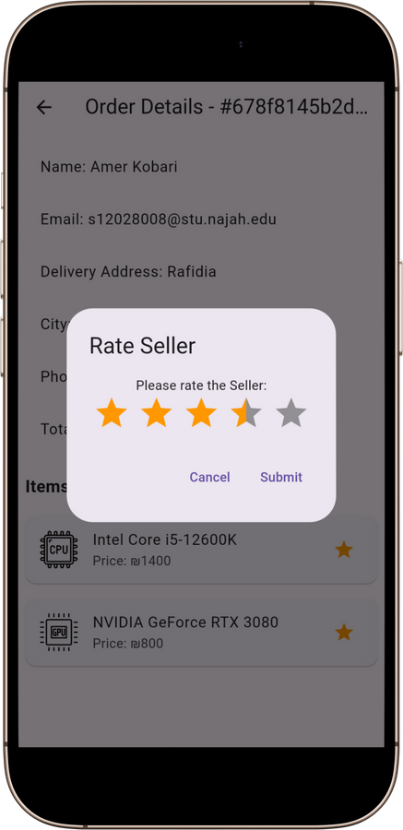
HardwareBazaar
Home
Service
About Us
Contact
Orders & Rating

Slide 18
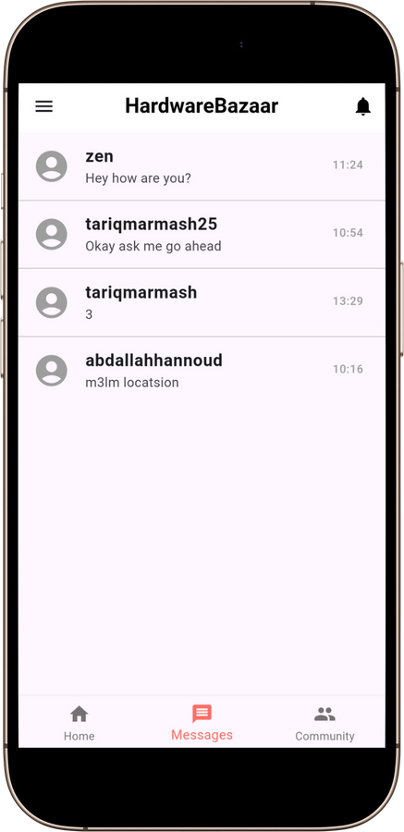
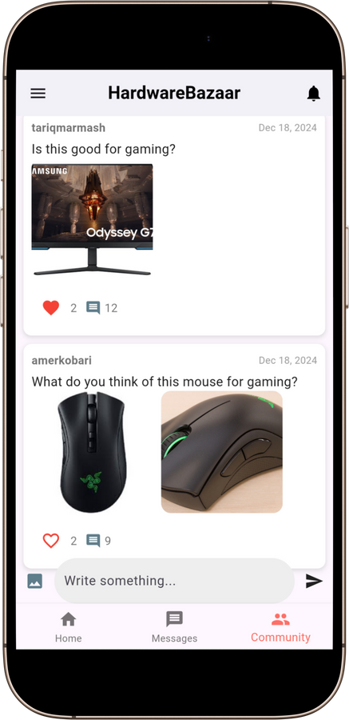
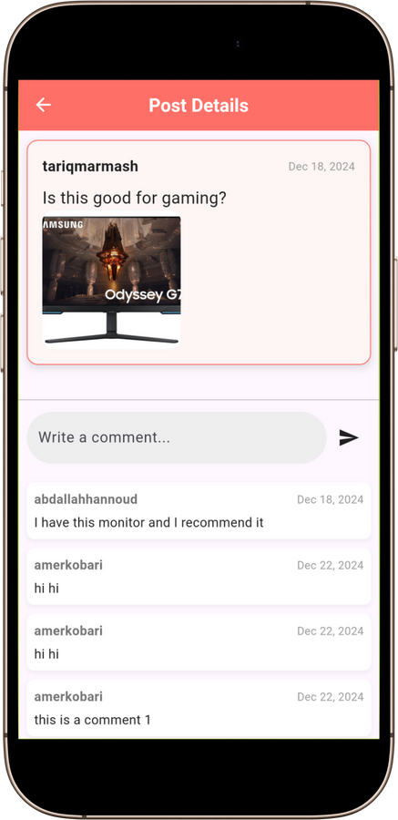
HardwareBazaar
Home
Service
About Us
Contact
Real-Time Features

Slide 19
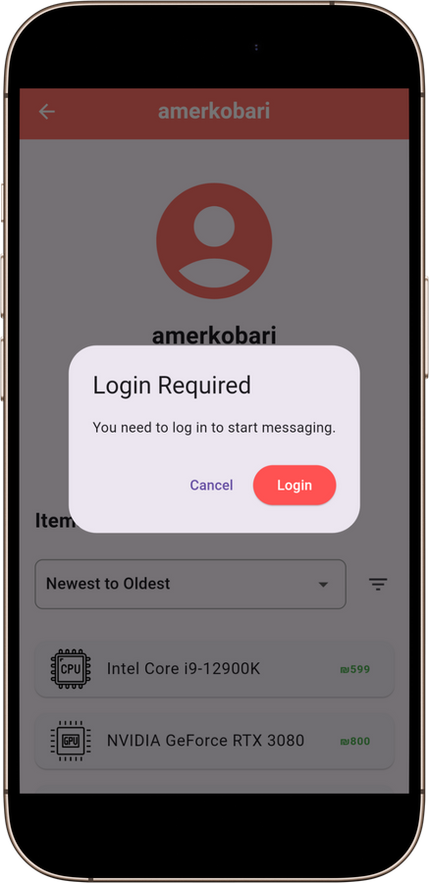
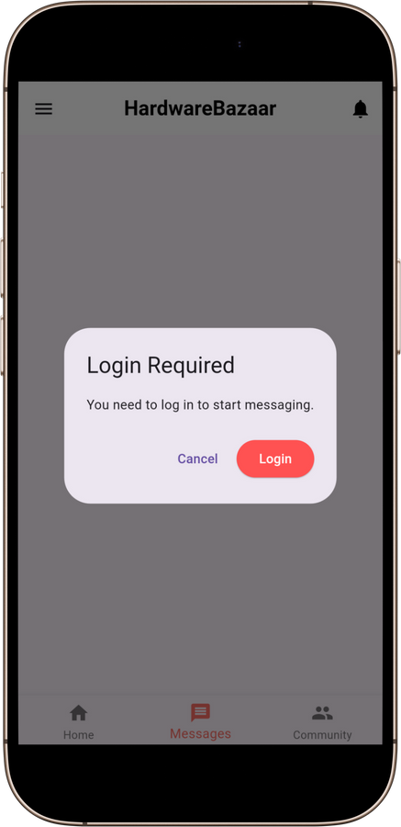
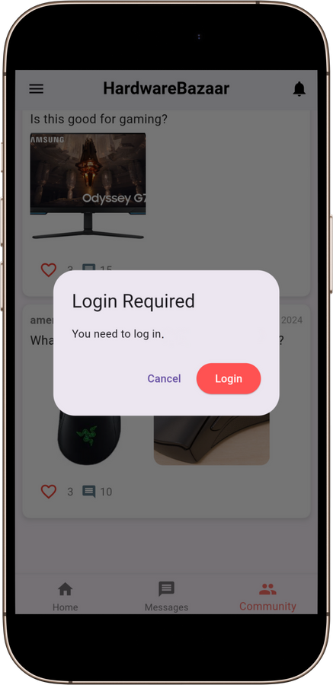
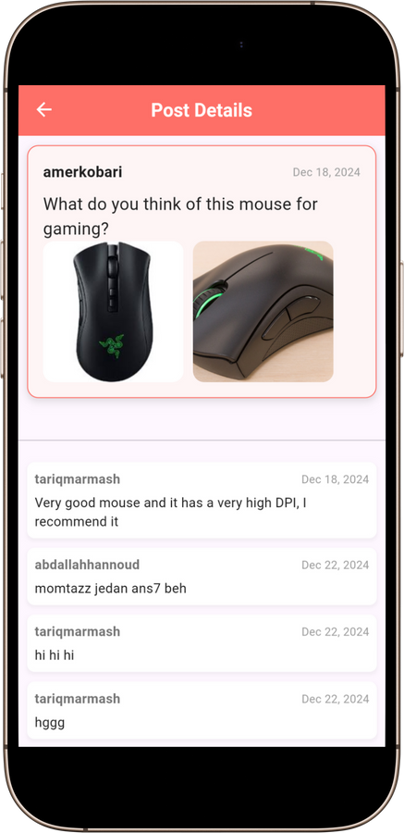
HardwareBazaar
Home
Service
About Us
Contact
Real-Time Features

Slide 20
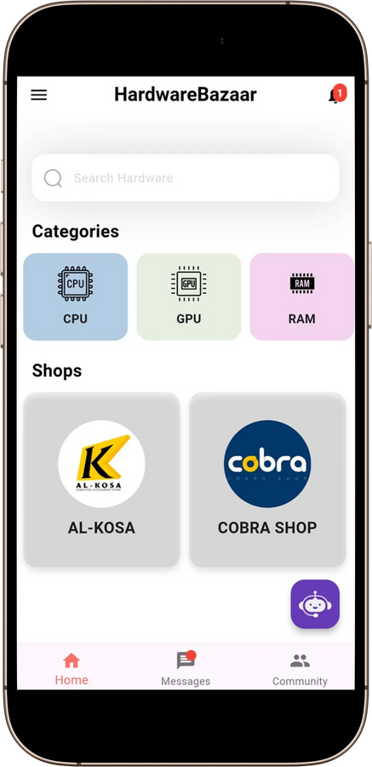
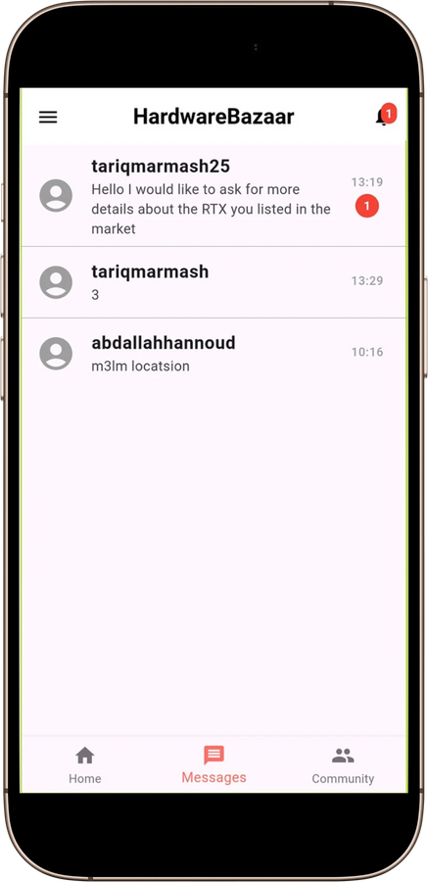
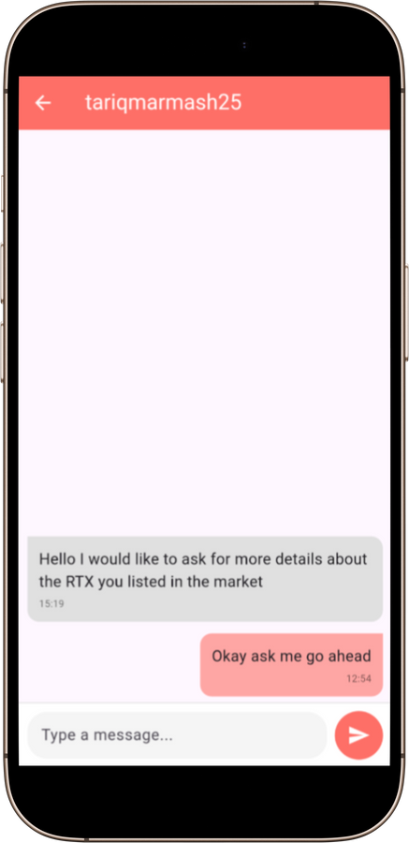
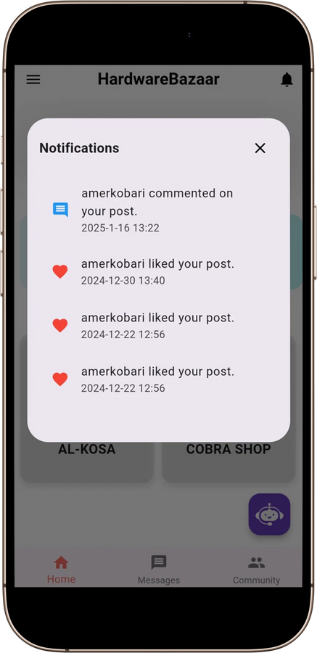
HardwareBazaar
Home
Service
About Us
Contact
Notifications Feature

Slide 21
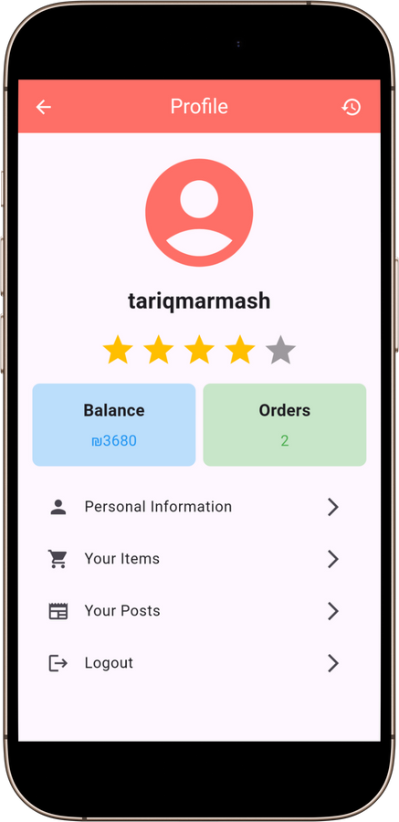
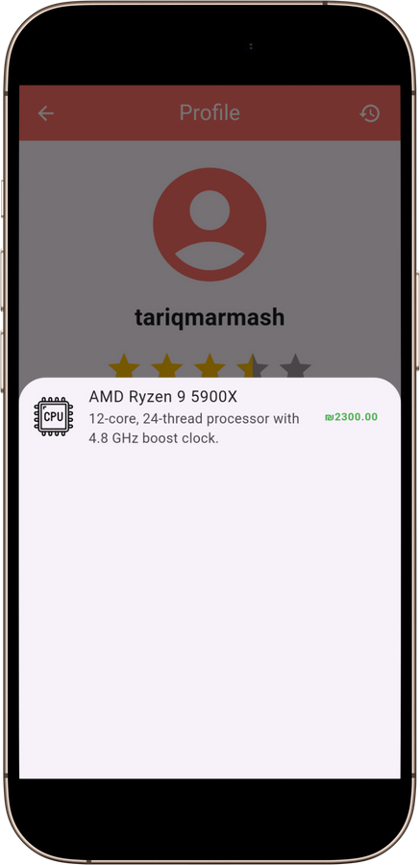



HardwareBazaar
Home
Service
About Us
Contact
User’s Profile

Slide 22




HardwareBazaar
Home
Service
About Us
Contact
Add new Item

Slide 23




HardwareBazaar
Home
Service
About Us
Contact
Request a new Shop

Slide 24



HardwareBazaar
Home
Service
About Us
Contact
User’s Shop

Slide 25

HardwareBazaar
Home
Service
About Us
Contact
Website Home Page

Slide 26


HardwareBazaar
Home
Service
About Us
Contact
Shops

Slide 27


HardwareBazaar
Home
Service
About Us
Contact
Login & SignUp

Slide 28


HardwareBazaar
Home
Service
About Us
Contact
Admin Confirmation & details

Slide 29


HardwareBazaar
Home
Service
About Us
Contact
Order Tracking & Statistics

Slide 30


HardwareBazaar
Home
Service
About Us
Contact
Statistics & Orders

Slide 31


HardwareBazaar
Home
Service
About Us
Contact
Order Details

Slide 32
HardwareBazaar
Home
Service
About Us
Contact
Future Work
1
Introduce AI-driven personalized recommendations.
2
Add AR for component visualization.
3
Integrate third-party logistics for real-time delivery tracking.
4
Gamification features to enhance user engagement.

Slide 33
HardwareBazaar
Home
Service
About Us
Contact
Constraints
1
Integration of external services
2
Resource Limitations
3
Time Constraint

Slide 34

HardwareBazaar
Home
Service
About Us
Contact
DEMO
Now Let’s watch the
application demo...

Slide 35

HardwareBazaar
Home
Service
About Us
Contact
Thank You
Any Questions?

