Slide 1

Model for distillation tire pyrolysis oil

Slide 2
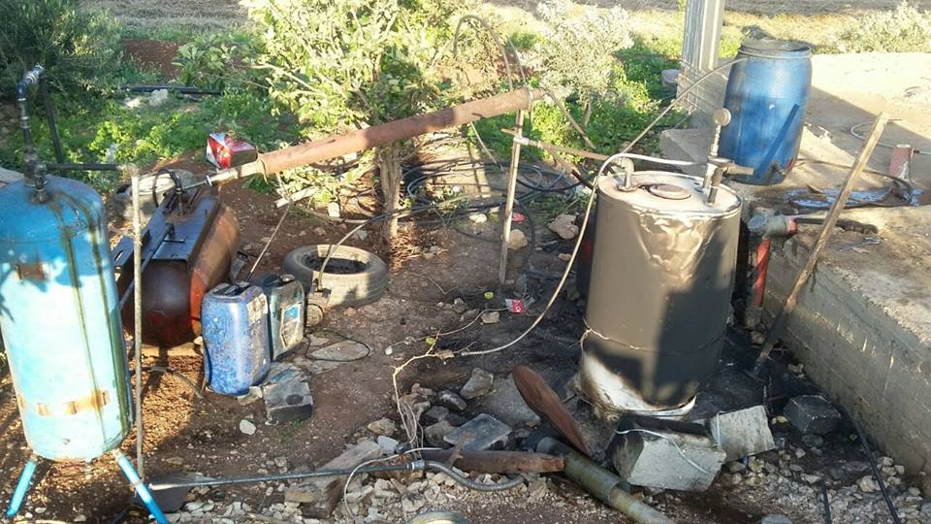

Slide 3
Titles to cover the topic:
Tire pyrolysis oil definition.
The goal of the project.
Model components.
Result & Conclusions.

Slide 4
Definition of tire pyrolysis oil :
Tire pyrolysis oil is crude oil produce from burning tires this oil contains many components and our project modification this crude oil to make it more efficiency by distillation .

Slide 5
Objectives
The main objective was build a system like prototype but in bigger form, this bigger form allowed us to use much amount of crude oil to produce acceptable amount of diesel.

Slide 6
components of treatment system
We will talk about components of our treatment system, and explain the importance of every component for the system.

Slide 7
components of treatment system
The components as following:
1- burn furnace
2- double tube heat exchanger
3- Pumps and pipe size

Slide 8
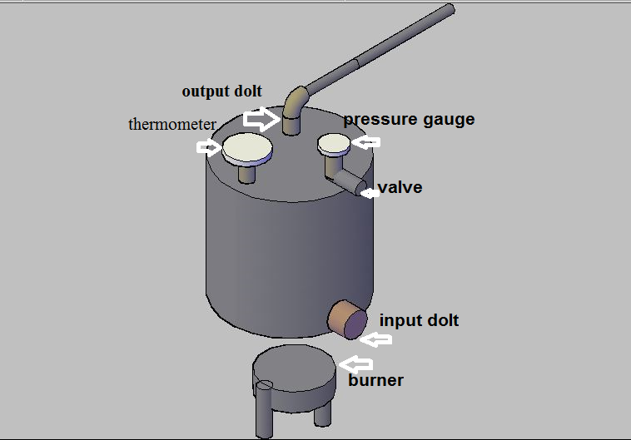
burn furnace

Slide 9
Components of burn furnace
1- isolated tank.
2- burners.
3- input dolt
4- thermometer.
5- pressure gauge.
6- valve.
7- output dolt.

Slide 10
Process of burn furnace
1- adding the crude oil through the input dolt to inside the furnace.
2- closing the input dolt.
3- checking and making sure that all the components in good situation.
4- running the burners.
5- wait few minutes, the crude oil start changing from liquid to gas
6- the gas start leaving the furnace the output dolt.

Slide 11

Double tube heat exchanger :
At the firs we have two method for flow
counter flow
parallel flow
we calculate logarithmic mean temperature difference ΔTlm to decide any type will be use
From this equation
ΔTlm for parallel = 34.73
ΔTlm for counter =42.68

Slide 12
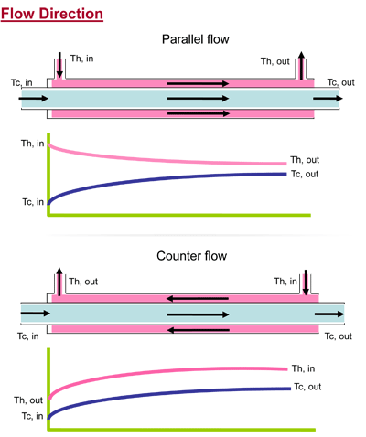

Slide 13
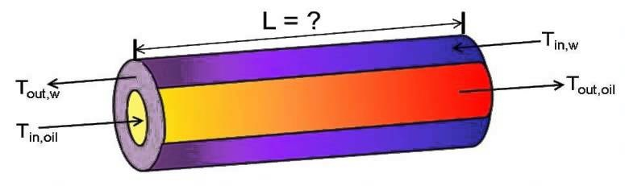
Design for double tube heat exchanger
TIn,steam

Slide 14

Calculate heat transfer rate
= 28043.1 watt
Calculate over all heat transfer U = 2244.06
And ΔTlm = 42.68
from this equations calculate L :
= 1.864m we use 2m

Slide 15
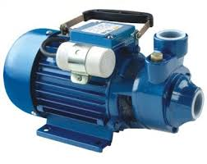
Pumps and pipe size

Slide 16
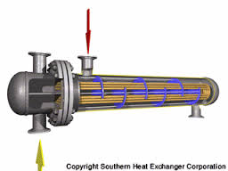
We take the flow rate from The largest quantity of fuel that distilled. It's a diesel.
**Refrigeration fluide is water

Slide 17
calculation
Q=m*cp*(Ti-To)
M=Q/(cp*ΔT)
Power=Q*Δp
Δp= γ*Δh
m(fule)=100L/h
m(fule)=0.03kg/s
Q(fule)=m*hfg
=0.03*851.17=25.6251kw

Slide 18
Qwater=Qfule=25.6251kw
Qwater=m(water)*cp* ΔT
25625=m*4180*25
M=0.245L/s
Assume Δp/L=350Pa/m
pipe size=25mm
Δp=350*15*1.5=7875pa
Power= Q*Δp
=0.245*10^-3*7875=2.588*10^-3 hp

Slide 19
Results
Pump used (1/2)hp to pump water from the tank to the heat exchanger and a(1)hp pump for pumping fuel from the fuel tank to tank interaction.
The pump type is (Speroni)made in Italy.Qmax(5.35L/min) and max capacity is 0.37 KW.

Slide 20

Engineering solution

Slide 21
Introduction :
After doing the process of distillation and take out the liquid oil of all kinds at different temperatures
there is the amount of raw materials does not happen on its distillation at high temperatures
almost natural gas.

Slide 22
Procedure :
the distillation process exit gasoline and diesel in different temperature.
produces natural gas similarities distillation which do not happen at high temperatures.
It is transferred to the storage tank that size 100 liters.
and filled with almost two-thirds of its volume with water to prevent ignition and explosion inside the tank when the use of gas in the ignition process.
transported by pipeline to the gas burner and we using Centrifugal fan to make good and complete ignition

Slide 23
Result :
Thus the combustion process is completed quantity subjectively and use the resulting gas after all concocted
the process is self-ignition rather than the use of wood and burner

Slide 24
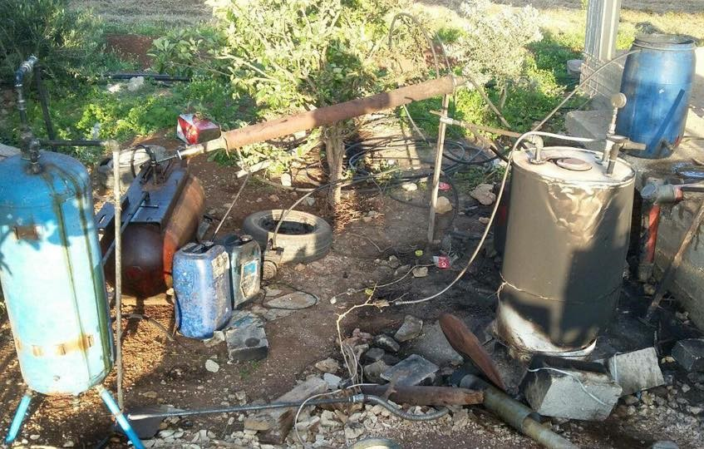

Slide 25
  Results and discussions

Slide 26
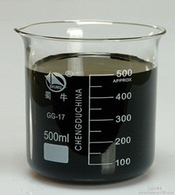
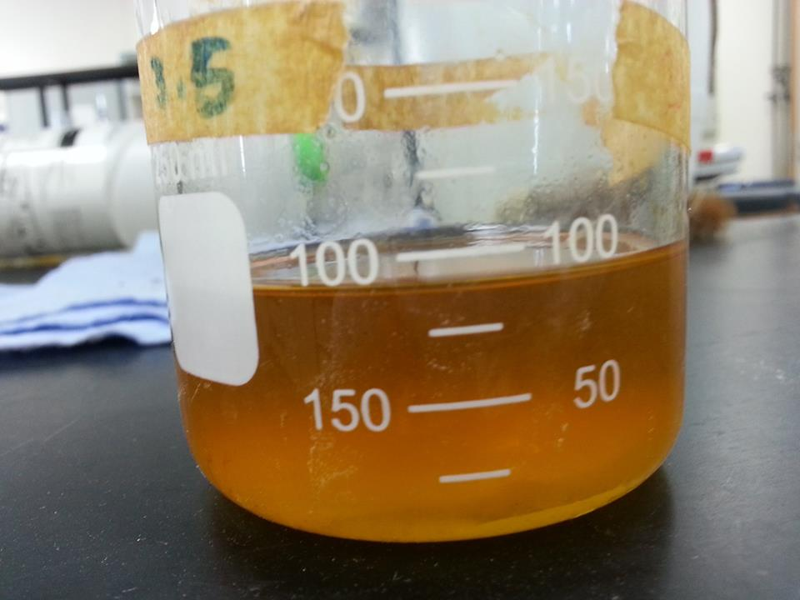
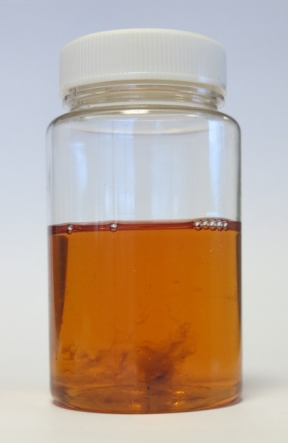
Results and discussions
Sample No. 1 : 10% of 500 mL where distillated
Crude TPO sample
Distillated TPO sample
Diesel sample

Slide 27
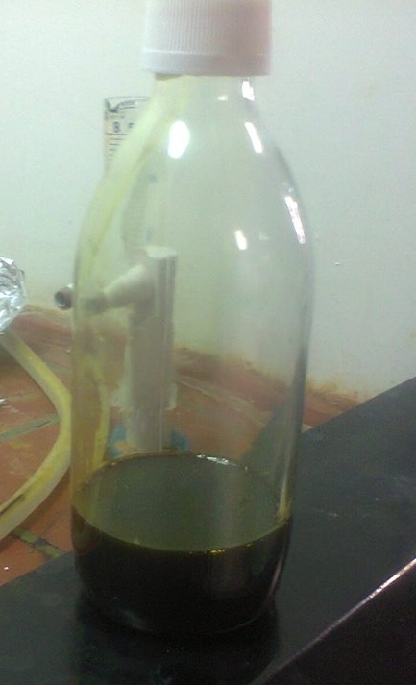
Results and discussions
Sample No. 2 : 70 mL of TPO were all distillated
Needs desulfurization before the distillation process
Crude TPO sample
Distillated TPO sample
Diesel sample

Slide 28
Sr. No. | Test | Method Of Testing | Result
1 | Density at @150 C | ASTM D 4052:2002 | 0.7930 gm/ml
2 | Acidity (mg KOH/gm) | ASTM D 974:2002 | 0.76
3 | API Gravity @ 600 F | ASTM D 1298:1999 | 46.67
4 | Flash Point COC | ASTM D 92-05a | <400 C
5 | Kinematic viscosity @ 400 C | ASTM D 445:2005 | 2.149 mm2/s
6 | Color | ASTM D 1500:2004a | D 8
7 | Conradson Carbon residue | ASTM D 189:2005 | 0.010% (wt)
8 | Asphaltine content | ASTM D 3279:2001 | 0.21% (wt)

Slide 29
9 | Ash Content | ASTM D 482:2003 | < 0.01% (wt)
10 | Calculated carbon aromatic index | ISO 8217 :1996 | 763.4
11 | Pour Point | ASTM D 97-05a | - 40 C
12 | Sediment by extraction | ASTM D 473:2002 | 0.012 (wt)
13 | Specific gravity @ 150 C | ASTM D 4052:2002 | 0.7932
14 | Sulphur content | ASTM D 4094:2003 | 75 ppm
15 | Water by distillation | ASTM D 95-05el | < 0.05% (vol)
16 | Colorific value | ASTM D 240 cal/g | 10000

Slide 30
17 | Distillation range | ASTM D 86:04 b
 | Initial boiling point |  | 71°C
 | 05% Recovery |  | 110°C
 | 10% Recovery |  | 141°C
 | 20% Recovery |  | 185°C
 | 30% Recovery |  | 226°C
 | 40% Recovery |  | 261°C
 | 50% Recovery |  | 291°C
 | 60% Recovery |  | 319°C
 | 70% Recovery |  | 343°C
 | 80% Recovery |  | 365°C
 | 85% Recovery |  | 380°C

Slide 31
Conclusion

Slide 32
Thank You

