Slide 1
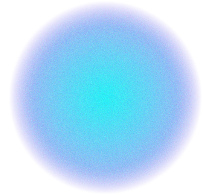

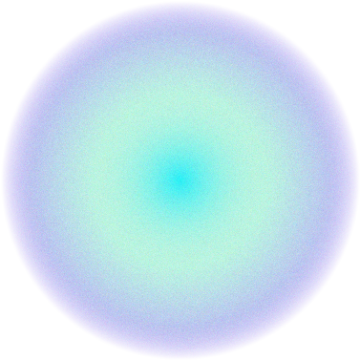
Production and Characterization of Nanocomposites composed of Polyvinyl alcohol and synthesized silver nanoparticles
Graduation project 2
Prepared by:
Abeer Bsharat Shahed Salameh Sondos Soboh
Supervisor :
Dr.Shadi Sawalha

Slide 2
Table of contents
01
03
04
Introduction
Opjectiv
Methodology
05
06
07
Charactaresation
Results
Conclusions
02
Problem statement

Slide 3
01
Introduction

Slide 4
Nanotechnology
Nanotechnology explores unique material interactions on a nanoscale (1-100 nanometers),offering diverse possibilities. Nanocomposites, integrating particles of varying scales into matrices, excel in mechanical and electrical enhancements, contributing to modern technological advancements.

Slide 5
02
Problem statement

Slide 6
Synthesizing silver nanoparticles faces challenges in achieving precise control over size and shape, and most manufacturing methods require a long time. They also face challenges related to toxicity, stability, and chemical reactivity. In addition to several problems with its properties .
PVA properties like thermal ,electrical, and other properties are not sufficient to use them for applications.
Some food packages are not resistant to bacteria. It causes contamination of food with bacteria.

Slide 7
03
Opjective

Slide 8
Synthesis of Ag-NPs using rapid method (microwave assisted method).
Studying the effect of the power on Ag-NPs properties like optical, electrical properties.
Enhance a properties of PVA films properties such as electrical, thermal and anti-microbial.

Slide 9
04
Methodology

Slide 10
Material
Silver Nitrate (AgNO3)
Polyvinylpyrrolidone (PVP)
Ethylene glycol
Polyvinyl alcohol (PVA)
distilled water

Slide 11

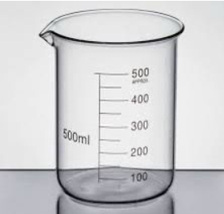
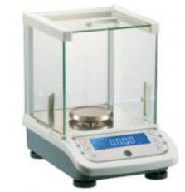
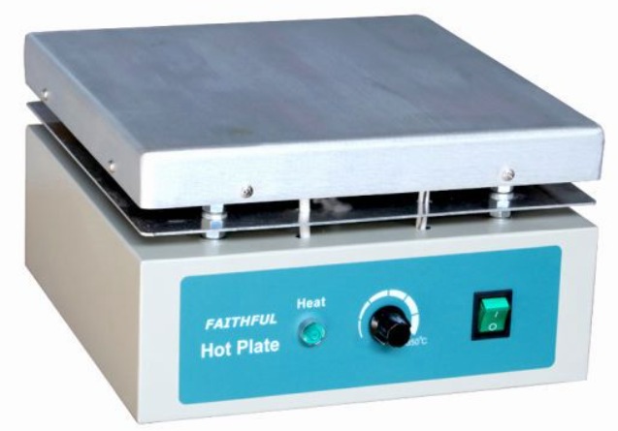
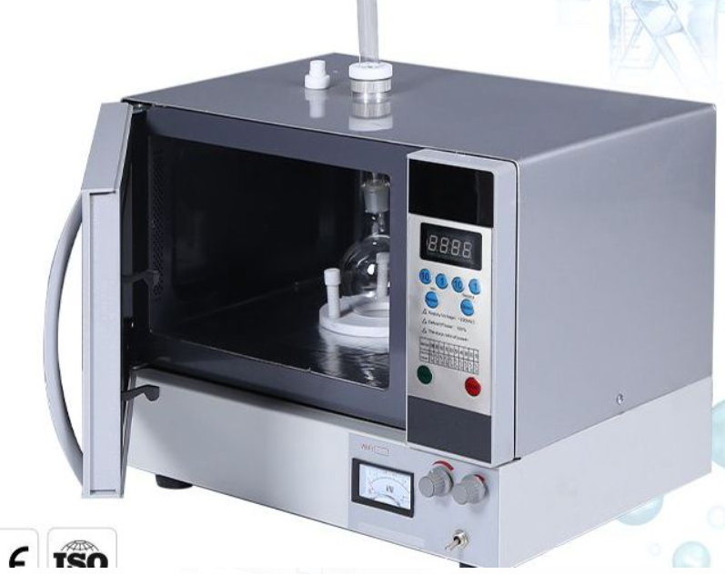
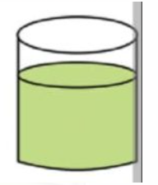
Synthesis of Ag-NPs
While stirring, we add
0.34g of PVP Gradually, after
completely dissolved
We add 0.17g
of AgNO3
Weight of
0.17g of AgNO3 and
0.34g of PVP
Add 40ml of
Ethylene glycol
Ag-NPs
solution
different
powers
90s
microwave
The product yield for Ag-NPs was 22.11%

Slide 12
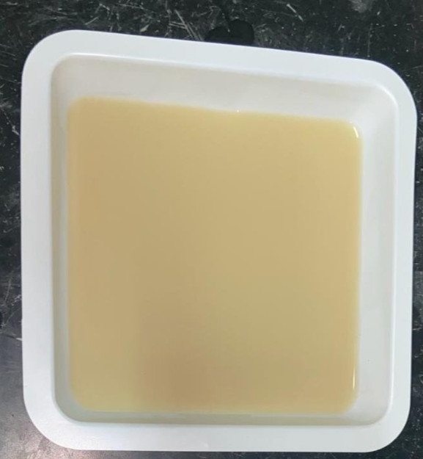
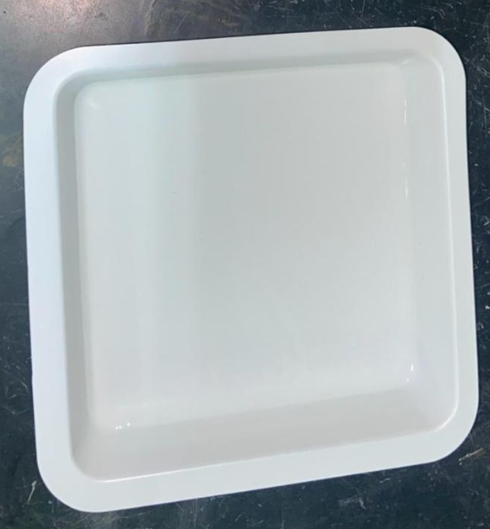
Synthesis of PVA/Ag nanocomposites
While stirring, we add
1.0g of PVP Gradually, after
dissolved completely, we add different
amount of Ag-NPs
Add 50ml of
distilled water
poured onto a
dry, leveled surface
Weight
1.0g of PVA
90C°
20 min
Dry
PVA/Ag nanocomposite film

Slide 13
05
Characterization

Slide 14
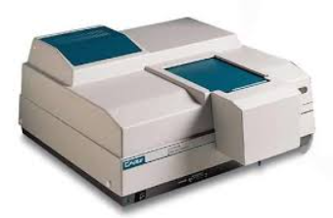
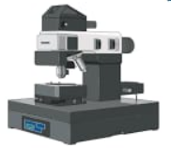
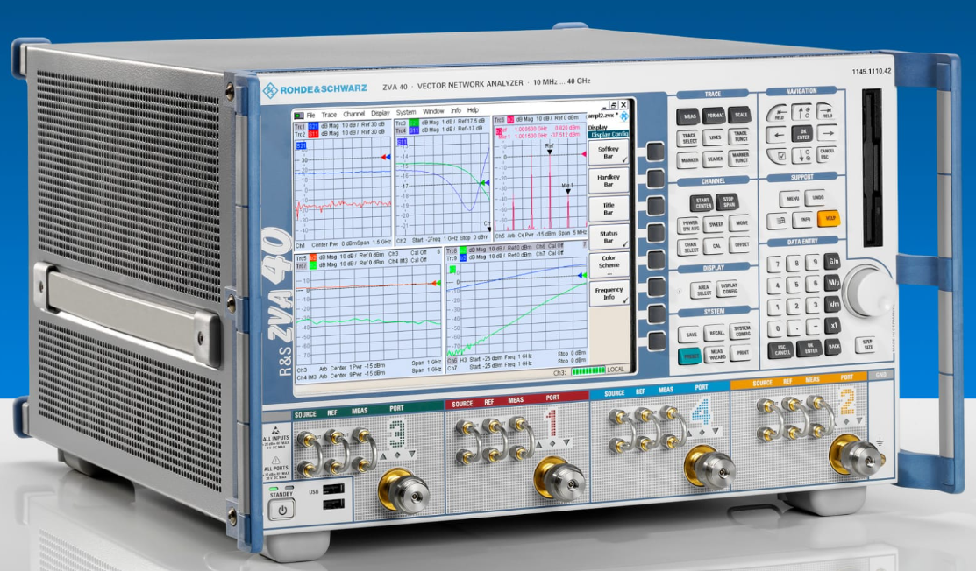
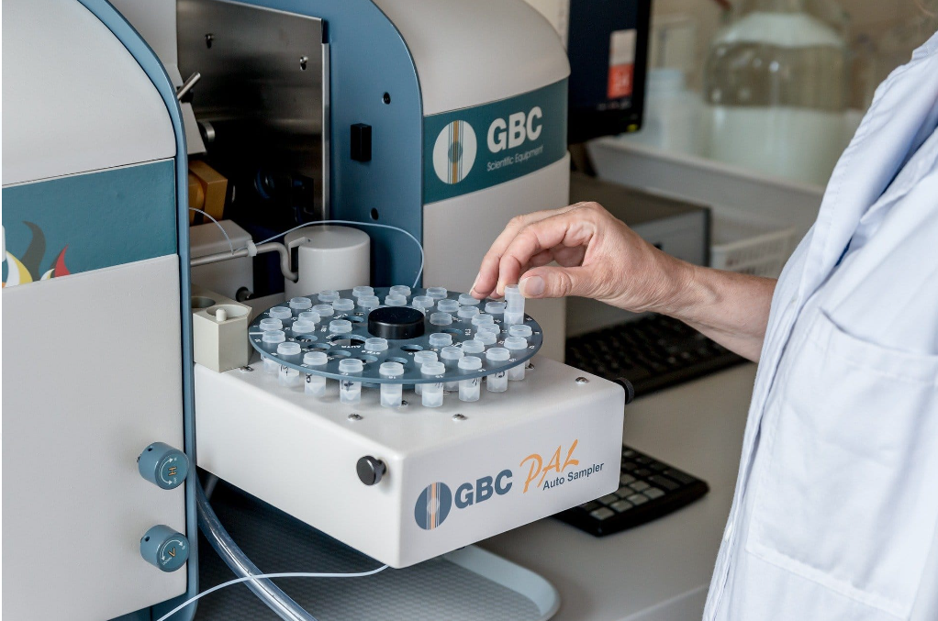
UV-vis spectra
AFM Microscopy
Vector network analyzer
Differential ScanninCalorimetry (DSC)

Slide 15
06
Results
Synthesis
Characterization Results

Slide 16
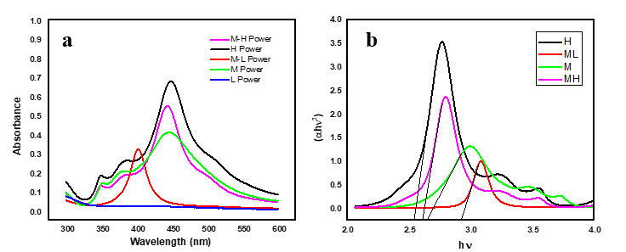
UV-VIS SPECTROSCOPY
(a) UV-vis absorption spectra of synthesized Ag-NPs at different power (b) Tauc plot of Ag-NPs at different power.

Slide 17
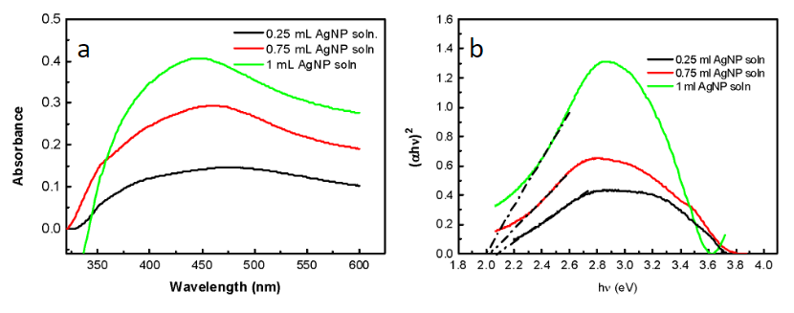
UV-VIS SPECTROSCOPY
(a) UV-vis absorption spectra of synthesized PVA / Ag nano composite (b) Tauc plot of PVA / Ag nano composite at medium high power.

Slide 18
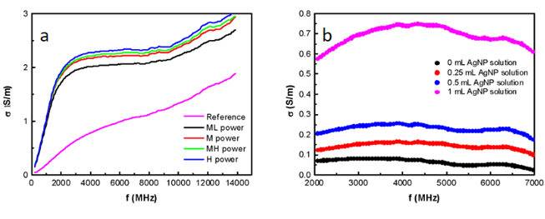
Vector network analyzer
(a) the conductivity of synthesized Ag-NPs (b) the conductivity of synthesized PVA / Ag nano composite with different volume Ag-NPs.

Slide 19
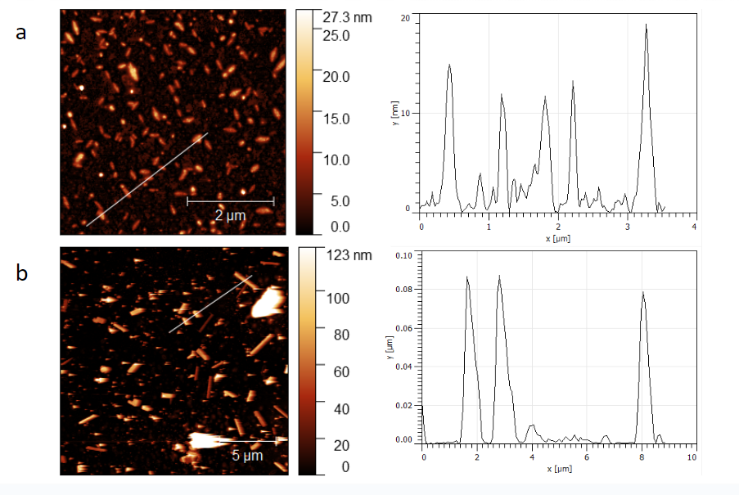
AFM Microscopy
(a) The morphology and size for Ag-NPs at medium power (b) The morphology and size for Ag-NPs at medium high power.

Slide 20
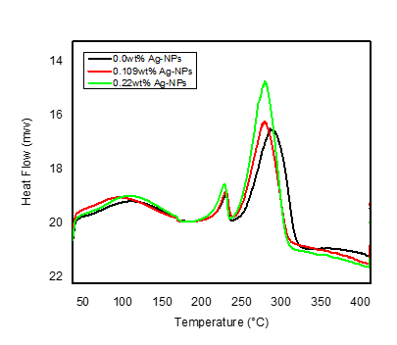
Differential Scanning Calorimetry (DSC)
Wt% Ag | Xc %
0.0Pure PVA | 14.047
0.11 Ag-NPs | 14.204
0.22Ag-NPs | 18.331
DSC results for Ag/PVA nanocomposites film containing different wt% of Ag-NPs .

Slide 21
Antibacterial Activity.
Microbial and Fungal Growth Inhibition MIC values (μg/mL) of different powers.
ATCC Number | microbe Strain | Gram type | L | M-L | Power M | M-H | H
DPC 5645 | MRSA | + ve | 20 | 17 | 18 | 183 | 330
ATCC 25923 | S. aureus | + ve | 20 | 17 | 18 | 183 | 330
ATCC 25922 | E. coli | - ve | 10 | 8.6 | 18 | 91 | 330
ATCC 13883 | Klebsiella pneumoniae | - ve | 5 | 4.3 | 4.6 | 45 | 330
ATCC 8427 | Proteus vulgaris | - ve | 20 | 8.6 | 18 | 45 | 160
ATCC 9027 | Pseudomonas aeruginosa | - ve | 5 | 4.3 | 4.6 | 45 | 330
Number of colony | from36to6
Kills | 84%
Bacteria | E.Coli

Slide 22
08
Conclusions

Slide 23
Microwave-assisted method.
Effect of Power Levels on Ag-NPs.
Ag/PVA Nanocomposite Film Formation.
Properties of Ag/PVA Nanocomposite.
Ag-NPs, enhancing antibacterial activity.
The Ag/PVA nanocomposite film significantly reduced colony-forming units of E. coli bacteria.

Slide 24
Thanks
Do you have any questions?

