Slide 1


BUILDFLOW
GRADUATION PROJECT (SOFTWARE)
Supervisor:
Dr. Amjad AbuHassan
Students:
Doaa Yasin Jararaa
Wala’ Essam Ashqar

Slide 2
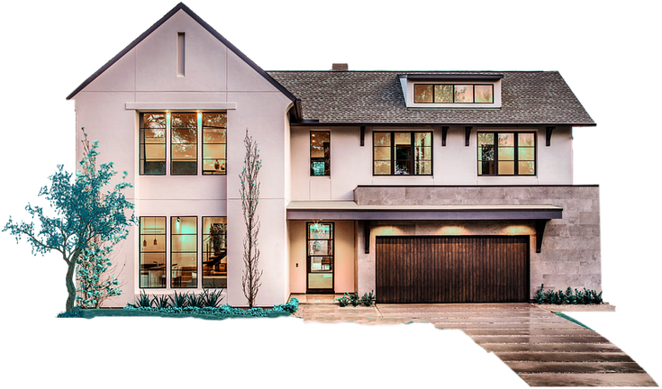

Table of Contents:
01
Main Idea
02
Technology
03
Features & Roles
04
Constraints
05
Future work

Slide 3

Main idea
BuildFlow is a construction project management platform designed specifically to streamline personal home construction projects.
It bridges the communication gap between project owners, engineering offices, and companies.

Slide 4

Technology
FRONTEND
  language & Framework
  Main Libraries
  http
  webview_flutter & webview_flutter_android
  intl
  file_picker
  image_picker
  curved_navigation_bar
  flutter_secure_storage
  get_storage
  logger
  url_launcher
  http_parser & mime
Dart, Flutter

Slide 5
Technology
BACKEND
  language & Framework
  Others
Database ORM (Object-Relational Mapping):
Sequelize
Authentication & Security:
JSON Web Tokens (JWT)
Bcrypt.js
Express Middleware
libraries:
pg & pg-hstore
jsonwebtoken
cors
dotenv
multer
Node.js Express.js

Slide 6

Technology
DATABASE

Slide 7



Technology
  Development & Collaboration Tools
  Version Control System: Git
  Code Hosting & Collaboration: GitHub
  IDE: VS Code
  API Testing Tool: Postman
  Package Managers:
  Pub (for Dart/Flutter)
  npm (Node Package Manager)

Slide 8


Technology
OTHER TOOLS
  Third-Party Services & APIs
  3D Model Viewing:
Planner 5D
  Payment Gateway:
Flutter Braintree (A PayPal Service)
  Firebase:
  Geomlog:
Flutter Map

Slide 9


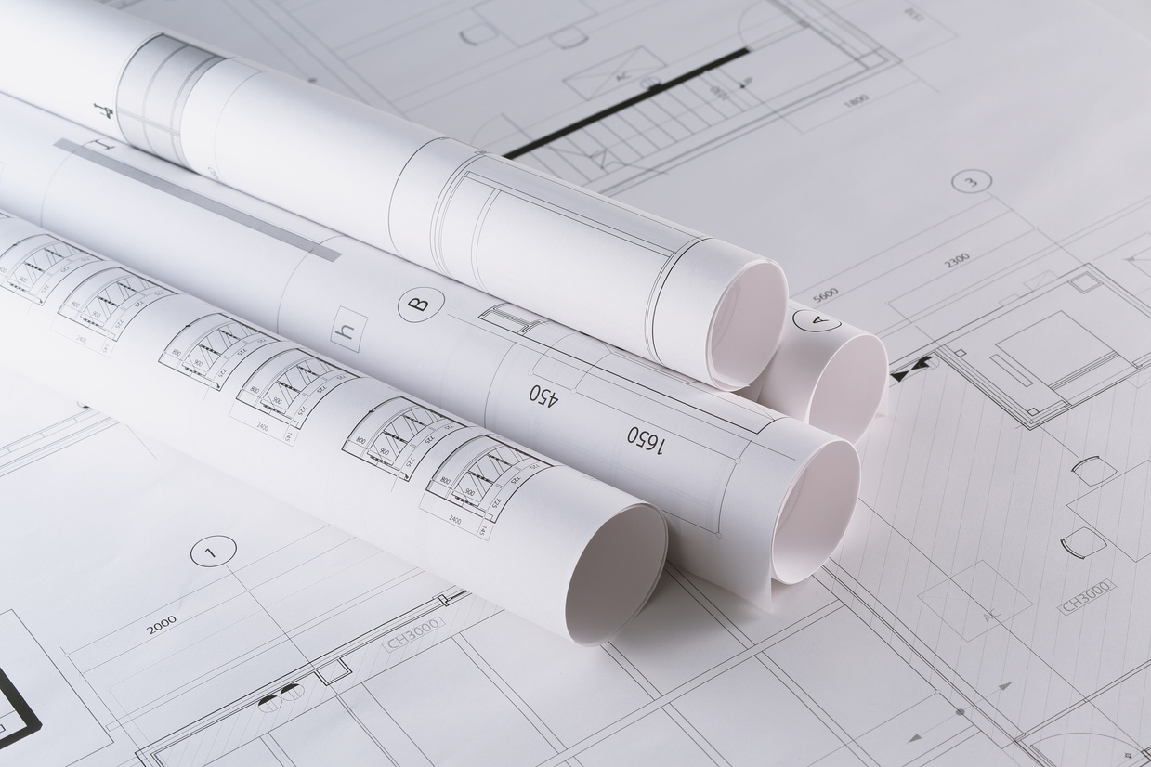
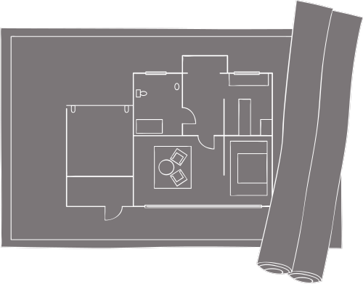
Features & Roles

Slide 10
  Users
  Project creation
  Service Provider Selection
  Project Management
  Communication
  Financials
  Review & Feedback
  Profile Management
Features & Roles

Slide 11
  offices
  Request Management
  Approval Workflow
  Project Execution & Delivery
  (Design Track)
  (Supervision Track)
  Financials
  Communication
  Reputation Management
Features & Roles

Slide 12

  Companies
Features & Roles
  Profile Management
  Selection & Assignment
  Project Collaboration
  Reputation Management

Slide 13
Features

Slide 14
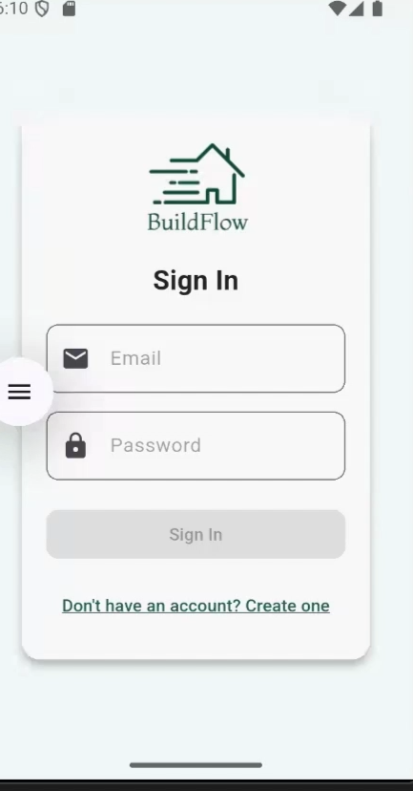
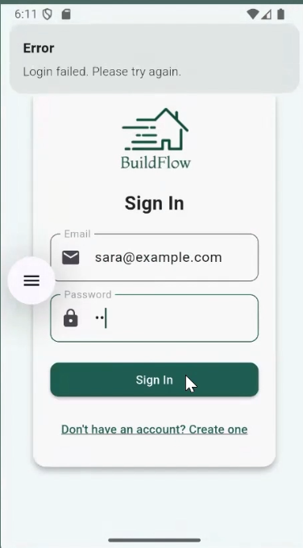
Authentication & vaildation
Sign in

Slide 15
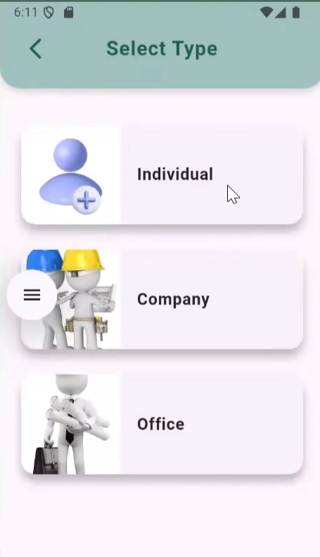
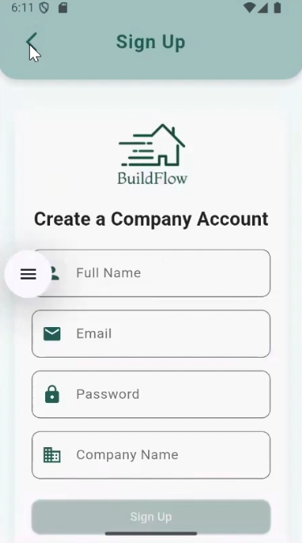
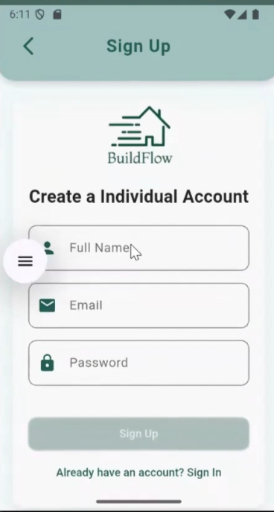
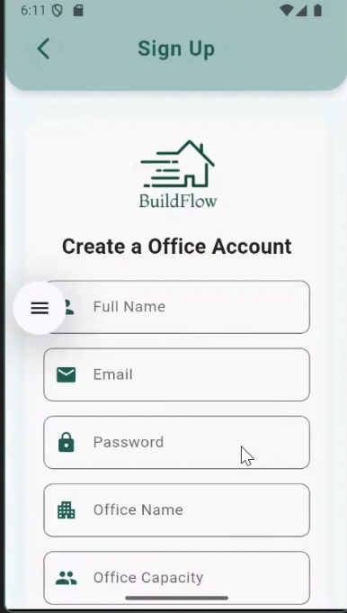
Authentication & vaildation
Sign up

Slide 16
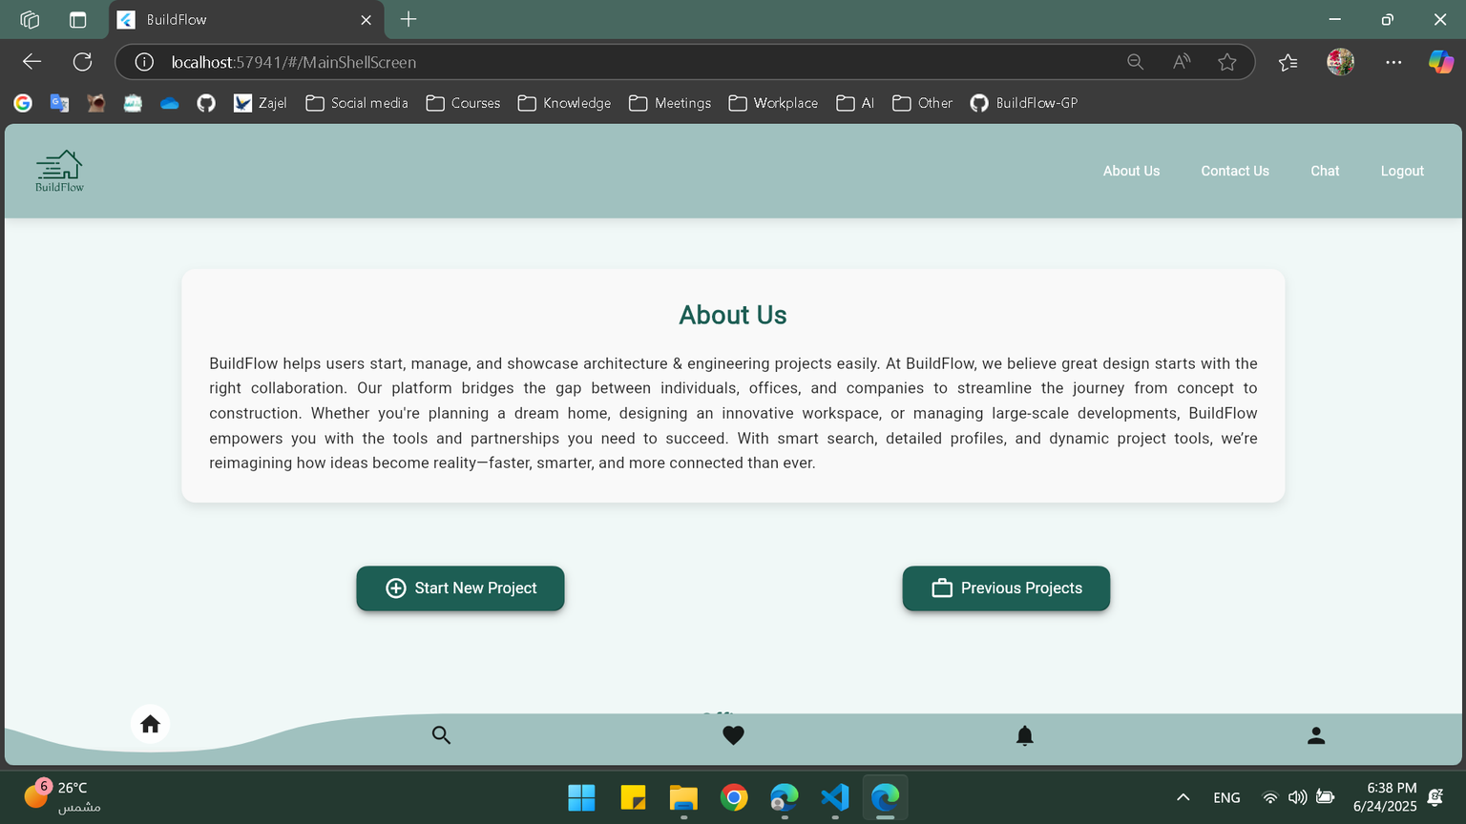
Home Page

Slide 17
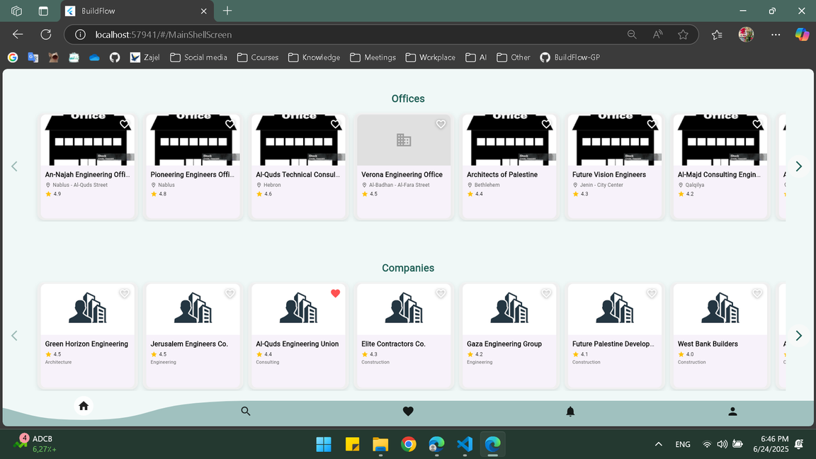
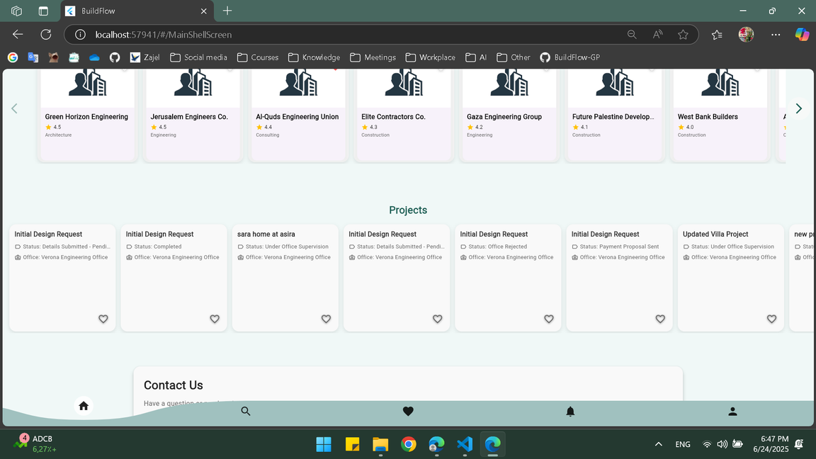
Home Page
suggestions as recommendation system
Offices and Companies
Projects

Slide 18
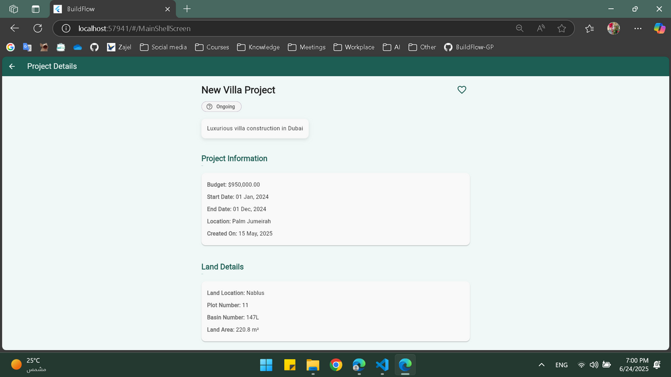
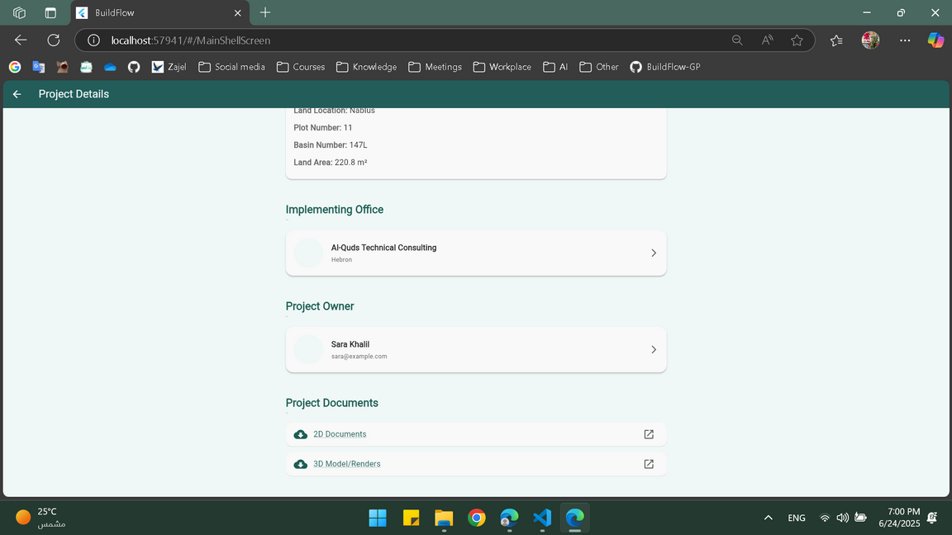
Home Page
Profiles for non-owners

Slide 19
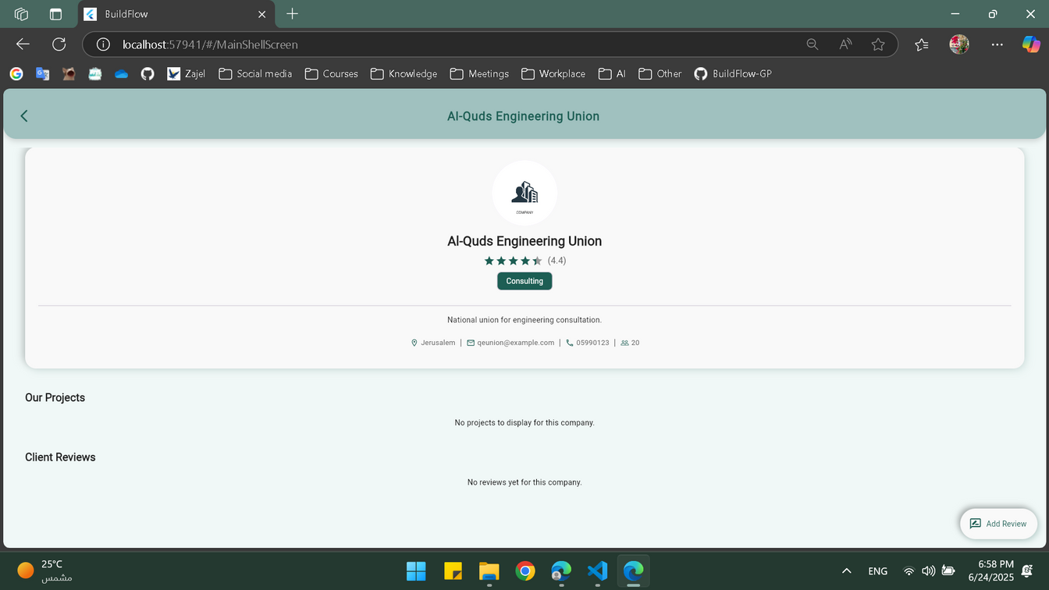
Home Page
Profiles for non-owners

Slide 20
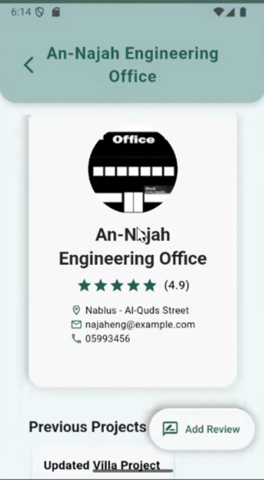
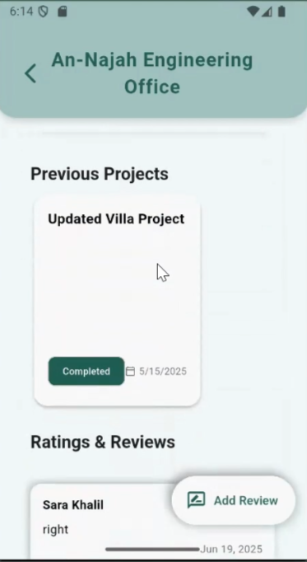
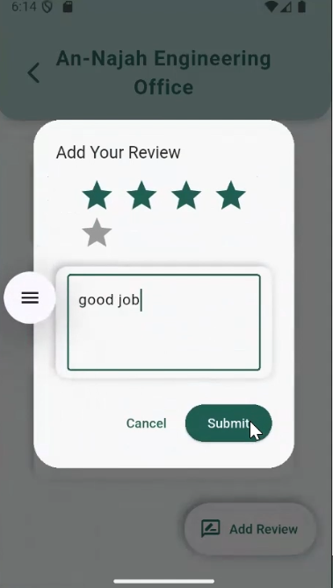
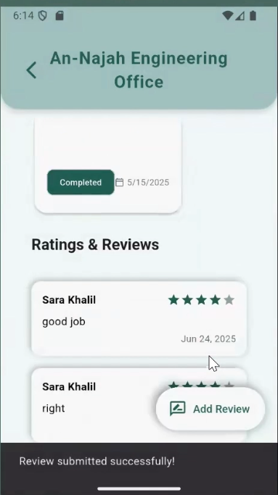
Home Page
Profiles for non-owners

Slide 21
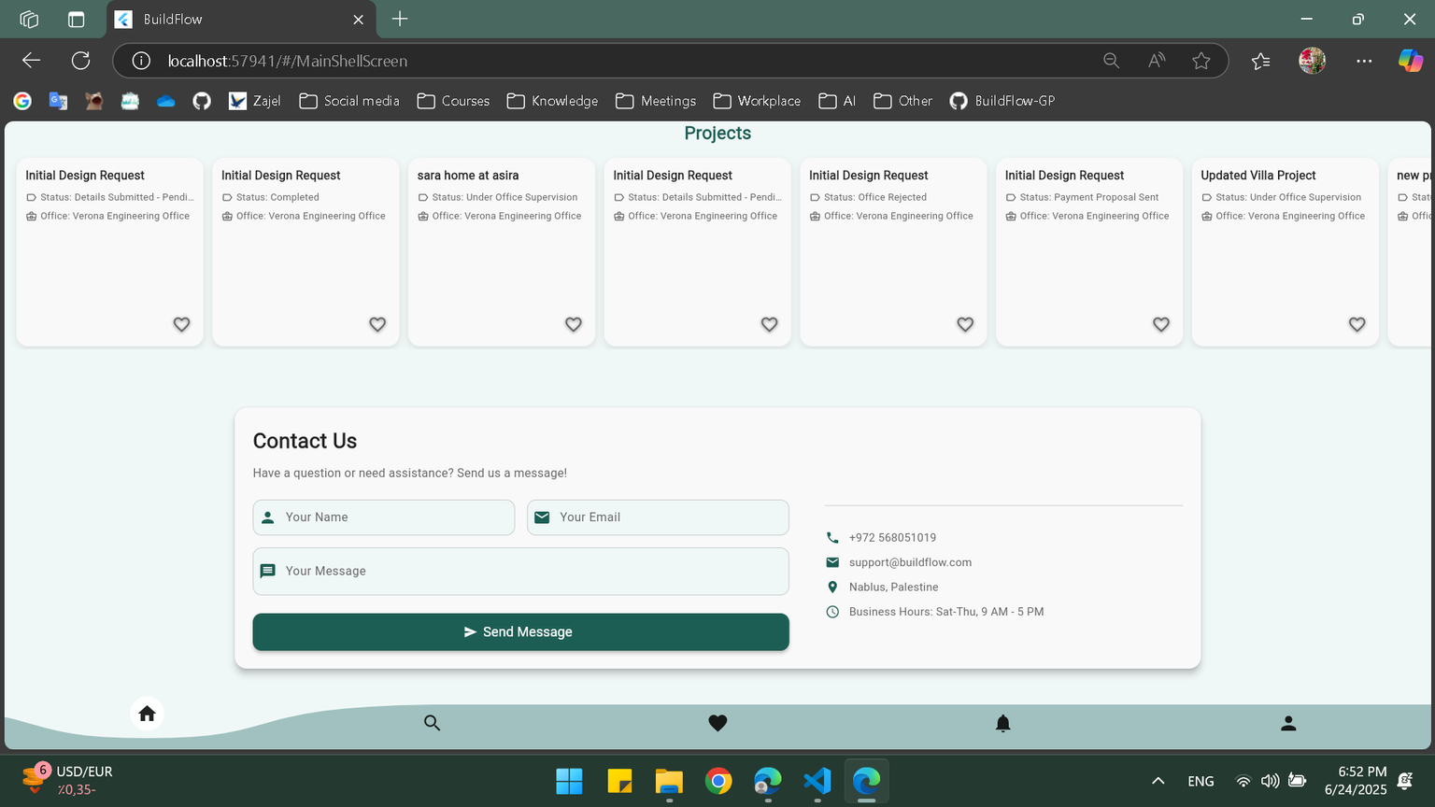
Home Page
Contact us by email

Slide 22
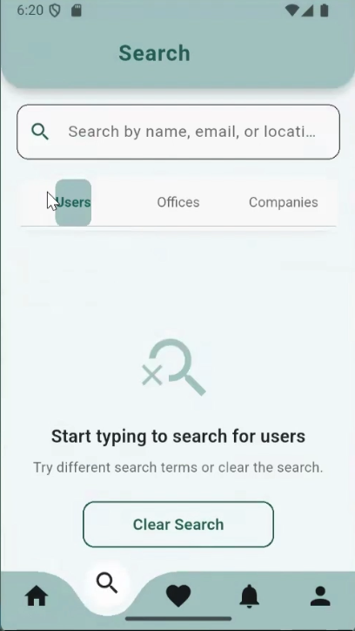
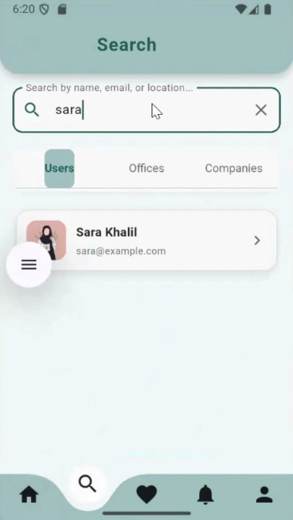
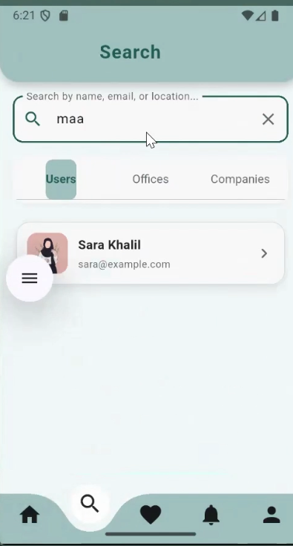
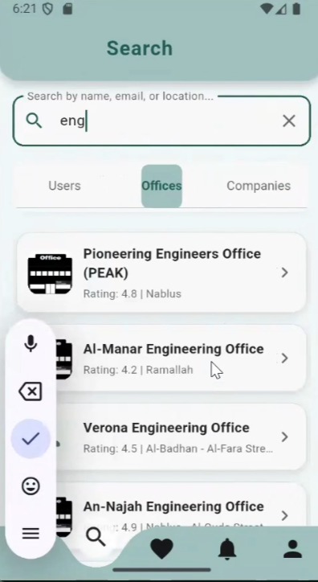
Search Page
search screen
search by name
search by Location
search by offices

Slide 23
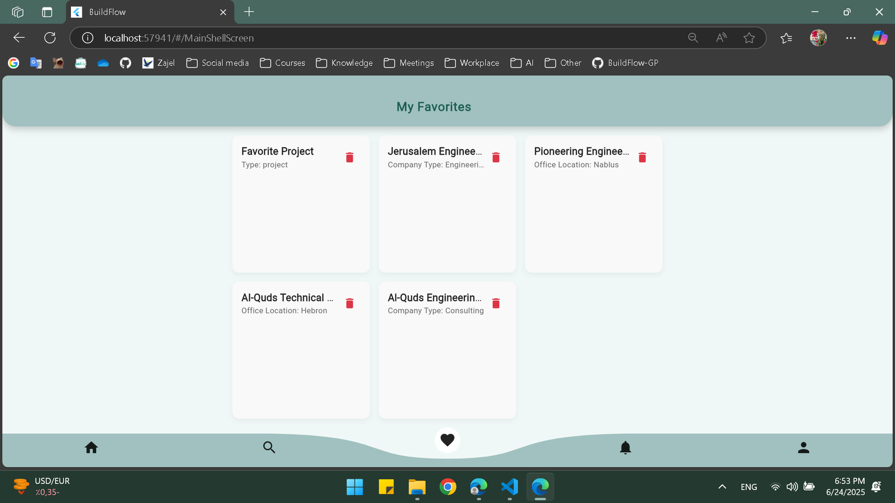
Favorite Page

Slide 24
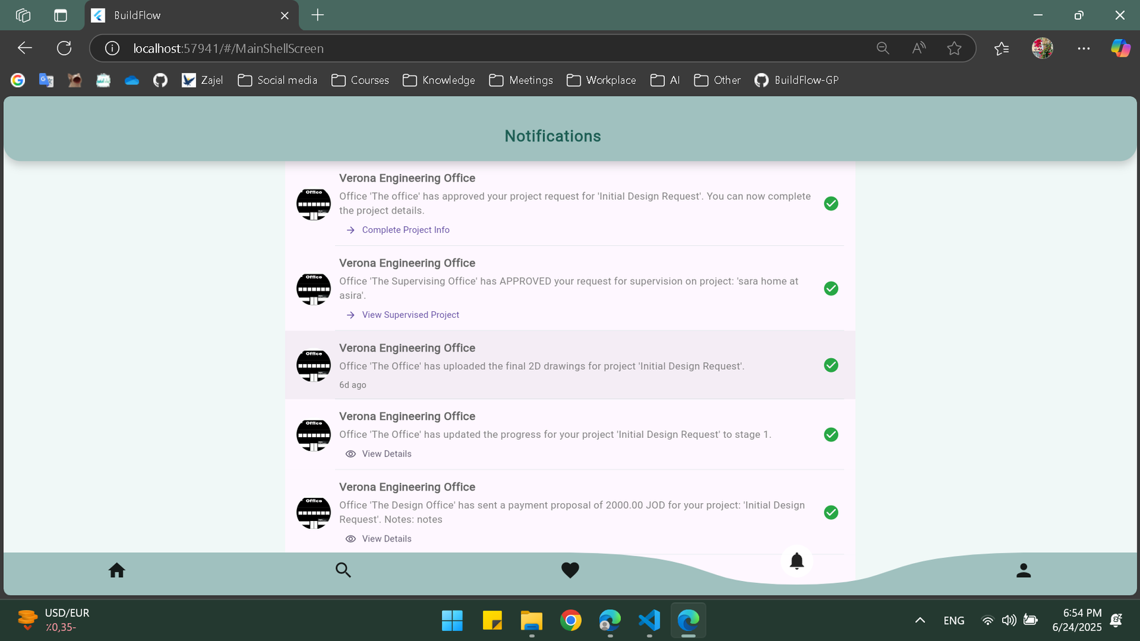
Notification Page

Slide 25
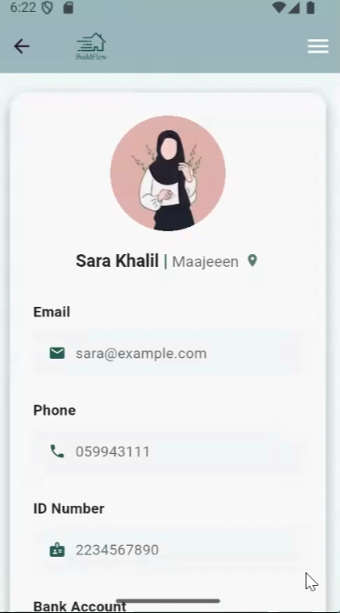
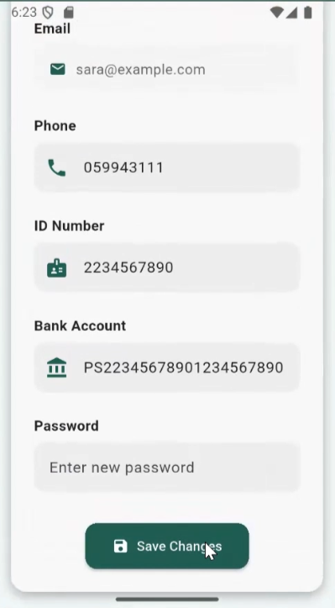
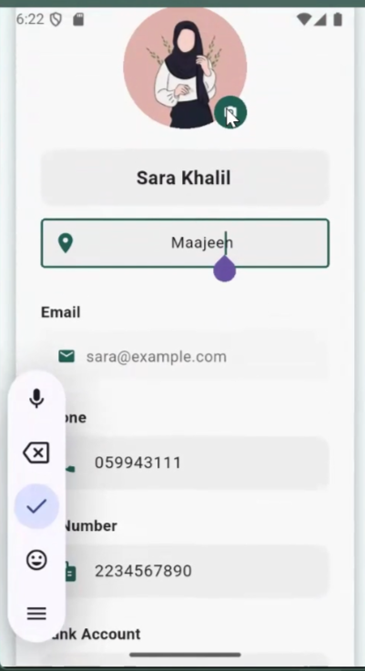
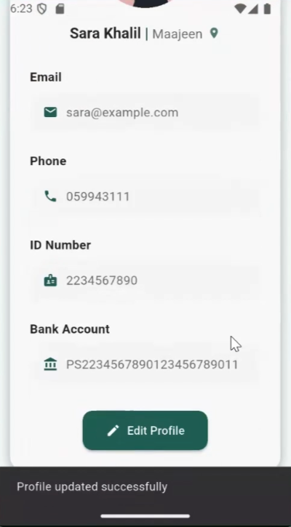
Profiles
User

Slide 26
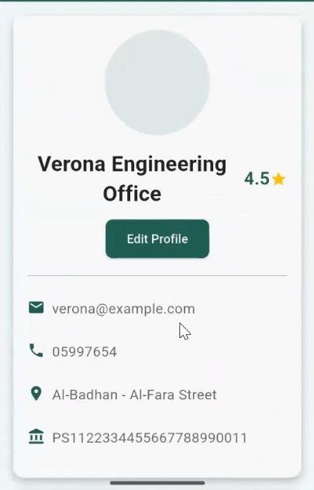
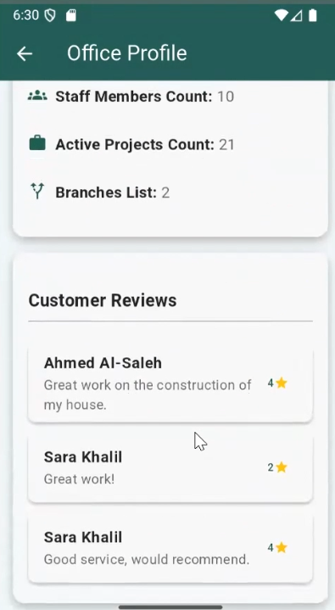
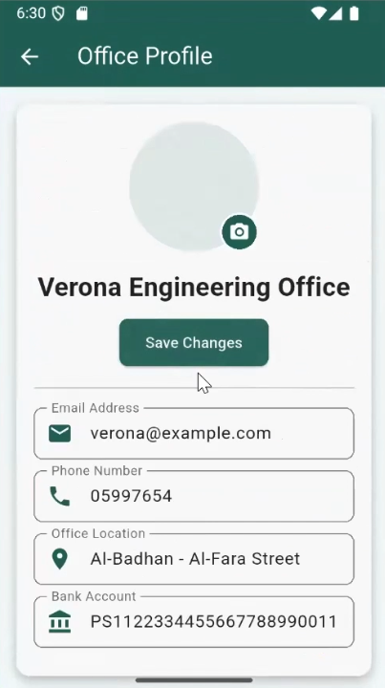
Profiles
Office

Slide 27
  Design
  Supervision
Types of projects
  Consaltation

Slide 28
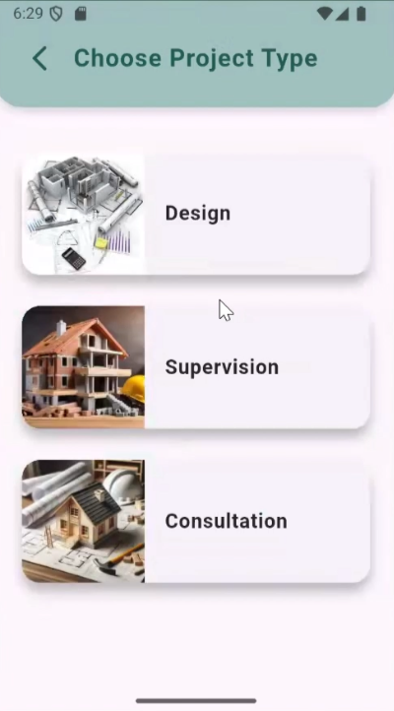
Types of projects

Slide 29
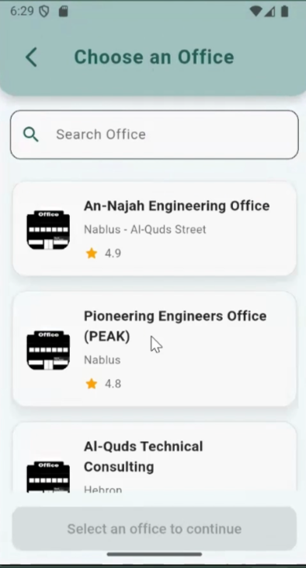
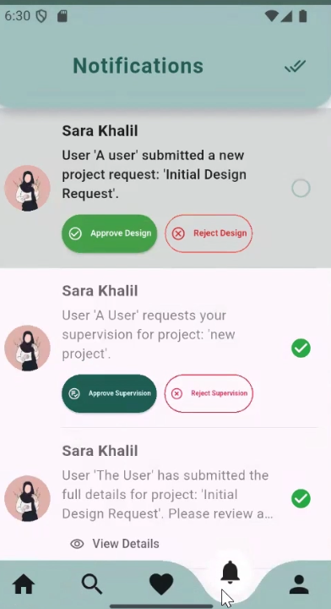
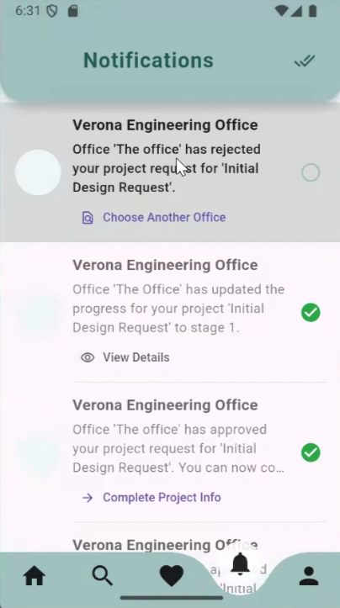
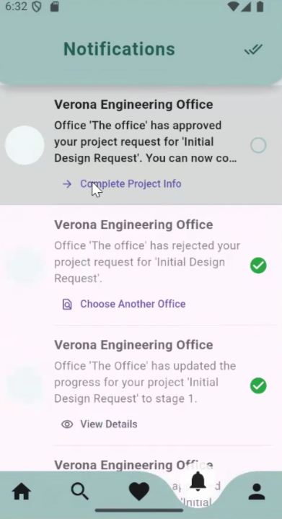
Design

Slide 30
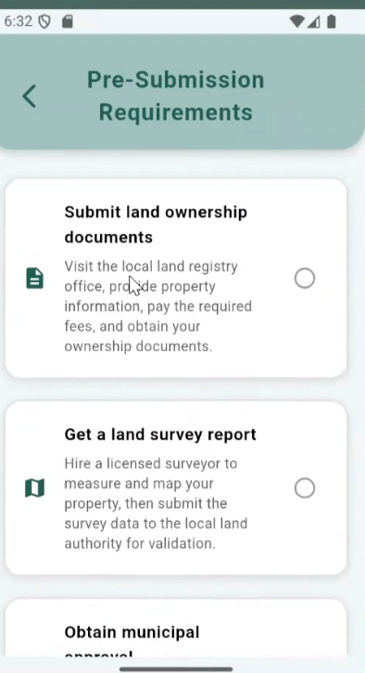
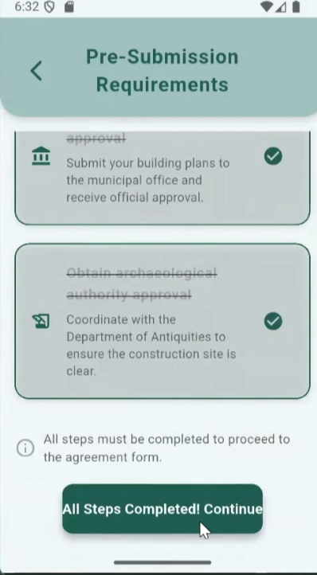
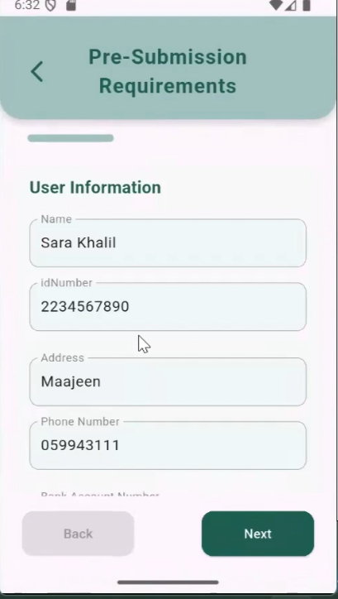
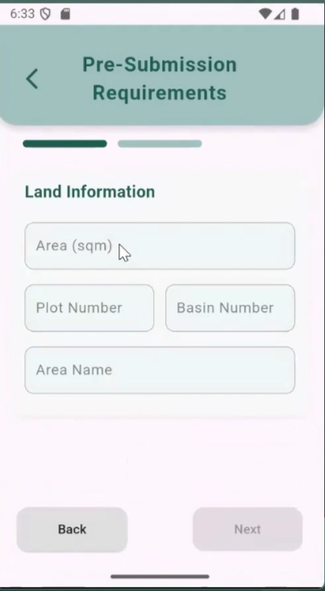
Design

Slide 31
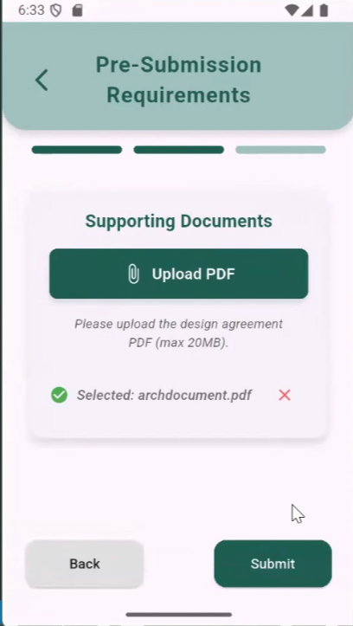
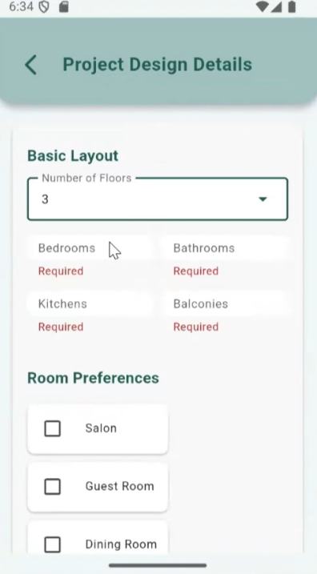
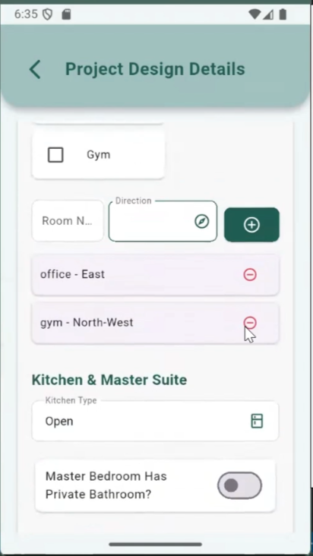
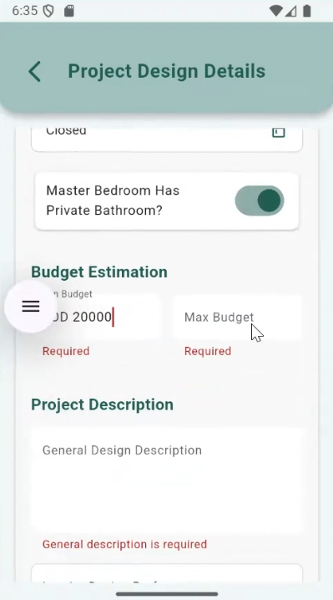
Design

Slide 32
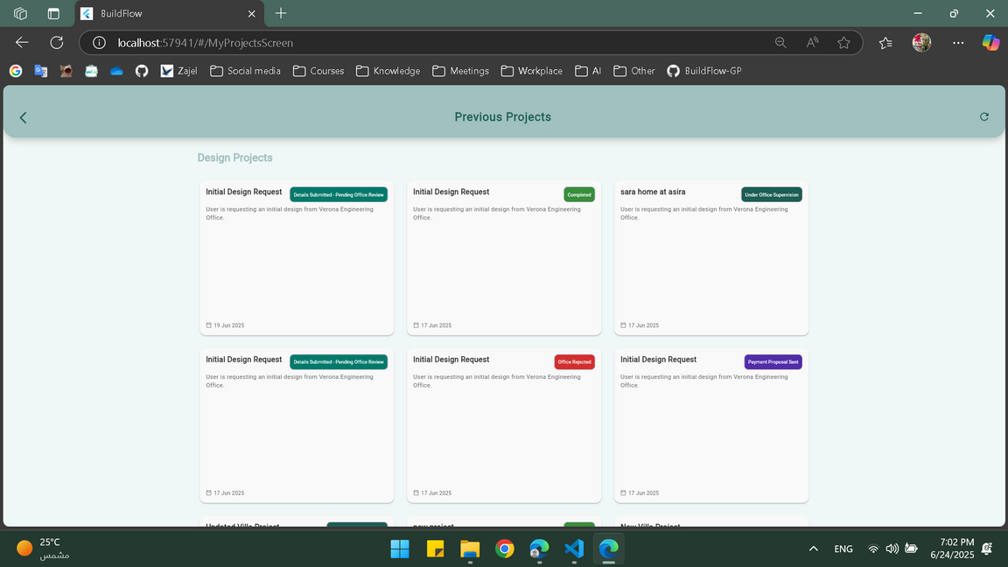
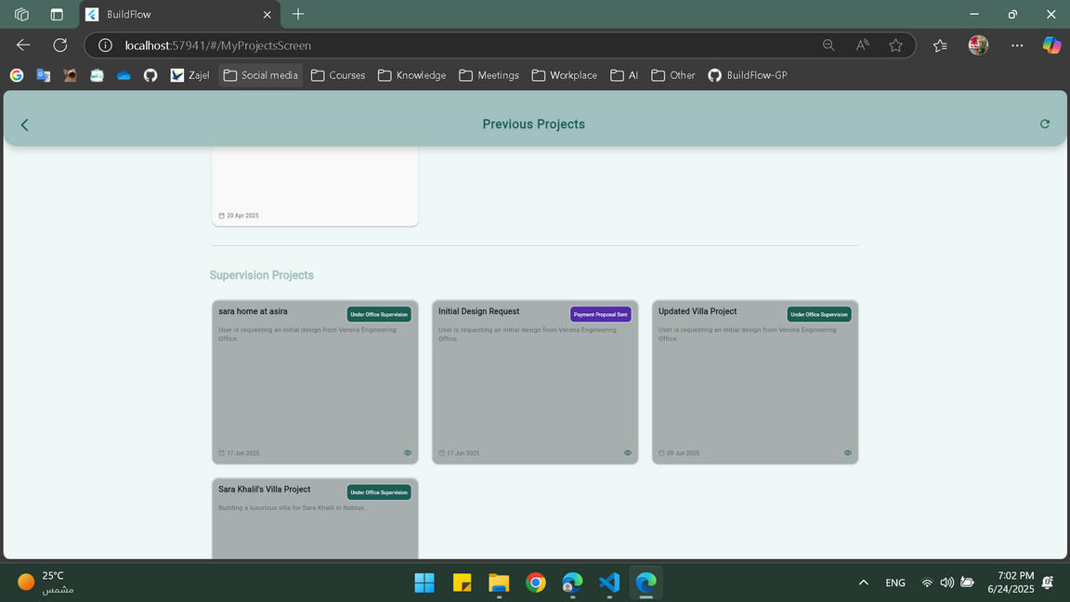
Previous Projects

Slide 33
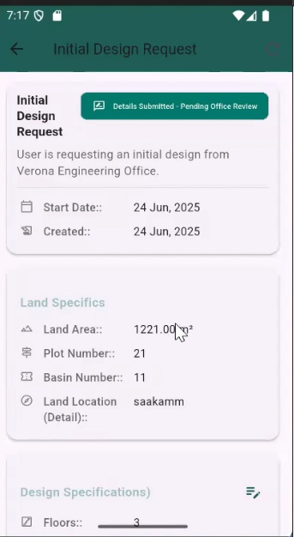
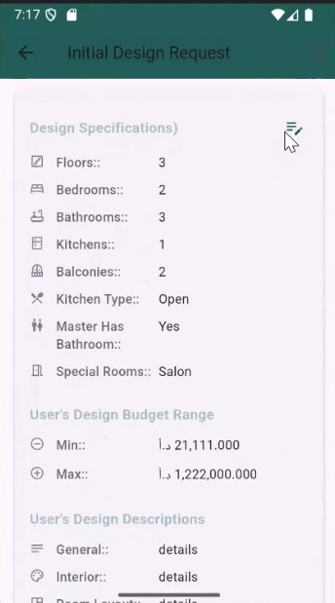



Details of design project
for user

Slide 34



Details of design project
for office

Slide 35



Details of design project
for office

Slide 36

5d Planner

Slide 37



5d Planner

Slide 38




Supervision

Slide 39


Supervision Details
for user

Slide 40




Supervision Details
for office

Slide 41


Consultation

Slide 42

Map Page

Slide 43

Map Page

Slide 44

Map Page

Slide 45



  constraints
Restricted map tools with incomplete location coverage in Palestine.
Limited land data and difficulty accessing official documents.
Payment integration issues due to Braintee library incompatibility with emulator
Limited free access to tools like OpenRoute and Planner 5D.

Slide 46

FUTURE WORK
Advanced Analytics
Expanded Mapping API
To track budgets, timelines, performance, and past evaluations.
Using official government GIS data for accurate land verification.
AI Chatbot for Consultation
To provide instant support, guidance, and basic consultation.
Offline Support
Multilingual Support
Enhancing mobile access in areas with poor internet connectivity.
Making the platform accessible in both English and Arabic.

Slide 47
Thank you very much!

