Slide 1
Solar Powered Autonomous Battery Electric Vehicle Model

Slide 2
AIMS AND OBJECTIVES
The major goal of this project is to produce a prototype for an autonomies BEV that uses Solar power as a major power source for the vehicle.
We also aim to make a compatible self-driving system that walk with the artificial

Slide 3
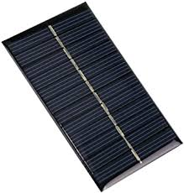
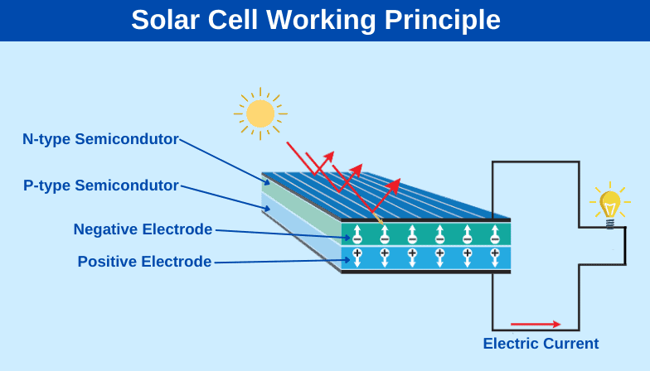

Slide 4
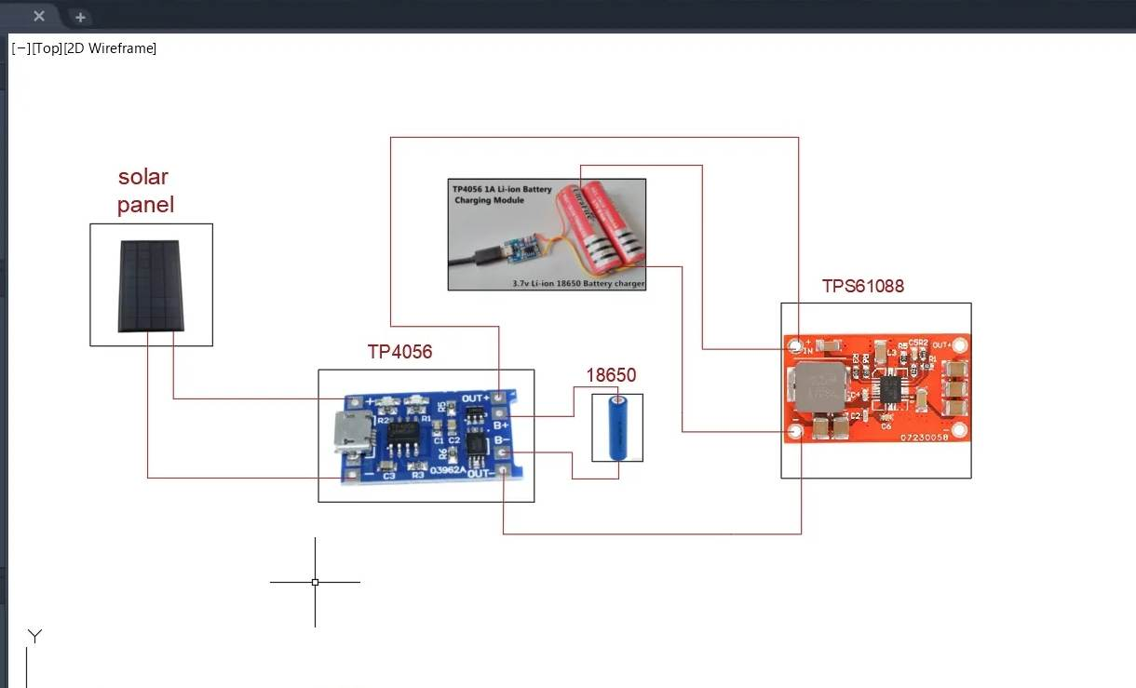

Slide 5
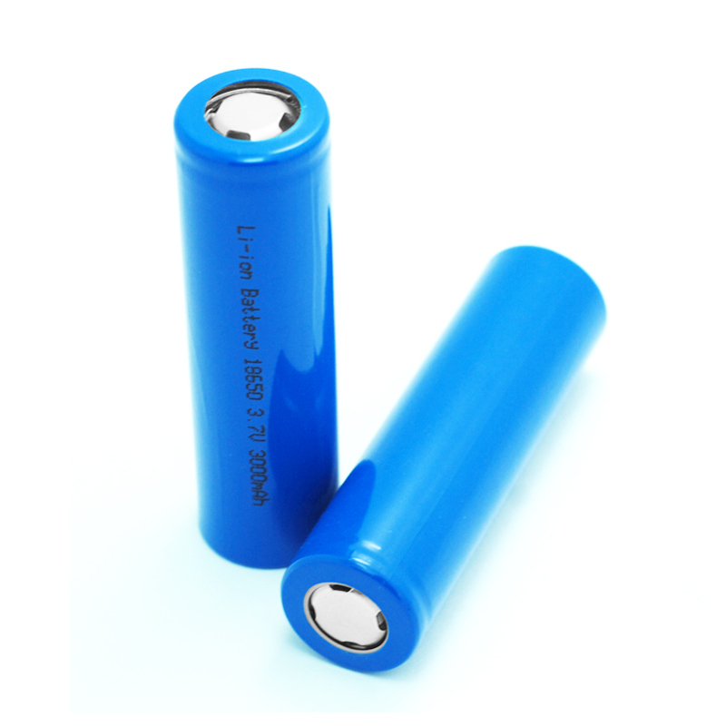
18650-lithium battery
he 18650-lithium battery is a common rechargeable battery format that has become widely used in various electronic devices.
the battery has a nominal voltage from 3.6v to 3.7v, And when fully charged the voltage can reach 4.2v and when discharging it can reach 3v.
With regard to the current carried by the battery, it ranges from 1500mA to 3500mA

Slide 6
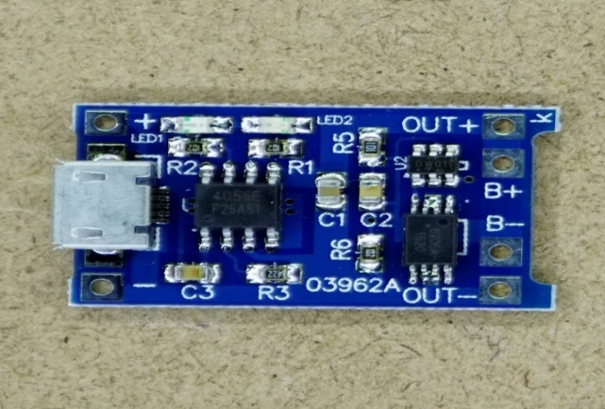
TP4056 lion battery charging module

Slide 7
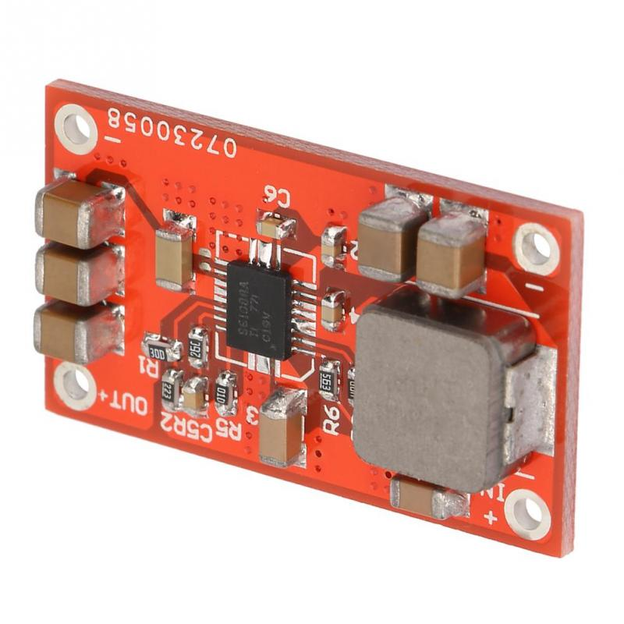
TPS61088 Boost Step Up Power From 2.7 To 5V 3A Supply Module

Slide 8
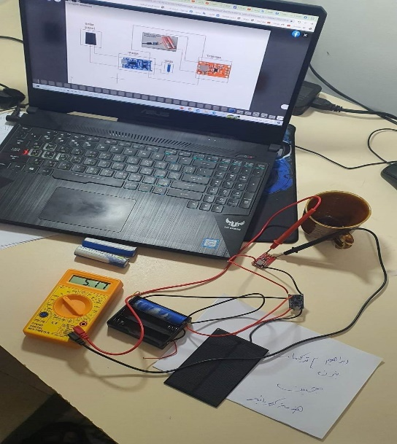

Slide 9
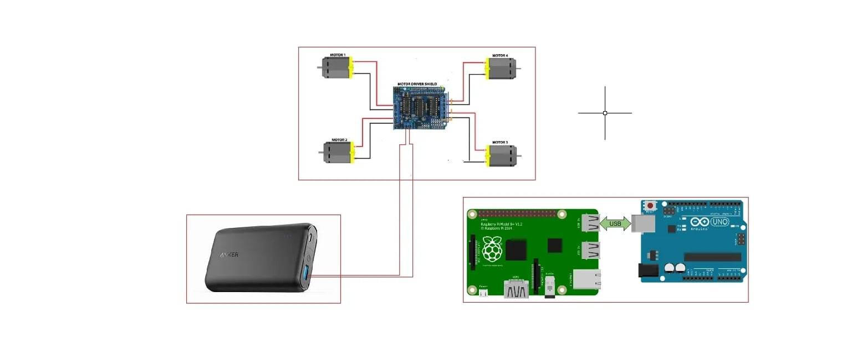

Slide 10
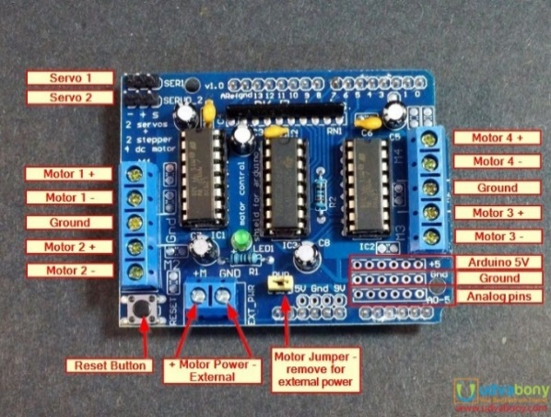
L293D motor shield for arduino

Slide 11
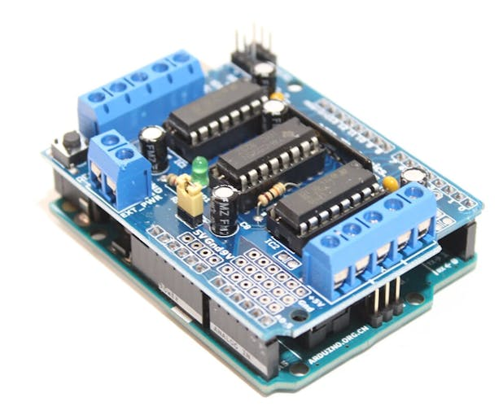
How Arduino connect with shiled

Slide 12
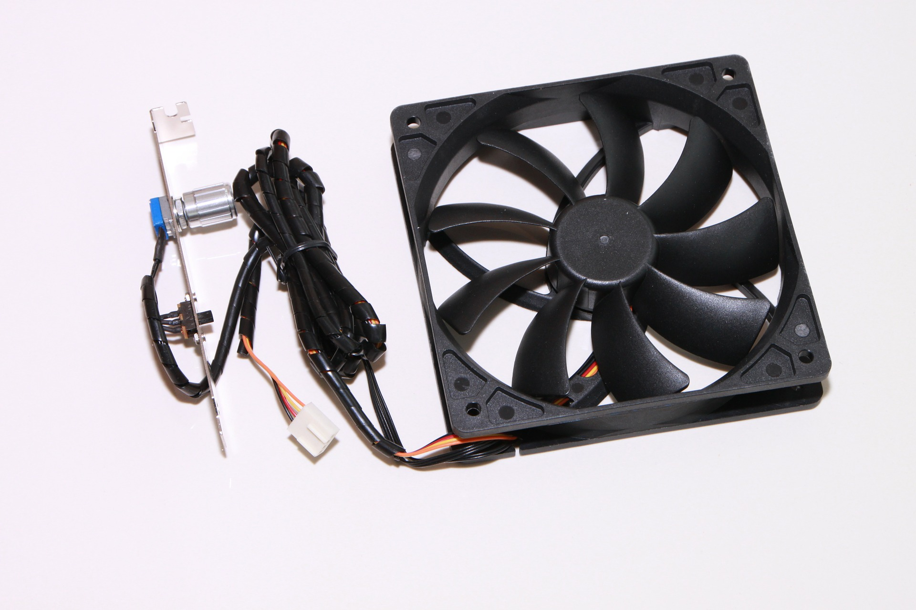
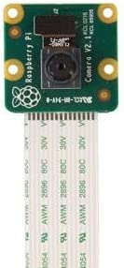
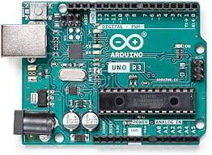
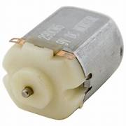
current distribution
0.7A
.025A
1.2A
0.05A_0.2A
1.2A
solar
bank
2.35A
2.2A
4.55A
1=4*0.25A

Slide 14
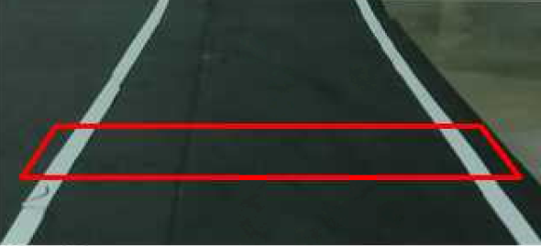
Create a region of interest

Slide 15
void Perspective()
{
line(frame,Source[0],Source[1], Scalar(0,0,255), 2);
line(frame,Source[1],Source[3], Scalar(0,0,255), 2);
line(frame,Source[3],Source[2], Scalar(0,0,255), 2);
line(frame,Source[2],Source[0], Scalar(0,0,255), 2);

Slide 16
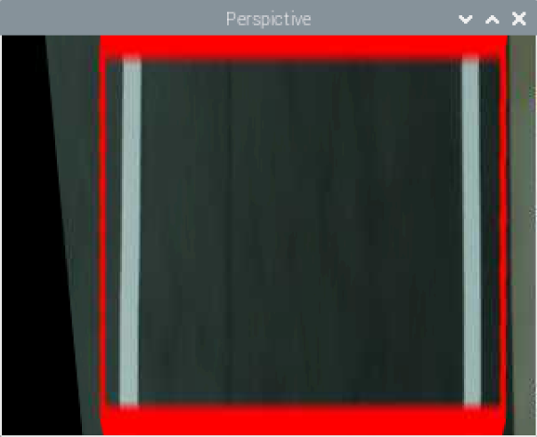
Perspective transformation

Slide 17
Matrix = getPerspectiveTransform(Source,Destination);
warpPerspective(frame,framePers, Matrix , Size(400,240));

Slide 18
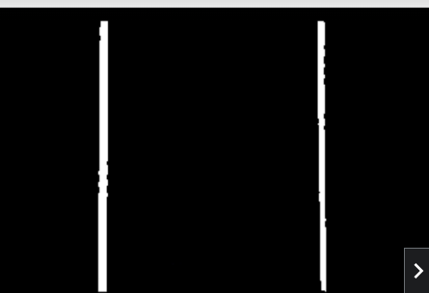
Threshold and canny edge function

Slide 19
void Threshold()
{ cvtColor(framePers,frameGray,COLOR_RGB2GRAY);
inRange(frameGray,200,255,frameThresh);
Canny(frameGray,frameEdge, 100, 500, 3, false);
add(frameThresh, frameEdge, frameFinal);

Slide 20
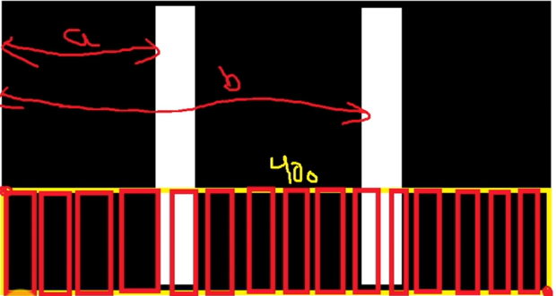
Track lanes positioning

Slide 21
void histogram()
{
histogramLane.resize(400);
histogramLane.clear();
for (int i=0; i<400; i++)
{
ROIlane= frameFinalDuplicate (Rect(i,140,1,100));
divide(255,ROIlane,ROIlane);
histogramLane.push_back((int)(sum(ROIlane)[0]));
}
}
void lanefinder()
{
vector<int>:: iterator Leftptr;
Leftptr= max_element(histogramLane.begin(), histogramLane.begin() + 150);
LeftLanePos= distance(histogramLane.begin(),Leftptr);
vector<int>:: iterator Rightptr;
Rightptr= max_element(histogramLane.begin()+ 250 , histogramLane.end());
RightLanePos= distance(histogramLane.begin(),Rightptr);
line(frameFinal, Point2f(LeftLanePos,0),Point2f(LeftLanePos,240), Scalar(0,255,0), 2);
line(frameFinal, Point2f(RightLanePos,0),Point2f(RightLanePos,240), Scalar(0,255,0), 2);

Slide 22
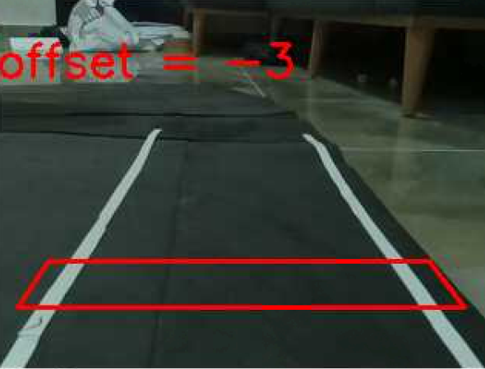
Positioning lane and frame centers

Slide 23
void lanecenter ()
{
laneCenter = (RightLanePos-LeftLanePos)/2 + LeftLanePos;
frameCenter = 176;
line(frameFinal, Point2f(laneCenter,0),Point2f(laneCenter,240), Scalar(0,255,0),3);
line(frameFinal, Point2f(frameCenter,0),Point2f(frameCenter,240), Scalar(255,0,0),3);
offset= laneCenter-frameCenter;

