Slide 1

Mommy's Bridge
Prepared by: Rahaf Nasrallah and Masa Masri
Supervised by: Dr. Abdallah Rashed

Slide 2

Outline
  Introduction
  Motivation
  Project Details
  Future Work
  Constraints
  Demo

Slide 3

01.
Introduction

Slide 4

02.
Motivation
Motivated by the desire to support working moms and ensure their peace of mind, Mommy's Bridge offers a convenient app for managing nursery schools and providing real-time updates on their children, bridging the gap between professional life and parental responsibilities.

Slide 5

03.
Features
  Localized (English&Arabic support).
  Speech Recognition.
  Text to Speech.
  Audio prompts using Kids friendly voice (Good job,Try again, drag&drop,...)

Slide 6








Technologies and Frameworks

Slide 7

1- Website

Slide 8
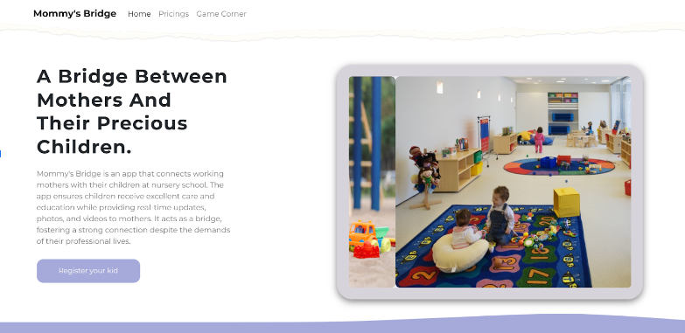
Landing Page

Slide 9
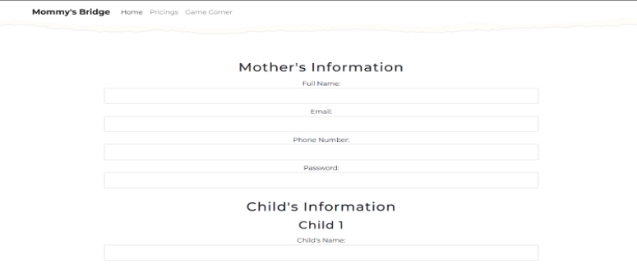

Registeration

Slide 10
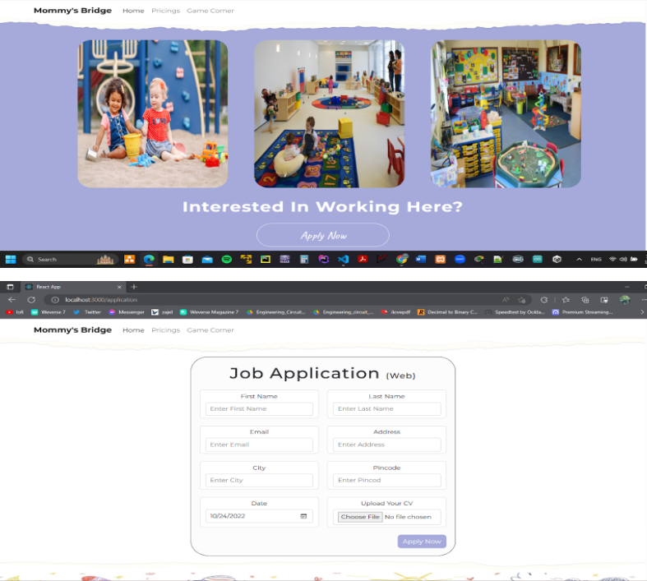

Apply for a job

Slide 11
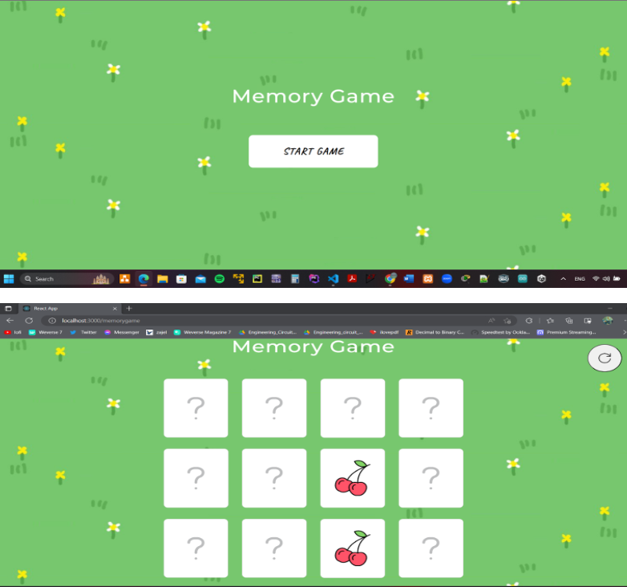
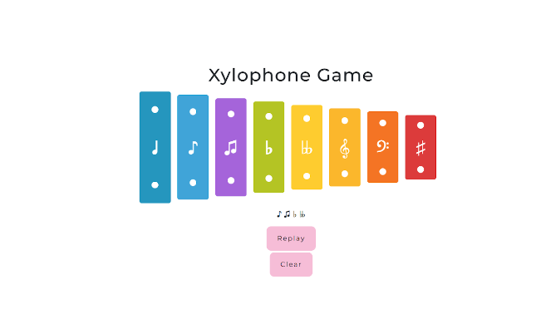
Games

Slide 12
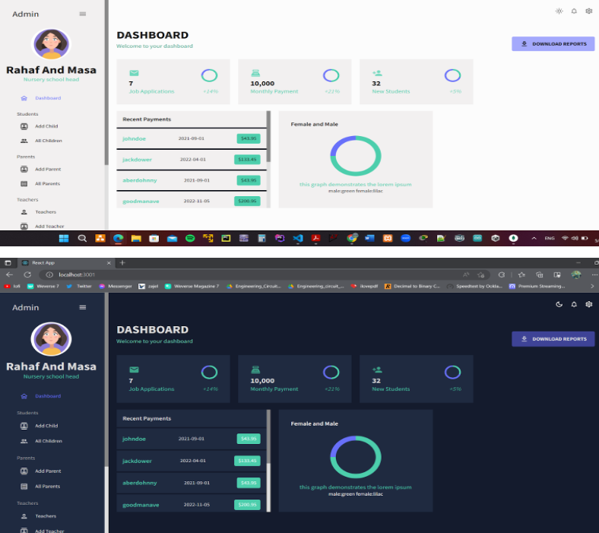
Admin Dashboard

Slide 13
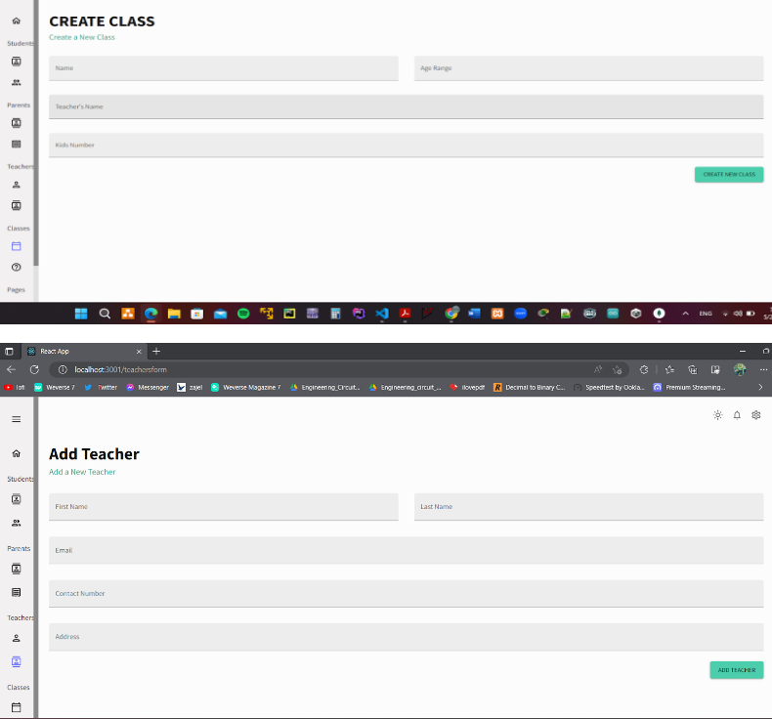
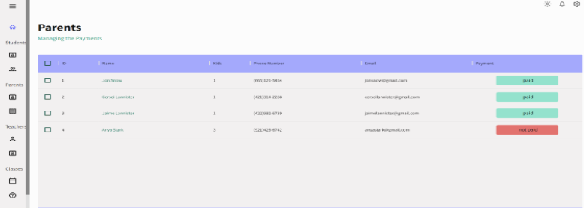
Tables

Slide 14
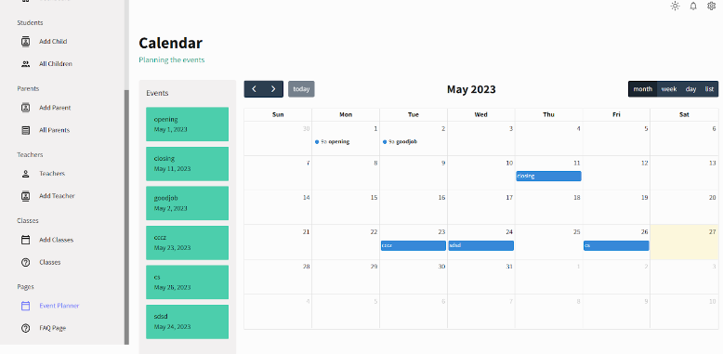
Event Mangement

Slide 15

2- mobile application

Slide 16
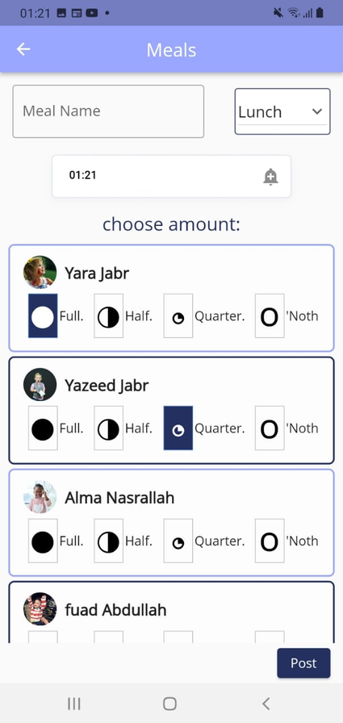
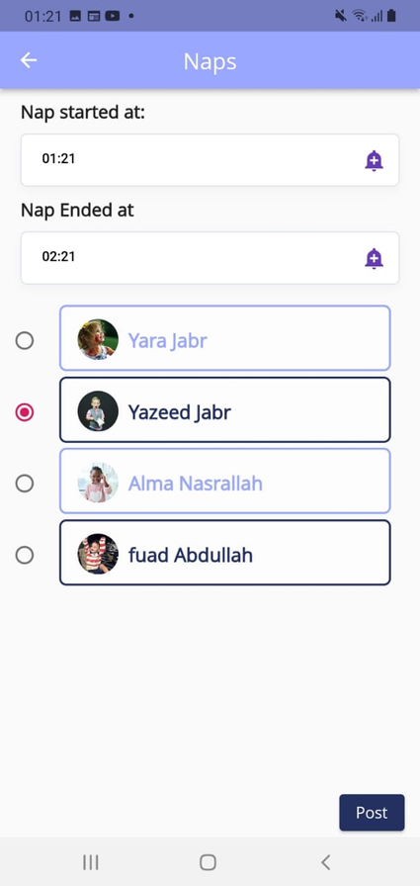
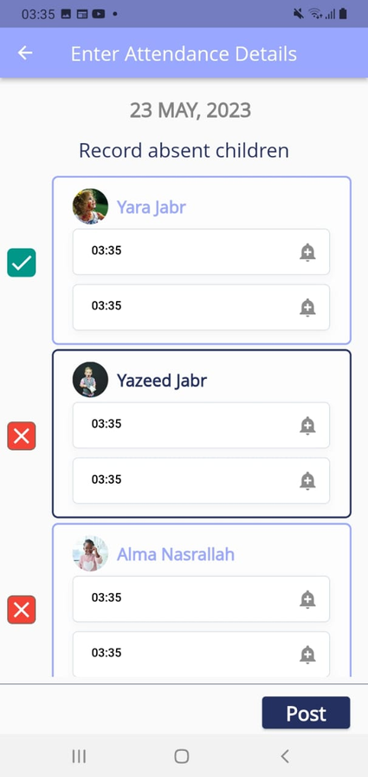
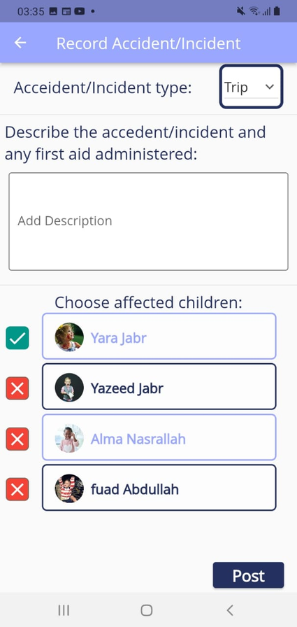
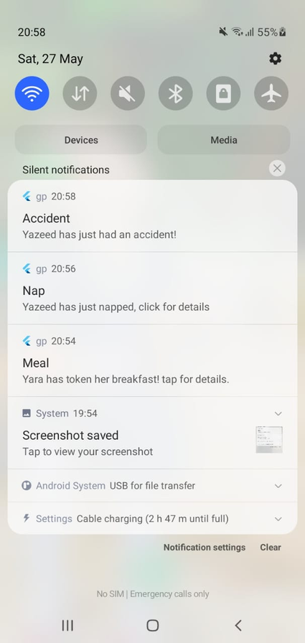
1- Logging in as Teacher

Slide 17
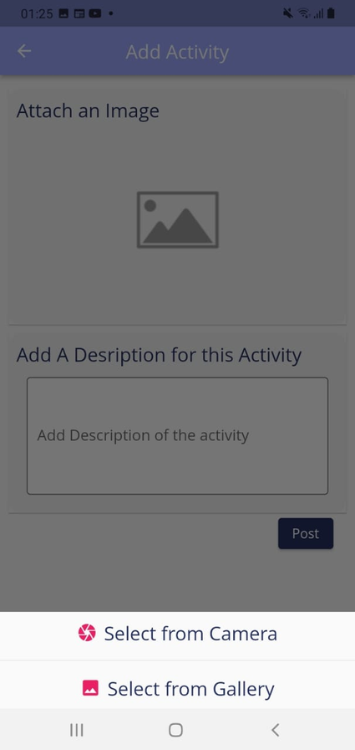
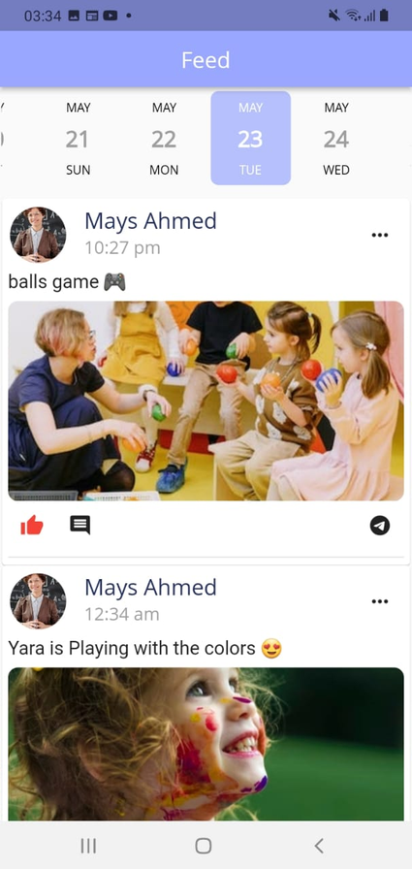
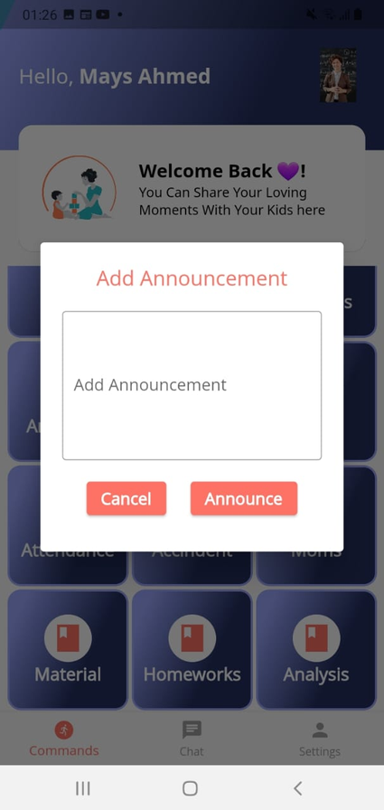
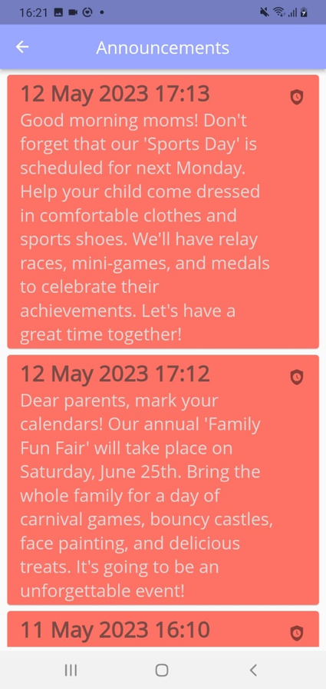
Activitities & Announcements

Slide 18
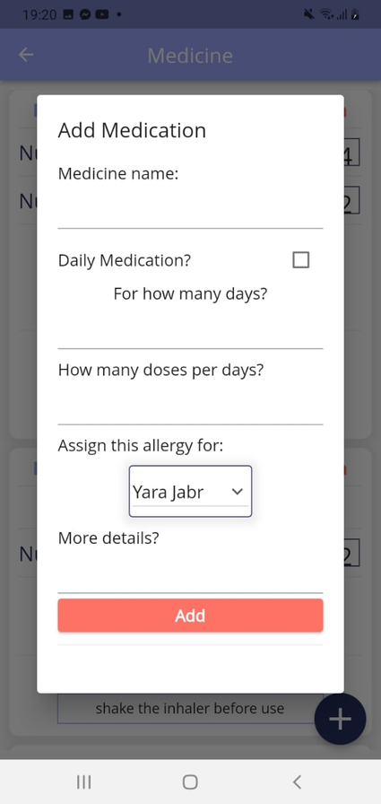
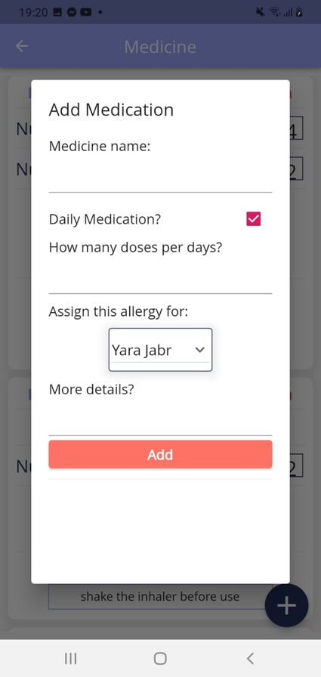
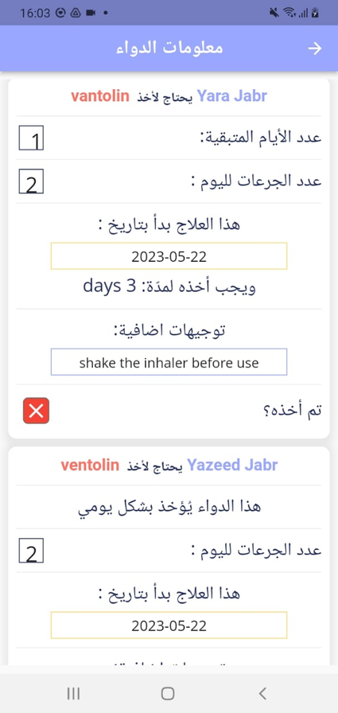
Medicine & Treatment
added by mom, viewed by teacher

Slide 19
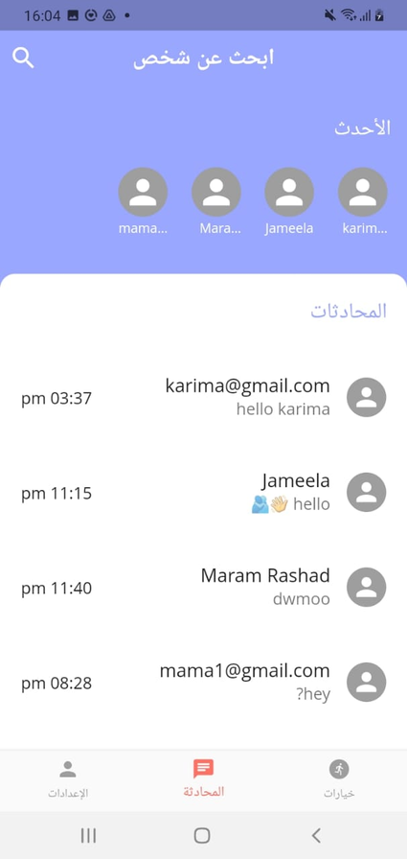
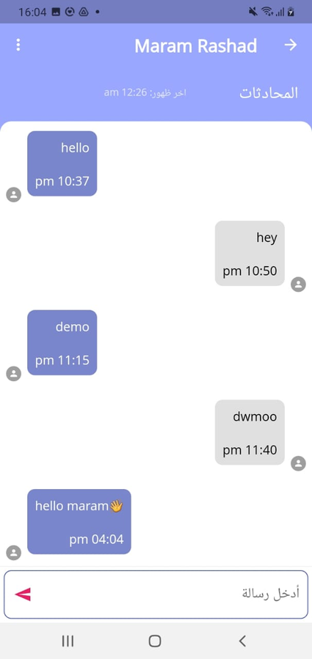
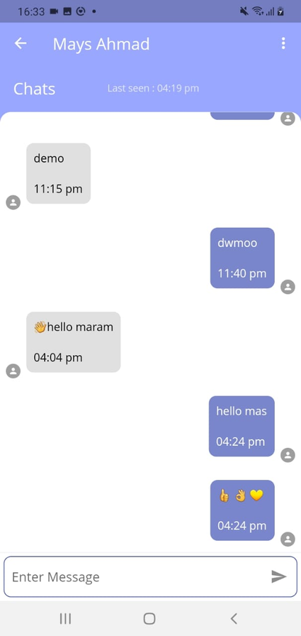
Chat messages

Slide 20
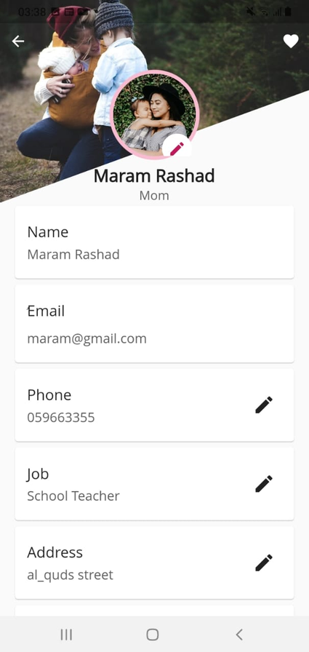
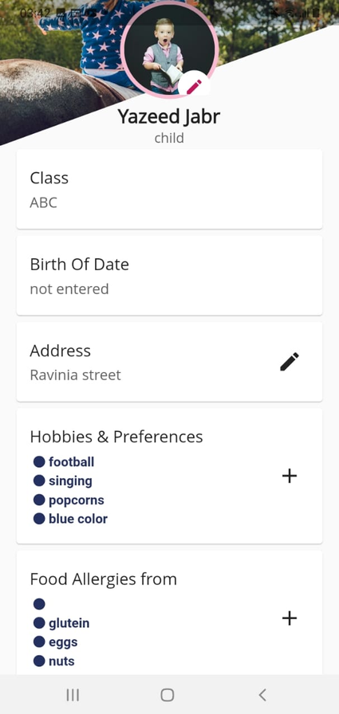
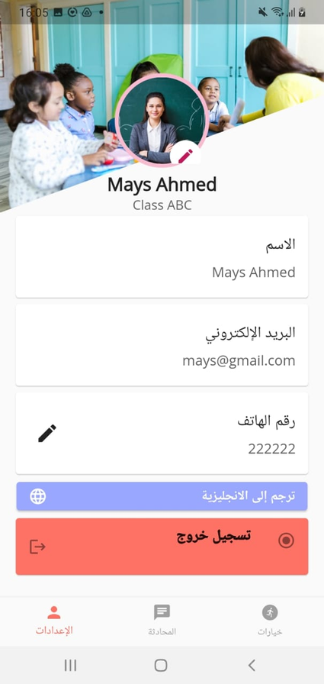
Profiles with Editable data

Slide 21
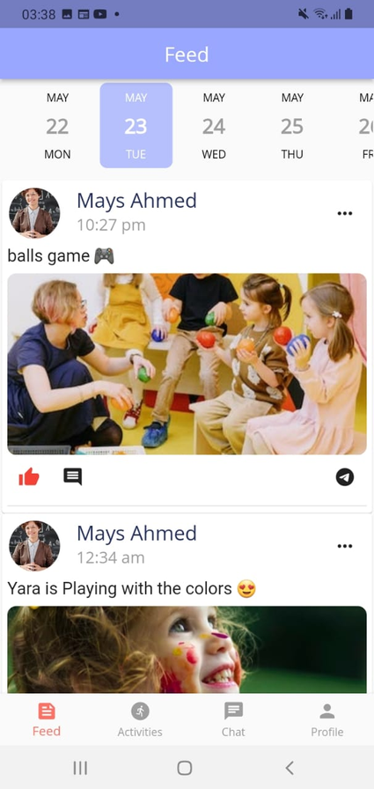
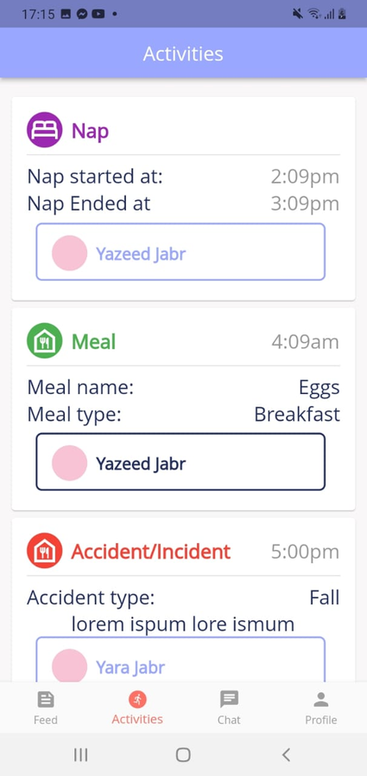
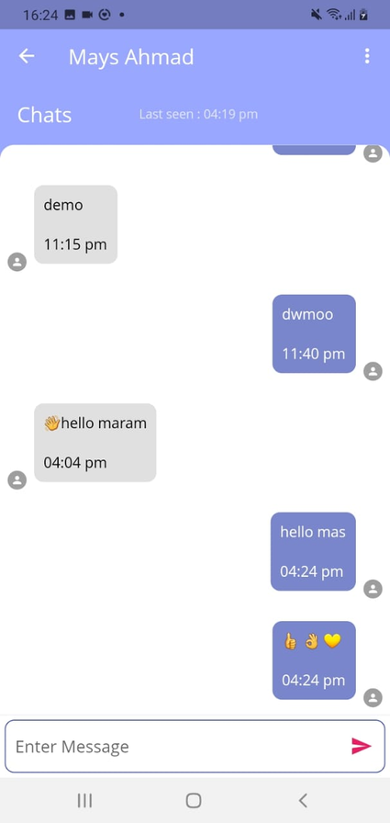
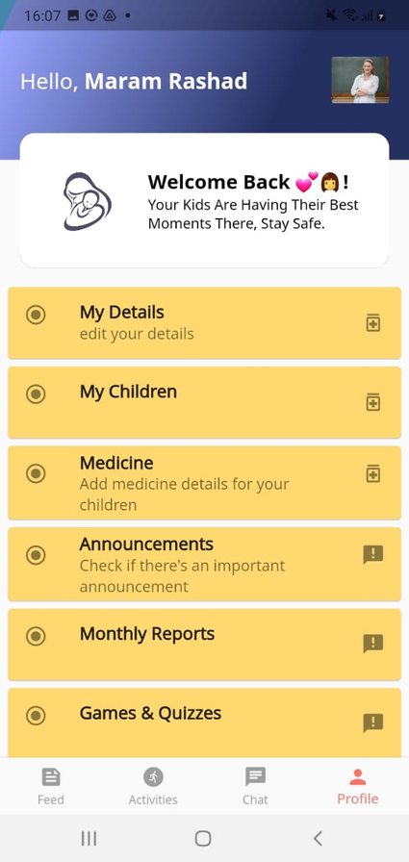
2-Logging in As Mom

Slide 22
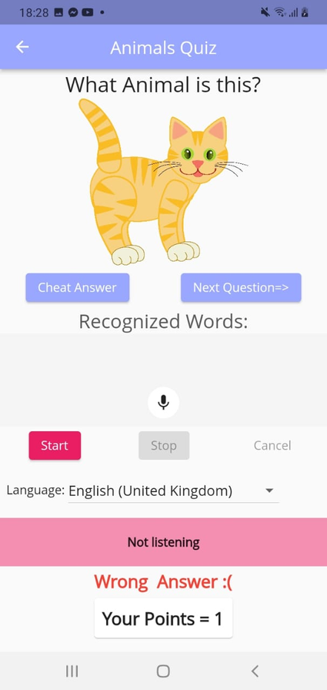
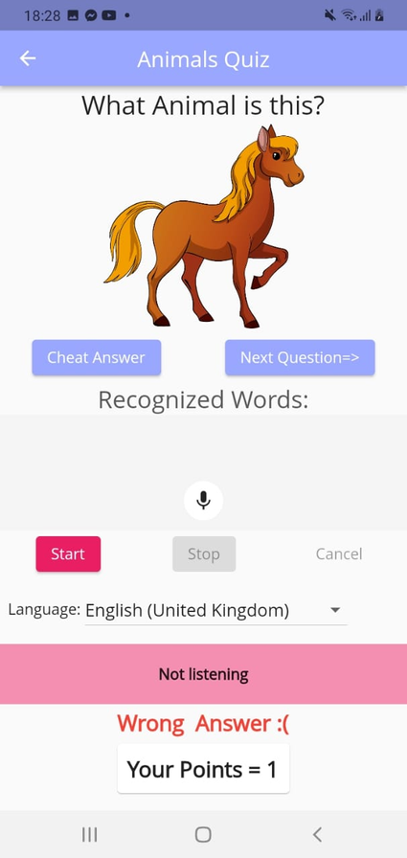
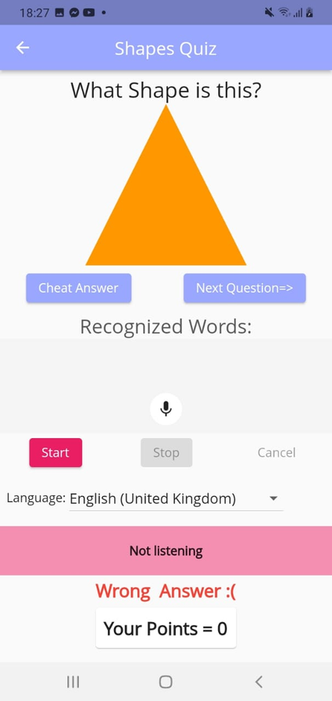
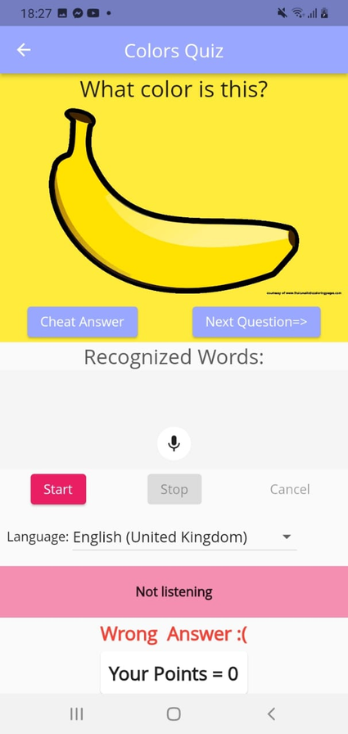
  Games & Quizzes
1- Guess the name of this shape, animal, color
using voice recognition with audio prompts

Slide 23
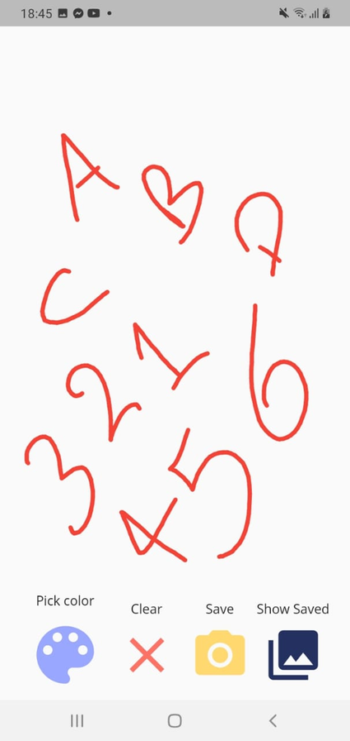
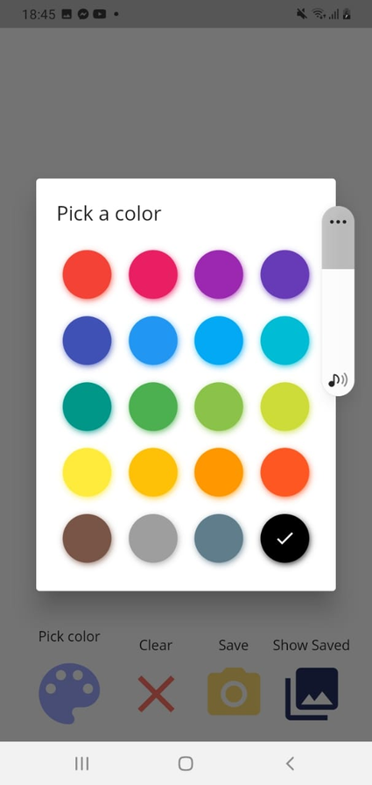
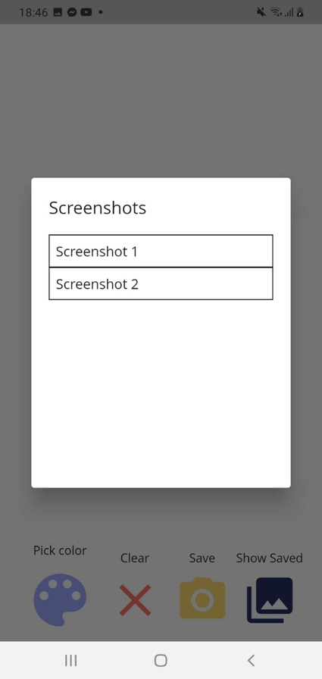
  Games & Quizzes
2- Drawing Space with color picker & save as image

Slide 24
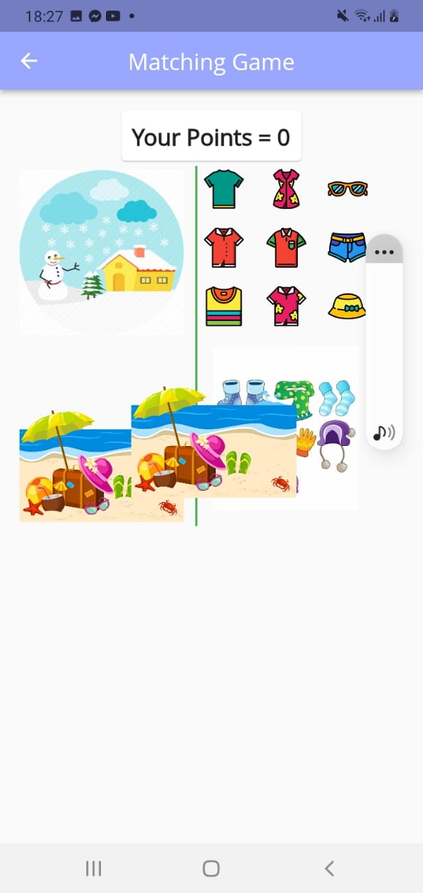
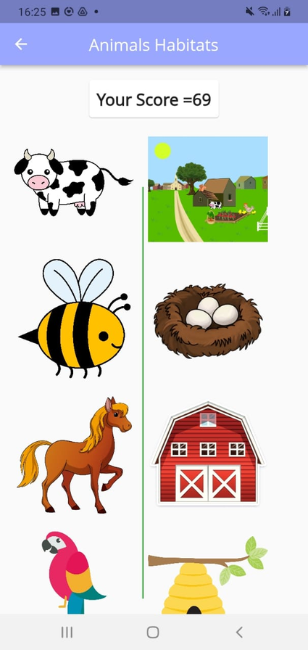
  Games & Quizzes
3- Matching games Drag & Drop with voice prompts

Slide 25
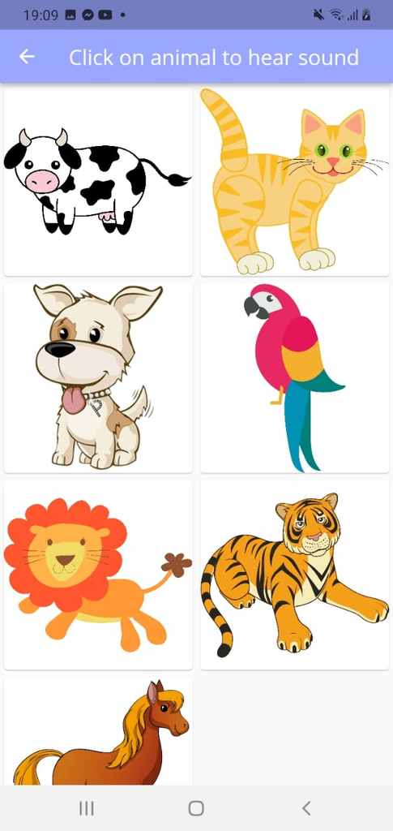
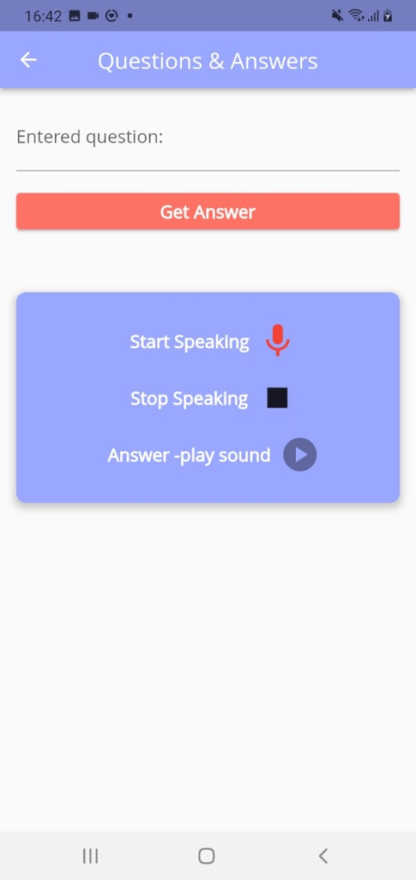
  Games & Quizzes
4- Animals Sounds
5- Q&A

Slide 26
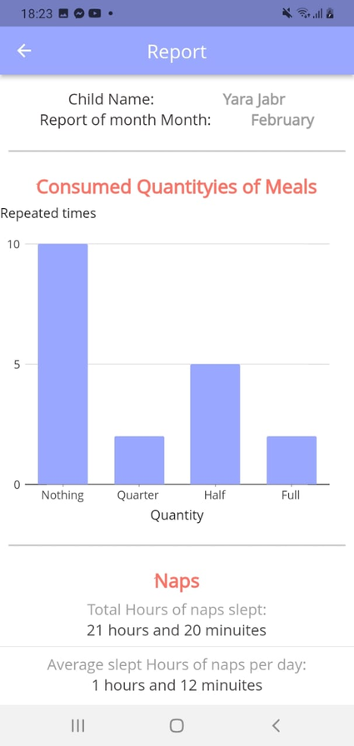
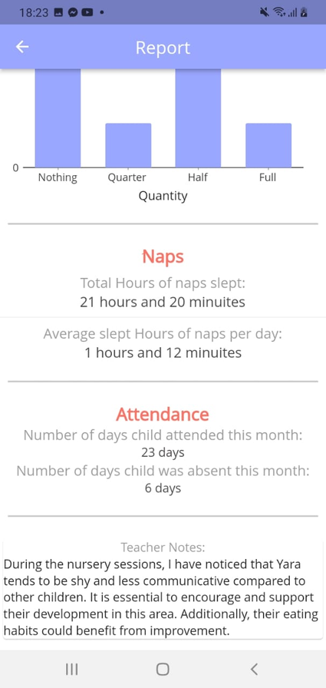
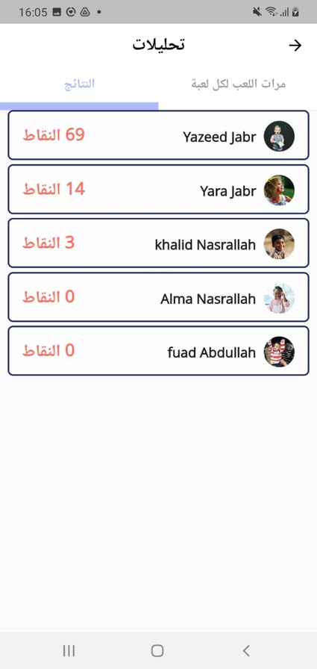
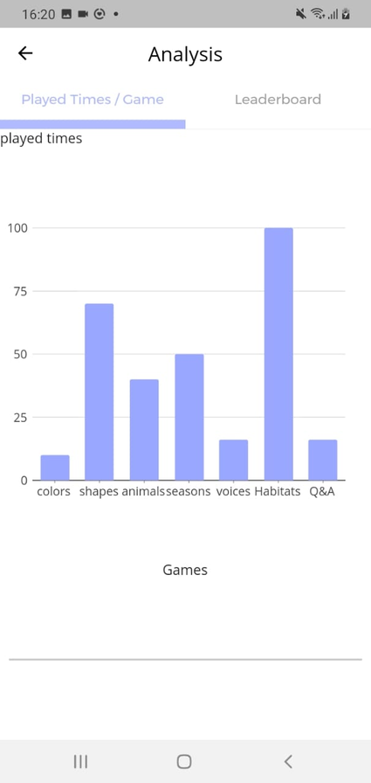
Reports
Games Analysis

Slide 27

04.
Future Work

Slide 28

01
02
On demand live videos
More Games

Slide 29

05.
Constraints

Slide 30

  Limiting Time
  Learning New Technologies and Frameworks
challenges

Slide 31

07.
Demo

Slide 32



Any Questions?

