Slide 1
Water distribution network and Wastewater collection system for Zawata village
By :
mustafa amr
Submitted to :
Dr. Hafez Qadri Shaheen

Slide 2
Outline
Introduction.
Objectives and significance of the project.
Study area.
Methodology.
Modeling , Analyzing and design.
Results
Conclusion and Recommendations

Slide 3
Introduction
Water is the most important component in the human life which forms 70% of human body.
An important element like water should be available in high level of accessibility, safe, clean, and in adequate quantity
Water used in the home for flushing, bathing, laundry, cleaning dishes, floor drainage .And water used by industry, this produce wastewater so we need to method to disposal from this waste, its called sewage system.
Notes:
Because of this, Water distribution networks are used to transmit water from the resources to the consumptions. It decreases the effort, time, cost and make the life easier

Slide 4
Objectives
Evaluating the existing water distribution network
Redesign water distribution network
Design wastewater system

Slide 5
Significance of work
water network doesn’t work efficiency
high percentage of loss which reaches 30%
So we will evaluate and redesign network
There’s no existing sewer system in Zawata

Slide 6
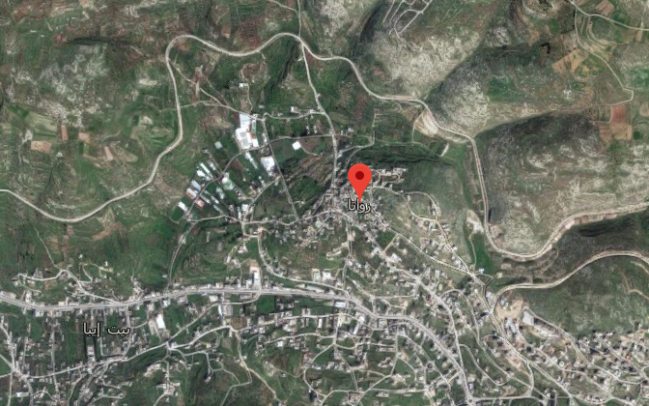
Study area
Zawata (Arabic: زواتا) is a Palestinian village in the Nablus Governorate, located 6 km northwest of Nablus City. Connected through a local road with the main road Nablus – Tulkarm
have a population of about 2,537 Capita.
with an elevation of 530 m above sea level and consists of approximately 3558 dunums

Slide 7
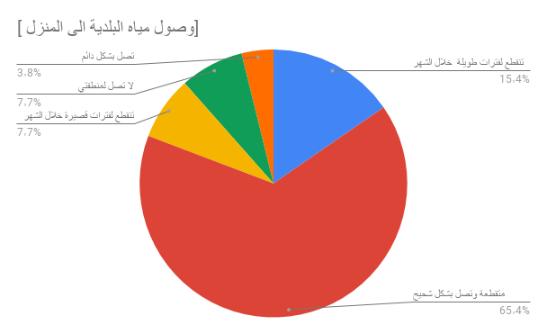
Questionnaire

Slide 8
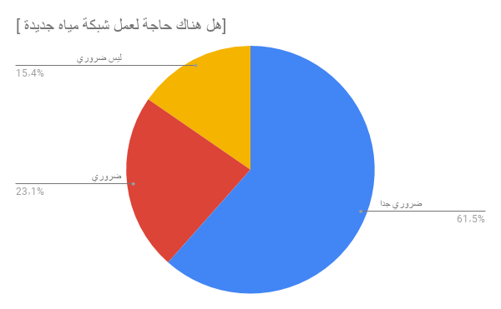
Questionnaire

Slide 9
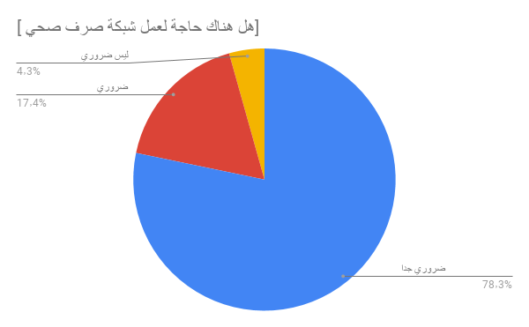
Questionnaire

Slide 10
Methodology
Selection of the study area
Data Collection
Data analysis
Giving recommendations
Evaluation and Redesign

Slide 11
Data collection
Structural map.
Contour map.
Road network.
Houses distribution.
Population of our study area.
Boundary of study area.

Slide 12
Data collection
Existing network map.
Pipes diameter is 2 in and it's type is steel .
Reservoir location.
demand per capita.
Monthly Demand.
Water recourses

Slide 13
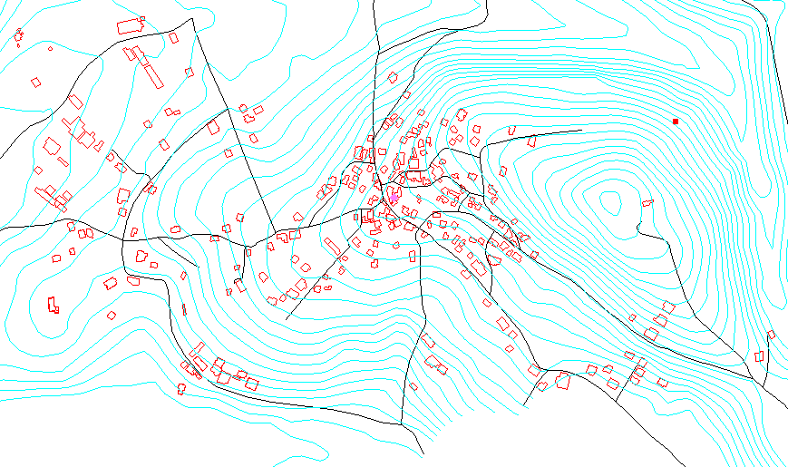
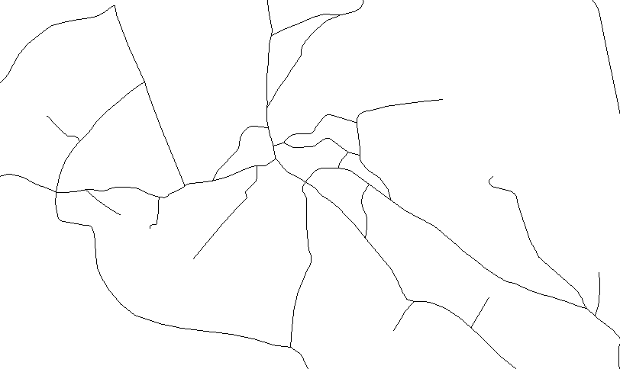
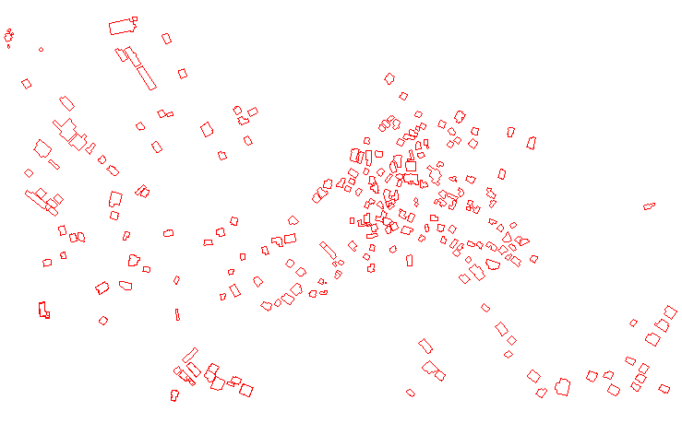
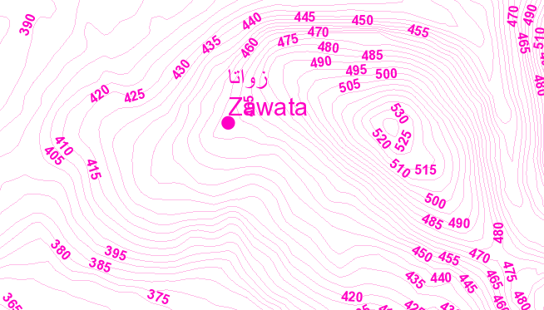
Structural map for Zawata
Road map for Zawata
Houses distribution for Zawata
Contour map for Zawata

Slide 14
Water recourse
Ein Beit Elma
Alkhazan aljded
Ein defna
Ein Beit Elma have pump with flow 100 m³/hr and head 300 m H2O
give water by 5 cycle in summer and 7 cycle in winter

Slide 15
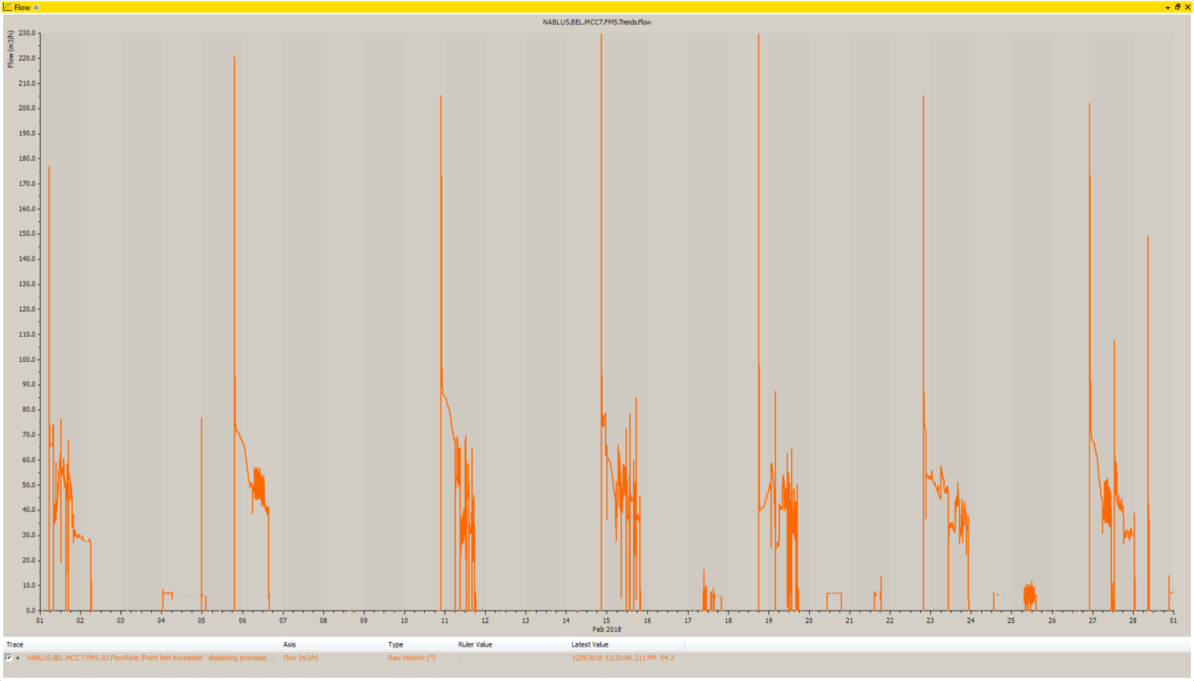
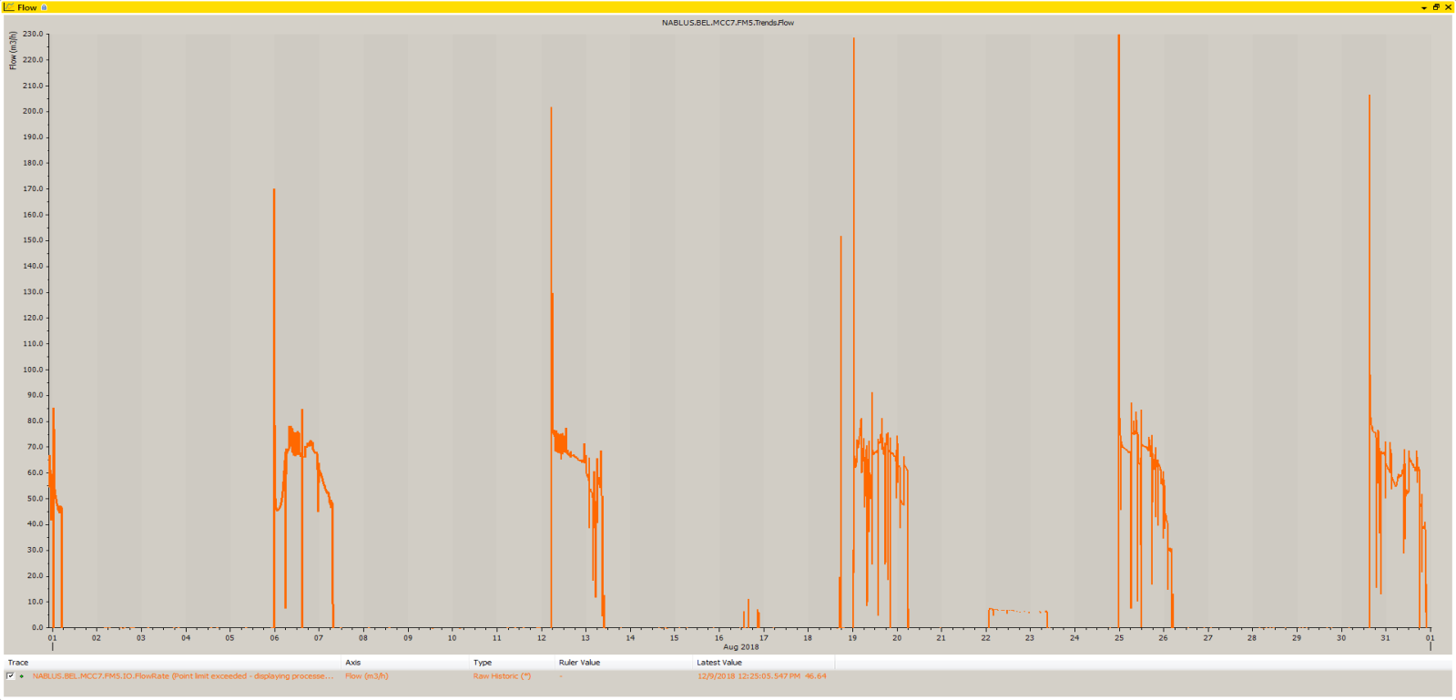
February 2018
august 2018

Slide 16
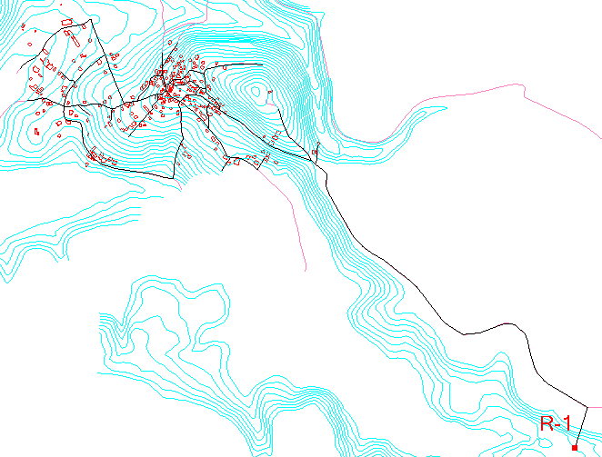
Ein beit elma

Slide 17
Monthly supply
Month | Supply (m³) |  | Month | Supply (m³)
January | 4494 |  | July | 3968
February | 4627 |  | August | 5415
March | 3968 |  | September | 6143
April | 5417 |  | October | 4970
May | 4195 |  | November | 5113
June | 6003

Slide 18
Water Distribution network
(Analyzing ,evaluating, Designing and modeling)

Slide 19
Data analyzing
Population forecasting of design period 45 year
P₂₀₀₇ = 1875 Capita
P₂₀₁₇ = 2537 Capita
1. The "constant growth rate with compounding" method.
F= P (1 + r)^{n} =12348 Capita
2. Arithmetic Growth rate
= 5583 Capita F = P + Kt
3. Exponential Growth rate
F = P (e^{kt}) = 10178 Capita

Slide 20
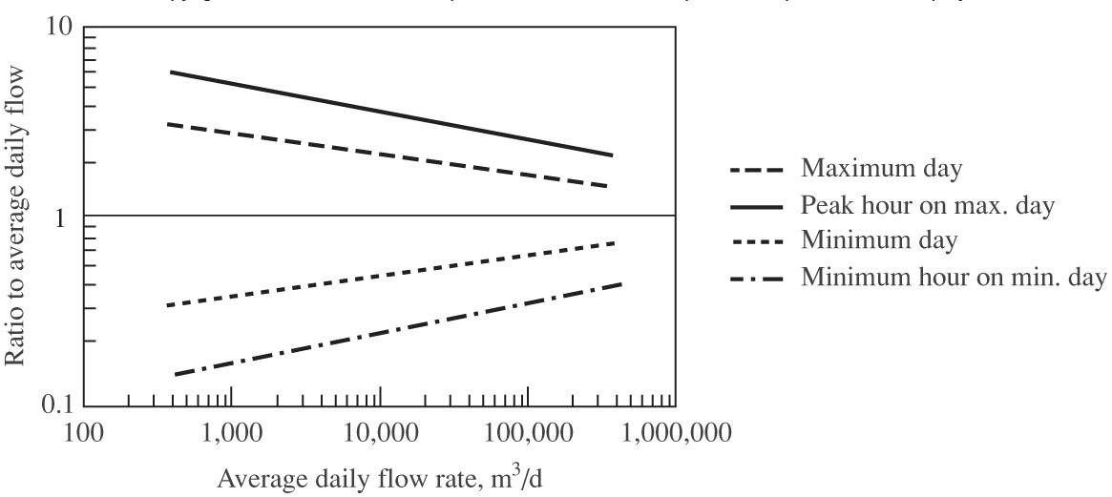
Data analyzing
Peak Hour Factor (PF)
PF = 14*P^^{-1/6}
=14*12348^^{-1/6}= 2.9 = 3
In winter
PF = 30 / 7 = 4.2 = 5
In summer
PF = 30 / 5 = 6
Water distribution network use PF = 6
Wastewater collection system use PF = 3
Q_{evaluation} = 205 m³/day

Slide 21
Data analyzing
Demand
Q month = 6143 m³ /month
Q_{evaluation} = 6143/30 = 205 m³/day
Current demand per capita is =(205*1000)/2537= 81 L/c-d
Q _{design} = (Future population) * L/c-day * hourly factor
Q _{design} = (12348 * 120 * 6 )/1000 = 5927 m³/day

Slide 22
Designing
Design considerations
Velocity : range ( 0.3 - 3.0 ) m/s .
Pressure :range ( 20 – 100 ) mH2O.

Slide 23
Modeling
Evaluation modeling with current demand .
Evaluation modeling with future demand .
Design modeling with future demand .

Slide 24
Designing
Inserting the data that we collect to WaterCAD.
Allocation of junctions and reservoir.
Drawing pipes and entering there properties.
Determine elevations of junctions and reservoir and length of pipes using TRex tool.
Apply Thiessen polygon theory to determine the service area of each junction.
Using GIS to find out the demand in the area currently by Thession polygon.
Run the model.

Slide 25
Results
Evaluation modeling with current demand
Velocities :
velocity between 0.01 and 1.13 m/s

Slide 26
Results
Evaluation modeling with current demand
Pressures :
The pressure found to be between 304 and 418 m H₂O.

Slide 27
Results
Evaluation modeling with future demand
Velocities :
Velocities between 0.18 and 33.85 m/s .
Presser found to bebetween - 16,312and -33,017 m H₂O

Slide 28
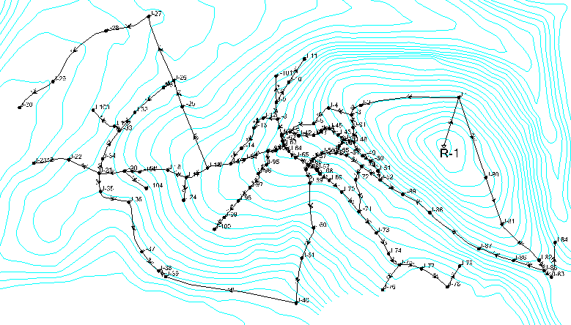
Design modeling

Slide 29
Results
Velocities :
Velocities between 0.01 and 2.61 m/s

Slide 30
Results
Pressures :
The pressure found to be between 21 and 105 m H₂O.

Slide 31
Wastewater Collection Systym
(Analyzing , Designing and modeling)

Slide 32
Data analyzing
estimation of the waste water generation per capita .
Wastewater generation rate is 80%.
Peak factor is 3.
Infiltration rate is 20% from consumed water.
WWG/capita-day = 0.8* water consumption L/c-day * (hourly factor + infiltration %)
WWG/capita-day = 0.8*120*(3+0.2)
= 403.2 L/capita-day.
Total load in system = 403.2*12348 = 4979 m³/day

Slide 33
Designing
Design considerations
Average velocity
  A 2 m/s maximum velocity .
  A 0.6 m/s minimum velocity .
Slope
  The slope of the sewer is the difference in the sewer invert elevations per sewer length.
  A minimum slope of 1%.
  A maximum slope of 15%.
Cover
  The minimum cover should at least be 1 m.
  The maximum cover should not exceed 4 m.

Slide 34
Designing
Design considerations
The flow in conduit is partially flow has percentage 75%.
Sump depth is zero.
Manning coefficient is 0.013
Steady state condition.
Outfall type is free outfall.
Diameter of manhole is 1 m.
The material of conduit is circular uPVC.

Slide 35
Design modeling
Add data for SewerCAD software “Contour Map, Building layout, road layout".
Allocate the location of manholes and outfall.
Tracing conduit between manholes.
By using Trex tool determine the ground elevation for manholes and length of conduit.

Slide 36
Design modeling
Define unit sanitary load
Define extreme flow setup
Find out the load in the area currently by Thession polygon.
Adding the total load using load builder tool
Define all project constraints
Run the model.

Slide 37
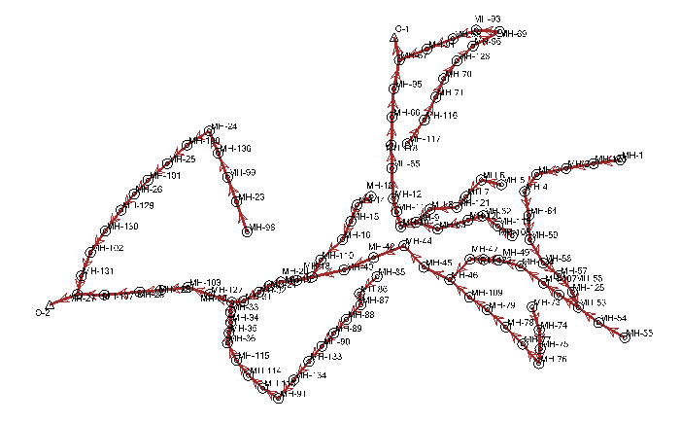
Design modeling

Slide 38
Results
velocities are distributed between 0.6 and 3.4 m/s
some of the velocities are out of the range (0.6 to 2 m/s ),

Slide 39
Results
Slopes distributed between 1 and 15 %

Slide 40
Results
Cover are distributed between (.8 and 4.5 )m/s
one of the them are out of the range (0.8 to 4 m)

Slide 41
Results
Cover are distributed between (.8 and 4.5 )m/s
one of the them are out of the range (0.8 to 4 m)

Slide 42
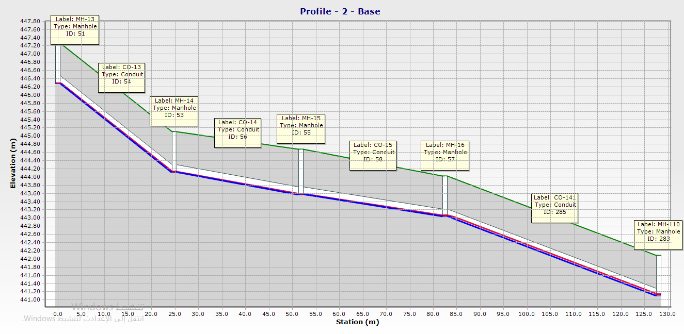
Results
Profile from manhole
(MH-13) to manhole
(MH-110).

Slide 43

Results
Tow outflow in system equal
load in system =4979 m³/day

Slide 44
Conclusion and Recommendations
Water distribution network
The existing network with future demand
The new design network.
Wastewater collection system
The design system

Slide 45

Thank YOu

