Slide 1

Design for paltel company in Nablus
An-Najah National University
Faculty of Engineering & Information Technology
Department of Building Engineering
Prepared By:
Mohammed halabi
basel abbas
Supervisor: Eng. Hind tbaileh

Slide 2
Contents:
Site analysis
Architectural Design
Environmental Design ( thermal design )
Mechanical system Design
Safety design
Environmental design ( ACOUSTIC )
Structural system Design
Electrical design

Slide 3
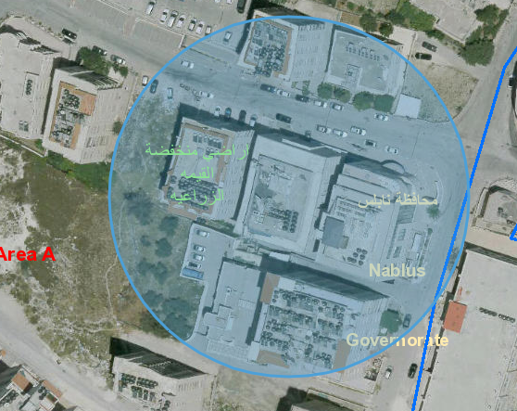
Architectural design
Site analysis
The site is located at the east of Nablus city, east of Nablus near to (Aljunaid Prison), it’s to the north of Rafidia street, about 520m above sea level and 3.2 kilometers away from city center. The Site has a total area of 1089 m2.

Slide 4
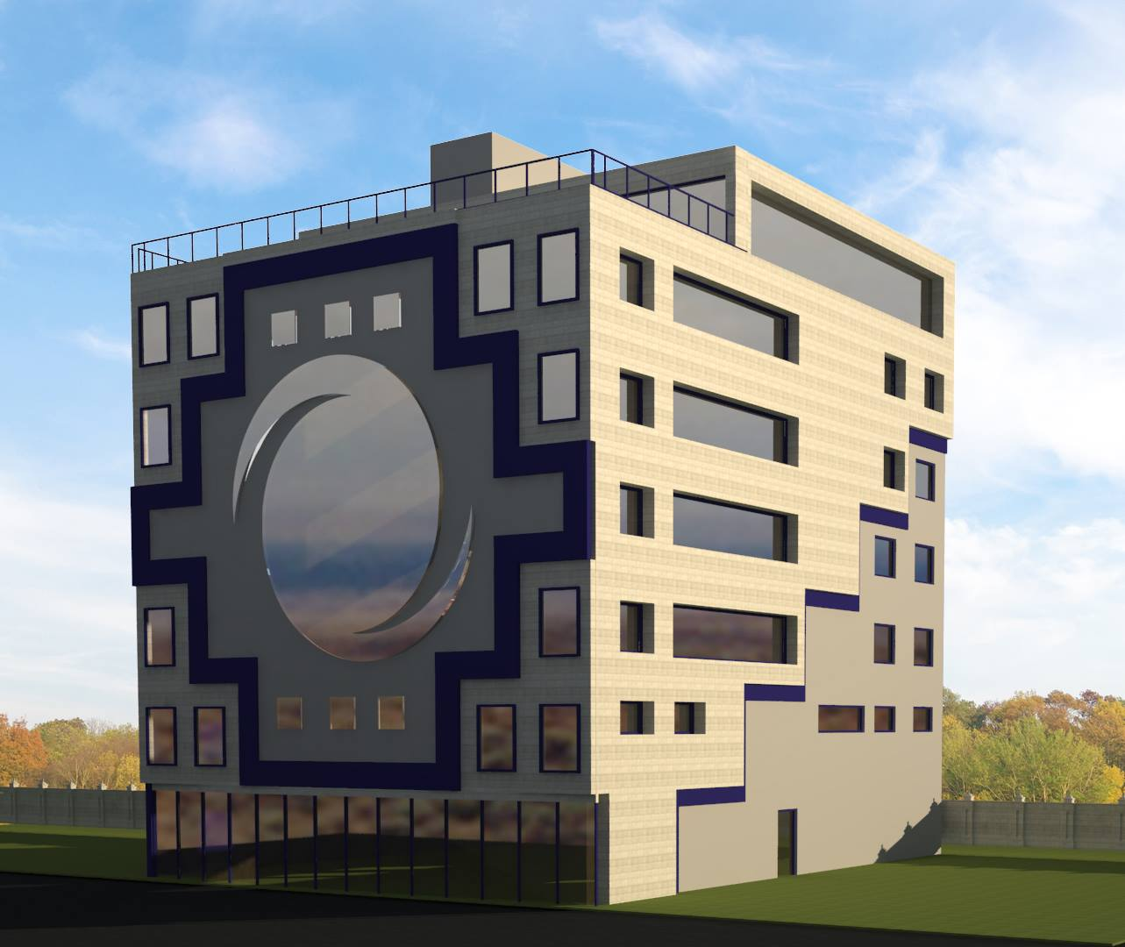
3D model

Slide 5
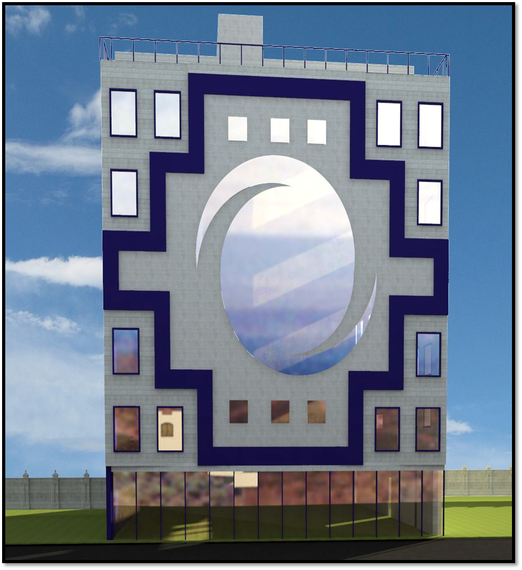
3D model

Slide 6
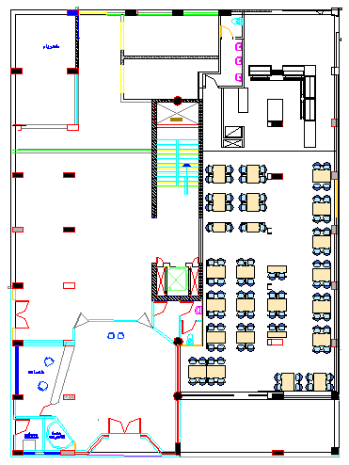
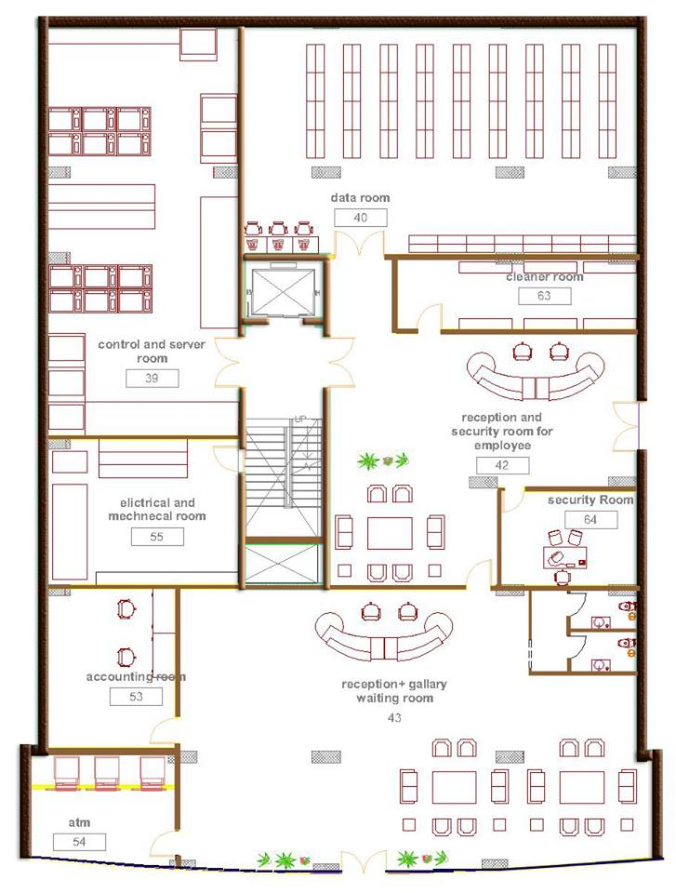
Ground Floor

Slide 7
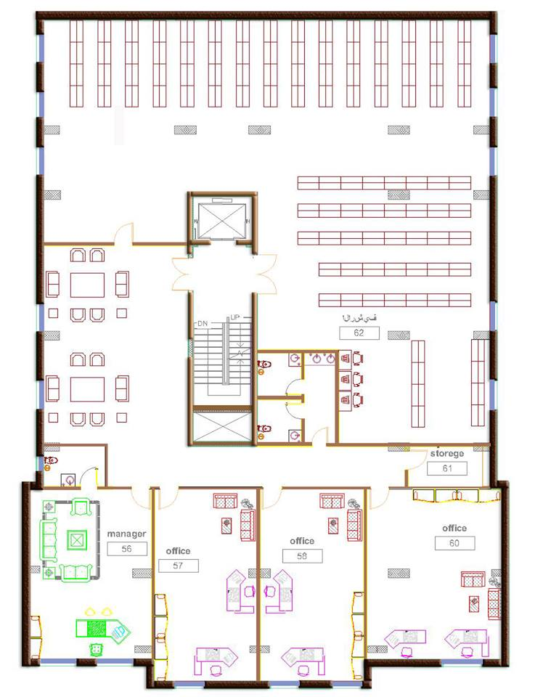
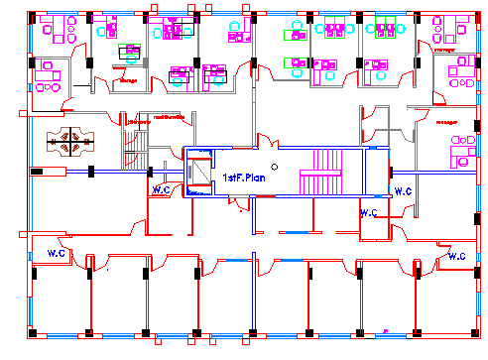
First Floor (archive)

Slide 8
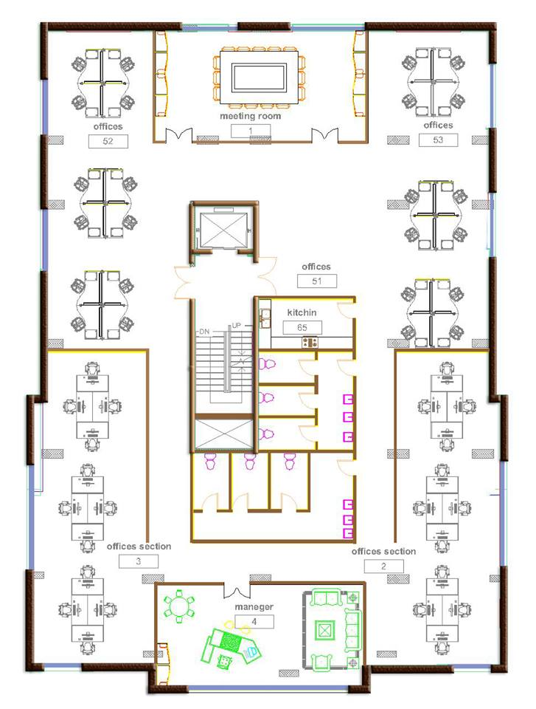
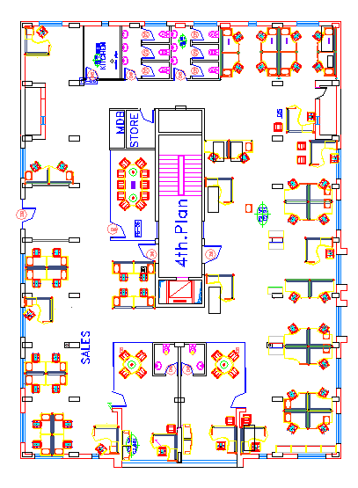
Second Floor ( the repeated office floor )

Slide 9
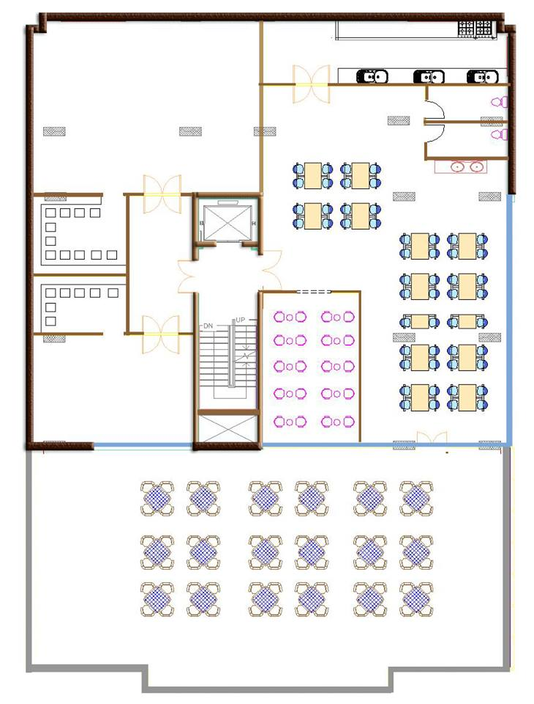
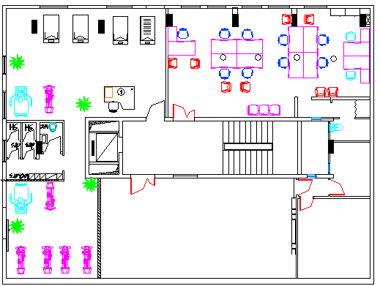
The 7th Floor

Slide 10
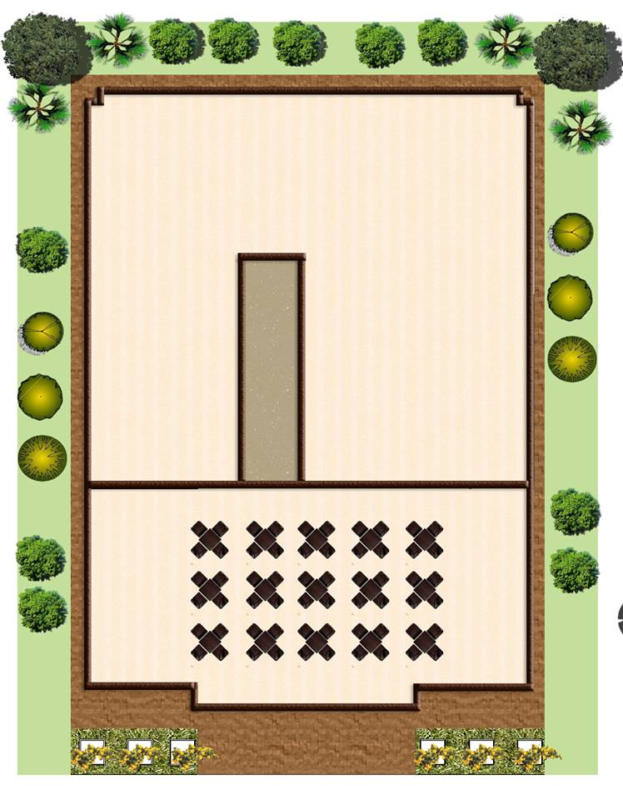
site plan

Slide 11
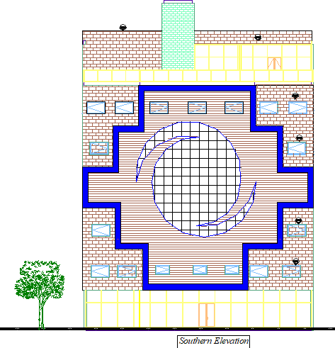
Southern Elevation

Slide 12
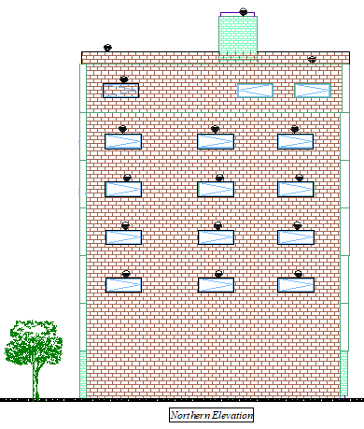
Northern Elevation

Slide 13
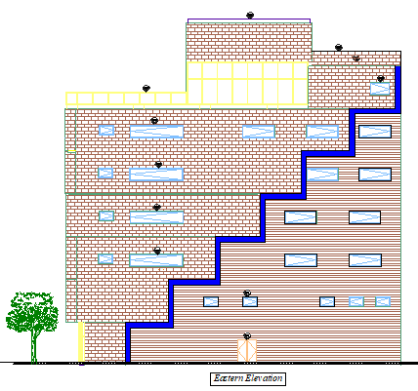
Eastern Elevation

Slide 14
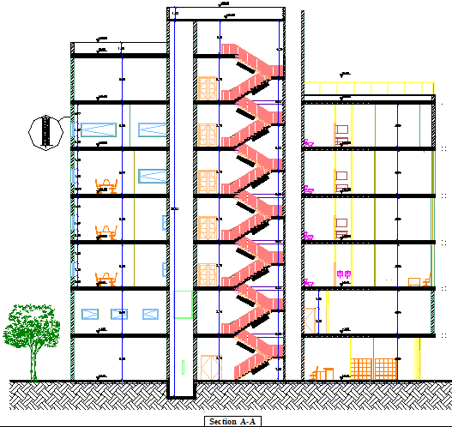
Section A-A

Slide 15
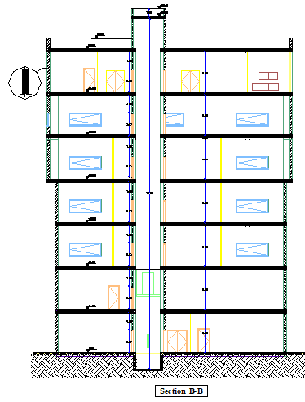
Section B-B

Slide 16
Environmental Design
Thermal Design
Old U value for building envelope
New U value for building envelope
Component | U-value (w/m²-k)
External Wall | 2.624
Partition Wall | 2.685
Floor | 2.585
Roof | 0.85
Windows (Clear glass 4 mm ) | 3.097
Component | U-value (w/m²-k)
External Wall | 0.458
Partition Wall | 1.582
Floor | 0.268
Roof | 0.498
Windows (Double glass, low e, 6 mm) | 1.960

Slide 17
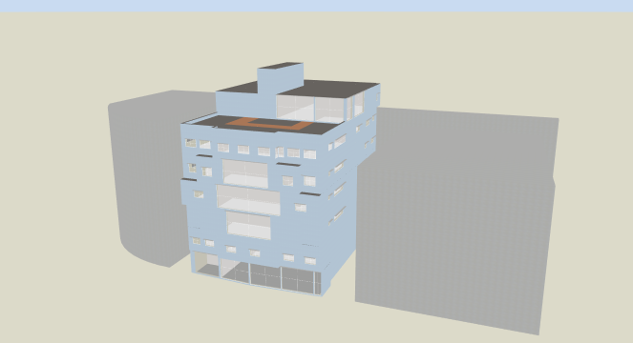
Design Builder program ( 3D Model )

Slide 18
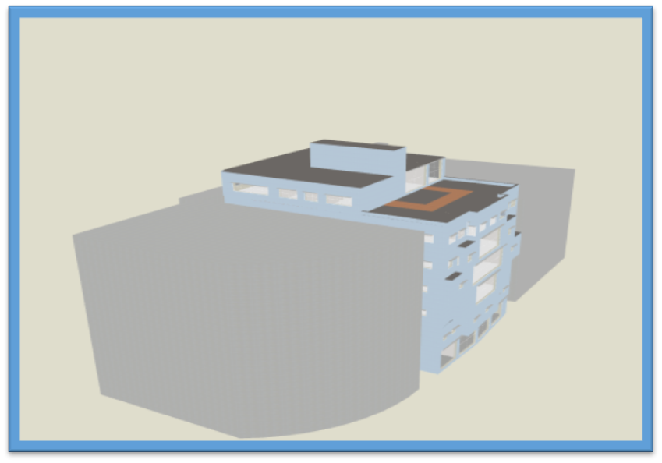

Slide 19
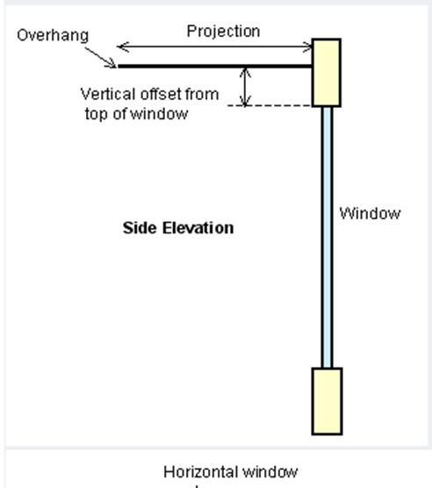
Shading
The overhang was used for shading with 0.36 m projection

Slide 20
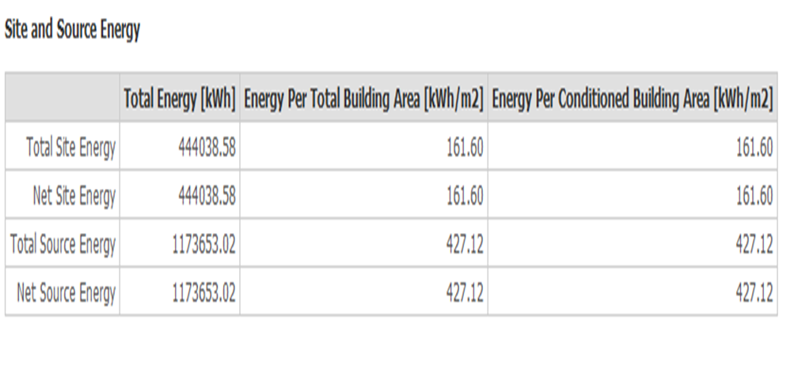
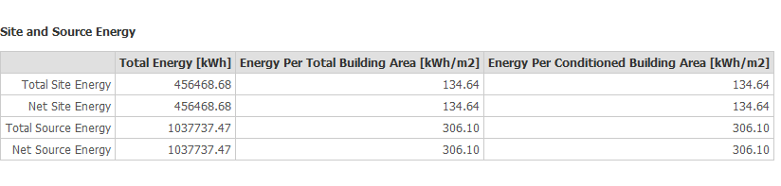
Thermal Design
Heating and cooling load
Cooling load 85.4 kw
Heating load 41.9 kw
Site and Source Energy
Old total site energy
New total site energy

Slide 21
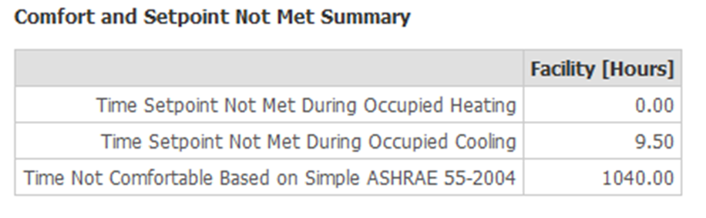
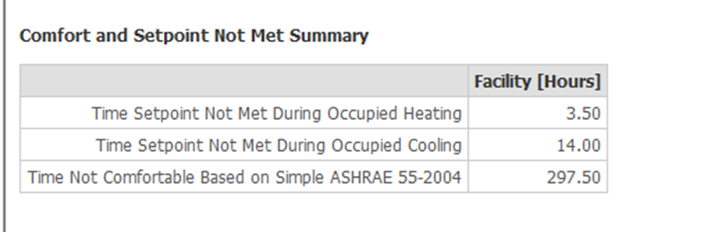
Times not Comfortable
Old time not comfortable
New time not comfortable

Slide 22
Mechanical Design

Slide 23
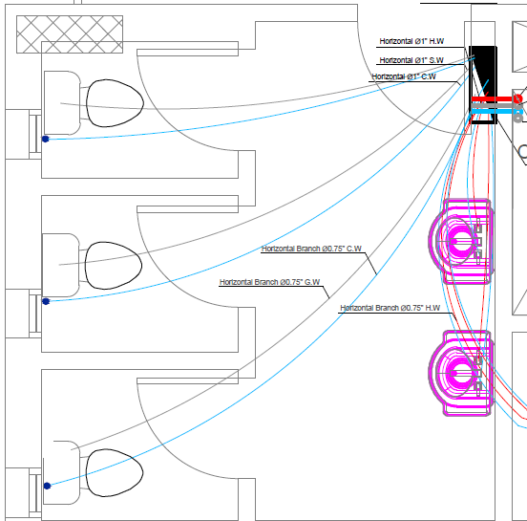

Water demand = 3.225 $m^{3}$/day
Water Supply System

Slide 24
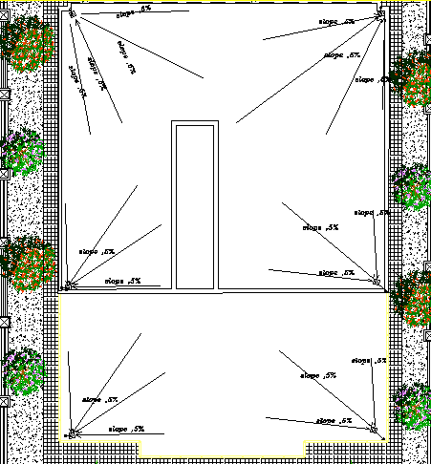
Rain Water Drainage

Slide 25
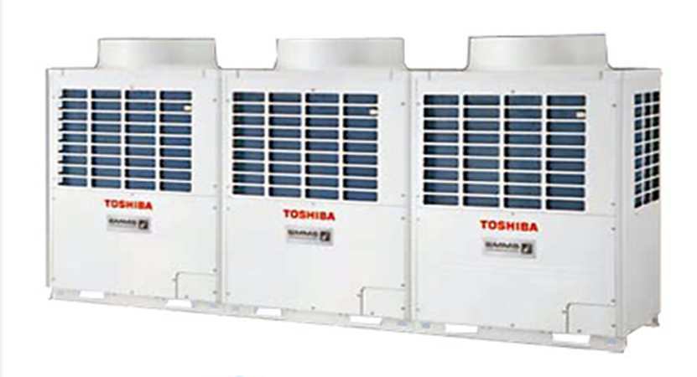
(HVAC (System
VRF system
Outdoor unit Selected From Toshiba company with
Cooling capacity 135 kw
Heating capacity 150 kw
(SMMSi ) MODEL NO: MMY-AP4824HT8-E

Slide 26
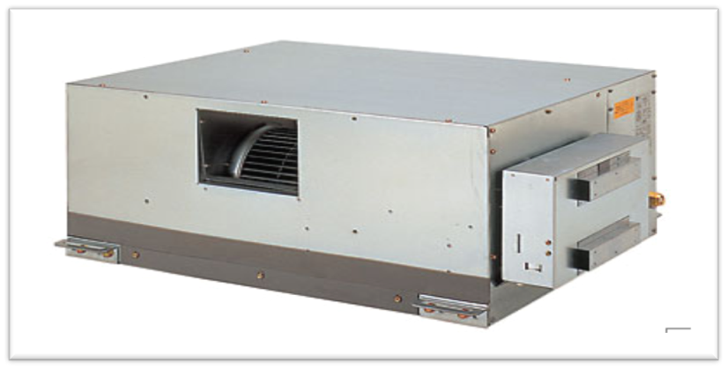
(HVAC (System
VRF system
Fan coil From Toshiba company depending
on volumetric flow rate for each space.
great power up to 28 kw

Slide 27
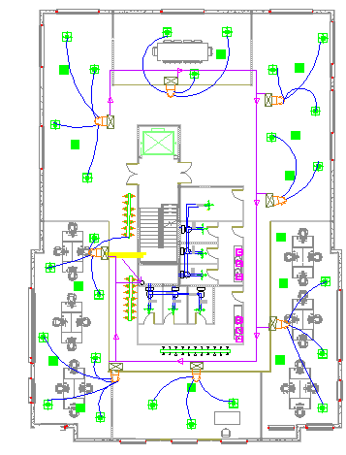
Second floor HVAC system layout

Slide 28
Firefighting and Safety Design

Slide 29
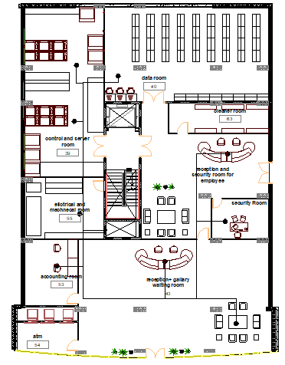
Sprinkler System
Sprinkler System
for Ground Floor

Slide 30
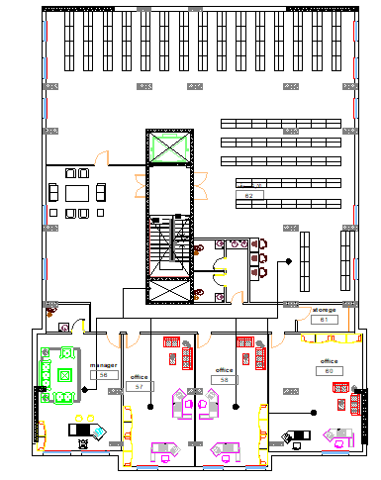
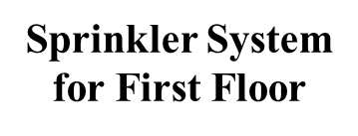

Slide 31
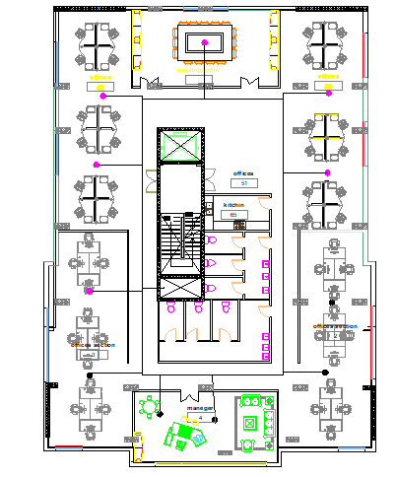
Sprinkler System
for second Floor

Slide 32
Quantity Surveying and Cost Estimation for mechanical and finishing

Slide 33
Cost Estimation
Directorate of Health | Total labor cost | Total material cost | Total Direct Cost (Nis)
Mechanical Work | 56288 | 185560 | 241,848
Finishing Work | 434031 | 1221283 | 1,655,314
Total direct project cost |  |  | 1897162

Slide 34
Acoustics Design

Slide 35
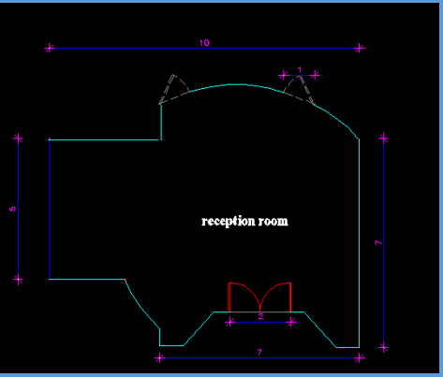
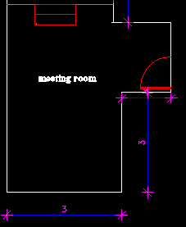
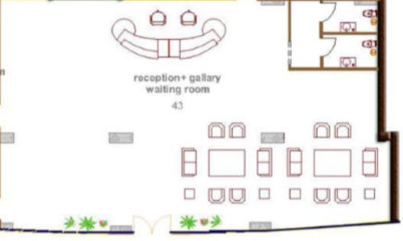
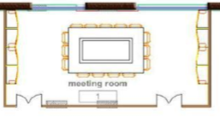
RT60 (Reverberation Time)
Old Spaces
New Spaces

Slide 36
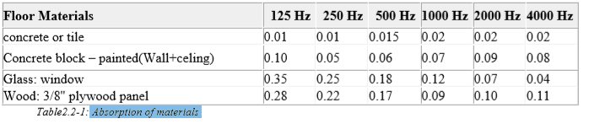
RT60 (Reverberation Time)
Absorption of materials

Slide 37
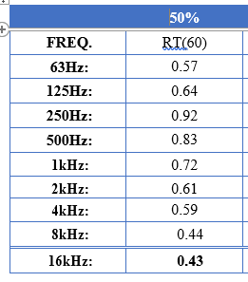
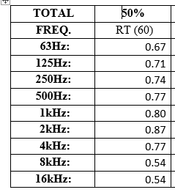
RT60 (Reverberation Time)
Old RT60 Values for Reception
New RT60 Values for Reception
Recommended
Reception
(0.4-0.8)

Slide 38
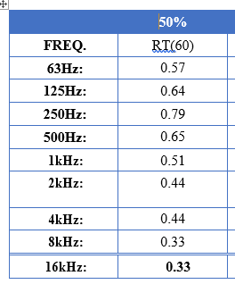
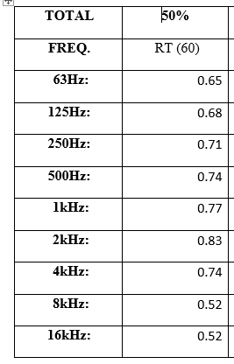
RT60 (Reverberation Time)
Old RT60 Values for meeting room
New RT60 Values for meeting room
Recommended
meeting room
(0.6-.1.1)

Slide 39
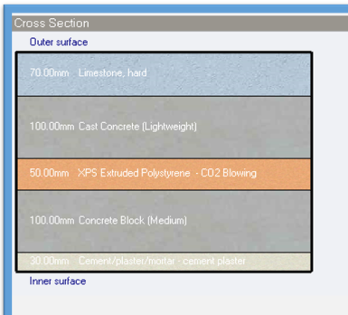
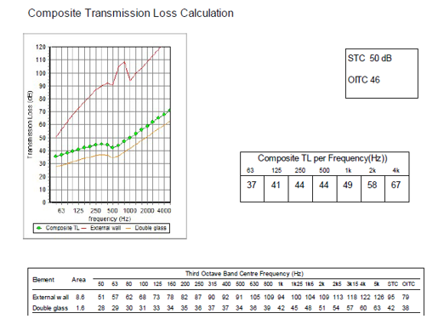
STC
TL = 50 dB
For External Wall of office
Recommended Value 52dB
External Wall

Slide 40
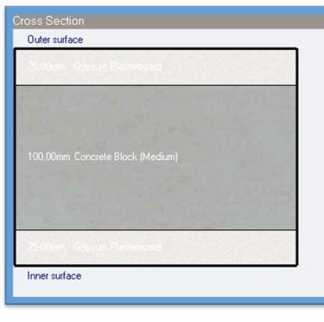
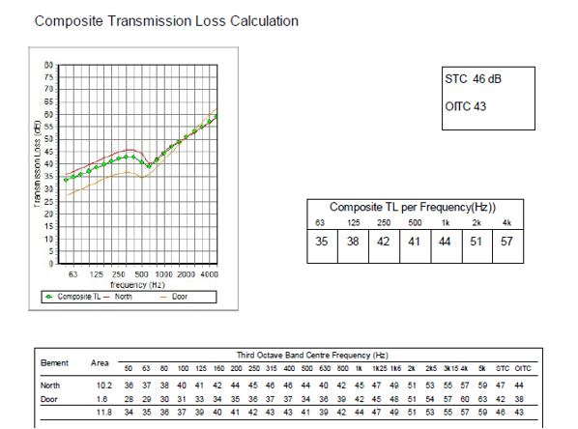
STC
For adjacent offices
Recommended Value 45 dB
TL = 46 dB
Internal Wall

Slide 41
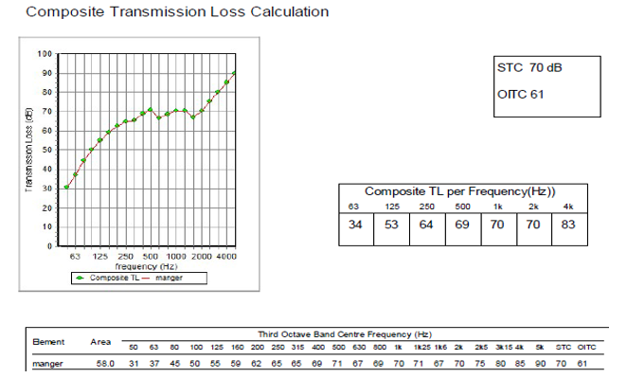
IIC For Ceiling
IIC = 70 dB

Slide 42
Structural Design

Slide 43
Codes and Loads
  Loads
  Live Load = 4 kN/𝑚^2
  SID = 4 kN/𝑚^2
  Eq Load coefficients:1.2 DL + 1.2 SID + 1.6 L.L
  R = 5.5 ,
  I = 1
  Z = 2B (Nablus) =.2 ,
  Cv= 0.40 ,
  Ca = 0.28
  Soil Profile ((SD))
Codes
• ACI 318-14 for reinforced concrete elements
• UBC 97 for design of Seismic load, Load combinations.

Slide 44
Structural system
Materials
Concrete , B350
Steel fy = 420 Mpa
Final Design Sections
Slab thickness 35 cm
Columns dimensions ( 100*40 & 90*30) cm
Beams dimensions ( 35 * 60 & 35* 50 & 80*35 &50*70 &70*70 & 20*50 ) cm
Structural System
One Way Ribbed Slab
Walls Thickness 35 cm

Slide 45
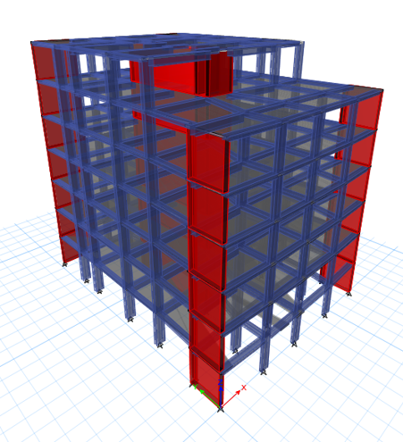
3D-Modeling

Slide 46
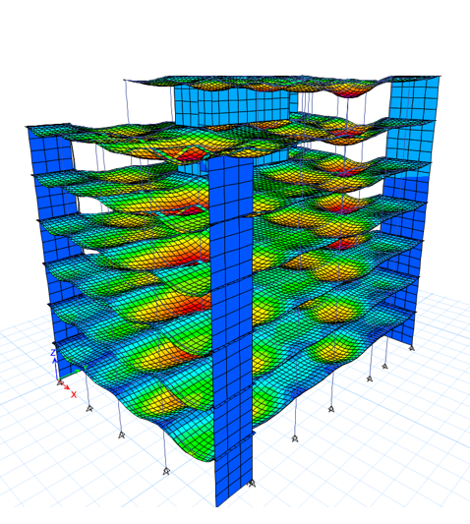
Model Checks
1…Compatibility Check

Slide 47
Model Checks
2…Equilibrium Check
Done for Dead (.016), SID(.035) and Live load(.035) with difference less than 5 %.
3…Internal Forces Check
Done for 2 samples of beams and columns with difference less than 10%

Slide 48
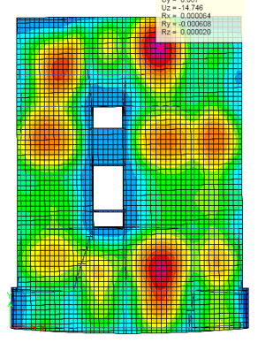
Model Checks
14.746
4…Deflection Check
Limit = L/240
= 6.5/ 240 = 27 mm

Slide 49
Model Checks
5…Period Check
Period from ETABS = 0..792 sec.
Period from hand calculation= 0.594
T from ETABS < 1.4 from hand calc.
0.792 sec.< 0.8316 sec.

Slide 50

Slab Reinforcement

Slide 51

Slab Reinforcement

Slide 52

Beams Reinforcement

Slide 53




Beams Reinforcement
B3
B4
B5ا
B6

Slide 54



Columns Reinforcement
c1

Slide 55


Columns Reinforcement

Slide 56



Footing Reinforcement

Slide 57


Footing Reinforcement

Slide 58


Footing Reinforcement

Slide 59


Ground Beams Detailing

Slide 60


Shear Wall Reinforcement

Slide 61

Stairs Reinforcement

Slide 62
Structural Consumption Estimation
Total | Labor | Material | Type
3250958 | 1100818 | 2150140 | Structural

Slide 63
Past and New Design
Past
New Design
Not Designed For Seismic Load
Earth quick Design Based
Structural Elements compatible with architectural purposes
Lower construction cost

Slide 64
Electrical Design

Slide 65

First Floor socket plan

Slide 66

First Floor ups plan

Slide 67

First Floor Lighting Plan

Slide 68



Luminaires Layout
49.4
Old Main Luminaire
New Main Luminaire
95
57

Slide 69


3D Rendering View for Selected Rooms
meeting Room
Receptipn

Slide 70


meeting Room
Required illuminance 500 lux
Required uniformity (>0.60)
Average Illuminance
577 Lux
UGR = 16

Slide 71

Power Consumption Estimation
Electricity Consumption Estimation

Slide 72
Thank You

