Slide 1
Advertising Laser Projector
Prepared by
Bodour AbuZarour
Thana’ Mer’i
Supervisor: Dr Alaa Eldin El Masri
5/23/2012

Slide 2
Outlines
Main idea of Laser Projector ?
Components and Tools.
Design and Implementation.
Applications and features.
Future Work.
References.

Slide 3

Main Idea of Laser Projector ?
The basic idea is to create a character
projector that linked to a Pc via
serial port.
Switching on and off a laser beam being reflected off a rotating polygonal mirror.
display dot matrix style text onto any surface.

Slide 4
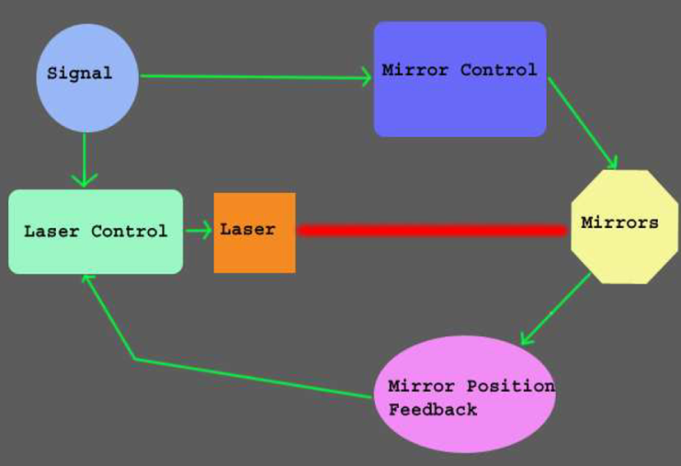
Main Idea of Laser Projector ?
Figure 1

Slide 5

Applications and Features
Entertainment and Advertisements purposes.
Simple Structure.
Cheap.
Dynamic Display.
Display up to 5 characters each with 6*7 “pixels” on a grid. .

Slide 6
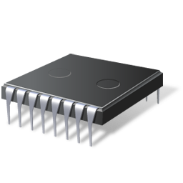
Components and Tools
Used Hardwar :
Microcontroller PIC18F4620.
Basic circuit with 20 MHZ oscillator.
12v DC Motor.
5mW laser Pointer.
ULN2003A-motor (high voltage, high current Darlington arrays).
7 Pieces of mirrors with sizes 3.5*2.0 cm and 1mm thickness.
QRD1114 - Reflective Object Sensor.

Slide 7
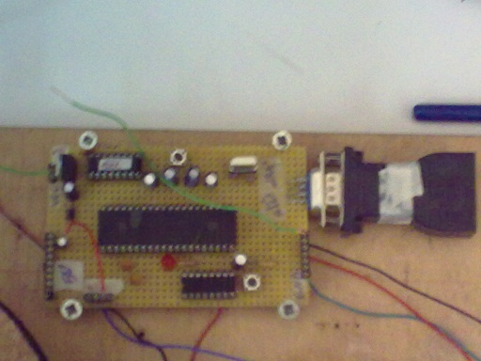
Design and Implementation(cont)
Microcontroller circuit
Figure1

Slide 8
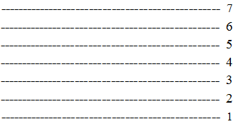
Design and Implementation
Hardware Stage:
Aligning the mirrors
gluing the mirrors with different
angles and moving them with
high speed with a laser pointing
to the mirrors will reflect laser
dot sweeps the screen from right to left !
because it does it very quickly your eyes actually see
horizontal solid line.
Figure 2

Slide 9
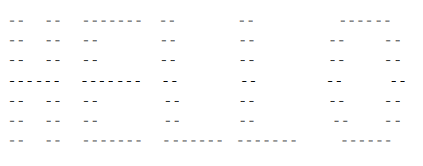
Design and Implementation(Cont)
When the laser turns on and off at the right time we could get the text we need to be displayed.
Figure 3

Slide 10
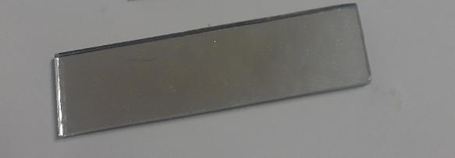
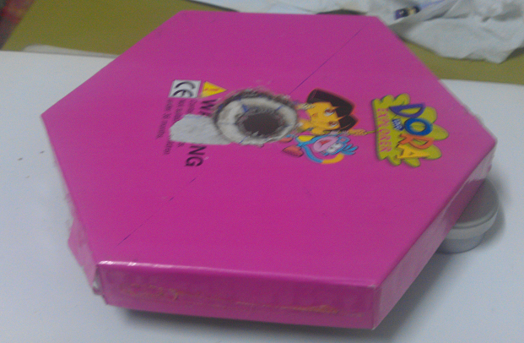
Design and Implementation
Choosing the Polygon
We started with hexagonal polygon to align 6 mirrors each with 3cm* 8cm with 3mm thickness.
Figure 4 Figure 5

Slide 11
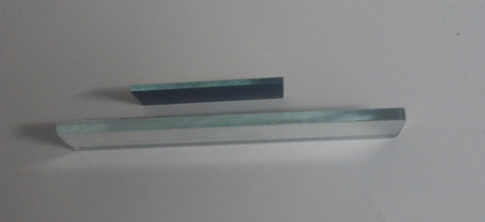
Design and Implementation(Cont)
Thickness Problem
Figure 6

Slide 12
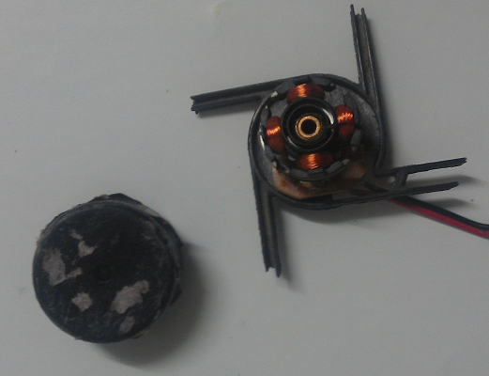
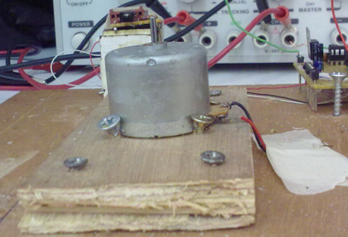
Design and Implementation
we tried using cooler fan, and then moved to dc motor.
Choosing the Motor
Figure 7 Figure 8

Slide 13
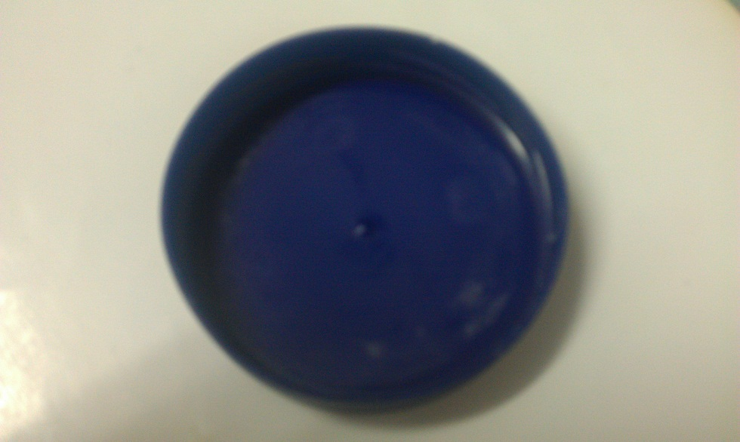
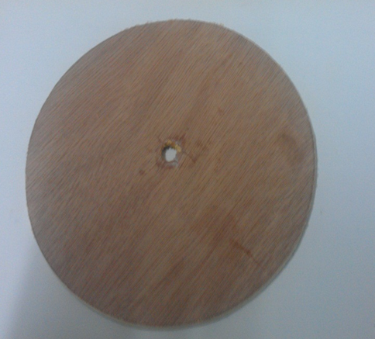
The new Polygon structure
Figure 9 Figure 10

Slide 14
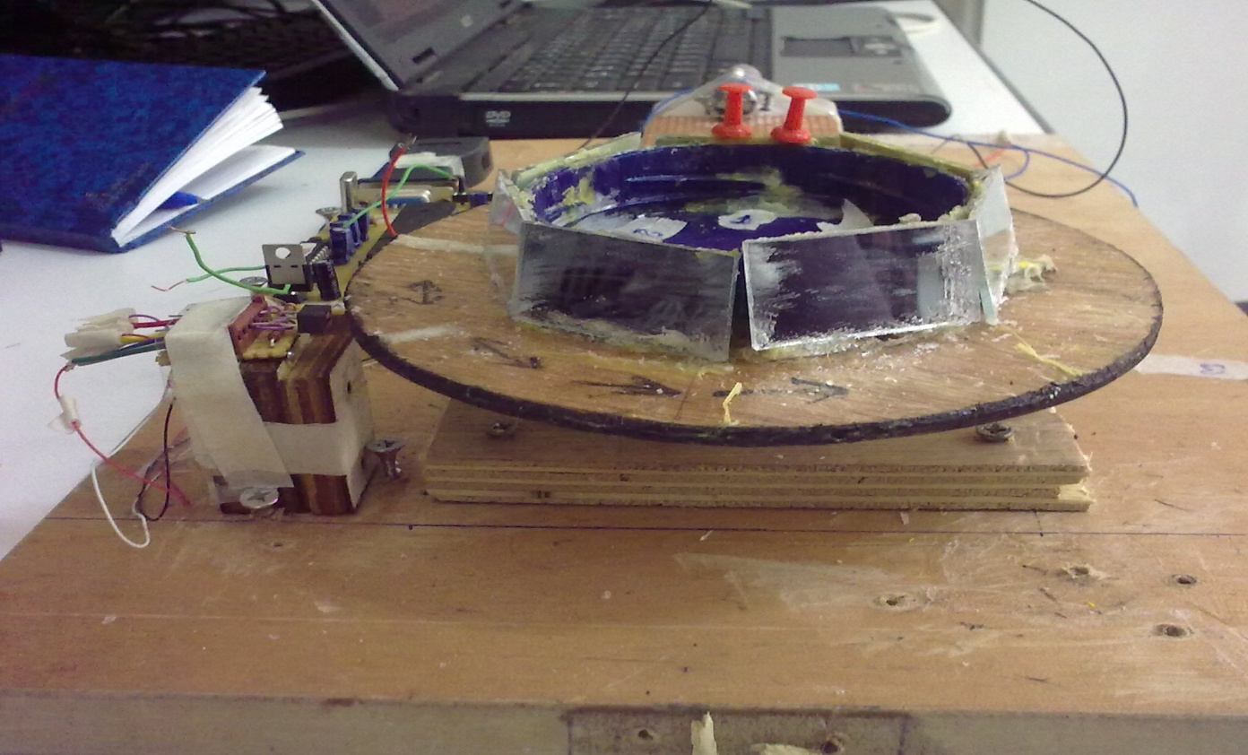
Design and Implementation(Cont)
Using the sensor with the final polygon.
Figure 11

Slide 15
Design and Implementation(Cont)
Software Stage:
Code to represent main grid
Reference line
Reference is mirror 3 by sensor feed back!
Arranging mirrors
Mirrors starts from bottom to top
Notes:
50 us each pixel
Different delay to adjust sync. Problems with delay ,periods are not equal,oscilator
Static and dynamic,,,,5 char. Each char 6 pixels….each char has 7 functions (7 mirrors )

Slide 16
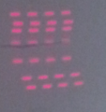
Design and Implementation(Cont)
Code to represent dot matrix
On off port’s output.
Controlling laser beam.
50 us each pixel
Delay to design the text pattern.
Synchronization

Slide 17
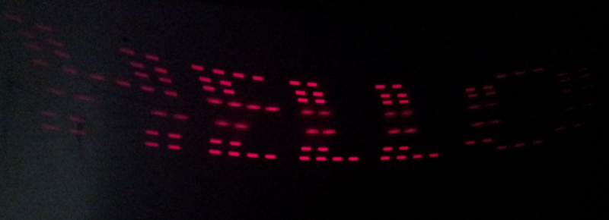
Design and Implementation(Cont)
Static and Dynamic patterns
Hello text static
Dynamic: you can enter up to five chars.

Slide 18
Future Work:
Improve brightness by using higher power laser.
Increase the number of horizontal lines by either aligning more than one laser beam or increasing the number of mirrors.
Adding more characters.
With additional enhancement it could display a funny animations and movable texts.

Slide 19
References
Websites to demonstrate the basic idea and the techniques of the project.
https://sites.google.com/site/shakirfm/briefconceptandworking
https://sites.google.com/site/shakirfm/briefconceptandworking
http://heim.ifi.uio.no/haakoh/avr/

Slide 20
Thank You
☺

