Slide 1

Aqar (عَقَارْ)

Slide 2

W h y A q a r ?
0
1
T a r g e t G r o u p
0
2
T e c h n o l o g i e s
0
3
0
F e a t u r e s
4
F u t u r e Wo r k
Table of Contents
0
5
02

Slide 3

Why Aqar ?
Challenges for Buyers: Lack of Unified Platform
Challenges for Sellers: Absence of Dedicated Showcase
03

Slide 4
Why Aqar ?
Palestine Real Estate Platform (منصة فلسطين العقارية)
TABO (طابو)
Social Media (Facebook , Instagram , ..etc. )
04

Slide 5

      Target Group
Local Residents
Expatriates
Tourism Sector

Slide 6

Technologies
06

Slide 7






Technologies
Front End
Back End
NLP
Database

Slide 8

Features
08

Slide 9

User App

Slide 10
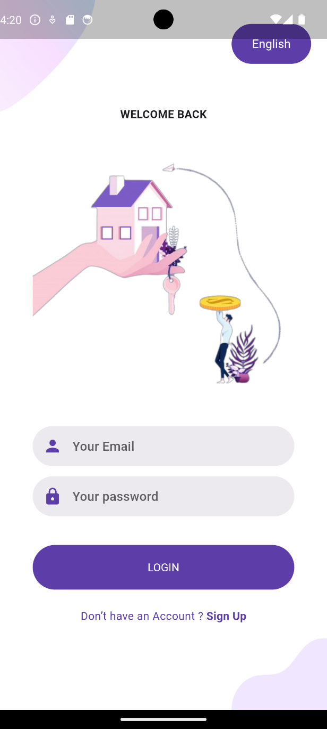
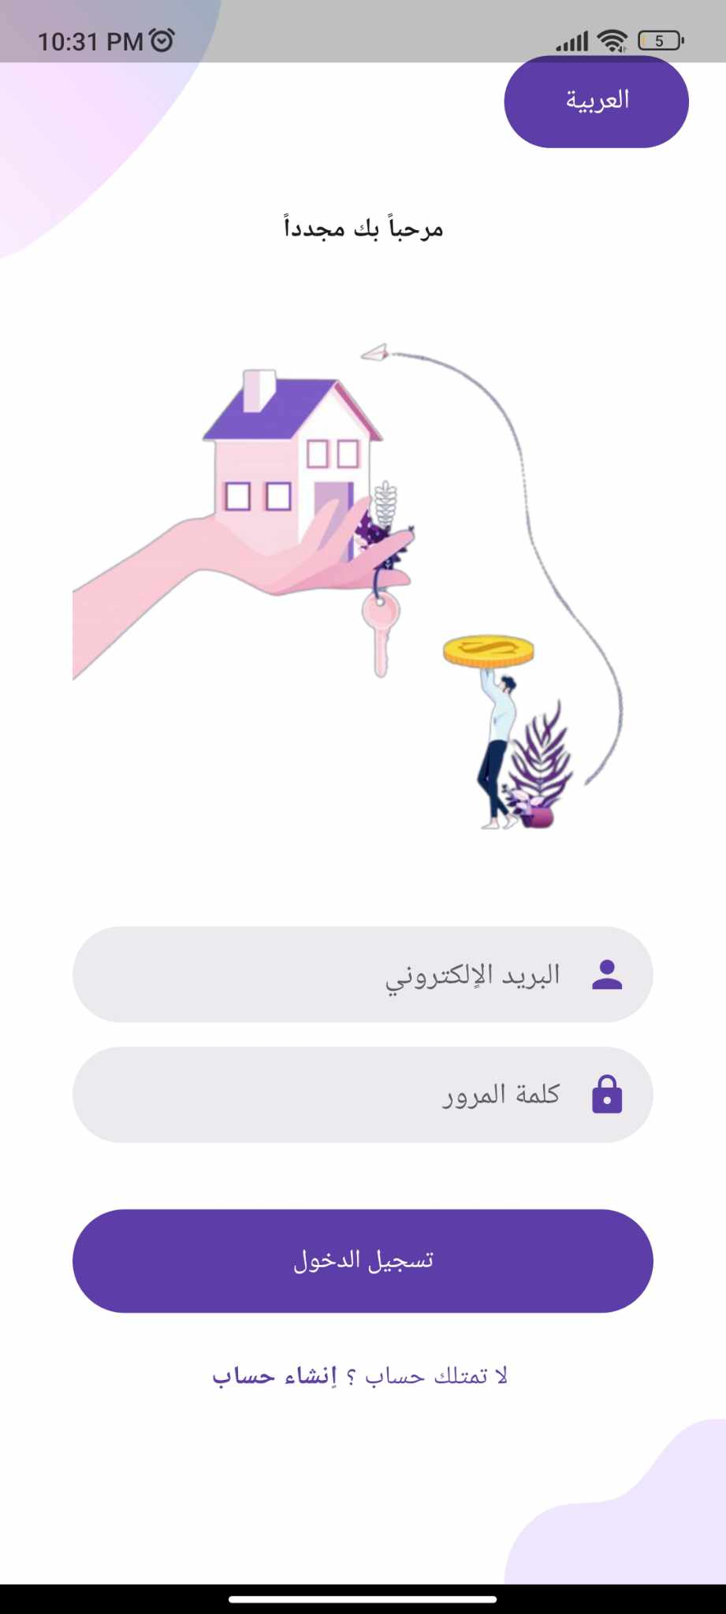
Login
— Include a credit, citation, or supporting message
13

Slide 11
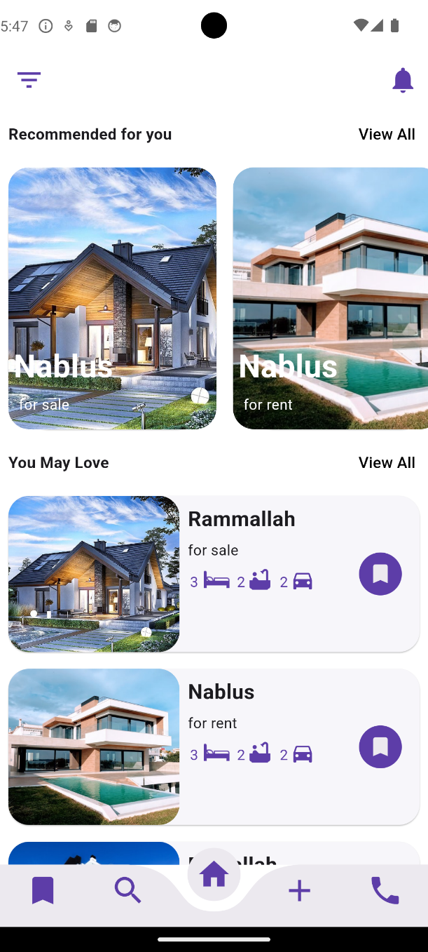
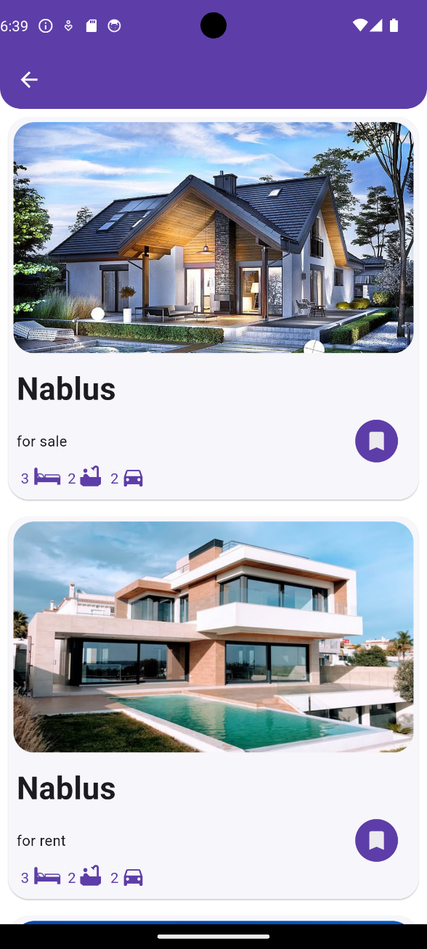
View Properties and Recommendation System
15

Slide 12
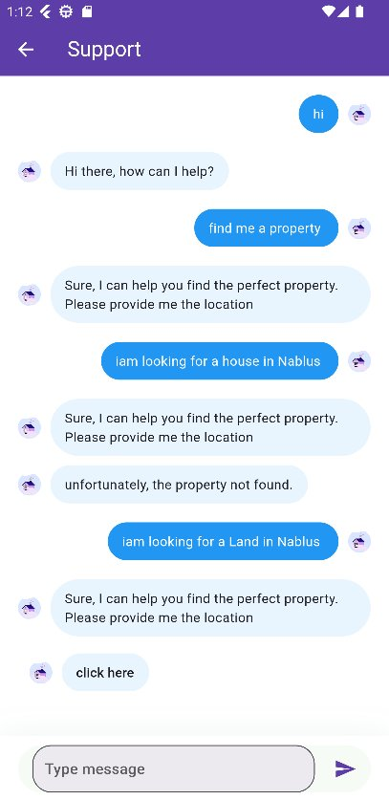
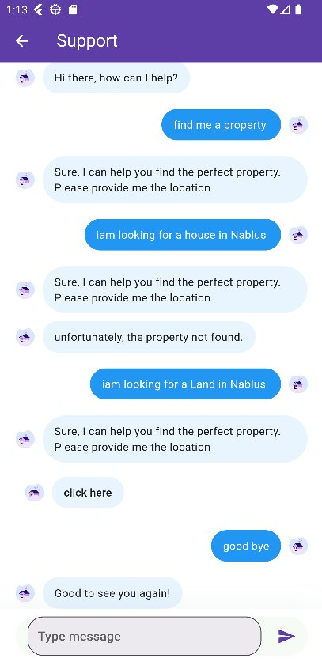
Chat Bot
— Include a credit, citation, or supporting message
19

Slide 13
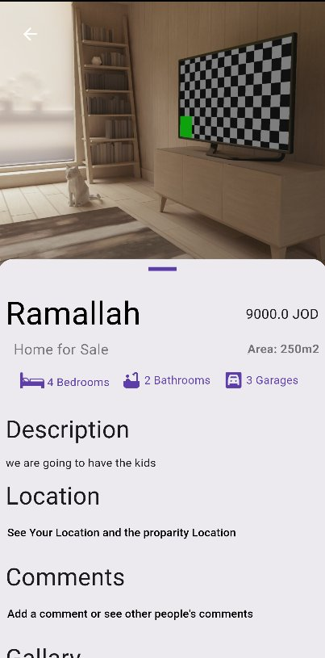
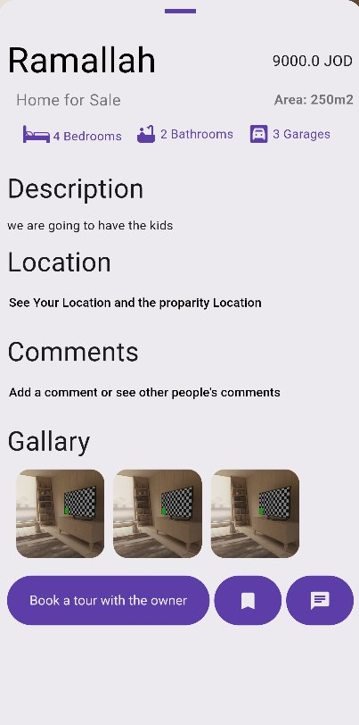
Property Description
— Include a credit, citation, or supporting message
17

Slide 14
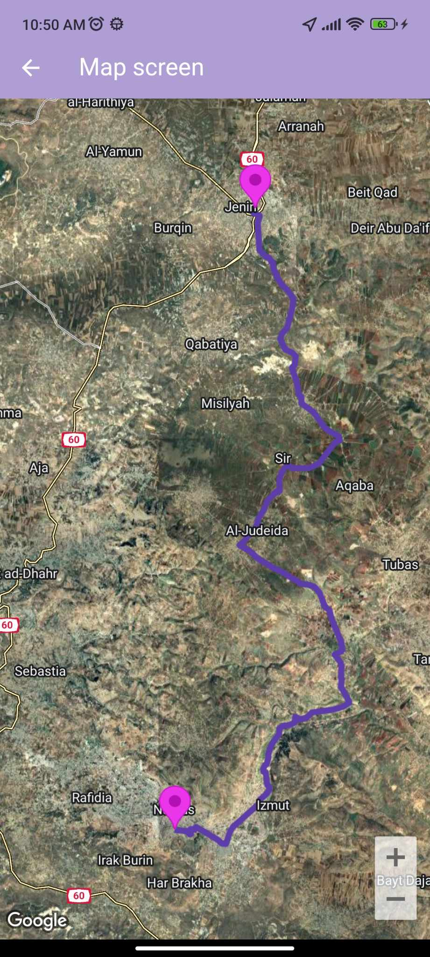
Google Maps
— Include a credit, citation, or supporting message
20

Slide 15
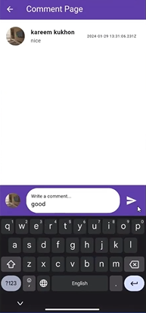
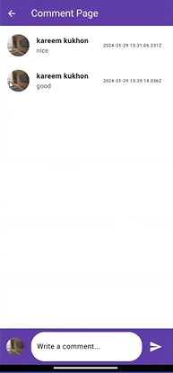
Comments
— Include a credit, citation, or supporting message
20

Slide 16
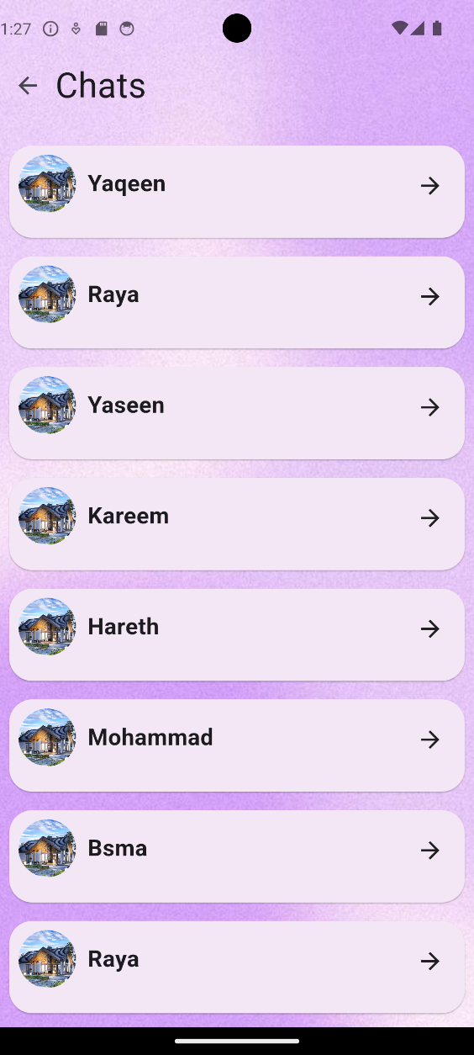
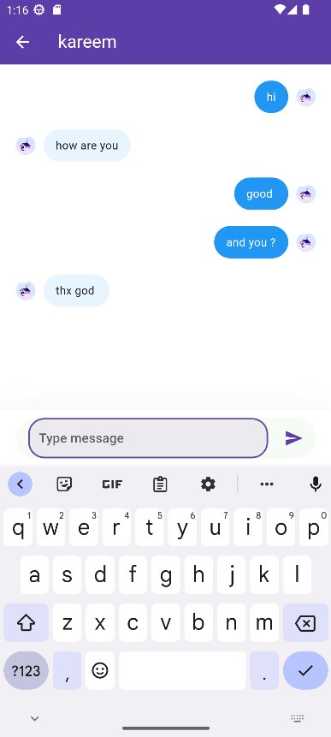
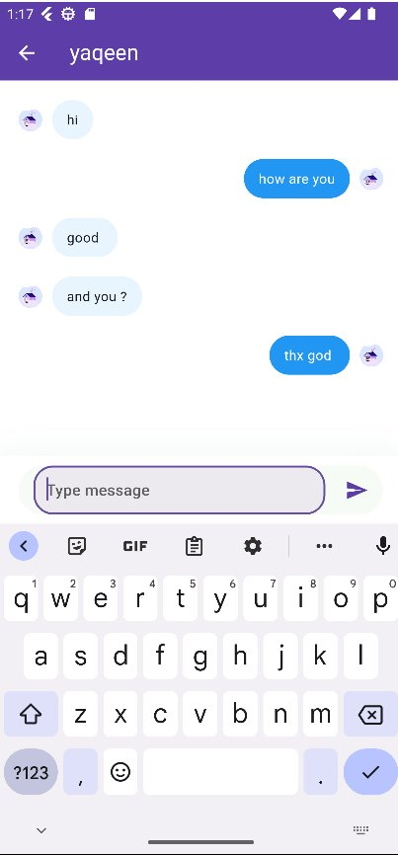
Chat
— Include a credit, citation, or supporting message
19

Slide 17
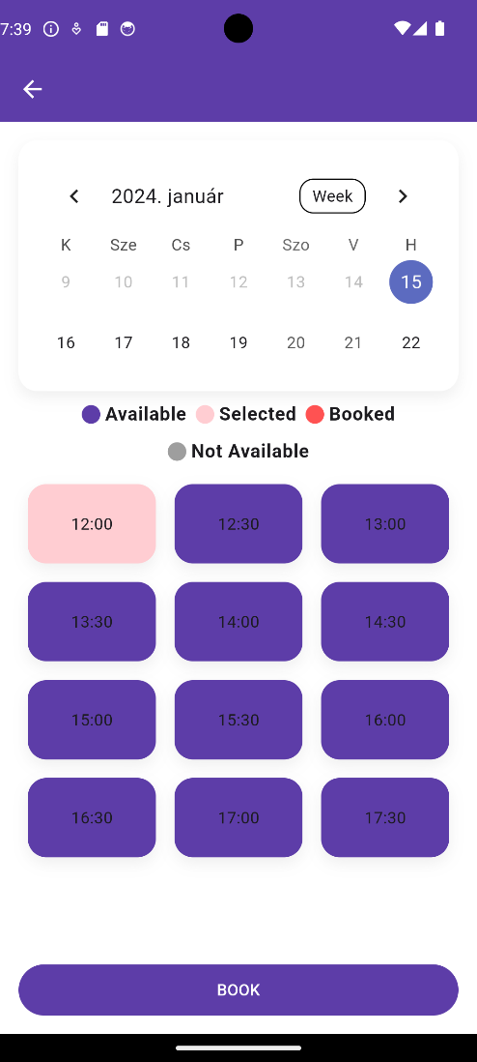
Appointment Booking
— Include a credit, citation, or supporting message
18

Slide 18
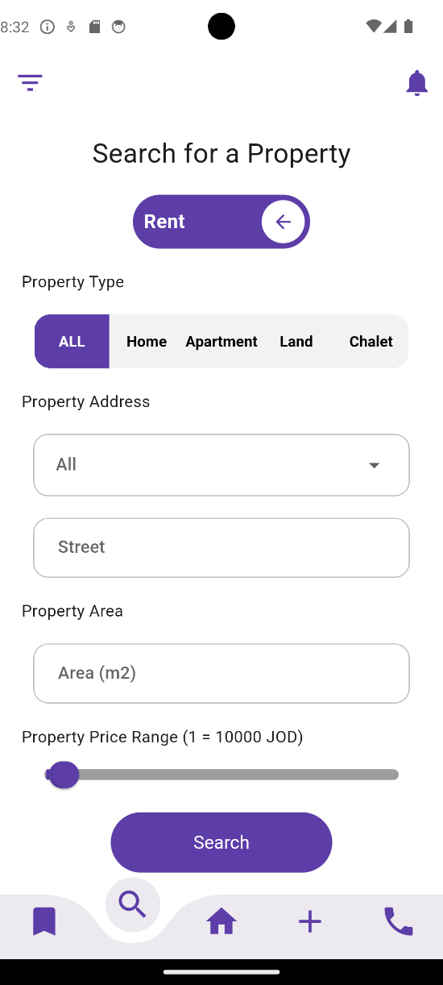
Filtering
— Include a credit, citation, or supporting message
20

Slide 19
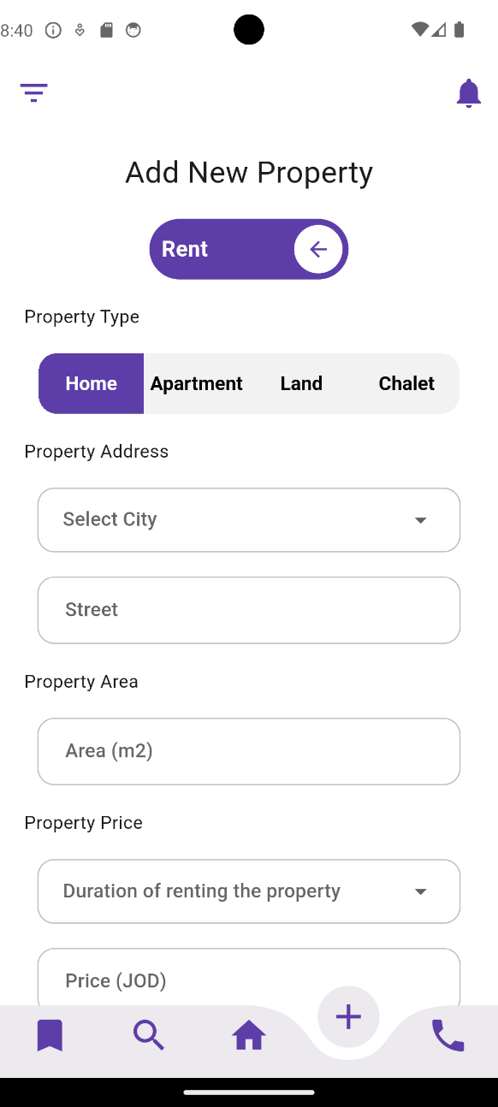
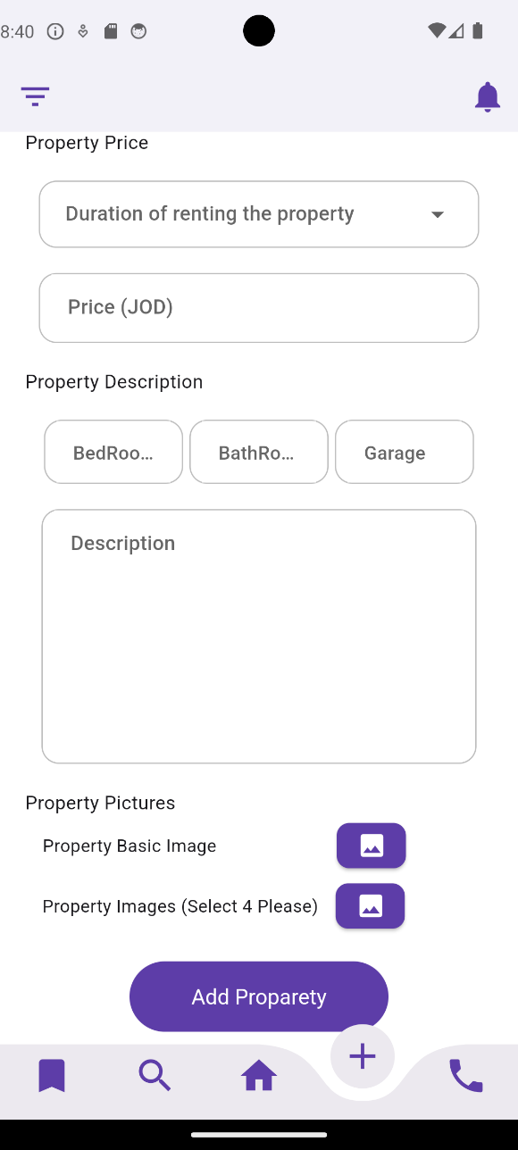
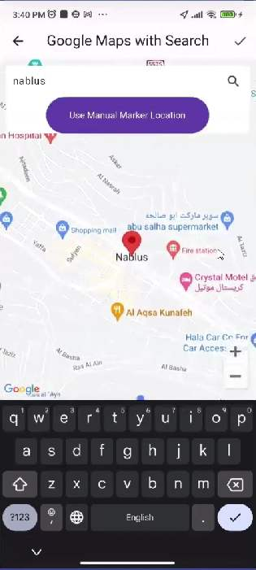
Add Property
— Include a credit, citation, or supporting message
21

Slide 20
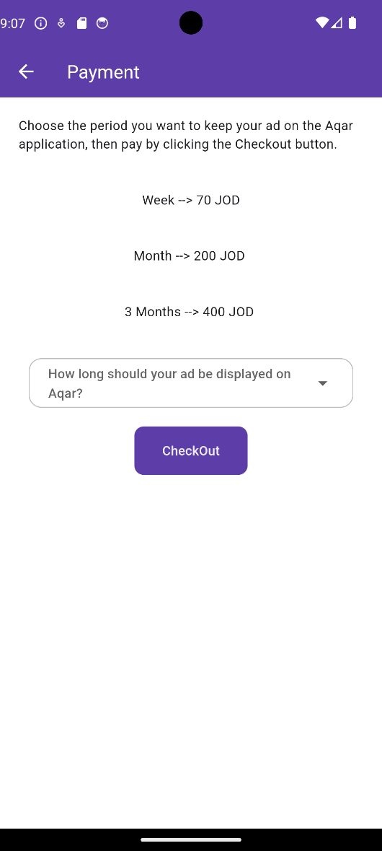
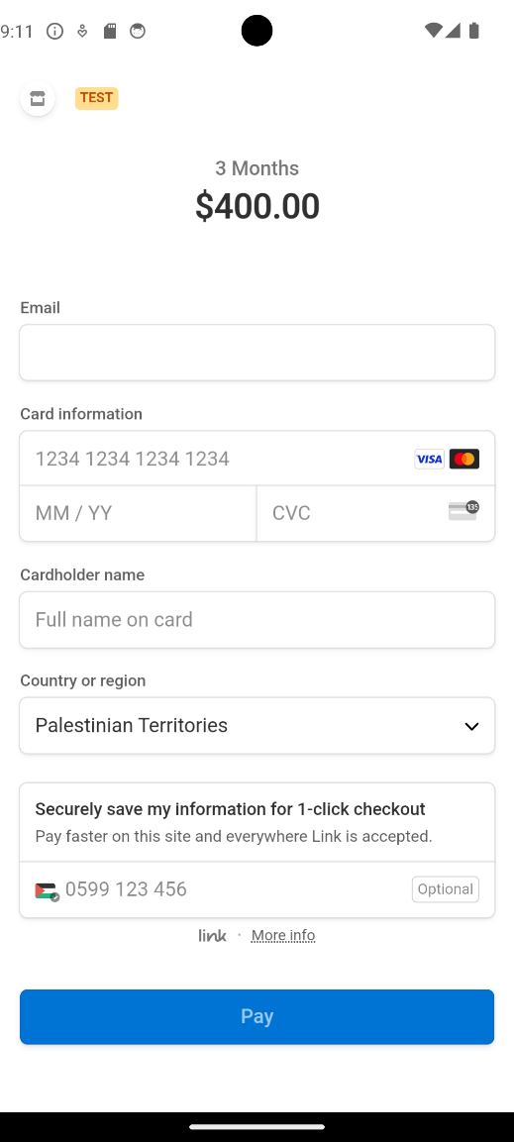
Payment
— Include a credit, citation, or supporting message
22

Slide 21
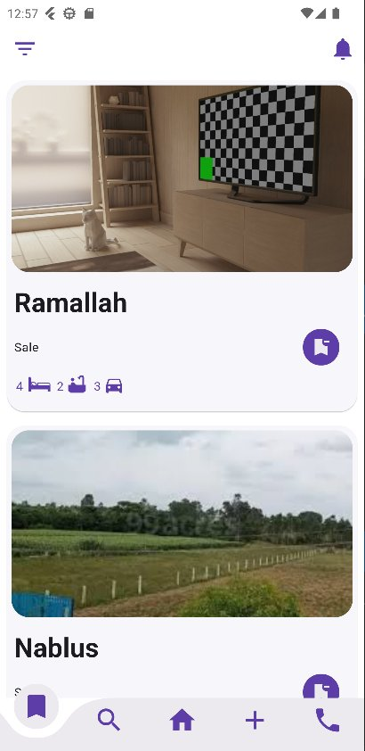
Saved Properties
— Include a credit, citation, or supporting message
30

Slide 22
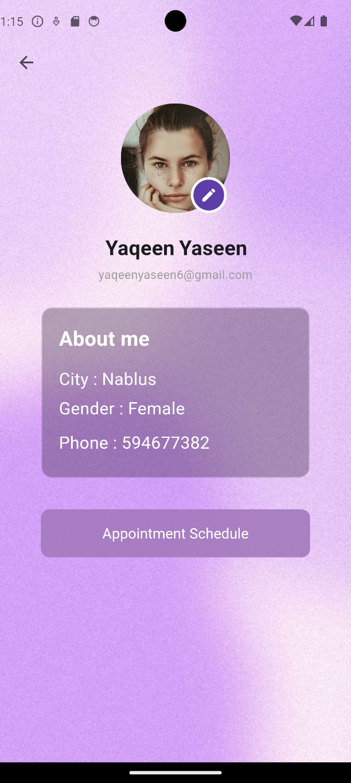
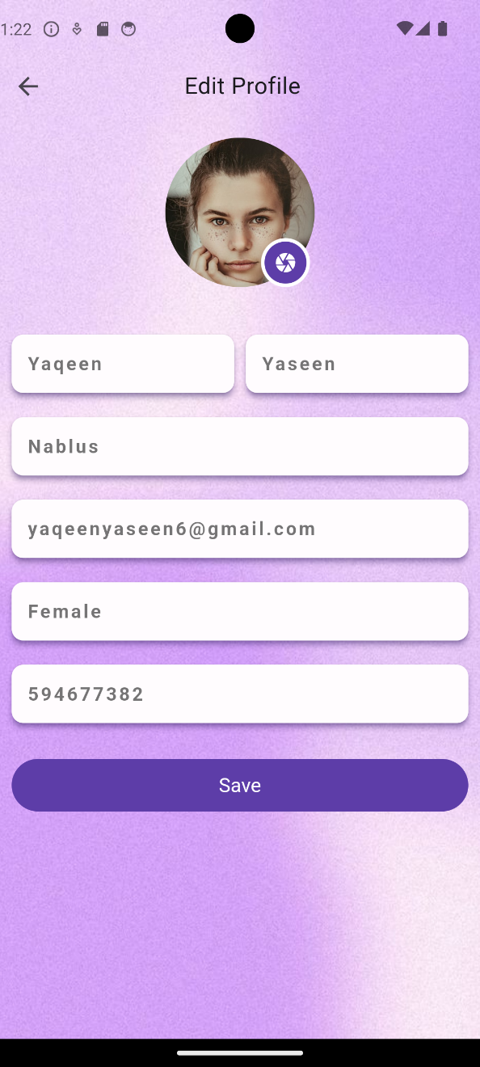
Profile
— Include a credit, citation, or supporting message
18

Slide 23
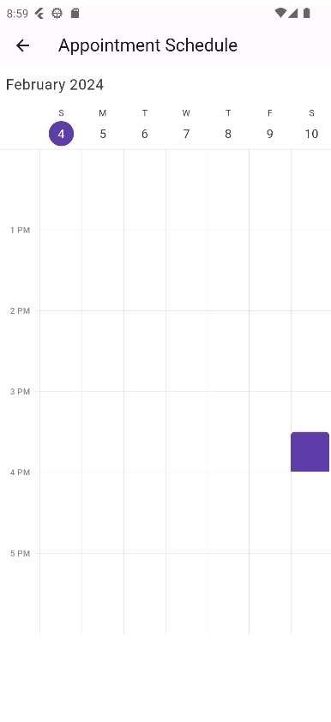
Appointments schedule
— Include a credit, citation, or supporting message
18

Slide 24



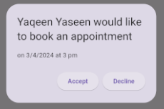
Notifications
— Include a credit, citation, or supporting message
28

Slide 25
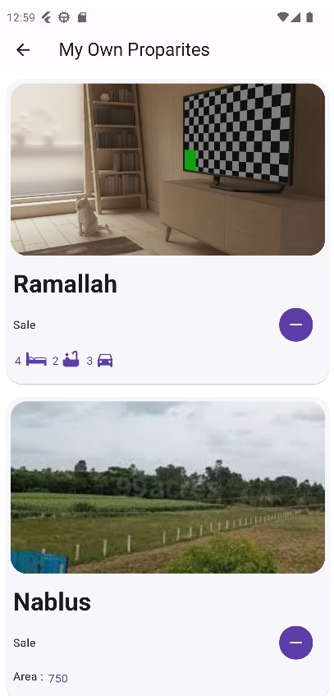
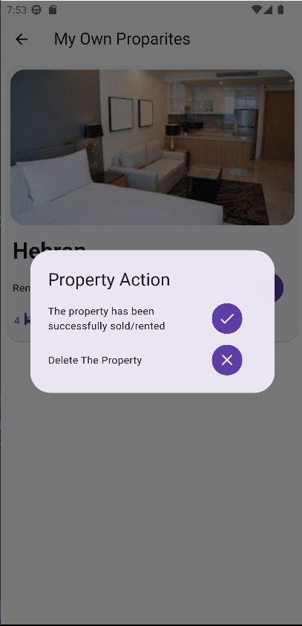
My Properties
— Include a credit, citation, or supporting message
30

Slide 26
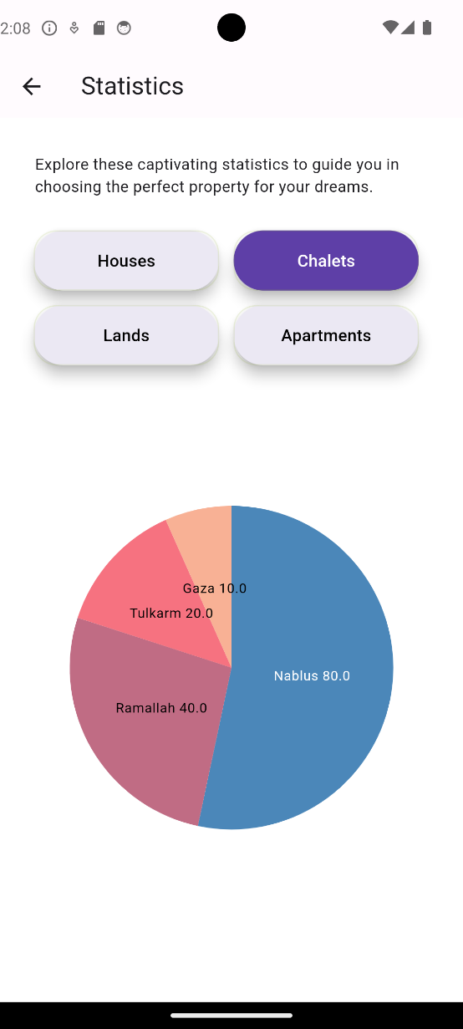
Statistics
— Include a credit, citation, or supporting message
30

Slide 27
Admin App

Slide 28
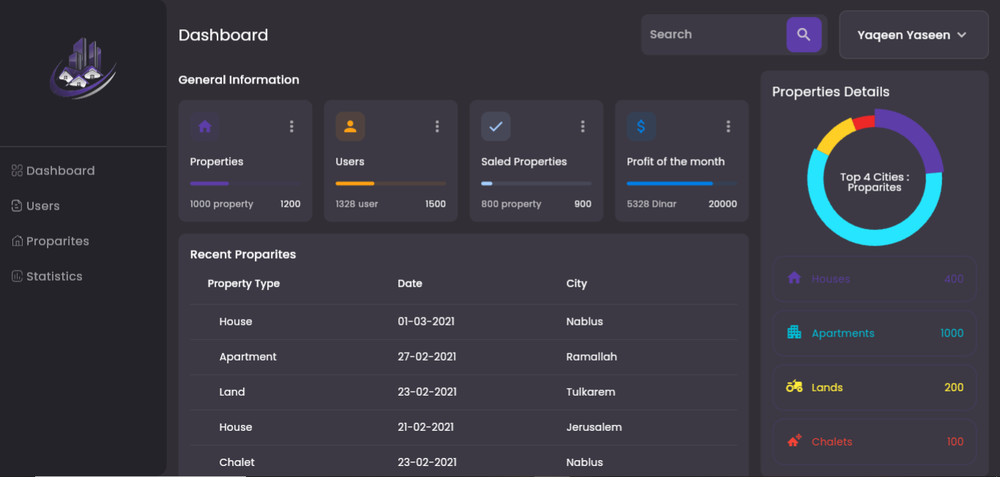
Dashboard
— Include a credit, citation, or supporting message
32

Slide 29
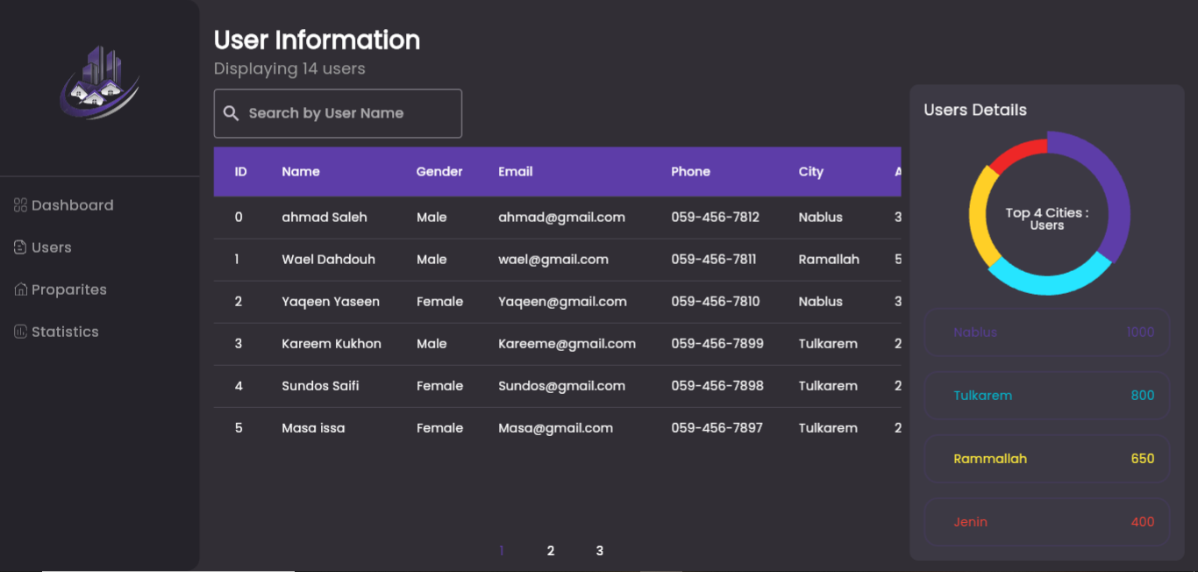
Users
— Include a credit, citation, or supporting message
34

Slide 30
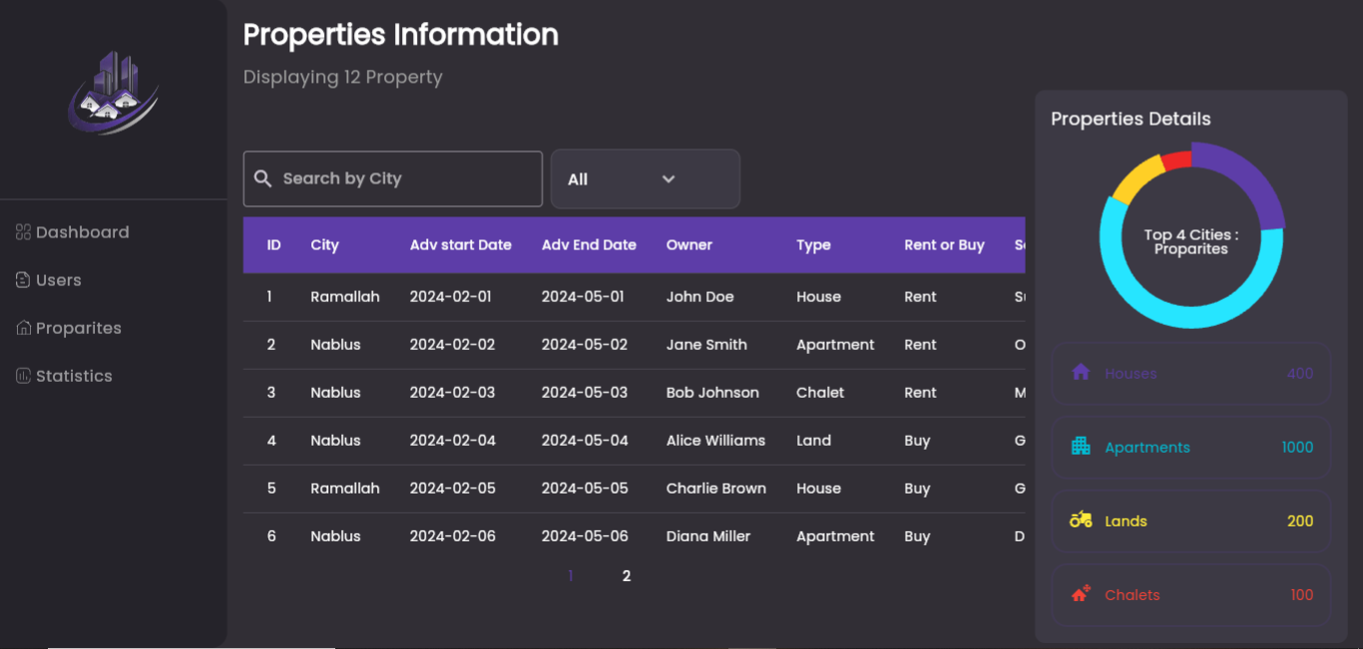
Properties page
— Include a credit, citation, or supporting message
40

Slide 31
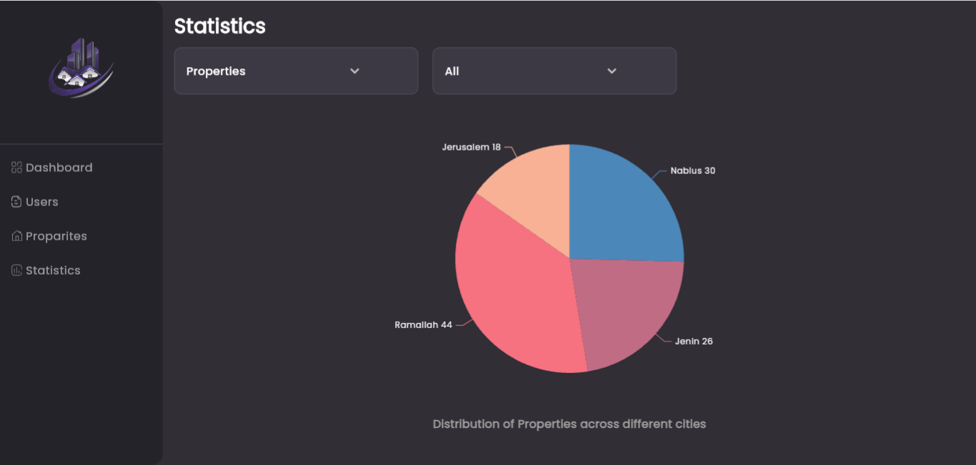
Statistics Page
— Include a credit, citation, or supporting message
46

Slide 32


      Responsive App
Let’s See

Slide 33
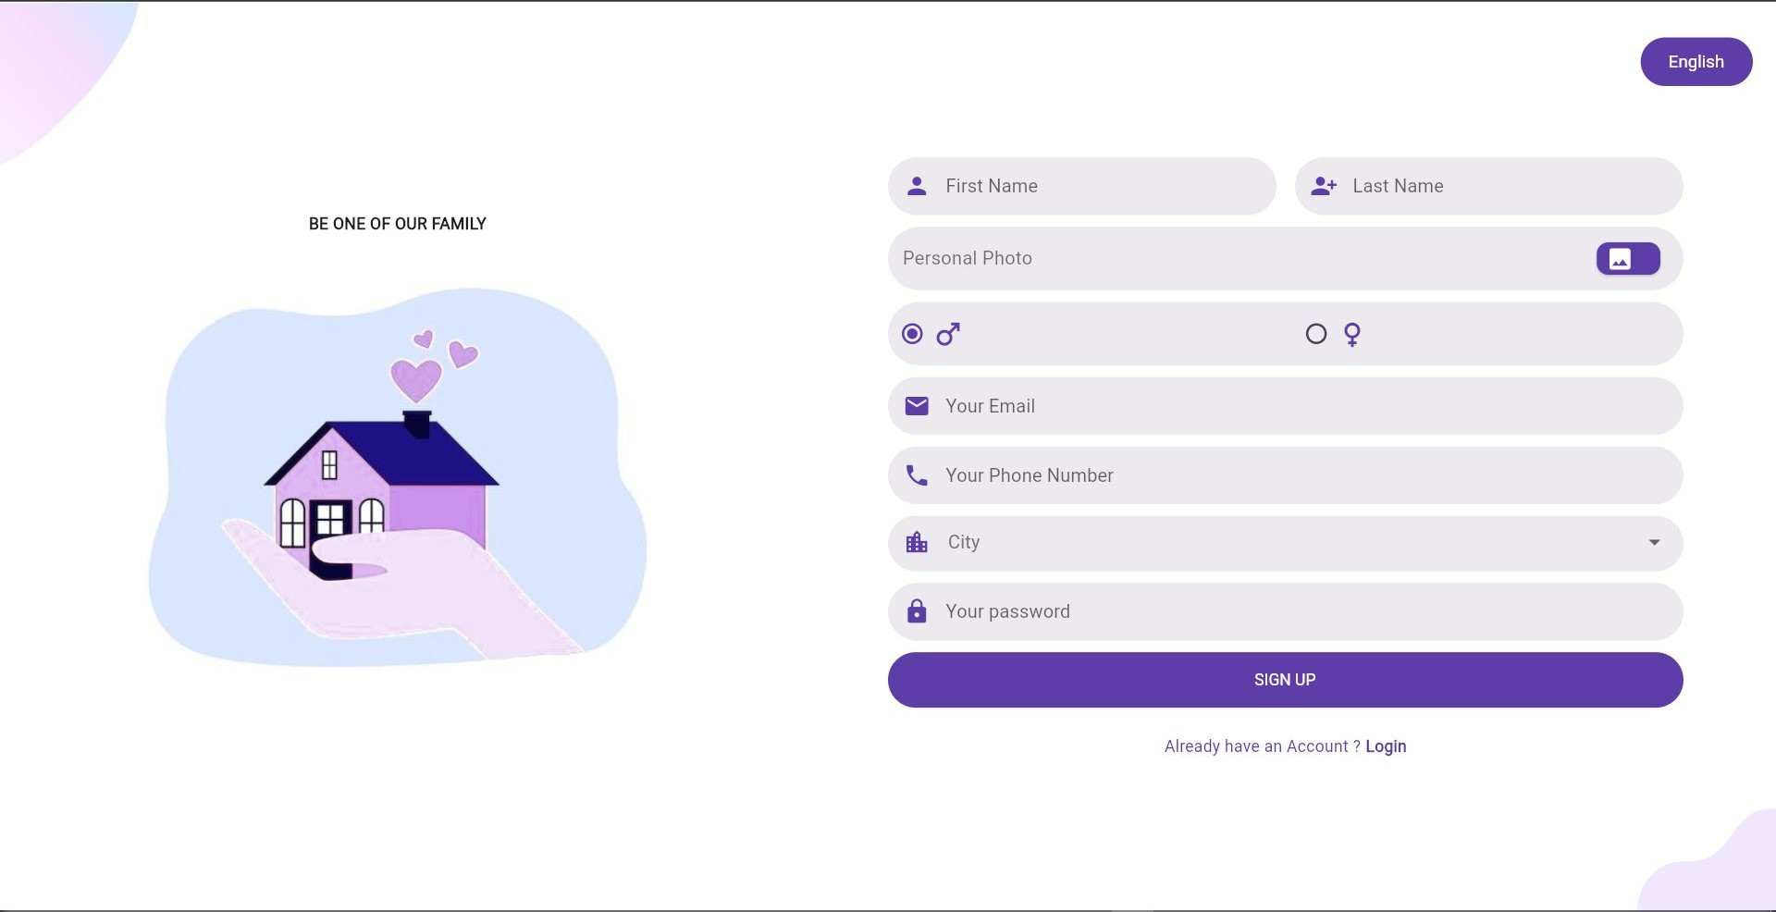
— Include a credit, citation, or supporting message
33

Slide 34

— Include a credit, citation, or supporting message
33

Slide 35
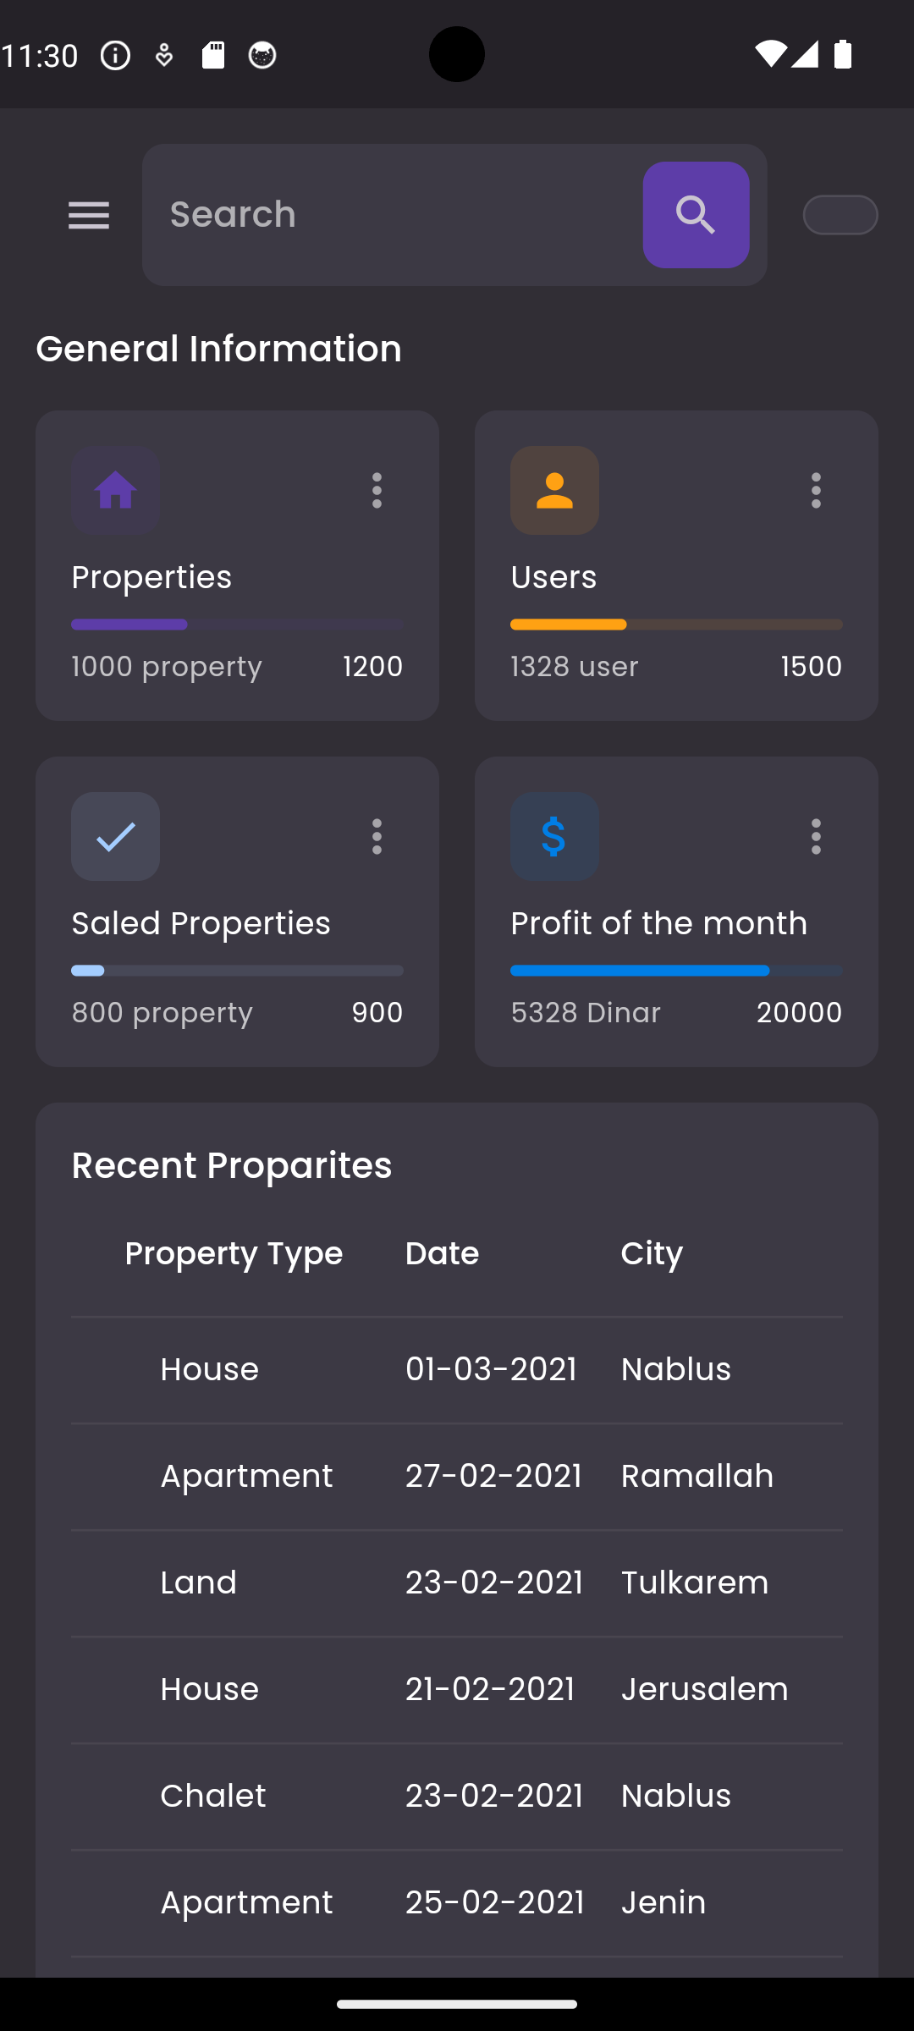
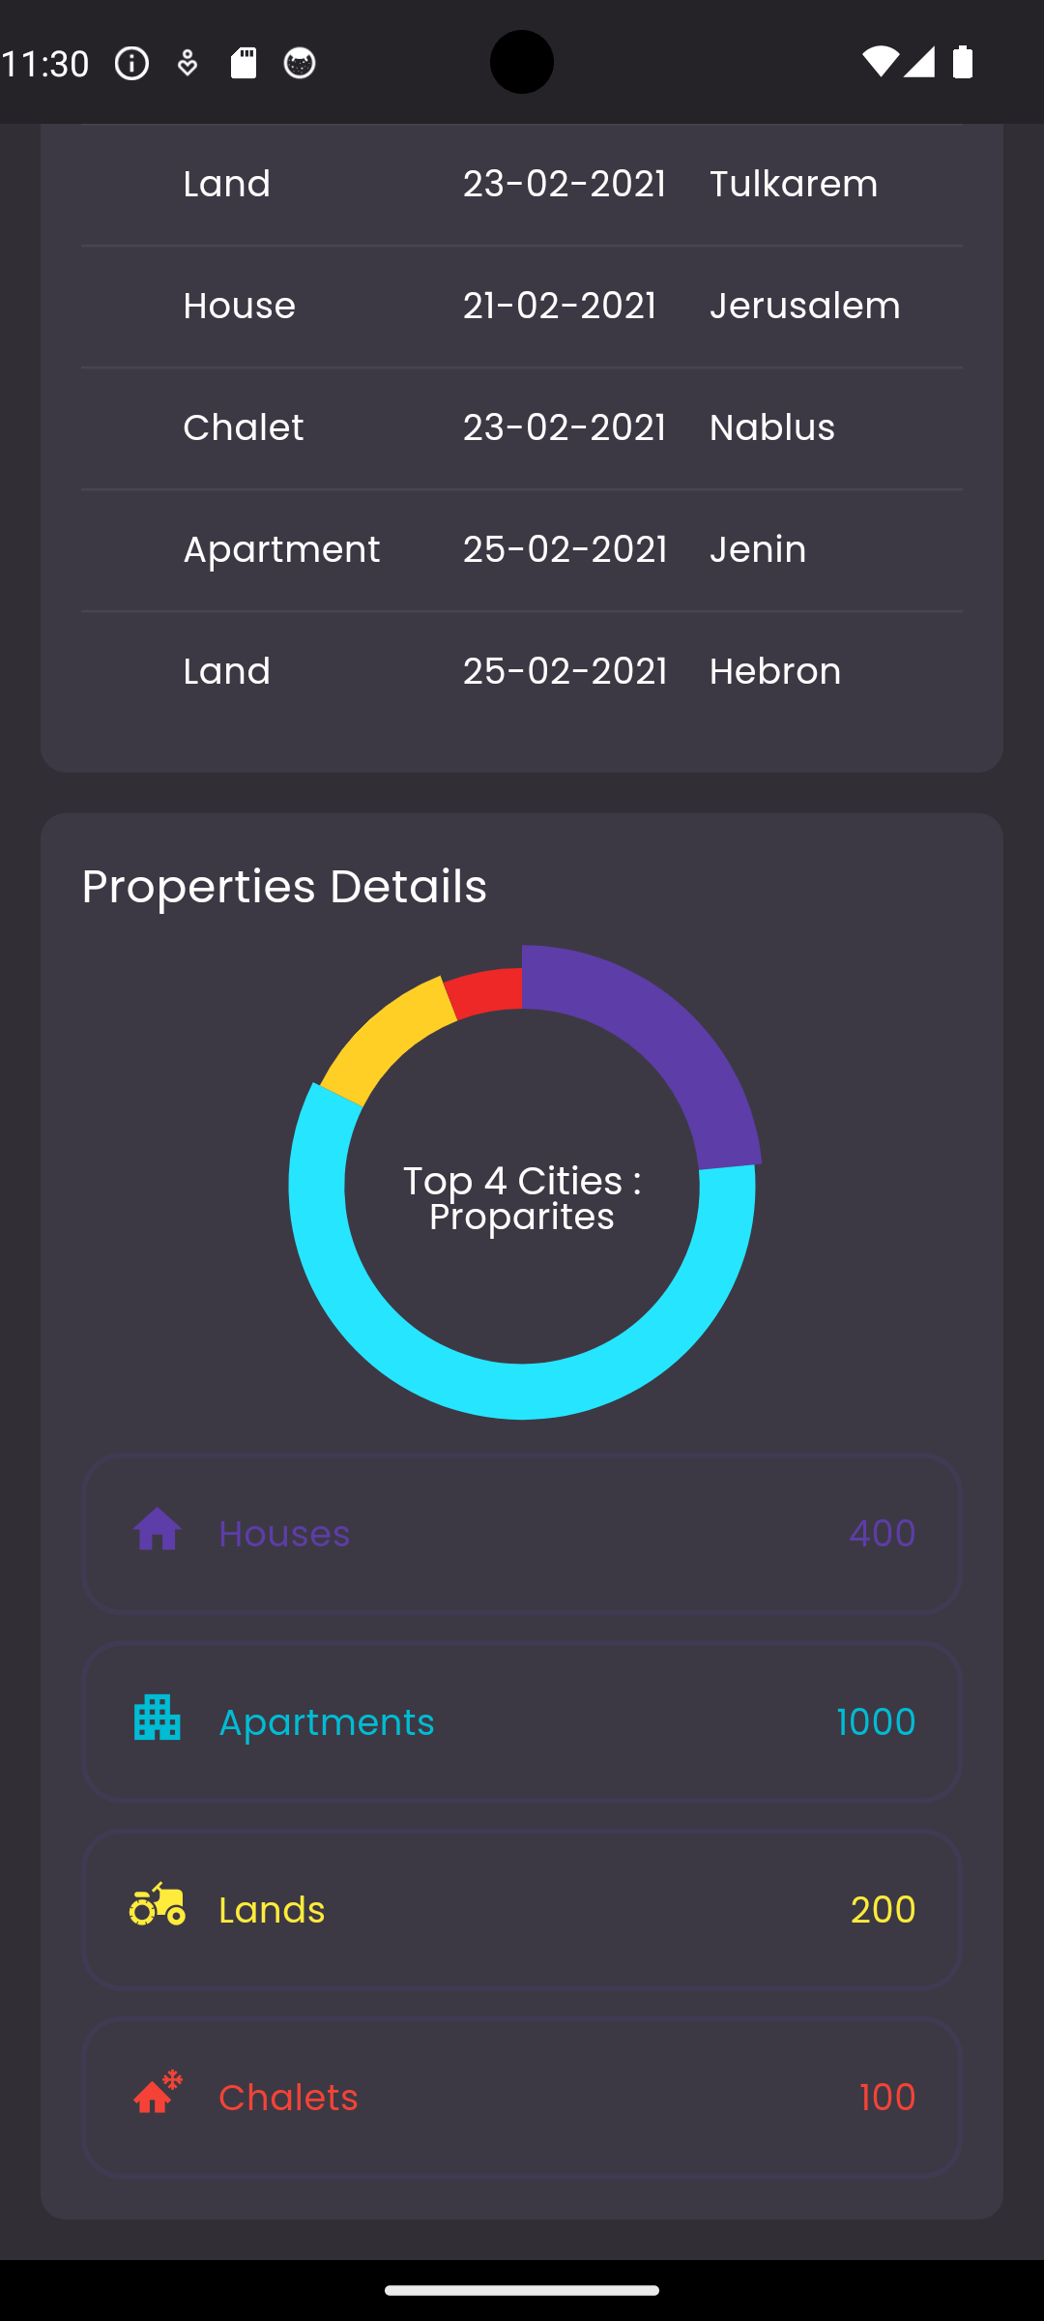
— Include a credit, citation, or supporting message
33

Slide 36
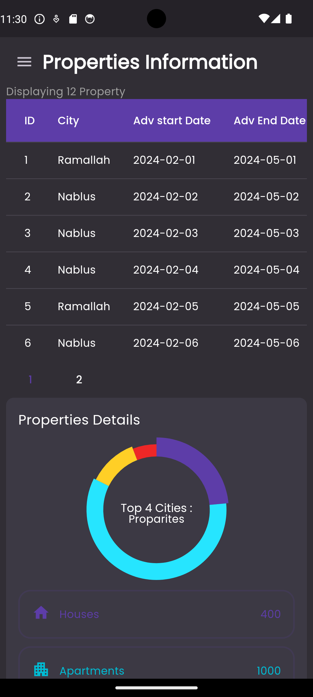
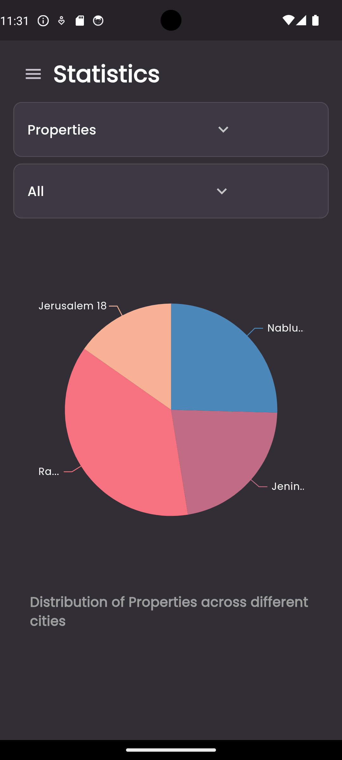
— Include a credit, citation, or supporting message
33

Slide 37
Future Work
Property auction
Property Comparison Tool
Social Media Sharing
Audio Call

Slide 38


Any Questions ?
It's so lovely to meet all of you!

Slide 39

Thank you for listening.

