Slide 1

Analysis and Redesign of WDN for Beita, Connect with Gis, SCADA system
An– Najah National University
Prepared by:-
Ghada al-sheikh.
Mays Zyoud.
Supervisor : Dr.Abdelhaleem Khader.

Slide 2
Outline
Objective.
Study Area.
WDN Review.
Redesign WDN.
Results.
GIS.
SCADA system.

Slide 3
Objective
Analysis the existing water distribution network.
Redesign the existing water distribution network.
Connect the old and new water distribution network with GIS.
SCADA system.

Slide 4
Study area
Location:
- Beta is a town located to the south-east of the city of Nablus away about 13 Km.
- This town is surrounded by Hawara from the west , Aqraba to the east , Awarta and Oodla to the north , Yatma , Osarin and Qabalan to the south.

Slide 5
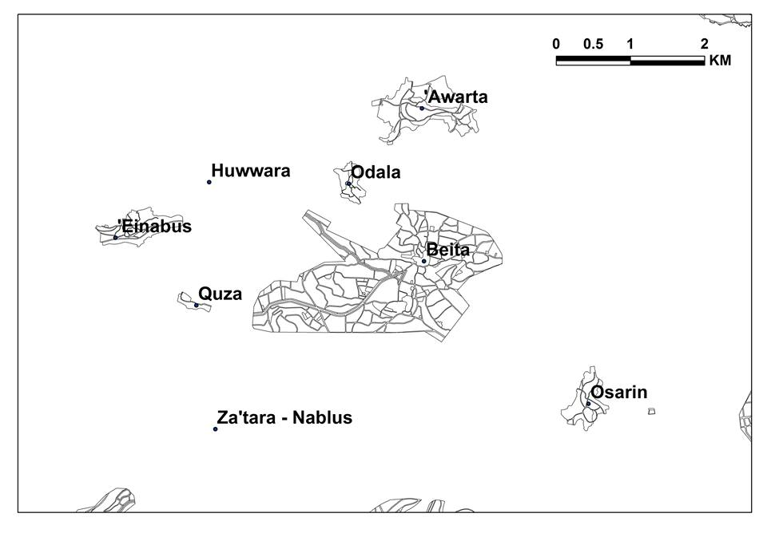

Slide 6
Topography :
- The elevation of Beita is 700 m above sea level.
- This town varies in its terrains, It is formed of mountains and a number of valleys which extends from east to west.
Land use :
Its land is famous in agriculture, It grows olives, grapes, figs and almonds.

Slide 7
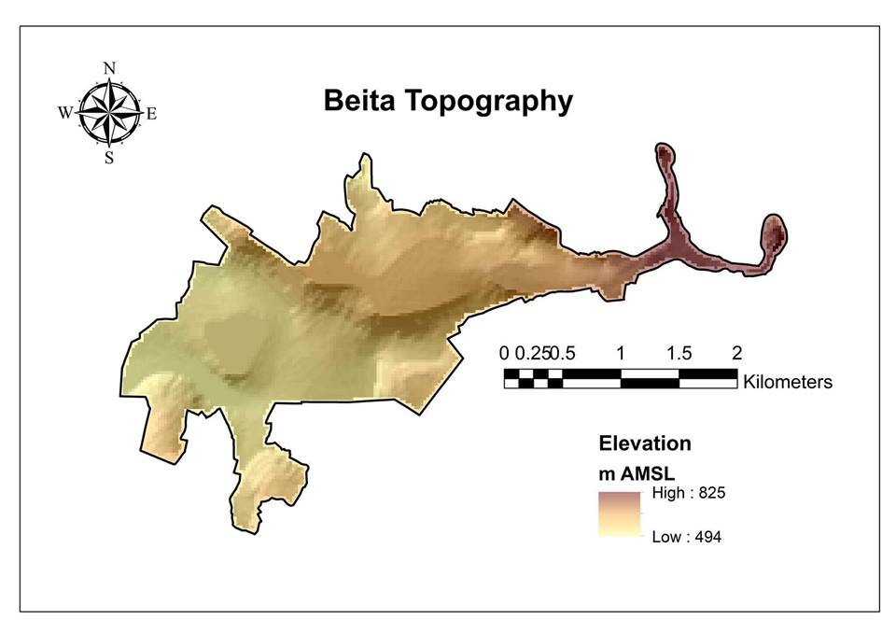

Slide 8
Population :
Population Estimations Palestinian Central of Statistics
Year | 2007 | 2010 | 2012 | 2014 | 2015 | 2016
Population | 8982 | 9625 | 10078 | 10545 | 10781 | 11017
Area :
Its total area is around 17622 donums, the master plan for the town involves an area of 8520 donums.

Slide 9
Sources of water:
Suppliers | source | Q (m³/day) | notes
Mekarot Company (Israeli occupation) | Quza well | 1200.00 | Main source
Water Department and sanitation services of the Council of the Joint Planning and Development - Southeast region Nablus A | Rojeb well | 40.00 | Secondary for east region
Municipality | Ein Olem Well | 20.00 | Secondary for the water plant and the number of subscribers

Slide 10
Graduation Project 1 Review
Water Distribution Network

Slide 11
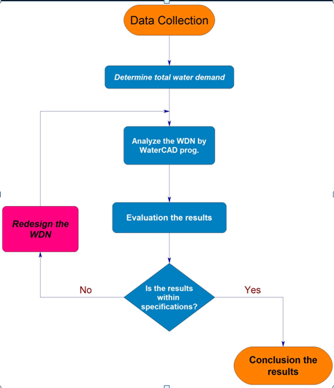
Methodology

Slide 12
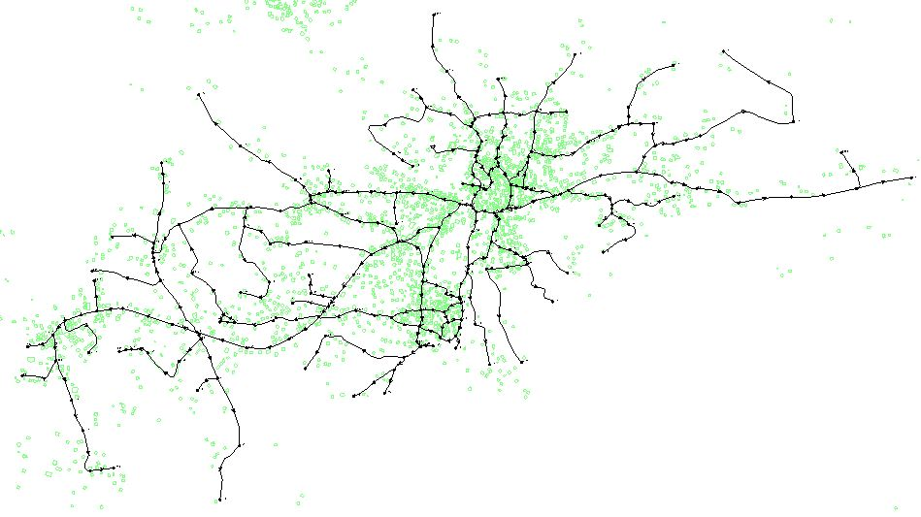
the existing water distribution network

Slide 13
Results
Junctions
pipes

Slide 14
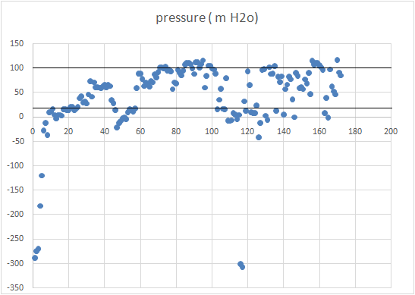
Pressure:

Slide 15
We got negative pressure .
We got pressure more than the maximum limit 100 mH₂O.
We got zero pressure.

Slide 16
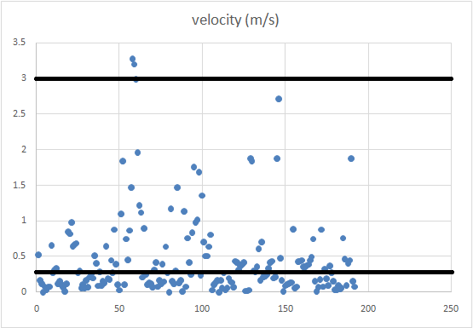
Velocities:

Slide 17
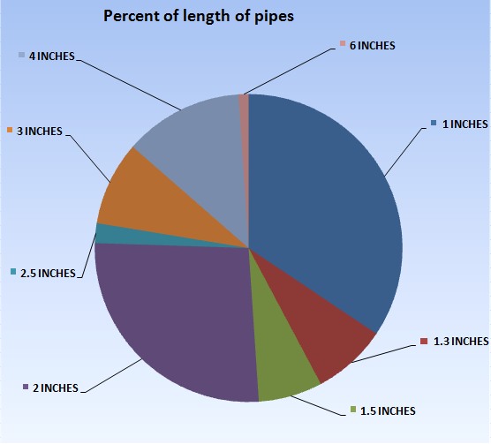
Distribution of pipes:
Percent(%) | Diameter(in)
34.3% | 1"
7.8% | 1.3"
6.7% | 1.5"
26.5% | 2"
2.08% | 2.5"
8.8% | 3"
12.5% | 4"
1.04% | 6"

Slide 18
Water Status :-
497,572 m³/ y | Supply
299,366 m³/ y | Consumption
39.8 % | Unaccounted %
11,017 | Population Served
74.45 L/c.d | Average water use per capita

Slide 19
Redesign WDNs

Slide 20
Important information needed for deign
Population growth rate.
Design Period.
Water Demand.
Pipe Material and Class Classification.
Minimum and Maximum pipe diameter.

Slide 21
Population
 | Year 2000 | Year 2010 | Year 2040
Population growth in percent | 3 | 2.5 | 2
Our project design period ( 30 years ) divided into two intervals
from year ( 2017 ) to year (2040 ),i (annual growth rate) = 2.5%
From year (2040) to year ( 2047 ),i (annual growth rate ) = 2%
P ( 2040 ) = P (2017)×( 1 + i )^n …….. n = 23 years
P ( 2040 ) = 11621×(1.025)^23 = 20506 capita
P ( 2047 ) = P ( 2040 )×( 1 + i )^n ……. n = 7 years
P ( 2047 ) = 20,506 ×(1+02)^7 = 23554 capita

Slide 22
Design Period
Design Period for the new water distribution network is 30 years.
From 2017 to 2047

Slide 23
Demand Distribution
Average domestic per capita consumption | Year 2000 | Year 2010 | Year 2040
[m³/capita/year] | 50 | 57 | 83
Phase 1 (2017-2040):
We calculated the population at year 2040 by Annual compounding method:
P(2040) = 20,506 capita
So the demand in this phase :
(20506×57)/365 = 3,202.3 m³/day

Slide 24
Phase 2 (2040-2047):
We calculated the population at year 2045 by Annual compounding method :
P(2047) = 23,554 capita.
Then the population that increased in this phase = 3,048 capita
So the demand in this phase :
(3,048×83)/365 = 693.10 m³/day
Total demand = 3202.3 + 693.10 = 3,895.4 m³/day.
We considered that the flow will be continuous flow
so the factor will be equal to ( 1.8 )
so ,
design demand = 1.8 × 3895.4 = 7011.72 m³/day.
Approximately = 7012 m³/day

Slide 25
Design Pipe Material and Class Classification
Commercial pipes are manufactured in various pipe materials; for example:
poly (vinyl chloride) (PVC), un plasticised PVC (uPVC), polyethylene (PE), asbestos cement (AC),
high-density polyethylene (HDPE), mild steel (MS), galvanized iron (GI) and electric
resistance welded (ERW).
These pipes have different roughness heights, working pressure, and cost.

Slide 26
Design Minimum and Maximum pipe diameter
The minimum pipe sizes are normally specified based on total population of a city. Generally, a minimum size pipe of 100 mm for residential areas and 150 mm for commercial, industrial areas is specified .But it also allows to use the 50 mm for the small towns.
The maximum size of a distribution main depends upon the commercially available pipe
sizes for different pipe material,

Slide 27
In any Redesign stage of any project, there are many scenarios to execute.
Scenario one (Pressure).
Scenario two (new resources).
Scenario three (Pipe).

Slide 28
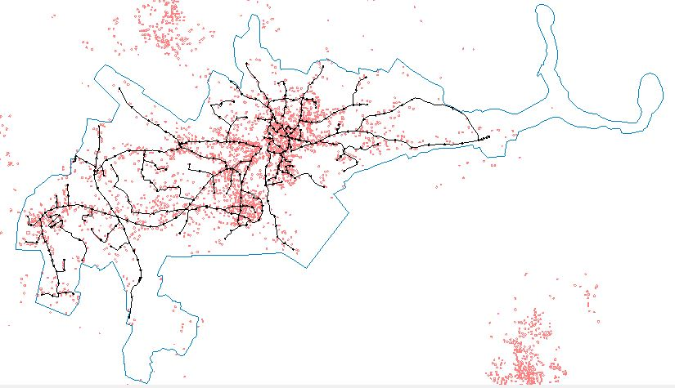

Slide 29
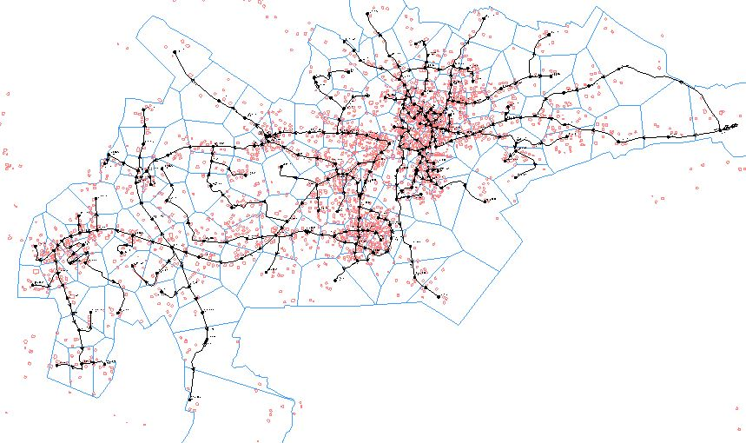

Slide 30
Results
Junctions
pipes

Slide 31
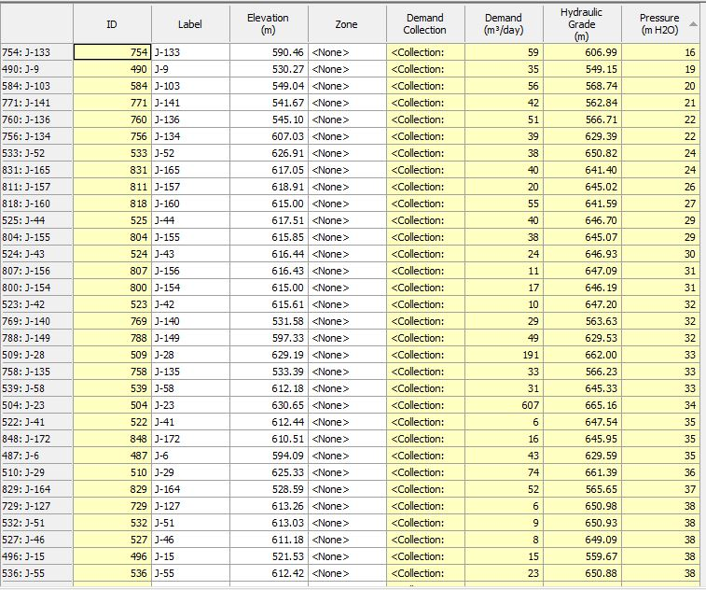
Sample of the results on junctions after Redesign

Slide 32
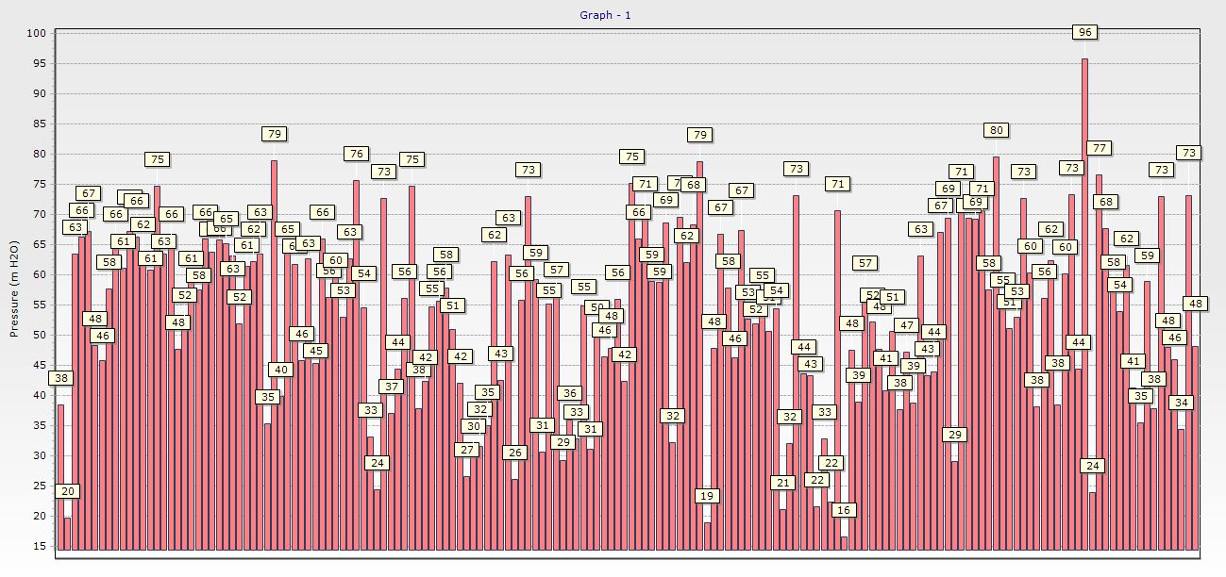

Slide 33
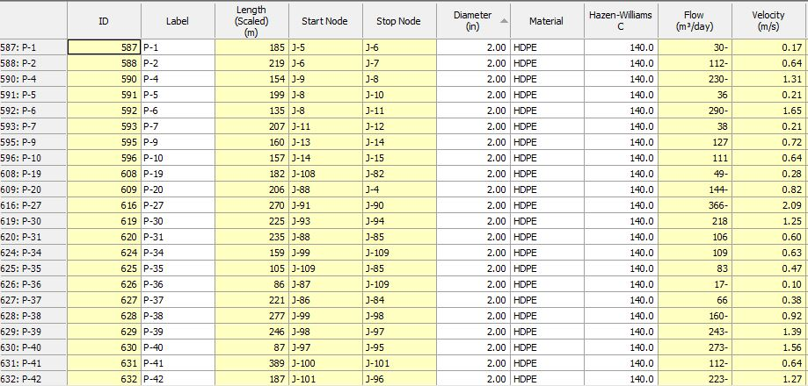
Sample of the results on Pipes after Redesign

Slide 34
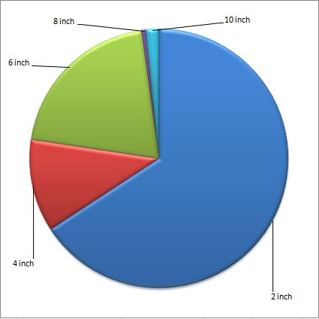
Distribution of pipes:
Percent % | Diameter (inch)
65.789% | 2''
11.578% | 4''
20.526% | 6''
0.526% | 8''
1.578% | 10''

Slide 35
Geographic information system (GIS)

Slide 36
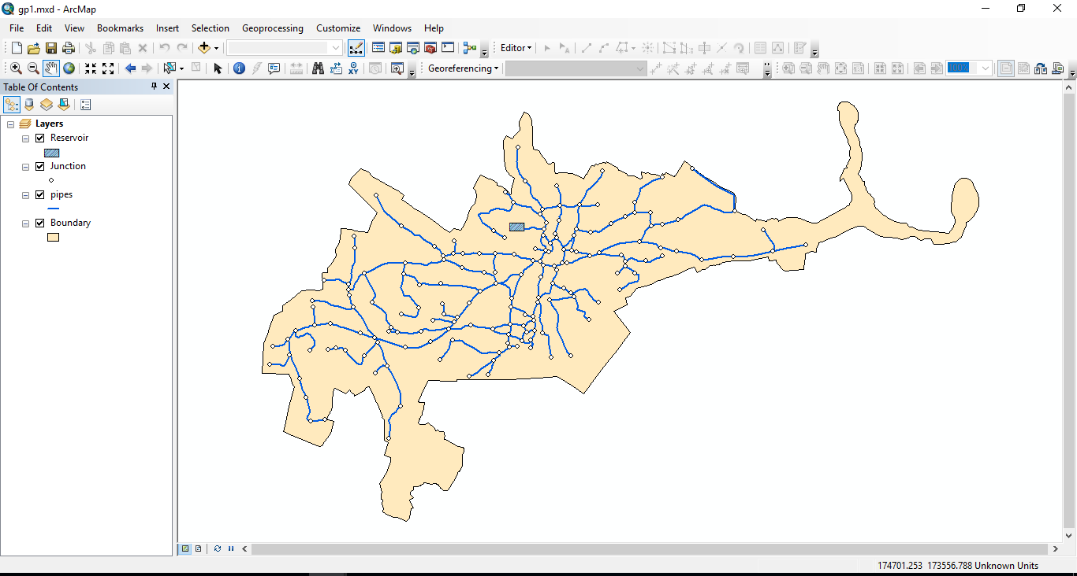

Slide 37
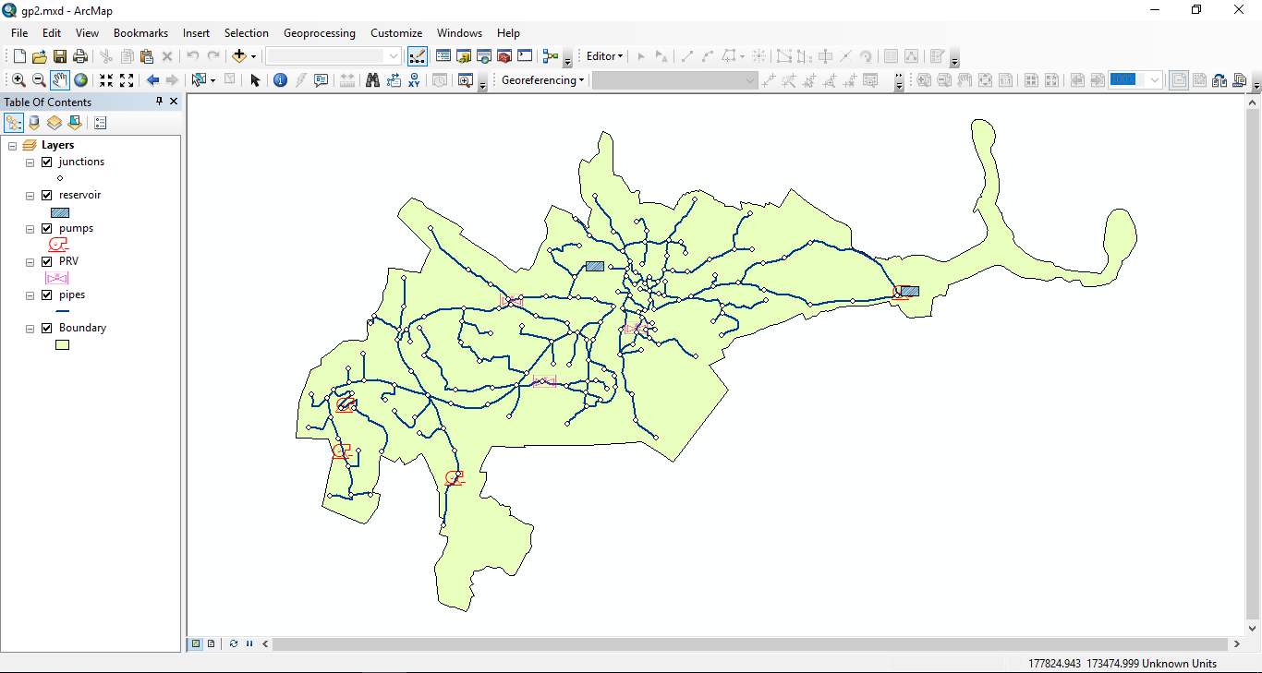

Slide 38
SCADA System for Monitoring Water Supply Networks

Slide 39
SCADA ( Supervisory Control and Data Acquisition ) .
Where we can use it?
How it works?

Slide 40


