Slide 1
Smart Braille Display For Education
Done By : Aseel Zamel Roba Darawsheh
Supervisor : D.Emad Natsheh Eng. Asmaa Afeefi

Slide 2
Outline
Introduction
motivation
Tools and Technologies
Features
Demo
Existing problems
Future Work
Conclusion

Slide 3
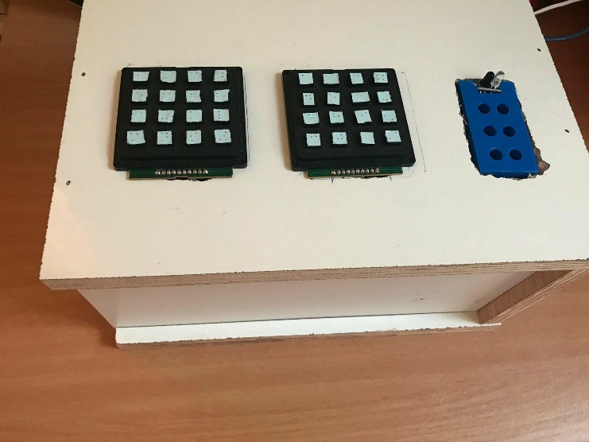
Introduction
A device showing Braille characters dynamically.
Simple calculator for the blind.
A system that helps to answer the letters to suit the blind

Slide 4
motivation
Blind people suffer in many ways of their lives including education.
There is a very common language for blind people which is Braille language. Nowadays, the language using paper so they deal with the words in static way.
In recent years a new way has appeared and it’s the sound. It is appears because the life is not always static.

Slide 5
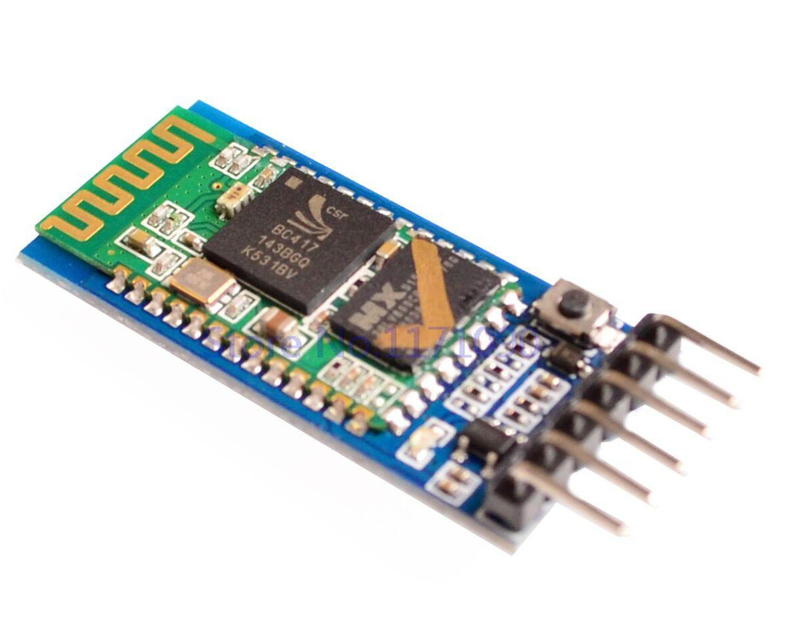
Tools and Technologies
Bluetooth module:

Slide 6
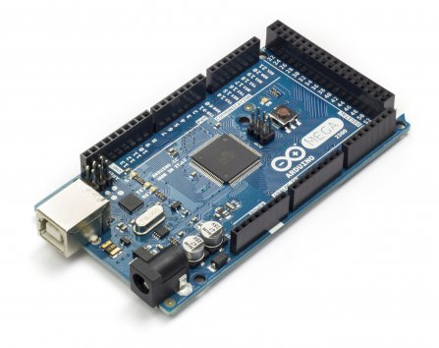
Arduino Mega :

Slide 7
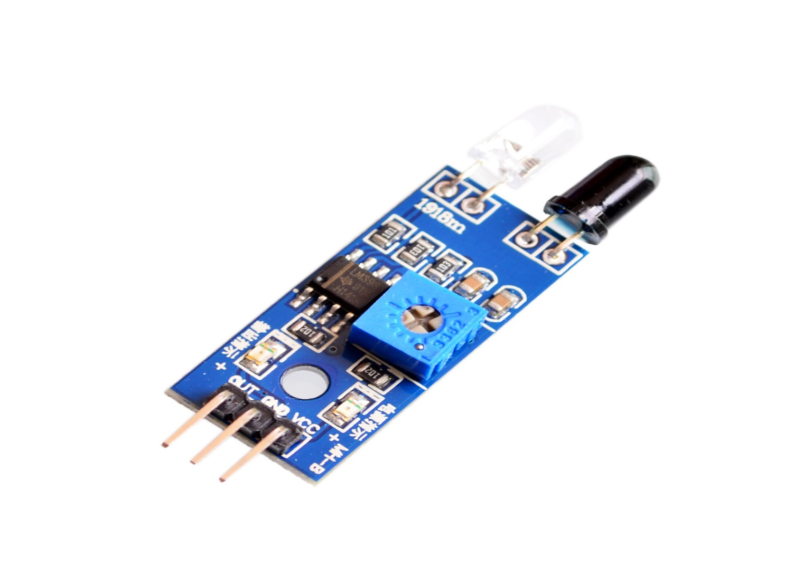
IR Obstacle Avoidance Sensor Module:

Slide 8
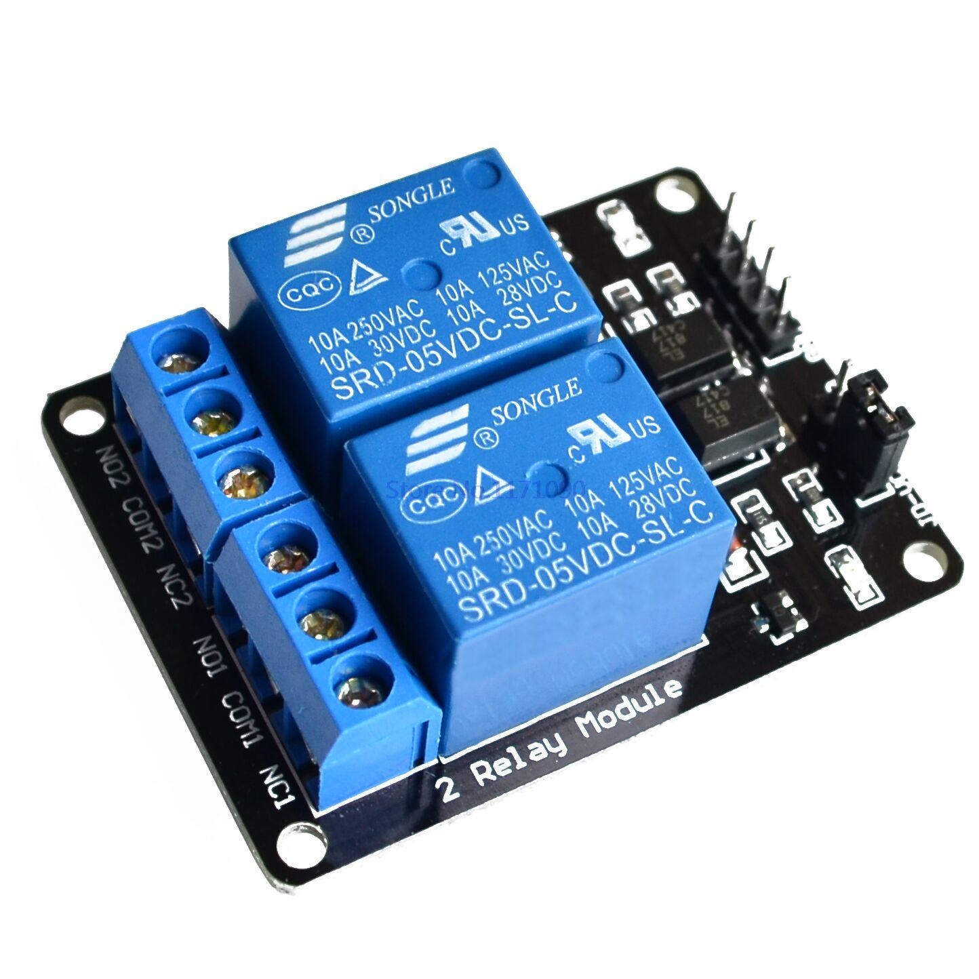
5V 2-Channel Relay Module:

Slide 9
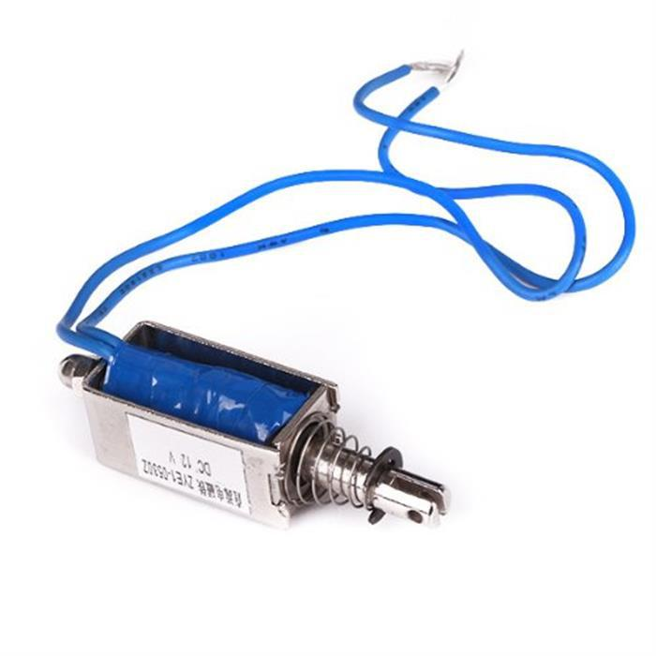
Solenoid:

Slide 10
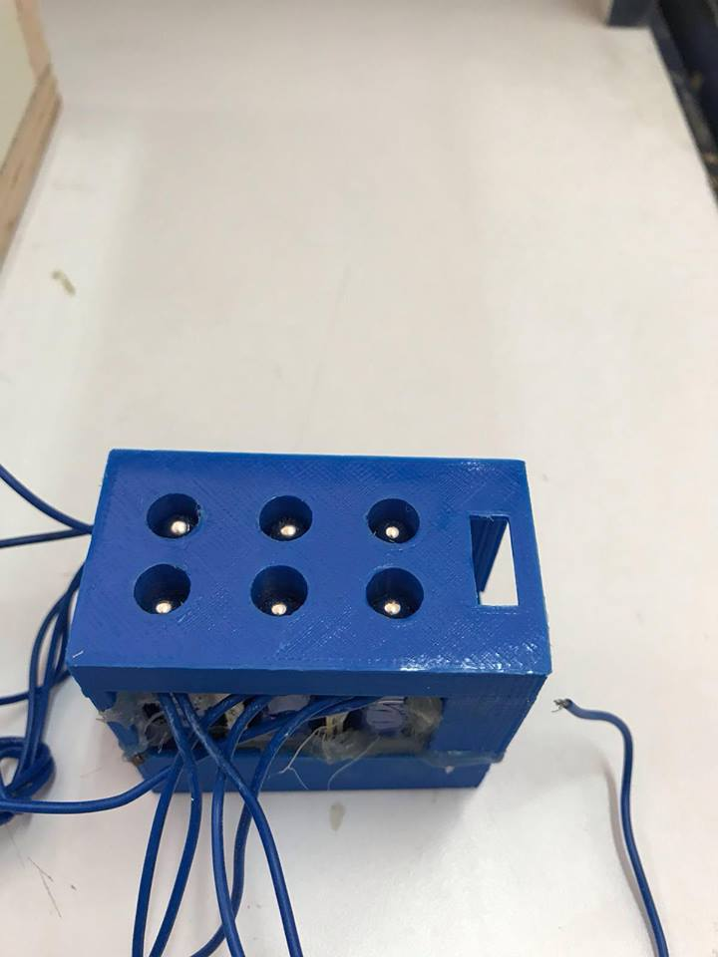
Braille Module:

Slide 11
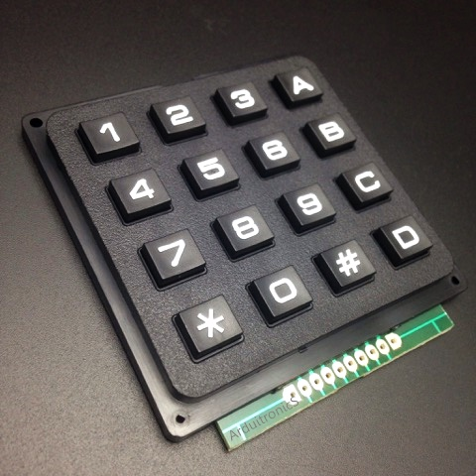
Keypad:

Slide 12
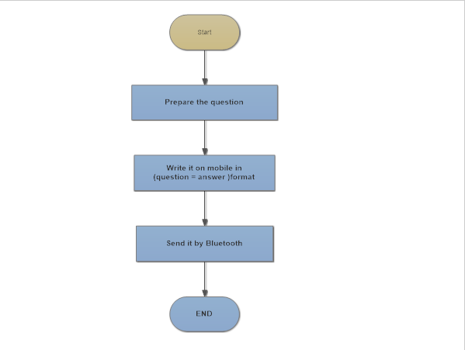
(Features)
Admin Part (Teacher):

Slide 13
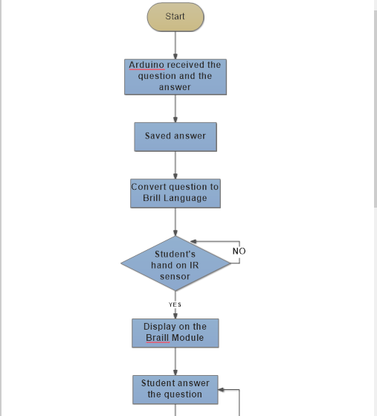
User Part (Blind Student):

Slide 14
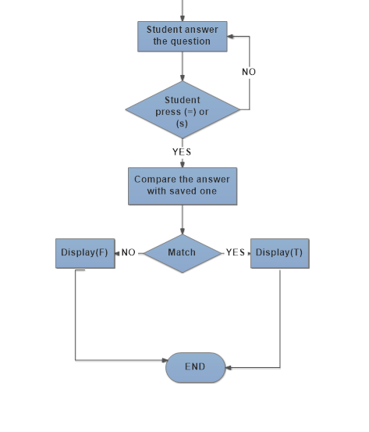

Slide 15
Demo
Send number question
Replay
No answer
Send question

Slide 16
Existing problems
There wasn't a 3D design for our Braille Module on internet.
High cost for one Braille Module.

Slide 17
Future Work
we will improve the software system so it could manage with more students.
we will continue the project and convert it to ATM.
The basic idea of our project could be extended to several application. For example book reader , a wall clock and dealing with smart phones .

Slide 18
Conclusion
At the end, we hope that our project success in achieving new technology that would help blinds to get rid of papers and sound so it could help blinds so much in their lives and their education.

Slide 19
Thank you
^_^

