Slide 1
Graduation Project II
Sustainable Solid Waste Management for Higher Educational Institutions, An-Najah National University Main Cafeteria, Case Study
Prepared by:
Jawdat Lubadeh
Hamdi Shaheen
Islam Sawalha
Tahseen Qashou
Madleen Ghanem
Under supervision: Eng. Reema Nassar

Slide 2
First, we will discuss a brief summery of Graduation Project I

Slide 3
Solid Waste Management
Solid waste management refers to the collection, transportation, and disposal of solid waste materials. It includes the management of both residential and commercial waste, as well as industrial waste.
Collect
Treat
Transfer
Dispose

Slide 4
Ensuring Safe Disposal of Solid Waste
Reducing
Recycling
Waste reduction
Composting
Practices that help to reduce the amount of waste that needs to be landfilled or incinerated.
Landfills and incineration facilities are used for the safe disposal of remaining waste.

Slide 5
Addressing the Global Issue of Solid Waste
Increasing waste generation
Limited disposal capacity
Lack of proper collection and transportation
Climate change
Limited recycling and composting
Environmental pollution
Public health concerns

Slide 6
Environmental Challenges in Palestine
Financial constraints
Lack of control
Limited resources
The Israeli occupation limits
Pollution of water and land
Desertification
Poor land management
Water scarcity

Slide 7
Solid Waste Management in Palestine
Recycling and composting programs are limited
Majority of the waste is sent to landfills
Landfills are not properly managed
This can lead to environmental pollution and public health concerns

Slide 8
Solid Waste Management for Higher Education Institutions
Sustainable Solid Waste Management strategies for an institution can include:
Recycling and composting programs
Collection and transportation
Waste reduction
Research and innovation
Education and outreach

Slide 9
Literature Review
Authors Country Year | Procedure | Focus | Findings
Shadi Moqbel Jordan 2018 | 3 days of the measure. Weight out – Weight in. Sample of 67 bins 1000L. Manual sorting. | Estimation of the waste generation rate. characterization of the solid waste being generated. Potential to recycle. | 8113 kg/day. 1019.64 kg is manual. 12.6% of total waste. 87% is treatable.

Slide 10
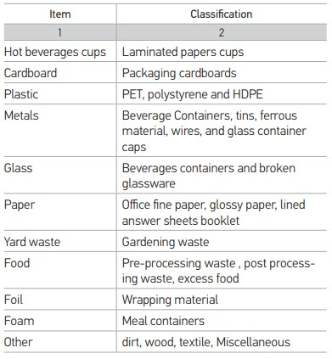
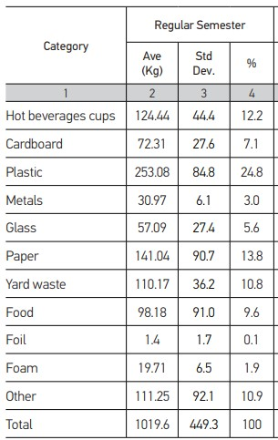

Slide 11
Authors Country Year | Procedure | Focus | Findings
Al Khatib et al. Palestine 2018 | 5 days of measure. Weight out – Weight in. 3 Samples of 2.5 kg 50 L from each area. Manual sorting. | Estimation of the waste generation rate. characterization of the solid waste being generated. Estimation rate per capita. | 34 tons/day. 0.51 kg per capita day.
نفس الشيء عمل جدول مثل الاردنية

Slide 12

UNEP SDGs
Goal 12 of the United Nations' Sustainable Development Goals (SDGs) is to "Ensure Sustainable Consumption and Production Patterns".

Slide 13
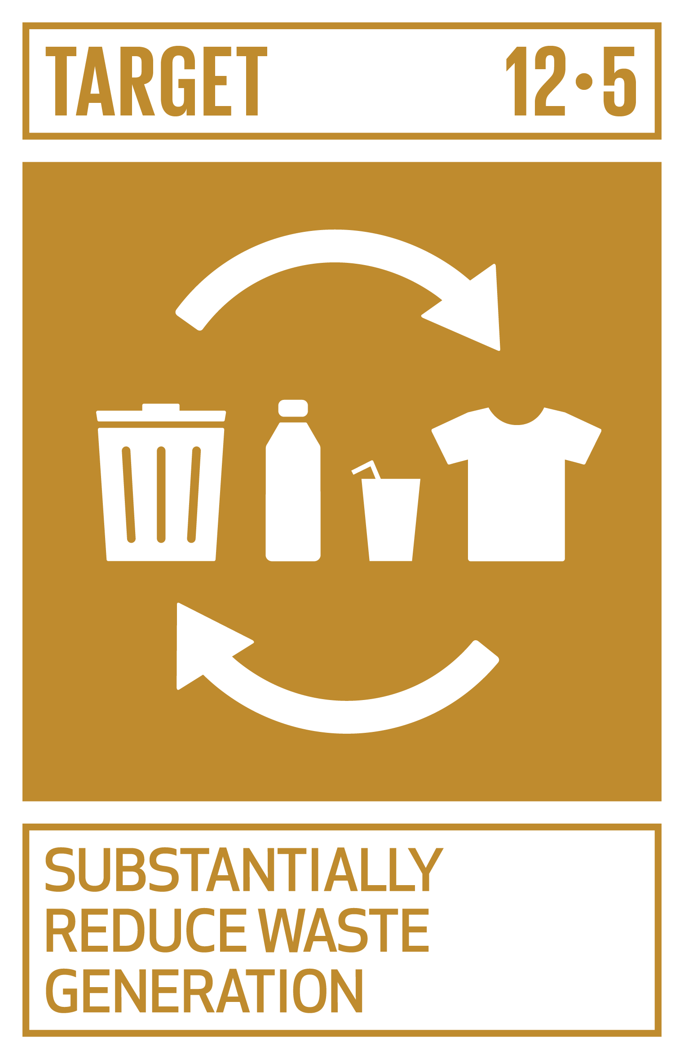
Target 12.5: By 2030,
substantially reduce waste generation
through prevention, reduction, recycling, and reuse.

Slide 14
Now, we will continue the presentation of Graduation Project II
Focusing on the main cafeteria of An-Najah National University as a case study

Slide 15
Objectives
Implementing Financially and Environmentally Responsible Waste Management Strategies.
Quantifying Solid Waste Generation and Categorization.
Enhancing Student Knowledge and Engagement in Waste Management.
Gathering Financial and Operational Data.
Analyzing Data for Feasibility and Revenue Projection.
Projecting Financial Viability.
Proposing Recommendations for Expansion and Policy Revision.
Contributing Valuable Insights and Serving as a Model.

Slide 16
Methodology
Methodology
Data Collection
Data Analysis

Slide 17
Data Collection
Surveys
Interviews
Waste collection and separation

Slide 18
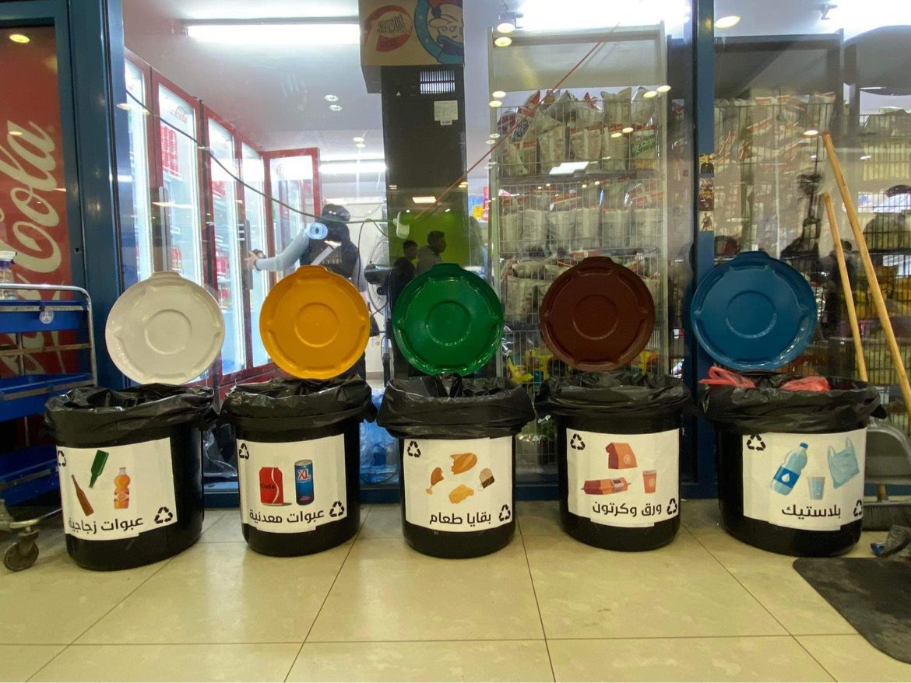
Waste Collection and Separation
Objective: Determine precise quantities of each type of solid waste in the cafeteria.
Five containers: Strategically placed with a 75-liter volume capacity.
Waste categories: Glass, metal, cardboard, plastic, and organic materials.
Systematic categorization: Ensured efficient measurement and analysis.
Data collection period: Spanned 15 working days.

Slide 19

Surveys and Questionnaires
150 questionnaires were collected, with 100 personal interviews and 50 through social communication, and the results were similar.
Examining students' awareness and knowledge of solid waste management at the university and their attitudes towards waste sorting
The survey also inquired about participants' recycling habits as well as their perceived daily consumption quantities.

Slide 20

Interviews
Interviews were conducted with various key stakeholders in the solid waste sector, including:
Individuals holding official positions within the Nablus and Tulkarm municipalities.
Technical personnel working at Zahret Al-Finjan and Al-Monia landfills.
Local market solid waste traders in Eastern Nablus.
Employees from the general services department of An-Najah National University.

Slide 21
Data Analysis
Quantity Surveying Analysis
Questionnaire Analysis

Slide 22
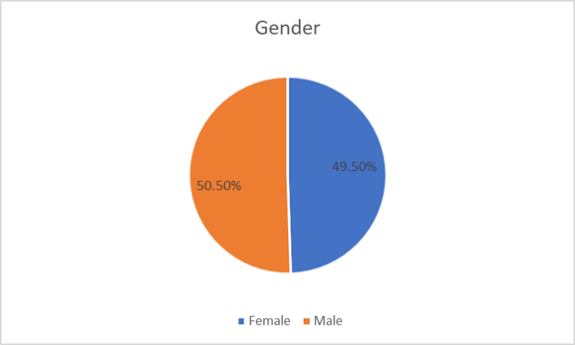
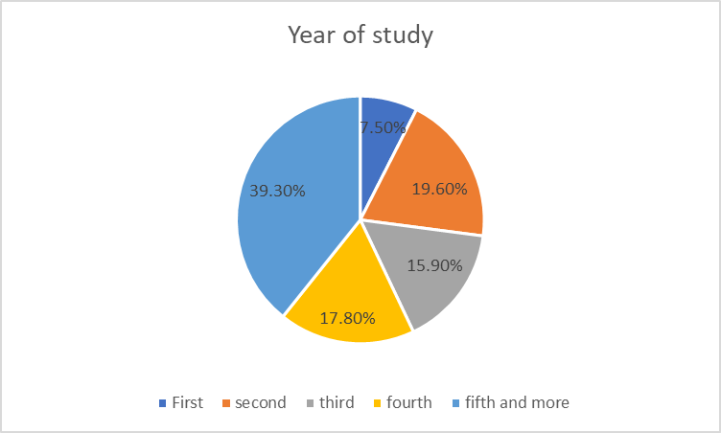
Questionnaire Analysis
Gender
Academic year

Slide 23
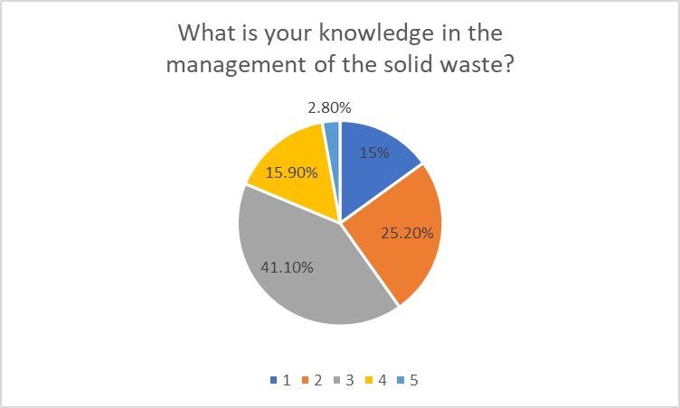
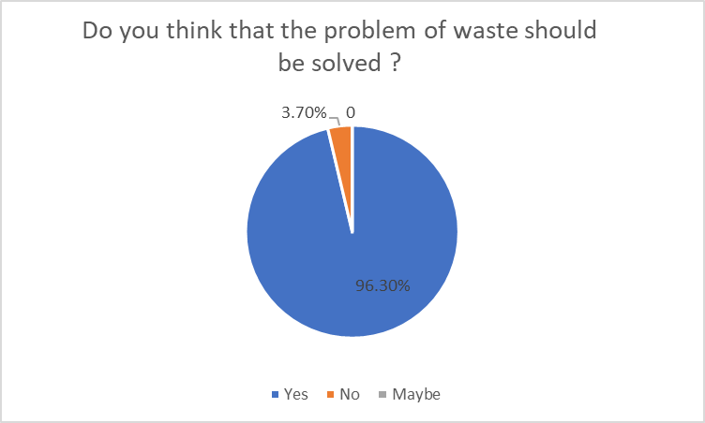
Questionnaire Analysis
Familiarity with the concept of solid waste management
Importance of solving solid waste issues

Slide 24
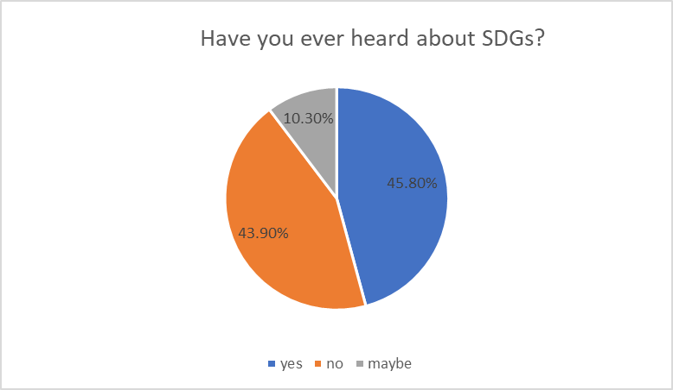
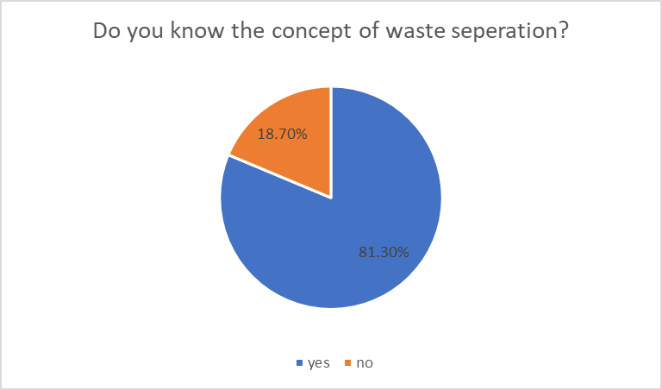
Questionnaire Analysis
Participants’ knowledge of SDGs
Participants’ knowledge of solid waste sorting

Slide 25
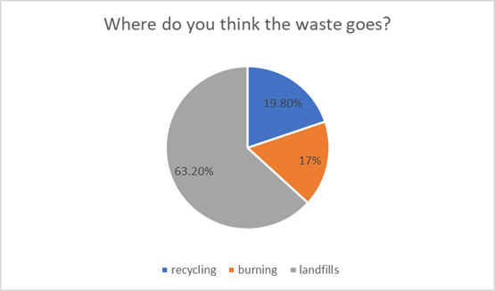
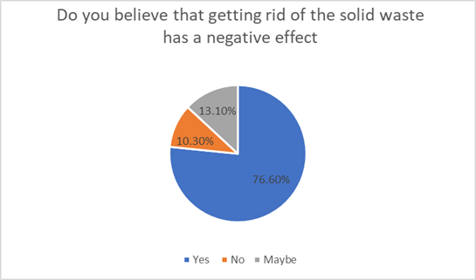
Questionnaire Analysis
The disposal destination of waste subsequent to collection
Understanding of the negative consequences of solid waste disposal

Slide 26
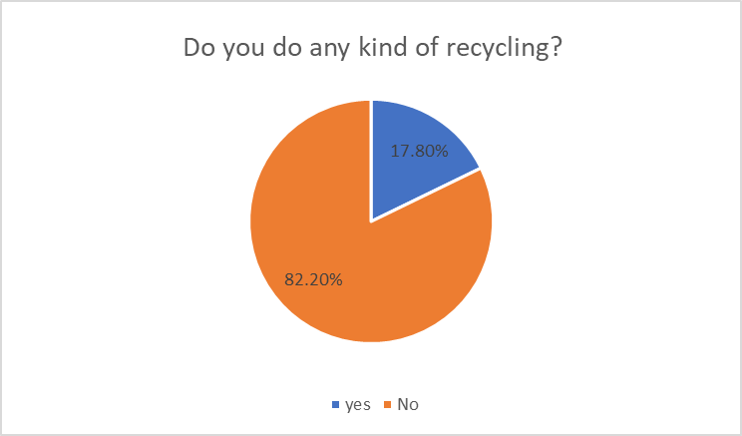
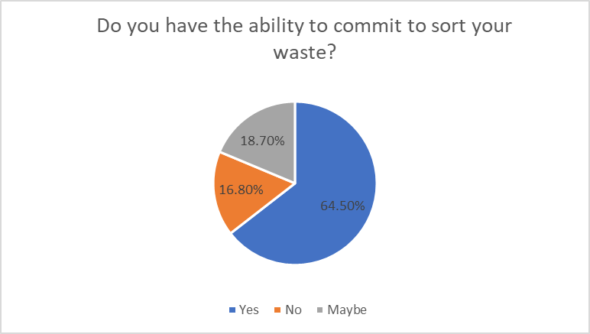
Questionnaire Analysis
Participants' recycling habits
Participants' attitudes towards waste sorting

Slide 27
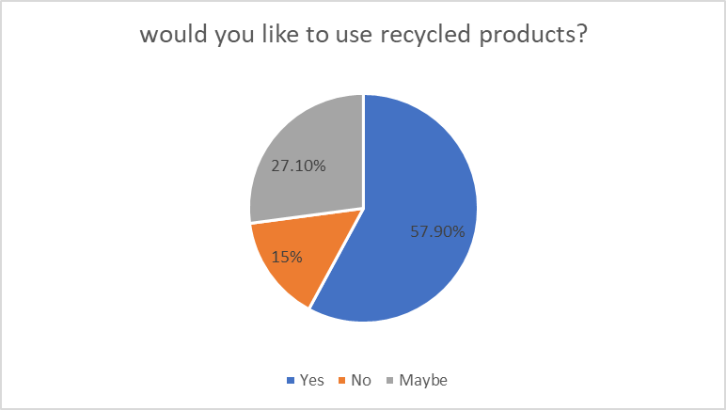
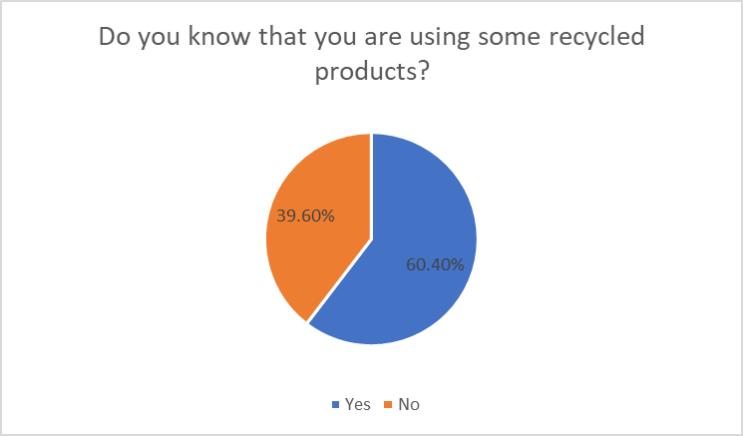
Questionnaire Analysis
Inclination towards using recycled products
Participants’ familiarity with using recycled items

Slide 28
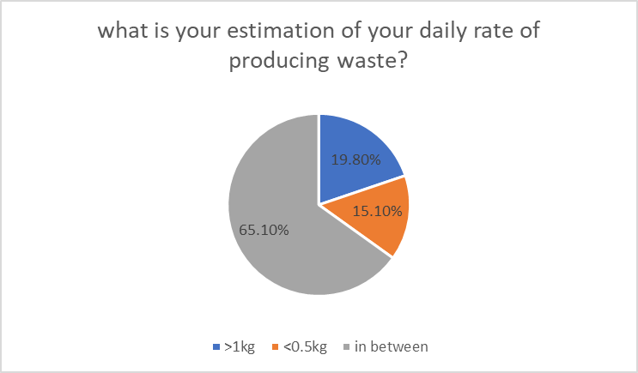
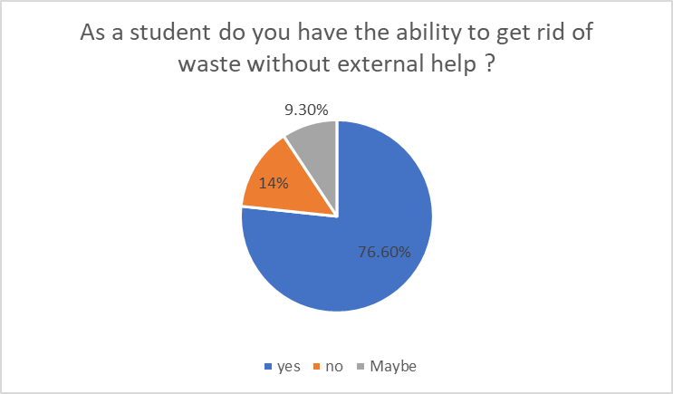
Questionnaire Analysis
Participants' estimation of their daily per capita waste production
Participants' responsibility as university students to manage waste

Slide 29
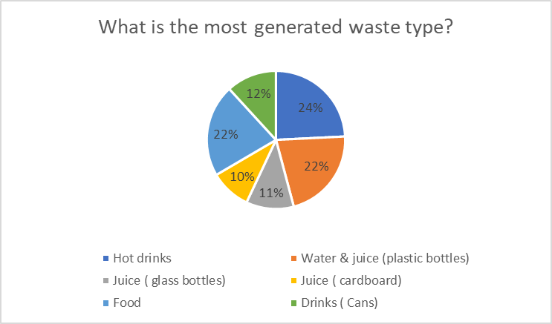
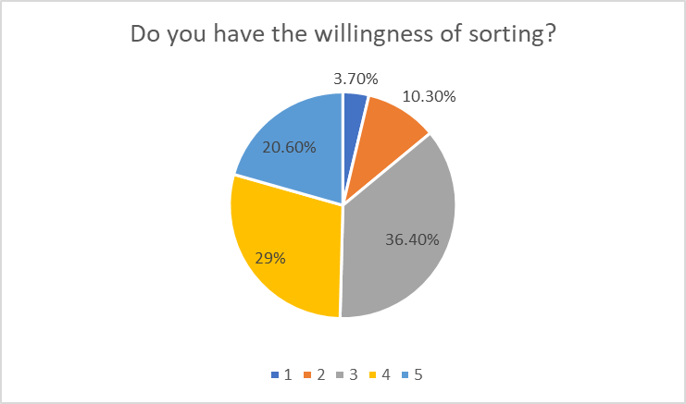
Questionnaire Analysis
The most frequently used materials in cafeteria
Respondents' willingness of sorting

Slide 30
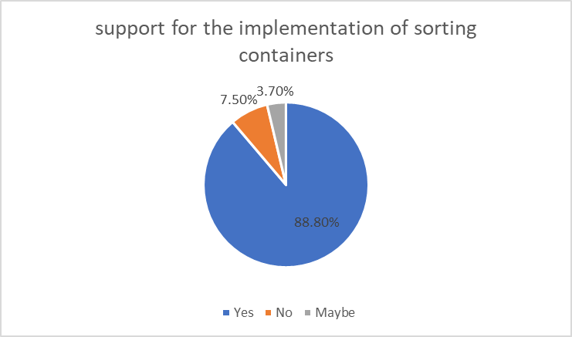
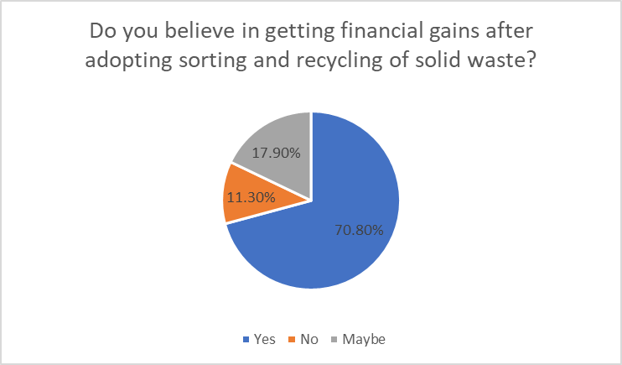
Questionnaire Analysis
Respondents' support for the implementation of sorting containers in various areas of the university
Participants belief in getting financial gains after adopting sorting and recycling of solid waste

Slide 31

Quantity Surveying Analysis
Mixed waste quantity surveying
Separated waste quantity surveying
Prediction of waste quantities for a semester
Projection of semester waste amounts assuming complete waste separation
Revenue estimation
Initial capital cost estimation
Potential savings
Expenses estimation
Project’s feasibility estimation

Slide 32
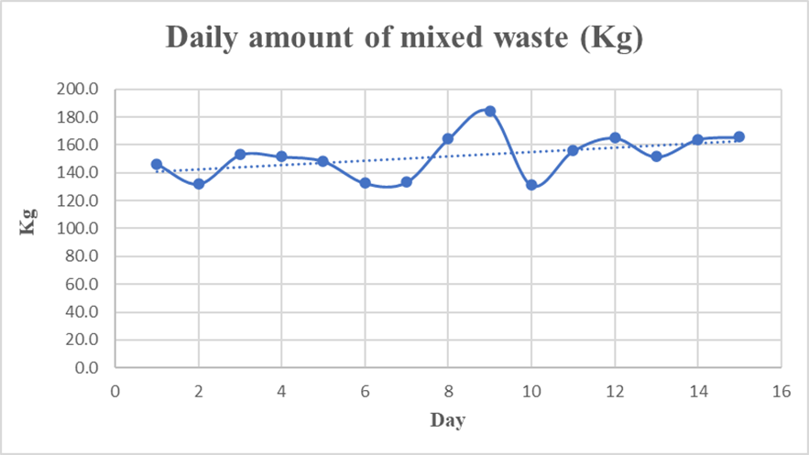
Mixed waste quantity surveying

Slide 33
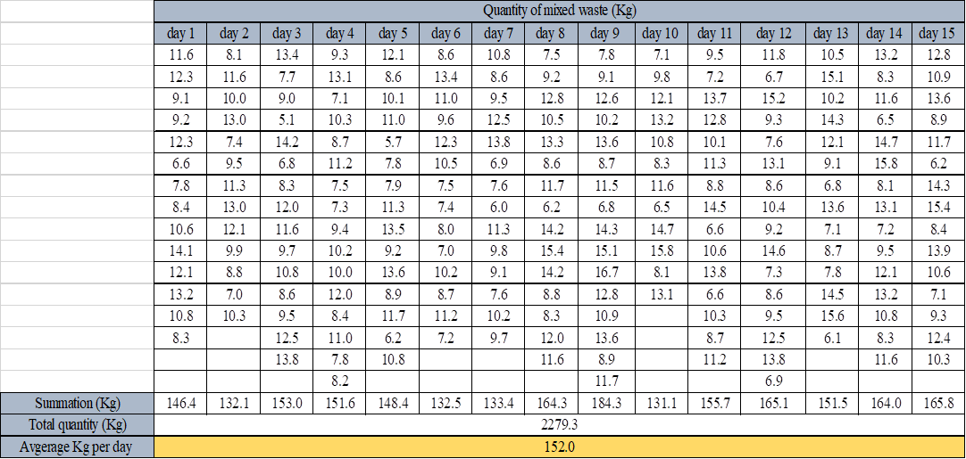
Mixed waste quantity surveying

Slide 34
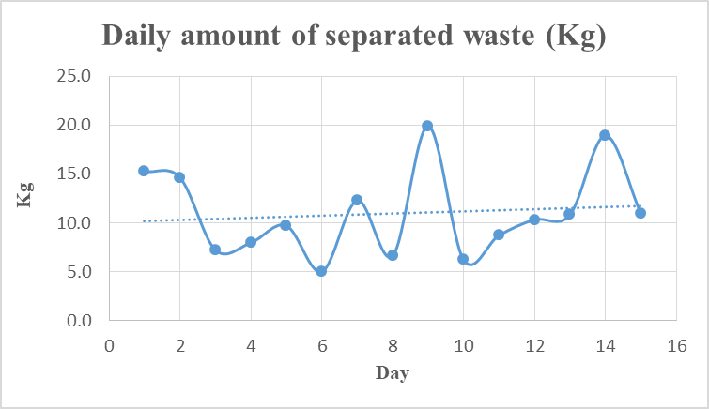
Separated waste quantity surveying

Slide 35
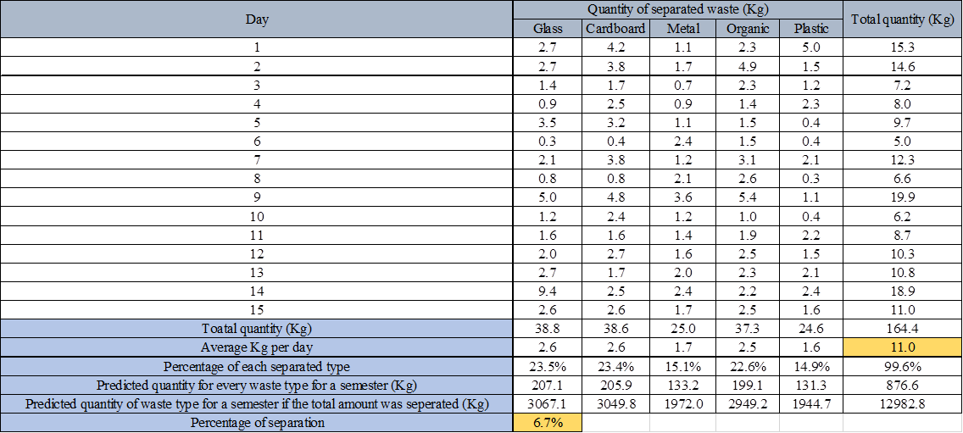
Separated waste quantity surveying

Slide 36
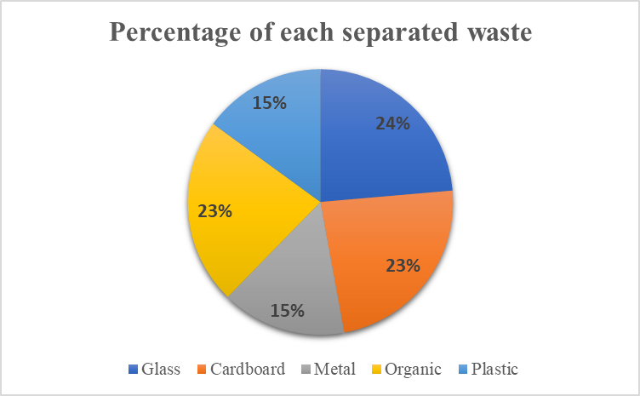
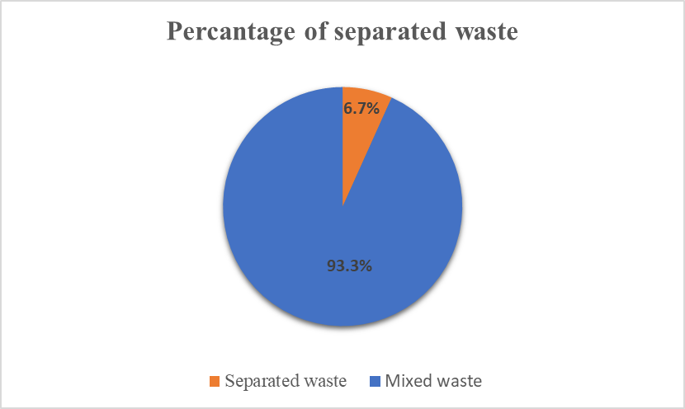
Percentage of the separated waste

Slide 37
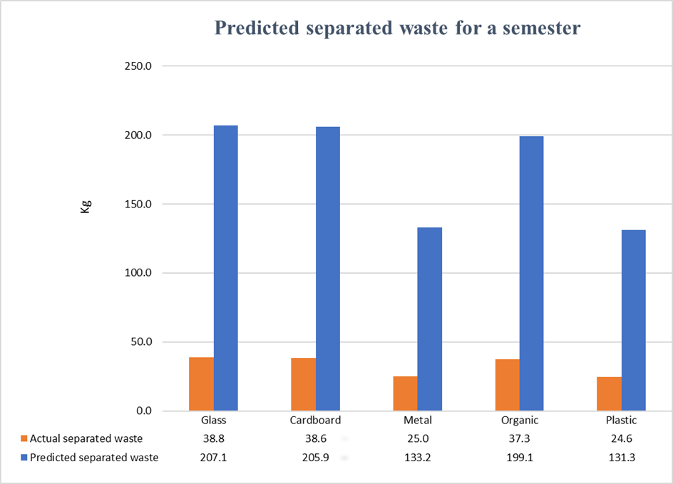
Prediction of waste quantities for a semester

Slide 38
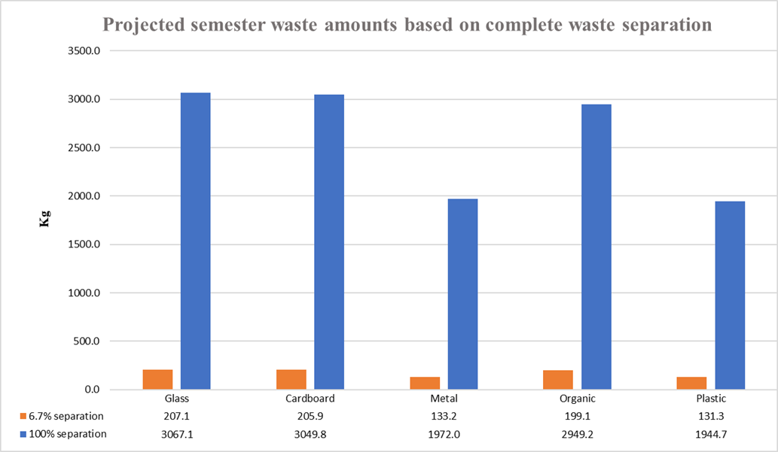
Projection of semester waste amounts assuming complete waste separation

Slide 39
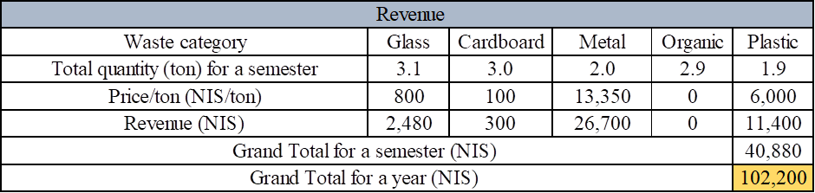
Revenue Estimation

Slide 40
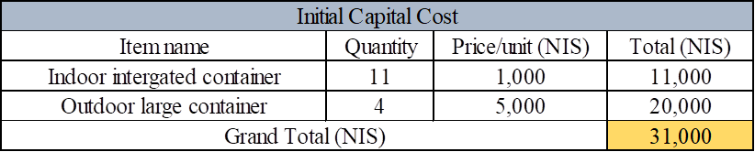
Initial Capital Cost Estimation

Slide 41
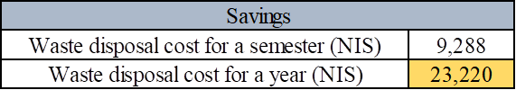
Potential Savings

Slide 42
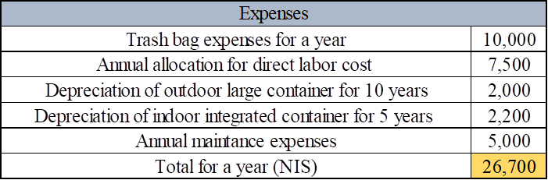
Expenses Estimation

Slide 43
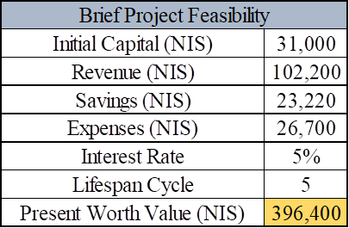
Project’s Feasibility Estimation

Slide 44
Results and Findings: Economical Aspects
Projected annual revenue from waste management system: 102,200 NIS
Exclusion of organic waste justified by market constraints and logistical challenges.
Potential savings of 23,300 NIS from reduced disposal costs and improved efficiency.
Revenue potential can be enhanced through marketing strategies and partnerships.
Present worth analysis indicates a value of 396,400 NIS over five years, demonstrating financial feasibility.
Valuable insights for decision-making and policy revisions.

Slide 45
Results and Findings: Questionnaire Findings
Participants demonstrated varying levels of knowledge about waste management.
Lack of incentives hindered participation in waste sorting activities.
Majority believed waste is primarily sent to landfills.
Cafeteria's waste separation rate was 6.7%, indicating room for improvement.
Limited knowledge about recycled products hindered their adoption.
Students recognized their responsibility in waste disposal.

Slide 46
Results and Findings: Environmental Aspects
Total environmental and health damage costs 1460 NIS per year.
Responsible waste management reduces pollution and improves health outcomes.
Inefficient waste management burdens the municipality financially.
Comprehensive waste management strategies are essential for environmental sustainability.
Sustainable waste management promotes public health and resource preservation.

Slide 47
Conclusions and Recommendations
Implement campus-wide waste separation program with clear guidelines for proper sorting and disposal.
Establish comprehensive recycling program with accessible bins and collaboration with local recyclers.
Invest in suitable containers and disposal facilities for efficient waste collection and separation.
Foster partnerships with stakeholders for knowledge sharing and potential funding opportunities.

Slide 48
Conclusions and Recommendations
Promote waste management education through curriculum integration, campaigns, and workshops.
Conduct cost-benefit analysis to ensure project feasibility and economic viability.
Introduce composting systems for effective organic waste management.
Prioritize sustainable procurement practices to reduce environmental impact.
Monitor and evaluate waste management practices through performance metrics and audits.
Support research and innovation in waste management technologies and practices.

Slide 49
THANK YOU!

