Slide 1

Smart PetHome
Supervisors:
Dr. Luai Malhis
Dr. Emad Natshes
Participants:
Hassan Abu Thiab
Mohammad Mousa

Slide 2
Table of Contents
1 Problem & Motivation
The problem our project is aiming to solve
2 Solution
The solution we committed to
3 Main Functionalities
The main features our project provides
4 Challenges
The challenges we have faced during the implementation
5 Future Work
What we will do to update and enhance the system

Slide 3
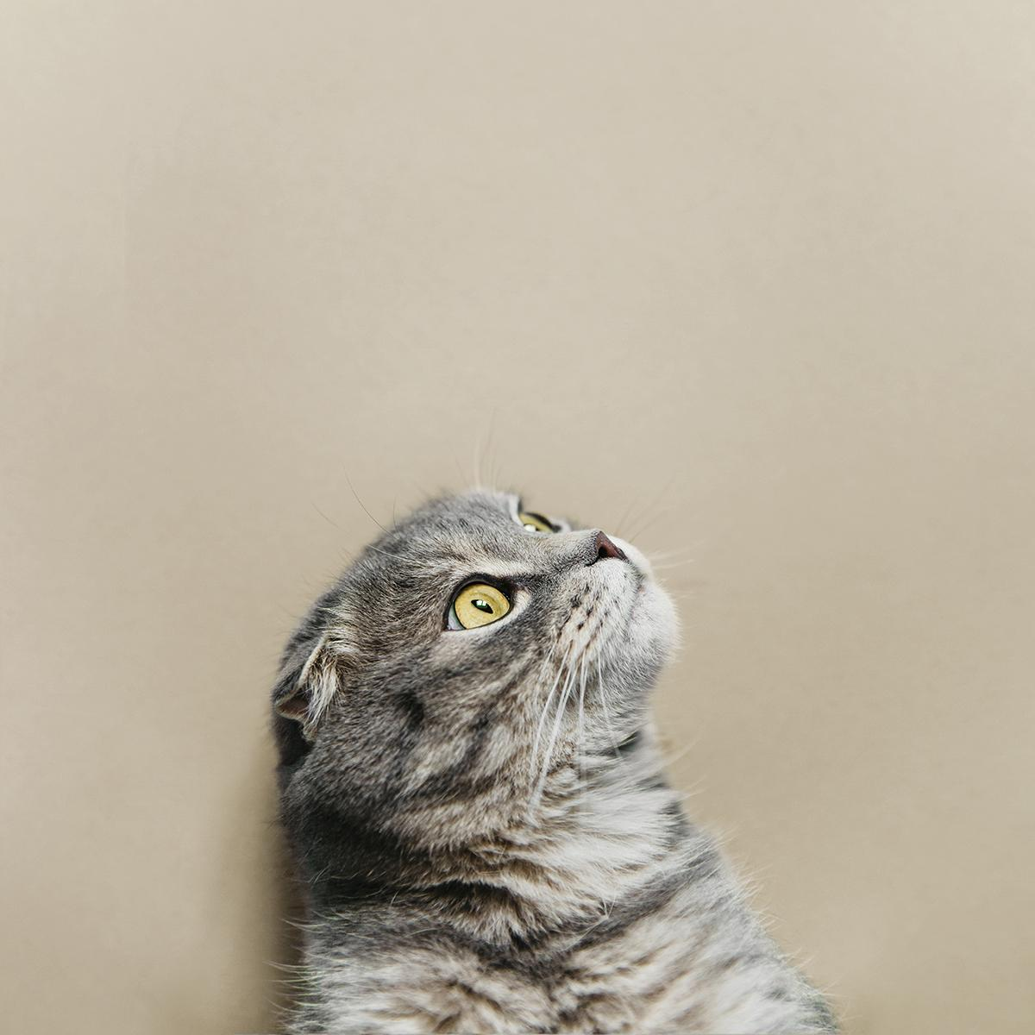
Problem & motivation

Slide 4
Problem & Motivation cont.
Being unable to keep track of pets
Lack of the ability to take care of pets while the pet owner is outside
Saving the pet owner’s time
Having to manually feed your own pet many meals a day
Having some luxury by having a smart PetHouse

Slide 5

Solutions

Slide 6
Solutions cont.
A Smart Pet House which can do:
Simplify managing the pet meals for the pet owner
Provide the pet owner with a food schedule for the pet
Notify the User of any escaped cat out of the house
Tracking the escaped pet (GPS)
Monitoring system, lighting system, air conditioner

Slide 7
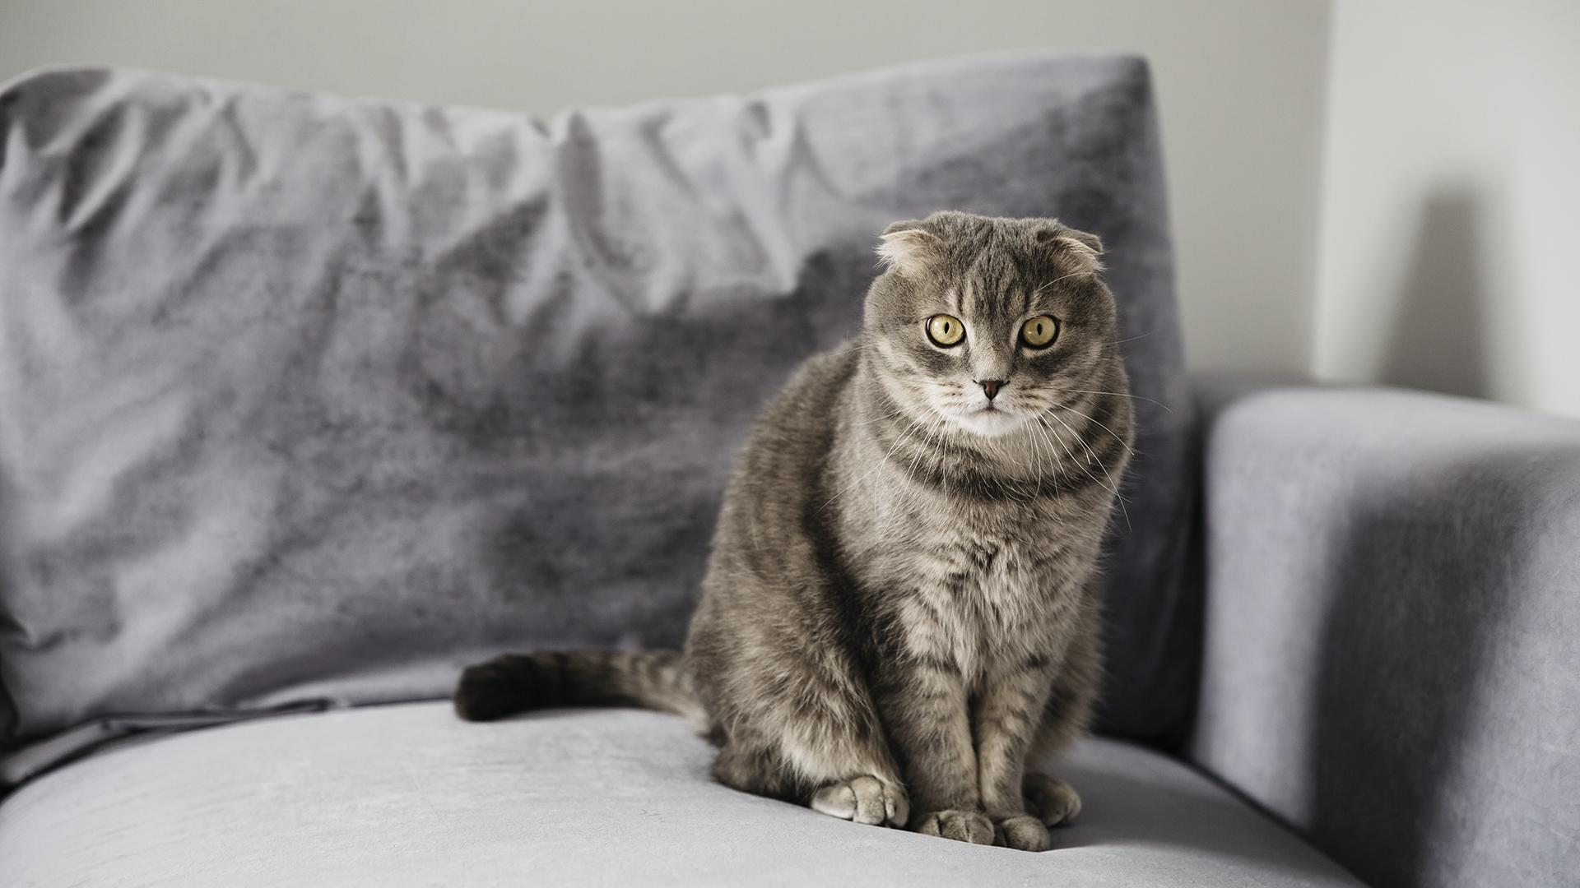
Main Functionalities

Slide 8
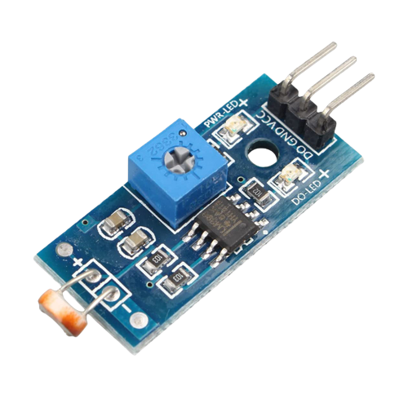
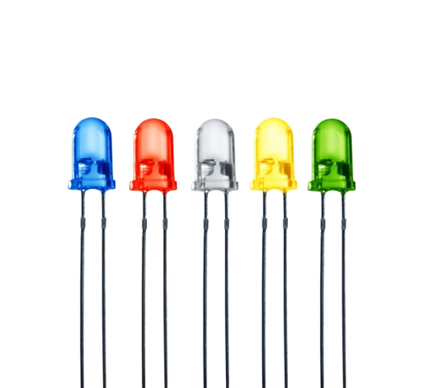
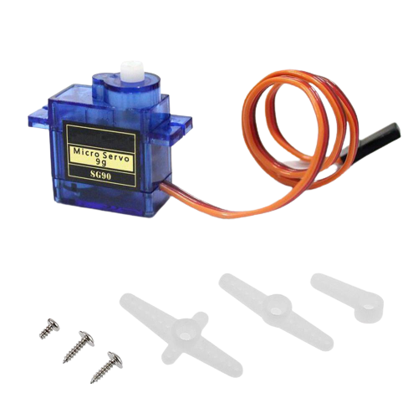
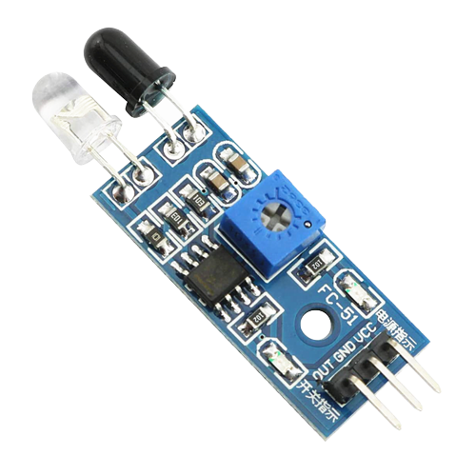
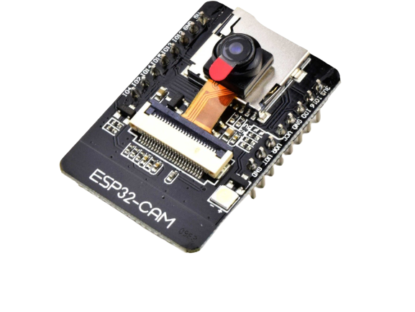
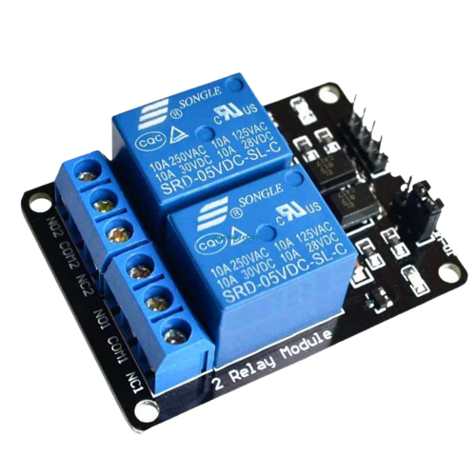
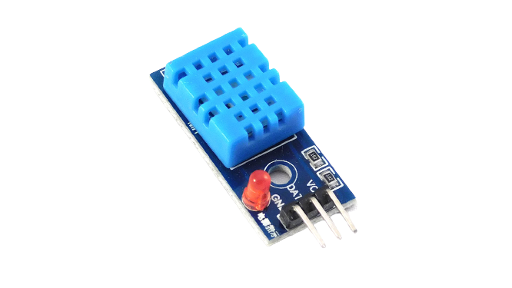
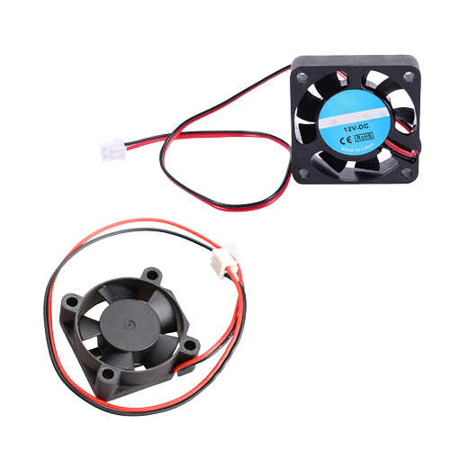
Indoor lighting system
Air Condition system
Monitoring System
House Gate System
This system can be managed automatically or manually.
This system responsible of open and close the house gate automatically or manually.
Tools :
LDR
LEDs
Tools :
Servo motor
IR sensor
Door piece
This is the system responsible for maintaining a certain temperature level.
Monitoring the house by the Camera
Tools :
Temperature Sensor
Relay
12v Fan
Tools :
ESP32Cam
Relay

Slide 9
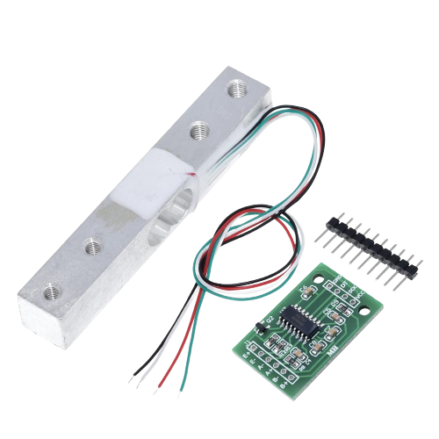
Pet Feeding System
This system responsible of feeding the pet a specific weight for each meal managed manually using the app
How Does It Work ?
The user can control dropping the a specific weight of food immediately also scheduling 3 meals a day with a specific weight each meal
Tools :
Servo motor
Weight Load Cell & HX711
3D printed pieces

Slide 10
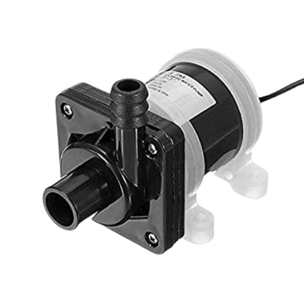
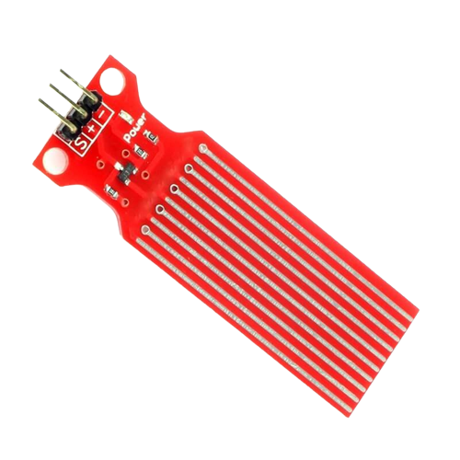
Water Refilling System
The system responsibility is to fill the water tank in a automatic or manual way.
How Does It Work ?
When the water level get lower than a certain level the system will start the water pumping into the pet water bowl.
Also the user can turn on and off the pump manually from the mobile app.
Tools :
Water level sensor
12V pump
relay

Slide 11
Pet Security system
This system notify the pet owner if their pat went through the door .
How Does It Work ?
When the user turn on the pet sensor option from the mobile app if the sensor on the door detect a pet the system will notify the user their pet might be out.
Tools :
2 IR sensors

Slide 12
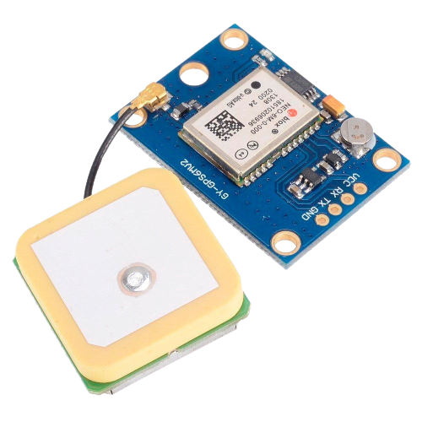
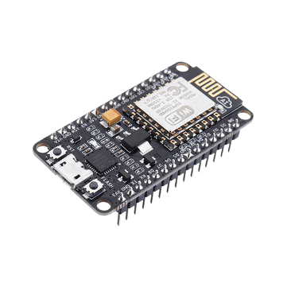
Pet Tracking system
This is the system responsible for keep tracking of the pet’s location
How Does It Work ?
When the user opens the map on the app to track their pets, The GPS chip on the pet will send the location’s coordinates to the app so the pet owner can see the pet’s location on the map
Tools :
GPS6MV2
NodeMcu ESP8266

Slide 13
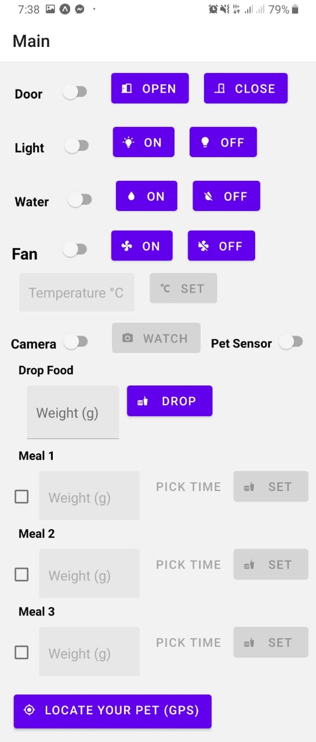
Mobile App
This is the software which give the user to control and monitor the house remotely.

Slide 14
Challenges

Slide 15
Challenges cont.
Lack of time with a 3 months period
Lack of experience with components and chips.
Lack of and High price of some chips.

Slide 16
Future Work

Slide 17
Future Work cont.
Add windows control feature .
Make the system more controllable .
The ability to handle more pet tasks automatically such as cleaning the litterbox.
Image Processing and AI to add up onto the functionality of the camera rather than just monitoring.
Better tracking system using GPRS/GSM

Slide 18
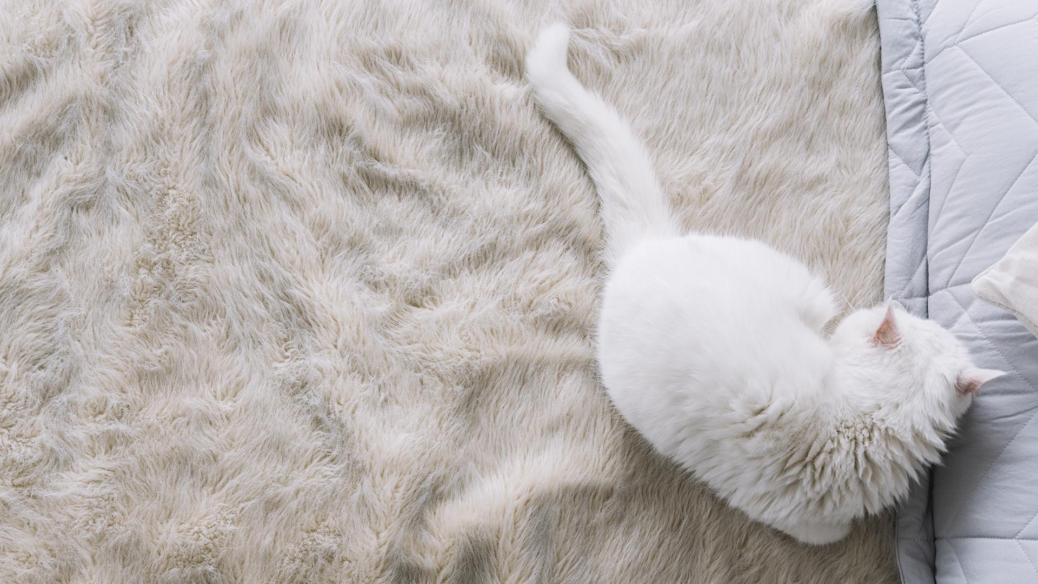
Thanks!
Do you have any questions?
Supervisors:
Dr. luai Malhis
Dr. Emad Natshes
Participants:
Hassan Abu Thiab
Mohammad Mousa

