Slide 1
Mapping Of Flooding Risk From Stormwater In The City Of Nablus
And The Management And Design Of The Stormwater Drainage System
Prepared By: - Ekram Saleh
-Hassan Zeid
-Haya Abozant
-Mohammad Abu Sanfa
Under Supervision: Dr. Mohammad Al-Masri

Slide 2


Table of Contents
01
Introduction
02
Study Area
03
The Questionnaire And Interviews
Management Of The Problem
04
Assessment To The Problem
05
06
Analysis By StormCAD
07
Redesign
08
Discussion
09
Conclusion
10
Recommendation

Slide 3
01
Intoduction
Objectives
Methodology

Slide 4
Objectives
Analyzing simulating the existing stormwater collection network by means of observations and StormCAD software in order to assess the efficiency and adequacy the network.
Spotlighting the problematic areas that has a flooding risk.
Management and Redesign of the current network .

Slide 5
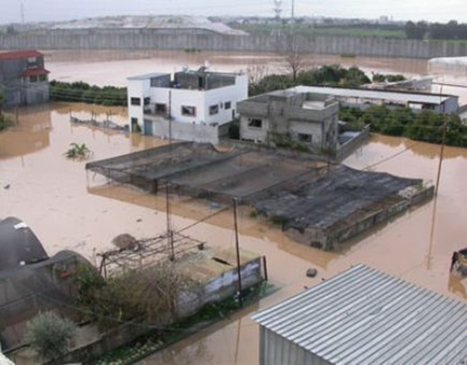

Slide 6
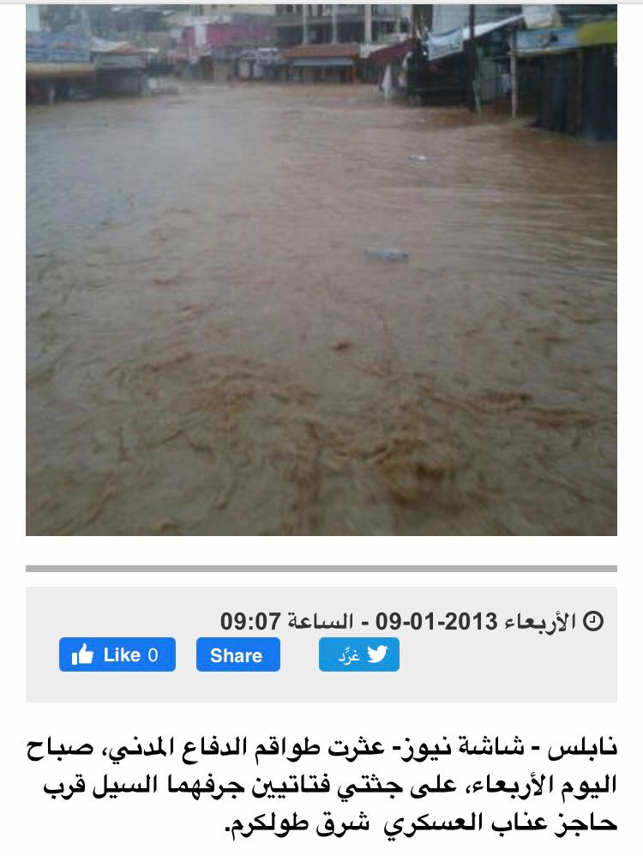

Slide 7
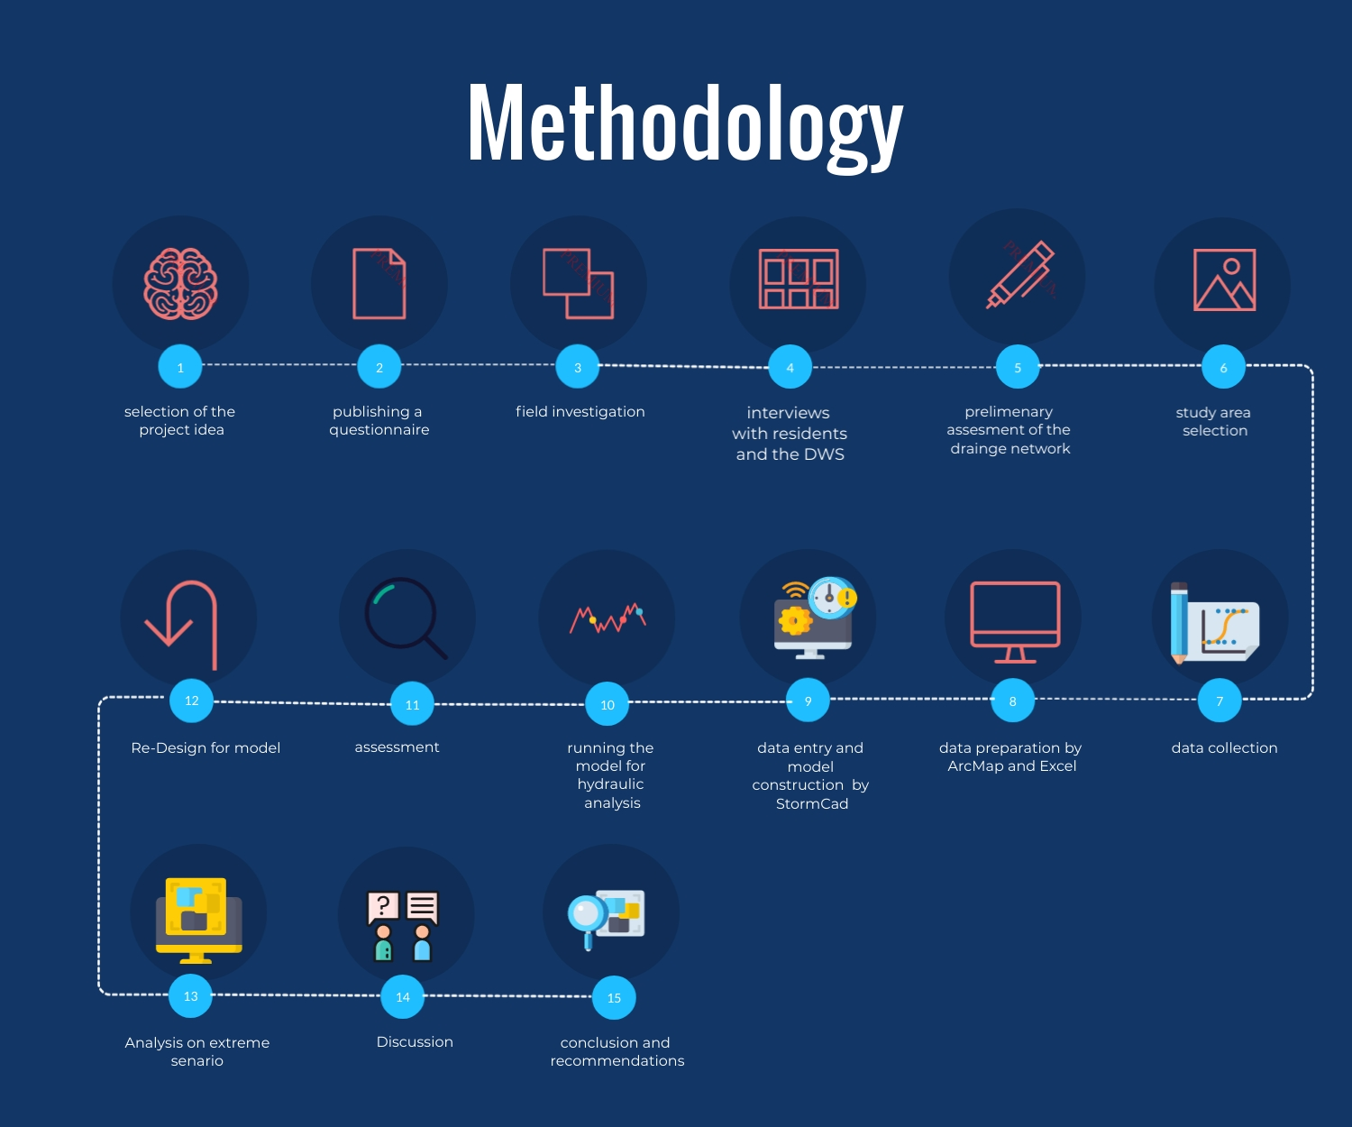

Slide 8
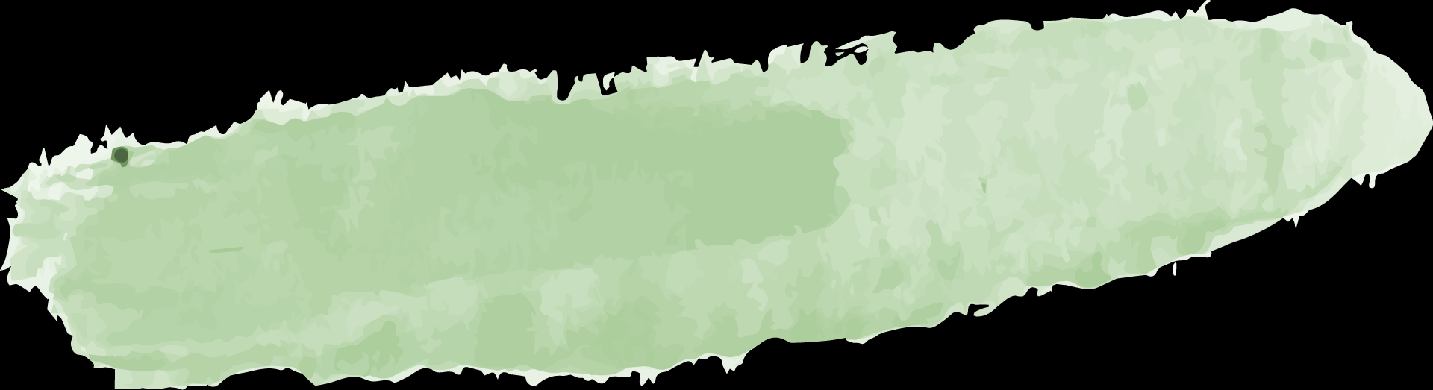
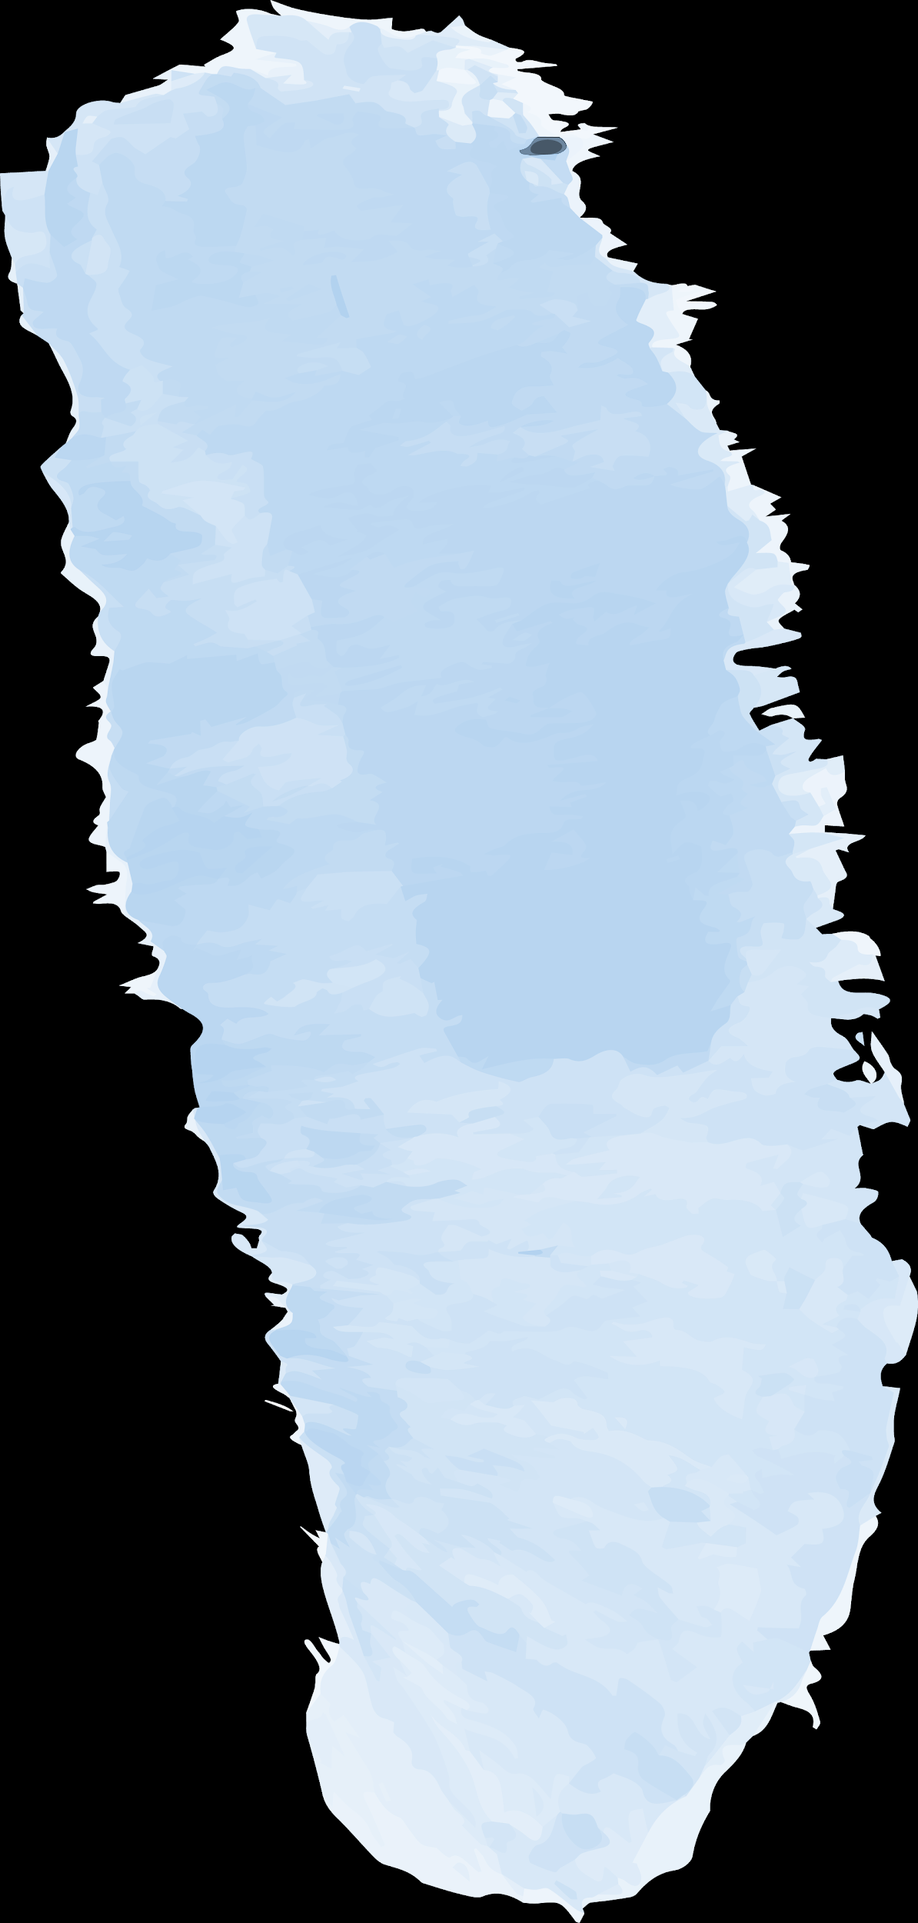


Assumptions
01
The characteristics of the catch basins were the same as those of the nearest manholes given by the DWS
02
Land cover/use was classified to three categories:
  Lands : C= 0.2
  Buildings : C =0.5
  Roads : C = 0.7
03
For catch basins 30% clogging factor was assumed due to bad general cleanliness condition of streets and catch basins

Slide 9
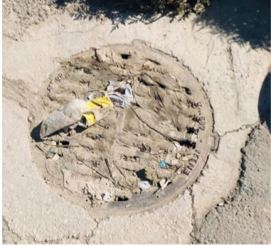

Slide 10
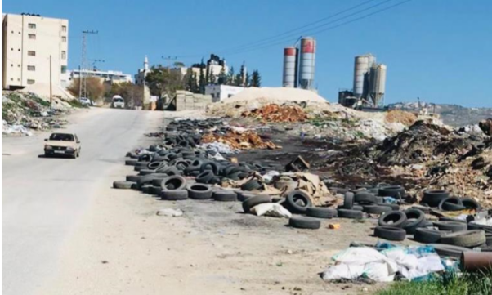

Slide 11
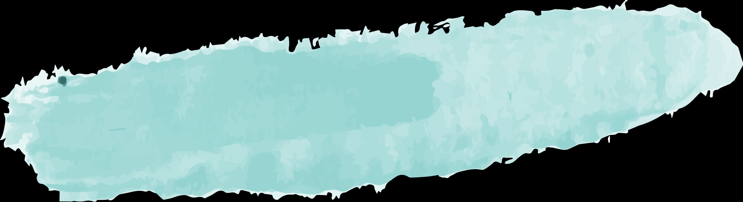
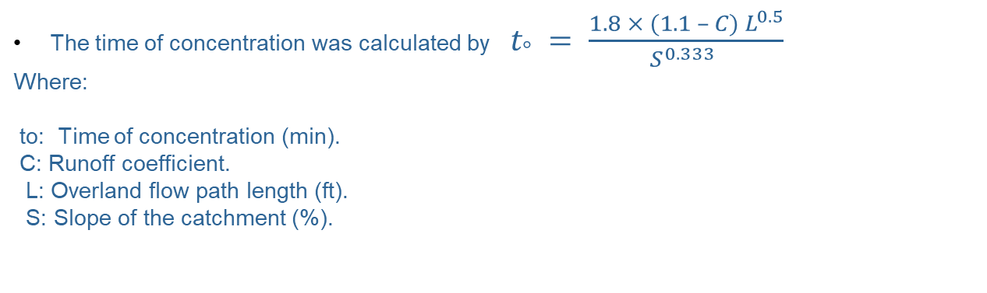
Calculations:
The time of concentration was calculated by $t_{°} = \frac{1.8 × (1.1 – C) L^{0.5}}{S^{0.333} }$
Where:
to: Time of concentration (min).
C: Runoff coefficient.
L: Overland flow path length (ft).
S: Slope of the catchment (%).

Slide 12
For overland flow, CIA method was used in StormCAD
Where :
Q = maximum runoff (ft3/sec)
C = runoff coefficient (-)
I = intensity of rainfall for a selected frequency and duration equal to at least the time of concentration (in/hour)
A = drainage area (acres)

Slide 13
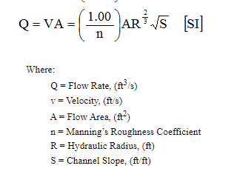
For gravitational flow in conduits manning equation was used in StormCAD

Slide 14


Limitations:
01
there is a lack of previous studies and data about this subject and specially in Nablus city
The method of data collection of the catch basins was not that much accurate and depend on the accuracy of the GPS app , However, much efforts were dedicated to get higher possible levels of accuracy.
02

Slide 15
02
Description of the study area

Slide 16
The average annual rainfall in Nablus city is around 660.1 mm. Nearly, 80% of this rain falls between December and March
Nablus city is witnessing an increasing speed of urbanization where impervious areas are increasing and leading for higher runoff coefficient ( c )
Nablus city is topographically divided into two parts eastern and western , the efforts of analysis were concentrated only on the western part and At-Tofah valley is considered as the outfall of western part .

Slide 17
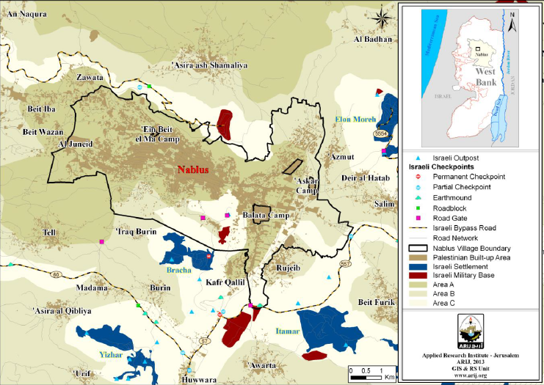

Slide 18
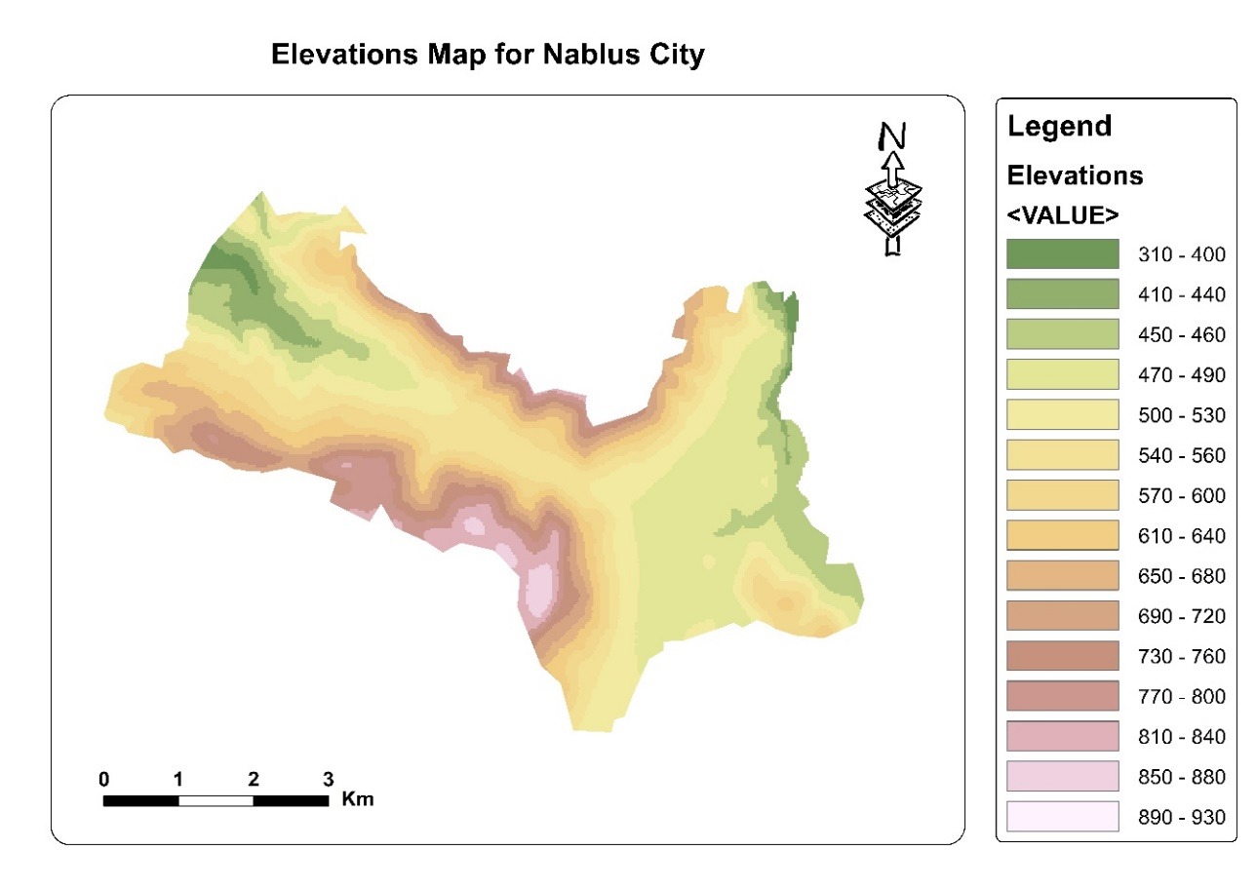

Slide 19
03
The Questionnaire And Interviews

Slide 20
Questionnaire
Why?
For Whom?
Questions?
Responses!

Slide 21
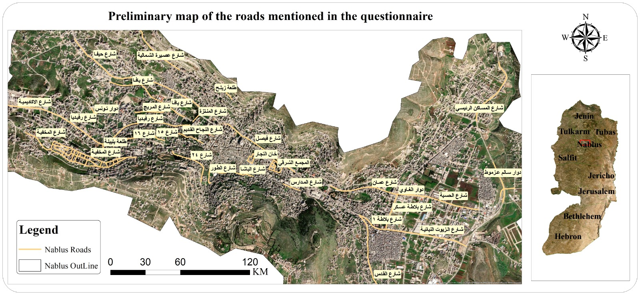

Slide 22
Field Investigation & Interviews

Slide 23
04
Assessment To The Problem

Slide 24
There are different reasons for floods:
01
The topographic nature of Nablus
02
Large catchment area with insufficient and improper allocation of draining inlets and sometimes there is none
03
The low slopes of the roads (extremely flat) in these areas. This making them hardly able to drain the stormwater
04
Rapidly expanding urbanization where the drainage network still constant
05
Bad infrastructure

Slide 25
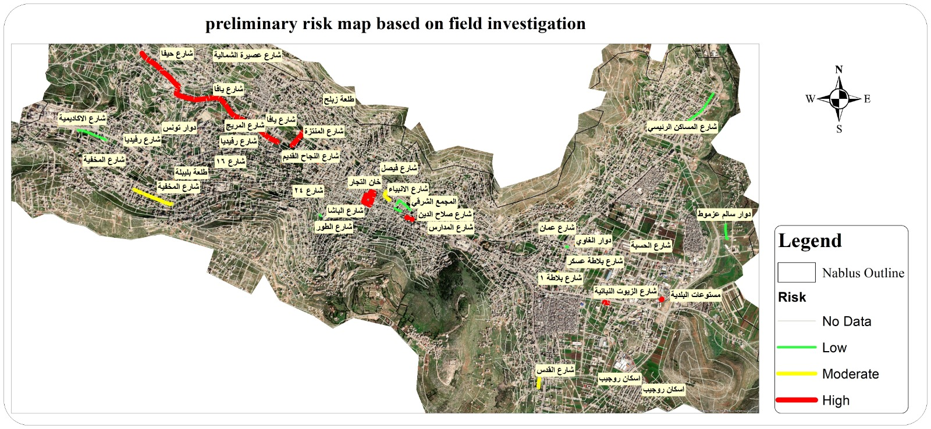

Slide 26
05
Management Of The Problem

Slide 27
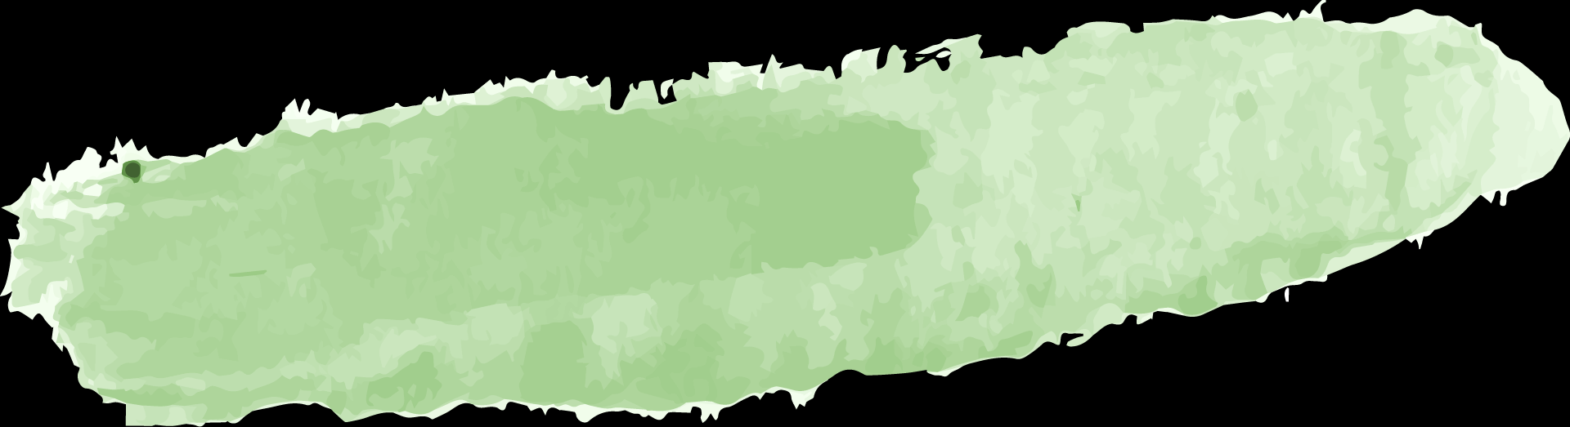

Maintenance
Awareness
Management of the problem
Rehabilitation
Data Base

Slide 28
06
Analysis By StormCAD

Slide 29
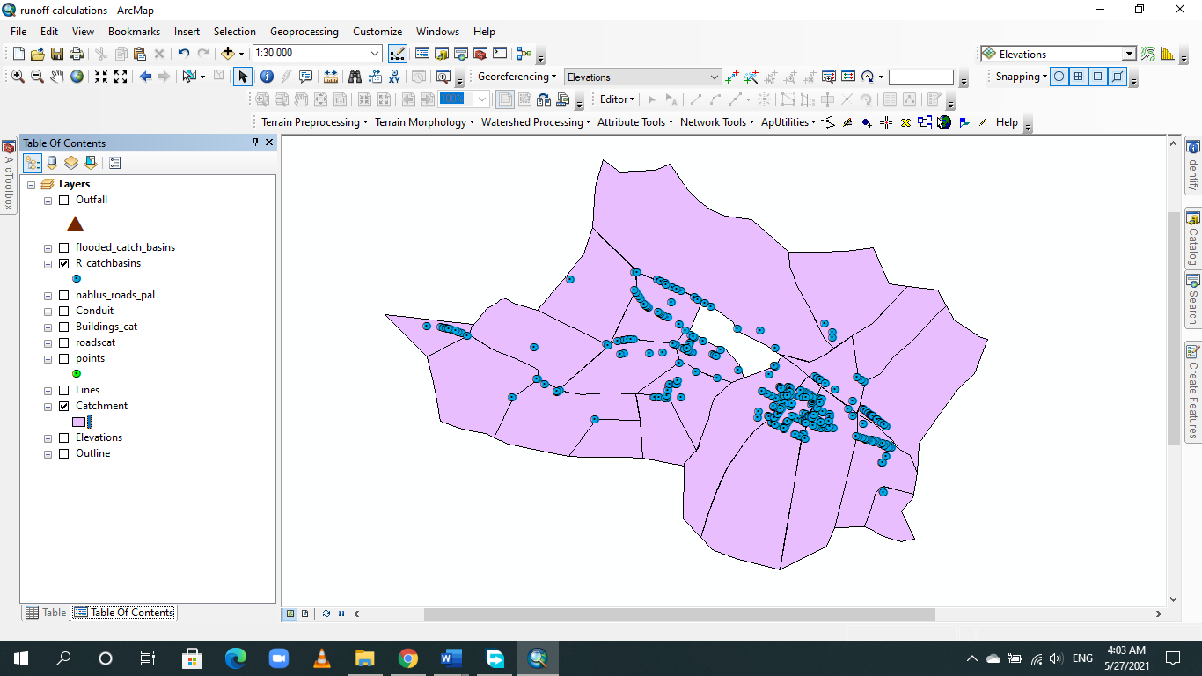
Catchment Delineation:

Slide 30
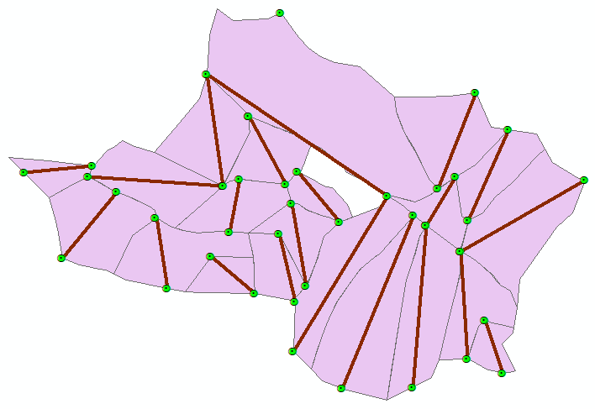
Overland Flow Path Length and Catchment Slope :

Slide 31
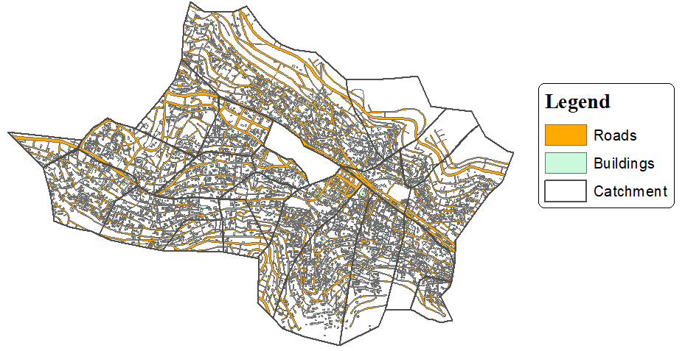
Land Use/Cover and Runoff Coefficient:

Slide 32
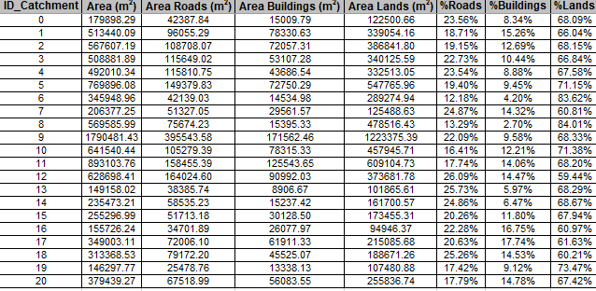

Calculations for Time of Concentration:
$$Using FAA method{ t}_{°} = \frac{1.8 × (1.1 – C) L^{0.5}}{S^{0.333} }$$

Slide 33
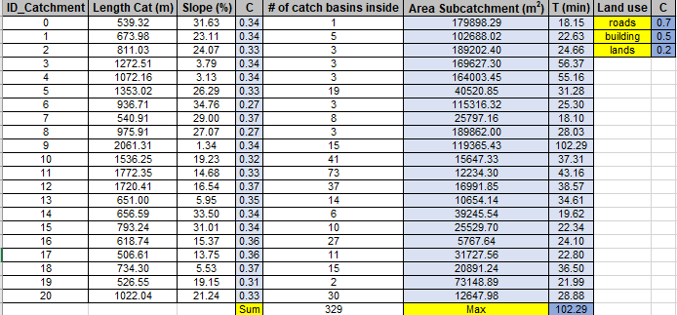
Calculations for Time of Concentration:
$$Using FAA method{ t}_{°} = \frac{1.8 × (1.1 – C) L^{0.5}}{S^{0.333} }$$

Slide 34
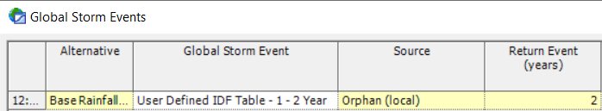
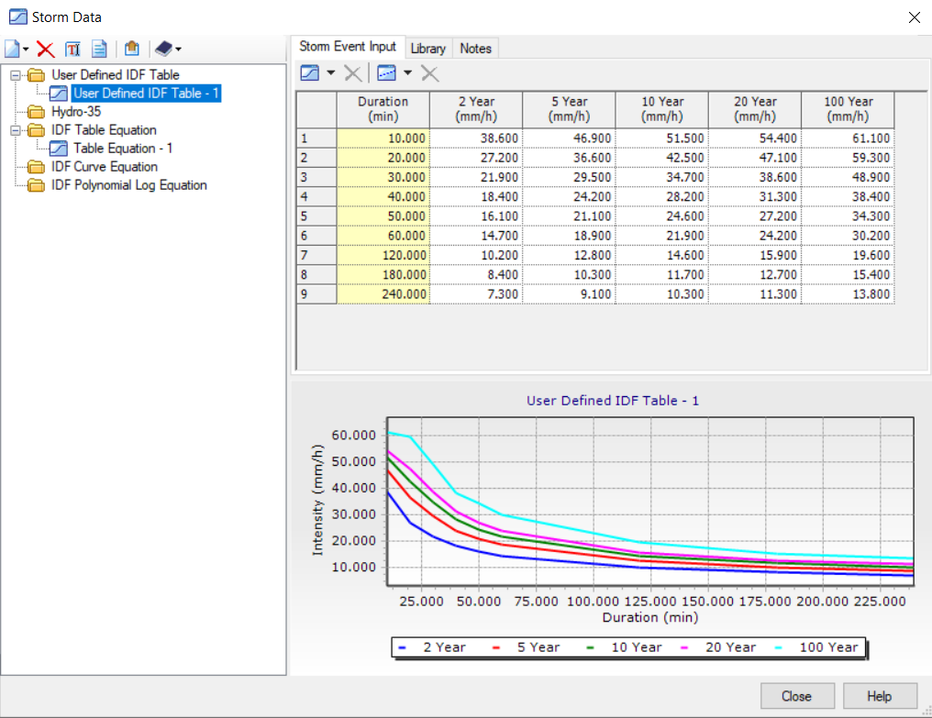
Storm Event Inputs :
The intensity 11.48 mm/hr

Slide 35
07
Redesign Process

Slide 36
As the preliminary analysis indicated, the current network was not designed enough to handle the stormwater . So there was a need to redesign the network.
The intensity was 16.67 mm/hr for a return period 10 years

Slide 37
Re-design criteria and standards
Velocity ranges between 0.5 m/s - 4 m/s.
Slope ranges between 1% - 10%.
Cover should not be less than 1 m and not exceed 6 m.
Partial flow not more than 90% of the capacity.

Slide 38
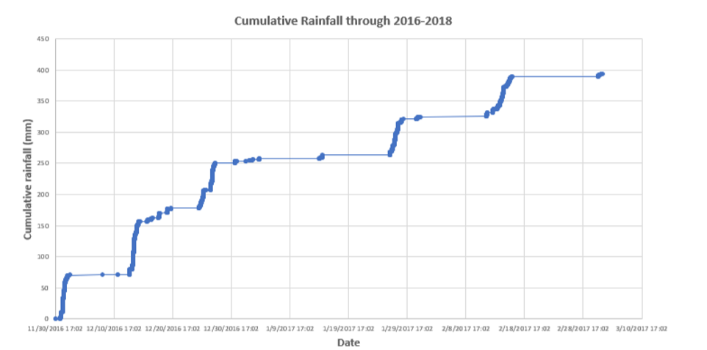
After the completion of the design, rainfall data for Nablus City through 2016-2018 were analyzed to get the highest intensity for a duration equals the time of concentration

Slide 39
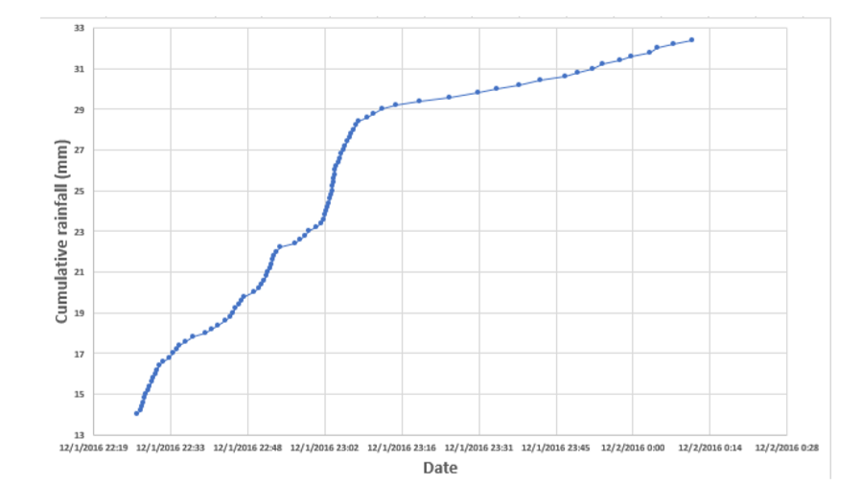
the highest intensity was found between (1.Dec.2016 at 22:27:00 and 2.Dec.2016 at 00:10:00)
This intensity was 10.62 mm/hr of a total depth 18.4 mm of rainfall duration 104 min

Slide 40
08
Discussion

Slide 41
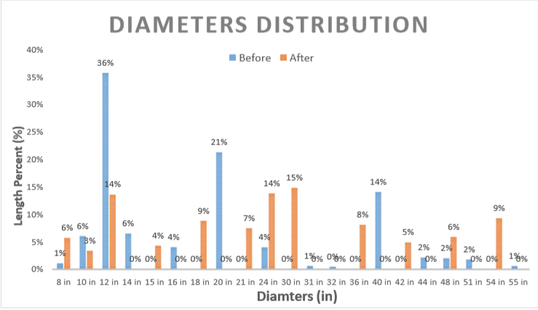

Slide 42
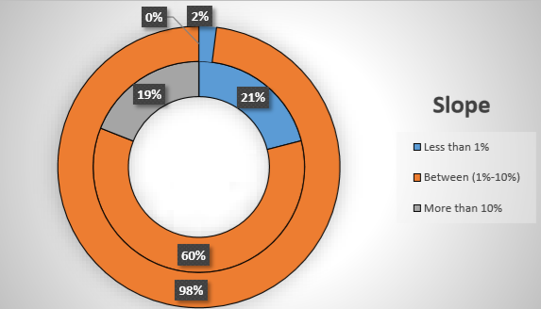

Slide 43
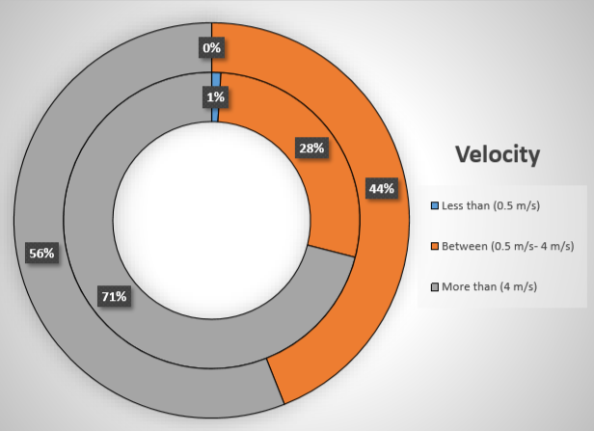

Slide 44
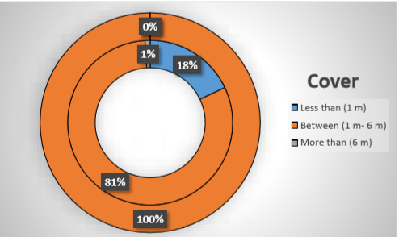

Slide 45
09
Conclusions

Slide 46
The results of the preliminary analysis indicated to a failure in the system at a return period of only 2 years and intensity of nearly 11.48 mm/hr.
The redesign was based on a return period of 10 years and an intensity of 16.67 mm/hr
it is hard to track the behavior of water on the real conditions, which lead to inaccurate estimation of time of concentration and the delineation of catchments boundaries

Slide 47
the proper distribution and the number of catch basins has a high impact on the behavior of the system and the drainage efficiency
The whole network requires replacement as the results of redesign shows.
After the redesign, the network was analyzed by an extreme storm event to ensure the capability of the system.

Slide 48
10
Recommendations

Slide 49
adding new and repositioning of catch basins
documentation of rainfall events by the DWS specify staff
Recommendations
possibility of making detention ponds
more surveying and statistical efforts

Slide 50
Thank You

