Slide 1
Performance comparison of VRF and chiller HVAC systems
Students:
Saed Shawahna
Mohammad Al-Rubu’
Supervisor:
Dr. Ramiz AL-khaldi

Slide 2
introduction
Energy in West Bank
Electricity demand increases with population growth.
Most power is imported externally.
Efficiency measures reduce overall consumption.
Problem statement
HVAC systems consume major electricity shares
Poor control causes unnecessary energy waste.
This study compares VRF and chiller.

Slide 3
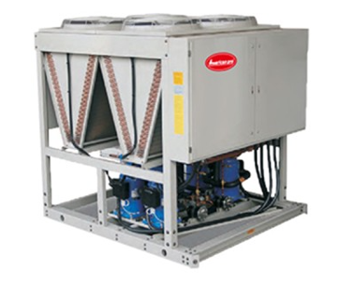

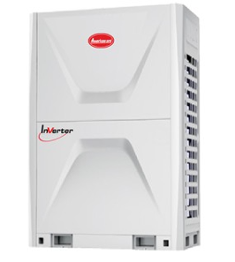
introduction
HVAC Existing Systems at West Bank
Split units dominate small buildings.
VRF serves multi-zone commercial facilities.
Central systems use chilled water loops.
VRF
Chiller
Split unit

Slide 4

introduction
Case study: Sabat Wedding Hall
Sabat Hall hosts large social events
Occupancy changes rapidly during ceremonies.
Cooling loads peak at event times.
The case evaluates real operating conditions

Slide 5
methodology
Climatic Conditions and Design Criteria
Climate data followed Palestinian code sources(31.9°C, RH 61.9%).
Indoor setpoints matched international comfort standards(24°C, RH 40%)
Cooling Load Calculation
Orientation, elevation, occupancy, and internal loads were considered.
Manual calculation resulted in a cooling load of 22.1 TR
HAP modeling ensured accuracy(22.5 TR)
HAP result was adopted for system design.

Slide 6
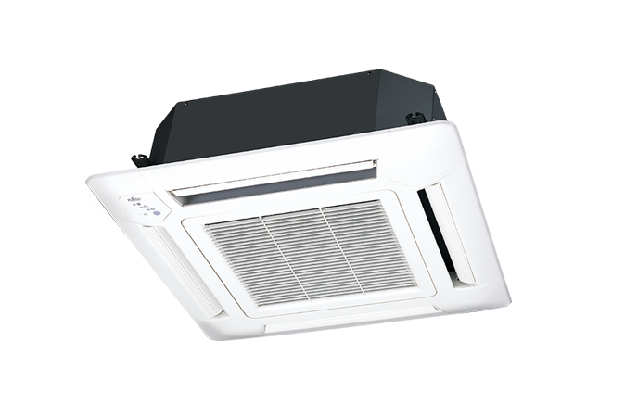
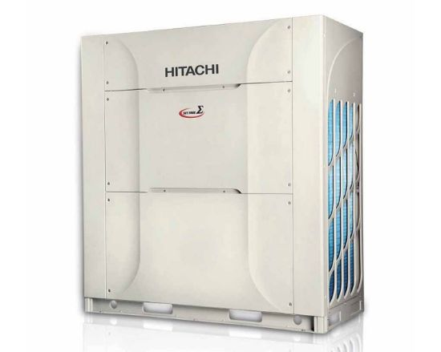

VRF System Design:
Outdoor unit
Copper piping
Indoor unit

Slide 7
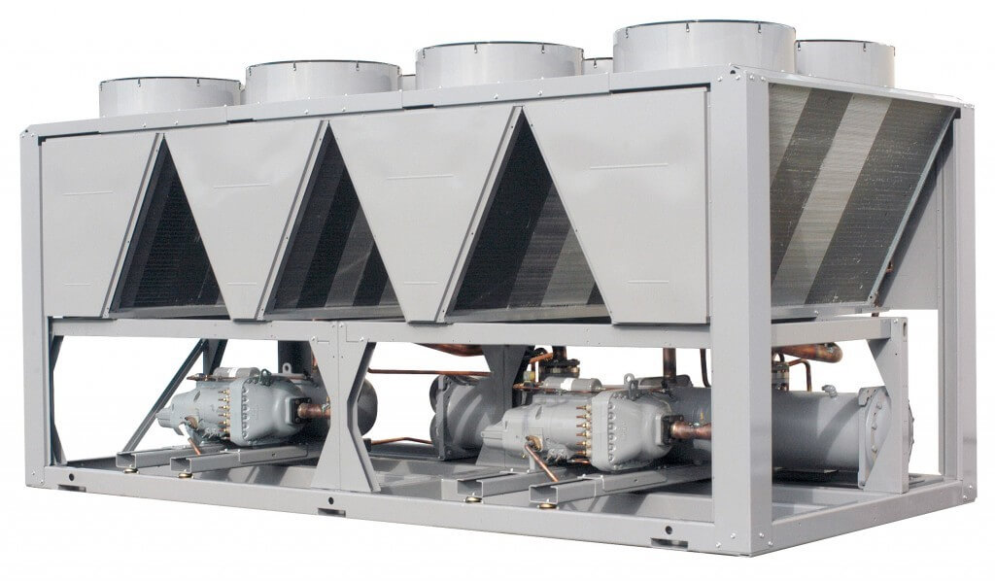
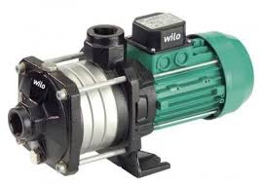
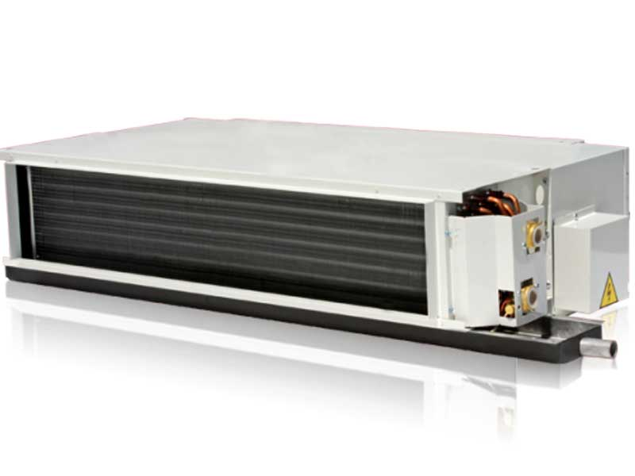
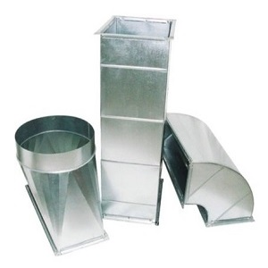
Air-to-Water Chiller System Design
Air-cooled Chiller
Water piping
Pump
FCU
Ducts

Slide 8
Economic Analysis for VRF System
Initial Cost Analysis :
Supplier quotation: 21,300 USD
Includes outdoor and indoor units
Includes controllers and installation accessories
Operating Cost Analysis:
Annual energy: 11,000 kWh/year
Electricity tariff: 0.7 NIS/kWh
Annual operating cost: 7,700 NIS/year

Slide 9
Economic Analysis for Chiller System
Initial Cost Analysis :
Total initial cost: 46,600 USD
Includes chiller and indoor FCUs
Includes piping, ductwork, and insulation
Operating Cost Analysis:
Annual energy: 13,100 kWh/year
Electricity tariff: 0.7 NIS/kWh
Annual operating cost: 9,200 NIS/year

Slide 10

Results and Analysis
Initial cost result
VRF initial cost: 21,300 USD
Chiller initial cost: 46,600 USD
Cost difference: 25,300 USD
VRF had lower initial cost
Chiller required more components

Slide 11
Results and Analysis
energy consumption results
VRF achieved 16.26% energy saving and lower annual operating cost
Item | VRF System | Chiller System | Saving
Annual Energy Consumption (kWh/year) | 11,000 | 13,100 | 2,100
Annual Operating Cost (NIS/year) | 7,700 | 9,200 | 1500

Slide 12

Discussion
Energy Performance
VRF saves energy with variable occupancy
Chillers consume more energy under variable loads
Economic Performance Discussion
VRF showed lower initial and operating costs
High electricity prices favor efficient VRF
Suitability for Local Conditions
Local conditions strongly affect HVAC selection
High electricity costs favor efficient systems

Slide 13
.
Comparison with Previous Studies
Most studies report higher VRF efficiency
Proper controls and installation are essential
Influence of Climatic and Local Conditions
Rising summer temperatures boost cooling demand
High electricity costs favor efficient systems
System Flexibility and Zoning Capability
VRF enables independent zoning and control
Chillers have lower zoning flexibility

Slide 14

Conclusion
Both systems met identical cooling load
VRF achieved higher energy efficiency
VRF performs better at part-load
VRF was the most suitable option

Slide 15
Thank you

