Slide 1

An-Najah National University
Faculty Of Engineering
Civil Engineering Department
HYDRULIC STUDY OF WATER NETWORK FOR SHWAIKA
Prepared By :Raya Freij
Supervision of Dr. Anan Jayousi

Slide 2

introduction
Water is the most basic and important need of life

Slide 3
Objective
Analyze the existing Water network in shweikah and modify it to meet the requirement for 30 years .

Slide 4
Study area

Slide 5
Shweika suburb 2.5 km to the north of the city of Tulkarm. The region altitude ranges between 61 MSL in the west and 156 MSL at the east. It follows administratively to the province of Tulkarm
The most popular well is Almesnawe well which supply area with drinking water

Slide 6
Collecting Data
Topographic map
Water network map
Aerial photo
Data regarding the network
Data regarding water sources in the area.
Population
Tulkarm Municipality

Slide 7
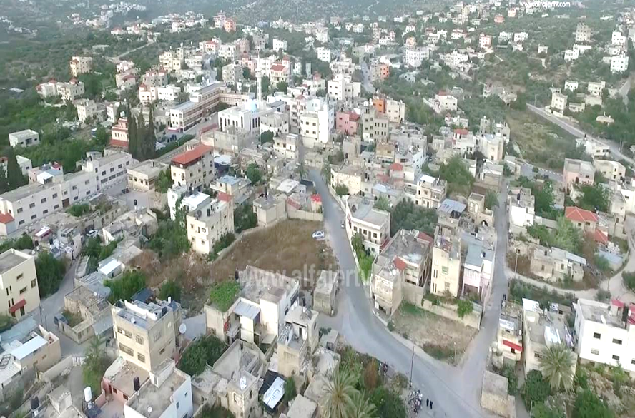
Questionnaire
the questionnaire include questions to measure the per capita water consumption ,the performance of the network ,the problems and the quality of water
110 houses

Slide 8
Computing Demand
Population in 2007 according to PCBS is 8540
Population=8540(1+2.5%)^10=10932
From questionnaire the per capita consumption equal 0.118 m^3/c.day
UFW=33%
Supply=(10932*0.118)/(1-0.33)=1925.34 m^3/day

Slide 9
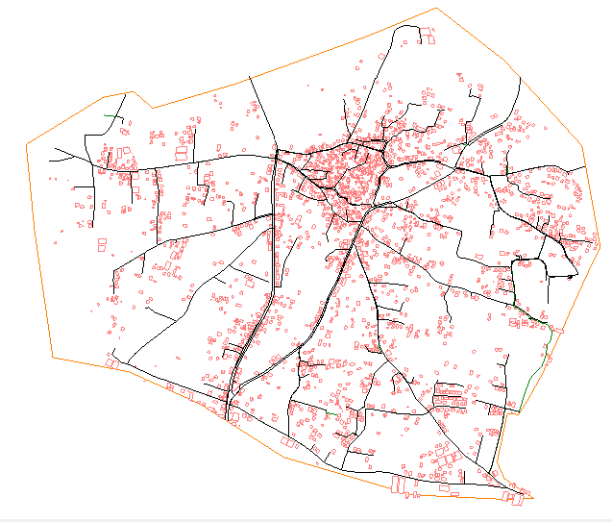
Modeling
WaterCAD Program→
Building the Model using Model Builder tool

Slide 10
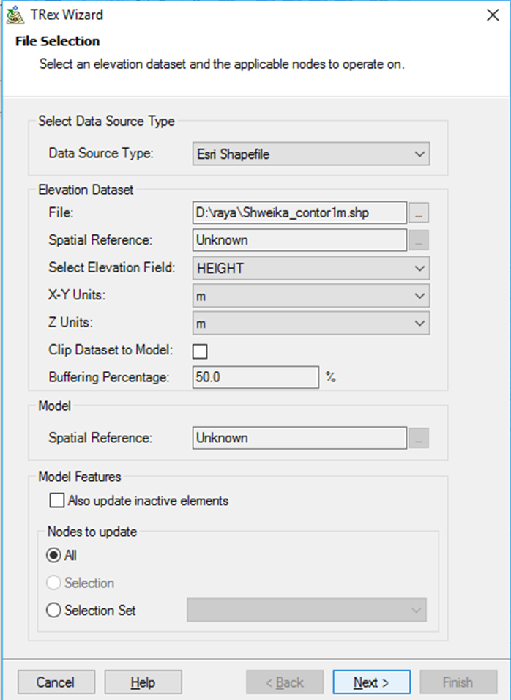
Read elevation of junctions from TRex:

Slide 11
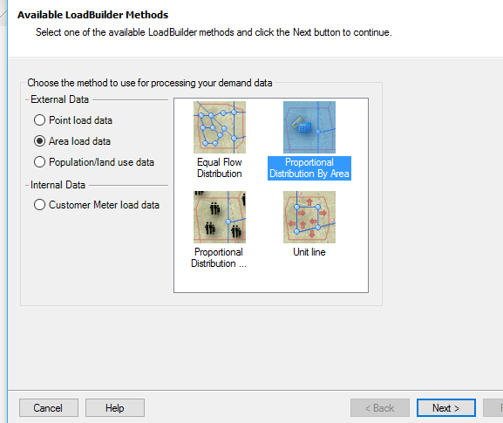
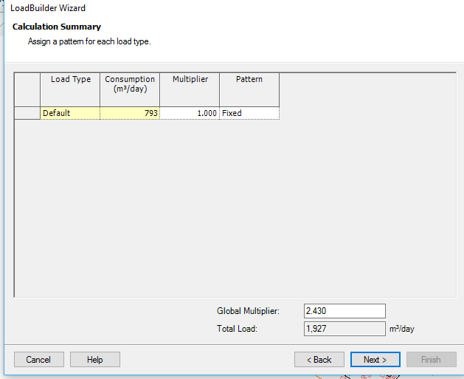
Demand of each node

Slide 12
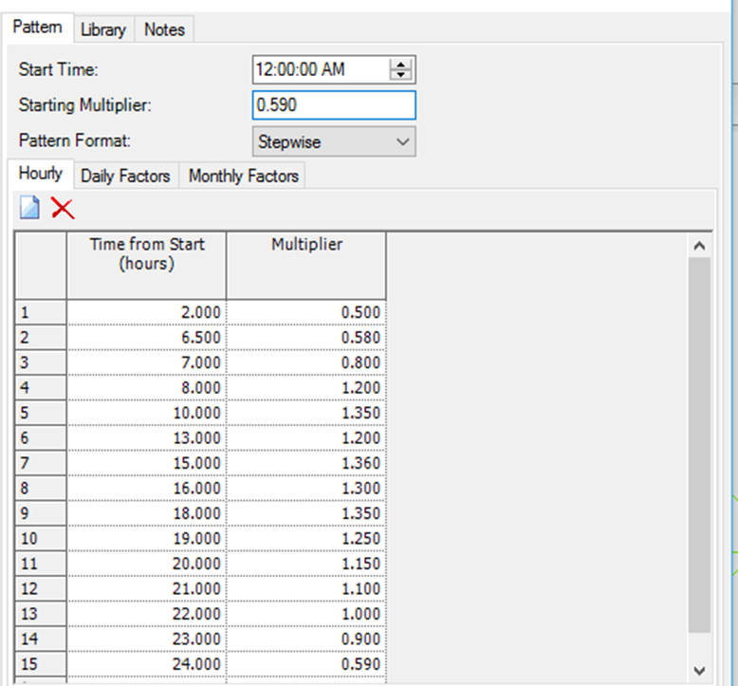
A logical demand pattern and multipliers has been obtained

Slide 13
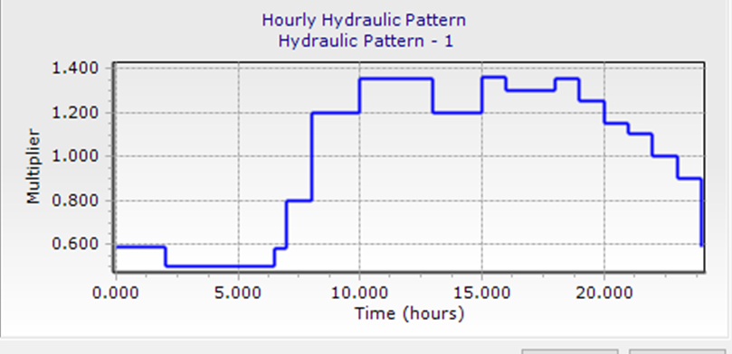
The minimum flow is during the period (2am -6.5am)
The maximum flow is during the period (15pm-16pm).

Slide 14
For modeling pumps we insert it as an elevation to the reservoir:
Elevation of Reservoir +head of the pump =99.37+120=219.37m.

Slide 15
Model for existing net work is ready run

Slide 16
Pressure results

Slide 17
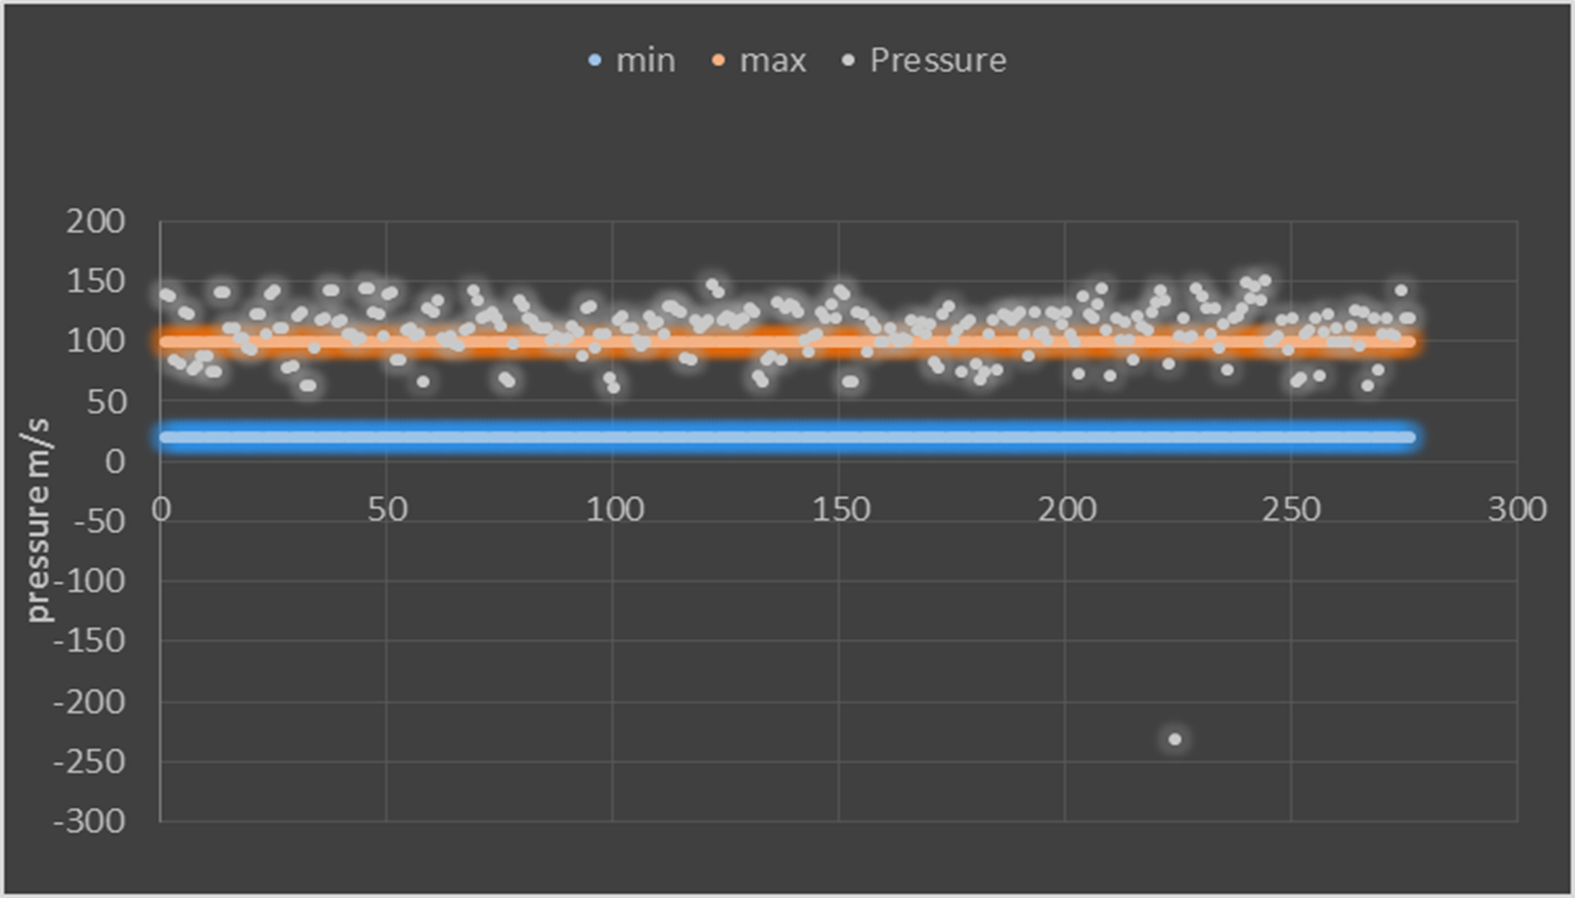

Slide 18
Velocity results

Slide 19
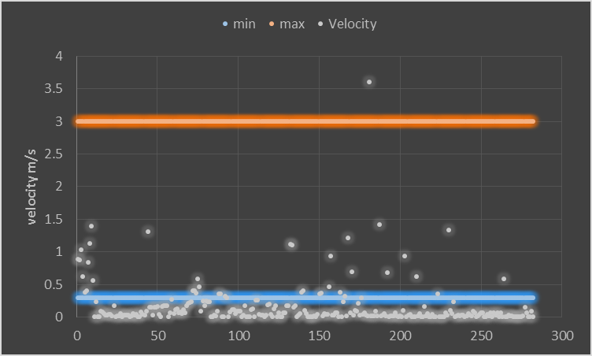

Slide 20
Future Water Supply Network

Slide 21
Design Criteria
*The velocities should be in the range of (0.2-3.0)m/s.
*The pressure limits are in the range of (20-100) m.
*Pipes used in the network are made of Steel and HDPE.
*Growth rate in the west bank is about 2.5%.

Slide 22
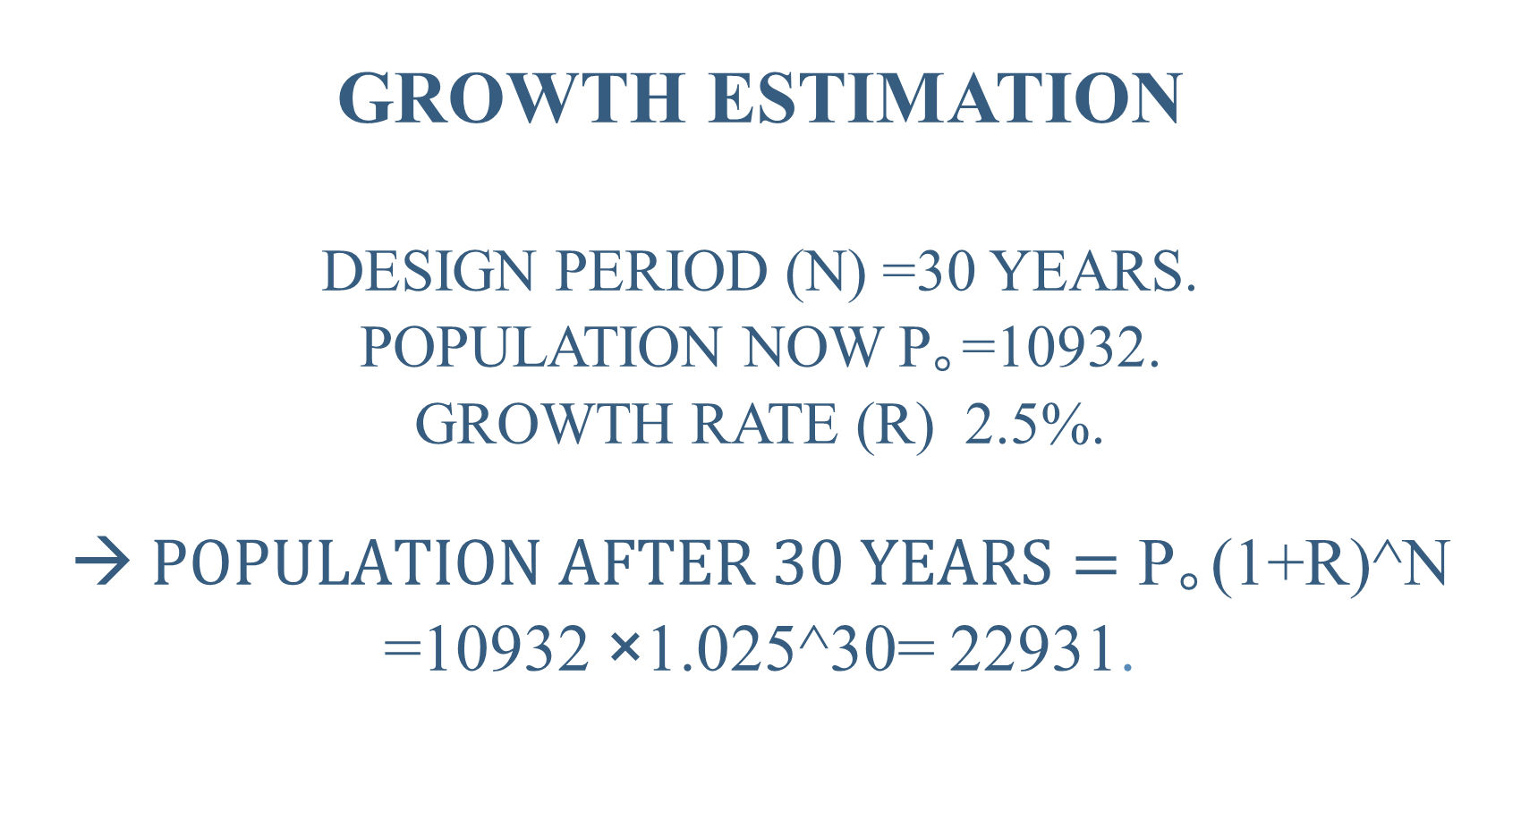
Growth estimation
Design period (n) =30 years.
Population now P｡=10932.
Growth rate (r) 2.5%.
→$Population after 30 years=$ P｡(1+r)^n =10932 ×1.025^30= 22931.

Slide 23
Calculating future demand

Slide 24
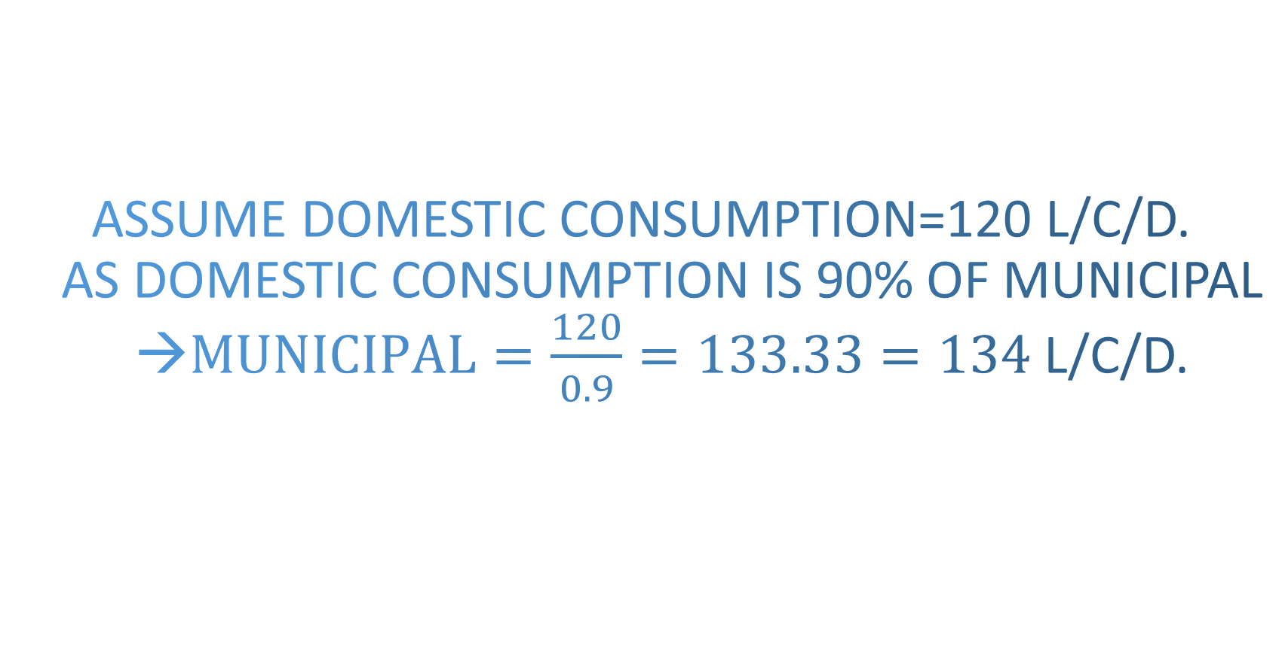
Assume Domestic Consumption=120 L/C/D.
As Domestic Consumption is 90% of Municipal →$Municipal=\frac{120}{0.9}=133.33=134$L/C/D.

Slide 25

Assume Physical Losses =15%.
Supply =$\frac{134}{1−0.15}=\frac{134}{0.85}$= 157.64 L/C/D.

Slide 26
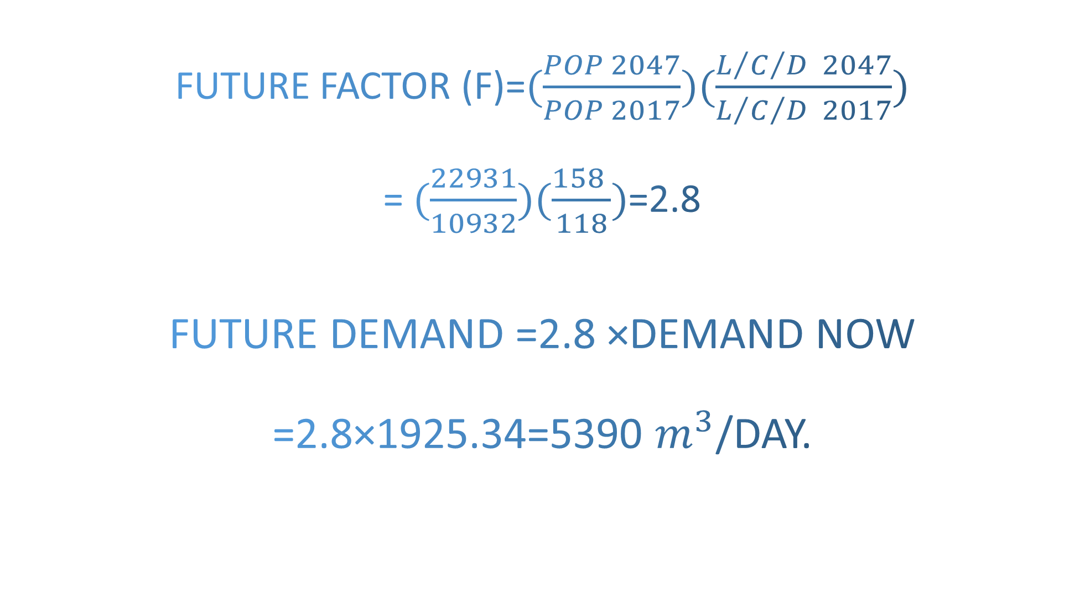
Future Factor (F)=$(\frac{POP 2047}{POP 2017})(\frac{L/{C/{D 2047}}}{L/{C/{D 2017}}})$
=$(\frac{22931}{10932})(\frac{158 }{118})$=2.8
Future Demand =2.8 ×Demand now
=2.8×1925.34=5390 $m^{3}$/day.

Slide 27
distribute Future Demand between junctions
→Run the model

Slide 28
Future Pressure results

Slide 29
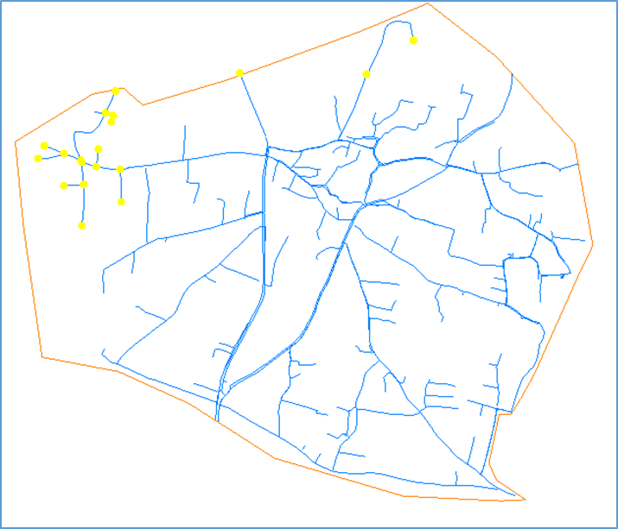

Slide 30
Future Velocity results

Slide 32
Recommendations
There is some pipes should be replaced by a larger one to solve velocity problem .

Slide 33
# | D old | D new
P-271 | 4 | 6
P-78 | 3 | 4
P-2 | 3 | 4
P-3 | 3 | 4
P-16 | 3 | 4
P-17 | 3 | 4
P-221 | 3 | 4
P-222 | 3 | 4
P-280 | 1 | 2
P-18 | 2 | 3
P-286 | 2 | 3
pipes-112 | 2 | 3

Slide 34
Run

Slide 35
Pressure results

Slide 36
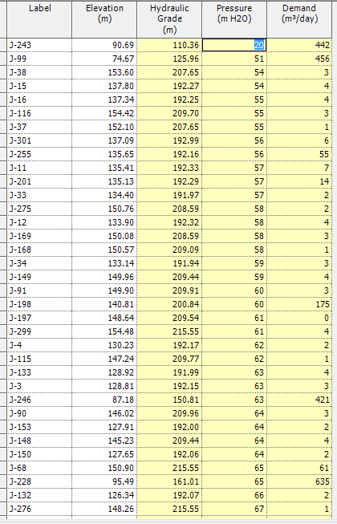

Slide 37
Velocity results

Slide 38
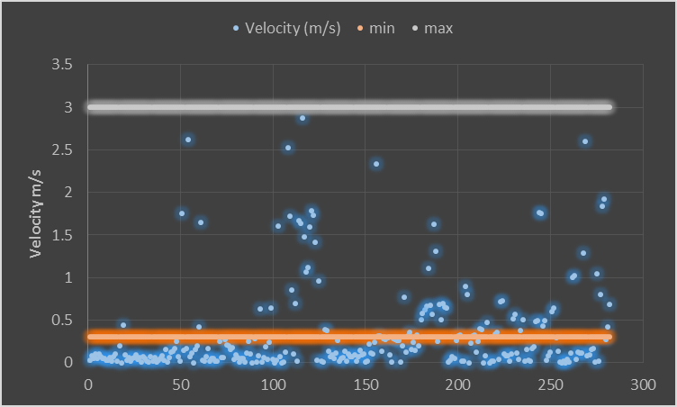

Slide 39
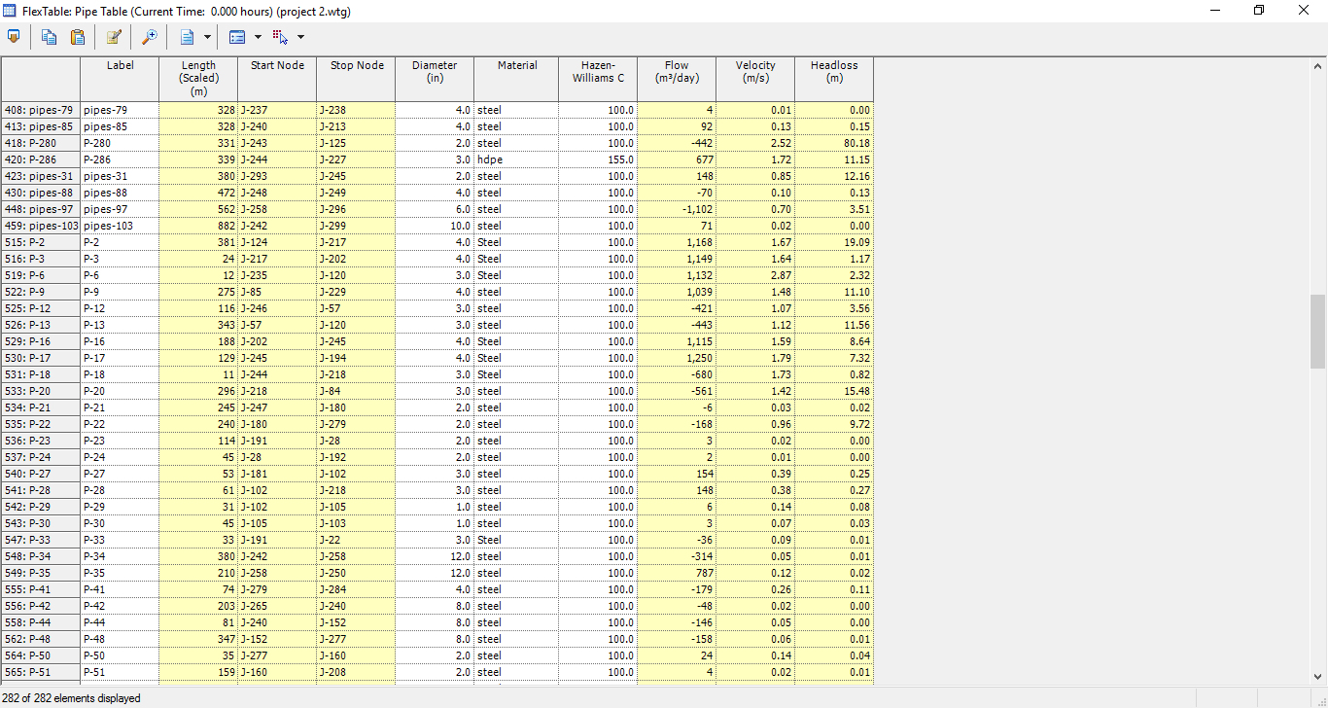

Slide 40
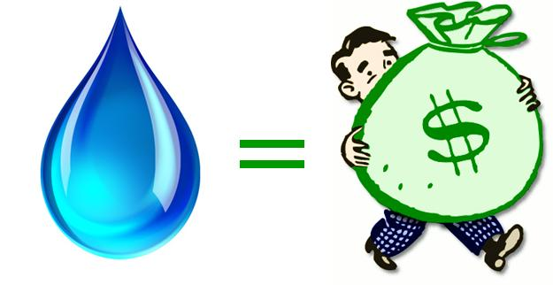
Cost Estimate

Slide 41
material | D | Cost(shekels)/m
steel | 0.75 | 10.5
steel | 1 | 13
steel | 2 | 34
steel | 3 | 45
steel | 4 | 70
steel | 6 | 105
steel | 8 | 160
steel | 10 | 200
steel | 12 | 240
hdpe | 1 | 13
hdpe | 2 | 25

Slide 42
# | D old | D new | Length | Cost/m | Cost(shekels)
P-271 | 4 | 6 | 10 | 105 | 1050
P-78 | 3 | 4 | 89 | 70 | 6230
P-2 | 3 | 4 | 381 | 70 | 26670
P-3 | 3 | 4 | 24 | 70 | 1680
P-16 | 3 | 4 | 188 | 70 | 13160
P-17 | 3 | 4 | 129 | 70 | 9030
P-221 | 3 | 4 | 118 | 70 | 8260
P-222 | 3 | 4 | 73 | 70 | 5110
P-280 | 1 | 2 | 336 | 34 | 11424
P-18 | 2 | 3 | 11 | 45 | 495
P-286 | 2 | 3 | 339 | 45 | 15255
pipes-112 | 2 | 3 | 467 | 45 | 21015
 |  |  |  | Σ | 119379

Slide 43


