Slide 1
Steel Structural Design
Supervisor : Dr. Sameer Al- helo
Prepared by:
Abdallah Sami Abdallah
Ahmad Saadi
Moad Al-Masri
Oday Melhem

Slide 2
Out line:
Introduction
Codes
Loads
Analysis
Checks
Design
Results and Conclusion

Slide 3
Introduction
The present project addresses the cover of a basketball court. The play area has the dimensions of 15mx28m while the cover is 20mx 39m. The Proposed structure is to be made of steel elements and covered by poly carbon transparent sheets. The structure is a standalone structure which should have a minimum height of 7 meters.
The intension is to use different sections, 2 different structural systems and different bracing configuration. A feasibility study follows to minimize cost. This is achieved by minimizing the resulting design weight. The design exercise includes the design of concrete spread footings, and all relevant connections.

Slide 4
Codes
The structure was designed using codes of practice and specifications that control the design process and variables.
The following codes and standards were used in this project:
1- IBC: International Building Code.
2- ACI: American Concrete Institute provision for reinforced concrete structural design.
3- Jordanian code.
4- UBC-97 code.

Slide 5
Loads
There are two types of loads based on
direction, gravity and lateral loads.

Slide 6
Gravity loads:
Dead load:
The weight of materials of construction incorporated into the building, including but not limited to walls, floors, roofs, ceilings, stairways, built-in partitions, finishes, cladding and other similarly incorporated architectural and structural items, and the weight of fixed service equipment, such as cranes, plumbing stacks and risers, electrical feeders, heating, ventilating and air-conditioning systems and automatic sprinkler systems.

Slide 7
live load:
A load produced by the use and occupancy of the building or other structure that does not include construction or environmental loads such as wind load, snow load, rain load, earthquake load, flood load or dead load.

Slide 8
Snow load:
Loads resulting from the accumulation of snow on the roof of the building vary widely according to the geographical location (climate) and height above the mean sea level (MSL).
Snow load are computed according to the Jordanian code for snow loads.

Slide 9
Rain load:
Each portion of a roof shall be designed to sustain the load of rainwater that will accumulate on it if the primary drainage system for that portion is blocked plus the uniform load caused by water that rises above the inlet of the secondary drainage system at its design flow.

Slide 10
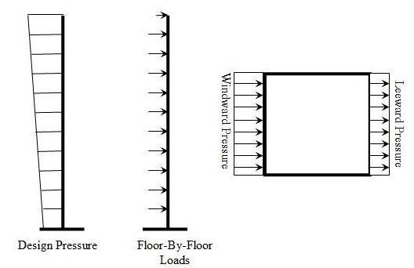
Lateral loads:
Wind load:
Wind load is produced due to change in momentum of an air striking the surface of a building.

Slide 11
Seismic loads:
There are two principles to design seismic load:
The equivalent static force procedure.
Dynamic analysis.
The equivalent static force method depend in equation F=ma , this formula depends on replacing of the seismic force by equivalent force called shear base force.

Slide 12
Load Combinations:

Slide 13
Analysis
Determination of load of those two models:
dead load :
Each frame in case 1 has weight equal to 27.9 KN equal 2.84 ton.
Each frame in case 2 has steel weight equal to 17.42KN equal 1.77 ton and concrete weight equal 126 KN equal 12.84 ton.

Slide 14
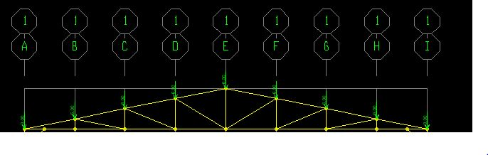
Live load:

Slide 15
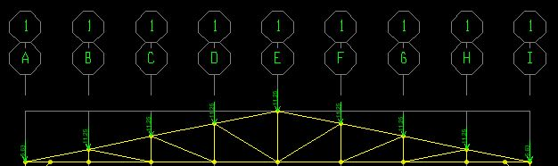
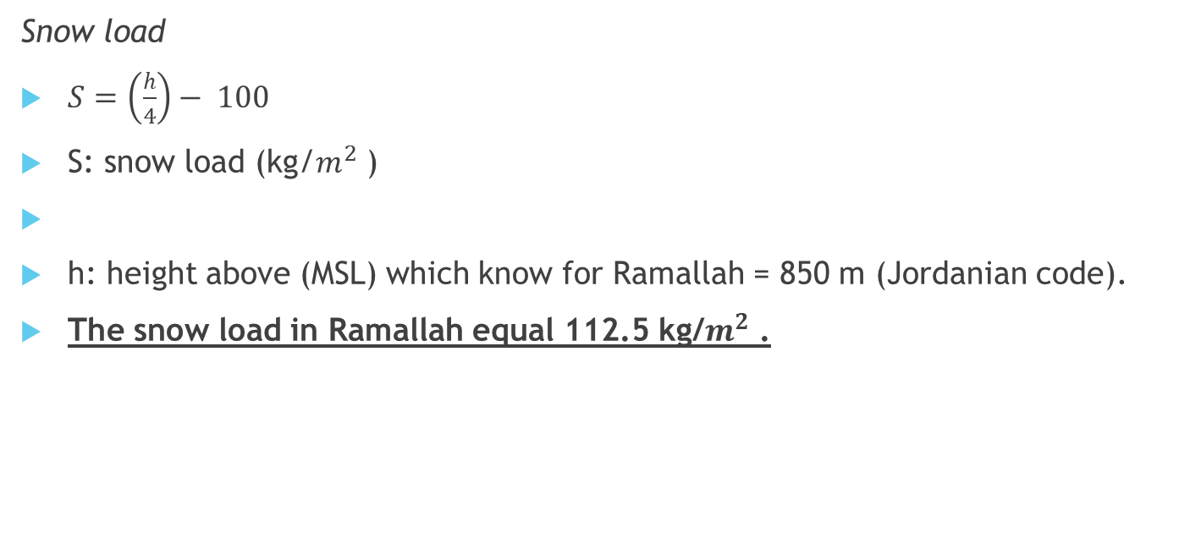
Snow load
$S=\left(\frac{h}{4}\right)− 100$
S: snow load (kg/$m^{2}$ )
h: height above (MSL) which know for Ramallah = 850 m (Jordanian code).
The snow load in Ramallah equal 112.5 kg/$m^{2}$ .

Slide 16
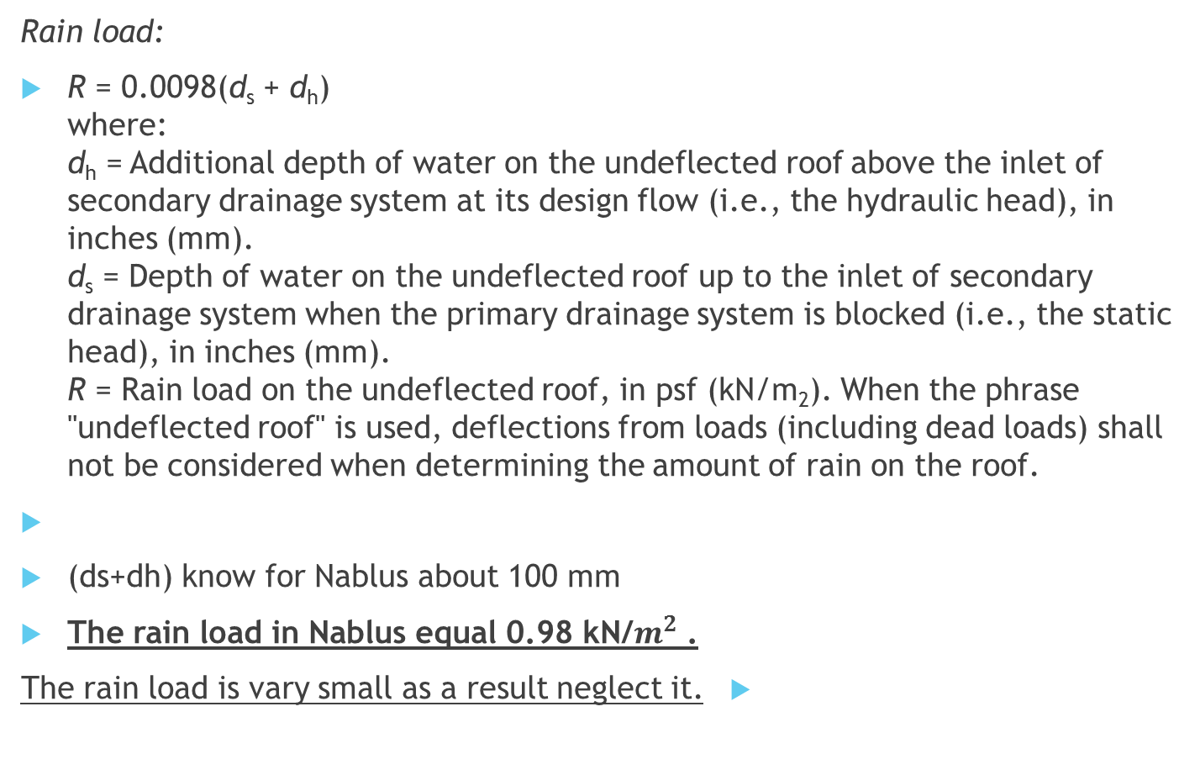
Rain load:
R = 0.0098(d_{s} + d_{h})
where:
d_{h} = Additional depth of water on the undeflected roof above the inlet of secondary drainage system at its design flow (i.e., the hydraulic head), in inches (mm).
d_{s} = Depth of water on the undeflected roof up to the inlet of secondary drainage system when the primary drainage system is blocked (i.e., the static head), in inches (mm).
R = Rain load on the undeflected roof, in psf (kN/m₂). When the phrase "undeflected roof" is used, deflections from loads (including dead loads) shall not be considered when determining the amount of rain on the roof.
(ds+dh) know for Nablus about 100 mm
The rain load in Nablus equal 0.98 kN/$m^{2}$ .
The rain load is vary small as a result neglect it.

Slide 17
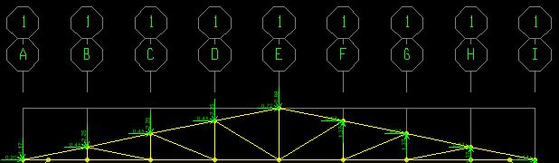
Wind load:
Assumption:
Velocity = 100 km/hr =27.78 m/s.
Exposure B.
I=1.
K zt=1.
Then qz=402Kz
H= 9 m
H less than 18m high of structure.
And less than 20 m width of structure.
Then the the structure is low-raised.
Inl lee ward Cp=-0.5
And Kh= 0.72
Then P= 123.012 N/m2

Slide 18
In side wall Cp=-0.7
P=202.608 N/m2
In wend ward Cp=+0.8
P=196.819 N/m2
Pmin=500/1.3 x Cp
For lee ward Pmin =192.3 N/m2
For side wall Pmin = 269.23 N/m2
For wind ward Pmin =307.7 N/m2
Because Pmin for all side largest than P , use Pmin for all side.

Slide 19
Sismic load:
Assumption:
The structure located in Nablus city
Zone 2B then Z=0.2
The type of soil is rock SB
R=8
Calculation:
Cv=0.2
Ct=0.035
Then T=2.05
W=22.4 KN
V for steel column structure=0.3
W=136.2 KN
V for concrete column structure=1.66

Slide 20
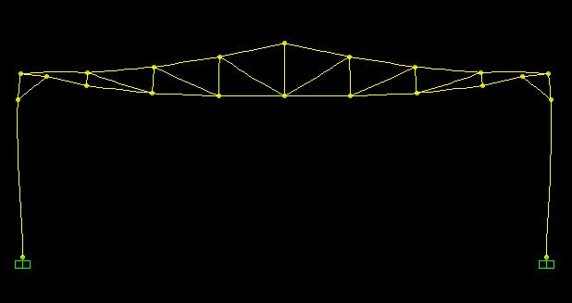
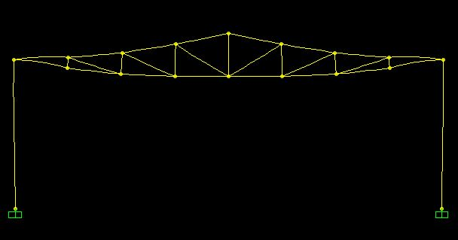
Checks
Compatibility Check
Check the model using the animation tool in SAP.
Case 1 Case 2

Slide 21
Check Equilibrium
This check will done for each load pattern separately, here we will check Live Load pattern:
For live load : (3x2+6x7)=48 KN , base reaction from live load =48KN, OK.
For snow load : (5.63x2+11.25x7)=90.01KN
base reaction from snow load =90KN,OK.

Slide 22
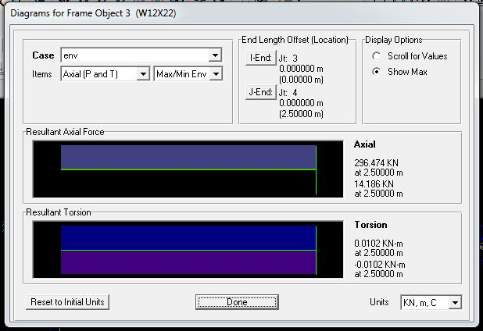
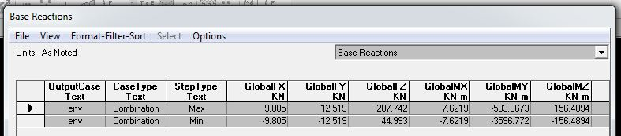

Stress-Strain Check Layout
$F_{o}×D=\frac{\frac{ƩLoad}{L}×L²}{8}$
$$296×2.5=\frac{\frac{287}{20}×20²}{8}\underset{→}{yields}740≈717.5 KN\underset{→}{yields} ok$$

Slide 23
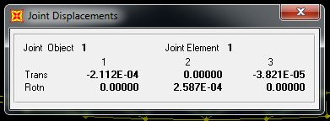
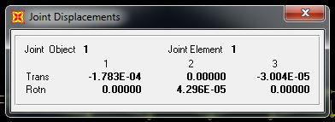
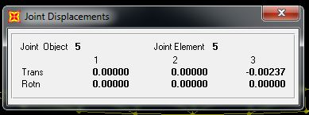
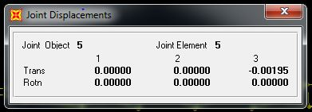
Check for Deflection
Case 1
Case 2

Slide 24
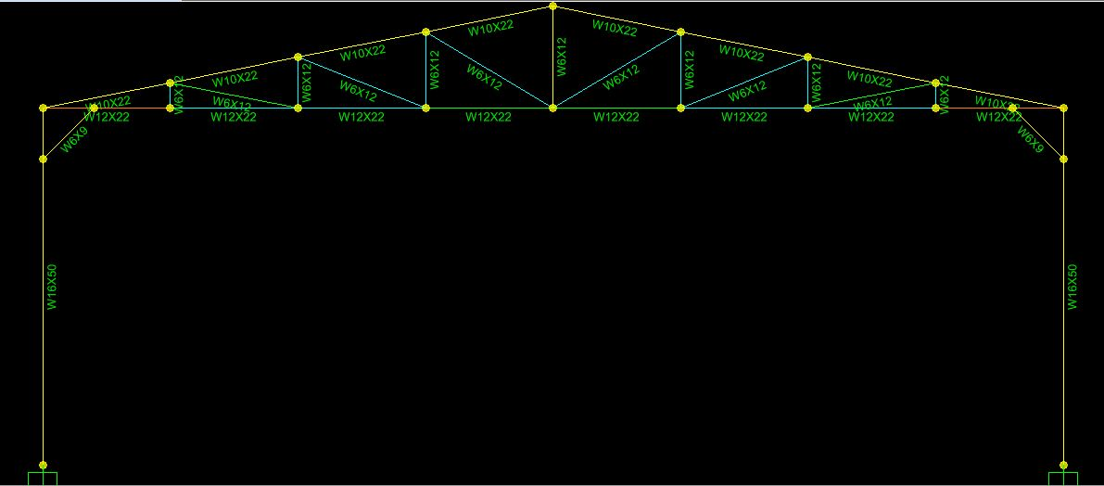
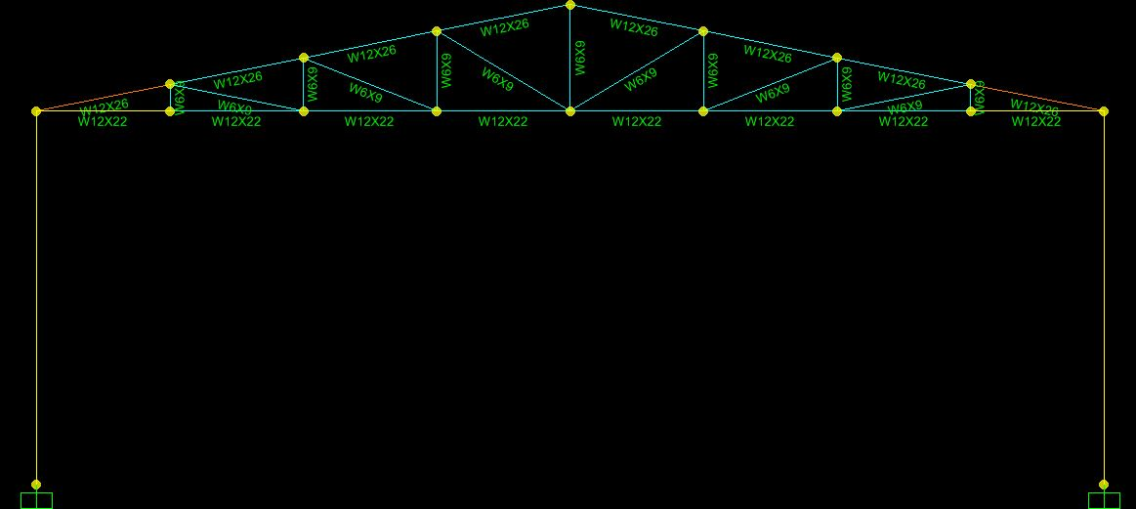
Design
Case 1 Case 2

Slide 25
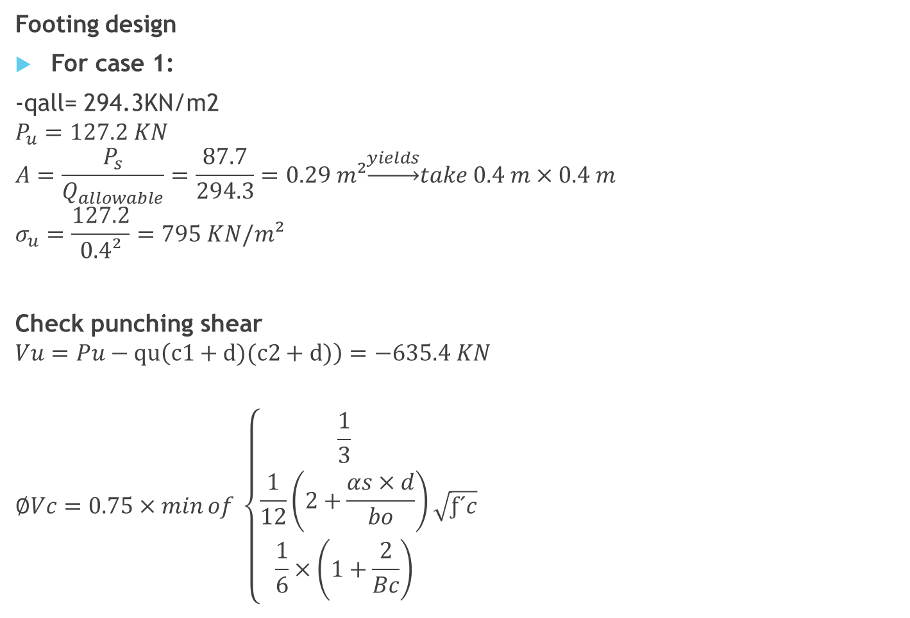
Footing design
For case 1:
-qall= 294.3KN/m2
$$P_{u}=127.2 KN$$
$$A=\frac{P_{s}}{Q_{allowable}}=\frac{87.7}{294.3}=0.29 m²\underset{→}{yields}take 0.4 m×0.4 m$$
$$σ_{u}=\frac{127.2}{0.4²}=795 KN/m²$$
Check punching shear
$$Vu=Pu−qu\left(c1+d)(c2+d)\right)=−635.4 KN$$
$$∅Vc=0.75×\min{of \left\{\begin{aligned}\frac{1}{3} \\ \frac{1}{12}\left(2+\frac{αs×d}{bo}\right) \\ \frac{1}{6}×\left(1+\frac{2}{Bc}\right)\end{aligned}\right.}\sqrt{ƒ´c}$$

Slide 26
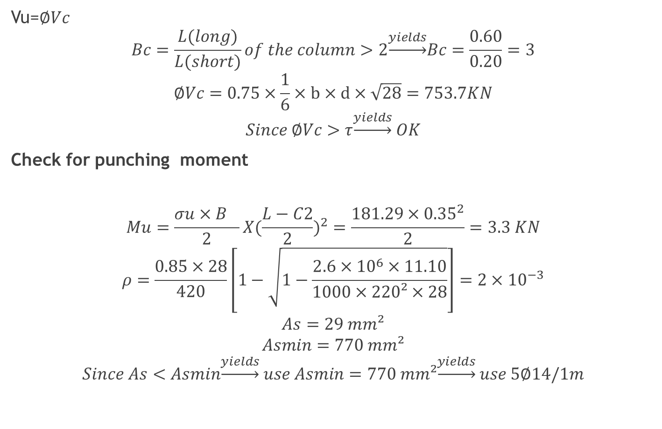
Vu=$∅Vc$
$$Bc=\frac{L(long)}{L(short)}of the column>2\underset{→}{yields}Bc=\frac{0.60}{0.20}=3$$
$$∅Vc=0.75×\frac{1}{6}×b×d×\sqrt{28}=753.7KN$$
$$Since ∅Vc>τ\underset{→}{yields} OK$$
Check for punching moment
$$Mu=\frac{σu×B^{}}{2}X(\frac{L−C2}{2})^{2}=\frac{181.29×{0.35}^{2}}{2}=3.3 KN$$
$$ρ=\frac{0.85×28}{420}\left[1−\sqrt{1−\frac{2.6×{10}^{6}×11.10}{1000×220²×28}}\right]=2×{10}^{−3}$$
$$As=29 mm²$$
$$Asmin=770 mm²$$
$$Since As<Asmin\underset{→}{yields} use Asmin=770 mm²\underset{→}{yields} use 5∅14/1m$$

Slide 27
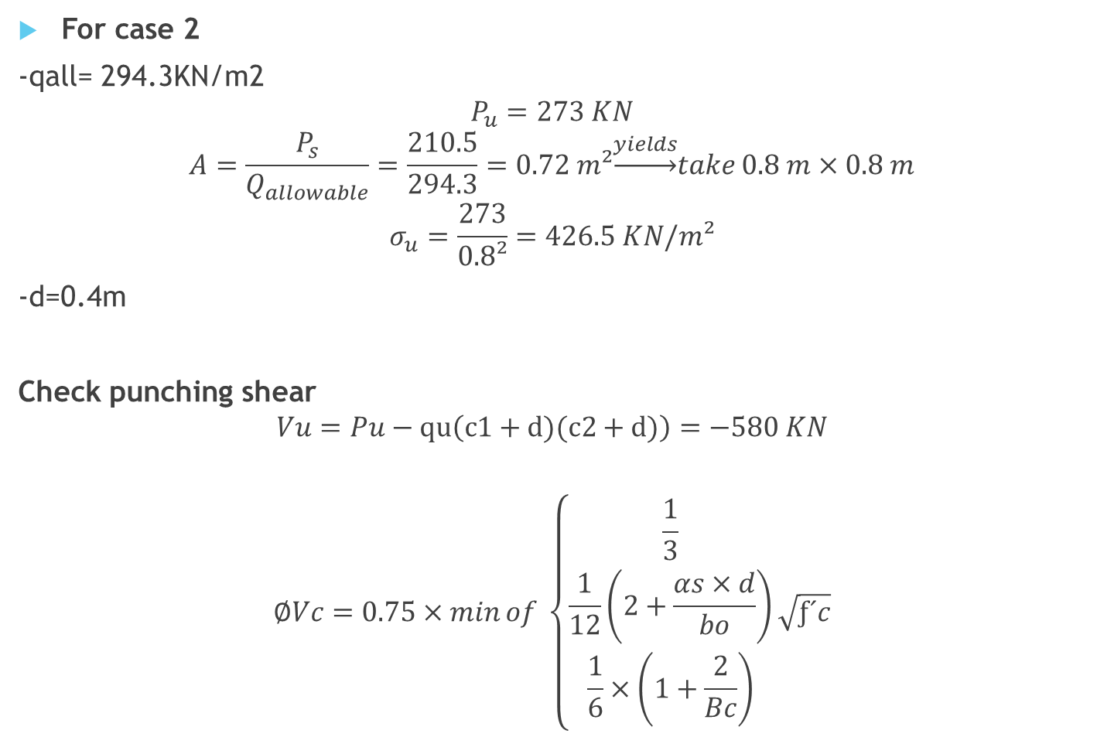
For case 2
-qall= 294.3KN/m2
$$P_{u}=273 KN$$
$$A=\frac{P_{s}}{Q_{allowable}}=\frac{210.5}{294.3}=0.72 m²\underset{→}{yields}take 0.8 m×0.8 m$$
$$σ_{u}=\frac{273}{0.8²}=426.5 KN/m²$$
-d=0.4m
Check punching shear
$$Vu=Pu−qu\left(c1+d)(c2+d)\right)=−580 KN$$
$$∅Vc=0.75×\min{of \left\{\begin{aligned}\frac{1}{3} \\ \frac{1}{12}\left(2+\frac{αs×d}{bo}\right) \\ \frac{1}{6}×\left(1+\frac{2}{Bc}\right)\end{aligned}\right.}\sqrt{ƒ´c}$$

Slide 28
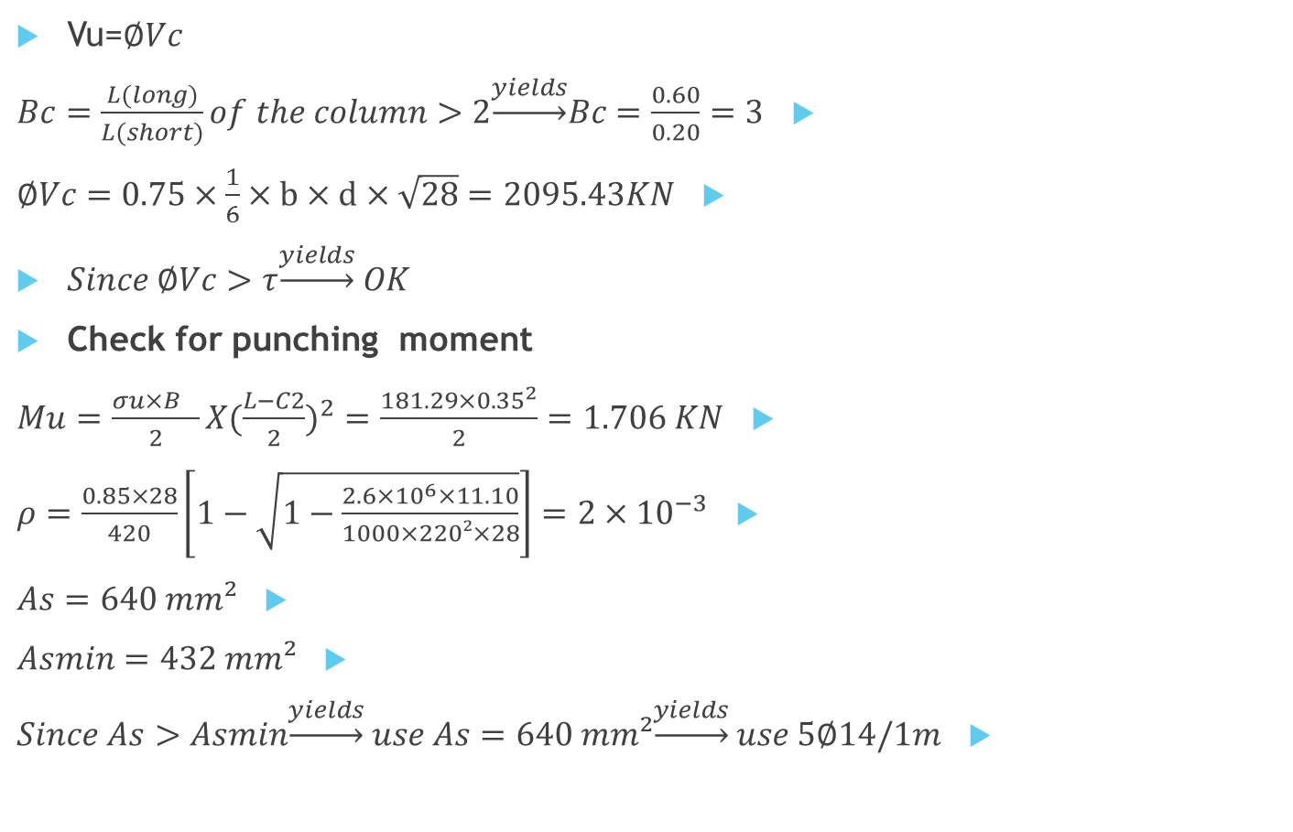
Vu=$∅Vc$
$Bc=\frac{L(long)}{L(short)}of the column>2\underset{→}{yields}Bc=\frac{0.60}{0.20}=3$
$∅Vc=0.75×\frac{1}{6}×b×d×\sqrt{28}=2095.43KN$
$Since ∅Vc>τ\underset{→}{yields} OK$
Check for punching moment
$Mu=\frac{σu×B^{}}{2}X(\frac{L−C2}{2})^{2}=\frac{181.29×{0.35}^{2}}{2}=1.706 KN$
$ρ=\frac{0.85×28}{420}\left[1−\sqrt{1−\frac{2.6×{10}^{6}×11.10}{1000×220²×28}}\right]=2×{10}^{−3}$
$As=640 mm²$
$Asmin=432 mm²$
$Since As>Asmin\underset{→}{yields} use As=640 mm²\underset{→}{yields} use 5∅14/1m$

Slide 29

Design of weld connection
E70XX weld is used Fu = 482 MPa.
Gust plate thickness 10mm
$$P_{U}=296.5 KN$$
$$P_{U}=∅P_{n}$$
$$296.5=0.75×lw×0.60×482×4\underset{→}{yields} lw=341.7 mm$$
Use lw= 342mm.

Slide 30

Tension member
W 12x22
$$P_{U}=275 KN$$
$$∅P_{n}\left(Yield\right)=\frac{0.90×4190×250}{1000}=942.75 KN$$
$$∅P_{n}\left(Fracture\right)=\frac{0.75×4190×400×0.9}{1000}=1131 KN$$
$$\underset{→}{yields} Yield Control$$
$$1131>942.75>pu\underset{→}{yieds} OK$$

Slide 31

compression member
w10x22
$$P_{U}=301.4 KN$$
$$\frac{KL}{r}=\frac{1×2.5×1000}{108.5}=23.04$$
$$∅F_{cr}=295 MPa (From tables of AISC code)$$
$$A_{g}=4910 mm²$$
$$∅P_{n}=295×\frac{4910}{1000}=1448.45 KN>301.4\underset{→}{yields} OK$$

Slide 32
Results and conclusion
1- Comparing between two structural models weight and price.
Case 1 has weight equal to 27.9KN equal 2.84 ton
Price of one ton equal 3000 NIS
Then the frame price equal 8535 NIS
And structure approximately price equal 110955 NIS
Case 2 has weight equal to 17.42KN equal 1.77 ton
Price of one ton equal 3000 NIS
Then the frame price equal 5328 NIS
And steel structure price equal 69264 NIS
And the price of concrete equal to 19656 NIS
All price equal 88920 NIS .

Slide 33
2- Base shear reaction
The base shear reaction for case 1 equal to 0.3
The base shear reaction for case 2 equal to 1.66
The deferent between base shear reaction is product from deferent in weight .
3- Shown in previous results the deferent in design of section size, this size is affected by type of material and size of columns.
4- Shown in previous checks the deferent in deflection values between two cases , case 1 has more deflection.

