Slide 1

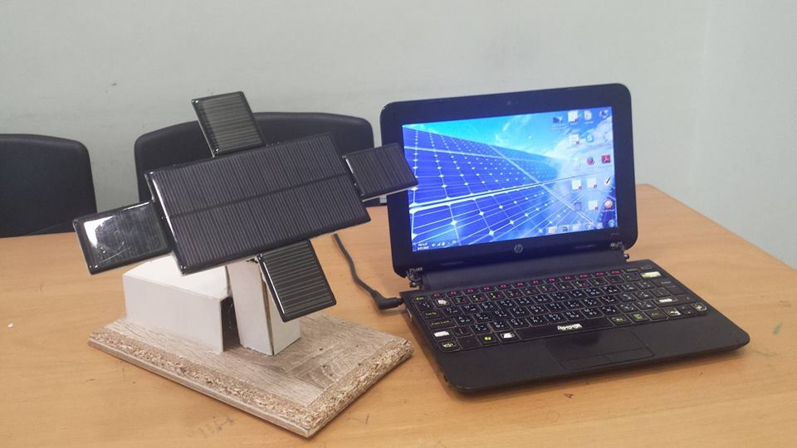
Automatic Dual Axis Solar Tracking system
Prepared by:
  Reem AL-khateeb
  Yasmeen Hanani
  Supervised by:
  Dr.Saed Tarapiah

Slide 2
Outline:
Introduction.
Solar cells.
Mechanical design .
Results and Analysis.
Conclusions.

Slide 3

Introduction:
Energy demand
The world is facing an energy demand because of the following reasons:

Slide 4
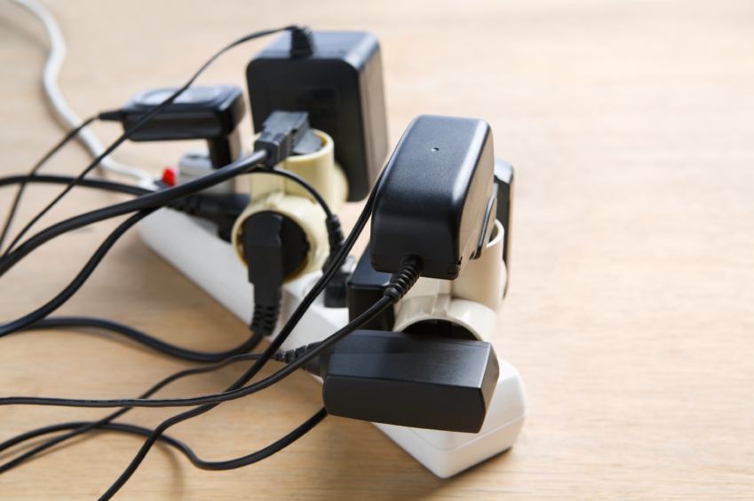
Reasons
Over consumption
Overpopulation
Levels of Coal , Gas and Oil are Decreasing
Poor infrastructure
Wastage of energy
Wars and attacks

Slide 5
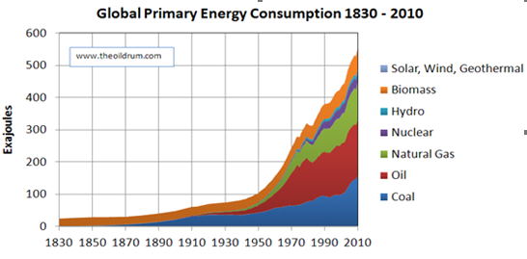
Over consumption
Notes:
energy consumption will increase 56% by 2040energy consumption will increase 56% by 2040

Slide 6

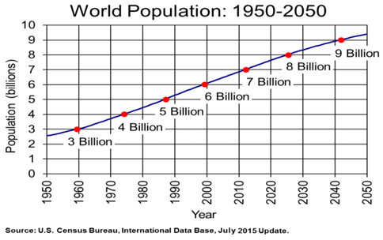
Overpopulation

Slide 7
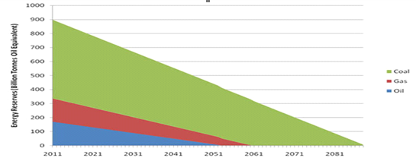
Levels of Coal , Gas and Oil are Decreasing
Notes:
In terms of energy source we rely on coal, oil and gas (the fossil fuels) for over 80% of our current energy needs.

Slide 8

Solution of Increasing Energy Demand ?

Slide 9
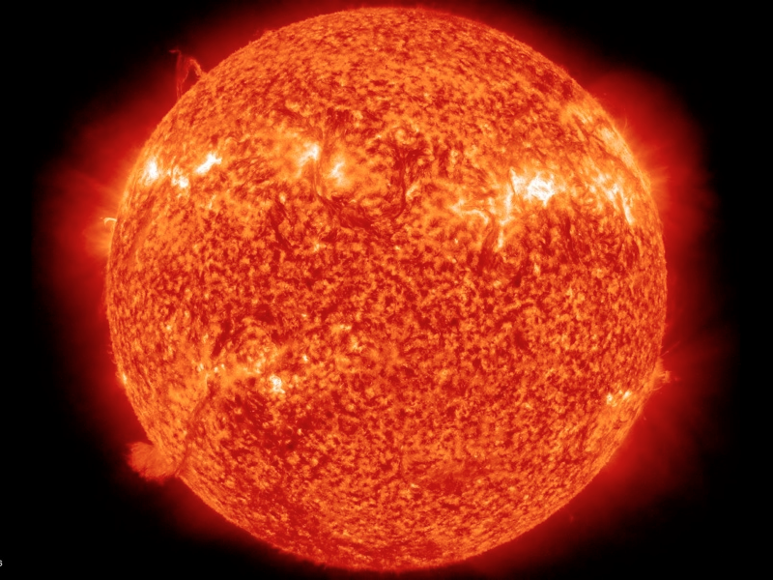
Renewable energy

Slide 10

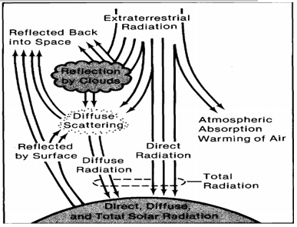
Why solar energy ?
The power output from the sun is 3.86 x 10^20 MW per second which is huge.
Notes:
The power output from the sun is 3.86 x 10^20 MW per second which is huge, it several billion times the electric capacity of the U.S. utilities. The energy reaching the earth atmosphere is about 1.73KW per square meter. . Leaving the earth surface with a maximum sunlight intensity of 1 kwatt per meter square.

Slide 11
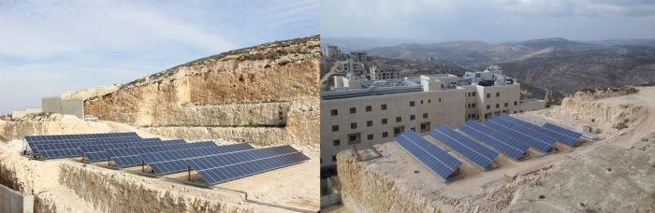
For Palestine, particularly there is a great tendency to use solar energy, for example, the use of solar cells in many fields like what Research and Energy Center done

Slide 12
Our project
Automatic Dual axis solar tracking system.

Slide 13
Solar tracker definition
A solar tracker is a device used to change the position of a solar panel in a manner that will make the sun ray's perpendicular to the panel, in order to increase the efficiency.

Slide 14
Methods of drive
Active Trackers: uses motors and to direct tracker as commanded by the controller responding to the solar direction provided by the sensor.
Passive Trackers: determine the position of the sun through pre- recorded data for a particular area
Notes:
1- uses motors and gear train to direct tracker as commanded by the controller responding to the solar direction
2- uses a low boiling point compressed gas fluid that is driven to one side or the other to cause the tracker to move in respond to an imbalance
3- use no sensing but instead determine the position of the sun through pre- recorded data for a particular area. They rotate at regular time intervals.

Slide 15
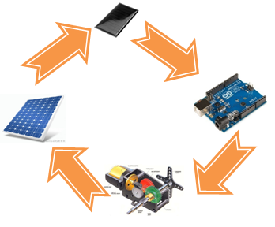
Electrical design

Slide 16

Solar Cell

Slide 17
They have two types:
Monocrystalline
Polycrystalline
Notes:
شرح لكل وحدة سطر

Slide 18
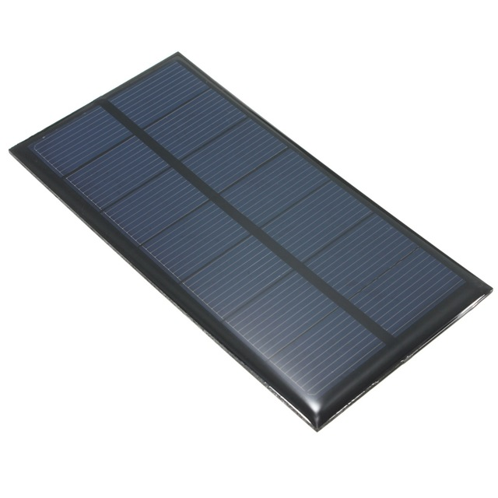
We have chosen polycrystaline solar panel.
Is simpler and cost less than monocrytaline.
Capacity : 6V 150mA
Max. Power:0.86W

Slide 19
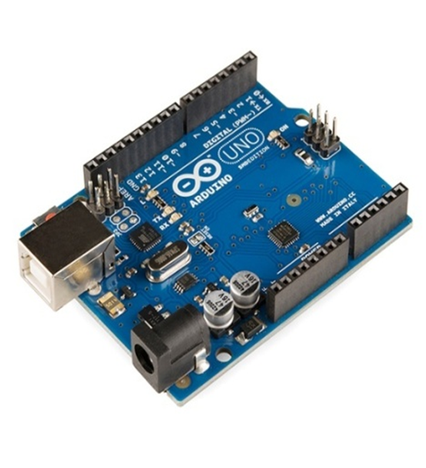
Arduino Uno
Notes:
The program for the tracking controller has been written in C++ language code for the arduino Uno microprocessor.

Slide 20
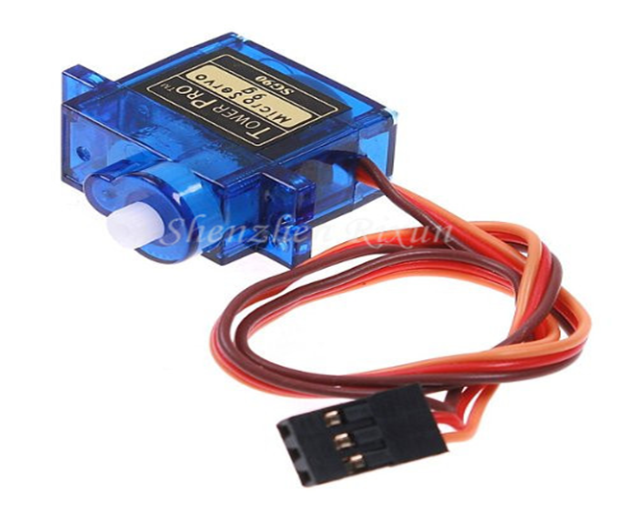
Servo Motors
They typically have a movement range of 180 deg but can go up to
210 deg.
Operating speed: 0.3second/ 60 degree
Operating voltage: 4.2V~6V
Notes:
The output shaft of a servo does not rotate freely, but rather is made to seek a particular angular position under electronic control.

Slide 21
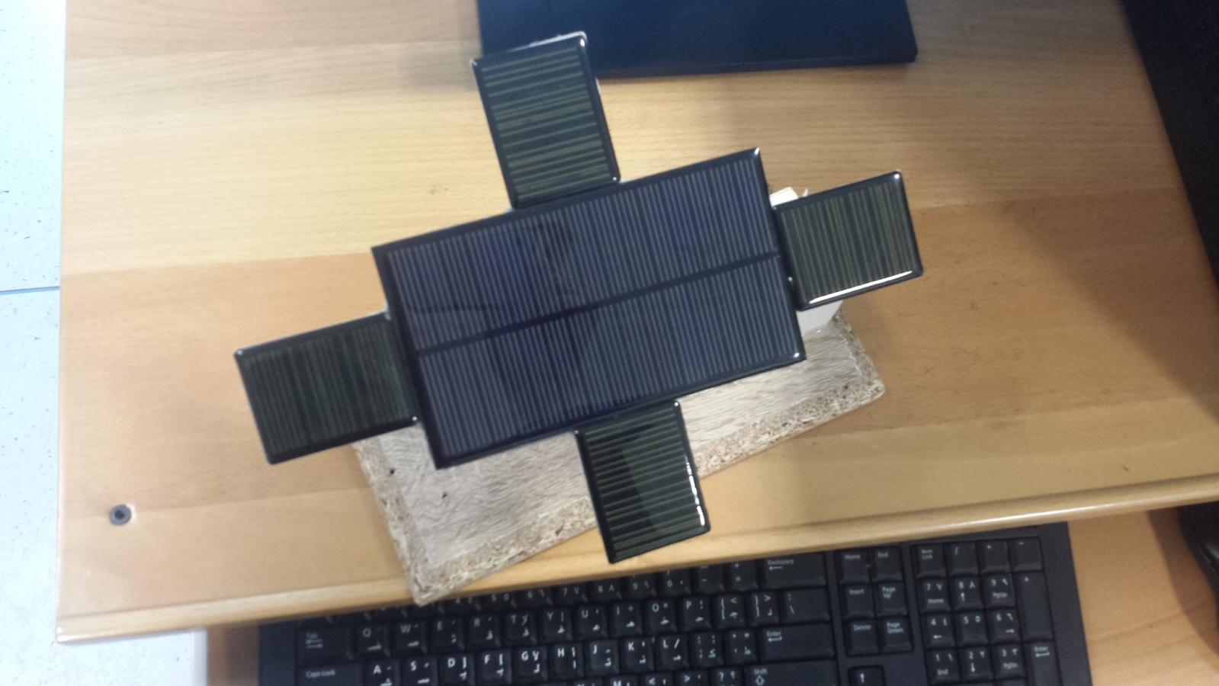
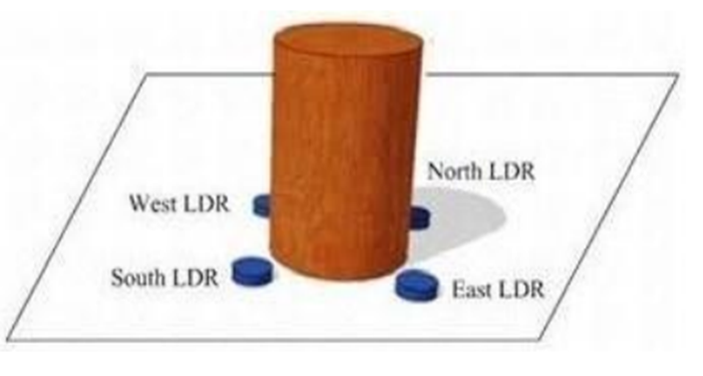
Sensor circuit design
Notes:
After testing some circuit designs, we have decided simple four- sided with a shadow blocking, see fig16. They are set in a manner such that they have the same voltage when they are pointing to the sun; this is possible because the sensors are set at 45o to the base of the sensor. When the cylinder is not pointing to the sun, the voltage across the sensor that is exposing more to the sun is going to be higher from the others. Thus a comparator will decide the way of movement, which is toward the higher voltage sensor. Two opposite sensors are used for tilt movement and the others are used for rotational movement.

Slide 22
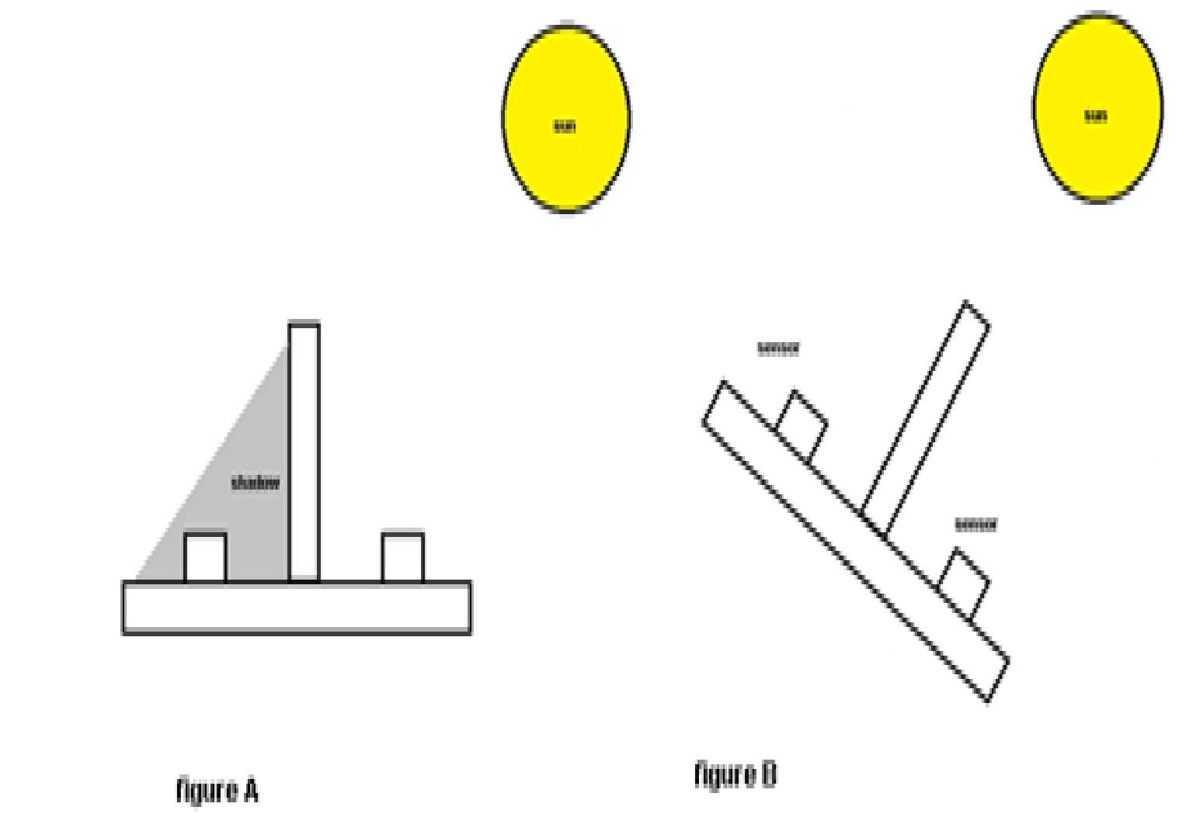

Slide 23
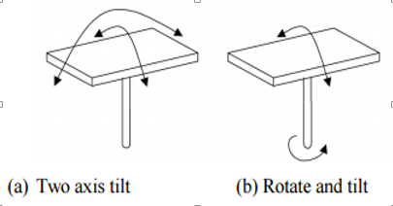
Mechanical design
Method of alignment :

Slide 24
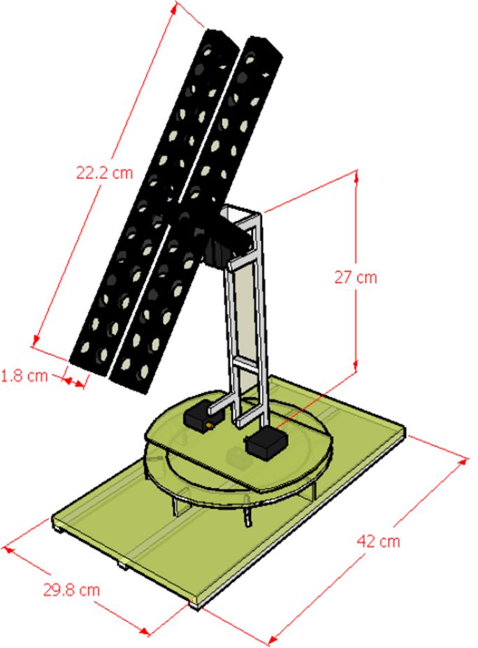

Slide 25
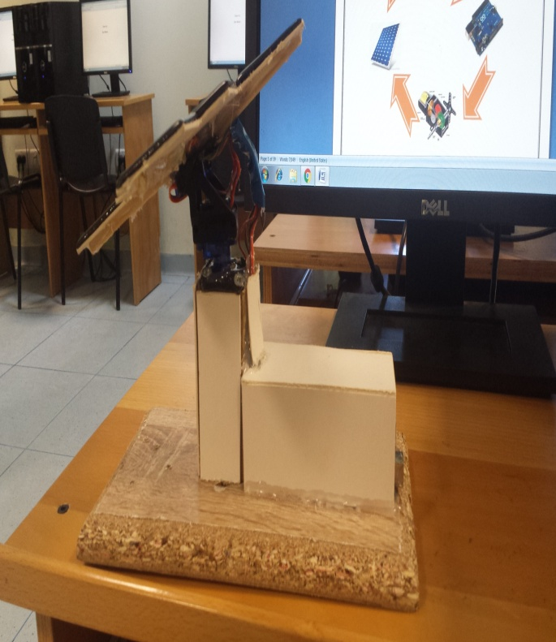
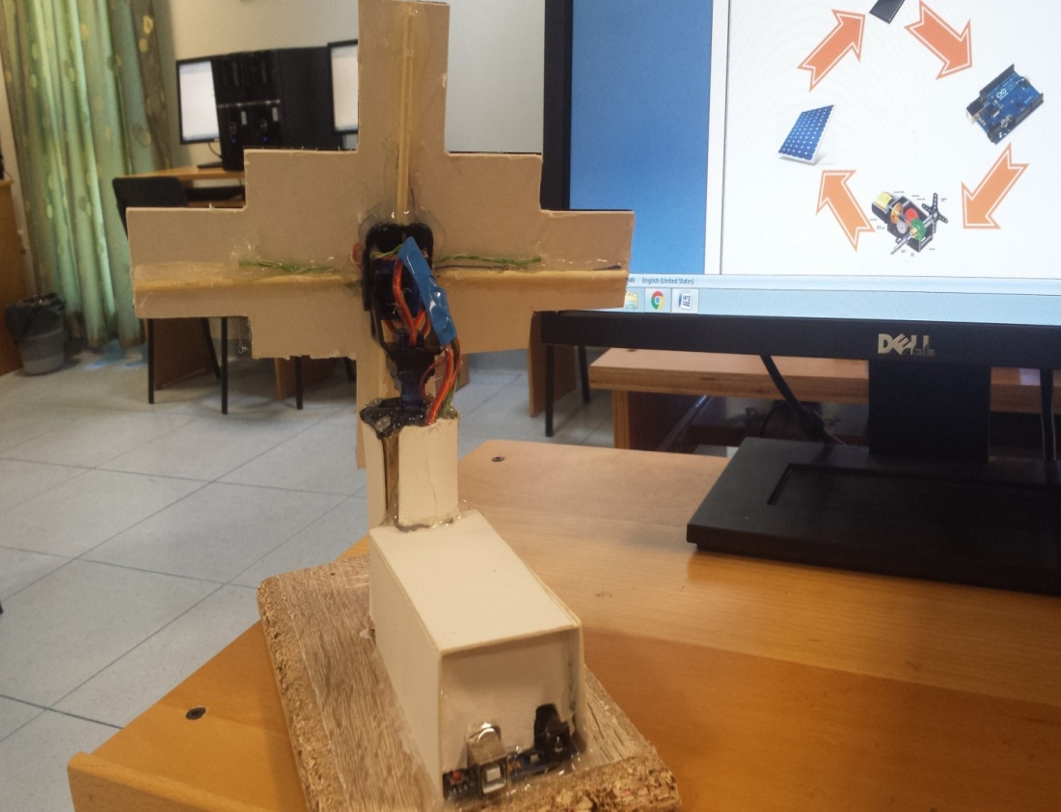
Side view
Back view
Upper view

Slide 26
Flow chart

Slide 27
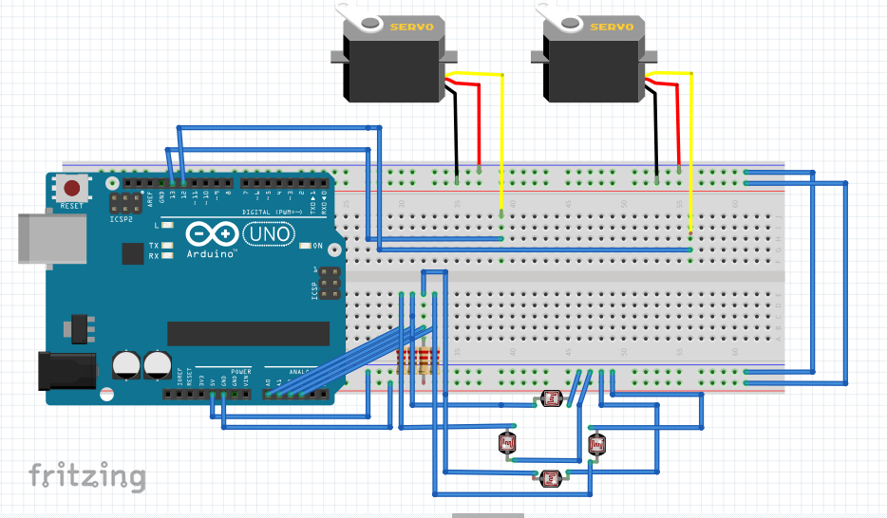
Complete circuit

Slide 28
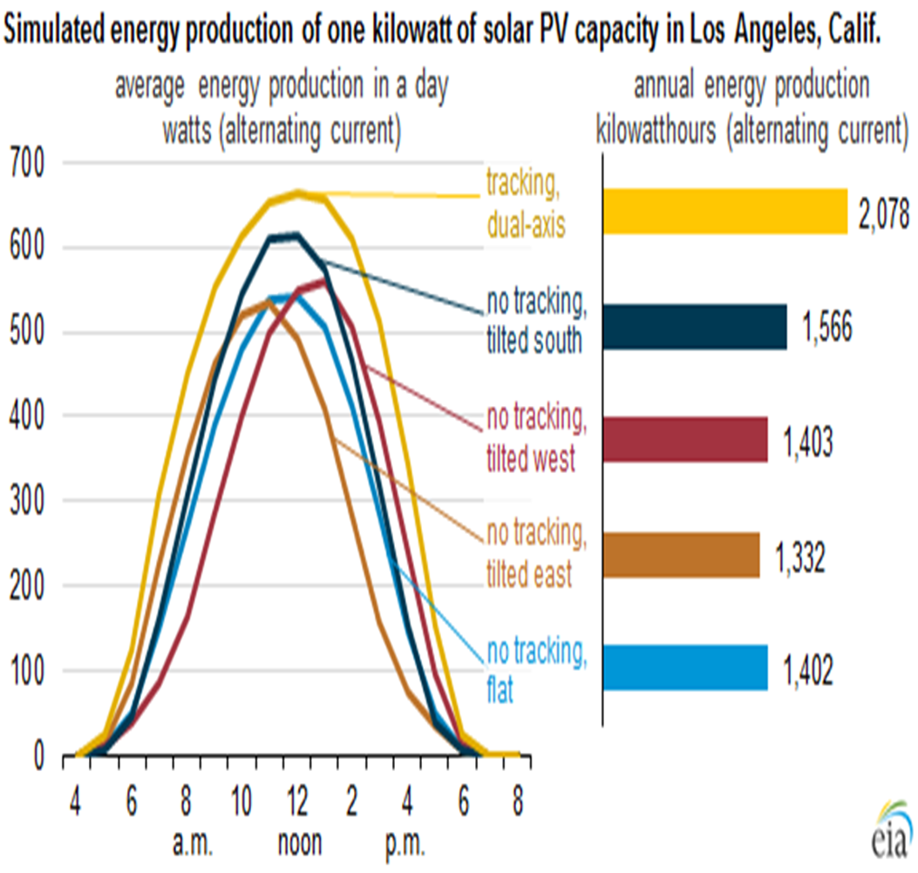
Results and analysis:
Notes:
The following result was done in EIA, U.S energy information administration. It shows an output power comparison between tracking dual axis, no tracking tilted south, no tracking tilted east, no tracking tilted west, and no tracking flat, during one day in kilowatt see
When our project is done during the next semester , we expect to have nearly similar results.

Slide 29
Conclusions and Recommendations
finally after we make our model and when we comparing the tracking by the use of Polycrystalline Mini PV with fixed solar panel system we find that the efficiency of microcontroller based solar tracking system is improved by 30-45% and we think that all parts of experimental setup are giving good results, and cost effective in long run.
The solar tracker can be still enhanced by adding special features in terms of protection from rain and wind in the future work.

Slide 30


