Slide 1
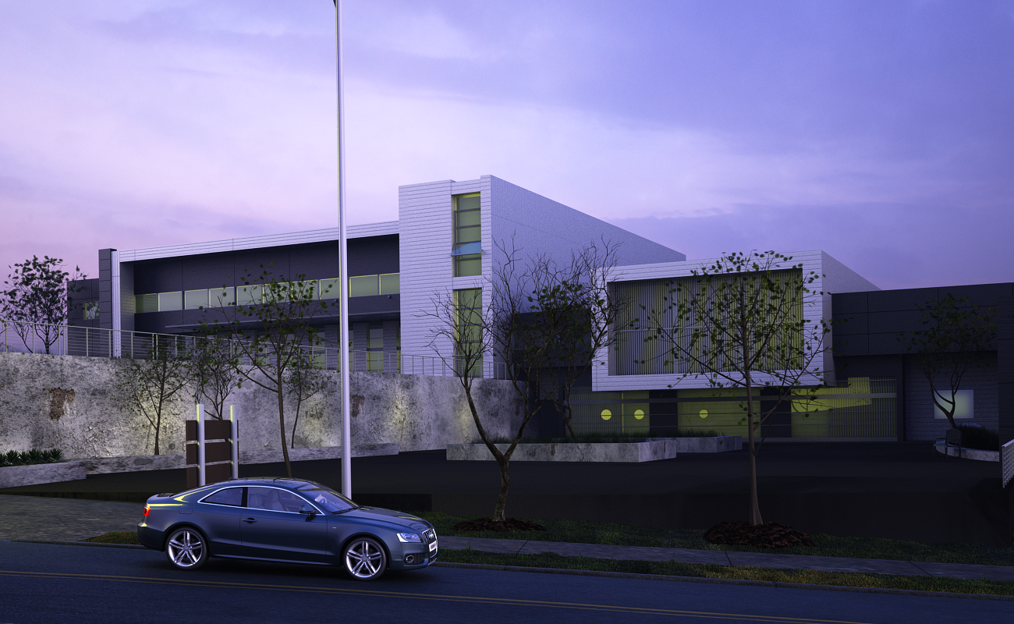

Youth Recreation
Center
Prepared By
Ameed Amer Aya Khalid
Lama Dahboor Morad Jararah
Supervisor
Dr. Mokarram Abbas

Slide 2
Outline
Site location
Architectural Design
Environmental Design
Structural Design
Mechanical Design
Safety Design
Electrical Design
BOQ

Slide 3
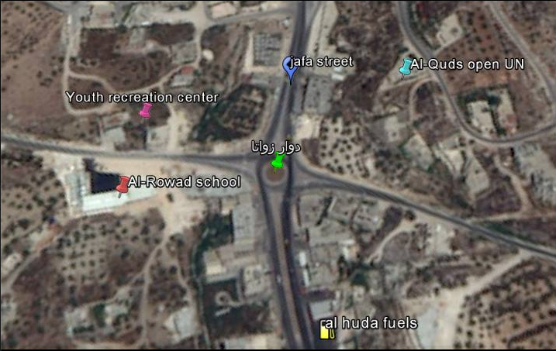
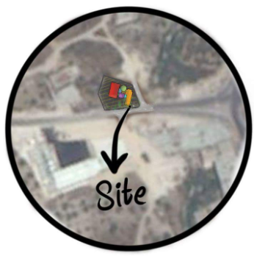

Slide 4
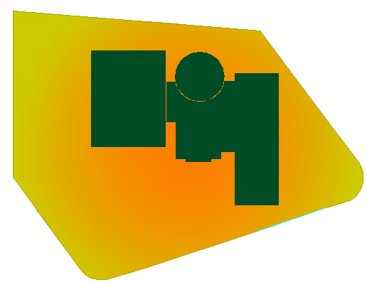
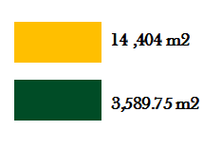
10,810 m2
4,125 m2
Total =14,935 m2

Slide 5
Outline
Site location
Site plan
Architectural Design
Circulation and entrances
Environmental Design
Parking
Structural Design
Plans
Mechanical Design
Safety Design
Elevations
Electrical Design
BOQ

Slide 6
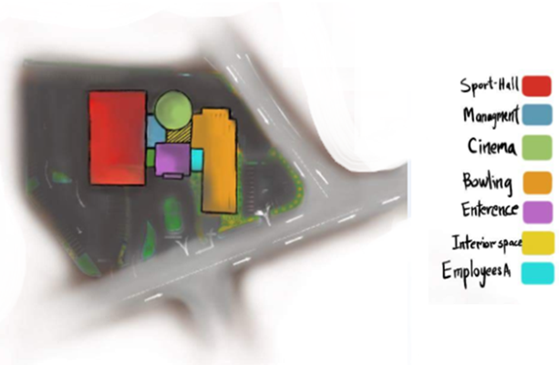
Site plan

Slide 7
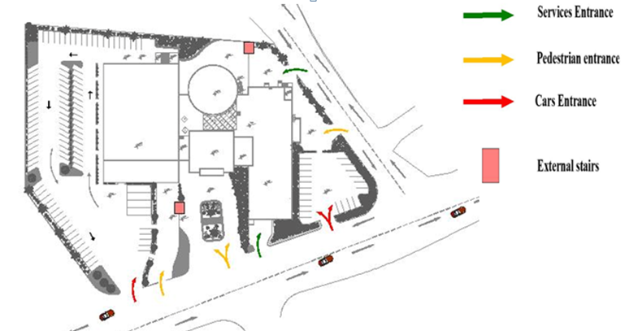
Circulation and Entrances

Slide 8
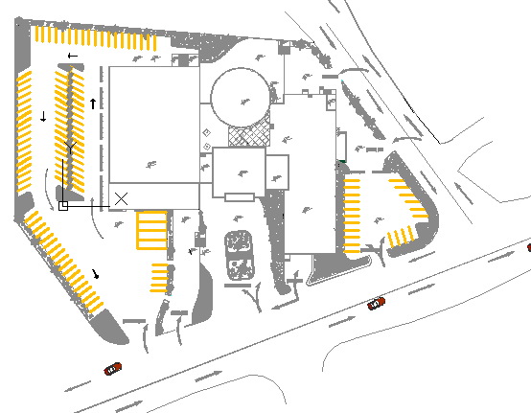
Parking
Area = 4950 m2
No. car parking | zone
22 | Bowling
97 car 4 busses | Sport-hall

Slide 9
Outline
Site location
Site plan
Architectural Design
Circulation and entrances
Environmental Design
Parking
Structural Design
Plans
Mechanical Design
Safety Design
Elevations
Electrical Design
BOQ

Slide 10
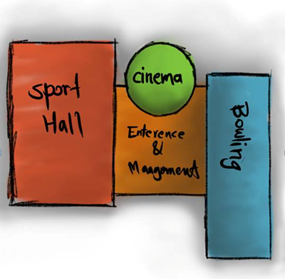
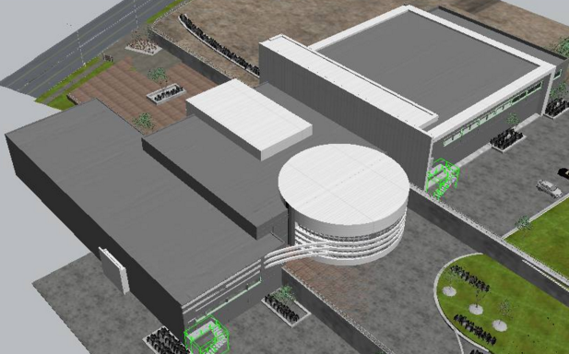
Conceptual plan
final Design

Slide 11
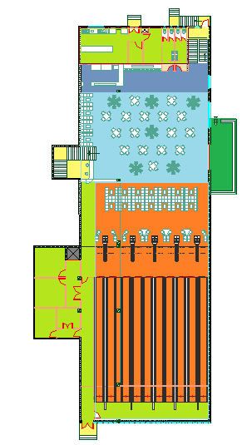
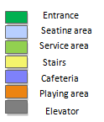
Basement Floor
Total Area = 1334 m²

Slide 12
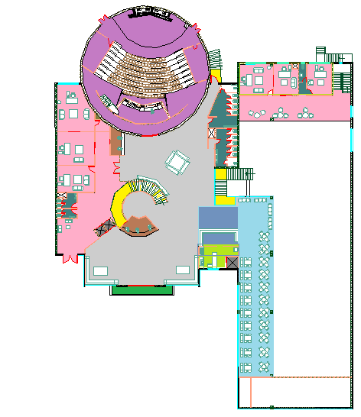
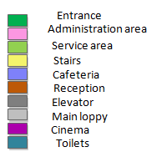
Ground Floor
Total Area = 1678 m²

Slide 13
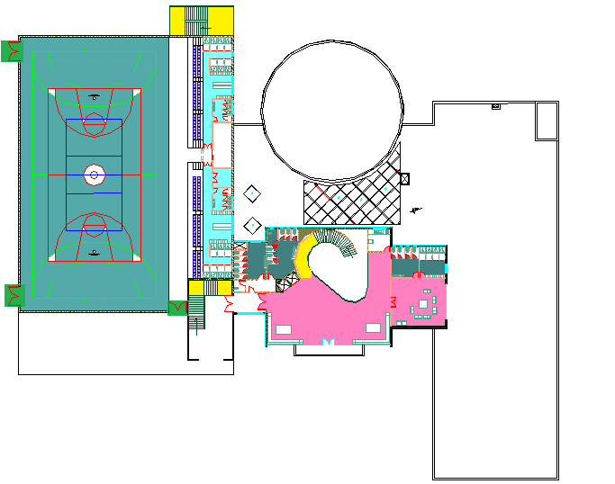
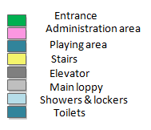
First Floor
Total Area = 2010 m²

Slide 14
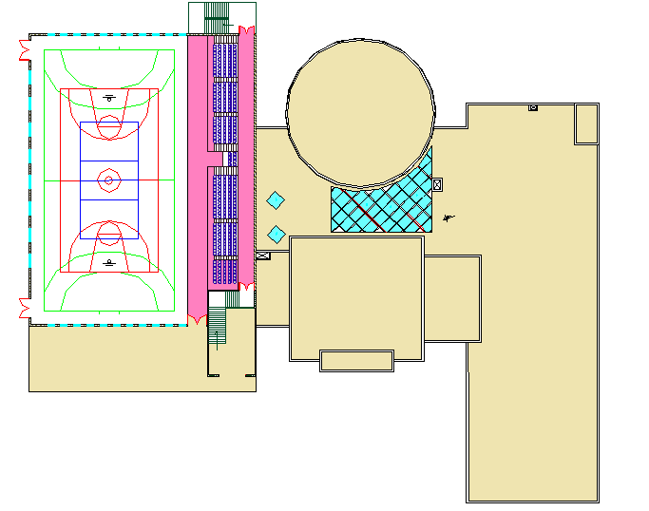

Second Floor
Total Area = 277 m²

Slide 15
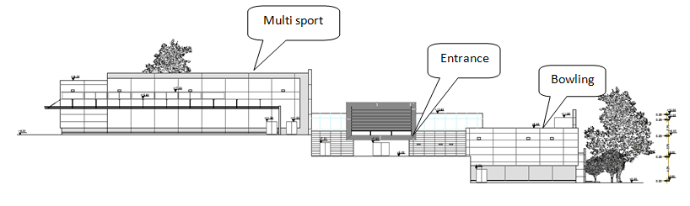
East Elevation

Slide 16
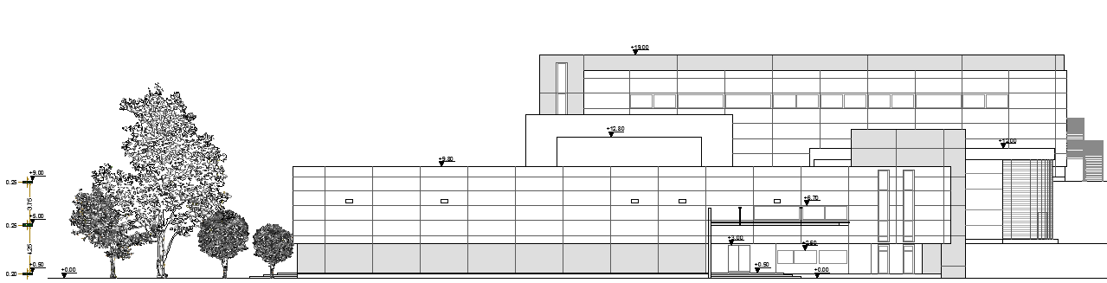
North Elevation
Bowling Entrance

Slide 17
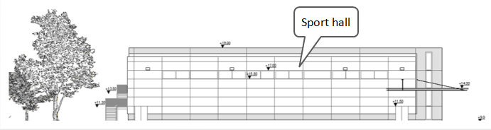
South Elevation

Slide 18
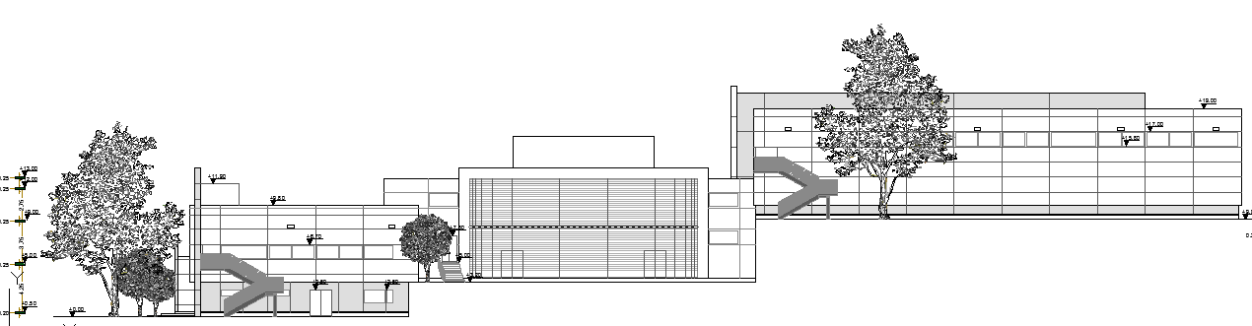
West Elevation
Cinema

Slide 19
Outline
Site location
Best orientation
Architectural Design
Shading Design
Environmental Design
Structural Design
Daylight factor
Mechanical Design
Thermal analysis and materials
Safety Design
Acoustical design
Electrical Design
BOQ

Slide 20
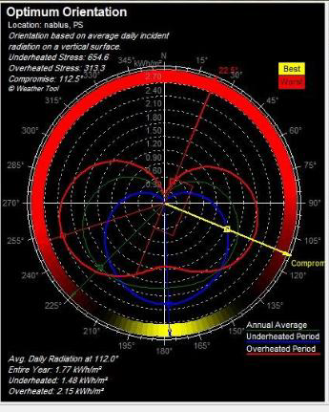
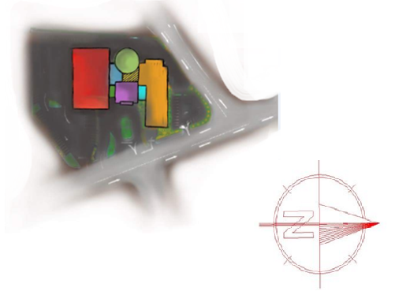
Best orientation
Building orientation
112.5 ◦

Slide 21
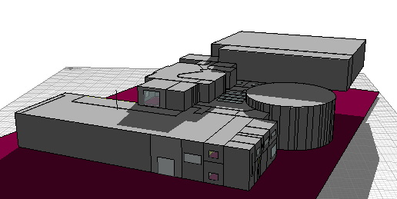
Building in ecotect

Slide 22
Outline
Site location
Architectural Design
Best orientation
Environmental Design
Shading Design
Structural Design
Daylight factor
Mechanical Design
Thermal analysis and materials
Safety Design
Electrical Design
Acoustical design
BOQ

Slide 23
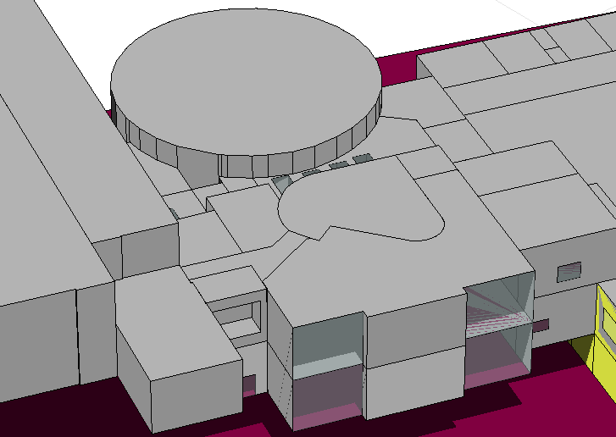
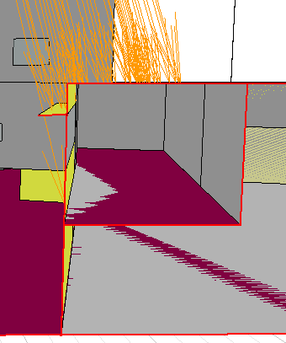
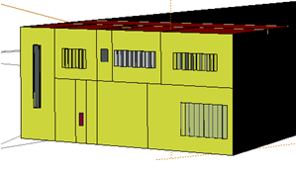
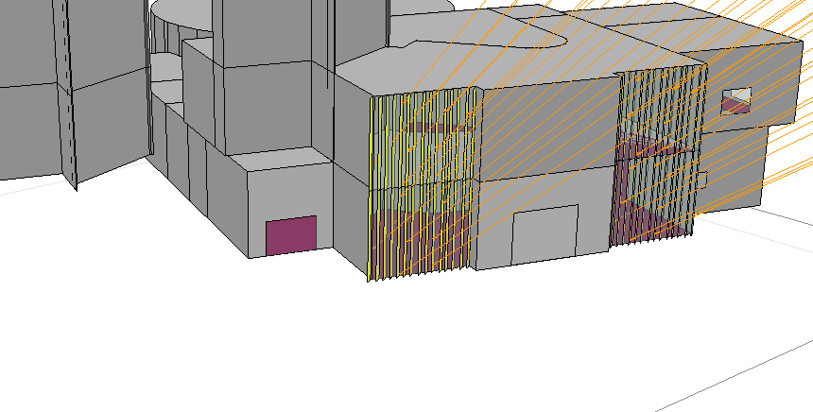
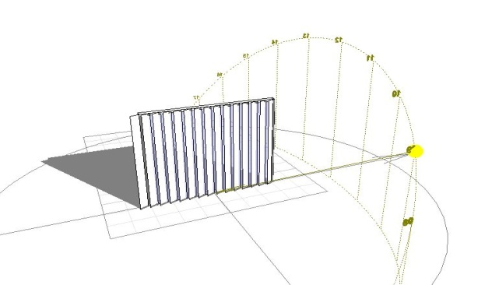
west
South
East
Fixed – 100 cm
vertical Adjustable
Louvers - 40 cm
vertical Adjustable
Louvers - 40 cm

Slide 24
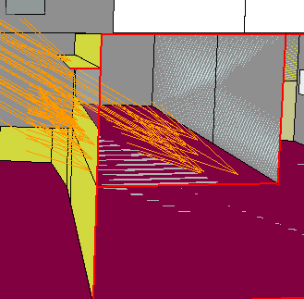
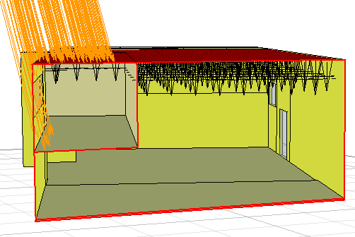
Cafeteria shading - South
After shading in summer
After shading in winter
Before shading

Slide 25
Daylight Factor
the whole building % daylight is 3.35 % which is good and between (2-6 )% and can have it by 75 .12 % as an average autonomy

Slide 26
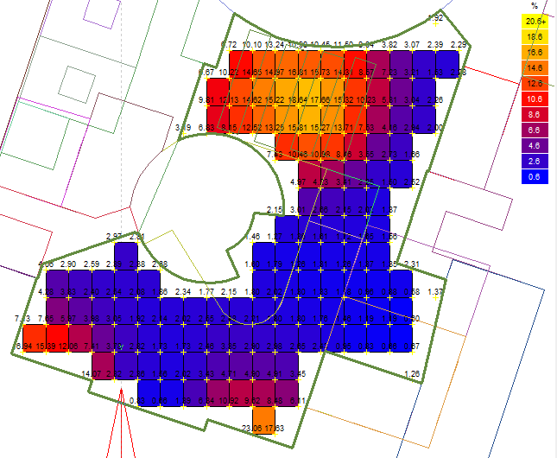
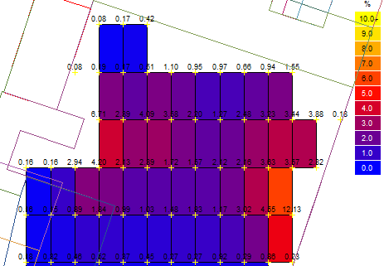
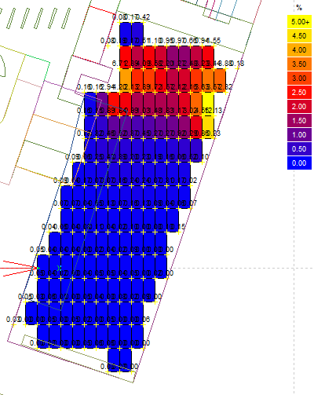
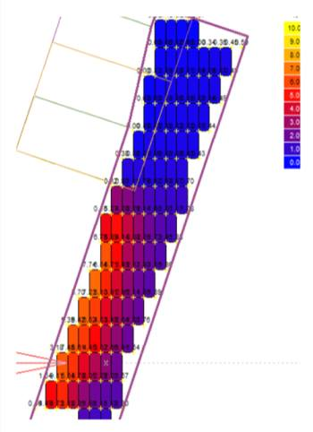
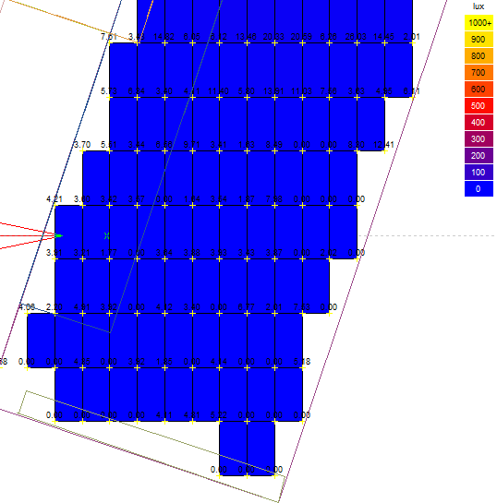
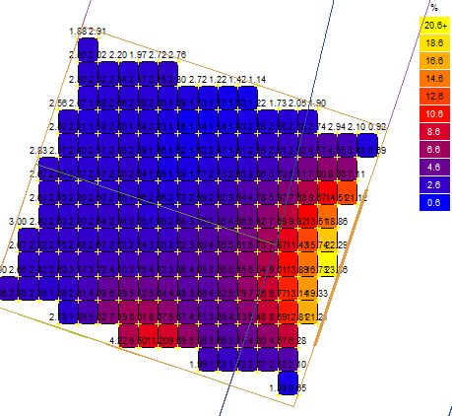
Daylight factor
Day light 5.19%
Autonomy 86.44%
Day light 3.5%
3.14%
Autonomy 88.7%
Day light 4.35%
Autonomy 85.6%
0.88 %
0.06 %

Slide 27
Thermal Analysis
Bowling
Entrance and management
Sport -hall

Slide 28
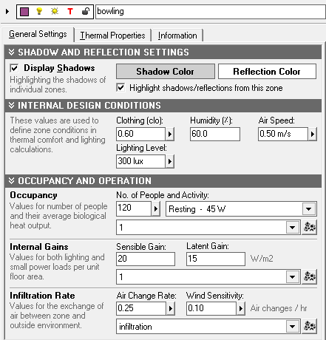
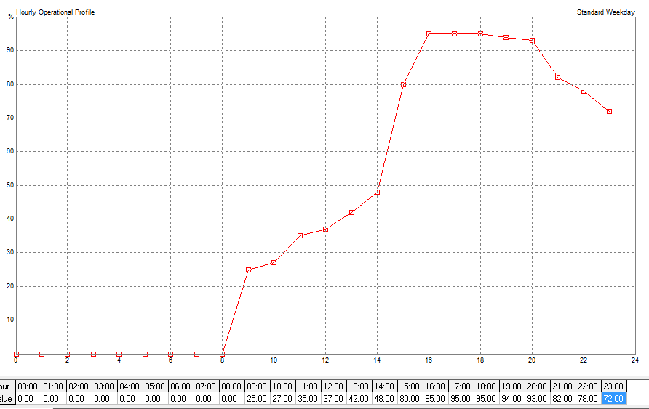
Bowling
120 person – full occupancy – Full air conditioned

Slide 29
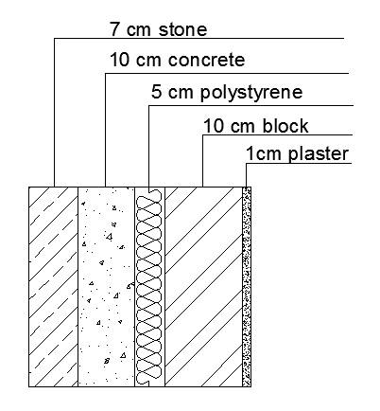
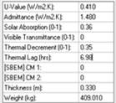
Materials :
External wall of U = 0.41 W/m2.K

Slide 30
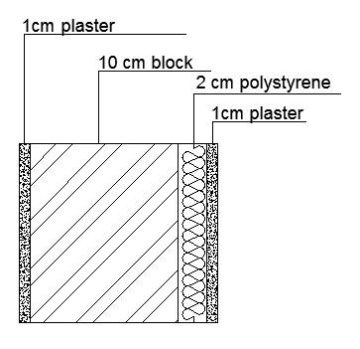
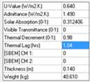
Internal wall of U = 0.64 W/m2.K

Slide 31
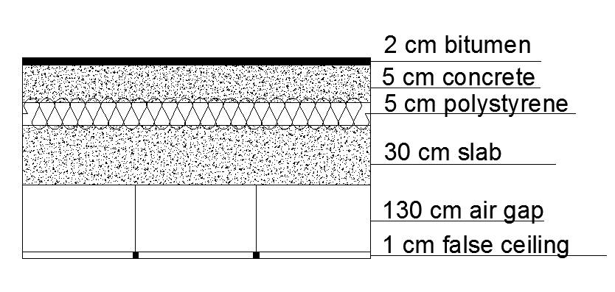
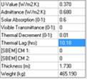
Roof of U = 0.37 W/m2.K

Slide 32
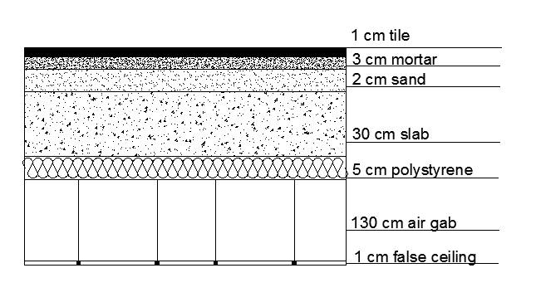
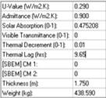
Floor-ceiling intersection of U = 0.29 W/m2.K

Slide 33
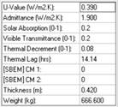
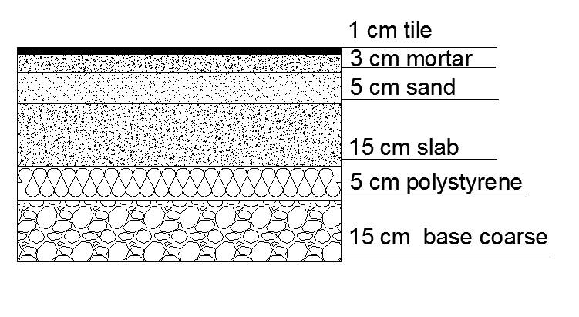
Ground floor of U = 0.39 W/m2.K

Slide 34
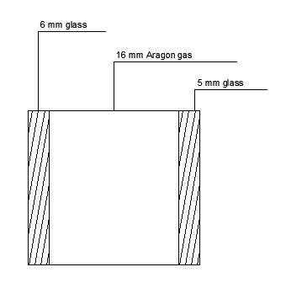


Glass material :
Glass (a) in bowling and cafeteria and entrance of U = 1.1 W/m2.K
(6mm Stopray Galaxy on Clear vision pos)

Slide 35


For other windows in the building we used glass (b) of U = 1.5 W/m2.K:
(6MM STOPRAY INDIGO 48 T POS)

Slide 36

Skylight material :
Polycarbonate (Structured Sheets) , 25mm multiwall UV protected polycarbonate ,
UV =1.7W/m2K
LT = 65%

Slide 37

Bowling
Breakdown analysis :
Conduction Losses | Internal gains
74% | 95.2%

Slide 38

Heating/cooling loads (Bowling)
Max Heating: 27218 W at 12:00 on 18th January
Max Cooling: 64271 W at 19:00 on 30th July

Slide 39
Outline
Site location
Best orientation
Architectural Design
Shading Design
Environmental Design
Daylight factor
Structural Design
Mechanical Design
Thermal analysis and materials
Safety Design
Acoustical design
Electrical Design
BOQ

Slide 40
Reverberation Time RT60
The optimum reverberation time for bowling is 1-1.5 ,
Perforated gypsum plaster on ceiling and acoustic plaster on walls is needed to get the required RT60

Slide 41


Perforated Gypsum Plaster.
acoustic plaster

Slide 42


RT₆₀ before any improvement
RT₆₀ after applying the improvements

Slide 43
Outline
Site location
Design cods
Architectural Design
Design Data
Environmental Design
Structural Design
Structural Elements
Mechanical Design
Etabs Result
Safety Design
Detailing
Electrical Design
BOQ

Slide 44
Design Codes
The American Concrete Institute code (ACI 318-11).
The seismic design according to UBC-97.
The analysis and design were done using SAP2000, and ETABS 2015 programs.

Slide 45
Design Data
1. Concrete compressive strength
f’c =32 MPa for slabs and beams.
f’c = 32 MPa for shear walls, columns and footings.
2.Yielding strength of steel
The yield strength of steel Fy= 420MPa
3. Bearing capacity of soil
the bearing capacity of soil = 300 KN/m2

Slide 46
Structural Systems
One way ribbed slab “Bowling Building”
Thickness :
One way ribbed slab = 32 cm

Slide 47
Structural Elements
Beams
Shear wall
Columns
Slabs
Footing
Spiral Stairs

Slide 48

3D Modeling
ETABS 2015

Slide 49


Checks
ETABS 2015
Compatibility & Deflection Check:

Slide 50

Checks
ETABS 2015
Equilibrium Check

Slide 51


Seismic Design
Response Spectrum
W= 32837.18 KN , Include D.L+S.D+0.25LL
UBC-97
I = 1
R= 4.5
Ca= 0.20
Cv= 0.20
T = 0.24 sec

Slide 52


Slab Reinforcement

Slide 53


Beams Reinforcement

Slide 54


Columns Reinforcement

Slide 55


Footing Reinforcement

Slide 56


Footing Reinforcement

Slide 57


Spiral Stairs Reinforcement

Slide 58


Shear wall Reinforcement

Slide 59
Outline
Site location
Architectural Design
Environmental Design
Structural Design
Water supply system
Mechanical Design
Drainage system
Safety Design
HVAC
Electrical Design
BOQ

Slide 60

Water consumption
Total building of water demand = 7223.4 g/ day

Slide 61

a water tank of 125 m3

Slide 62

Total FU’s | Collector
59 | 1
12 | 2
60 | 3
70 | 4
7 | 5
48 | 6
68 | 7
82 | 8
60 | 9
64 | 10
64 | 11
Vertical of 2.00 in
Horizontal of 1.50 in
Branch of 1.00 in
Meter of 2.00 in

Slide 63
Outline
Site location
Architectural Design
Environmental Design
Structural Design
Water supply system
Mechanical Design
Drainage system
Safety Design
HVAC
Electrical Design
BOQ

Slide 64


Drainage system for Bowling-Basement and Ground Floor
26
5

Slide 65



Drainage system for Bowling-Basement and Ground Floor

Slide 66


Roof and Storm water Drainage

Slide 67
Outline
Site location
Architectural Design
Environmental Design
Structural Design
Water supply system
Mechanical Design
Drainage system
Safety Design
HVAC
Electrical Design
BOQ

Slide 68


Design Data for Bowling :
Uw =0.410 W/m2.C
Uc =0.370 W/m2.C
Uadj =0.640 W/m2.C
Max Cooling: 64271 W @ 19:00 on 30th of July.

Slide 69



For bowling space we used air handling unit (AHU-B) and return fan,

Slide 70


Main Duct sizing :
v=7.1m3/s , vA-B=10m/s ,then (Δ𝑝/𝐸𝐿)=0.9

Slide 71



Diffuser selection :
23 x23 cm ceiling diffusers
such that the volumetric rate = 175 L/s and its throw 3-7.3m
Square diffusers (supply).
A fixed carbon
dioxide sensor
Diffusers (return).

Slide 72


Diffusers distribution:

Slide 73
Outline
Site location
Architectural Design
Environmental Design
Structural Design
Mechanical Design
Emergency signs
Safety Design
Sprinklers distribution
Electrical Design
Evacuation maps
BOQ

Slide 74


Emergency Signs

Slide 75

Fire Sprinklers Distribution
In Cinema

Slide 76

Fire Sprinklers Distribution
In Cafeteria – Ground Floor

Slide 77


Evacuation Maps

Slide 78
Outline
Site location
Architectural Design
Environmental Design
Structural Design
Mechanical Design
Socket distribution
Safety Design
Lighting distribution
Electrical Design
Dialux
BOQ

Slide 79


Distribution of Sockets

Slide 80


Distribution of Lighting

Slide 81


Artificial Lighting
Dialux Program

Slide 82



Artificial Lighting
Dialux Program

Slide 83


Special Lighting Effects -Bowling

Slide 84
Outline
Site location
Architectural Design
Environmental Design
Structural Design
Mechanical Design
Safety Design
Electrical Design
BOQ

Slide 85
Bill of Quantities
Bowling - Sample Structural
Total cost of structural elements per meter square = 334.56 $
Total Cost of the Bowling center = 391,435 $

Slide 86
Thank you
No Need for Questions

