Slide 1
Investigation of FIDIC Clauses and Causes of Disputes in Construction Projects Performance in West Bank
Prepared by:
Ayat Sawaftah Leen Sleman
Yazan Abbadi Zaid Ahmad
Presented to:
Dr. Mohammad Abu Nemeh Eng. Reema Bdair
Eng. Hussain Abu Zant

Slide 2
Outline
Review
Objectives
Methodology
Questionnaire
Questionnaire Analysis
Conclusion
Recommendations

Slide 3
Introduction
FIDIC
organization arose to establish regulations and roles in the form of model contracts. These regulations seek to achieve balance and form the relationship between the parties in a professional and legal manner, conserving their rights and duties.
FIDIC with its general and special conditions has organized issues between the parties.
FIDIC is the most widely used international form of construction contract in the world

Slide 4


Slide 5
Introduction
Research objectives
Identify the most frequently-used FIDIC clauses that have been used in construction projects.
Investigate the FIDIC and its contents to examine its ability in construction projects.
Identify the most significant causes of disputes in construction projects
Research Q’s
What is FIDIC and at what range it has been implanted in West Bank
Is there any difference between FIDIC and currently applied laws?
Do our parties refer to FIDIC in disputes ?

Slide 6
Introduction
Significance of the work
Improve the construction contracts in Palestine
Disputes minimization
Filling the gaps in FIDIC clauses
The contract is the mutual agreement between the parties, it’s based on offer and acceptance with policies which are easily understandable and legally.

Slide 7
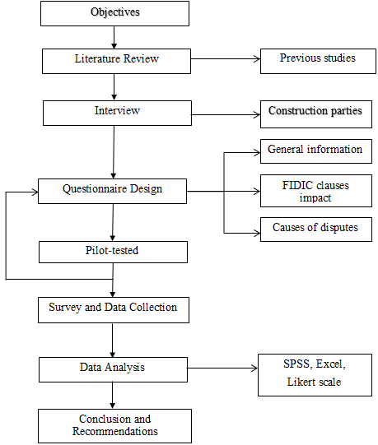

Slide 8
Methodology
There are two types of research strategies
1-Quantitative research.
2-Qualitative research.
In this research, the quantitative approach is selected to detect the impact of FIDIC on construction project performance for the quantities project characteristics like (cost, quality, safety and time).

Slide 9
Data Required
We have searched for problems that face projects in order to compare what is being done in the real case with what is stated in Palestinian conditions of contract for construction. After that, reference to the solution stated in FIDIC was be carried out, and then comparison of both solutions and conclusion of the better one has been done.

Slide 10
Data collection
Required data have been collected using the followings:
1- Literature review.
2- Interviews.
3- Pilot-tested.
4- Questionnaire:.

Slide 11
Sample size
The objective of sampling is to provide practical means of enabling the data collection and possessing the components of the research to be carried out whilst ensuring that the sample provides a good representation of the population.
Municipalities and owners of public projects have been our targeted owners.
Contracts companies in West Bank represent the targeted contractors.
The targeted consultants and contractors are corporations for engineering consultations, according to the Palestinian Engineers Syndicate.

Slide 12
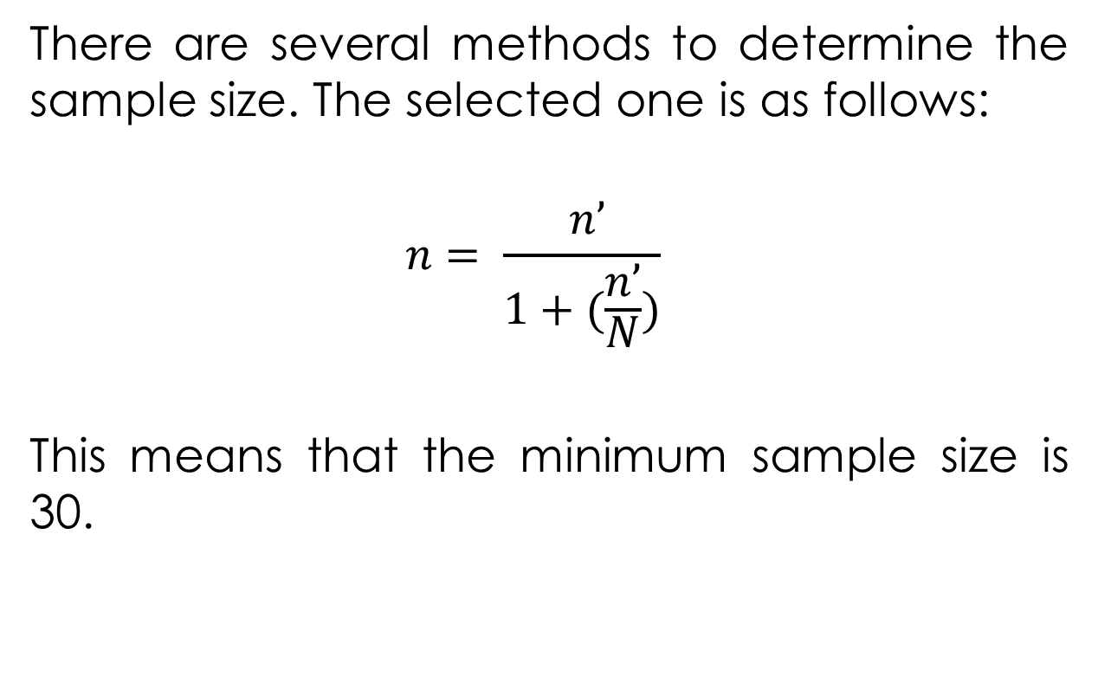
Sample size
There are several methods to determine the sample size. The selected one is as follows:
$$n= \frac{ n’}{1+(\frac{n’}{N})}$$
This means that the minimum sample size is 30.

Slide 13
Questionnaire
The questionnaire is composed of three parts:
1- Part one: General information.
2- Part two: FIDIC clauses.
3- Part three: Causes of disputes.

Slide 14
Causes of disputes
Causes of disputes in construction projects, which implement time, cost and quality
Causes related to financial problems
Causes related to the tender documents (contracts, drawings)
Causes related to specifications and materials adaptation (Quality)
Causes related to Political problems
Causes related to administrative problems
Causes related to the contract parties themselves
Causes related to the natural environment
Causes related to the career ethics

Slide 15
Data Analysis
The data has been analyzed using SPSS, MS Excel software, Likert scale

Slide 16
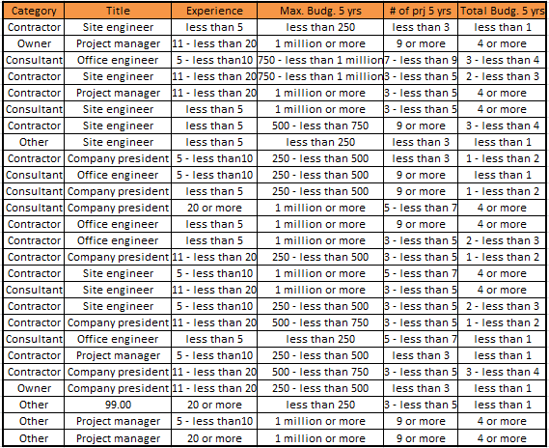

Slide 17
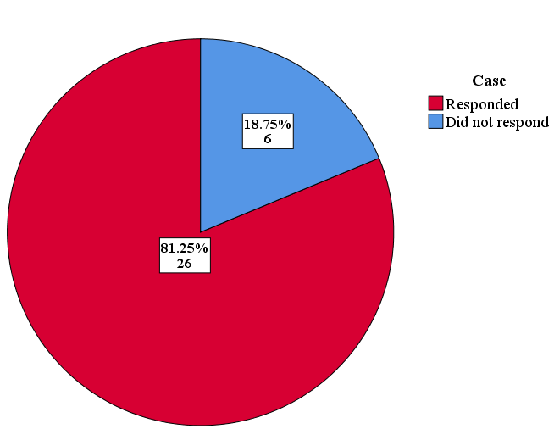
Questionnaire Delivery
Face to face

Slide 18
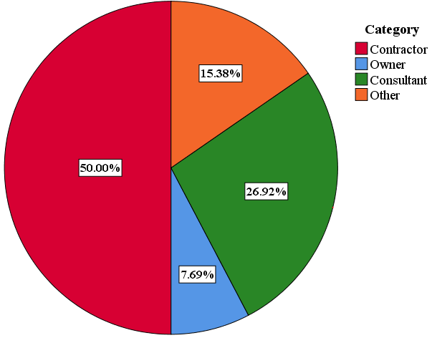
Questionnaire Analysis
1- Respondent Category

Slide 19
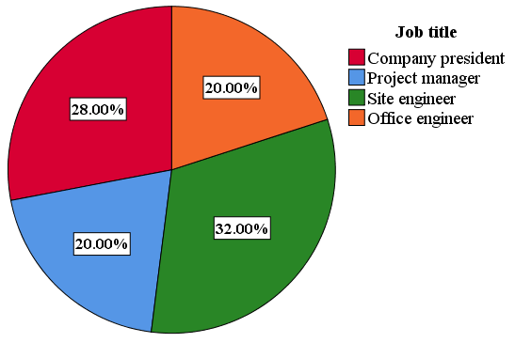
Questionnaire Analysis
2- Job Title

Slide 20
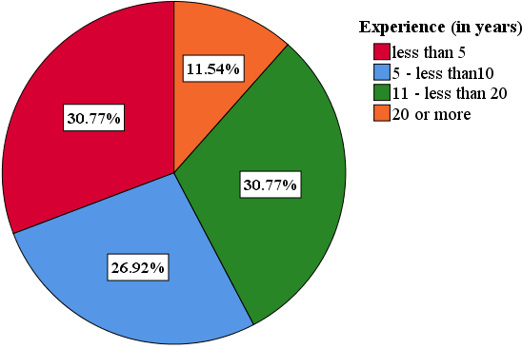
Questionnaire Analysis
3- Respondent Experience

Slide 21
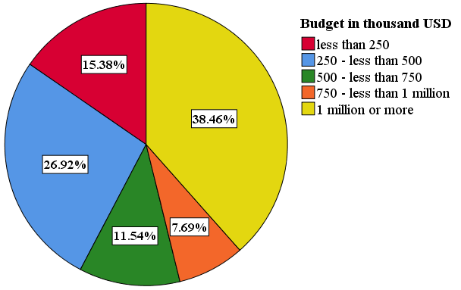
Questionnaire Analysis
4- Max Budget over 5 years

Slide 22
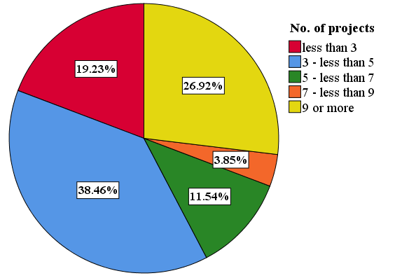
Questionnaire Analysis
5- No. of projects over 5 years

Slide 23
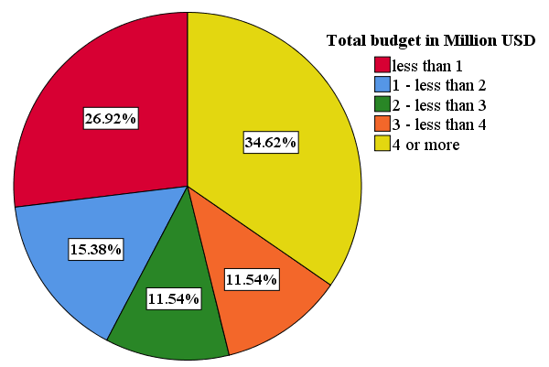
Questionnaire Analysis
6- Volume of work over 5 years

Slide 24
Questionnaire Analysis
7- Contractors’ Classification

Slide 25
Questionnaire Analysis
8- Consultants’ Classification

Slide 26

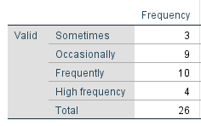
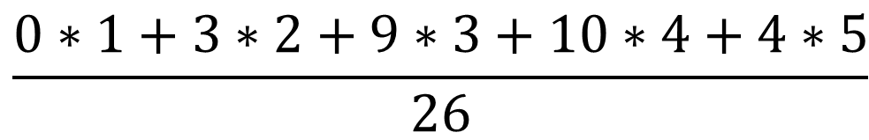
Ex:
$$\frac{0∗1+3∗2+9∗3+10∗4+4∗5}{26}$$
RII =
= 3.577

Slide 27
Questionnaire Analysis
Most Frequently-Used Clauses:
Ensure that all parties do their duties to the fullest
Final payment after initial submission of works
Damages requiring forced delay
Priority of contract documents in terms of implementation
Defects liability certificate

Slide 28
Questionnaire Analysis
Most Important Causes of Disputes:
The lack of perfection in the contract document
Donor countries funding governing project’s guidance
Weakness of drawing layouts

Slide 29
Conclusion
FIDIC clauses are widely used in contracts of construction projects in West Bank.
FIDIC clauses are a way to reduce the problems between contracts parties.
It is a reference to solve the disputes between contracts parties.

Slide 30
Conclusion
The most important clauses are those related to finance and time.
The most important causes of disputes are those related to political, economic, documents and specifications problems.
The most important causes of disputes can be avoided by following FIDIC clauses.

Slide 31
Recommendations
Special attention to the perfection of contract documents.
Open and honest communications between the contracting parties.
Clear process that encourages discussion of how the risk should be shared.

Slide 32
Recommendations
The engineer must be neutral with the duties specified in the contract.
Special attention to FIDIC clauses related to finance and time since delay will affect finance and vice versa.
In case of delay, the party who is responsible for a delay and the risk plan must be determined.

Slide 33
Recommendations
The party, which responsible for the variation in the orders and the required claims must be determined.
In case of suspension, the extension of time and the amount, which will be added, must be determined.
Enhancing the contractor's classification mechanism.
Repeat such studies every 5 years to keep up with contract sectors trends and needs.

