Slide 1

an-najah national university faculty of engineering & information technology department of building engineering
Energy Efficient Hotel Design
Prepared By:
Aseel Hlayel
Hiba Istaitia
Roula Ghoul
Moutasem Awwad
Supervisor: Eng. Fadi Fatayer

Slide 2
OUTLINE:
Introduction.
Site analysis.
Architectural Design.
Environmental Design.
Structural Design.
Mechanical Design.
Electrical Design.
Quantity Survey.

Slide 3
INTRODUCTION

Slide 4
INTRODUCTION
The hotel is a commercial establishment providing guest luxury and services.
The hotel is designed as five stars hotels with row houses around it.
Energy efficient hotel aims to use as minimum energy as possible.

Slide 5
SITE ANALYSYS

Slide 6
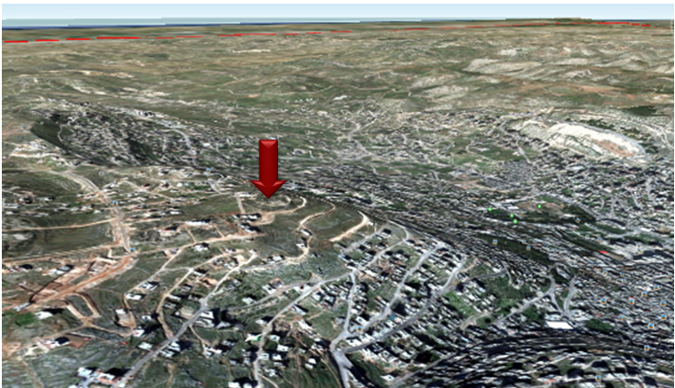
SITE ANALYSYS
The location is Nablus city, on mount of Gerizim, with an approximate area of 7770 m².

Slide 7
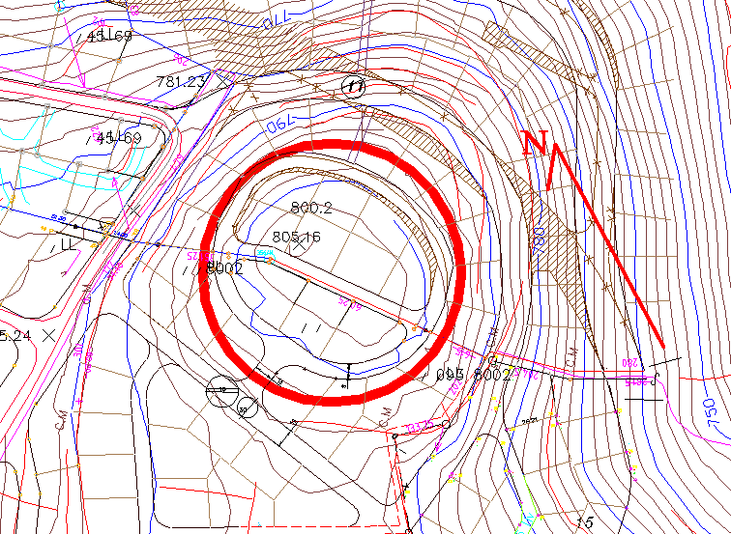
SITE ANALYSYS
No Surrounding Buildings.
The land slope is low.
Two streets in east and west.
The annual average wind speed (10) km / h.
The overall rate annual Relative humidity up to (60%).

Slide 8
ARCHITECTURAL
DESIGN

Slide 9
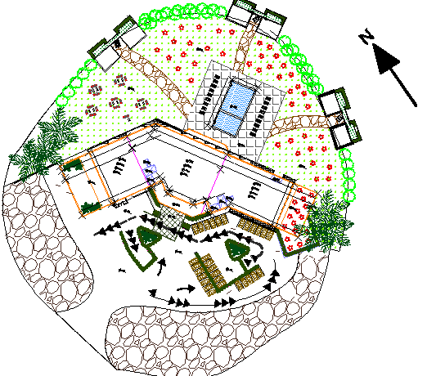
SITE PLAN

Slide 10
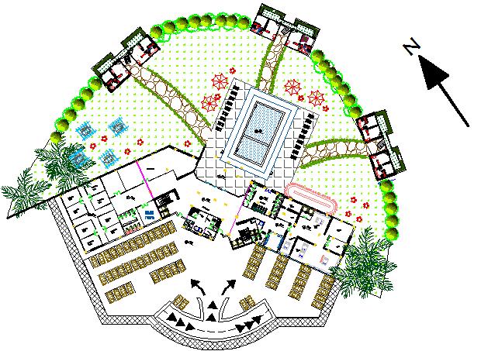
MASTER PLAN

Slide 11
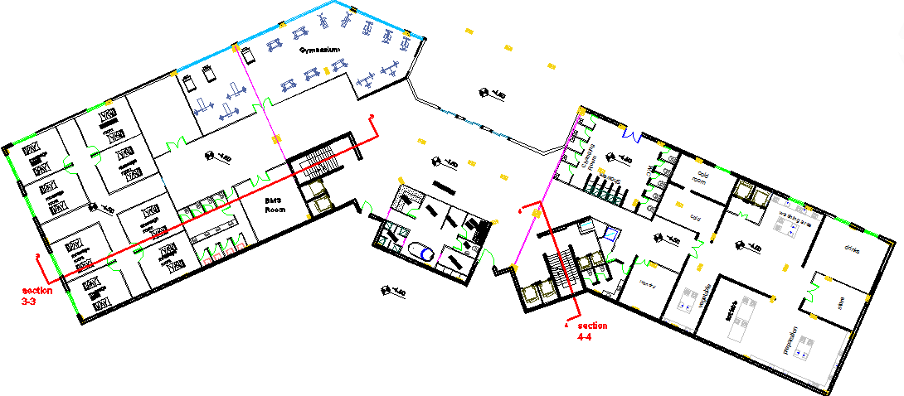
BASEMENT FLOOR
Area= 2212.1797 m²

Slide 12
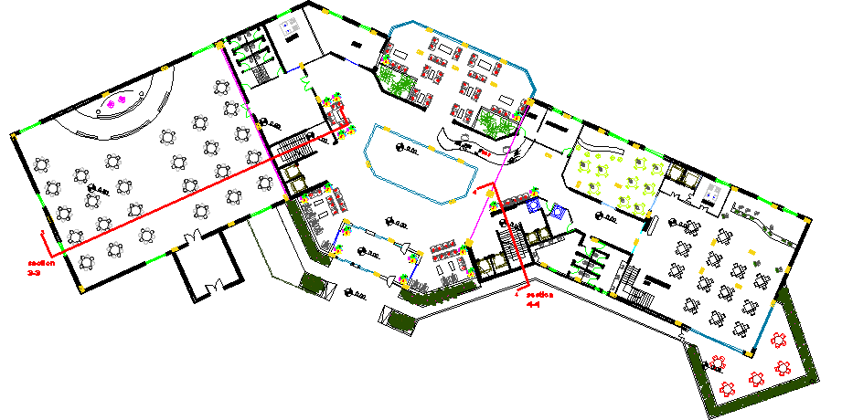
GROUND FLOOR
Area= 2540.4668 m²

Slide 13
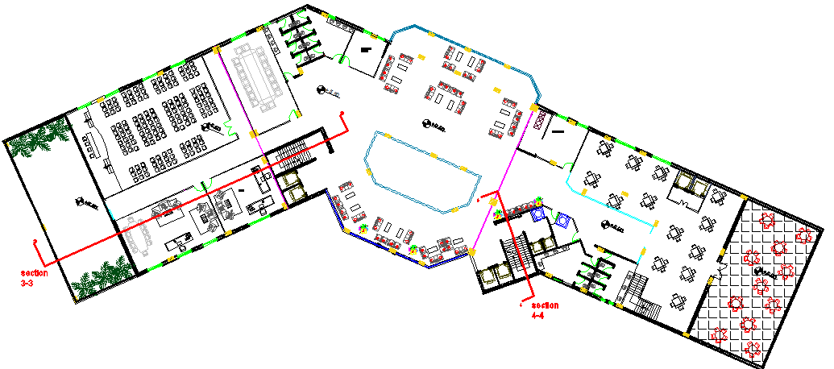
FIRST FLOOR
Area = 2416.0824 m²

Slide 14
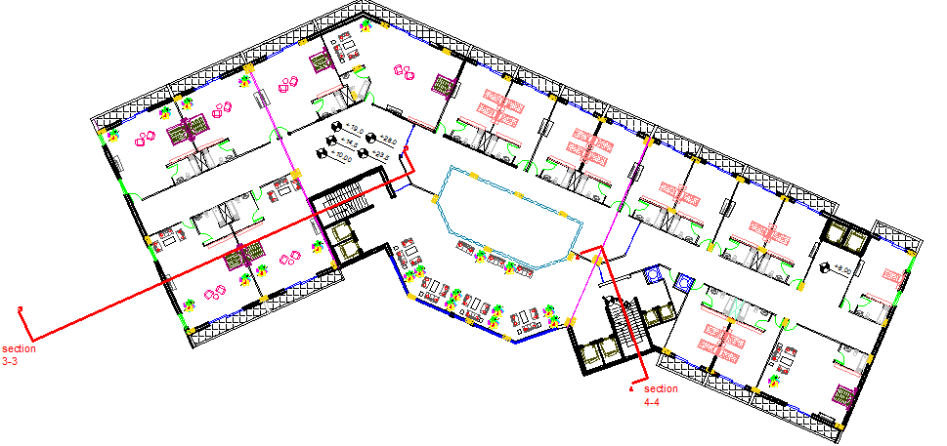
2nd, 3rd, 4th & 5th FLOOR
Area= 2021.4937 m²

Slide 15
Areas for the Facilities
Facility | Area (m²)
Single Bedroom | 40 m²
King Bedroom | 90 m²
Wedding | 750 m²
Kitchen | 380 m²
Restaurant | 420 m²
Reception | 40 m²
Entrance | 150 m²
Conference | 110 m²
Lobby | 140 m²

Slide 16
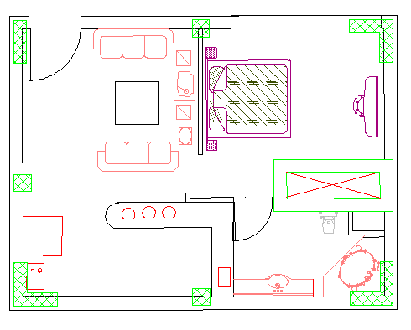
Row House
Floor area of block = 61.5 m²

Slide 17
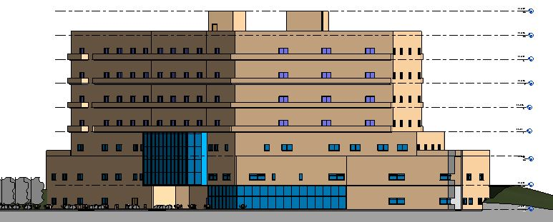
NORTH ELEVATION

Slide 18
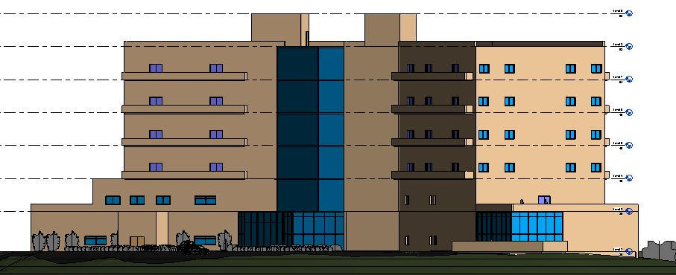
SOUTH ELEVATION

Slide 19
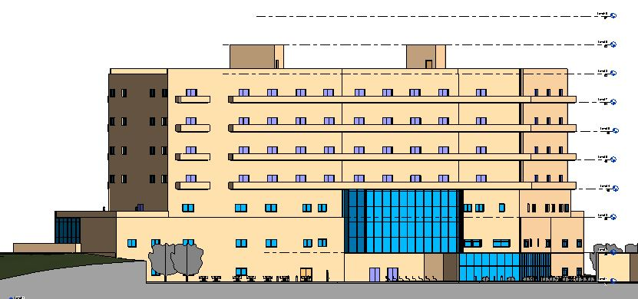
EAST ELEVATION

Slide 20
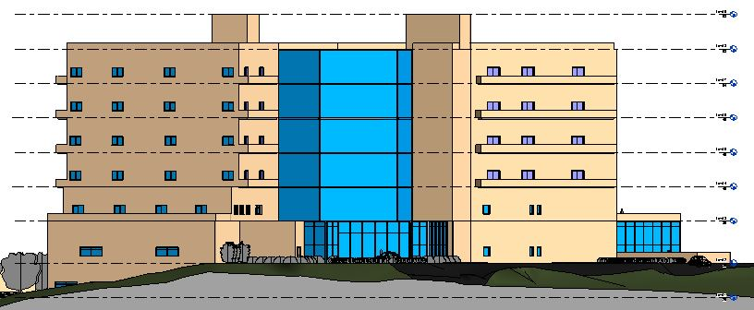
WEST ELEVATION

Slide 21
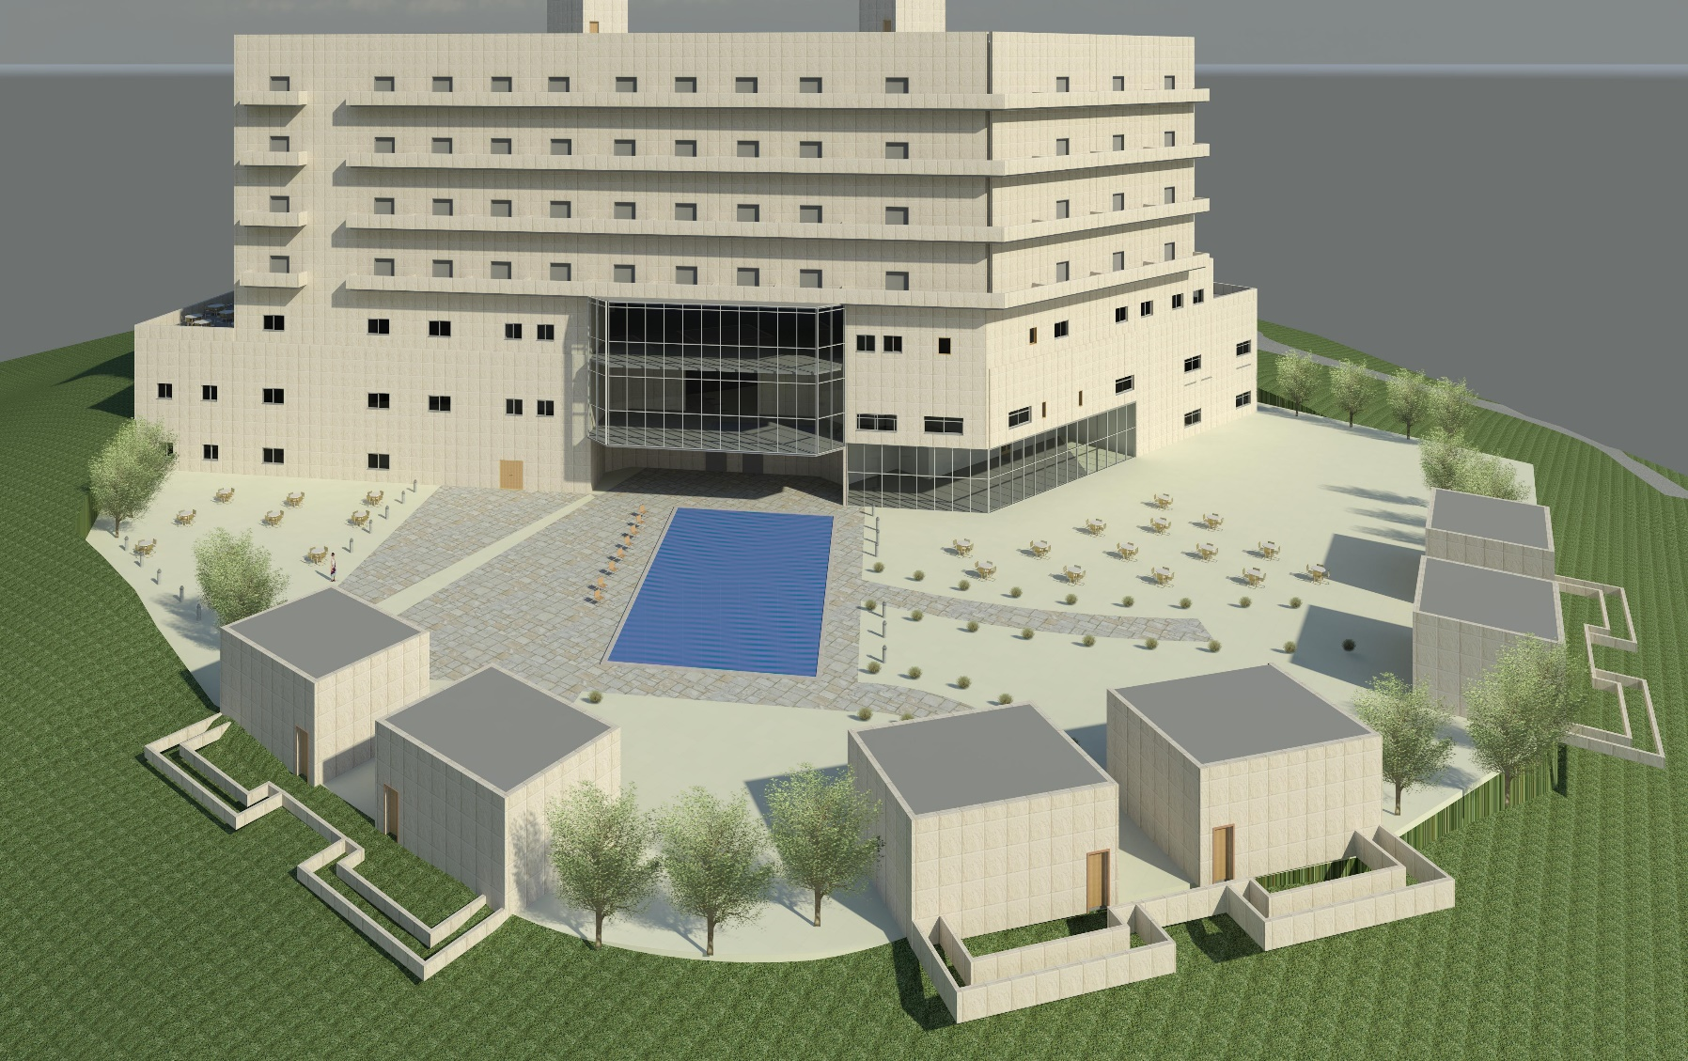
3D – GENERAL VIEW 1

Slide 22
ENVIRONMENTAL
DESIGN

Slide 23
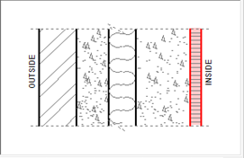
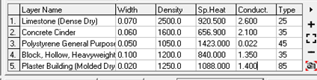
ENVIRONMENTAL DESIGN
Ext Walls comp.(u-value =0.520W/m2.k).
Notes:
EXT WALLS COMP.(U value =0.580

Slide 24
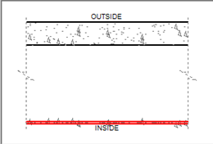

ENVIRONMENTAL DESIGN
Roof comp.(u-value =1.440W/m2.k)

Slide 25
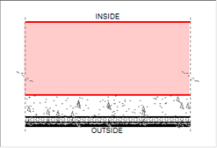

ENVIRONMENTAL DESIGN
floor comp.(u-value =0.790W/m2.k).

Slide 26
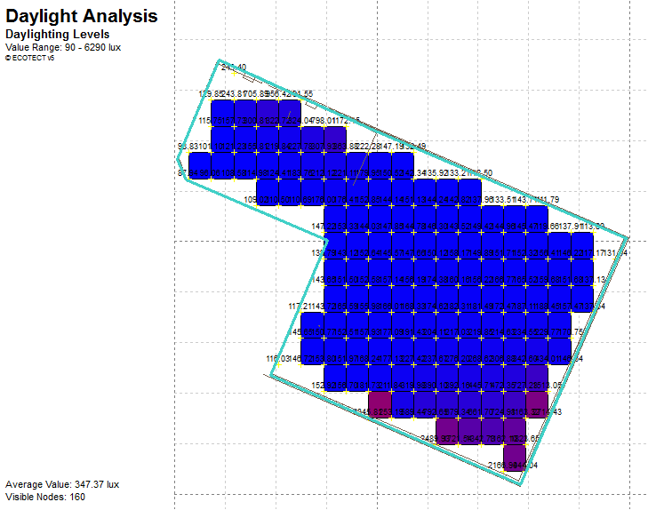
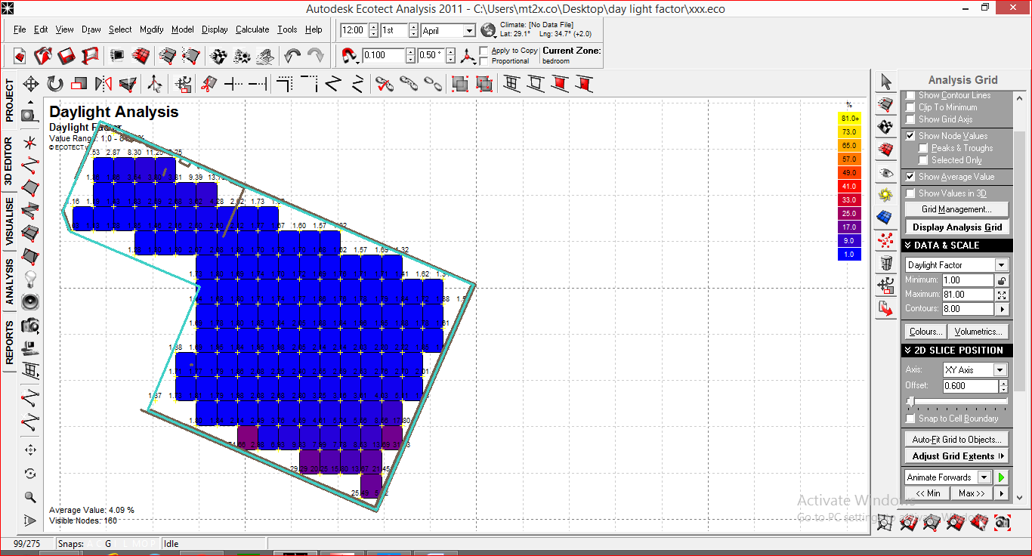
ENVIRONMENTAL DESIGN
Daylight factor for restaurant(D.F avg = 4.09% and D.L = 347.37 Lux.)

Slide 27
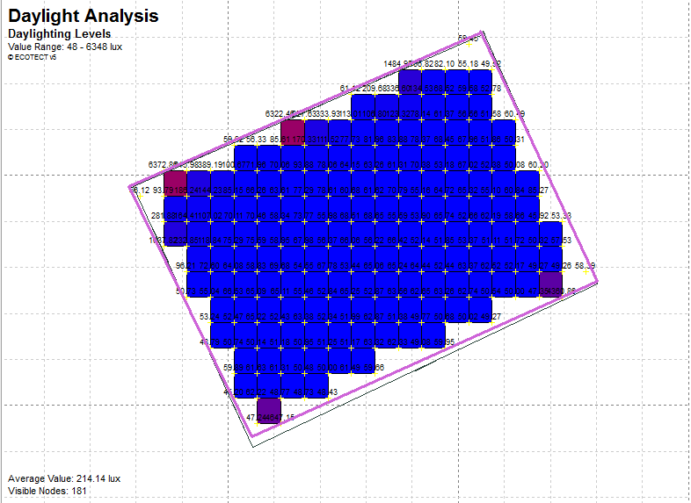
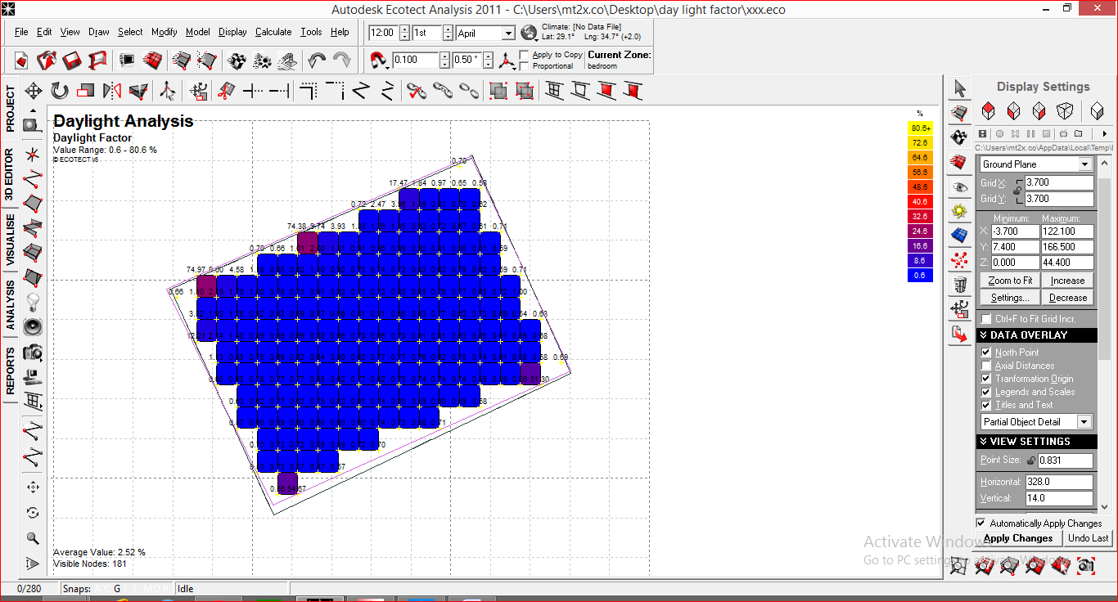
ENVIRONMENTAL DESIGN
Daylight factor for Wedding D.F avg = 2.52% and D.L = 214.14 lux.

Slide 28
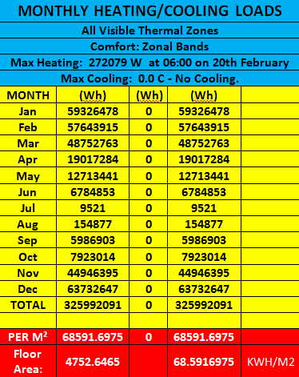
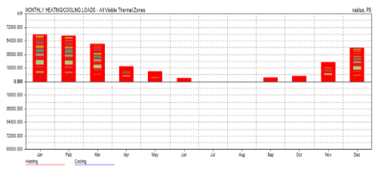
ENVIRONMENTAL DESIGN
Total heating load only.
The calculation of the loads done at critical state by using ecotect program , which is when the building is empty and at comfort band 22-26 C.

Slide 29
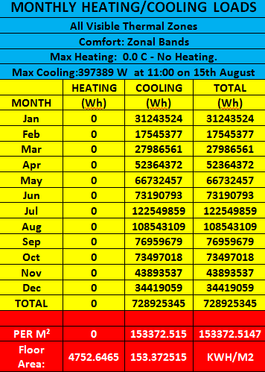
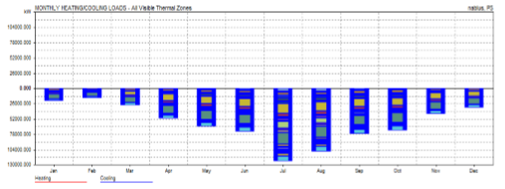
ENVIRONMENTAL DESIGN
Total cooling load only.

Slide 30
ENVIRONMENTAL DESIGN
After calculation for heating load and cooling load by ecotect program the total load for hotel=153.37+68.59=221.9 KWh/m2 which is below the maximum load for hotels=235KWh/m2 (According to Energy Stars Profitable Manager ) ,then the thermal system is good in the hotel.

Slide 31
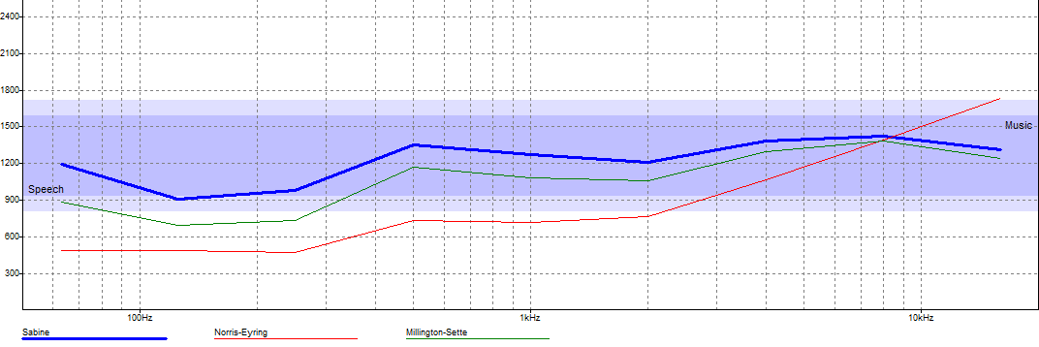
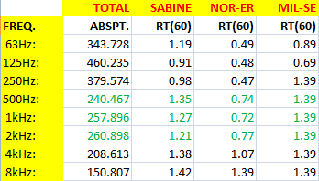
ENVIRONMENTAL DESIGN
Acoustical analysis
Reverberation time (RT60) for the restaurant when the occupancy=100%.

Slide 32
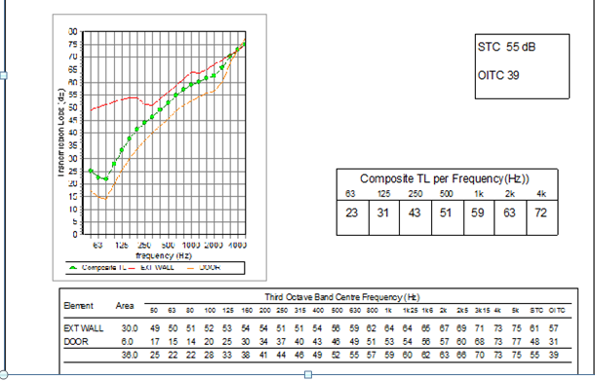
ENVIRONMENTAL DESIGN
Acoustical analysis
STC for external walls
The final STC for the ext wall=55dB> the stander for hotel=52 dB, which is very good.

Slide 33
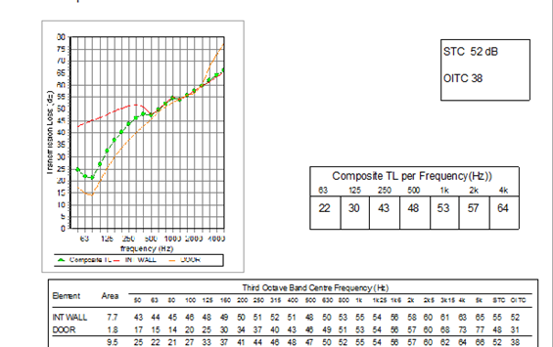
ENVIRONMENTAL DESIGN
Acoustical analysis
STC for internal walls
The final STC for the int wall=52dB> the standert for hotel=48 dB, which is very good.

Slide 34
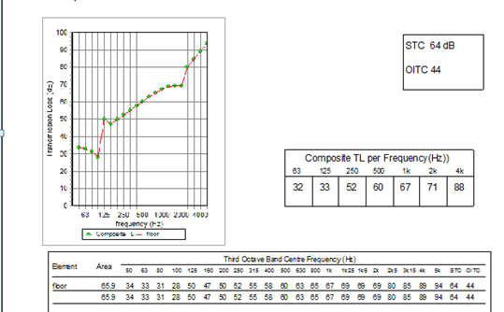
ENVIRONMENTAL DESIGN
Acoustical analysis
IIC for floor
The final IIC for roof =64dB> the stander for hotel=52 dB, which is very good.

Slide 35
STRUCTURAL
DESIGN

Slide 36
DESIGN CODES
ACI -318 for reinforced concrete structural
design.
UBC -97 for earthquake load computations.

Slide 37
DESIGN DATA
Concrete f´c= 24 MPa for slabs and beams
Concrete f´c= 28 MPa for columns and footings.
Yielding strength of steel Fy= 420 MPa.
Allowable bearing capacity of soil= 400 KN/m².
Load :
Live Load= 5KN/m² for Ground Floor.
3KN/m² for Other Floors.
Super imposed load= 6 KN/m².

Slide 38

SEISMIC DESIGN DATA
City of the structure is Nablus.
The seismic zone of Nablus is 2B where the factor Z=0.20.
The soil profile type is SB.
Ca= 0.20
Cv= 0.20
Importance factor I=1
The structural type is Intermediate,
R= 5.5.

Slide 39
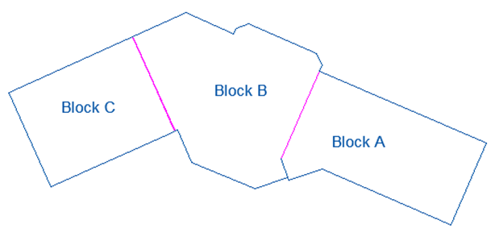
STRUCTRURAL MODEL
Total floor area of block “A” = 4772.77 m²

Slide 40
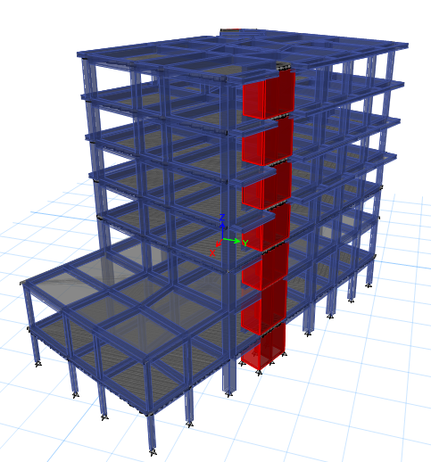
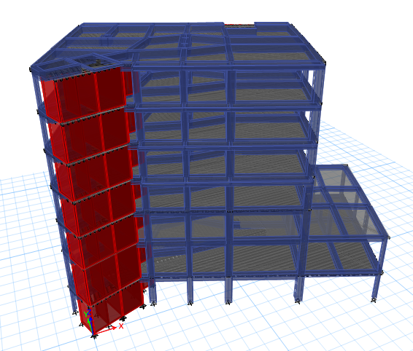
3D MODEL

Slide 41
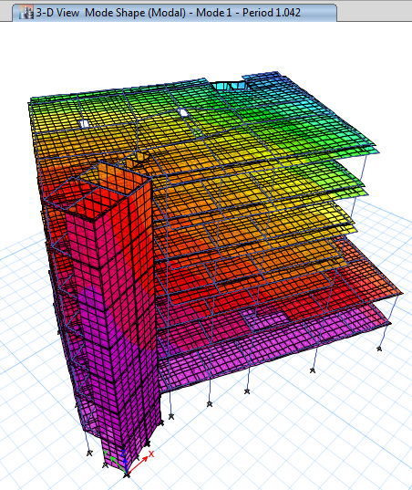
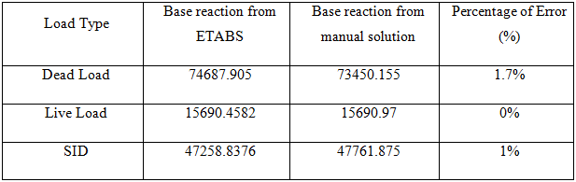
VERIFICATION OF MODEL
Compatibility Check.
Equilibrium Check.
According to ACI-318; %Error less than 5% which is OK.
Stress-Strain Relationship.
Period Check.
Deflection Check.
Drift Check.
Modal participation mass ratio.

Slide 42
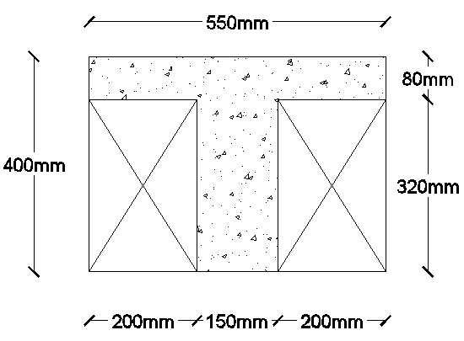
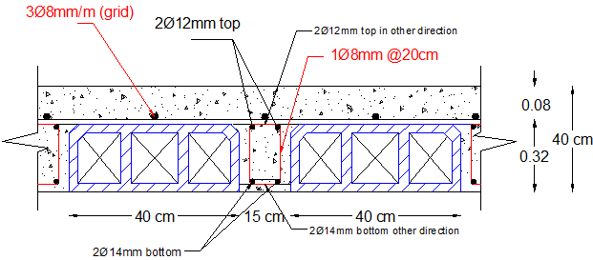
SLAB DESIGN
Two way ribbed slab is used with thickness of 40 cm.

Slide 43
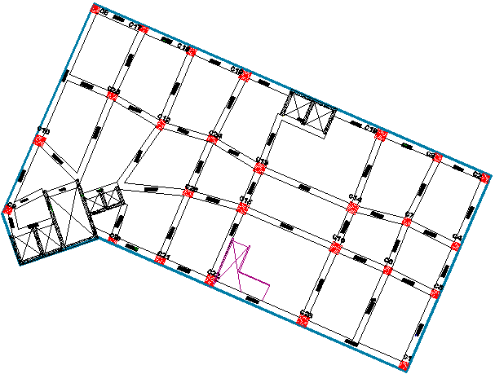
BEAM DESIGN
All beams are dropped beams with 90 cm depth and 60 cm width.

Slide 44
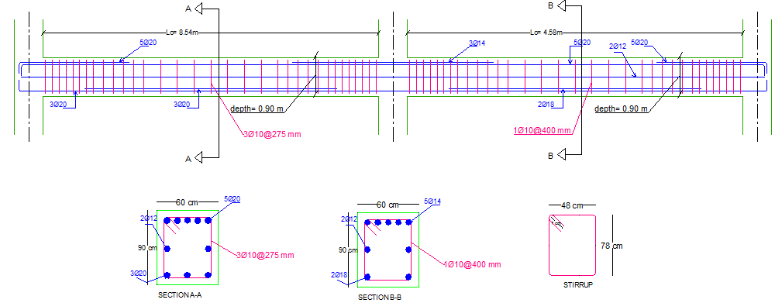
BEAM REINFORCEMENT
BEAM REINFORCEMENT
Beam | Depth (cm) | Width (cm) | Top Edge | Top Middle | Top Edge | Bottom Edge | Stirrups
3B12S1 | 90 | 60 | 5Ø20 | - | 3Ø14 | 3Ø20 | 1Ø10@27.5 cm
3B12S2 | 90 | 60 | 3Ø20 | 5Ø20 | 2Ø14 | 2Ø18 | 1Ø10@40 cm

Slide 45
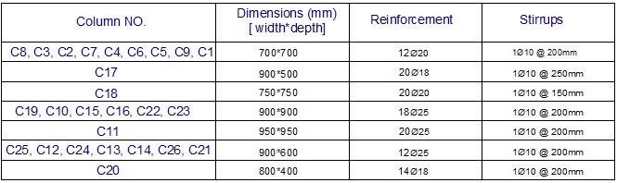
COLUMNS REINFORCEMENT

Slide 46
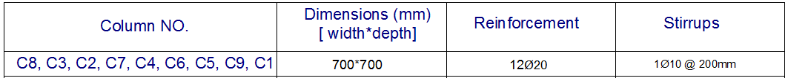
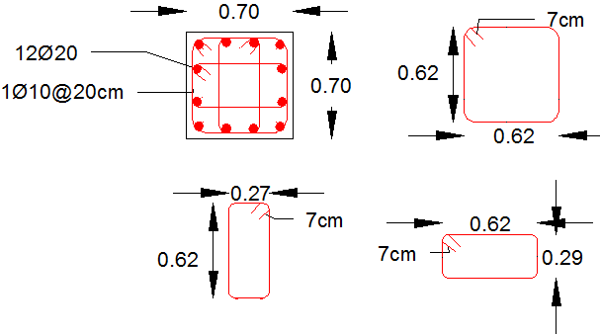
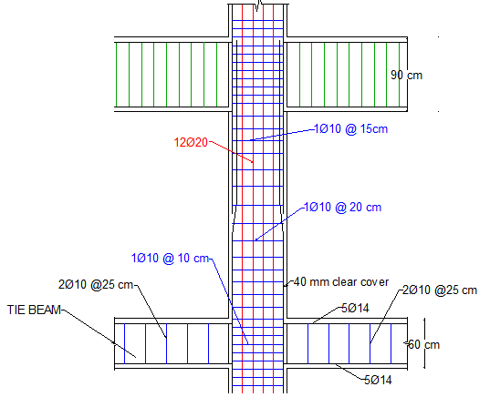
COLUMNS REINFORCEMENT

Slide 47
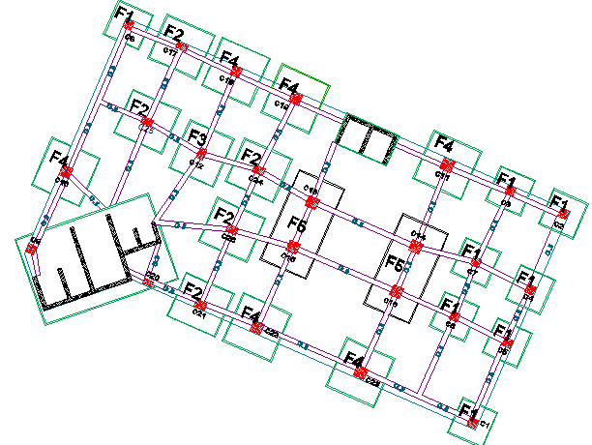
FOOTINGS REINFORCEMENT

Slide 48
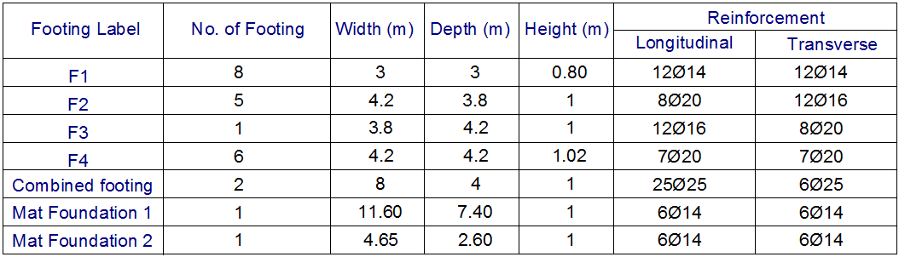
FOOTINGS REINFORCEMENT

Slide 49
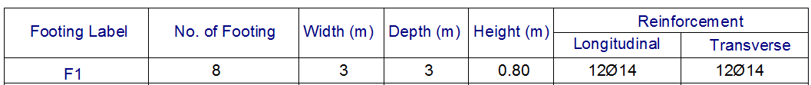
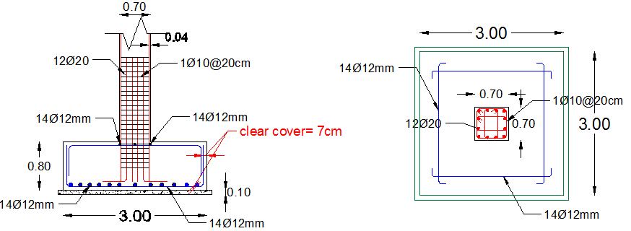
FOOTINGS REINFORCEMENT

Slide 50
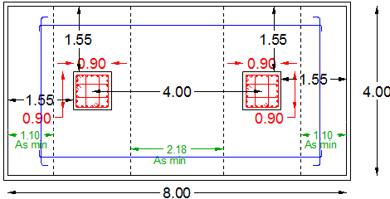
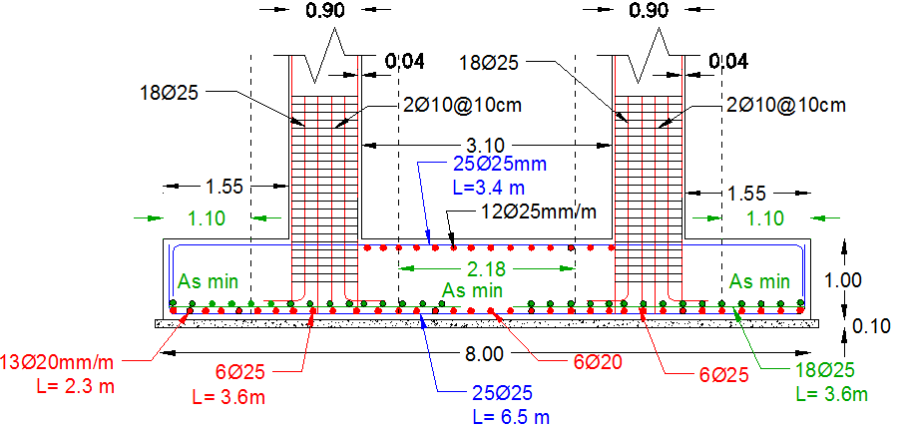
FOOTINGS REINFORCEMENT
Combined Footing:

Slide 51

STAIRS REINFORCEMENT
As min= 360 mm²→ 4Ø12/m

Slide 52

row house block design
3D MODEL

Slide 53
DESIGN DATA
Concrete f´c= 24 MPa for slabs and beams
Concrete f´c= 28 MPa for columns and footings.
Yielding strength of steel Fy= 420 MPa.
Allowable bearing capacity of soil= 400 KN/m².
Load :
Live Load=3.5KN/m²
Super imposed load = 6.21 KN/m².
Ca= 0.20
Cv= 0.20
Importance factor I=1
The structural type is Intermediate,
R= 5.5.

Slide 54


VERIFICATION OF MODEL
Compatibility Check.
Equilibrium Check.
Stress-Strain Relationship.
Deflection Check.
Period Check.
Drift Check.
Modal participation mass ratio.

Slide 55

SLAB DESIGN
One way ribbed slab with hidden beams
Thickness of slab 30 cm.

Slide 56


Beams design

Slide 57



beams REINFORCEMENT
Beam | Depth (cm) | Width (cm) | Top Edge | Top Middle | Top Edge | Bottom Edge | Stirrups
2CB2 | 30 | 40 | 2Ø20 | 2Ø14 | 2Ø14 | 2Ø18 | 1Ø10@130 cm
2CB9 | 30 | 40 | 2Ø20 | 2Ø14 | 2Ø14 | 3Ø14 | 1Ø10@130 cm
SECTION A-A

Slide 58



COLUMNS REINFORCEMENT

Slide 59

Columns and footing layout

Slide 60



FOOTINGS REINFORCEMENT

Slide 61




FOOTINGS REINFORCEMENT
Mat footing
SHEAR WALL REINFORCEMENT

Slide 62
MECHANICAL
DESIGN

Slide 63
General
Mechanical design of a building involves :
1. Water Supply System Design.
2. Drainage System Design.
3. HVAC System Design.

Slide 64
WATER SUPPLY SYSTEM
We've divided the building into three blocks and compute the sizes of the pipes for main vertical feeder, main horizontal feeder and branches for block A.

Slide 65


Water supply for BEDROOMS Floor

Slide 66
Water supply
Pipes Diameters for block A:
Diameter for vertical feeder → (2.5 inch)
Diameter for horizontal feeder → (1.5 inch) for basement floor .
Diameter for Branches → ( ¾ inch) for basement floor.

Slide 67





Water supply
Large-size Underground water tank :
6*5*3 m³ volume
Capacity =90 cubic meter.
Small 22 (1*1*1) m³
water tanks on the roof.
Pump between the underground tank and the small tanks on the roof

Slide 68

Water supply
Hot Water supply:
ETC-30 Evacuated solar system and boilers for heat water.
Roof area = 1860 m² expanded to 100 ETC-30 (1.86m*2m)
Mass of heat water = 22040 litter per day
40% of Heat water using ETC- 30 tube
60% of heat water using boilers.

Slide 69
Drainage System
Drainage fixture units:
WC: 4Dfu`s
Shower: 2Dfu`s
Sink: 2Dfu`s
Kitchen sink: 2Dfu`s

Slide 70

Drainage and manholes for basement

Slide 71


Dark water manholes
Grey water manholes

Slide 72


Drainage for bedroom floors

Slide 73
HVAC System
For HVAC design, VRF system has been used for bedrooms and VRF with VAV systems has been used for other facilities like restaurant and wedding hall.

Slide 74

Hvac indoor units
Curved units has been used in restaurant and wedding hall

Slide 75


Spot units “4 way cassette” has been used in corridors.
and wall mounted units has been used in bedrooms.

Slide 76

Horizontal fan coil units with different sizes has been used.

Slide 77
hvac calculation
18 indoor units (capacity of 7.1KW) are used for each bedroom floors.
11 indoor units are used for corridors for the same floor.
zone | area(m²) | Q(KW) | number of units
room1 | 65 | 5.12 | 1
room2 | 65 | 5.12 | 1
room3 | 65 | 5.12 | 1
room4 | 86 | 6.52 | 1
room5 | 86 | 6.52 | 1

Slide 78


Hvac plan for wedding hall and restaurant

Slide 79


HVAC plans for bedroom floors

Slide 80
ELECTRICAL
DESIGN

Slide 81

ELECTRICAL DESIGN
Lamps used in wedding hall.

Slide 82

ELECTRICAL DESIGN
Uniformity in wedding hall

Slide 83

ELECTRICAL DESIGN
Uniformity in wedding hall

Slide 84


ELECTRICAL DESIGN
Views for wedding hall

Slide 85


ELECTRICAL DESIGN
Views for restaurant

Slide 86


ELECTRICAL DESIGN
Views for bed room

Slide 87

ELECTRICAL DESIGN
Wedding hall and restaurant lighting plan

Slide 88

ELECTRICAL DESIGN
Bed room lighting plan

Slide 89

ELECTRICAL DESIGN
Wedding hall and restaurant socket plan

Slide 90

ELECTRICAL DESIGN
Bed room socket plan

Slide 91

ELECTRICAL DESIGN
Circuit breaker

Slide 92
SAFETY
DESIGN

Slide 93




Safety Signs used and distributed in the hotel
Exit Signs
Elevators should not use in case of fire or earthquake
Fire Exit Signs On Stairs

Slide 94


Safety Signs used and distributed in the hotel
First Aid
Fire Proof Door
BMS room
(Building Management
System )

Slide 95





Fire Protection system
Smoke detectors
Heat detectors
Fire hoses
Sprinklers
Fire extinguishers

Slide 96







Fire Protection system plan for basement floor

Slide 97





Evacuation plan for ground floor

Slide 98
QUANTITY SURVEY

Slide 99
Cost estimation
Type of work | Cost (NIS)
Earth Work | 1,208,197
Structure Work | 18,374,988
Architecture Work | 10,438,429
Mechanical Work | 4,453,840
total cost | 34,041,977
cost/area | 2,232NIS/m²

Slide 100
THANK YOU

