Slide 1
Young & Beautiful
Mohammad Salhi
Safwan Abu Hamra
Dr. Loai Malhis

Slide 2
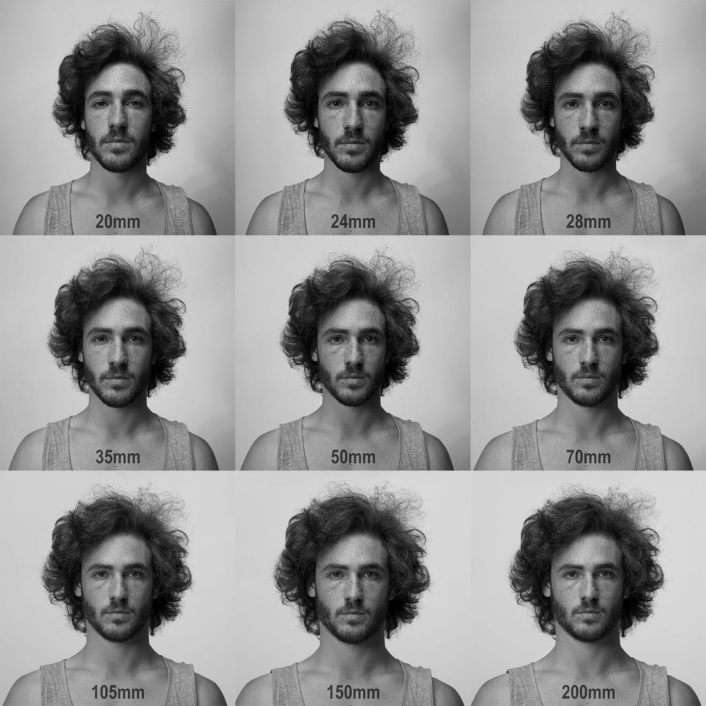
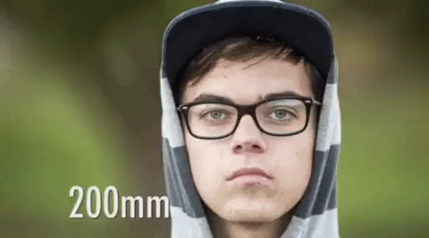
The focal length of a Selfie camera

Slide 3
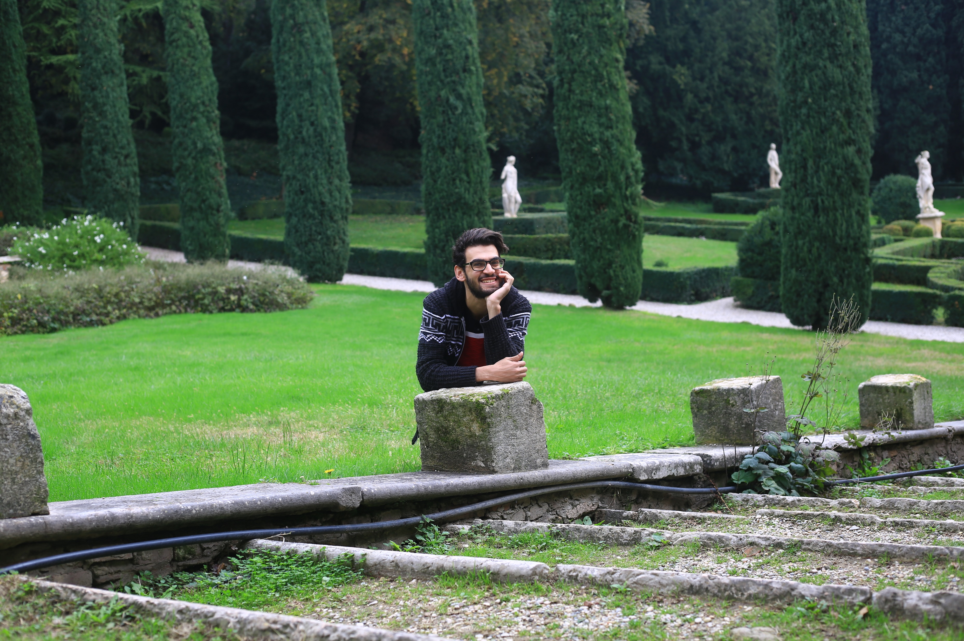
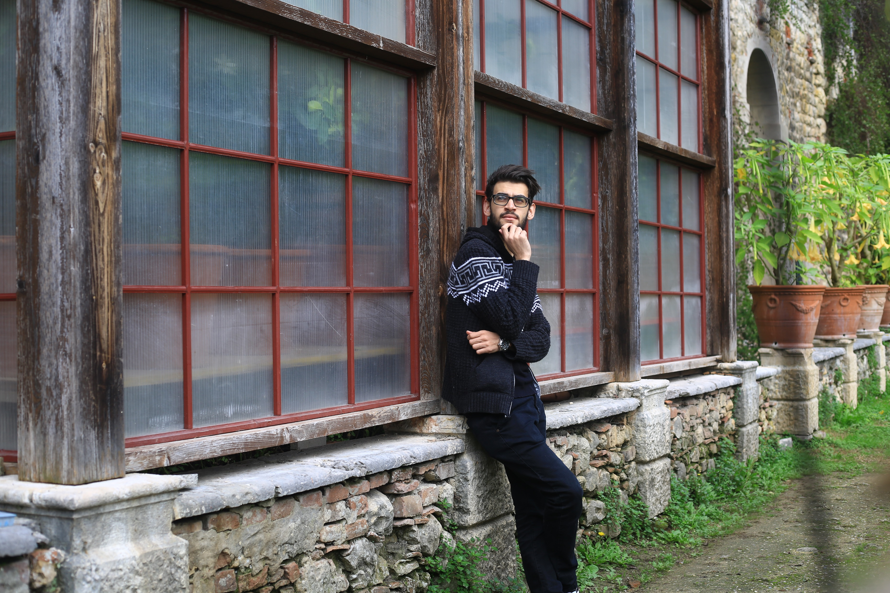
The front camera

Slide 4
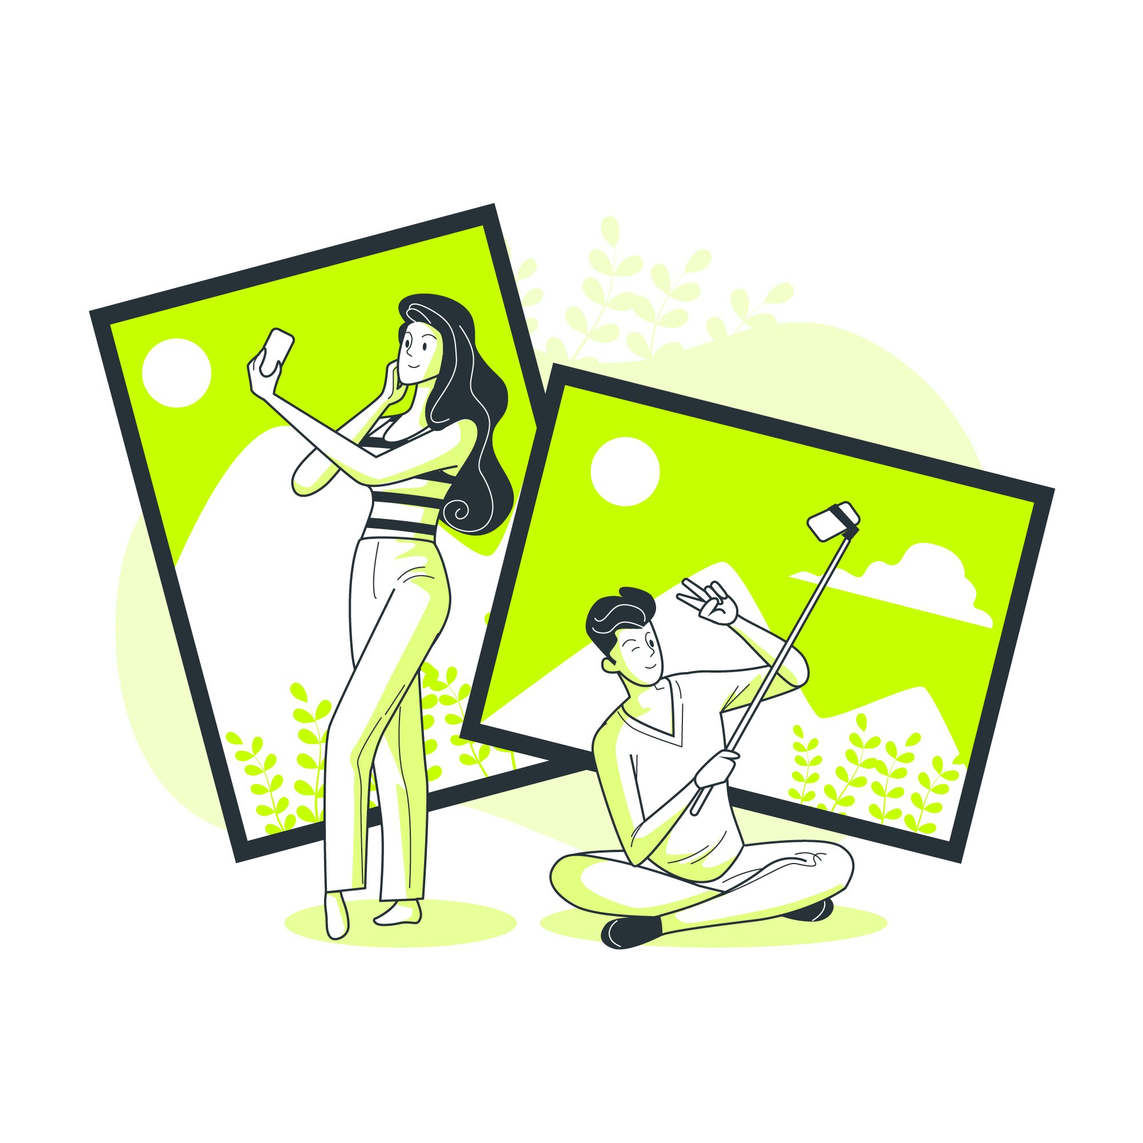
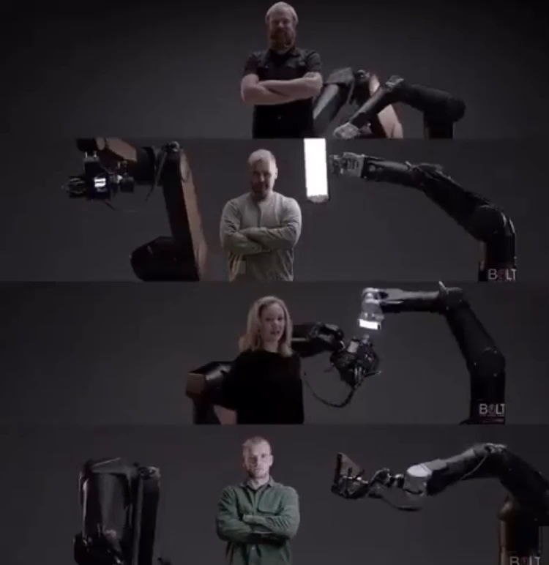
So What is this about ?
Taking a selfie of course !
Without the Aid of external people
At perfect positioning

Slide 5
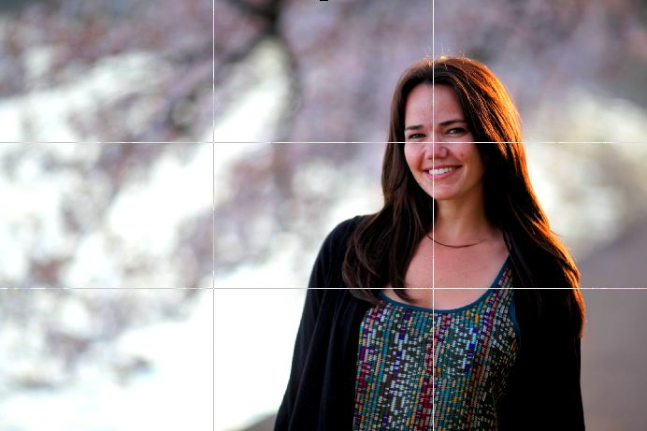
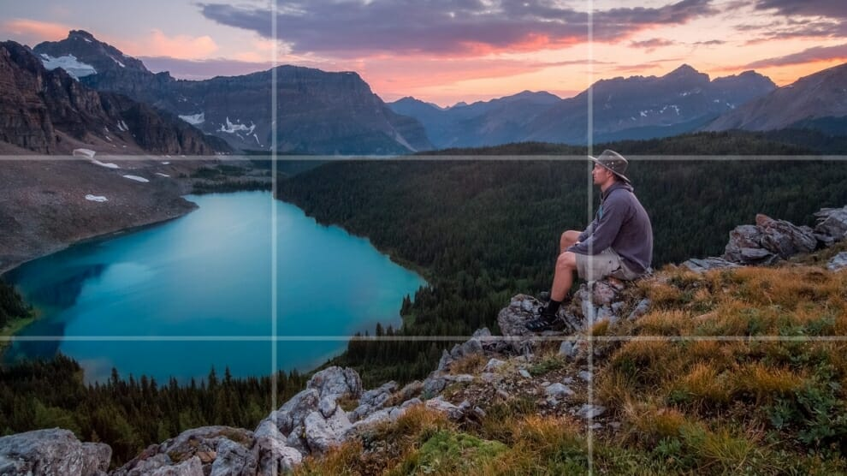
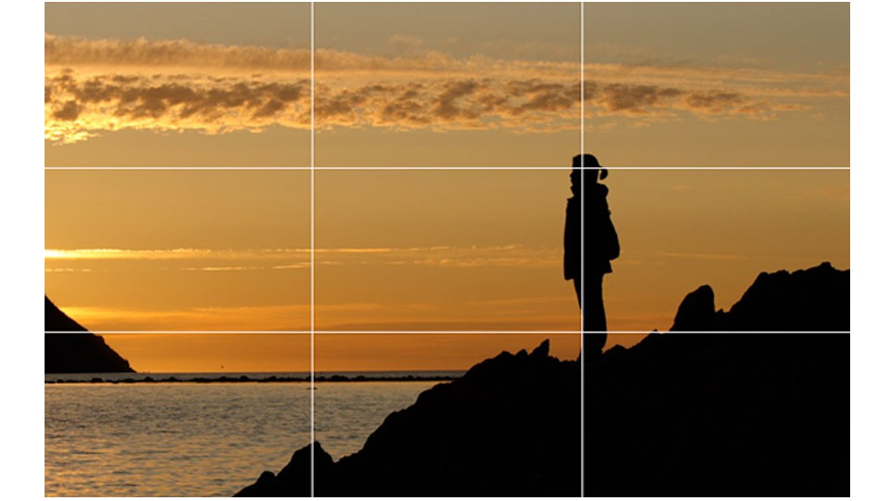
Rule of Thirds
Putting you where you want

Slide 6
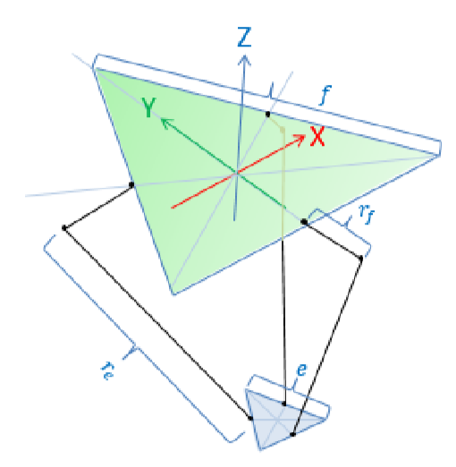

How did we do it ?
Delta robot model
Face detection technique

Slide 7
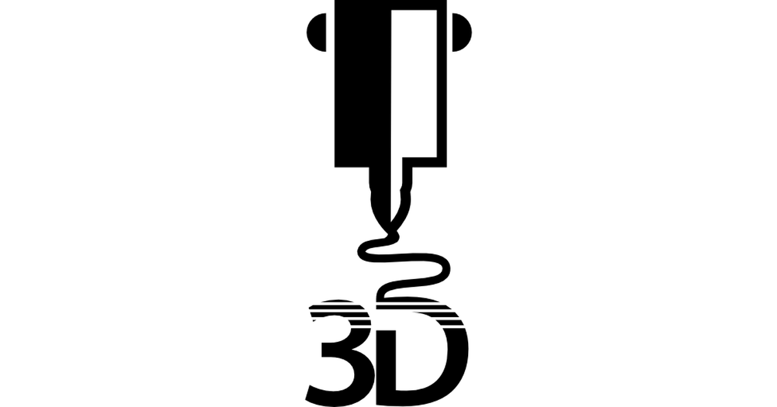
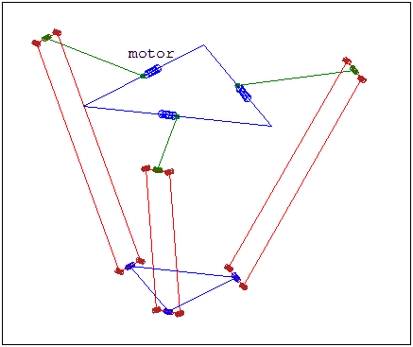

Delta robot

Slide 8
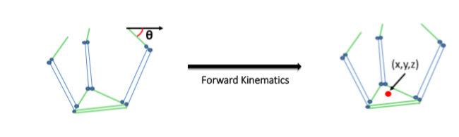
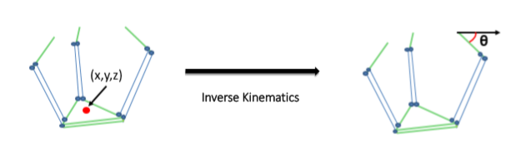
Delta robot algorithm

Slide 9
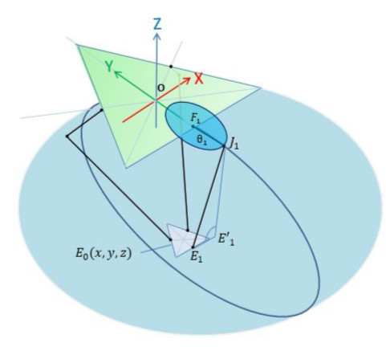
Inverse kinematics

Slide 10
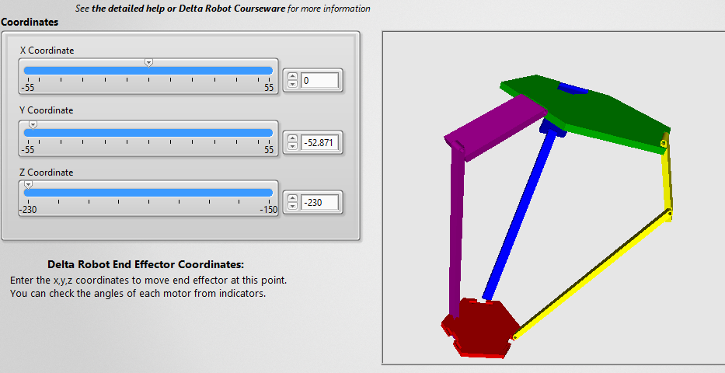
Ranges of values

Slide 11
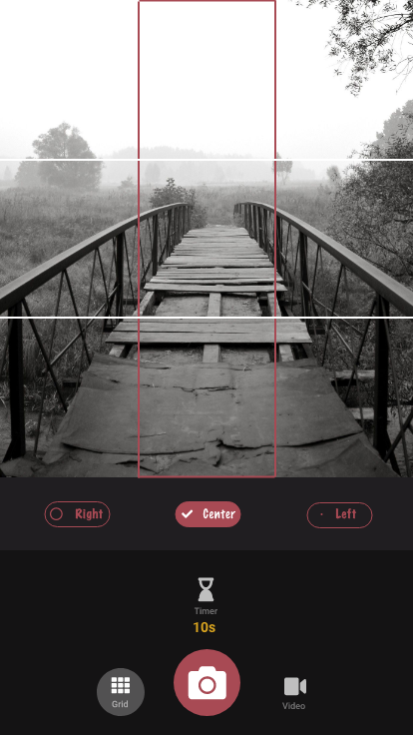
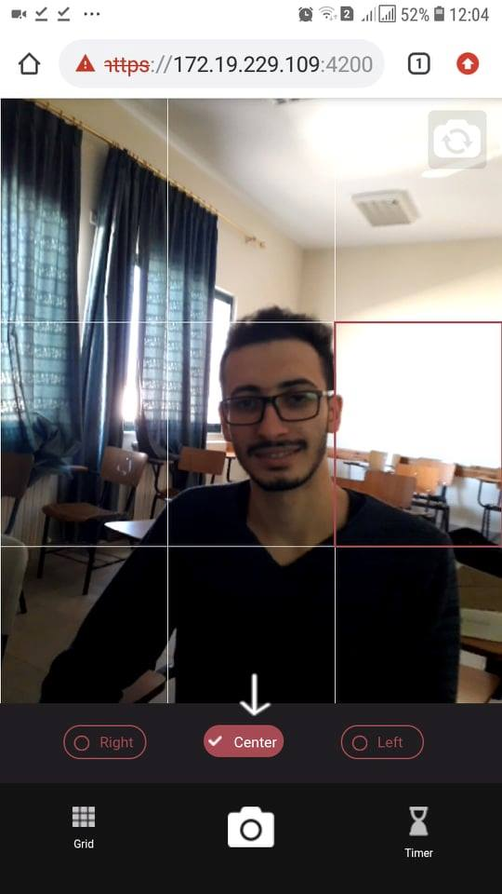
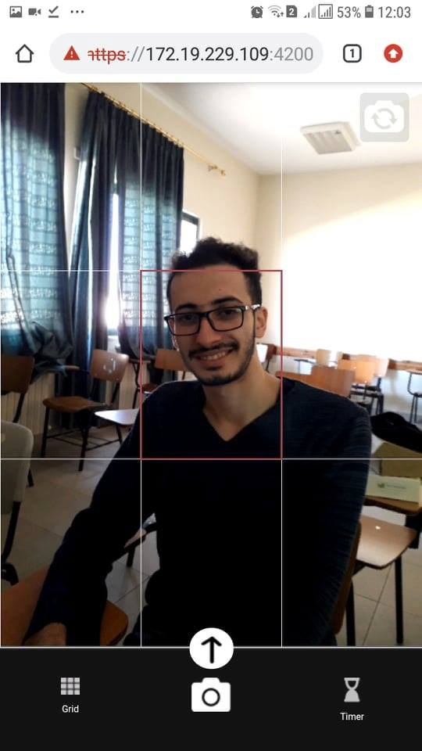
The app layout

Slide 12




Slide 13

The flow of the program

Slide 14
constraints
The weight
The mathematics
Shape of the app

Slide 15
Future work
The algorithm
Panorama
Z- dimension
Video capturing
A stand-alone app
A group selfie

Slide 16
Thank You
&
Happy Shooting

