Slide 1
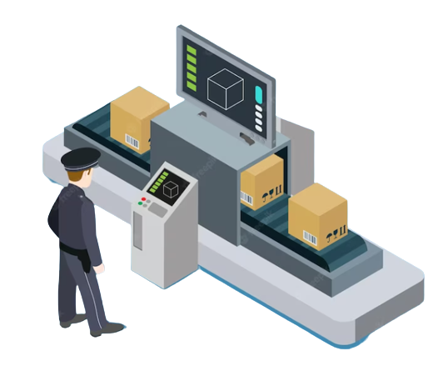

Sorting Master

Slide 2
CONTENTS
What is
Problems and objectives
Implementation
Constraints
Future work
2023

Slide 3



What is ?

Slide 4

What Is Sorting Master?
Certain industries face challenges in efficiently categorizing and organizing goods based on their country of manufacturing. Because it takes more time and effort, this frequently results in an increase in operational stress, which may lead to lower productivity and a lack of streamlined operation.
The ”Sorting Master” proposed by our concept aims to solve this issue by providing a sorting machine. This device improves the classification procedure by offering a system for classifying goods according to their geographic location of manufacturing.

Slide 5

Problem and objectives

Slide 6

Problem
The aim of the sorting machine project is to efficiently sort diverse objects according to their country of manufacture. The project attempts to improve and streamline the sorting process because traditional sorting involves a lot of time and effort.

Slide 7

Objectives
The objectives of the project are as follows:
Develop a tag scanning-based automated sorting system that efficiently and accurately classifies goods according to the country of manufacture. | Include a wireless control system using the ESP32 that enables users to remotely turn on and off the sorting device, offering simplicity and flexibility in use.
Create a web page interface to show the device's state, including whether it is on or off and giving current information on the number of sorted packages using an IR sensor. | Include an LCD display that displays each package's manufacturing country as it moves through the sorting process to provide immediate visibility.

Slide 8

Implementation

Slide 9

Hardware components

Slide 10

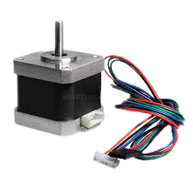
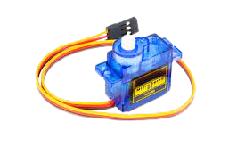
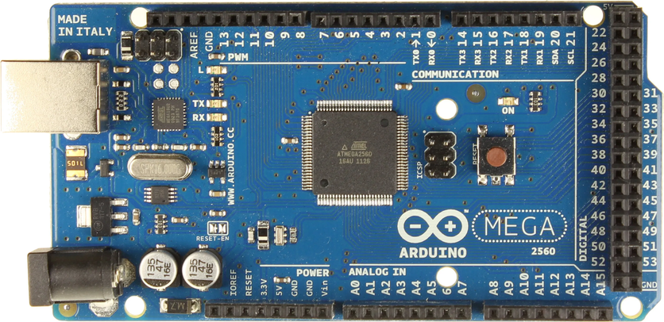
Arduino
Stepper motor
Servo motors

Slide 11
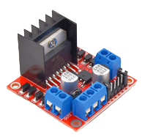
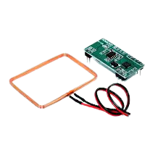
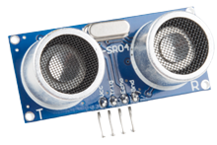
RFID-RDM6300
Ultrasonic Sensor
L298N Driver

Slide 12
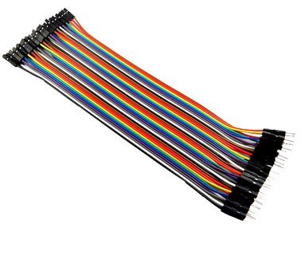
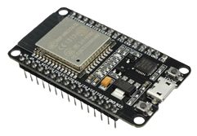

Jumper Wires
Infrared Sensor
ESP32 WROOM 32

Slide 13
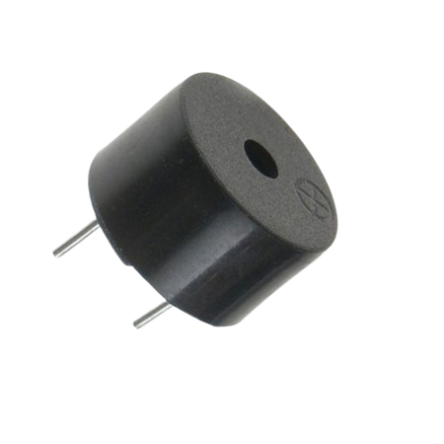
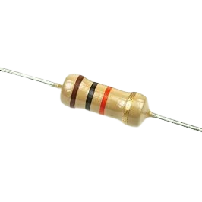
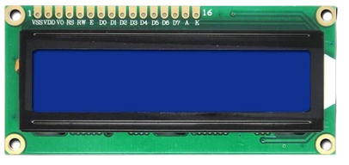
10k ohm resistor
LCD 2*16 Display
Buzzer

Slide 14
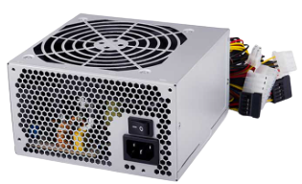
Power Supply

Slide 15


Software
and
Control

Slide 16
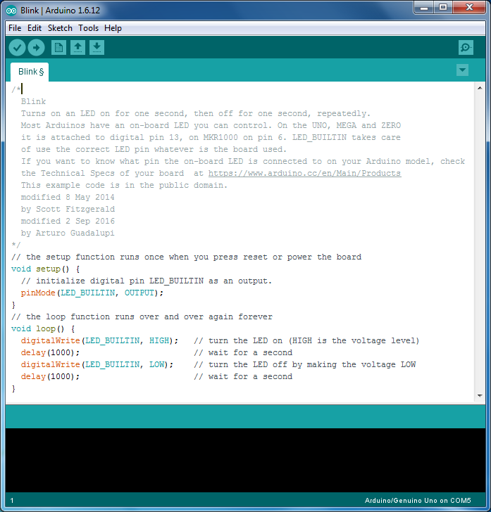


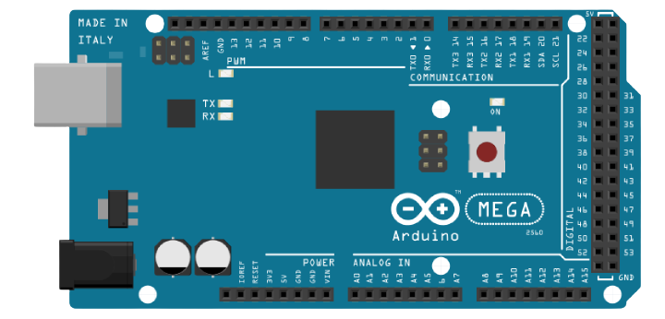
Arduino IDE

Slide 17
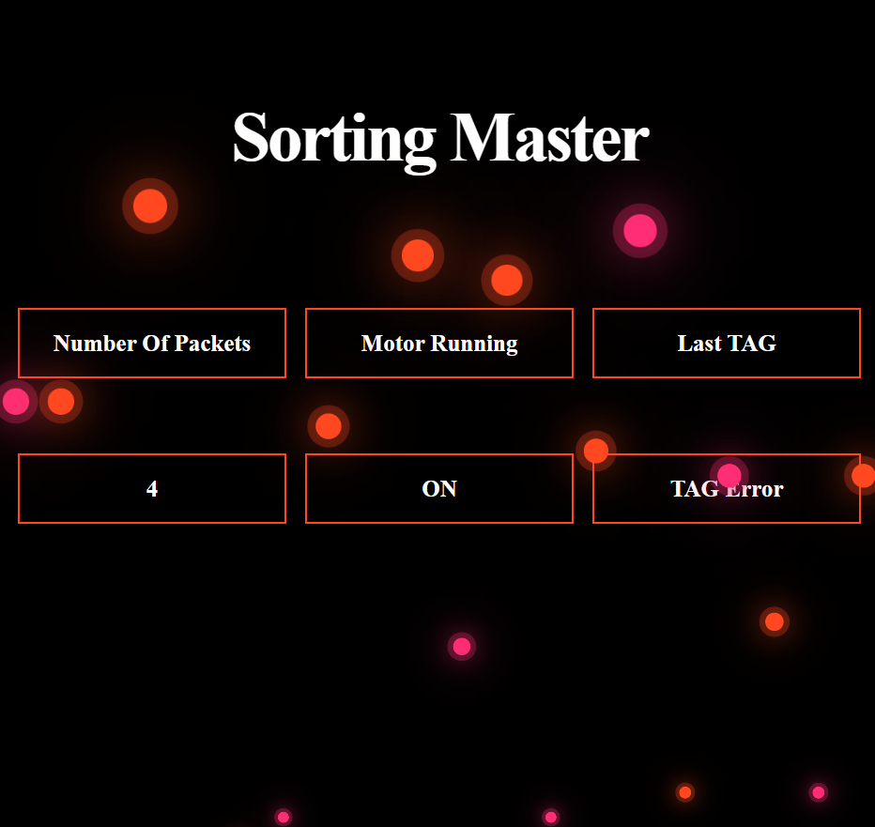

Serial Bluetooth Terminal

Slide 18

Constraints

Slide 19


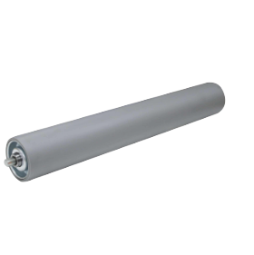
RFID-RDM6300
The Rodes Of The Belt
Time

Slide 20

Future Work

Slide 21




Camera-Based Barcode Recognition System
Robotic Arm for Sorting Process

Slide 22



Our Team Members
Taima Nizar Hamadneh
Areen Naser Jawabreh

Slide 23


