Slide 1

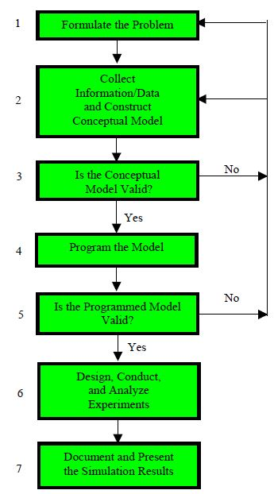
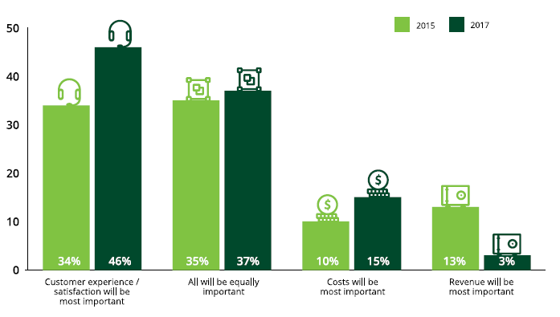
Discrete Event Simulation in Mada Al-Arab Call Center
“The method that proceeds without analysis is like the groping of a blind man.”
—Socrates
Abstract
Methodology
Results
In this project, we managed to develop a new key performance indicator (KPI) system that is more related and in line with the international standards. The first KPI is waiting time, which is equal to 40 seconds; according to the findings, we observed that approximately 80% of the customers still needed to wait longer than 40 seconds. For that reason, we identified that a standard of 40-second average hold time was acceptable. The second KPI is abandonment rate.
We found that this indicator, which was approved by the company, was equal 15%. We also conducted a terminating simulation to the most hours that did not meet the standards of the new KPI system. Those hours were from 5 p.m. to 11 p.m. We found, as suggested by help center website, that the maximum agents needed was 11 agents in the early shift. However, in our case we found that the number of agents in the same shift was 12 agents. It turned out that one agent from the early shift had changed his schedule so can he work in the late afternoon shift. By this change, we observed that the average hold time reduced by 15 % and abandonment rate by 27%
Customer experience rises to the top
Prepared by
Yousef Jaradat
Mohammad Hijawi
Supervisor
Eng. Tamer Haddad
This is a caption. You can replace the image and edit this text here.
Notes:
You can add your presentation notes here. This presentation template for research posters is fully editable so text, graphics and content can be updated to fit your own research needs.
Download more poster presentation templates from FPPT.com

