Slide 1
HEMOGLOBIN
GRADUATION PROJECT
PREPARED BY : AHMAD IBRAHIM
SUPERVISOR : DR.OTHMAN OTHMAN

Slide 2
CONTENTS
1
4
INTRODUCTION
FEATURES
2
5
WHAT IS THE PROPLEM ?
FUTURE WORK
3
6
THE SOLUTION
TECHNICAL

Slide 3

INTRODUCTION
Hemoglobin is an application that serves Nablus laboratories, as it saves the patient's time, coordinates all test matters, and also helps employees in arranging appointments and speeding up work.

Slide 4
WHAT IS THE PROPLEM?
The problem was that the patient felt difficult to go to the laboratory and wait for a period of time until the sample was taken and also wait to get the result or come back again to take it and also he may not know how much money he needs for the tests he wants.
?

Slide 5



After searching and asking the laboratories about the characteristics it needs to solve that, I succeeded in creating My application, which I called Hemoglobin, to solve these problems.
ASK
SEARCH
CREATING
THE SOLUTION

Slide 6
PATIENT FEATURES
.
1 APPOINTMENTS
Book appointments for tests.
2 PRICE
know the price list for each examination.
where there are notifications reminding you of booking an hour before your appointment.
3 NOTIFICATIONS
The patient can see his own results.
4 RESULT

Slide 7
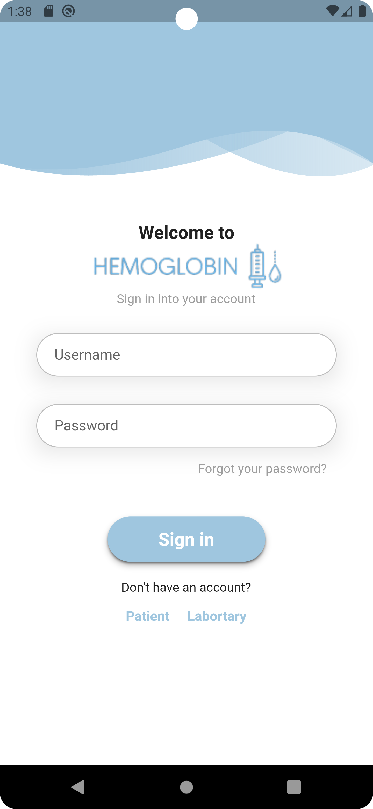
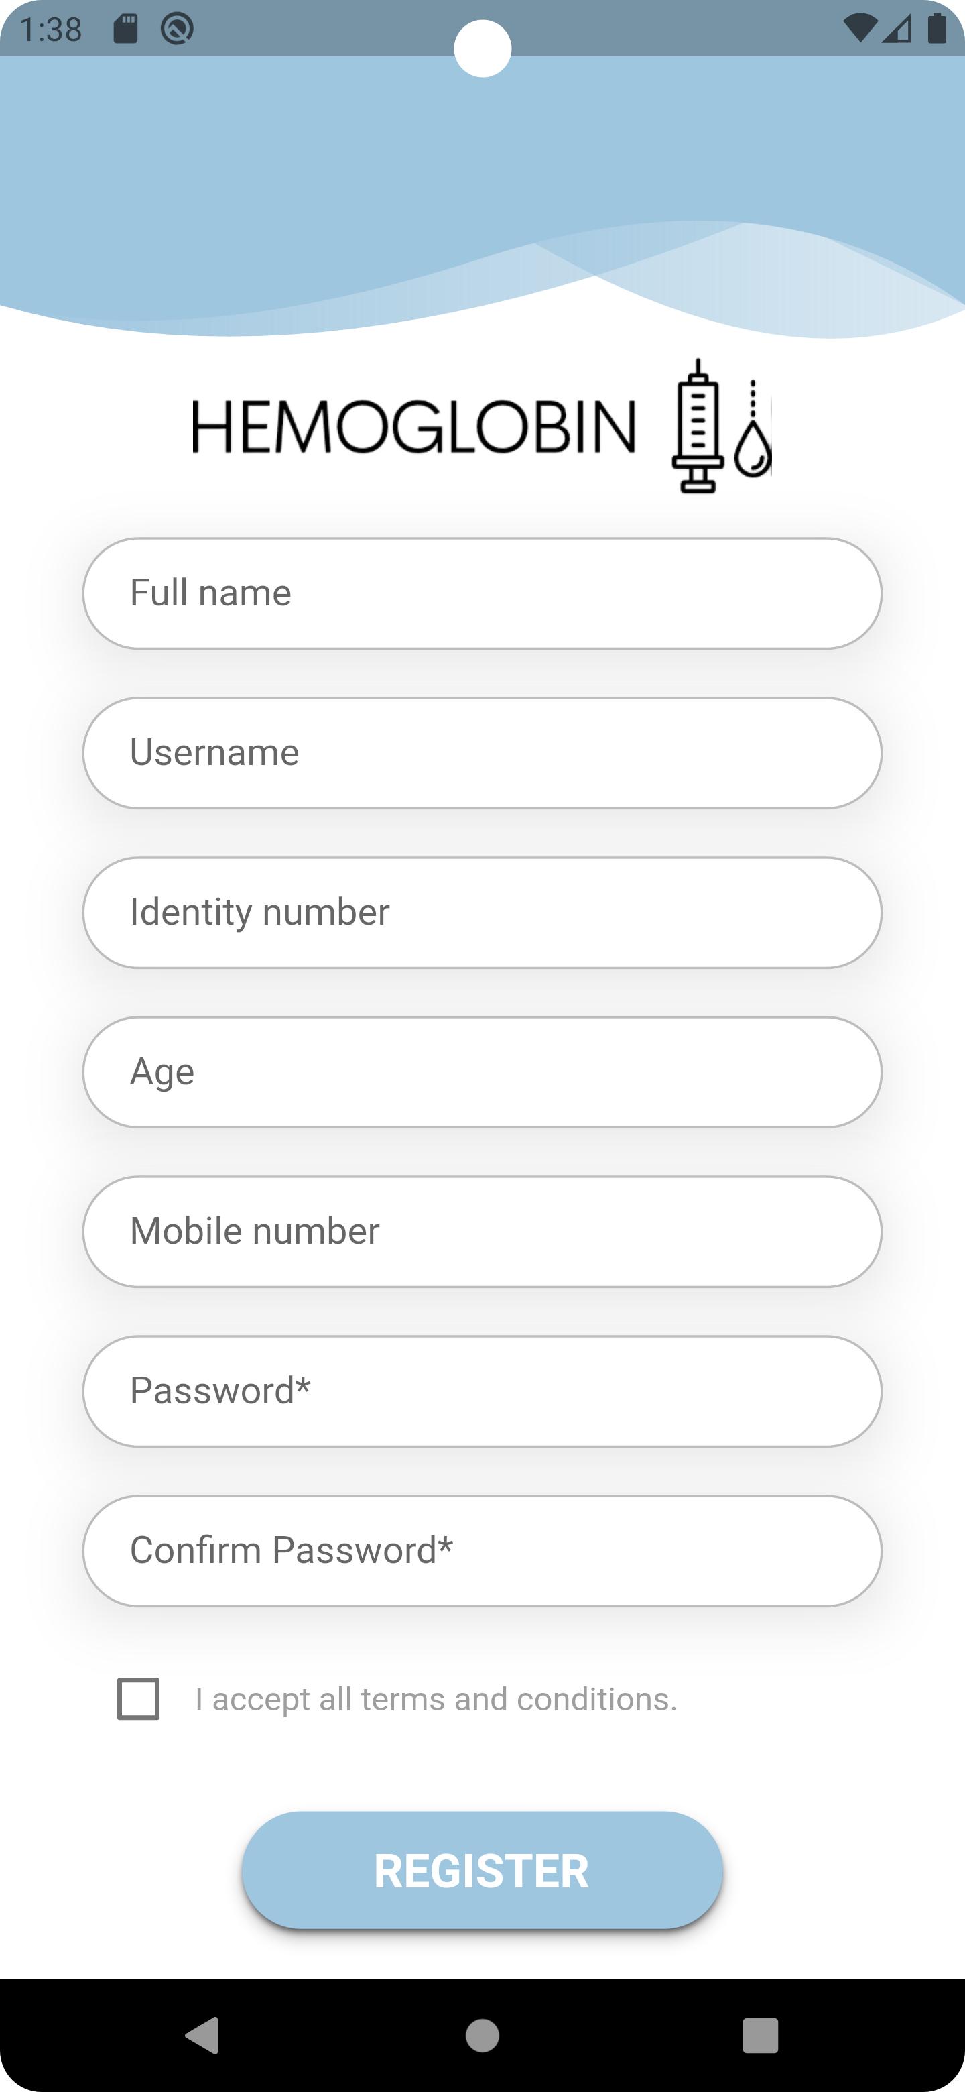

Slide 8
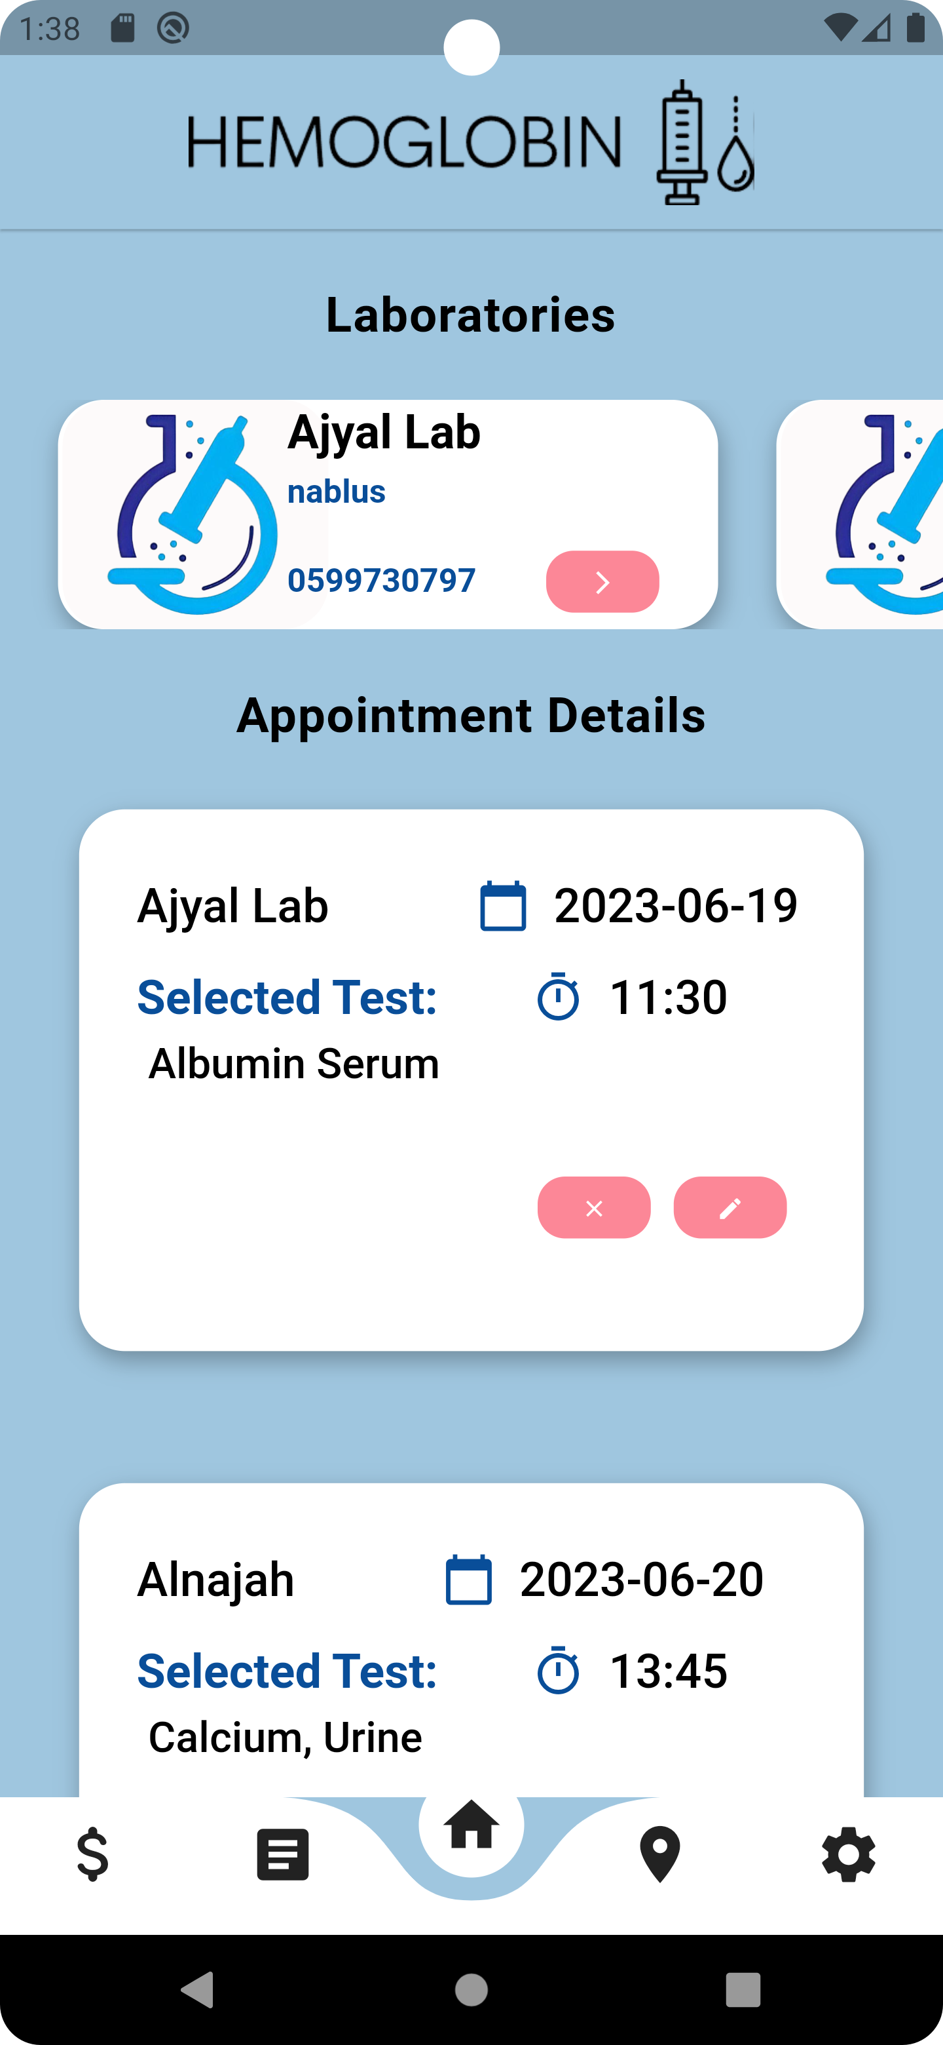
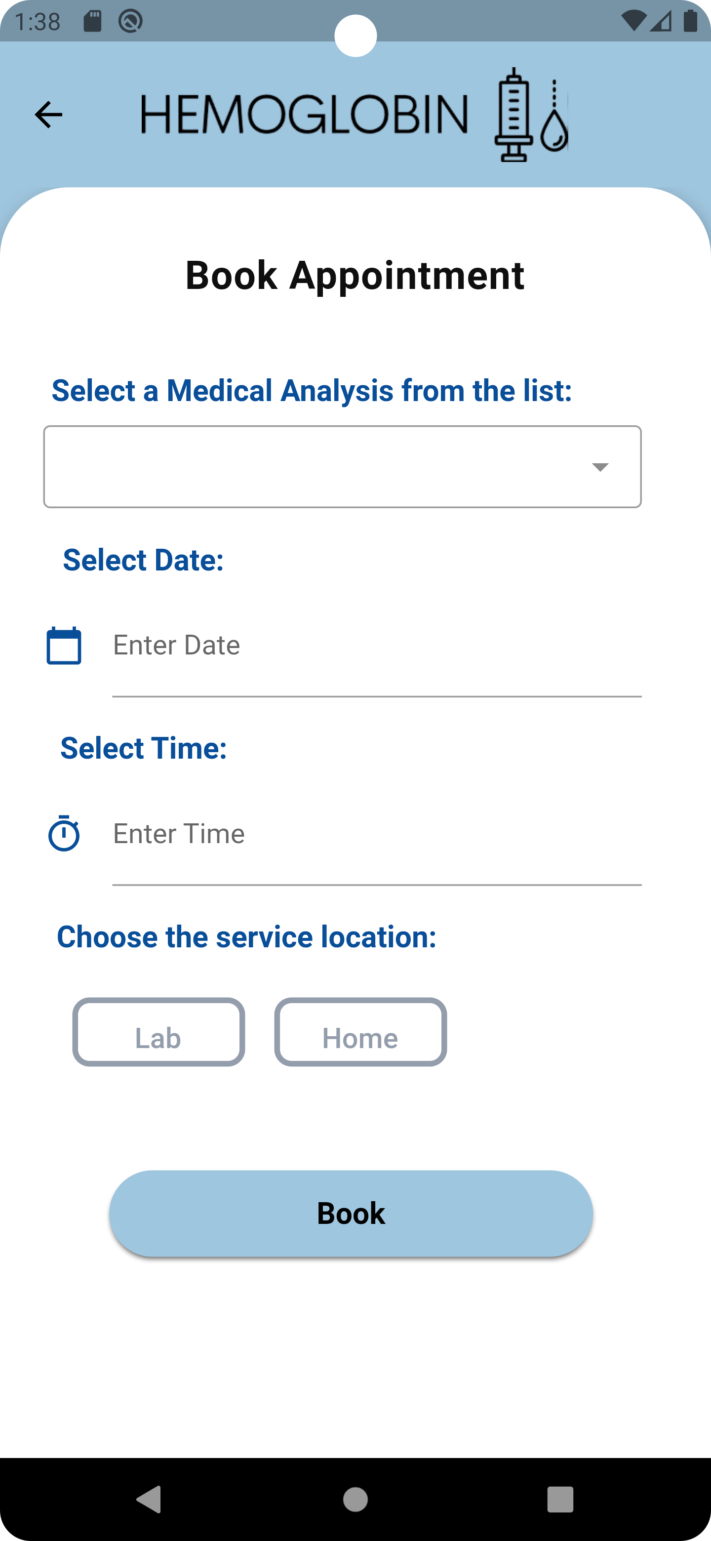

Slide 9
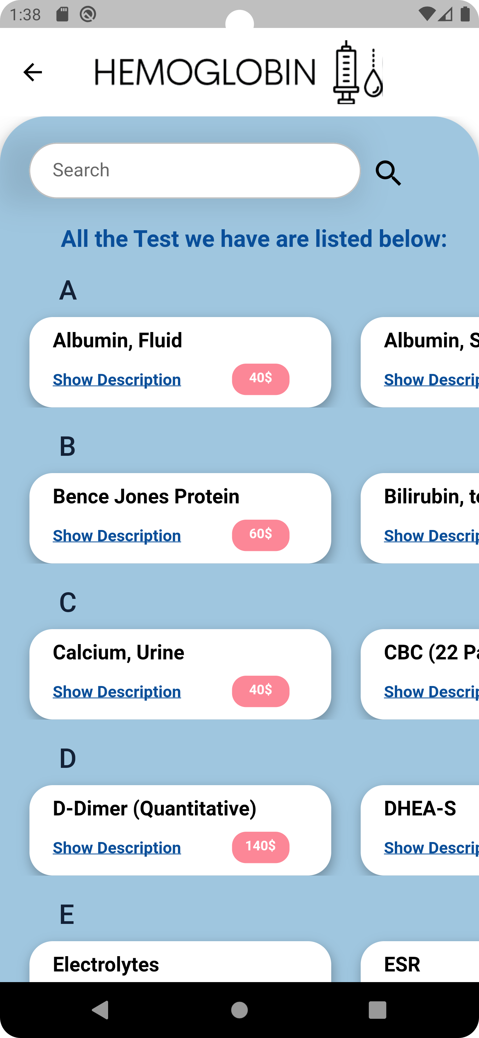
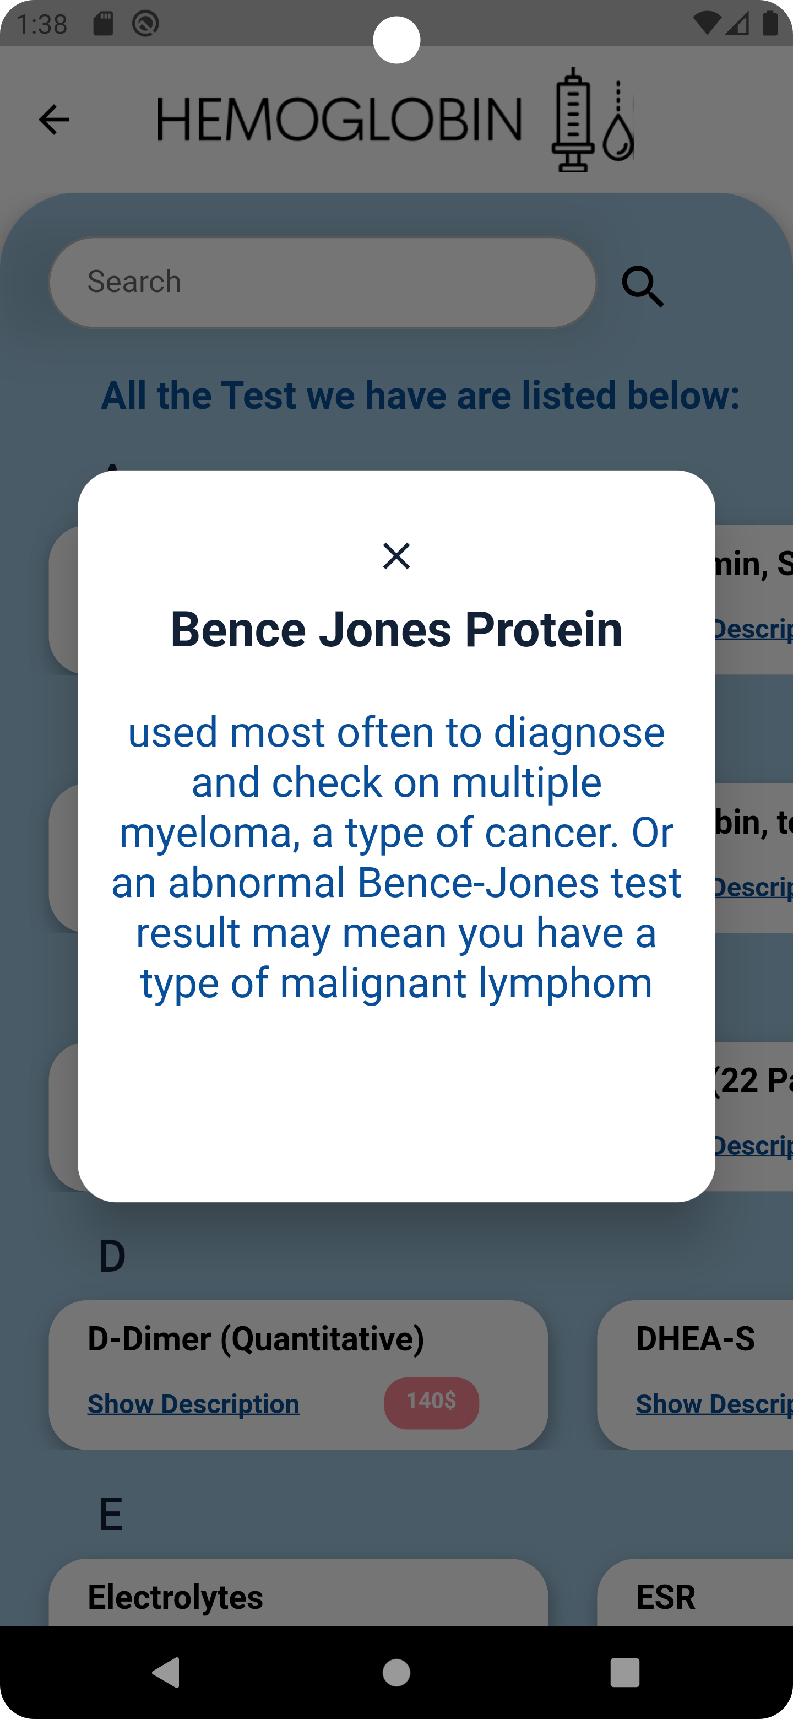

Slide 10
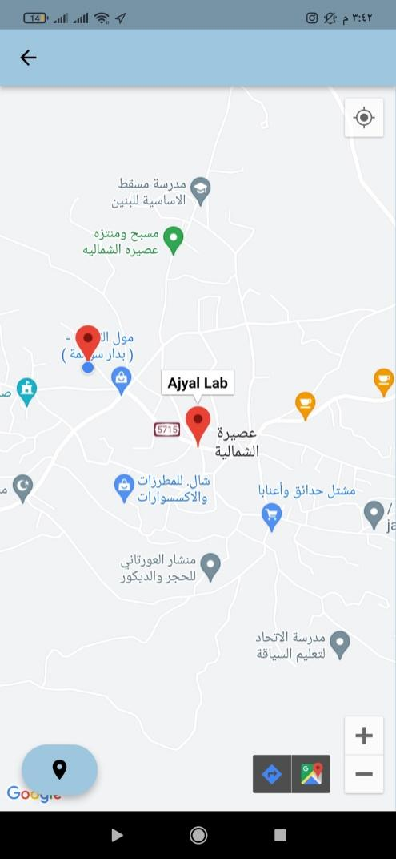
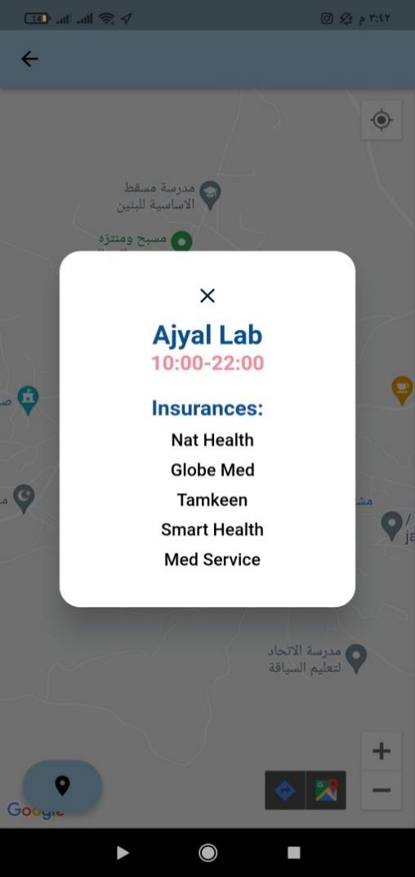

Slide 11
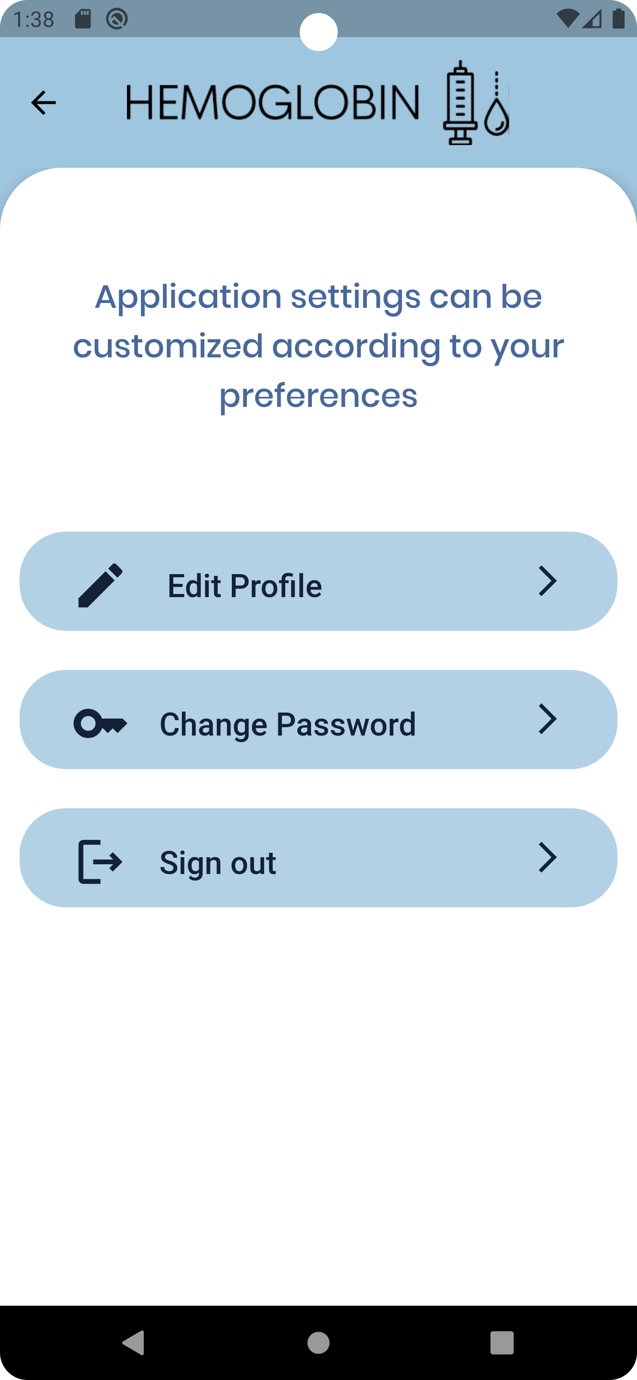
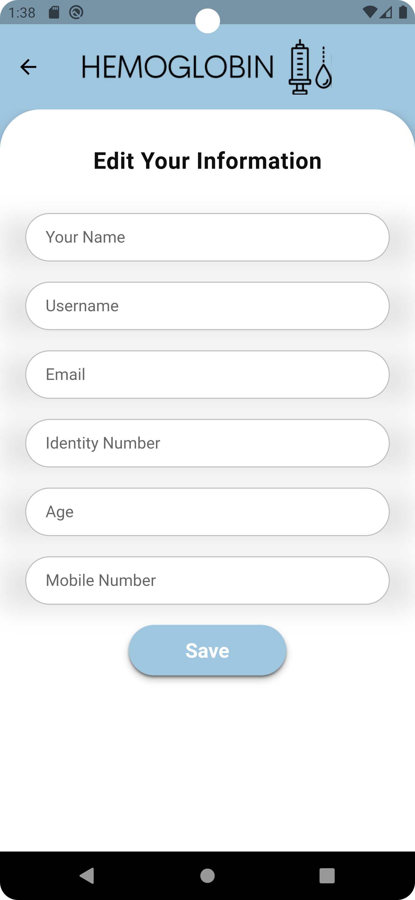
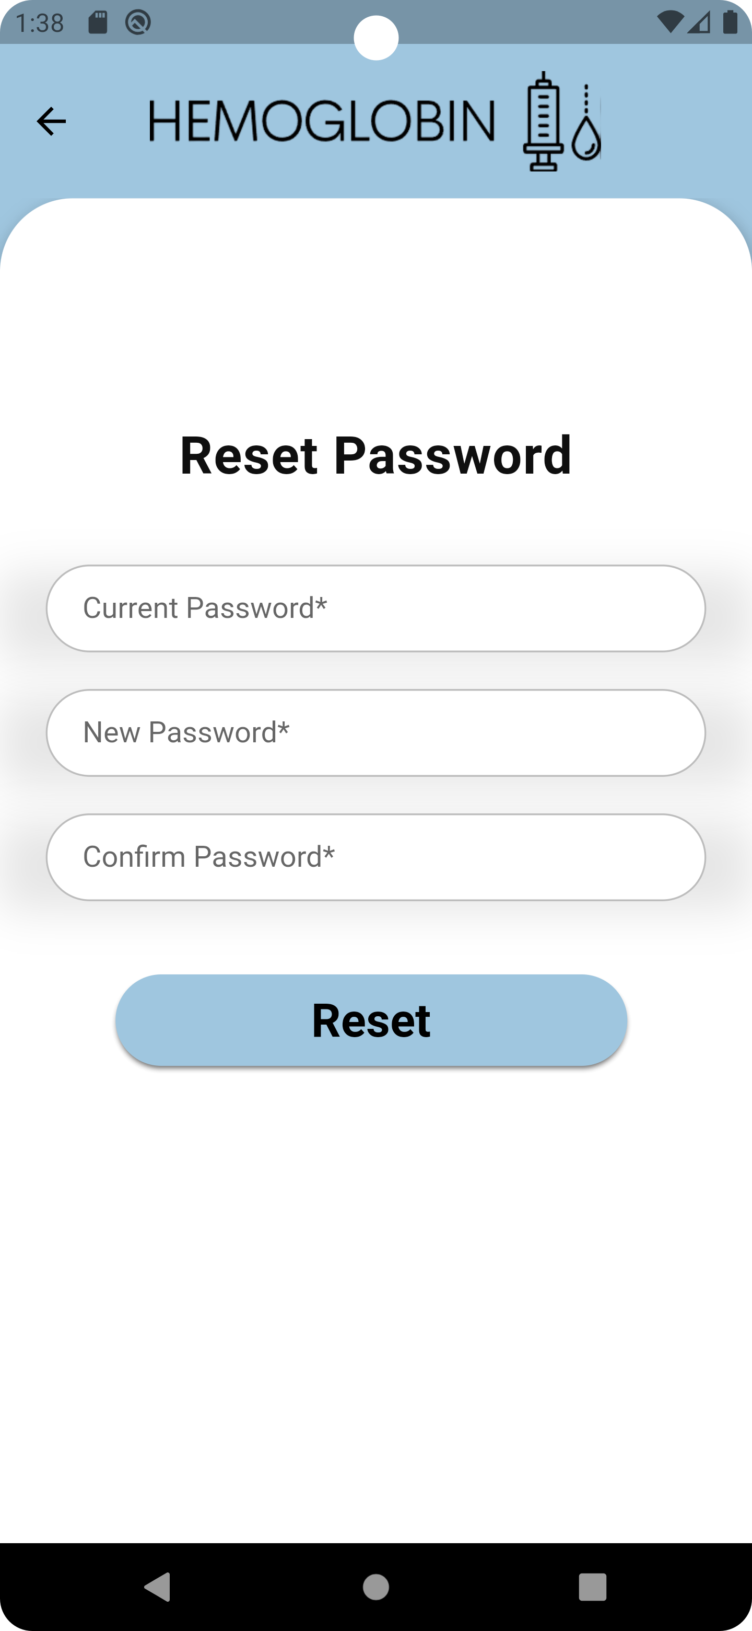

Slide 12
EMPLOYEE FEATURES
.
can view the details of the reservations made by the patient for his laboratory.
1 RESERVATIONS
He has a record of patients, their details, and the results of their examinations.
2 RECODRS
send results to patients.
3 RESULTS

Slide 13
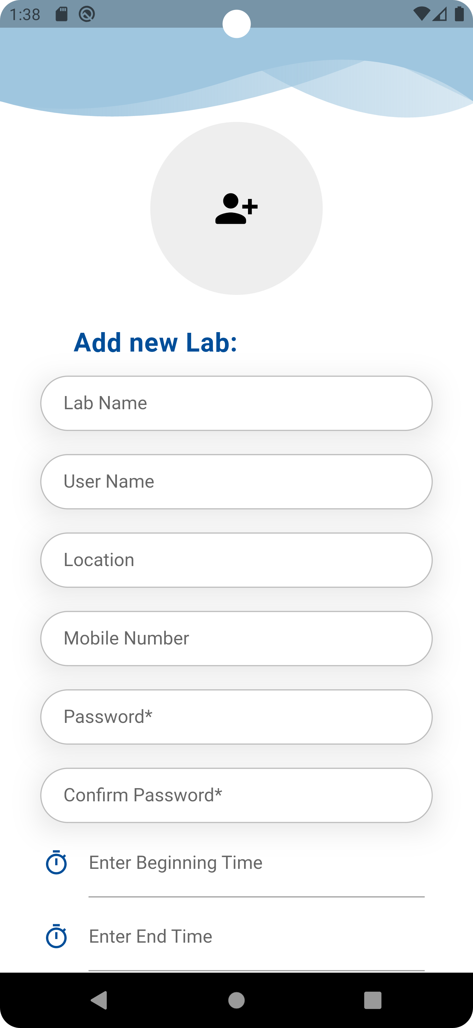

Slide 14
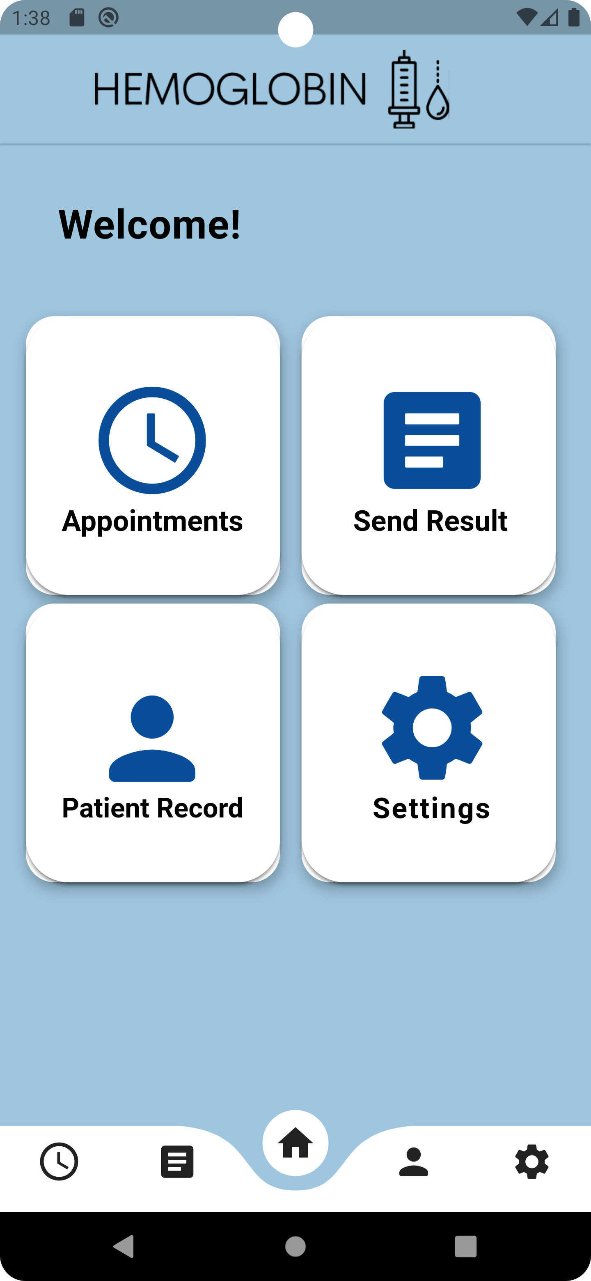
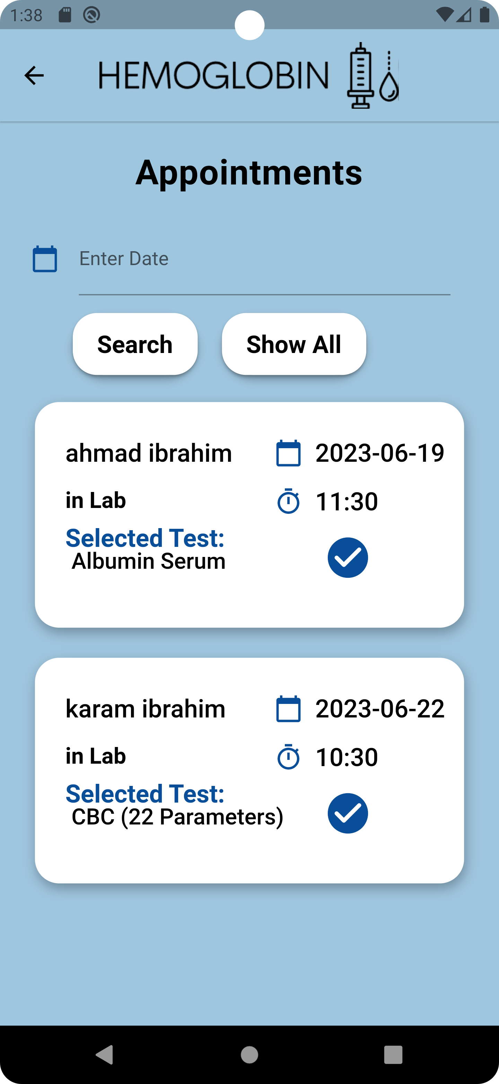

Slide 15
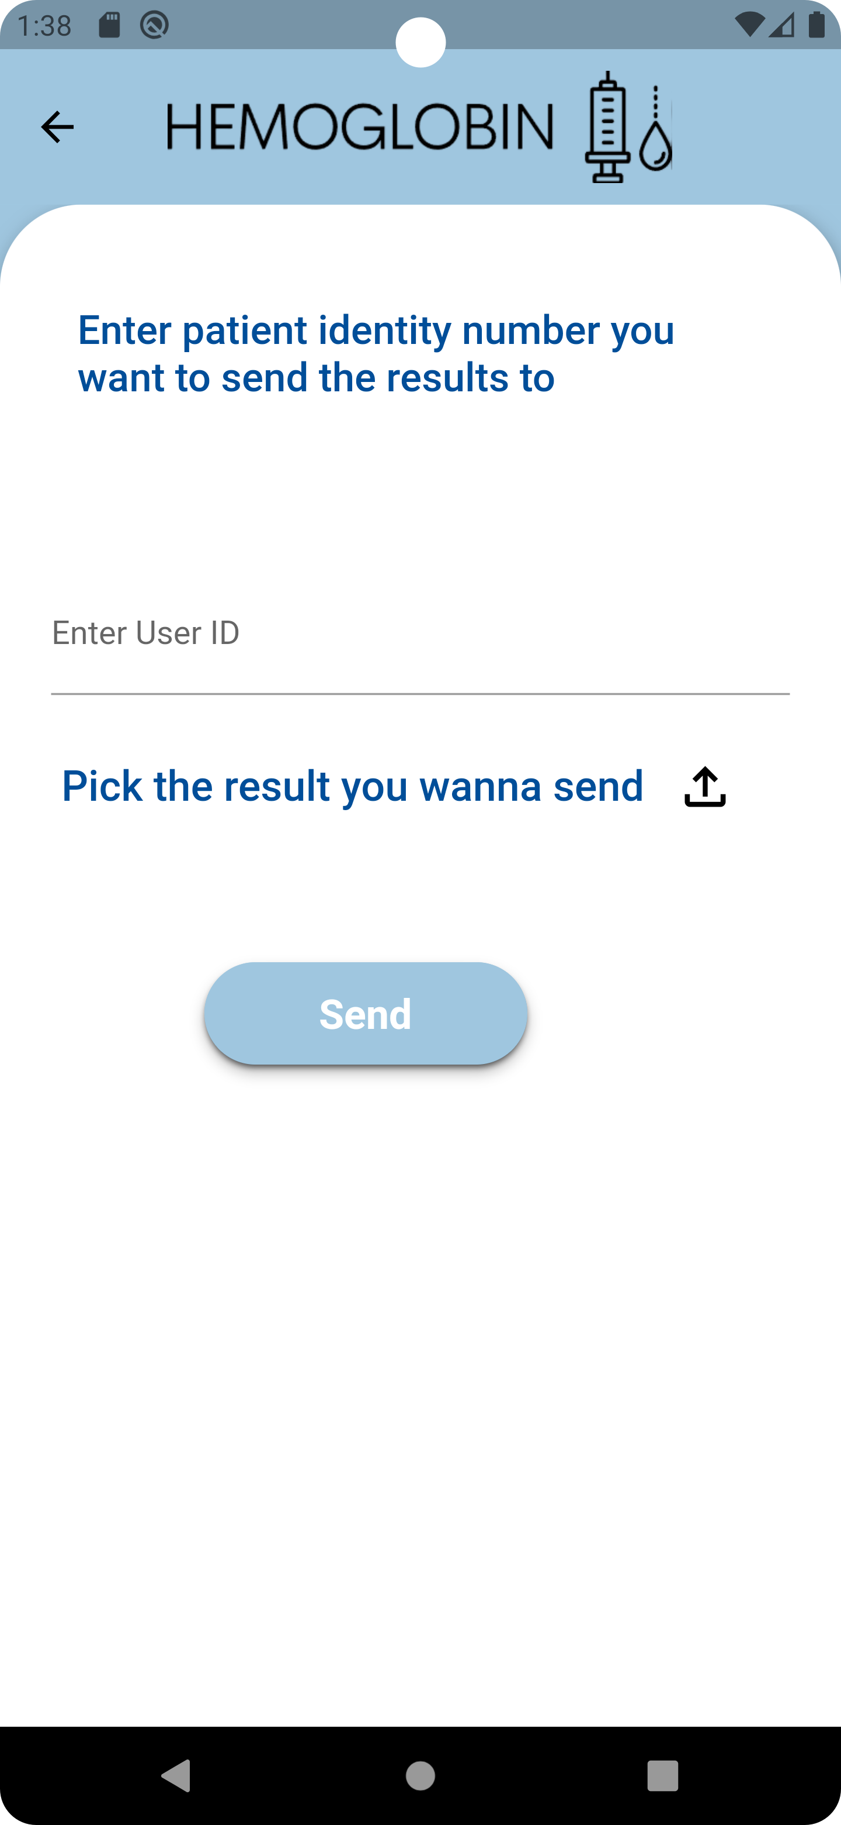
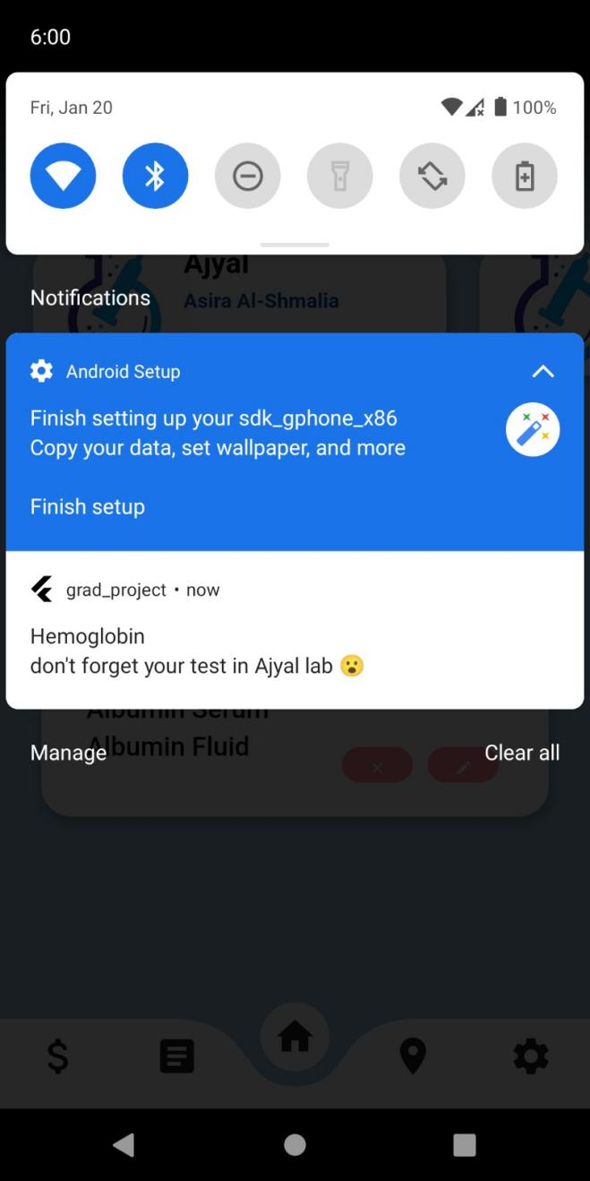

Slide 16
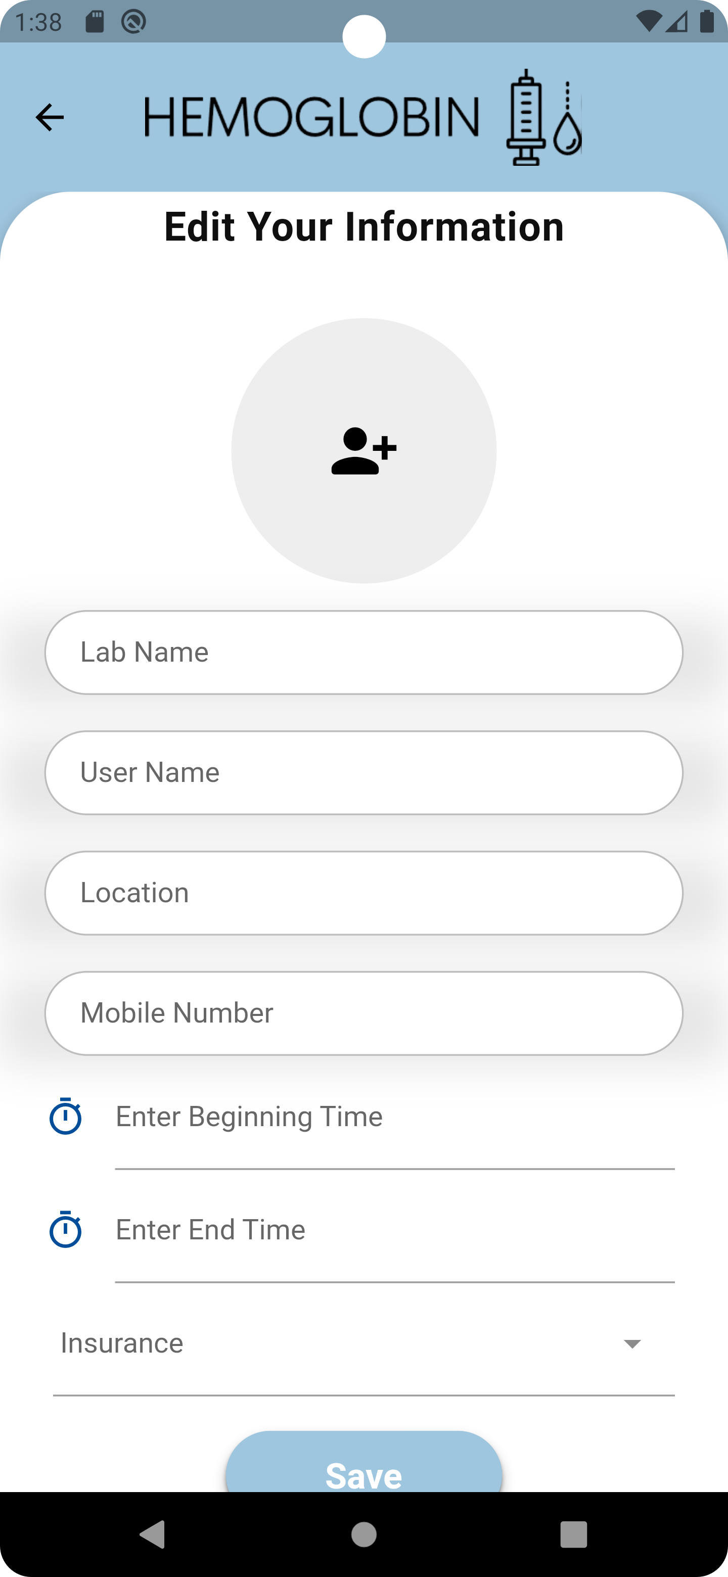

Slide 17
1
3
Link doctors and transfer the results directly to them for the patients who receive their treatment.
Chat between the patient and laboratory staff.
financial matters for the manager.
2
FUTURE WORK

Slide 18

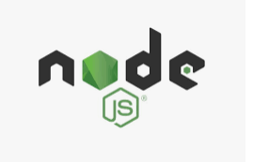
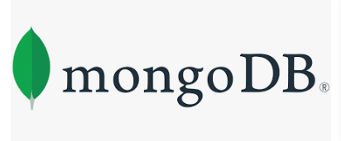
TECHNOLOGIES USED
FLUTTER
NODE JS
MONGODB
FRONT-END
BACK-END
DATABASE

Slide 19
THANK YOU

