Slide 1
IMPROVEMENT OF CLAYEY SOIL USING EGGSHELL POWDER AND QUARRY DUST
Prepared by: Suhad Thabet & Waad Thiab
Under Supervision:
Dr. Isam Jardaneh
Presentation Date
26/12/2019

Slide 2
Outline
Introduction
Review of soil improvement
Materials used and literature review
Laboratory test
Calculations and results
Conclusions and recommendations

Slide 3
INTRODUCTION

Slide 4
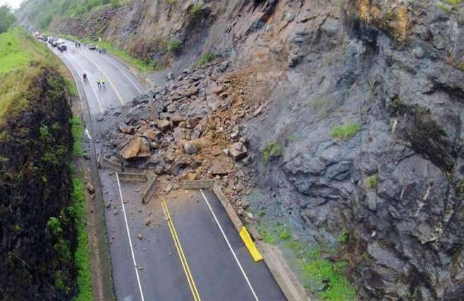
Land sliding
Definition
Types
Reasons for its appearance
Mechanism of dealing

Slide 5
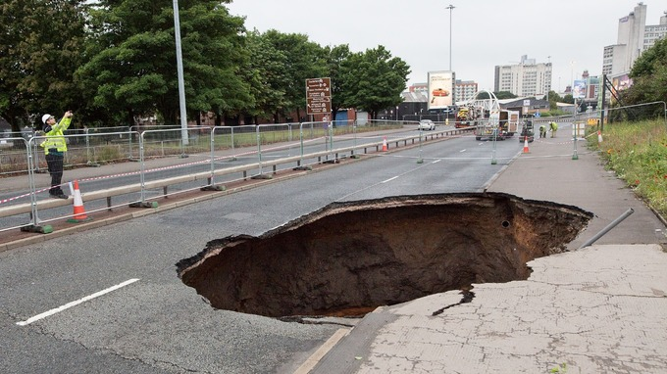
Cavities

Slide 6
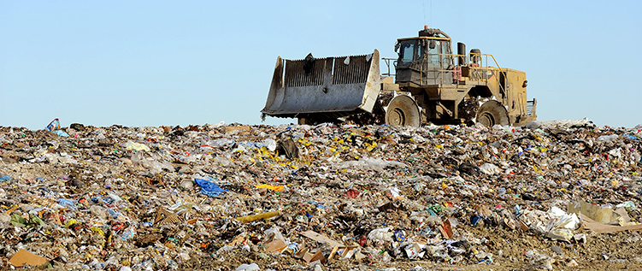
landfill

Slide 7
Expansion
Establishment of soil
Physical and chemical properties
Common test used to determine degree of swelling
Problem related to expansion

Slide 8
REVIEW Of SOIL IMPROVEMENT

Slide 9
The second project will be dealing with expansive soil
Facing weak geotechnical properties
alternative
Replace the exist soil
Design new structural member
Improvement of the exist soil

Slide 10
the best alternative is improvement of soil
Achieve effective cost, increase in bearing capacity and reduce the settlement etc.
Improvement of soil
densification
Shallow compaction
Deep compaction
Add mixture
Which is used in our project

Slide 11
MATERIALS USED AND LITERATURE REVIEW

Slide 12
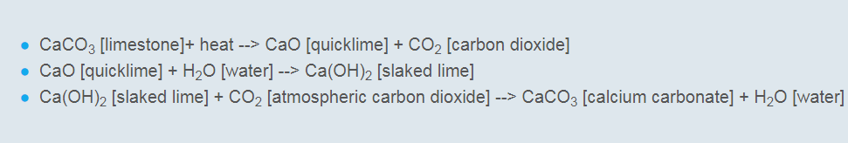
Eggshell powder
Eggs are one of the most prevalent food in the countries of the world.
calcium carbonate (CaCO3) (94%), magnesium carbonate (1%), calcium phosphate (1%) and organic matter (4%).
Consider as waste material, the US food industry produces 150,000 ton annual.

Slide 13
The sample from Gatoh Labnan in Rafedia, Nablus.
The eggshell waste was dried before grinding, and the powder was sieved using IS Sieve No. 200 (75µ).
We make four different % of eggshell powder (10%,15%,20%,25%)

Slide 14
Literature reviews
Replacement of Cement Using Eggshell Powder (Mohamed Ansari M, Dinesh Kumar M, Milan Charles J, Dr.Vani G)
replace the Portland cement by egg shell powder can increase the compressive strength of the concrete as shown
PERCENTAGE OF ESP ADDED | TRIAL NO | COMPRESSIVE STRENGTH ON 7th day
0 % | 1 2 3 | 18.49 17.32 18.65
10% | 1 2 3 | 22.08 20.81 21.44
15% | 1 2 3 | 24.00 22.50 23.60
20% | 1 2 3 | 21.03 18.60 19.11

Slide 15
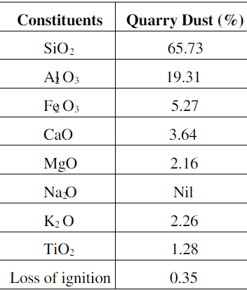
Quarry Dust
Quarry dust is a byproduct material produced by crushing process of rock.
Chemical composition of Quarry dust.
The Quarry Dust, was collected from a crusher in Ein Al-sibian, and was sieved using IS Sieve No. 200 (75µ) before use.

Slide 16
The principal elements in clay are silicone, aluminum and oxygen. Silicone atoms are position in the center of a pyramid.
Silicone atoms are formed a tetrahedron structure with four corner, aluminum atoms formed octahedron with eight corner which is hold together by intra-molecular forces
Quarry dust will make as a cementing material between clay particles due to the interaction.
Clay soil
oxygen
Silicate
Aluminum
will decrease the ability of the soil to absorb a lot of water.

Slide 17
Literature reviews
Roobhakhshan and Kalantari (2013)
they are conclude that there is remarkable influence on strength and CBR value at
1% lime + 6% quarry dust for CBR
7% lime + 6% quarry dust for U.C.S which are optimum percentage.
Ali and Koranne (2011)
They are conclude that there is a marked influence in controlling the swelling nature
When adding the same % of fly ash and quarry dust in the range (20-30)%, which is more effective than the addition of quarry dust/fly ash alone.

Slide 18
LABORATORY TEST

Slide 19
Clay soil
Fine-grained soil contains one or more clay minerals
We tried to reduce the swelling potential in clay.
We took the sample from a place near the university.
It has a high swelling potential; LL=56, PL=33, PI=23
We used Wet Sieving before using it. (Using IS Sieve No.200)

Slide 20
Several tests were done on:
Natural soil.
Eggshell powder (10%, 15%, 20%, 25%)
Quarry dust (5%, 10%, 15%)
Laboratory Test
Atterberg limits
Unconfined compression test
Atterberg limits
Liquid limit
Plastic limit
plasticity index

Slide 21
Liquid limit
Definition
Limiting moisture content at which clay passes liquid limit to plastic limit.
In Lab
Soil samples are 100gm.
Water content corresponding to 25 blows.
Calculated using graph (two point method).
We use Casagrande apparatus.

Slide 22
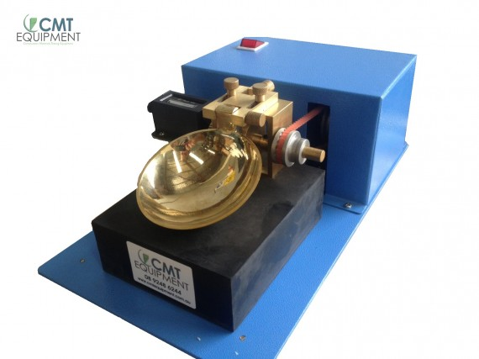
Casagrande apparatus.

Slide 23
plastic limit
Definition
Water content at which soil enters from Semi-Solid State to Plastic State.
In Lab
A ball is formed and rolled between fingers on glass or marble plate.
Process of remolding is repeated till it starts to crumble at 3mm.
Plasticity Index (PI) = LL-PL

Slide 24
Unconfined Compression Test
It is used to measure the shear strength of the soil.
The sample is preferred to be Undisturbed.
In Lab
We Remolded the sample. (3 layers, each 5 blows)
Three specimens used, each 147gm (natural soil, 25%ESP, 25%ESP+15%QD)
ω=18% of soil sample, γ=1.7 g/cm^3, height of the sample= 76mm

Slide 25
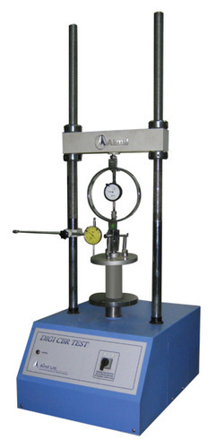
Unconfined Compression Device

Slide 26
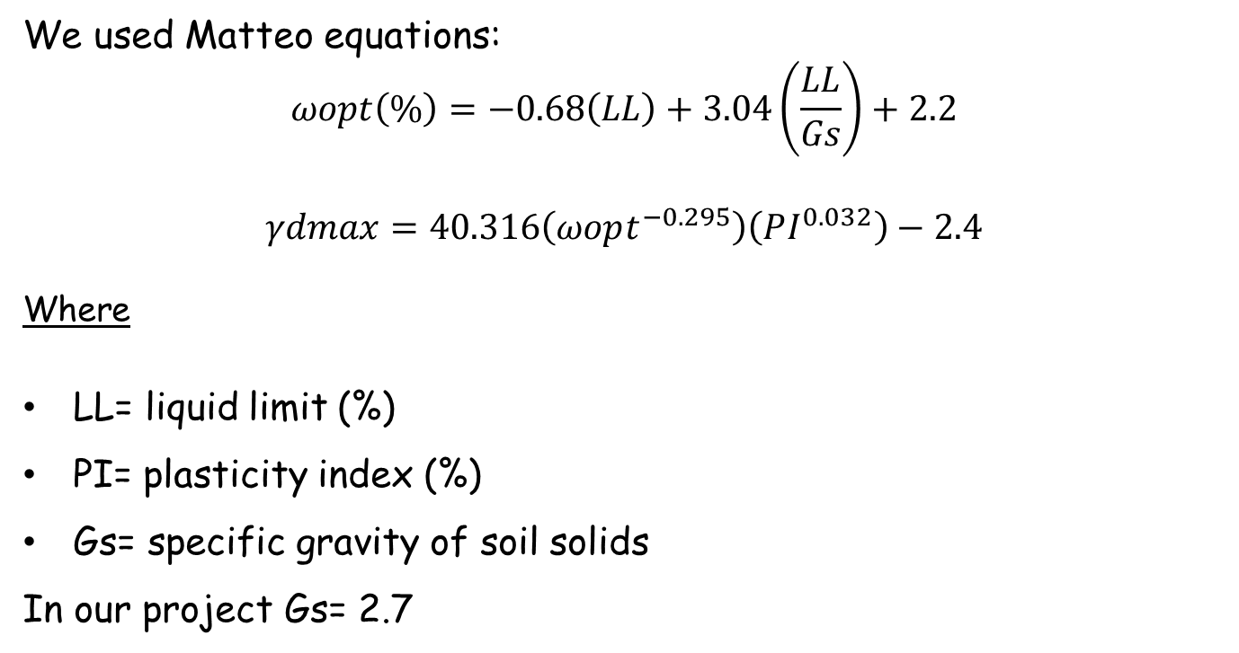
Optimum Moisture Content and Maximum Dry Density
We used Matteo equations:
$$ωopt\left(\%\right)=−0.68\left(LL\right)+3.04\left(\frac{LL}{Gs}\right)+2.2$$
$$γdmax=40.316\left(ωopt^{−0.295}\right)\left(PI^{0.032}\right)−2.4$$
Where
LL= liquid limit (%)
PI= plasticity index (%)
Gs= specific gravity of soil solids
In our project Gs= 2.7

Slide 27
CALCULATIONS AND RESULTS

Slide 28
Influence on Atterberg’s limits with varying % of ESP
0
10
15
20
25
Max. Dry Density
ESP (%)
L.L (%)
P.L (%)
P.I (%)
O.M.C
56.3
33.3
23.0
17.17
16.87
50.2
29.7
20.6
15.55
17.37
47.3
30.1
17.2
14.78
17.55
45.4
30.5
14.9
14.27
17.66
41.1
29.9
11.2
13.13
17.98

Slide 29
Variation of L.L, P.L and PI with varying % of ESP

Slide 30
Variation of O.M.C with varying % of ESP

Slide 31
Variation of M.D.D with varying % of ESP

Slide 32
Influence on Atterberg’s limits with optimum % of ESP and varying % of QD
% QD WITH OPTIMUM % ESP | L.L (%) | P.L (%) | P.I (%) | O.M.C | Max. Dry Density
25% ESP+5% QD
25% ESP+10% QD
25% ESP+15% QD
39.3
28.6
10.8
12.65
18.18
37.7
28.9
8.8
12.23
18.25
34.0
26.1
7.9
11.24
18.70

Slide 33
Variation of L.L, P.L and PI with optimum % of ESP and varying %of QD

Slide 34
Variation of O.M.C with optimum % of ESP and varying %of QD

Slide 35
Variation of M.D.D with optimum % of ESP and varying %of QD

Slide 36
Influence of % ESP and % QD in Unconfined Compression
0 | 0.2
25 + 0 | 0.161
25 + 15 | 0.117
Unconfined Compression Strength (MPa)
ESP% + QD %

Slide 37
Influence of adding % ESP in strength of soil.

Slide 38
Influence of adding % ESP & % QD in strength of soil.
Qu (MPa)

Slide 39
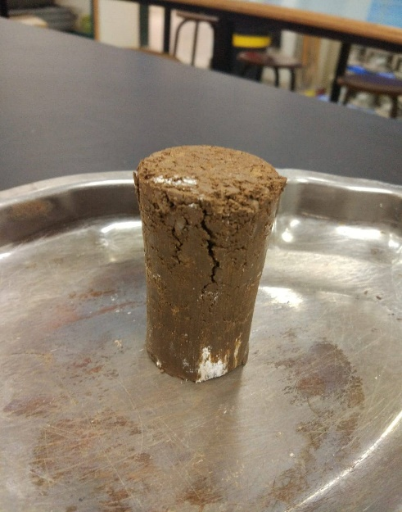
Shape of failure for naturel sample

Slide 40
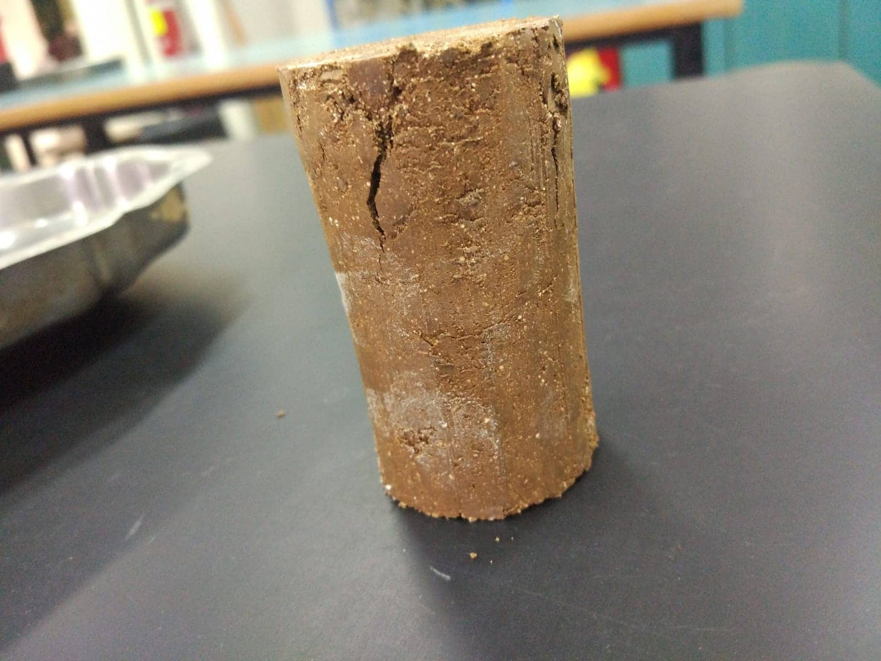
Shape of failure after adding 25% eggshell powder

Slide 41
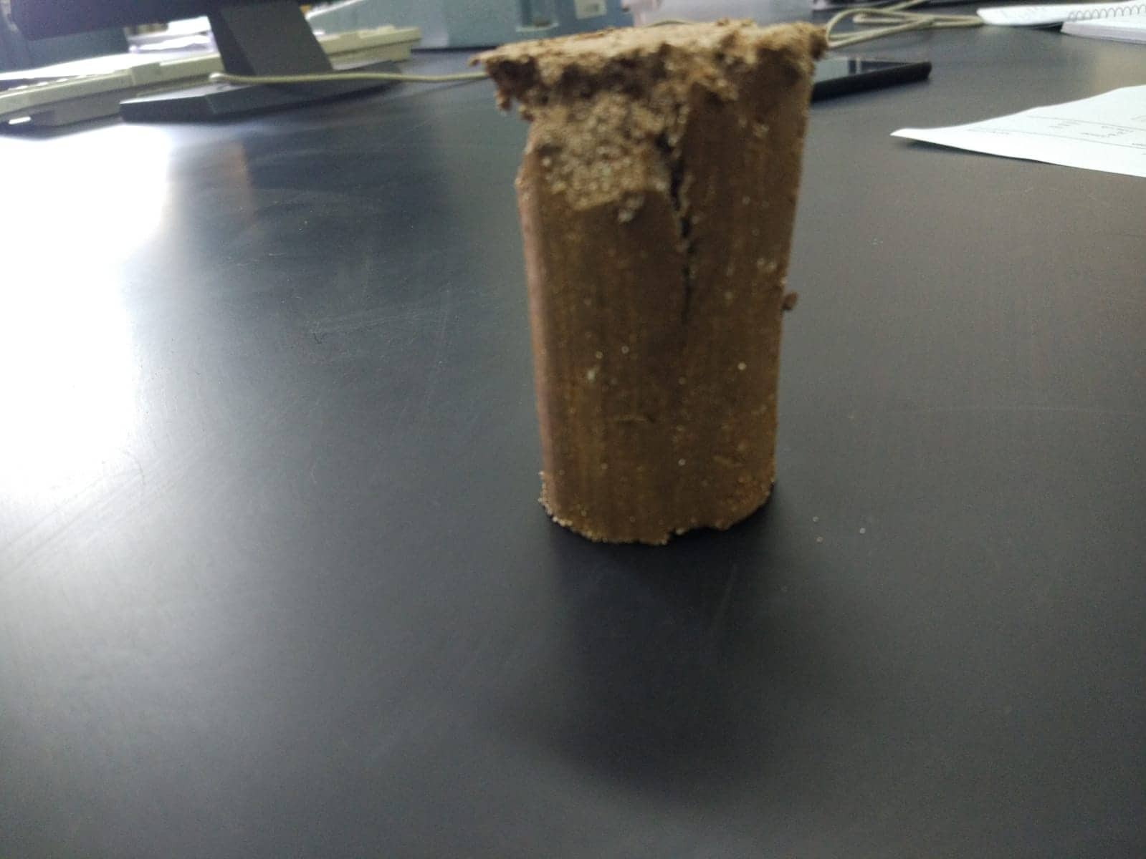
Shape of failure after adding 25% ESP & 15% QD

Slide 42
Conclusions and recommendations

Slide 43
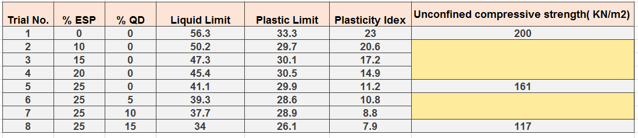
Conclusions

Slide 44
Recommendations
We recommended to use eggshell powder and quarry dust as 25% 15% respectively, because this is the optimum percentage of admixtures which gives us these previous results.
To better measure the strength of the soil with different percentages of admixtures (Eggshell and Quarry Dust), it is recommended to carry out Direct Shear Test or Tri axial Shear Strength Test in order to find both Cohesion and Angle of Internal Friction, rather than performing Unconfined Compression Test that find only Cohesion.

Slide 45


Slide 46
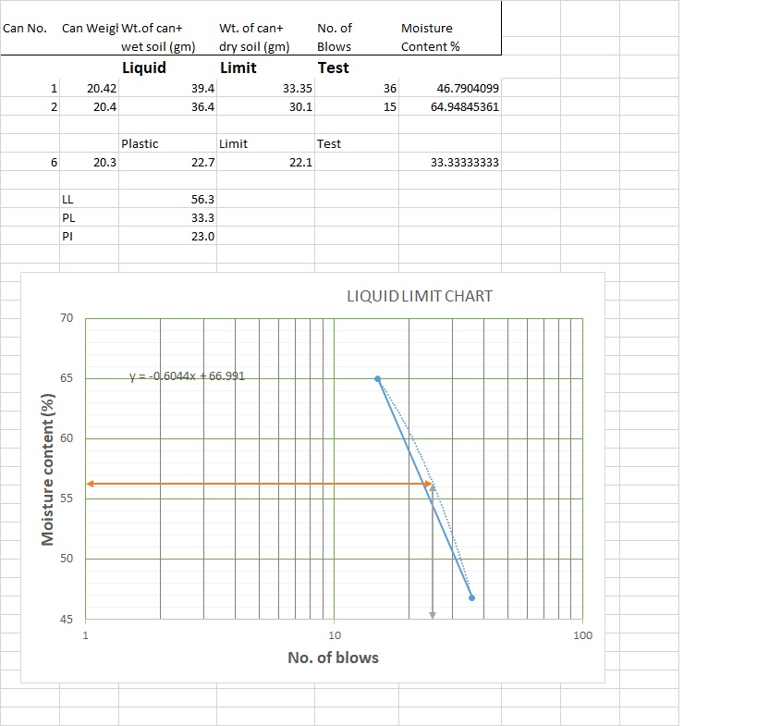
natural soil

Slide 47
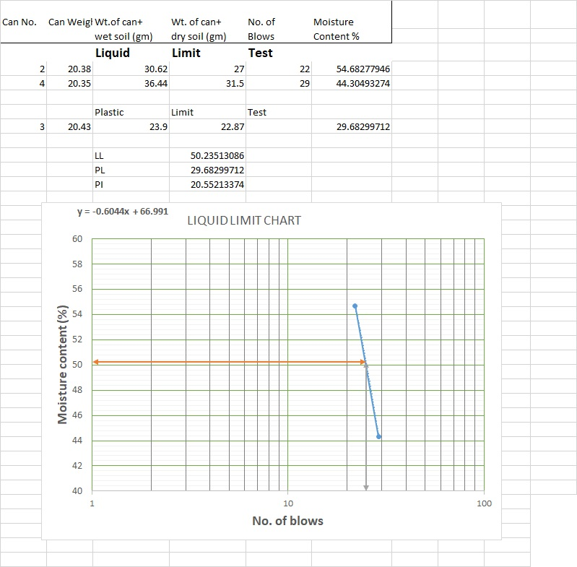
10% ESP

Slide 48
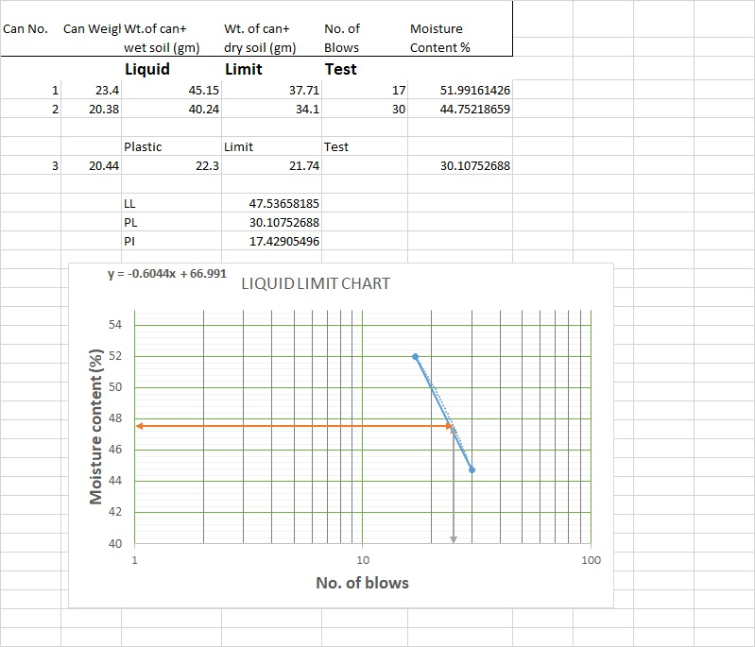
15% ESP

Slide 49
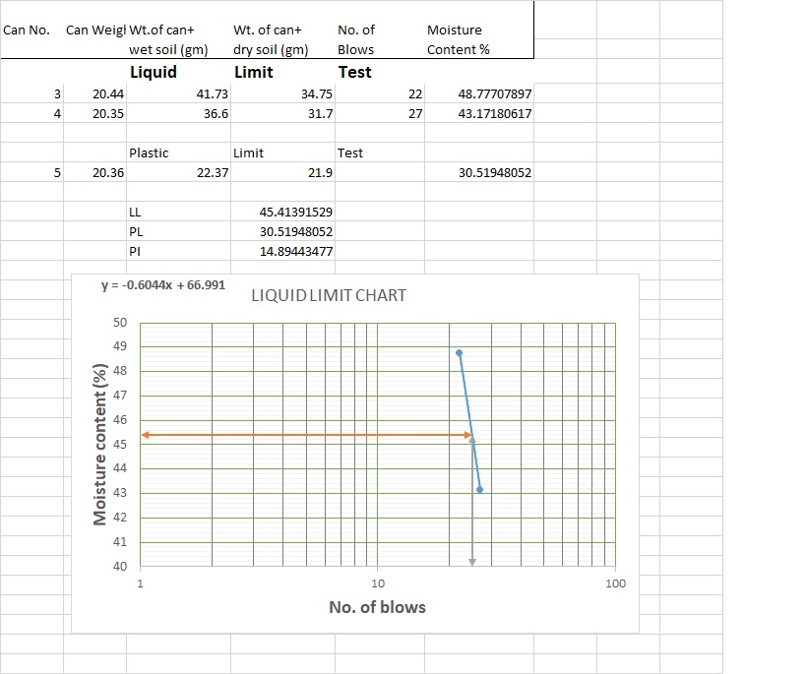
20 % ESP

Slide 50
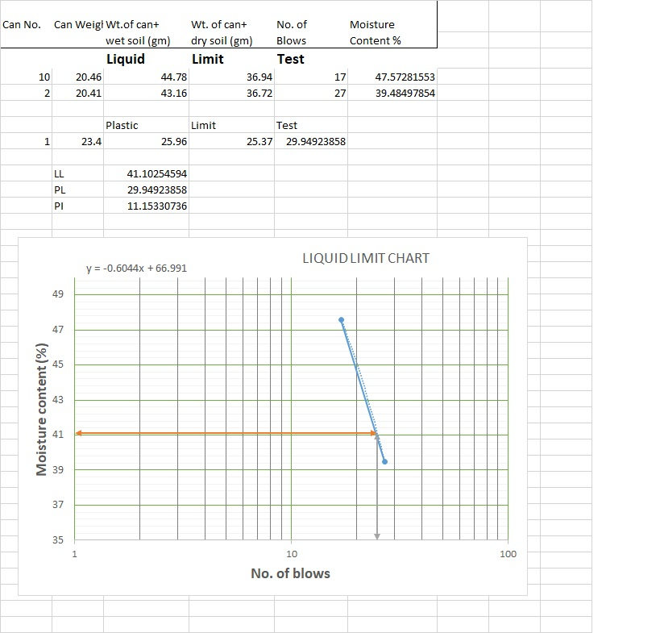
25 % ESP

Slide 51
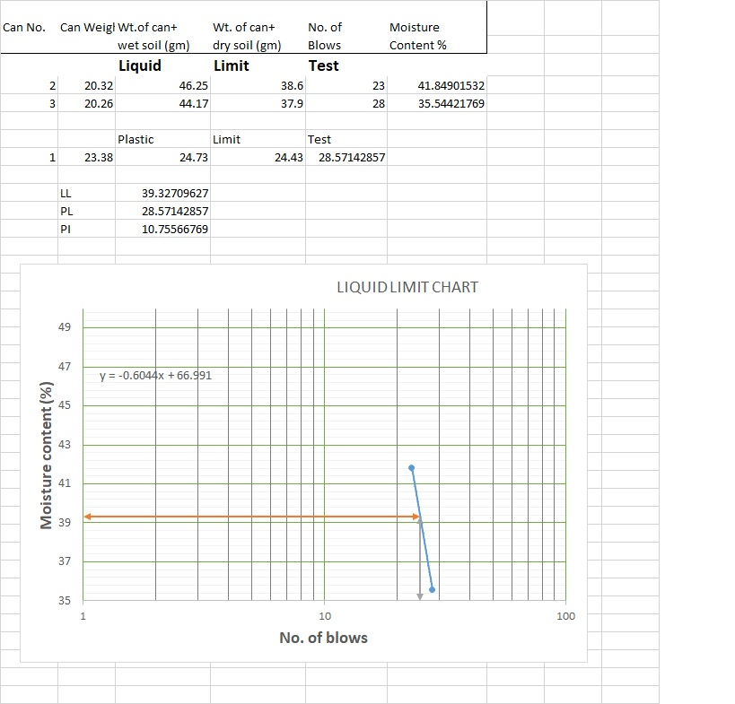
25 % ESP & 5% QD

Slide 52
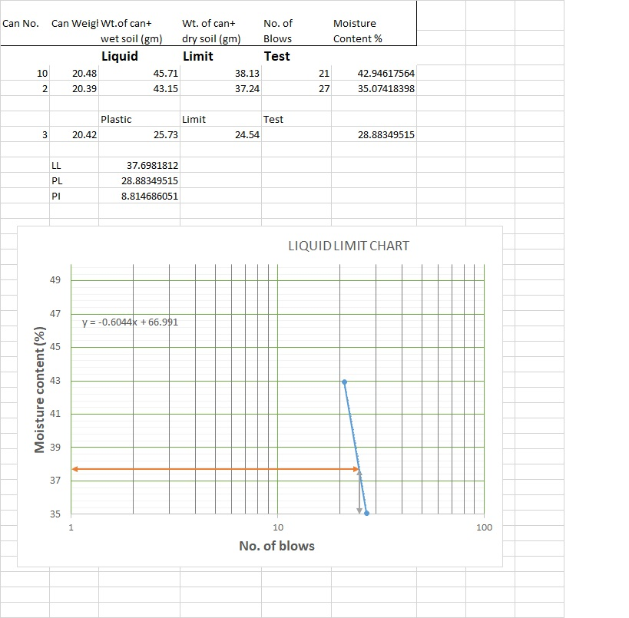
25 % ESP & 10% QD

Slide 53
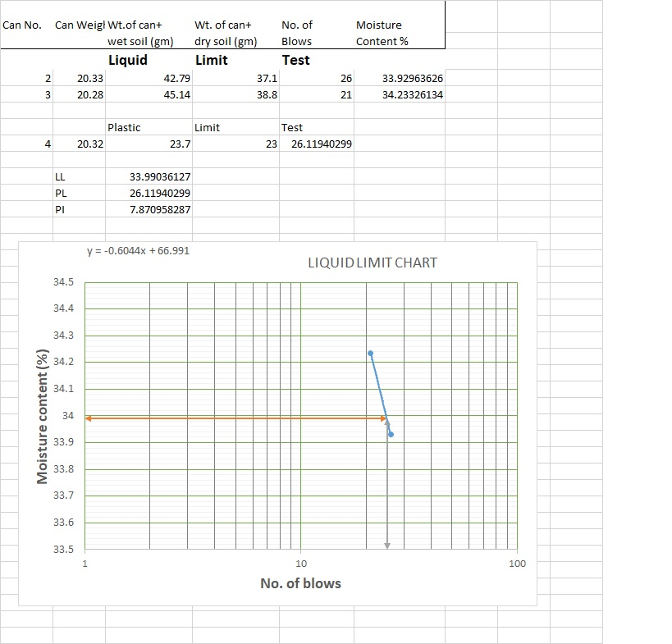
25 % ESP & 15% QD

