Slide 1

Multipurpose Cultural
Center
Prepared By:
Hadeel makhlouf Lama Foqha
Malak Salahat Shahd Hindi
Supervisor
Dr. Monther Dwekat

Slide 2
Outline
Site location
Architectural Design
Environmental Design
Structural Design
Mechanical Design
Safety Design
Electrical Design
BOQ

Slide 3
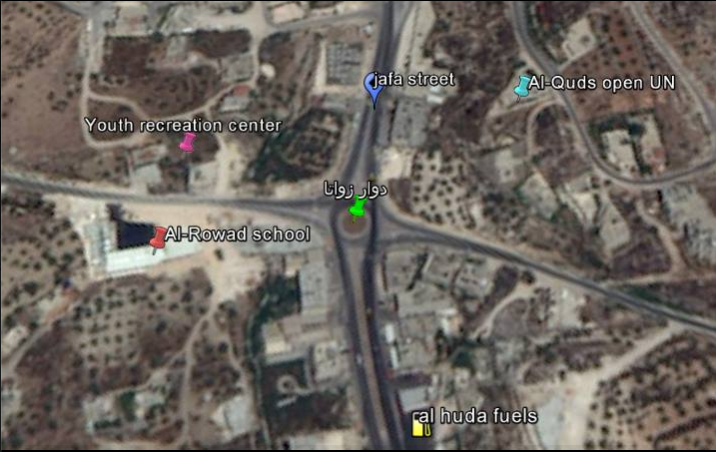
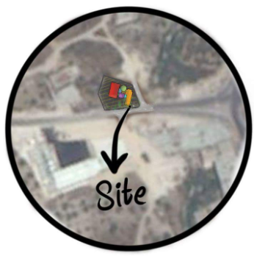

Slide 4
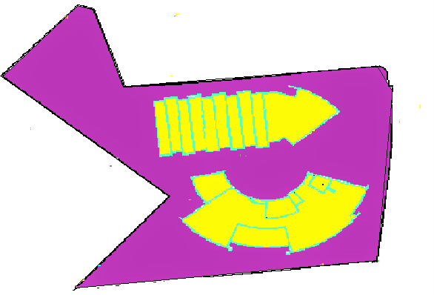

3262 m²
3738 m²
Total = 7000m²

Slide 5
Outline
Site location
Site plan
Architectural Design
Circulation and entrances
Environmental Design
Parking
Structural Design
Plans
Mechanical Design
Safety Design
Elevations
Electrical Design
BOQ

Slide 6
Site plan

Slide 7
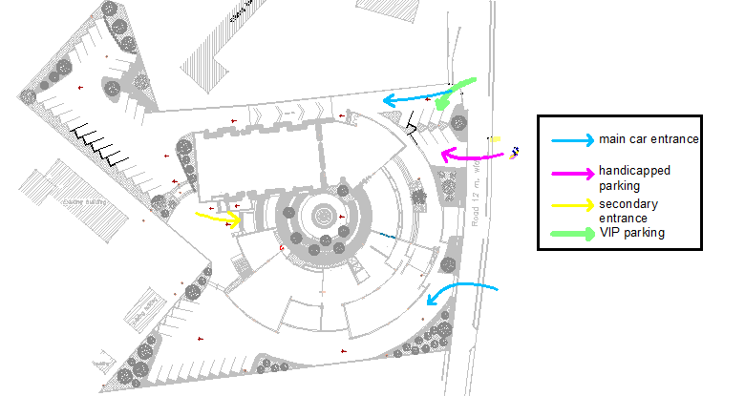
Circulation and Entrances

Slide 8
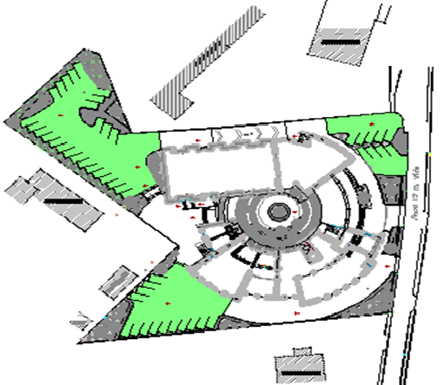
Parking
Area =2775 m²
60 | No. car parking

Slide 9
Outline
Site location
Site plan
Architectural Design
Circulation and entrances
Environmental Design
Parking
Structural Design
Plans
Mechanical Design
Safety Design
Elevations
Electrical Design
BOQ

Slide 10
Conceptual plan
final Design

Slide 11
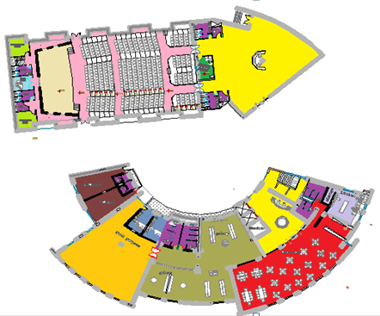
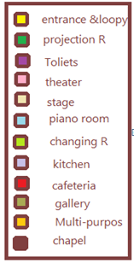
Ground Floor
Total Area = m²

Slide 12
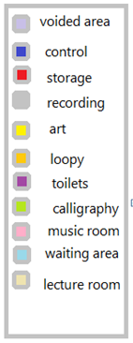
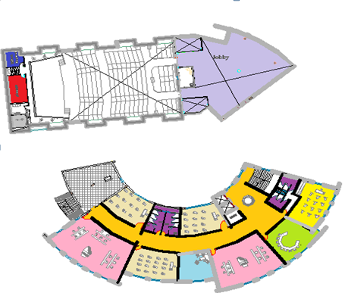
First Floor
Total Area = m²

Slide 13
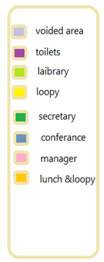
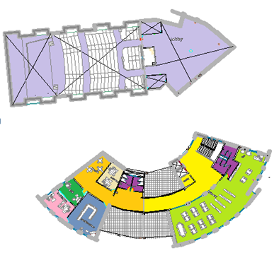
Second Floor
Total Area = m²

Slide 14
East Elevation

Slide 15
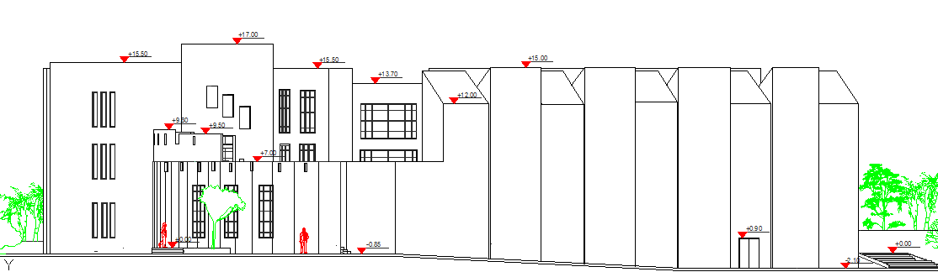
North Elevation

Slide 16
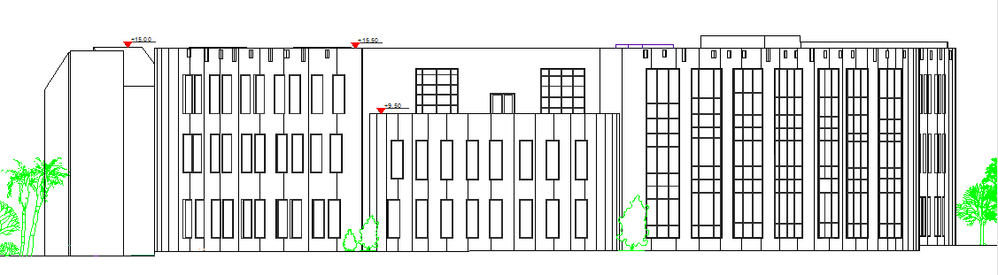
South Elevation

Slide 17
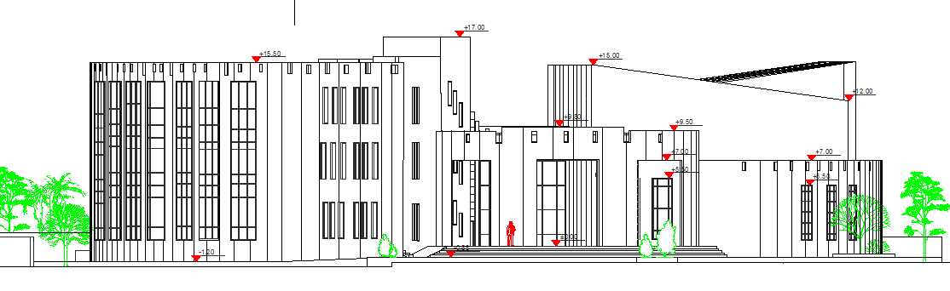
West Elevation

Slide 18
Outline
Site location
Best orientation
Architectural Design
Shading Design
Environmental Design
Structural Design
Daylight factor
Mechanical Design
Thermal analysis and materials
Safety Design
Acoustical design
Electrical Design
BOQ

