Slide 1
Scientific Research Project Topic:
Management Information Systems Major:
Challenges and Opportunities
Students:
Mais Hunjul
Rola Masri
Katreen Sheikh Ibrahim
Supervised By: Dr. Safa’a AbuJarour

Slide 2
Questions
What are the opportunities and challenges faced by students of the major?
What is the impact of student interest in computers and technology on choice of major?
Do the students have the required skills?

Slide 3
Motivation
This project studies the challenges and opportunities for students of Management Information Systems (MIS) Major.
We want to collect the opinions and experiences of MIS students by using a quantitative research method.

Slide 4
Contents
Literature Review
Methodology and Data Source
Results
Discussion
Recommendations and Implications
References

Slide 5
Literature Review → Three Main Aspects
Education
Technology
Influences on Choice of Major

Slide 6
1. Education
(Educational Management Information System) It is an information system designed to manage information in the education system, and is a repository for data collection, processing, analysis and reporting in educational institutions (Hassan Al-Derbasti, 2014).
Theories of Learning: Assumptions
Constructivist learning theory
Collaborative learning model

Slide 7
2. Technology
An information system is an arrangement of data, processes and information technology (IT) that interact to collect, process, store and present results in the form of information. (Siregar 2021)
One of its main goals is to be able to connect multiple data points in order to develop strategies for ways to improve operations(Markus 2012)

Slide 8
3. Influences on Choice of Major
A choice that most students give due consideration is likely to have an important impact on future employment, compensation, and enjoyment of employment (i. N. Rababah 2015).
Important for companies that hires graduates, especially if there is a shortage of qualified graduates (i. N. Rababah 2015).

Slide 9
Methodology and Data Source:
Quantitative Research Method
We used a questionnaire to collect data from students.
The questionnaire was published in groups on Facebook, and to our accounts on social media such as WhatsApp, Facebook, and Instagram.
171 responses were collected, 21 of them were incomplete, thus, they are invalid.
150 responses are valid and were considered in our analysis

Slide 10
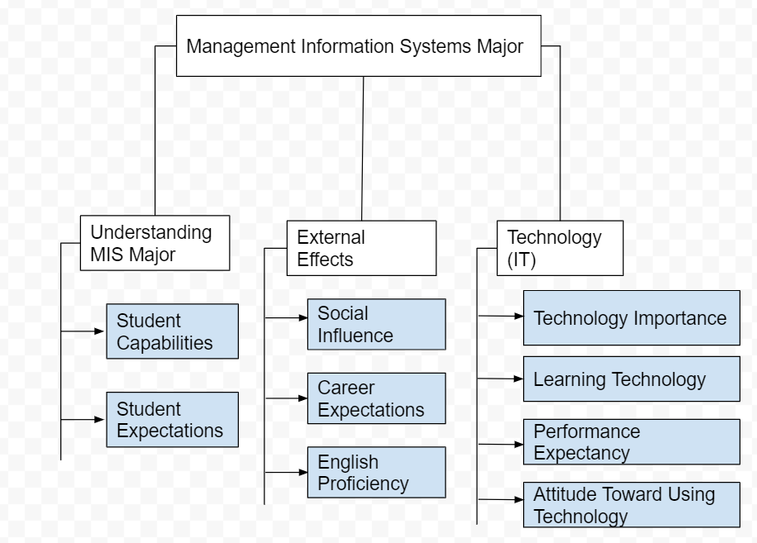
Research Model

Slide 11
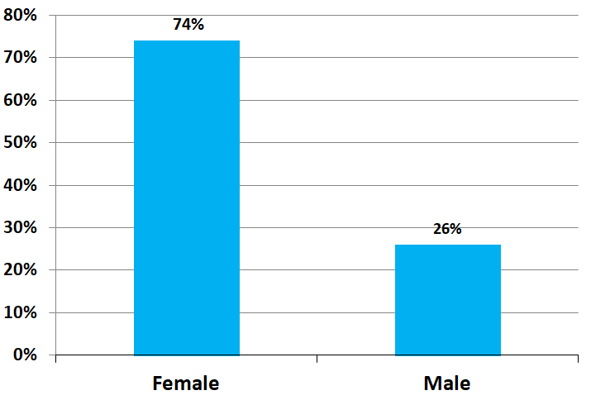
Demographics: Gender

Slide 12
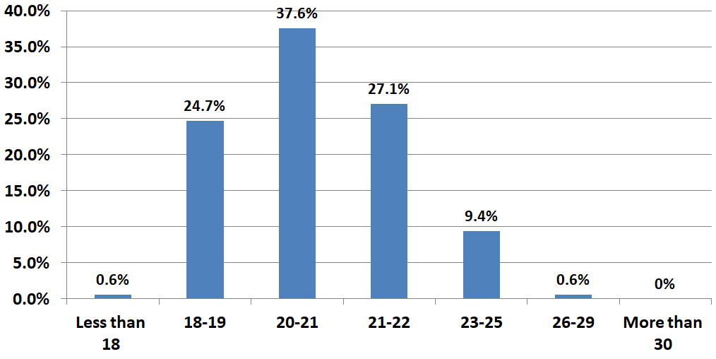
Demographics: Age

Slide 13
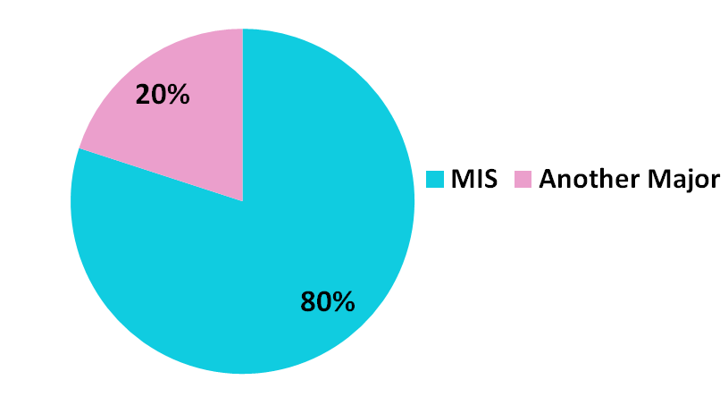
Demographics: Major

Slide 14
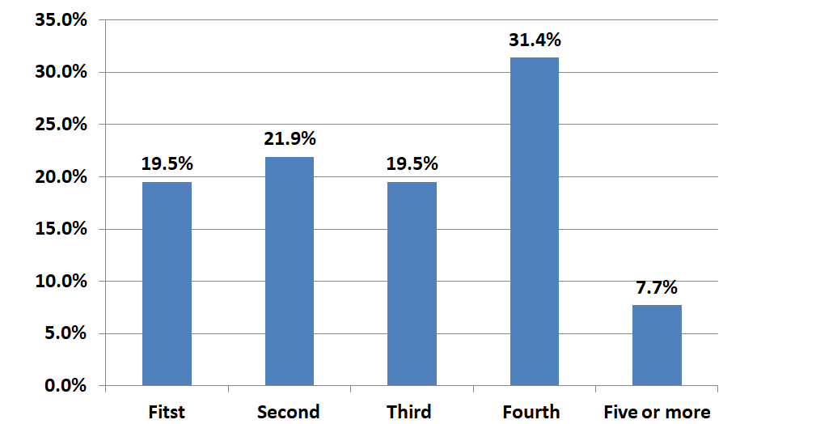
Demographics: Study Year

Slide 15
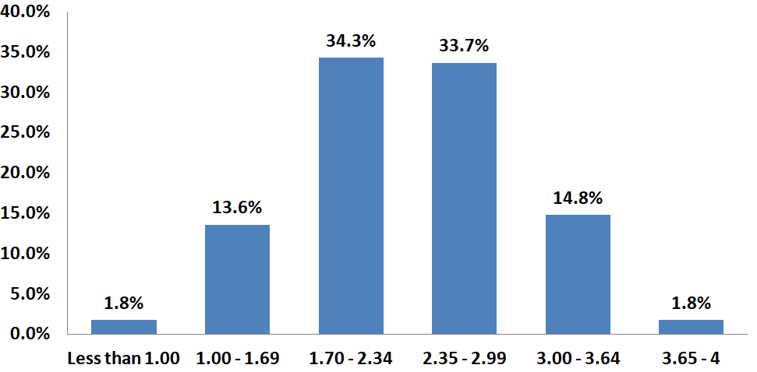
Demographics: GPA

Slide 16
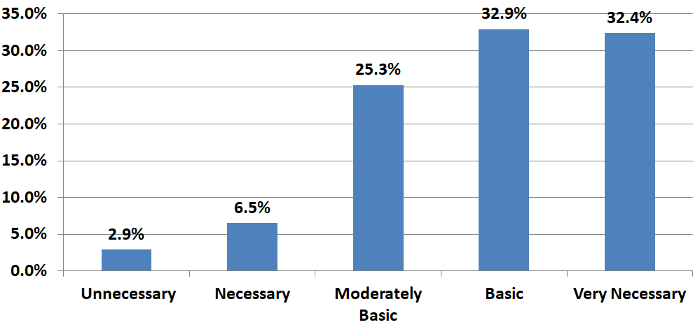
Student Capabilities: Teamwork skills

Slide 17
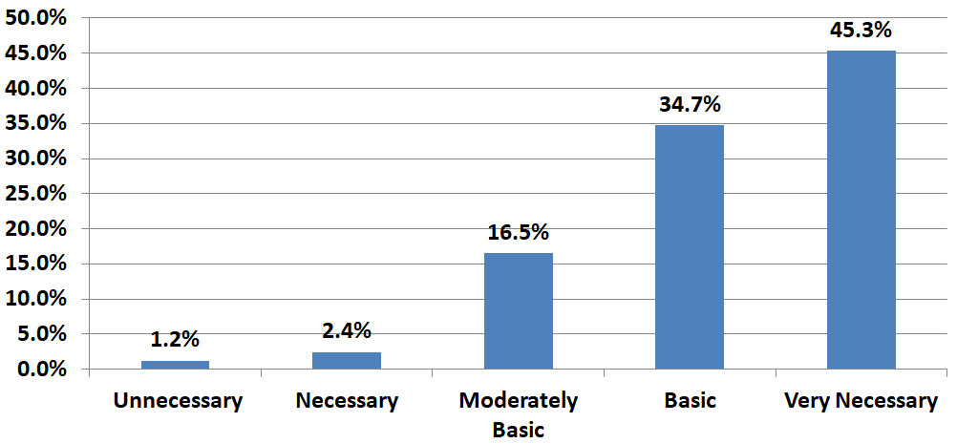
Student Capabilities: Ability to solve problems

Slide 18
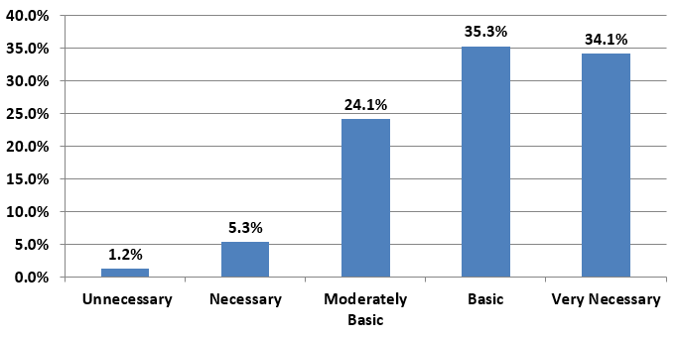
Student Capabilities: Creative solving ability

Slide 19
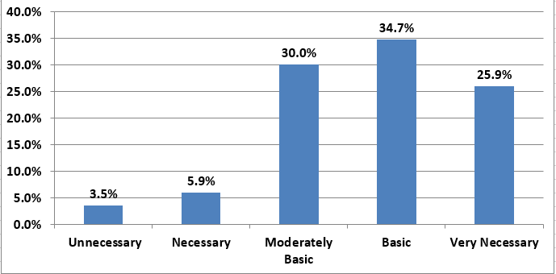
Student Expectations How important are the following information communication skills for you to be effective in your undergraduate studies? Organizing speech and dialogue

Slide 20
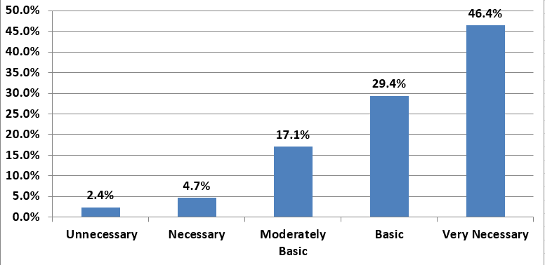
Student Expectations: How important are the following communication skills for you to be effective in your undergraduate studies? Correct Vocabulary

Slide 21
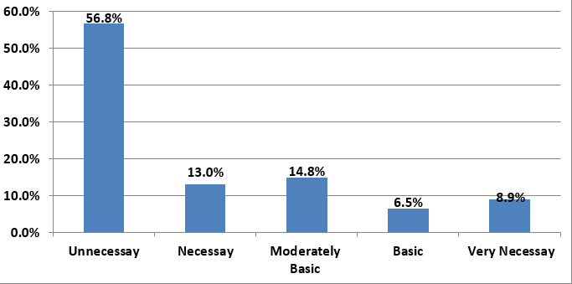
Social Impact: I study MIS because my family wants me to study this major

Slide 22
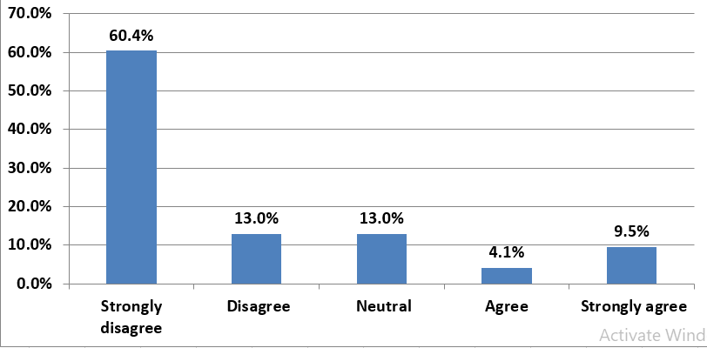
Social Impact: I study MIS because my friends convinced me.

Slide 23
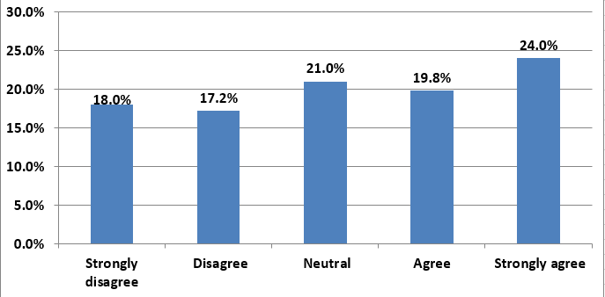
Social Impact: I am studying MIS I want to get a higher social status

Slide 24
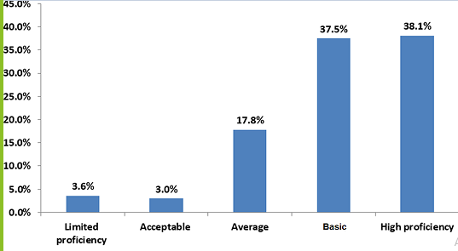
English Language: Reading

Slide 25
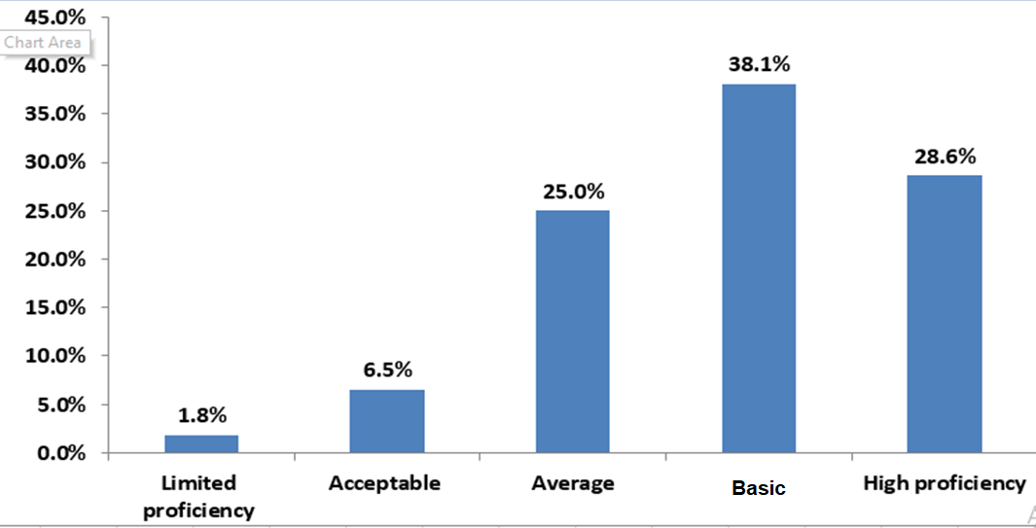
English Language: Writing

Slide 26
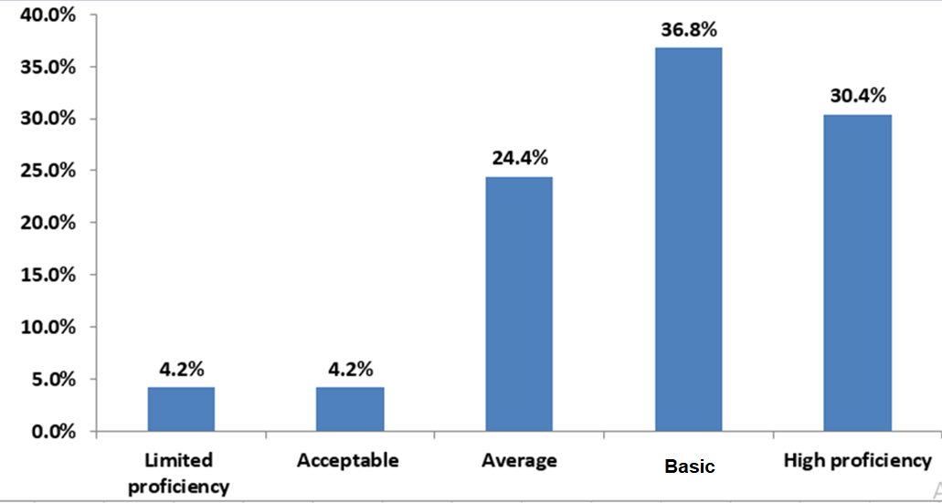
English Language: Listening and Understanding

Slide 27
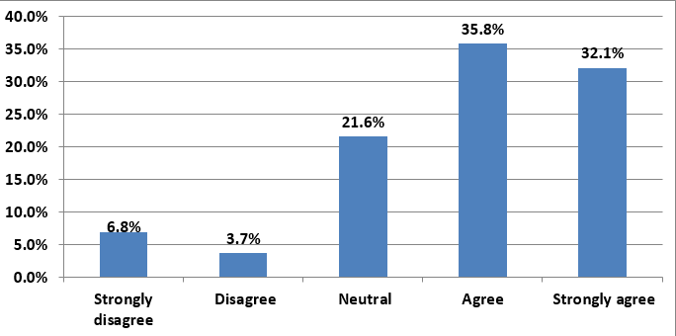
Career Expectations: I am studying MIS and expect to have many opportunities to work and train later

Slide 28
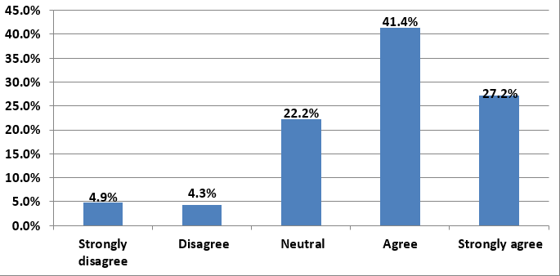
Career Expectations :Expect good career benefits in the future

Slide 29
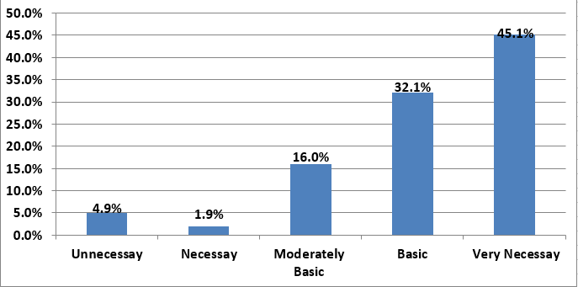
Technology: teachers committed to use new and advanced technologies in education

Slide 30
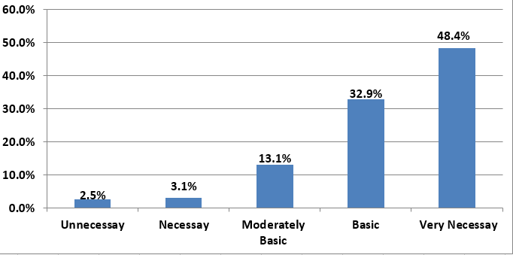
Technology: Learn, study or complete courses on your own

Slide 31
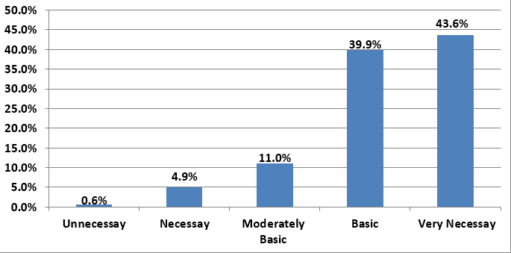
Performance Expectation: Using technology increases my productivity

Slide 32
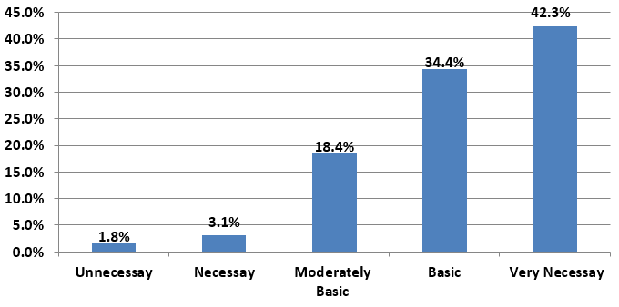
Performance Expectation: If I use technology, I will increase my chances of getting better grades

Slide 33
Discussion
What are the opportunities and challenges faced by students of the major?
It was found that some students face difficulties in the language, and some of them face a problem with technology and the way of learning information. It turns out that the opportunities available to students of the major in terms of job expectations are to find job opportunities after graduation.

Slide 34
Discussion
What is the impact of student interest in computers and technology on choice of major?
By analyzing the results, it was found that most students have skills in technology, and this affected their decision to choose a major
Do the students have the required skills?
Yes, most of the students had previous skills in terms of technology and English, so most of the students did not face difficulties

Slide 35
Recommendations and Implications
Strengthening the English language of the students
Increasing students’ productivity
Informing students about the availability of future job opportunities for MIS graduates
Persuading students before registering for courses with full knowledge of the specialization in all respects
Communicating information better
Developing ways of communicating information

Slide 36
References
Hassan Aldarbesti, J. P. Saxena. 2014. "Management Information System for Education." IOSR 1-9.
Siregar, Siti aisah. 2021. "IMPLEMENTATION OF THE RUP METHOD ON THE LABUHAN BATU UNIVERSITY STUDENT ACTIVITY UNIT INFORMATION SYSTEM." JURNAL INFOKUM 1-7.
Markus, A. Majchrzak & M. L. 2012. "TECHNOLOGY AFFORDANCES AND CONSTRAINTS." Encyclopedia of Management Theory 1-5.
Rababah, ibrahim N.Mansiand Khalid Ali. 2015. "6155UNDERSTANDING OF MIS SPECIALTY IN JORDAN: EMPIRICAL INVESTIGATION FROM STUDENTS’ PERSPECTIVEIbrahim." Journal of asian business strategy 1-7.

Slide 37
Thanks For Your Attention

Slide 38
Education | System | Tech | Management
Model of education management information systems, | Information | Information technology | knowledge management,
Specialty In MIS | Information's | IT capability | Management Information
MIS In University | New Normal | ITs | Management System
organizational capital | Knowledge Information System | E-Learning | Student Management Information
MIS Student | System Qualification | IT careers | IS management
MIS departments |  |  | Usability

