Slide 1

Techno- Economic Optimal of PV- battery grid-connected system
Group members:
Afnan Amjad
Khouloud Moqdi
Marah Bahloul
Reham Baniodeh
Supervisor:
Dr. Mohammed Al-Sayed

Slide 2
Outline :
Introduction.
Methodology.
Theoretical background.
Results and discussion.
Conclusions and Recommendation.

Slide 3

Introduction:
The development in renewable energy sources, and the exploitation of these sources in Palestine, where these sources are considered environmentally friendly, the use of renewable energy sources has become widely available, especially solar energy (photovoltaic systems), besides that, the Palestinian government and electricity companies have encouraged the citizens to install solar energy systems (photovoltaic systems) to reduce the dependence on the Zionist side in delivering electricity to residential areas.
.

Slide 4
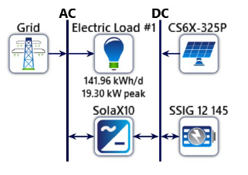
PV storage system as used in the described model

Slide 5
Methodology:
Scientific papers have been reading specializing in optimal PV- battery grid-connected system.
Taking of electrical loads from Back-Of the Envelope software.
Collect the necessary and appropriate data and information for all components of the system and the price for each part of the system.
Components modelling.
design of system by homer energy .
Find a value Levelized Cost of Energy (LCOE) .
Analysis and discussion of the resulting values.

Slide 6

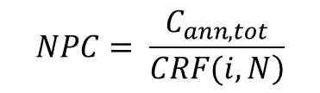

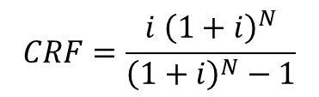
Theoretical background:
Solar radiation :
Net present value to annual:
$$NPC= \frac{C_{ann,tot}}{\left.CRF(i,N\right)}$$
$$CRF=\frac{i {\left(1+i\right)}^{N}}{{\left(1+i\right)}^{N}−1}$$
Levelized Cost of Energy:
$LCOE=\frac{C_{ann,tot}}{R_{prim}+R_{def }+R_{tot,grid,sales}}$

Slide 7
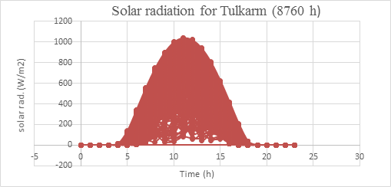
Results and discussion:
Solar radiation:

Slide 8
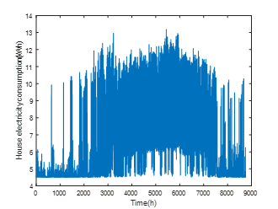
Electricity consumption for the home:

Slide 9
Photovoltaic systems (PV)
Several scenarios have been analyzed by using HOMER ENERGY program from this analysis, can guide and educate the citizen to choose the suitable one. During the following scenarios which will be analyzed should take into consideration that the citizen wants to cover all the loads from the solar system and the surplus will be stored and invested when there is a failure system .

Slide 10
The First Scenario:
Table 1: Price properties of photovoltaic systems.
PV (kW) | SOC(kWh) | COE($/kWh) | Initial cost ($) | NPC($)
5 | 0.314 | 0.117 | 29552 | 86645
6 | 1.0486 | 0.114 | 29998 | 85540
7 | 1.755 | 0.112 | 30301 | 84718

Slide 11
The Second scenario:
This scenario shows all the details and analyzes of the system- 8 kW- after it became clear that it is the best economically and in terms of charging the battery, it was approved and installed to solve the problem of the home power outage in the city of Tulkarm, which causes resentment and inconvenience to the citizens. According to data from Tulkarm Municipality, annual power outage hours in the city in the normal condition reach 70 hours per year.

Slide 12
Environmental Analyzes:
The emissions of gases from the system were analyzed within a year, as it was found that economically, in all scenarios, the prices are not related to the emissions result from the solar system.
Table 2: The environmental impacts of the system.
Value(kg/yr) | Quantity
18601 | Carbon dioxide
80.6 | Sulfur dioxide
39.4 | Nitrogen oxides

Slide 13
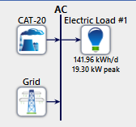
The third scenario:

Slide 14
Environmental Analyzes:
Table 3: The environmental impacts for generator 16kW
Table 4: The environmental impacts for generator 22kW
Value(Kg/yr) | Quantity
37379 | Carbon Dioxide
138 | Sulfur Dioxide
51.7 | Nitrogen Oxides
Value(Kg/yr) | Quantity
58175 | Carbon Dioxide
352 | Carbon monoxide
15.4 | Unburned Hydrocarbons
2.14 | Particulate matter
147 | Sulfur Dioxide
336 | Nitrogen oxides

Slide 15
Conclusions and Recommendation:

Slide 16
Thank you

