Slide 1
Active Power factor correction
For uncontrolled rectifier with c filter.

Slide 2
outline
Definition of the problem.
APFC using boost converter
Component of circuit.
Measured VS Simulink result.
conclusion.

Slide 3
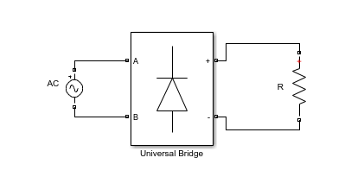
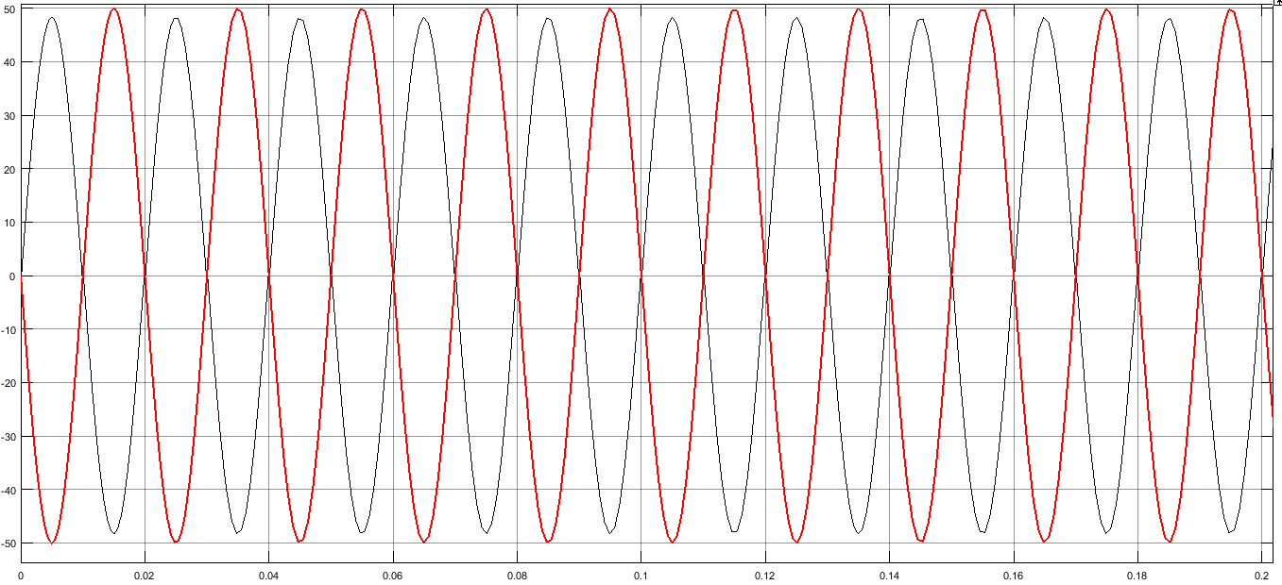
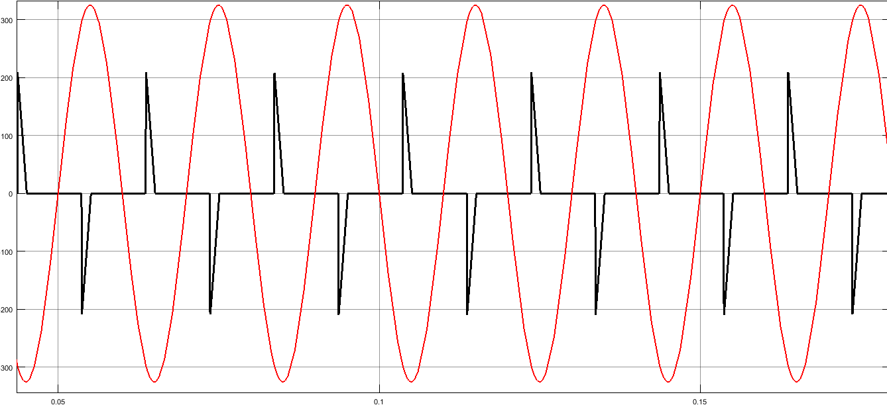
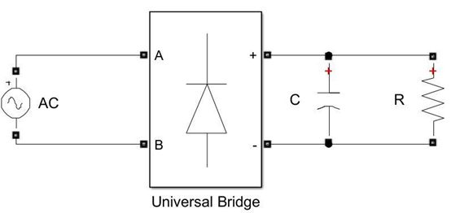
Problem definition
P.F = 1
P.F = 0.372

Slide 4
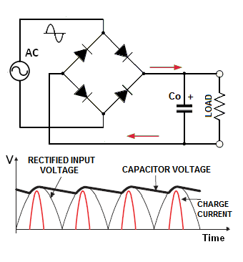
In order to start draw a current, the source voltage should be larger than the capacitor voltage, as the below figure shown.
This lead to distortion of the grid current wave, as shown below.
This meaning that there is a phase shift between input voltage and grid current waves, so that, a poor power factor will appear, and will be a high total harmonic distortion.

Slide 5
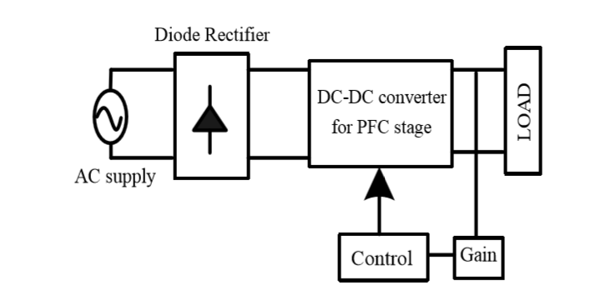
APFC using boost converter

Slide 6
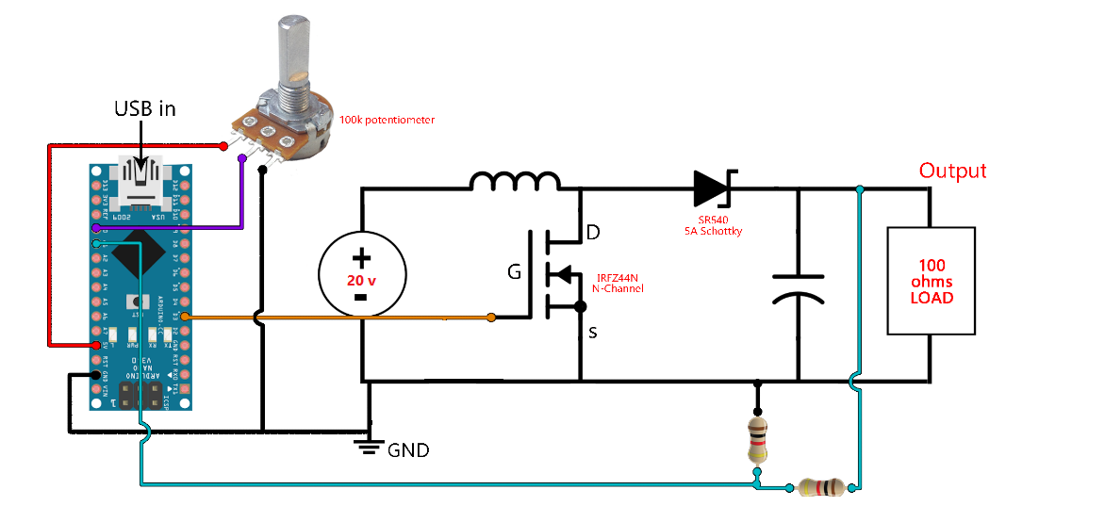
Component of circuit

Slide 7
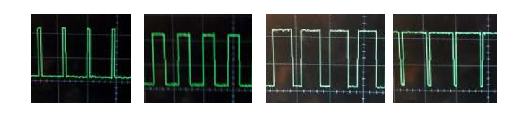
Boost converter

Slide 8
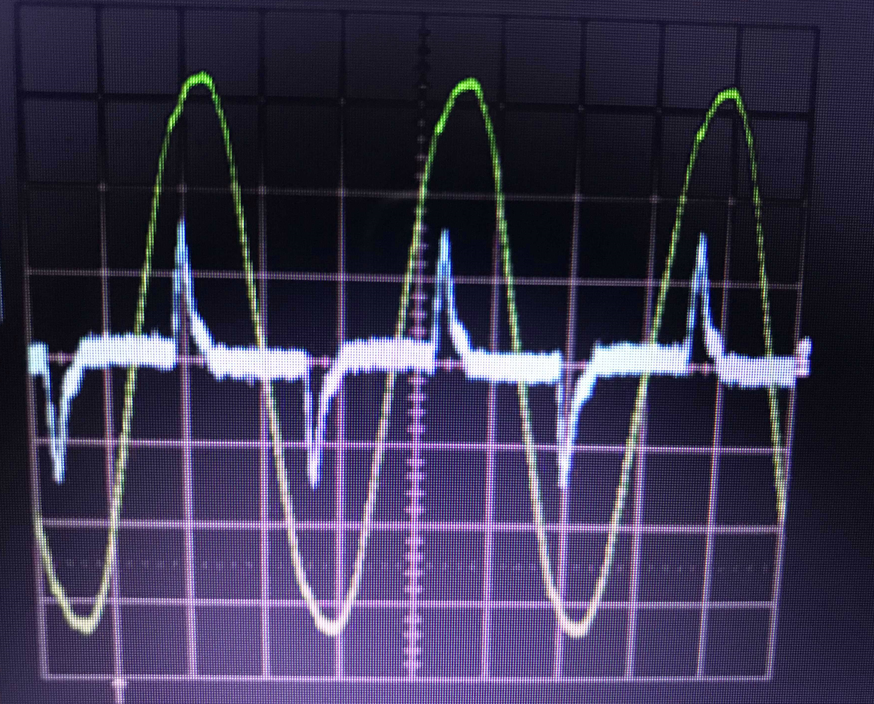
Real measurement
before correction, P.F will be 0.372

Slide 9
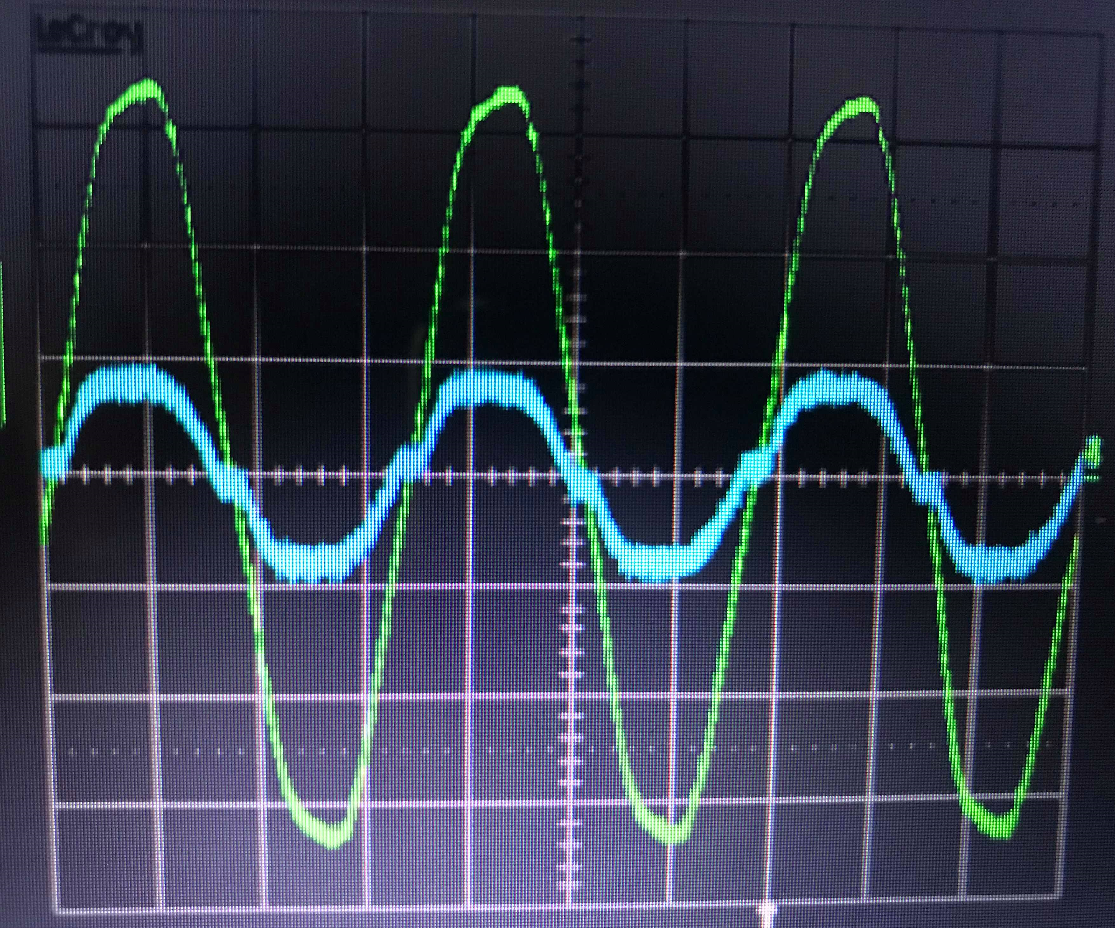
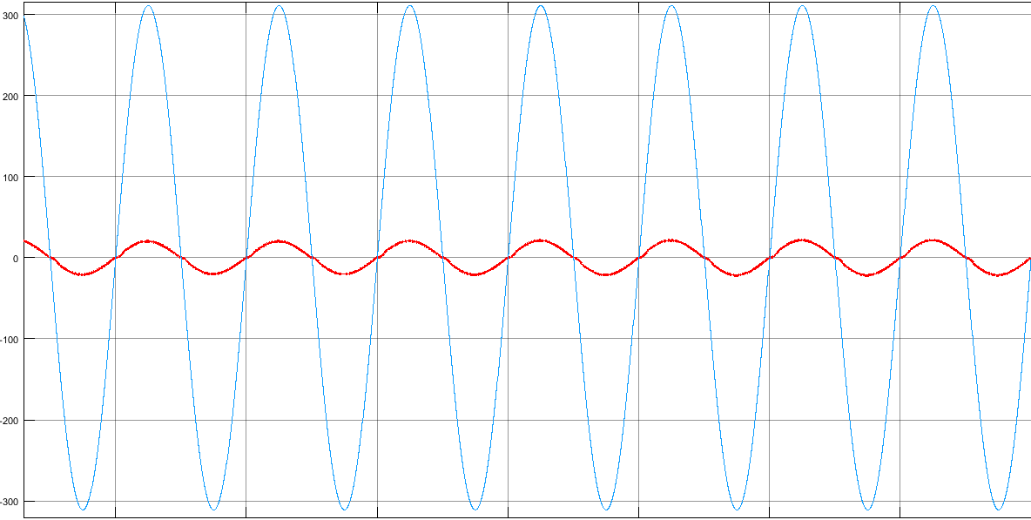
After correction, P.F will nearly unity =0.95

Slide 10
Conclusion
Finally, according to all things that explained before, we can treat the previous circuit after the bridge include DC/DC converter, control loop as a resistive load.
Note that the efficiency of the system after correction = 92.28%.

