Slide 1

Graduation Project II
3D Dynamic Analysis And Design of Al-Bathan Tourist Resort
An-Najah National University
Faculty of Engineering
Civil Engineering Department
By:
Ihab Tawfiq To’ma (11107459)
Mohammad Saber Jaradat (11107811)
Taher Nidal Jayyousi (11106466)
Supervisor Name :
Dr. Mounther Diab

Slide 2
Agenda
Introduction
Dynamic analysis
    Modes and Periods
    Response Spectrum Analysis
Design of Block A

Slide 3
Introduction
What we did in GP I

Slide 4
Introduction
GP I
Definition of Gravity Loads and Materials
Loads type and Values on slab of Zone A , B
Loads type and Values on slab of Zone C , D

Slide 5
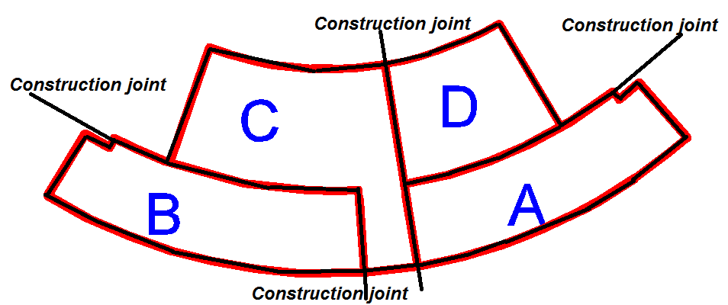
Introduction
GP I
Preliminary Design and Structural system

Slide 6
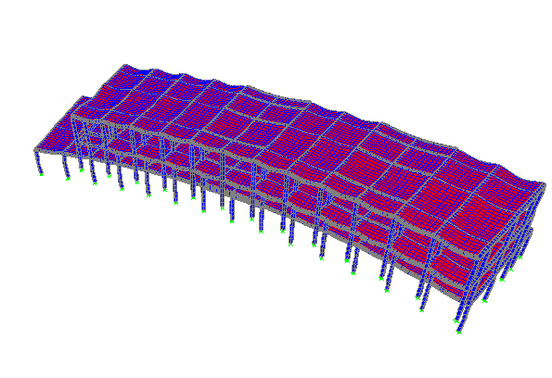
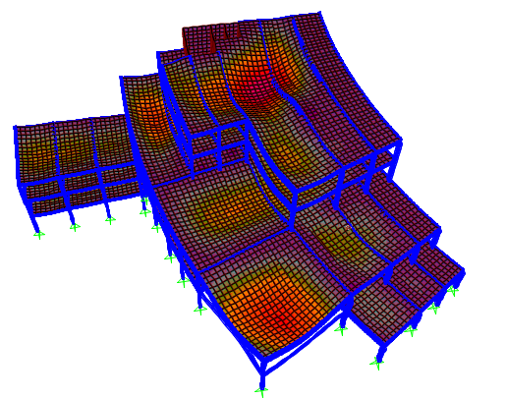
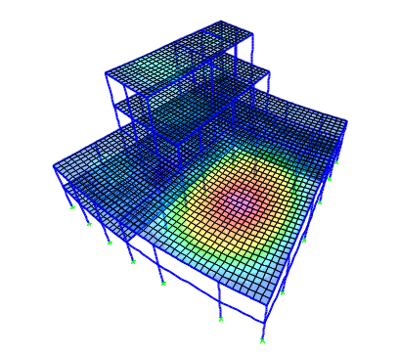
Introduction
GP I
Zone A
3-D Analysis using SAP
Zone C
Zone D

Slide 7
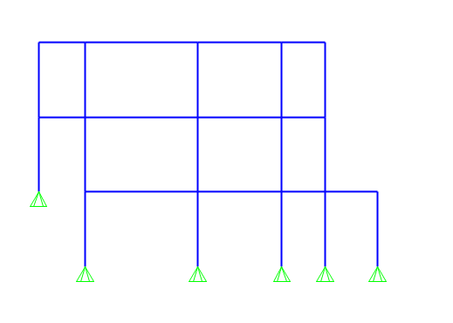
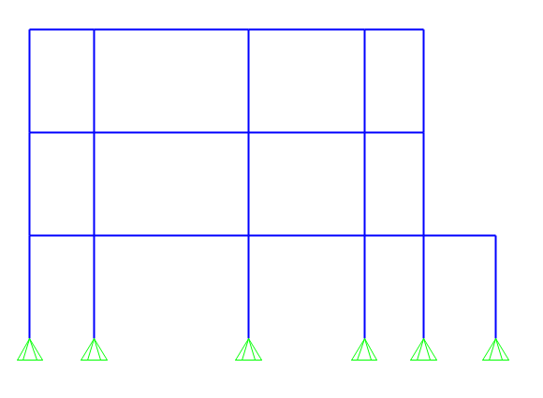
Introduction
GP I
Problems were Found in The Models

Slide 8
Dynamic analysis
Modes and Periods
Response Spectrum Analysis

Slide 9
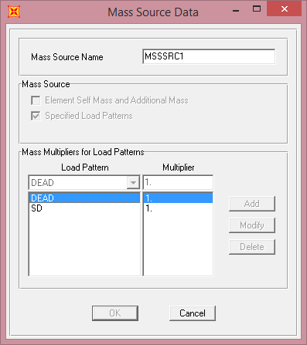
Dynamic analysis
Modes and Periods
Definition of mass source

Slide 10
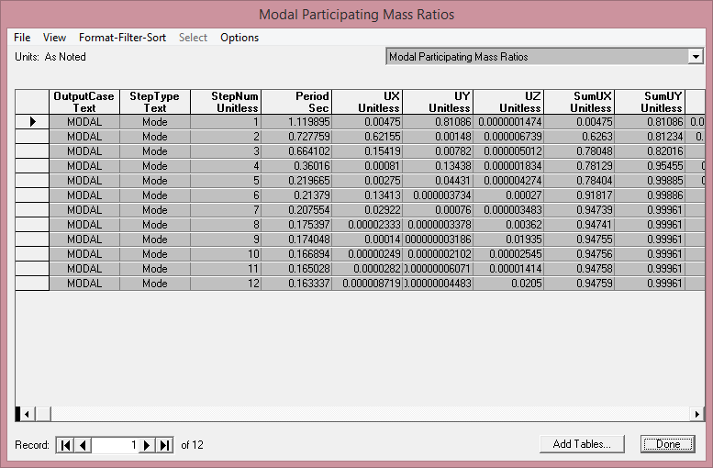
Dynamic analysis
Modes and Periods
Modal Mass Participation Ratio

Slide 11
Dynamic analysis
Modes and Periods

Slide 12
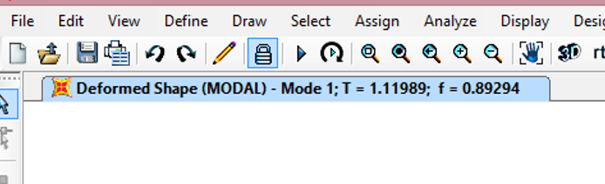
Dynamic analysis
Modes and Periods
Period in Y-direction
From SAP (mode 1): T=1.119 sec.

Slide 13


Dynamic analysis
Modes and Periods
Period in Y-direction
From manual calculations (Rayleigh method)
$T_{re}.=2π\sqrt{\frac{Σ(mass∗Δ^{2})}{Σ(F∗Δ)}}=2π∗\sqrt{\frac{1.437}{46.47}}=1.105$
floor | mass | force | Deff. | mass*d2 | force*d
 | ton | KN | m
B4 | 1234.022 | 810 | 0.0261 | 0.840628 | 21.141
B5 | 1234.022 | 810 | 0.0196 | 0.474062 | 15.876
B6 | 1694.115 | 1112 | 0.0085 | 0.1224 | 9.452
SUM | 4162.16 | 2732 |  | 1.43709 | 46.469
$$\%Difference=\frac{1.119−1.105}{1.105}∗100\%=1.2\%⟹OK$$

Slide 14
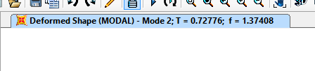
Dynamic analysis
Modes and Periods
Period in X-direction
From SAP (mode 2): T=0.7277 sec.

Slide 15


Dynamic analysis
Modes and Periods
Period in X-direction
From manual calculations (Rayleigh method)
$T_{re}.=2π\sqrt{\frac{Σ(mass∗Δ^{2})}{Σ(F∗Δ)}}=2π∗\sqrt{\frac{0.232}{18.24}}=0.71 sec.$
floor | mass | force | Deff. | mass*d2 | force*d
 | ton | KN | m
B4 | 1234.022 | 810 | 0.011 | 0.149317 | 8.91
B5 | 1234.022 | 810 | 0.0074 | 0.067575 | 5.994
B6 | 1694.115 | 1112 | 0.003 | 0.015247 | 3.336
SUM | 4162.16 | 2732 |  | 0.232139 | 18.24
$$\%Difference=\frac{0.7277−0.71}{1.105}∗100\%=2.56\%⟹OK$$

Slide 16
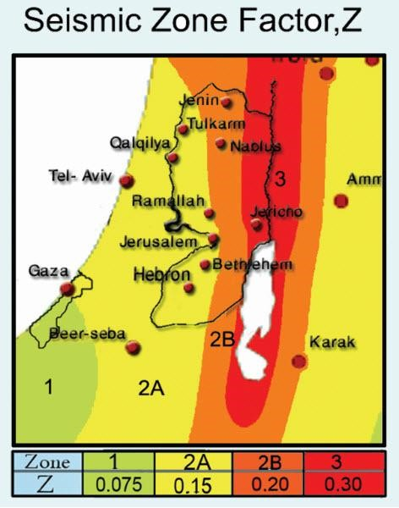
Dynamic analysis
Response Spectrum Analysis
IBC 2012/ASCE 7-10 Seismic Loads factors.
Z-factor
The mapped spectral accelerations for a one- second period:
S_1 = 1.25 * Z = 1.25 * 0.2 = 0.25 Israel standard SI 413 -202.1.2-2b
The mapped spectral accelerations for short period:
S_s = 2.5 * Z = 2.5 * 0.2 = 0.5 Israel standard SI 413 -202.1.2-2a

Slide 17
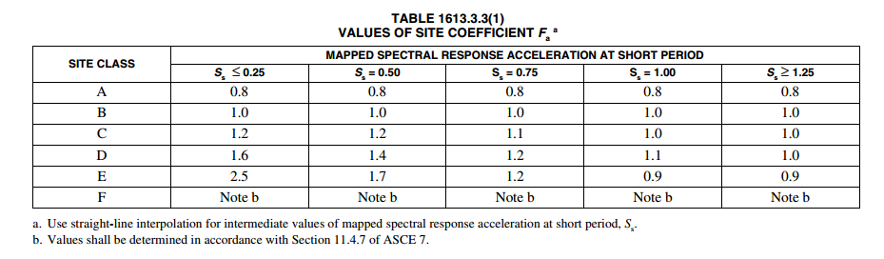
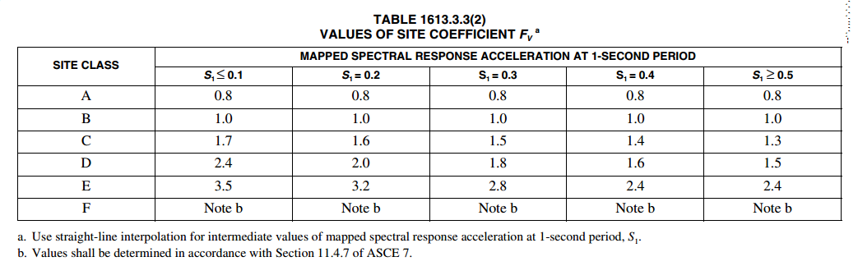


Dynamic analysis
Response Spectrum Analysis
IBC 2012/ASCE 7-10 Seismic Loads factors.
$$S_{MS}=S_{S}∗F_{a} \left(Equation 16−37, IBC 2012\right)$$
$$S_{M1}=S_{1}∗F_{v} (Equation 16−38, IBC 2012)$$
$$⟹S_{MS}=0.5∗1.4=0.7$$
$$⟹S_{M1}=0.25∗1.9=0.475$$
1.9

Slide 18

Dynamic analysis
Response Spectrum Analysis
IBC 2012/ASCE 7-10 Seismic Loads factors.
$$S_{DS}=2/3 S_{MS} (Equation 16−39, IBC 2012)$$
$$S_{D1}=2/3 S_{M1} (Equation 16−40, IBC 2012)$$
$$S_{DS}=\frac{2}{3}∗ 0.7= 0.4667$$
$$S_{D1}=\frac{2}{3}∗ 0.475=0.3167$$

Slide 19
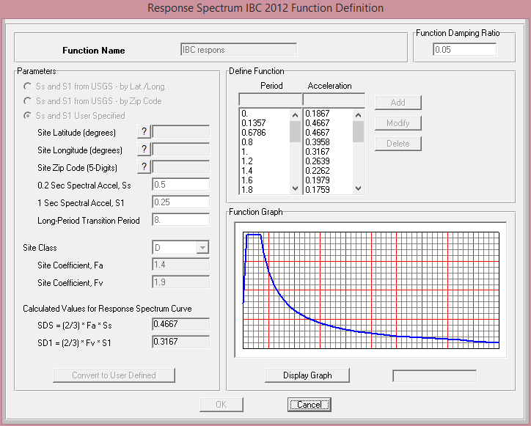
Dynamic analysis
Response Spectrum Analysis
Response spectrum function definition

Slide 20
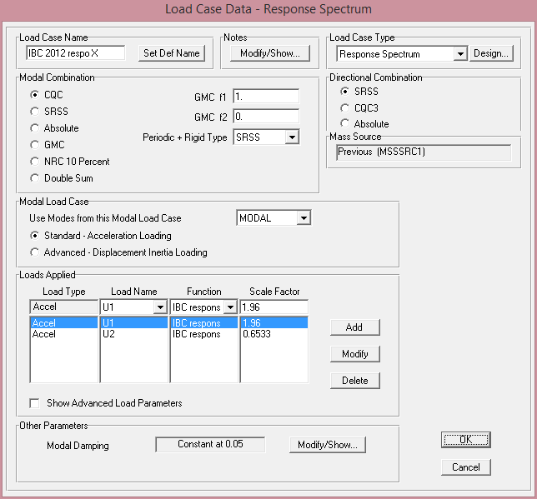
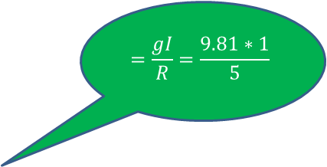

$$=\frac{gI}{R}=\frac{9.81∗1}{5}$$
$$=0.33∗1.96$$

Slide 21


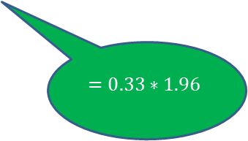
$$=\frac{gI}{R}=\frac{9.81∗1}{5}$$
$$=0.33∗1.96$$

Slide 22
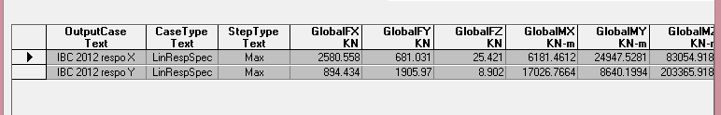
Dynamic analysis
Response Spectrum Analysis
Base Shear (V) from response spectrum

Slide 23
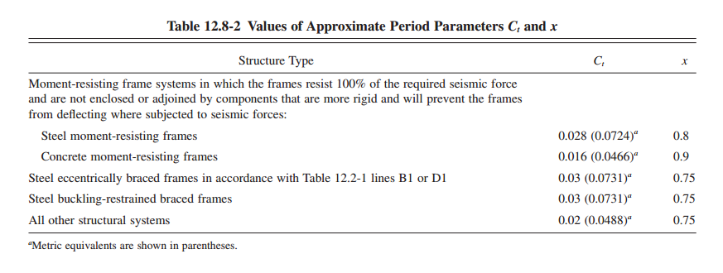
Dynamic analysis
Response Spectrum Analysis
Equivalent Static Calculations:
$$T = Fundamental period of the structure=C_{T}h_{n }^{x}$$
⟹T=0.0466*120.9=0.44 sec.

Slide 24


Dynamic analysis
Response Spectrum Analysis
Equivalent Static Calculations:
$$C_{S}=\frac{S_{DS}∗I}{R}=\frac{0.4667∗1}{5}=0.09334$$
The value of Cs shall not be less than:
$$C_{s min}=0.044S_{DS}I_{e}=0.044∗0.4667=0.0205$$
The value of Cs shall not be more than:
$$C_{s max}= \frac{S_{D1}∗I}{T∗R}=0.144$$

Slide 25

Dynamic analysis
Response Spectrum Analysis
Equivalent Static Calculations:
$$⟹C_{s}=0.09334$$
$$⟹V=0.09334∗40789.164=3807.26 KN$$

Slide 26

Dynamic analysis
Response Spectrum Analysis
Vertical distribution of seismic forces
Fx = Cvx V (Equation 12.8-11, ASCE 7 2010)
$$C_{vx}=\frac{W_{x}∗h_{x}^{k}}{Σw_{i}∗h_{i}^{k}}$$
(Equation 12.8-12, ASCE 7 2010 )
Floor | Wi | Hi | Wi*Hi | Cvx | Vi
 | KN | m |  |  | KN
B4 | 12105.76 | 12 | 145269.1 | 0.470748 | 1792.259
B5 | 12105.76 | 8 | 96846.08 | 0.313832 | 1194.84
B6 | 16619.27 | 4 | 66477.06 | 0.21542 | 820.1615
SUM | 40830.79 |  | 308592.3 |  | 3807.261

Slide 27
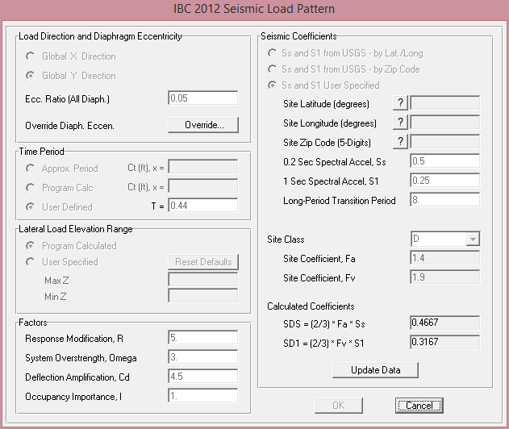
Dynamic analysis
Response Spectrum Analysis
Equivalent Static Check by SAP:

Slide 28
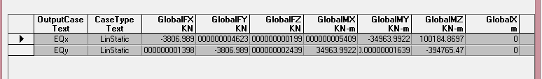
Dynamic analysis
Response Spectrum Analysis
Equivalent Static Check by SAP:

Slide 29

Dynamic analysis
Response Spectrum Analysis
Equivalent Static Calculations:
The scale factor for the X-direction must multiply by:
$$\frac{V_{ESM}}{V_{Res}.}=\frac{3807}{2580.55}=1.48$$
The scale factor for the Y-direction must multiply by:
$$\frac{V_{ESM}}{V_{Res}.}=\frac{3807}{1906}= 2$$

Slide 30
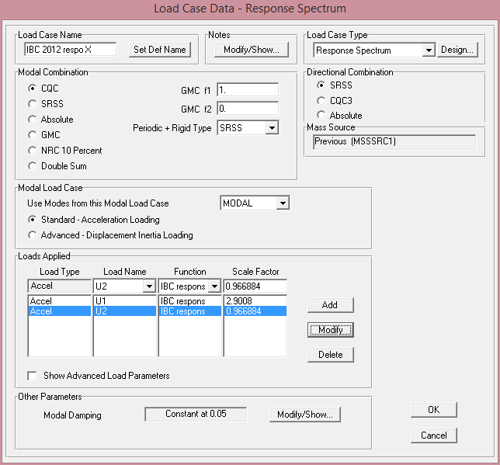
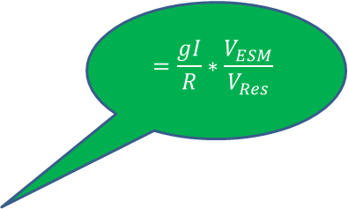

$$=\frac{gI}{R}∗\frac{V_{ESM}}{V_{Res}}$$
$$=0.33∗2.9$$

Slide 31
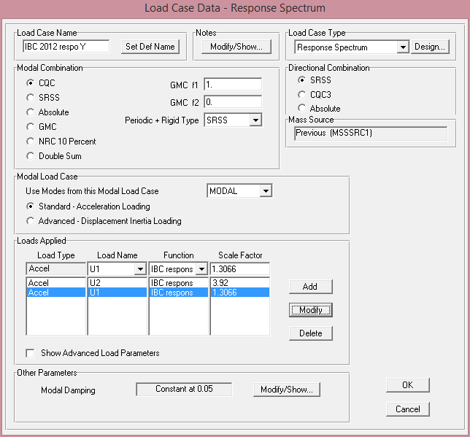
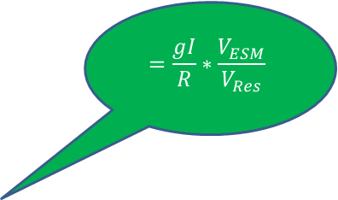
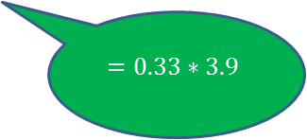
$$=\frac{gI}{R}∗\frac{V_{ESM}}{V_{Res}}$$
$$=0.33∗3.9$$

Slide 32
Design of Block A
Load combinations
DESIGN OF SLAB
DESIGN OF BEAMS
DESIGN OF COLUMNS
DESIGN OF FOOTINGS

Slide 33
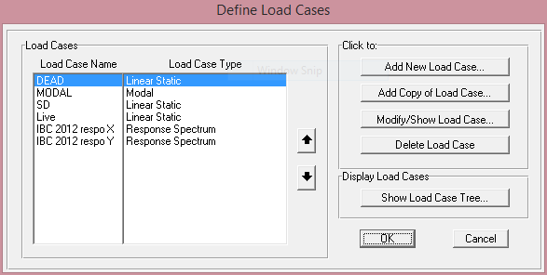
Design of Block A
Load cases

Slide 34
Design of Block A
Load combinations
• 1.4 D.L
• 1.2 D.L + 1.6 L.
• 1.2 D.L + 1.0 L. + 1.0 R.Spectrum (x)
• 1.2 D.L + 1.0 L. + 1.0 R.Spectrum (y)
• 0.9 D.L + 1.0 R.Spectrum (x)
• 0.9 D.L + 1.0 R.Spectrum (y)

Slide 35
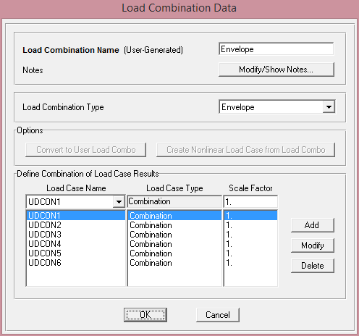
Design of Block A
Load combinations
* Envelope

Slide 36
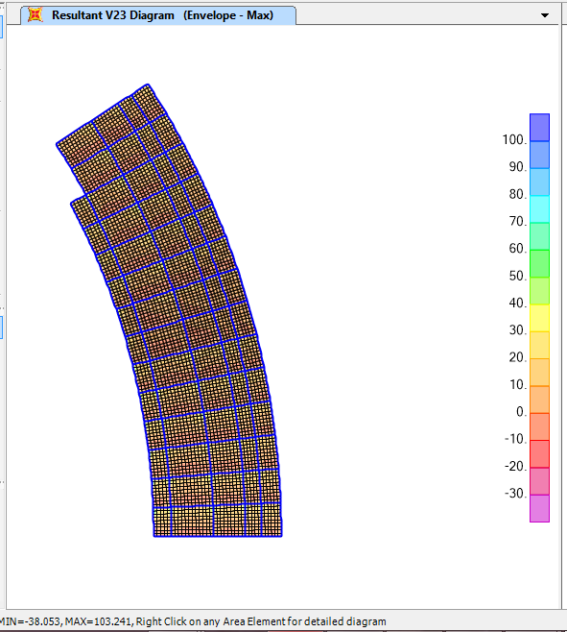

Design of Block A
DESIGN OF SLAB
$$φV_{c}=φ\frac{1}{6}\sqrt{f_{c}^{′}}b_{w}d=0.75∗\frac{1}{6}∗\sqrt{28}∗1000∗160=141106N$$
$$φV_{c}=141KN>103.23KN⟹OK$$

Slide 37
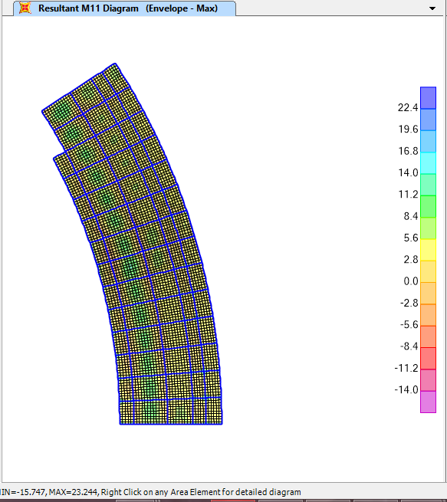


Design of Block A
DESIGN OF SLAB
$$For+ve moment$$
$$=\frac{0.85∗28}{240}\left(1−\sqrt{1−\frac{2.62∗23.24∗{10}^{6}}{1000∗{160}^{2}∗28}}\right)=0.0043$$
$$⟹A_{s}=0.0043∗1000∗160=688.8 mm^{2}$$
$$⟹use 7φ12/m for bottom steel$$

Slide 38
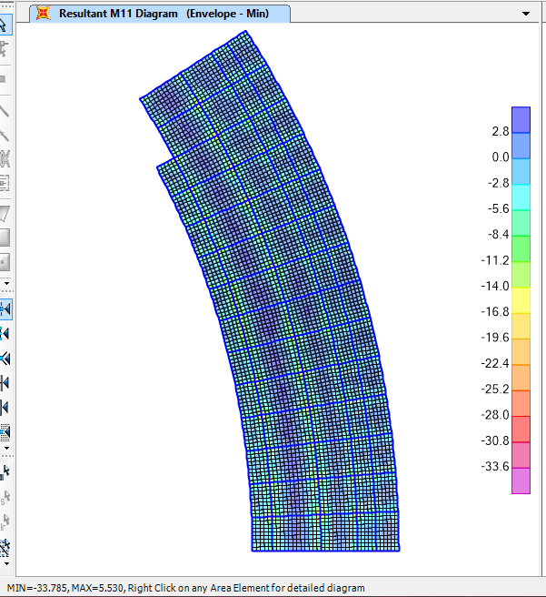

Design of Block A
DESIGN OF SLAB
$$For −ve moment$$
$$=\frac{0.85∗28}{240}\left(1−\sqrt{1−\frac{2.62∗33.785∗{10}^{6}}{1000∗{160}^{2}∗28}}\right)=0.0063$$
$$⟹A_{s}=0.0063∗1000∗160=1012 mm^{2}$$
$$⟹use 9φ12/m for top steel$$

Slide 39

Design of Block A
DESIGN OF SLAB
And for the other direction (Y-direction) use minimum steel
$$A_{s,min}=0.0018bd=0.0018∗1000∗160=288$$
$$⟹use 4φ12/m for bottom and top steel$$

Slide 40
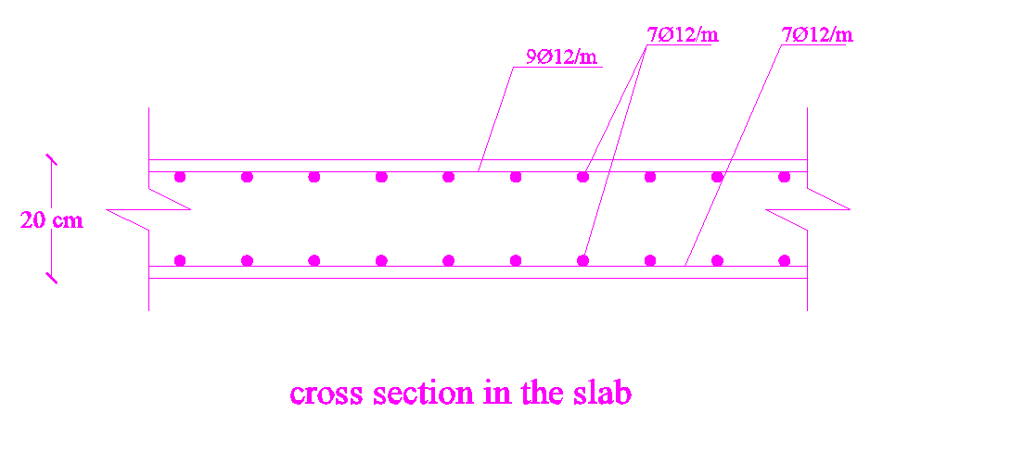
Design of Block A
DESIGN OF SLAB

Slide 41
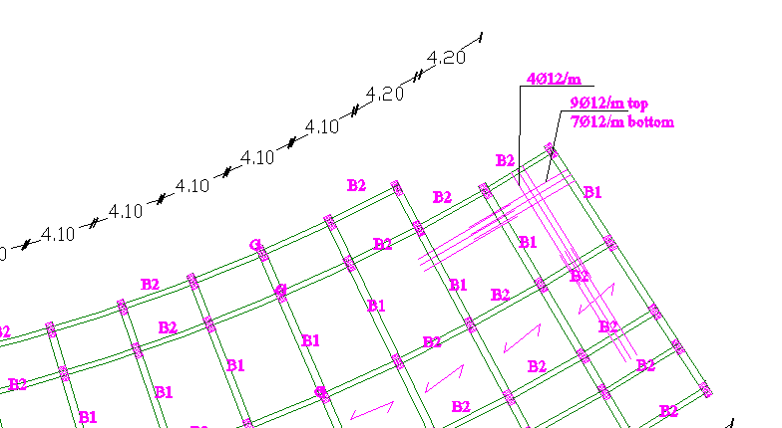
Design of Block A
DESIGN OF SLAB

Slide 42
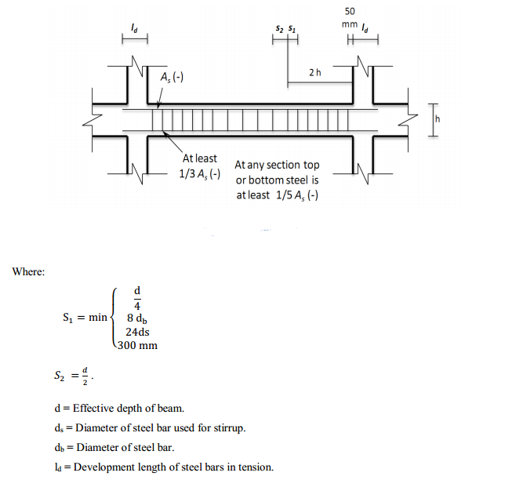
Design of Block A
DESIGN OF BEAMS

Slide 43
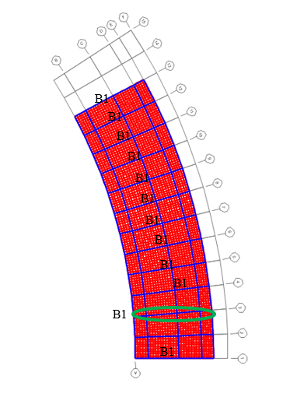
Design of Block A
DESIGN OF BEAMS
Design of Beam 1

Slide 44
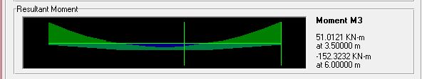

Design of Block A
DESIGN OF BEAMS
Design of Beam 1
$$M_{+ve,max}=51 KN.m$$
$$M_{−ve,max}=152.32 KN.m$$

Slide 45

Design of Block A
DESIGN OF BEAMS
Design of Beam 1
$$For +ve moment$$
$$=\frac{0.85∗28}{240}\left(1−\sqrt{1−\frac{2.62∗51∗{10}^{6}}{300∗{440}^{2}∗28}}\right)=0.0041$$
$$⟹A_{s}=0.0041∗300∗440=550 mm^{2}$$
$$⟹use 3φ16 for bottom steel$$

Slide 46

Design of Block A
DESIGN OF BEAMS
Design of Beam 1
$$For−ve moment$$
$$=\frac{0.85∗28}{240}\left(1−\sqrt{1−\frac{2.62∗152.32∗{10}^{6}}{300∗{440}^{2}∗28}}\right)=0.013$$
$$⟹A_{s}=0.013∗300∗440=1714 mm^{2}$$
$$⟹use 8φ16 for top steel$$

Slide 47
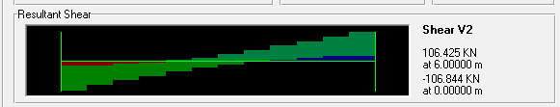

Design of Block A
DESIGN OF BEAMS
Design of Beam 1
consistent spacing between stirrups:
$$V_{c}=φ\frac{1}{6}\sqrt{f_{c}^{′}}b_{w}d=\frac{1}{6}∗\sqrt{28}∗300∗440=116.4KN$$
$$V_{s}=\frac{106.8}{0.75}−116.4=26KN$$
$$\frac{A_{V}}{s}=\frac{V_{S}}{f_{yt}d}=\frac{26∗1000}{420∗440}=0.14$$

Slide 48

Design of Block A
DESIGN OF BEAMS
Design of Beam 1
$${\left(\frac{A_{v}}{s}\right)}_{min}=\max\left\{\begin{aligned}0.062\sqrt{f_{c}^{′} }\frac{{ b}_{w}}{f_{yt}}=0.23 \\ \frac{0.35b_{w}}{f_{yt}}=0.25\end{aligned}⟹\frac{A_{v}}{s}\right.=0.25$$
$$Using stirrups diameter of 10 mm:$$
$$S =\frac{157}{0.25}=628mm$$

Slide 49

Design of Block A
DESIGN OF BEAMS
Design of Beam 1
$$s_{1}=\min\left\{\begin{aligned}\frac{d}{4}=\frac{440}{4}=110 mm \\ 8d_{b}=8∗16=128 mm \\ 24d_{s}=24∗10=240 mm \\ 300 mm\end{aligned}⟹s_{1}=110mm⟹use1φ10@10cm\right.$$
$$s_{2}=\frac{d}{2}=\frac{440}{2}=220 ⟹use 1φ10@15cm$$
From the face of support to a distance equal 2h= 1 m, use S1 between stirrups. Else, use S2.

Slide 50
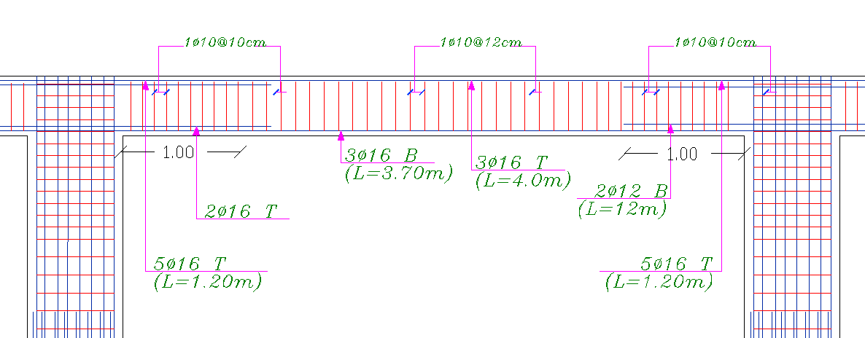
Design of Block A
DESIGN OF BEAMS
Design of Beam 1

Slide 51
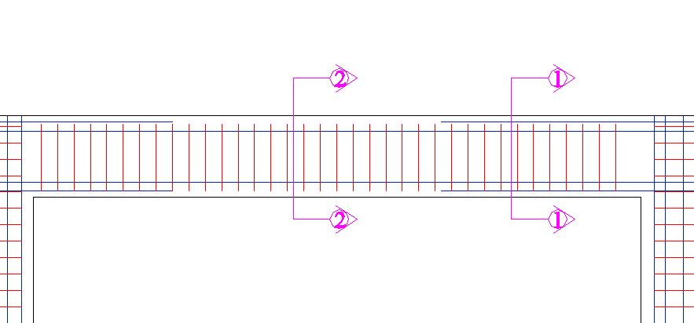
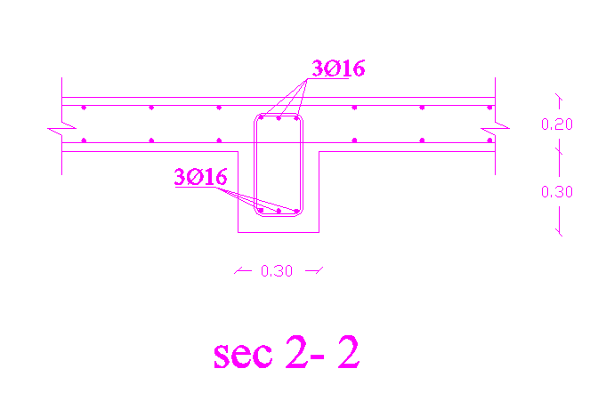
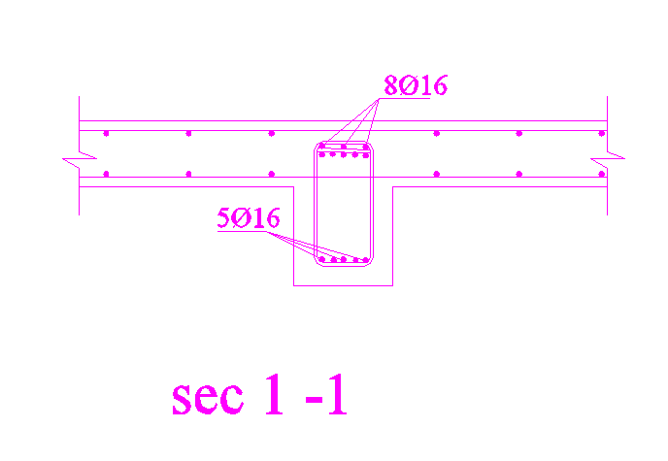
Design of Block A
DESIGN OF BEAMS
Design of Beam 1

Slide 52
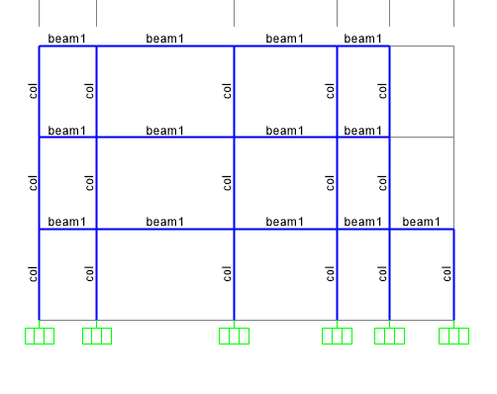
Design of Block A
DESIGN OF columns
Select The Certain Column

Slide 53
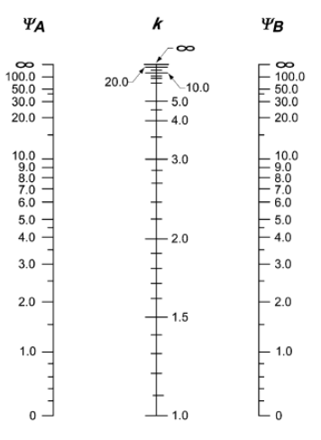


Design of Block A
DESIGN OF columns
Check Slenderness in Sway(Unbraced) Frames:
The ACI Code Allows Slenderness Effects to Be Ignored If:
$$\frac{kl_{u}}{r}≤22$$
$ψ=\frac{Σ{\left(\frac{EI}{L}\right)}_{columns}}{Σ{\left(\frac{EI}{L}\right)}_{beams}}$ =1.6 => k=1.4

Slide 54

Design of Block A
DESIGN OF columns
$$\frac{kl_{u}}{r}=19.6$$
No Slenderness in The Column, And Can Be Classified as Short column

Slide 55
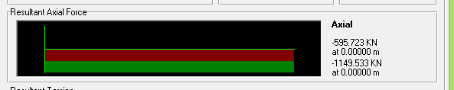
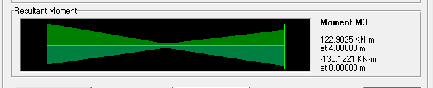

Design of Block A
DESIGN OF columns
$(\frac{ØP_{n}}{b h})$ / 7 = $(\frac{1149.5x{10}^{3}}{400x800})$ / 7 = 0.52 ksi.
$(\frac{ØM_{n}}{b h^{2}})$ / 7 = $(\frac{135x{10}^{6}}{400{x800}^{2}})$ / 7 = 0.753 ksi.

Slide 56
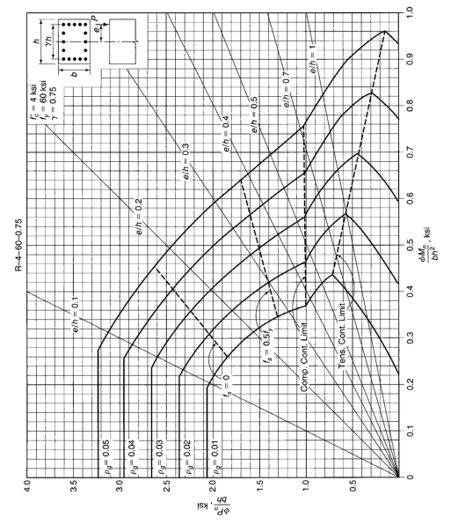

Design of Block A
DESIGN OF columns
$$⟹ρ=1\%$$

Slide 57
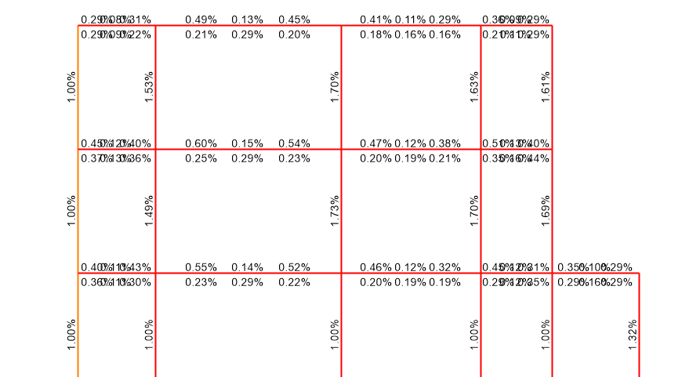


Design of Block A
DESIGN OF columns
$$ρFrom SAP=1.73\%$$
$$⟹As=5536 mm2$$
$$⟹use20∅18$$

Slide 58
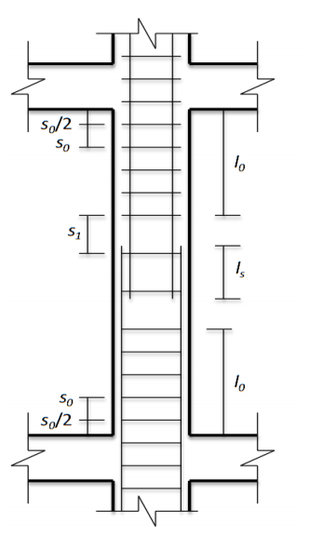


Design of Block A
DESIGN OF columns

Slide 59


Design of Block A
DESIGN OF columns

Slide 60

Design of Block A
DESIGN OF FOOTINGS
Group | Max. serves load | Max. ultimate load | Dimension
F1 | 1200 KN | 1700 KN | 2m*2m
F2 | 600 KN | 800 KN | 1.5m*1.5m

Slide 61


Design of Block A
DESIGN OF FOOTINGS
Design single footing F2
$$P_{u}=1700KN⟹q_{u}=\frac{1700}{2∗2}=420KN/{m^{2}}$$

Slide 62

Design of Block A
DESIGN OF FOOTINGS
Design single footing F2
$$M_{u}=\frac{q_{u}L^{2}}{2}=\frac{420∗{0.85}^{2}}{2}=151.7KN.m$$
$$⟹ρ=0.0035⟹A_{s}=1600 mm^{2}$$
$$A_{s,min}=0.0018∗1000∗500=900⟹usu A_{s}=1600 mm^{2}$$
$⟹usu 8φ16/m$in each direction

Slide 63


Design of Block A
DESIGN OF FOOTINGS
Design single footing F2

Slide 64
Discussion & Conclusion

