Slide 1





Slide 2

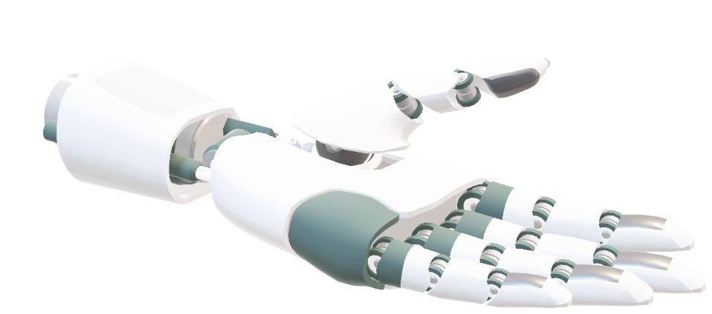
Project Name: Smart Weather Station Supporting Dual Communication (Wi-Fi + PLC)
🎓 Graduation Project 2
University: An-Najah National University
Faculty: Faculty of Engineering
Department: Electrical Engineering Department
Prepared by: Ali Mohammed Ali Al-Khalili, Fathi Fadi Rashed, Kamel Shareef Kamel Quraan, and Mohammed Imad Jawad Zaid
Supervised by: Dr. Omar Al-Tamimi
Academic Year: 2025 / 2026

Slide 3



Introduction
This project aims to design and implement a smart weather station capable of accurately measuring and analyzing weather conditions in real time, with support for dual communication methods, including wireless (Wi-Fi) and power line communication (PLC).
Despite the advancements in weather systems, there is still a clear gap in areas with weak communication network infrastructure.
This gap includes:
The inability to transmit data in real time.
The lack of wireless communications in some areas.

Slide 4


Importance of the Project
· Solving Network Limitations: Uses Power Line Communication (PLC) instead of wireless or fixed internet — ideal for rural and remote areas.
· Using the current power grid :Transmits data through existing electrical lines with no need for new infrastructure.
· Serving Strategic Sectors:
Farming : Real-time weather data for better irrigation and harvesting.
Energy: Improved load management.
Environment: Supports continuous monitoring and early warning systems.

Slide 5


Project Objectives
Build a Smart System
• Collect and analyze real-time weather data.
• Display data on an interactive interface LCD.
Use Communication (wirles+ PLC)
Cost-Efficient & Sustainable
• Use existing power lines — no need for new cables.

Slide 6
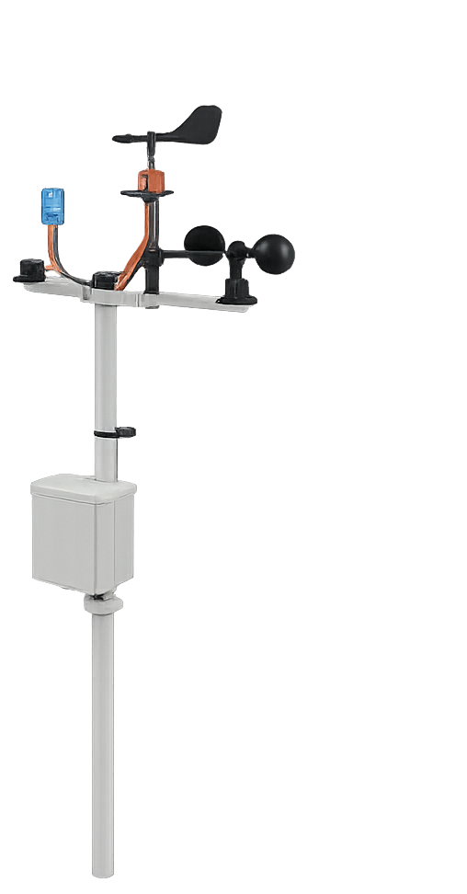


Power Source Used in the Project
(Main power source 220V, Adapter SMPS )
Types of Power Supply Units Used
Component | Function
Main 220V AC | An electrical power source used as the primary energy supply, typically connected through a transformer to a voltage regulator.
SMPS: Switched Mode Power Supply | An electrical adapter that converts voltage from 220V to or 3.3V or 12V or 5V or

Slide 7

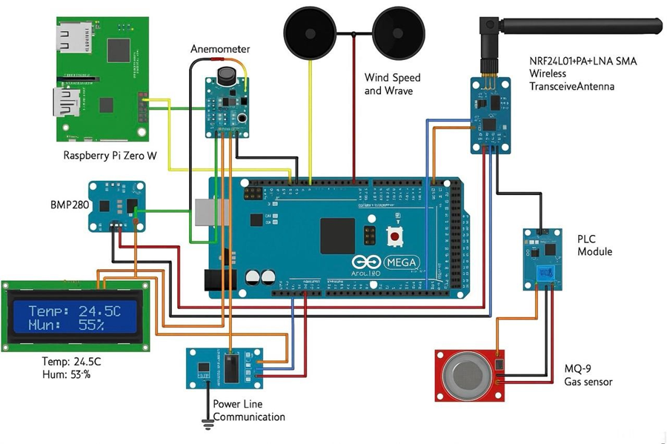
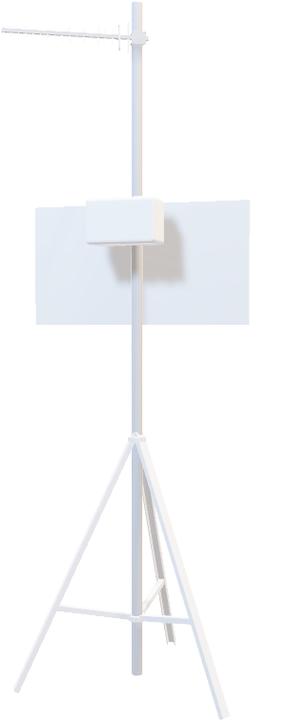
Complete System Diagram
Complete Wiring Diagram
• A wiring diagram showing how to connect:
All sensors and modules to the Arduino Mega
Communication line to the Raspberry Pi

Slide 8
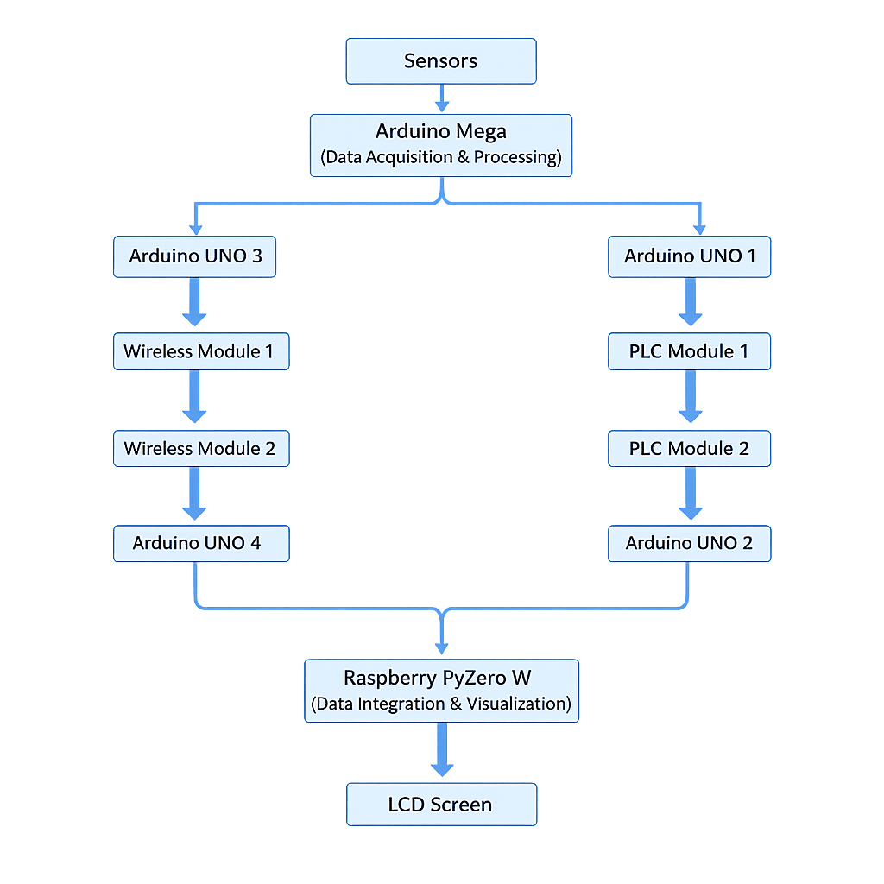
System Flow:

Slide 9
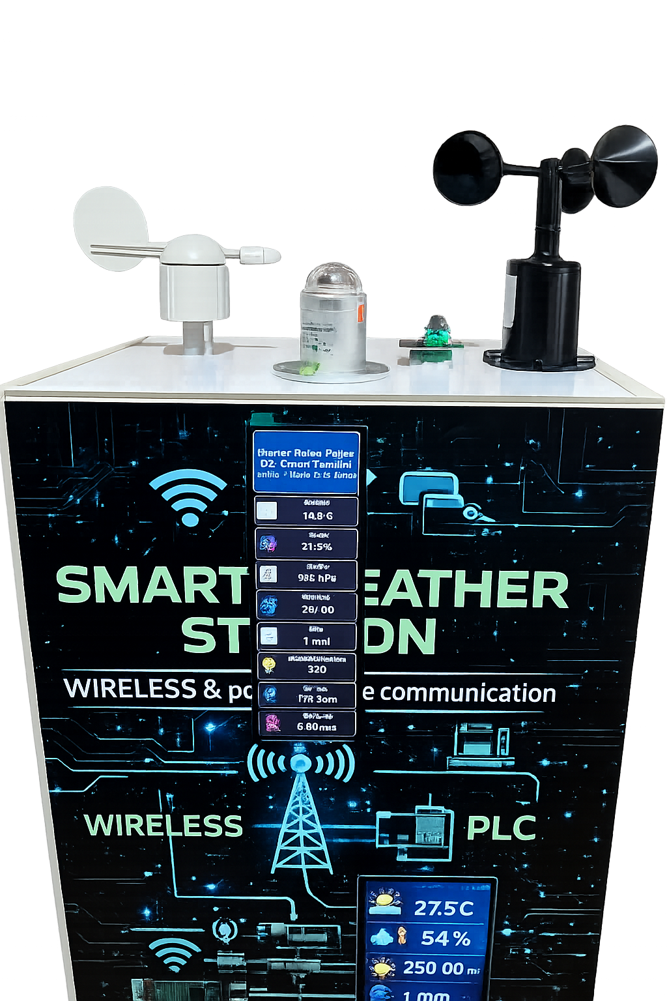
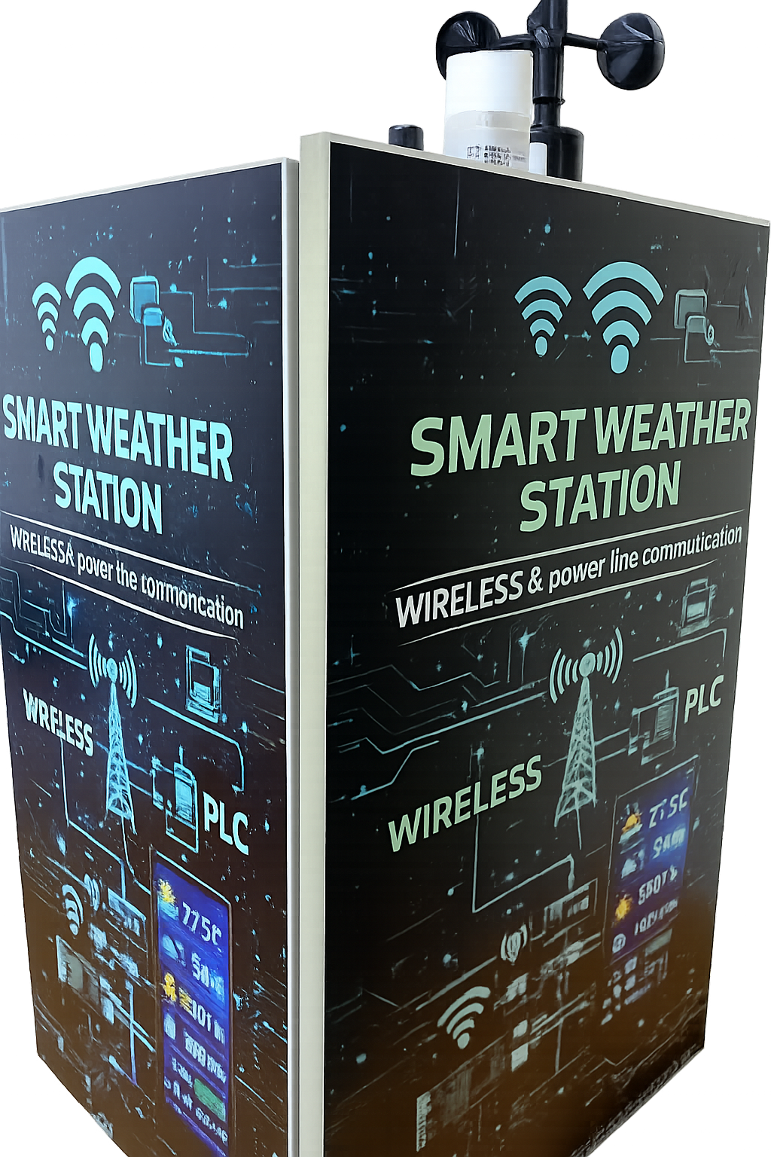

Slide 10
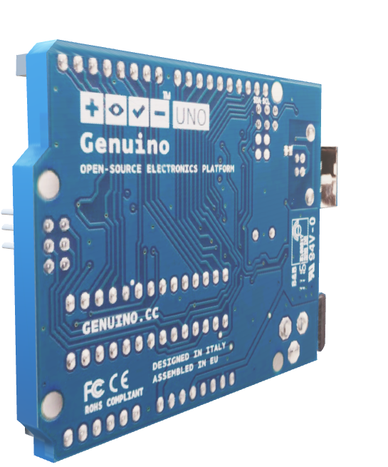
Hardware Components
Type | Component Used
Controller Unit | Arduino UNO -Arduino Mega 2560 – Responsible for reading sensors, processing, and sending to communication units.
Input Units | Sensor set includes: (BME680) It measures atmospheric pressure. It measures temperature . Humidity Sensor Rain Sensor (MH-RD) Gas Sensor (MQ-9) Wind Speed Sensor Wind Direction Sensor Light Meter Sensor
Display Interface | LCD Screen (1280×400) to display data + Raspberry Pi Zero W for a local graphical interface.
Communication Units | • Wi-Fi Module (e.g., NRF24L01) • PLC Module for data transmission over power lines.
Power Supply | • An electrical adapter that converts voltage from 220V to or 3.3V or 12V or 5V
Voltage Regulator | • LM2596-5V Voltage Regulator XL4016DC –DC Buck converter
Voltage Converter | XY-ITOV-4

Slide 11
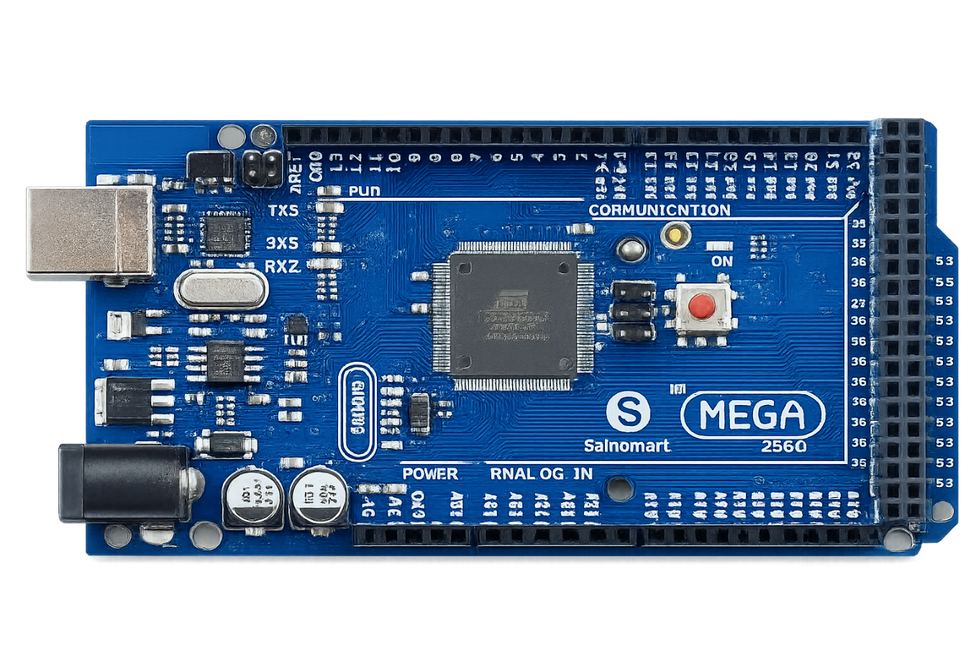

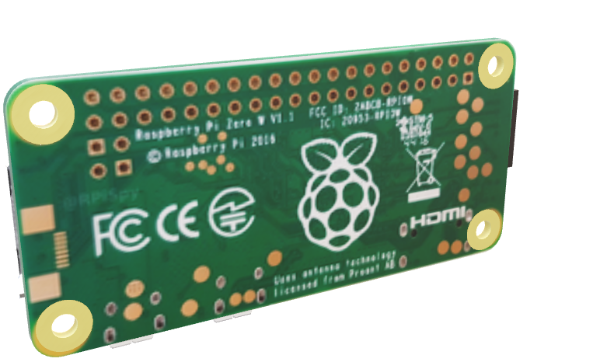
First: A detailed explanation of the hardware components used.
1.Arduino Mega 2560
• Function: Main control unit for sensors.
• Features: Large number of I/O pins and more memory than the Arduino Uno.
• Programming: Arduino IDE (C++) to collect data from sensors and transmit it wirelessly or over power lines.
• Operating voltage:
VIN input = 7–12V
Powered by a voltage regulator or 9V/12V source

Slide 12
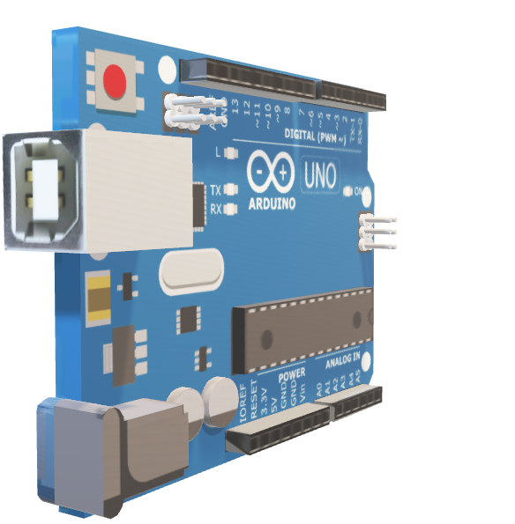
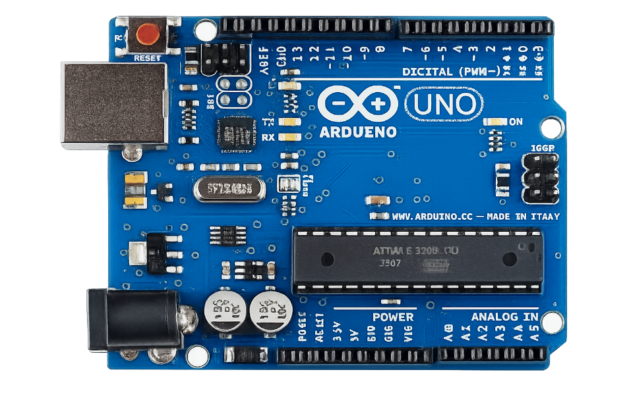
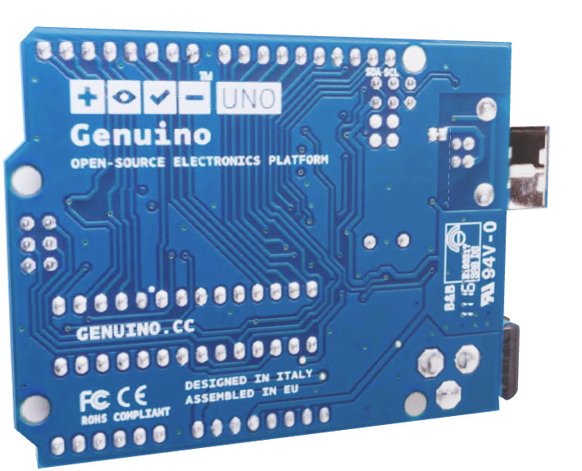
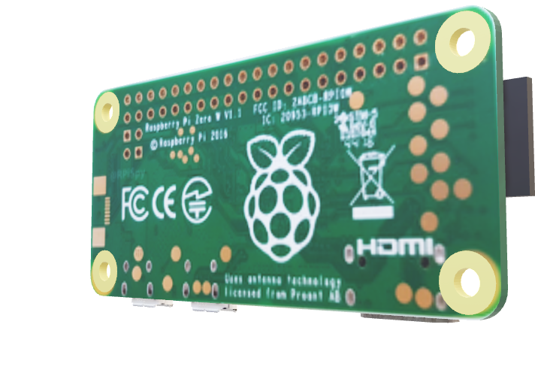
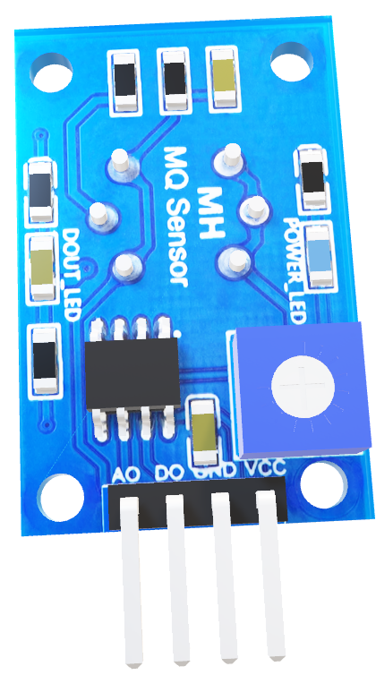

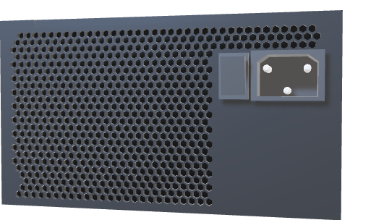
2.Arduino Uno
Key Features:
• Microcontroller: ATmega328P
• Operating Voltage: 5V
• Input Voltage (recommended): 7–12V
• Digital I/O Pins: 14 (6 PWM-capable)
•Analog Input Pins: 6 (A0–A5)
• Flash Memory: 32 KB
• SRAM: 2 KB
•Clock Speed: 16 MHz
• Communication: USB, UART (Serial), I2C, SPI
•Programming: via Arduino IDE through USB cable

Slide 13

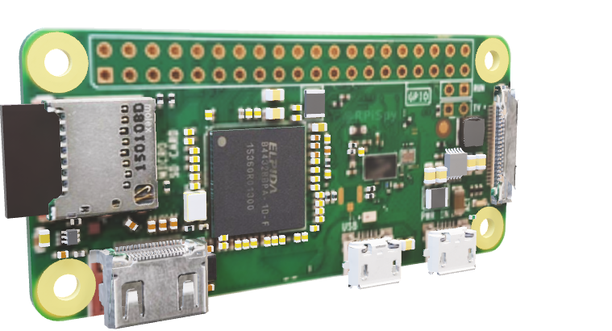
3.Raspberry Pi Zero W:
• Function: Central processing unit used to display and analyze data on a graphical interface.
Features: Wi-Fi support, small size, Linux operating system.
Programming: Python - used to display data on an LCD screen.
Typical operating voltage: 5V via Micro-USB port.

Slide 14
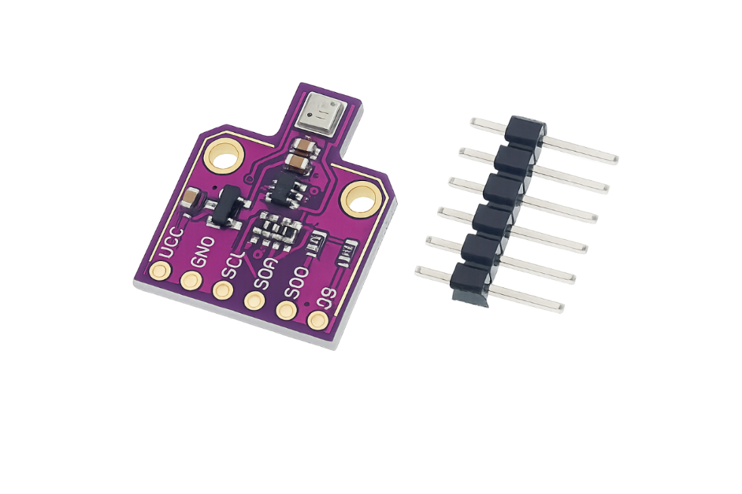

4.BME680 Sensor
Function:
• It measures atmospheric pressure.
It measures temperature and- humidity.
• Accuracy A: More accurate than the DHT11.
• Programming: DHT library for Arduino.
• Operating voltage: 5V

Slide 15
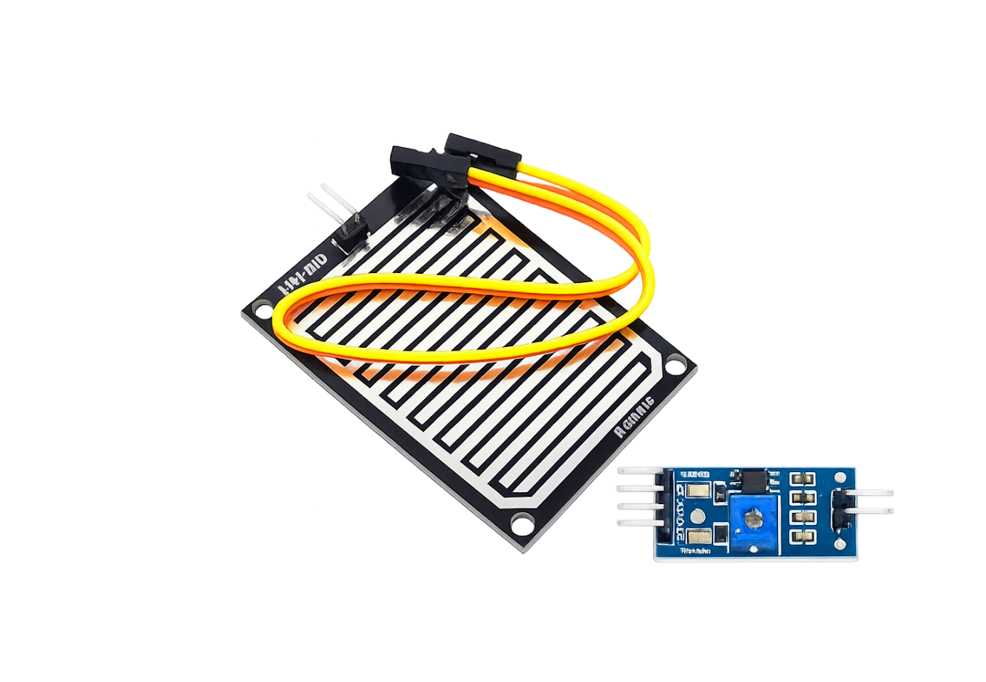
5. MH-RD Rain drop Sensor Module
• Function: Rain sensor.
• Programming: Reading the analog value and converting it to a rain/no rain state.
• Operating voltage: 5V

Slide 16
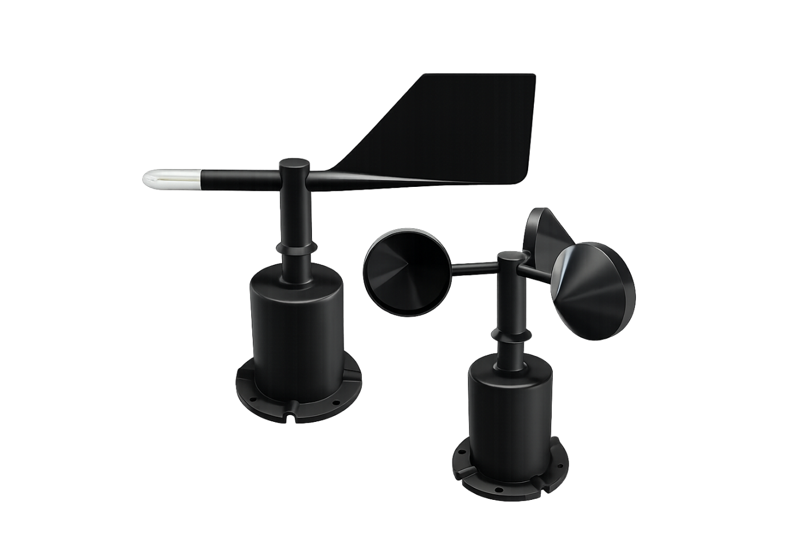
6.Wind Speed and Direction Sensors\ Anemometer and WindVane
• Function: Measuring wind speed and direction.
• Type: Typically analog or digital sensors based on magnetic pulses.
• Programming: Calculating the time between pulses or reading the voltage.
• Operating voltage: 24V
Direction Sensors :5v

Slide 17
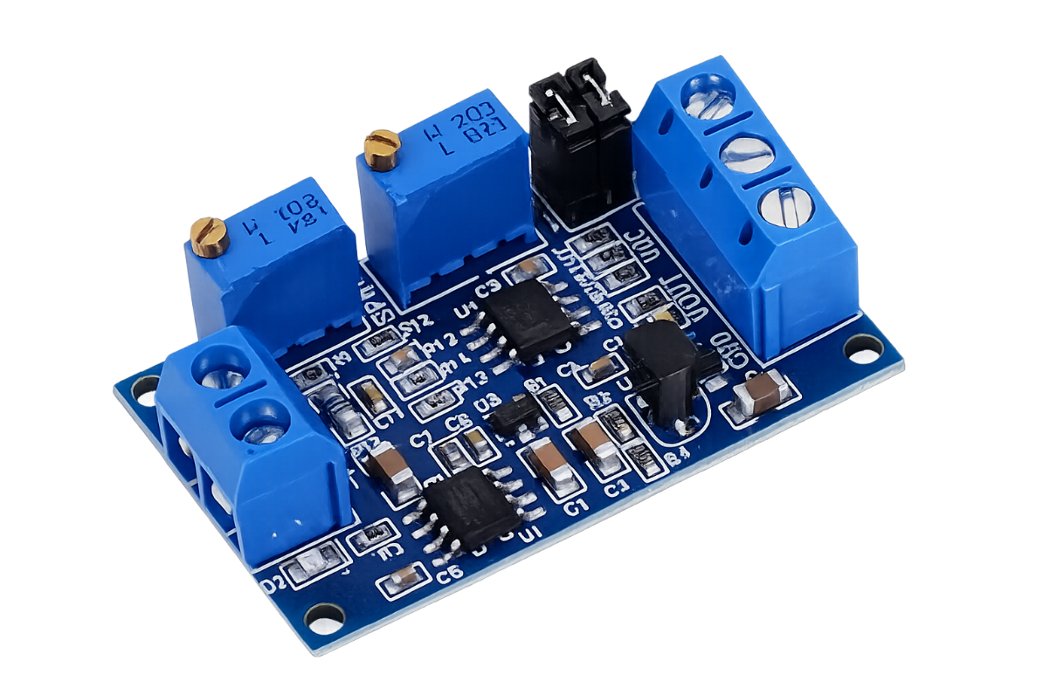
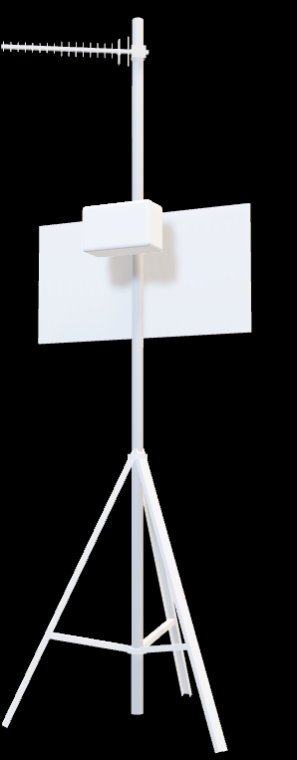
7.Voltage Converter XY-ITOV-4
Main Function:
Converting the 4–20mA current signal coming out of the wind speed sensor into a voltage signal
(0–5V) that can be easily read by an Arduino or any other microcontroller.
Purpose of Using the XY-ITOV Module

Slide 18
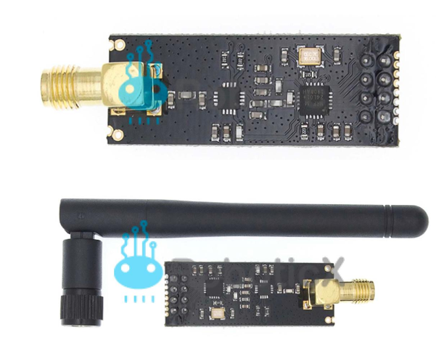
8.WIRELESS COMMUNICATION MODULE - 2.4GHz NRF24L01
• Function: Send data over long distances using low-power radio waves.
• Communication:Serial Peripheral Interface) SPI(.
• Operating voltage: 3.3V

Slide 19
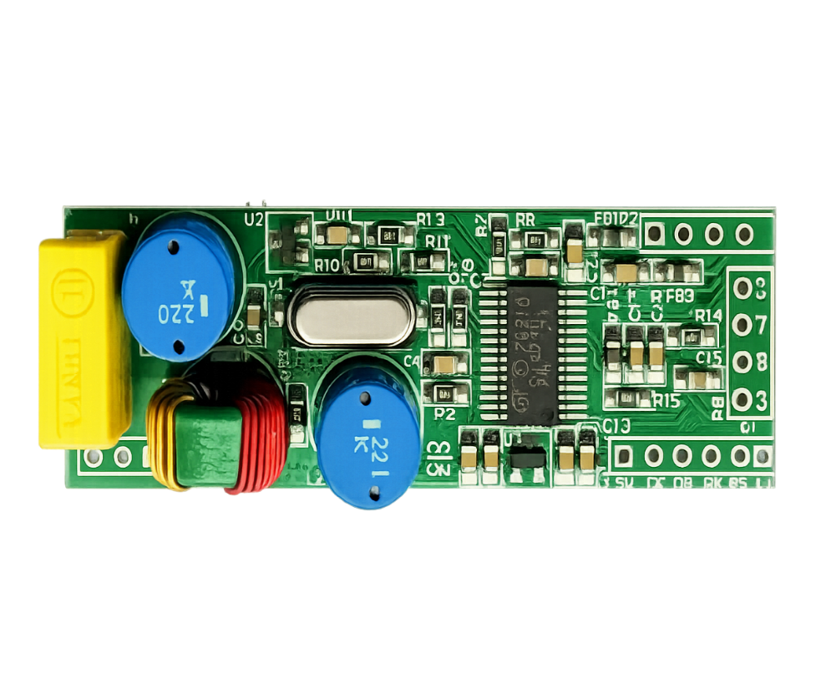
9.Power Line Communication (PLC) Module
Function: Transmits data over power lines.
Connection: Integrates with Arduino Uno
Operating voltage: 10V

Slide 20
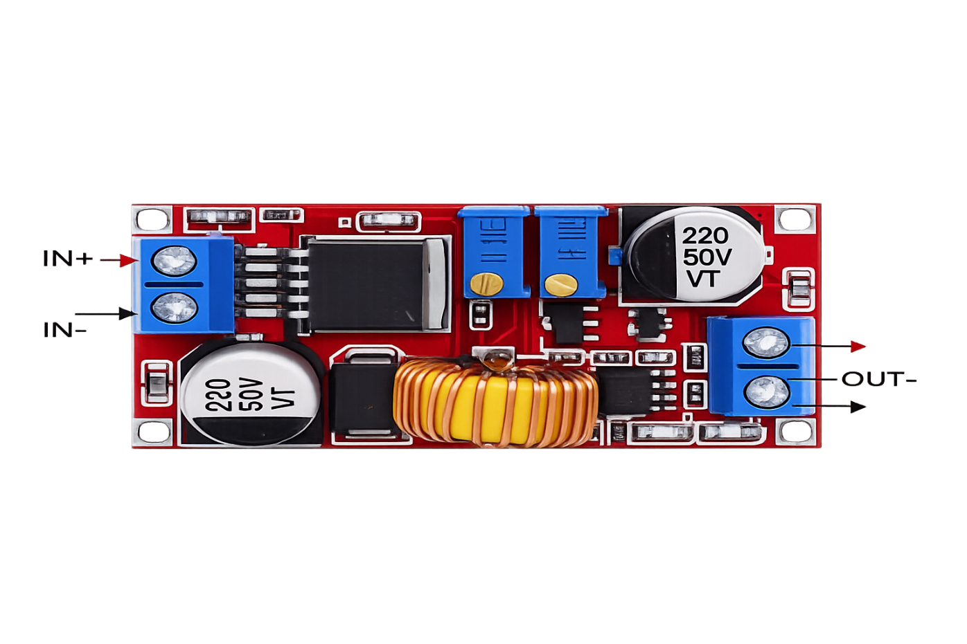
10.Power Regulation Module Description
To ensure safe and stable power delivery to the PLC Power Line Communication module, a DC-DC Buck Converter (XL4016) is used in the system.
This module steps down the input voltage from 12V DC (from the main power source) to a regulated 10V DC, which matches the operating requirements of the PLC communication circuit.

Slide 21
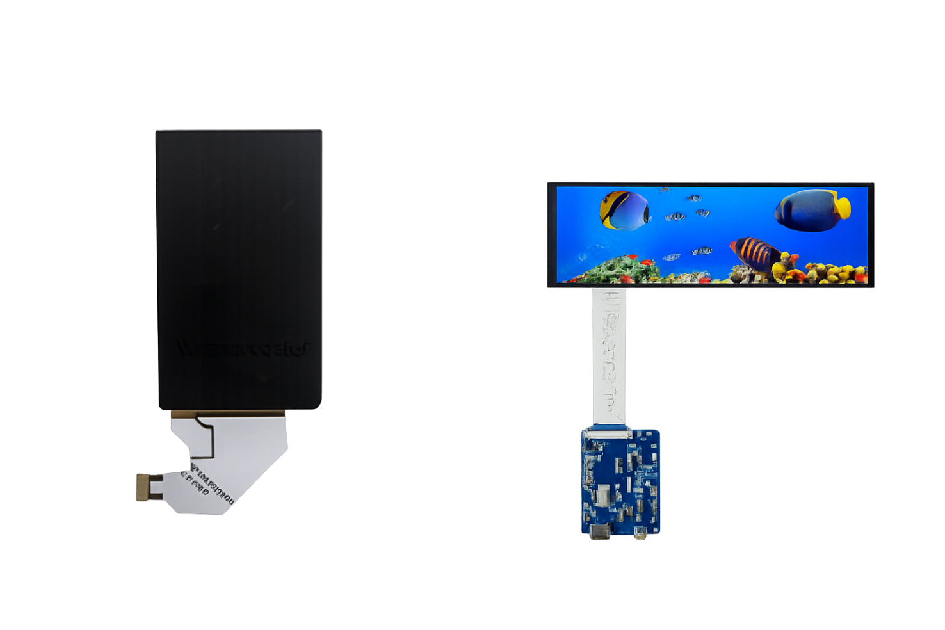
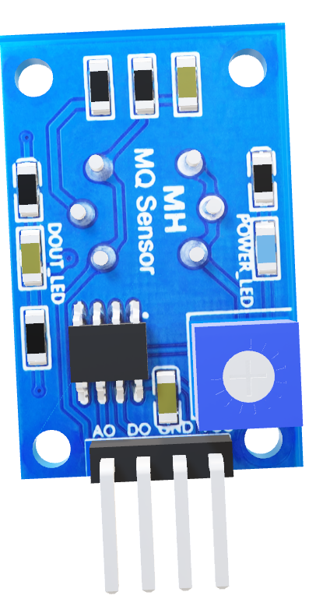
11.LCD screen
• Function: Displays data directly to the user.
• Operating voltage: 5V

Slide 22
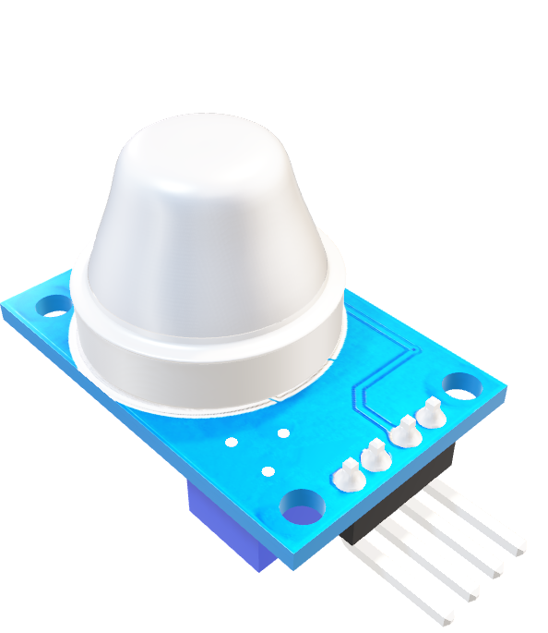
12.MQ-9 – Gas Sensor Module
Its primary function:
Detecting flammable and toxic gases, especially:
• (CO)
• Methane (CH₄)
• Operating voltage: 5V

Slide 23
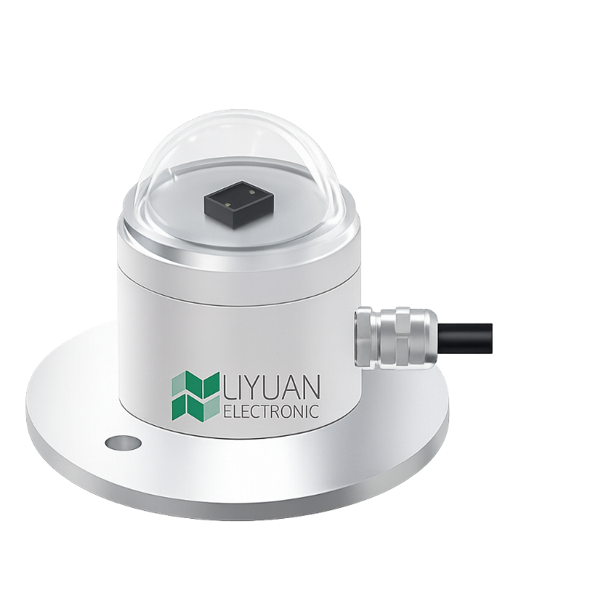

13.Light Meter Sensor
Main Function:
• Measures luminous intensity or ambient brightness.
• Operating Voltage: 24V

Slide 24
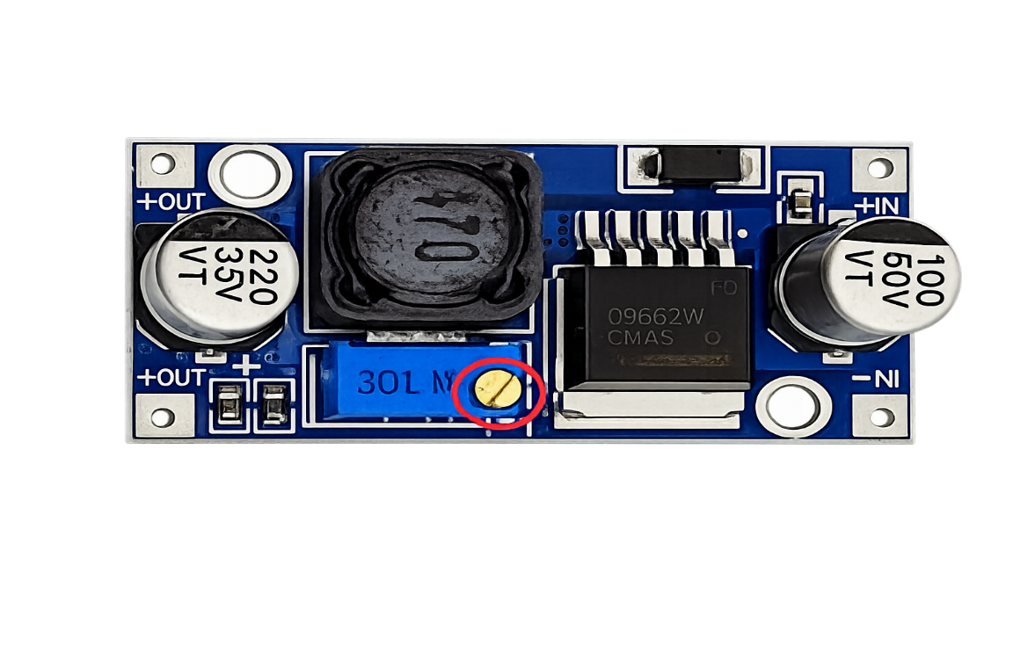
14.voltage regulator
The XL6009 is a DC-DC Switching Regulator used to raise or lower voltage, therefore it is classified as a Buck-Boost Converter
(Step-Up).
DC step-up transformer, capable of efficiently stepping the voltage from 12V to 36V.

Slide 25

15.Power Supply
We need it to reduce the voltage from 220V to 12V. "
1.AC to DC converter (Power Adapter / SMPS)
Component | Function
AC-DC Power Supply (Electrical Current Converter) | Takes 220V AC electricity from the wall and converts it to 3.3 v or 5V DC or 12V DC.

Slide 26
(Component) | (Quantity) | (USD) | (USD)
Light Meter Sensor"" | 1 | 34.79 | 34.79
Raspberry Pi Zero | 1 | 43.21 | 43.21
Wind Speed & Direction Sensor" | 1 | 18.00 | 18.00
PLC Communication Module" | 2 | 26.48 | 52.96
LCD Display 400×1280" | 1 | 40.00 | 40.00
Arduino Mega" | 1 | 40.00 | 40.00
BME680 Sensor" | 1 | 21.33 | 21.33
Rain Drop Sensor" | 1 | 5.13 | 5.13
GAS Sensor | 1 | 6.21 | 6.21
Wireless Communication Module" | 2 | 9.45 | 18.90
XL4016 DC-DC Buck Converte" | 1 | 10.00 | 10.00
SMPS Power Supply Unit (ATX) | 1 | 60.00 | 60.00
" Arduino Uno | 4 | 10.00 | 40.00
Voltage Regulator /XL6009 | 1 | 10.00 | 10 .00
wires | 20 | 10.00 | 10.00
.Voltage Converter XY-ITOV-4 | 1 | 40.00 | 40.00
(Control Cabinet) | 1 | 80.00 | 80.00
Estimated Cost
Smart Weather Station Components Cost (USD)
Total price: $508.75

Slide 27

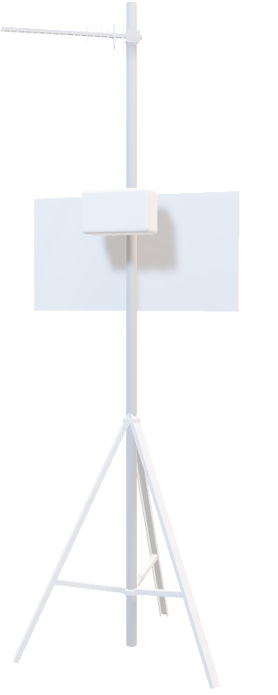
Sensor readings after being tested in summer and winter weather conditions:
Sensor | Summer | Winter
BME680 – Temperature (°C) | 28 – 40 | 5 – 18
BME680 – Humidity (%) | 20 – 40 | 40 – 80
BME680 – Pressure (hPa) | 1005 – 1012 | 1010 – 1020
Gas (MQ9 sensor) | 200 – 400 | 400 – 700
Wind Speed Sensor (m/s) | 0 – 3 | 3 – 10
Wind Direction Sensor (°) | 0 – 360 | 0 – 360
Rain Drop Sensor (Digital) | 1 (No Rain) | 0 (Rain)
Solar Radiation Sensor (w/m²) | 600 – 1023 | 100 – 400

Slide 28

The Future of Smart Weather Stations
Artificial Intelligence in Weather Forecasting
Uses AI to analyze weather data and provide accurate forecasts and early warnings.
Advanced Environmental Sensors
Improve monitoring of climate, air quality, and water usage through precise measurements.
Voice Control Support
Allows users to access weather data using voice commands for easier interaction.

Slide 29
The Future of Smart Weather Stations
Smart Control of Heating and Cooling
Optimizes HVAC systems based on real-time weather conditions to save energy.
Smart City Interaction
Supports smart city systems by providing weather data for better planning and emergency response.

Slide 30
END

