Slide 1
Greenhouse Controller
Presented by :
Ahmed Daghameen
Mohammed Hijaz
Supervised by :
Dr. Muhannad Al-Jabi

Slide 2
Outlines
What is Greenhouse Controller ?
Problem
Solution
How does it work ?
Components
Methodology
Challenges
Future Work
Demo

Slide 3
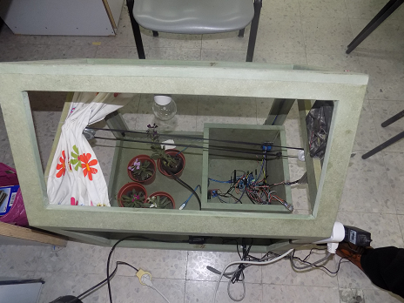
What is Greenhouse Controller ?
Greenhouse Controller is a smart controlling system that can help farmers and farm owners to automatically control their greenhouses
The system of irrigation, ventilation, light and shading is controlled depending on analyzing the data collected from multiple sensing units.

Slide 4
Problem!
Why did we choose this project ?
Wasted water resources by the wrong irrigation methods.
Short life time of the productive plants.
Catastrophic losses by the extreme weathers.
Poor agricultural methods used in our community.
We choose it not because it’s easy.
We choose it because it’s needed.

Slide 5

Solution
Choose smart system that choose the right time to irrigate the plants.
Provide the plants with good conditions to grow.
Provide good condition for plants to produce for longer time
System that could provide protection against extreme weather

Slide 6
How does it work ?
A sensor unit will collect the environment data.
Send the data to the control unit.
Control unit check the arrived data.
Control make decisions based on the analyzed data.
Control could receive commands of the user.
Control notify the user of the changed state of the system.

Slide 7
Components

Slide 8
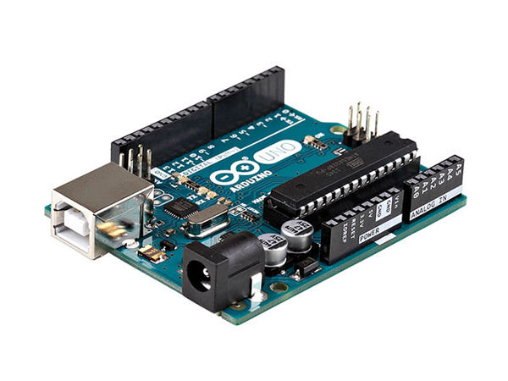
Arduino Uno microcontroller

Slide 9
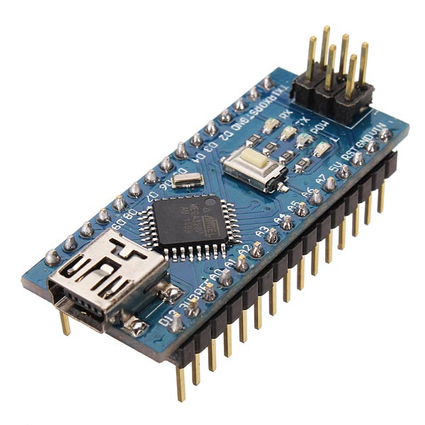
Arduino Nano microcontroller

Slide 10
HC‐35 Bluetooth module

Slide 11
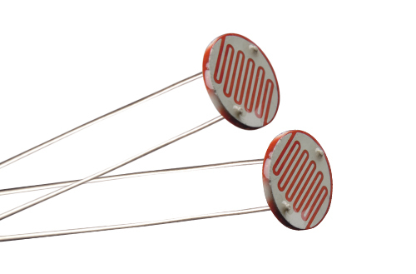
LDR : photo sensor

Slide 12
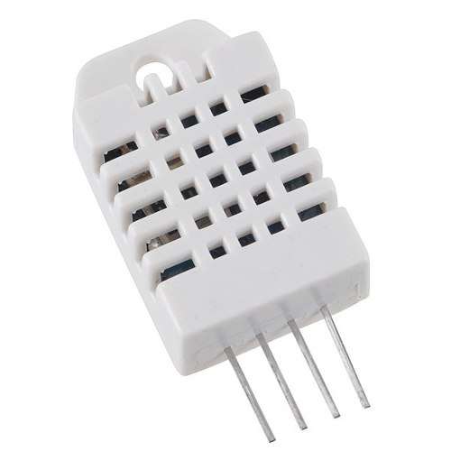
DHT22: Temperature and Humidity Sensor

Slide 13
Soil Moisture Sensor

Slide 14
SIM900 GSM/GPRS Shield

Slide 15
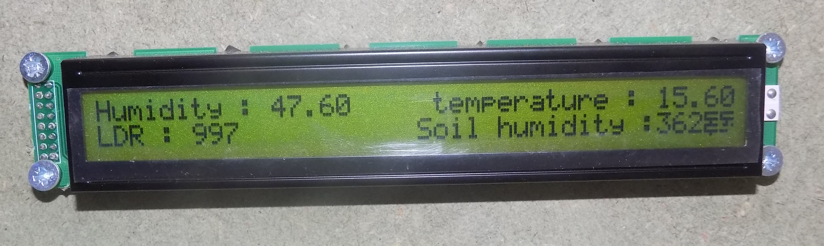
LCD 40x2 module

Slide 16
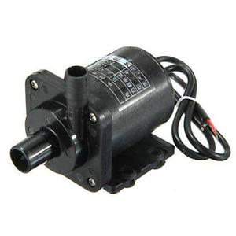
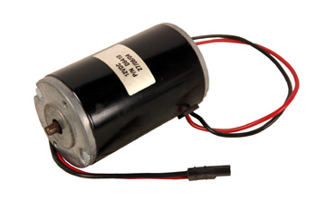
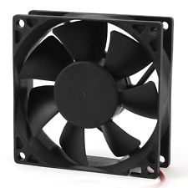
12 volts DC motors

Slide 17
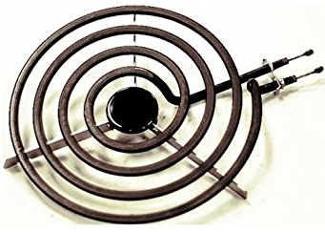
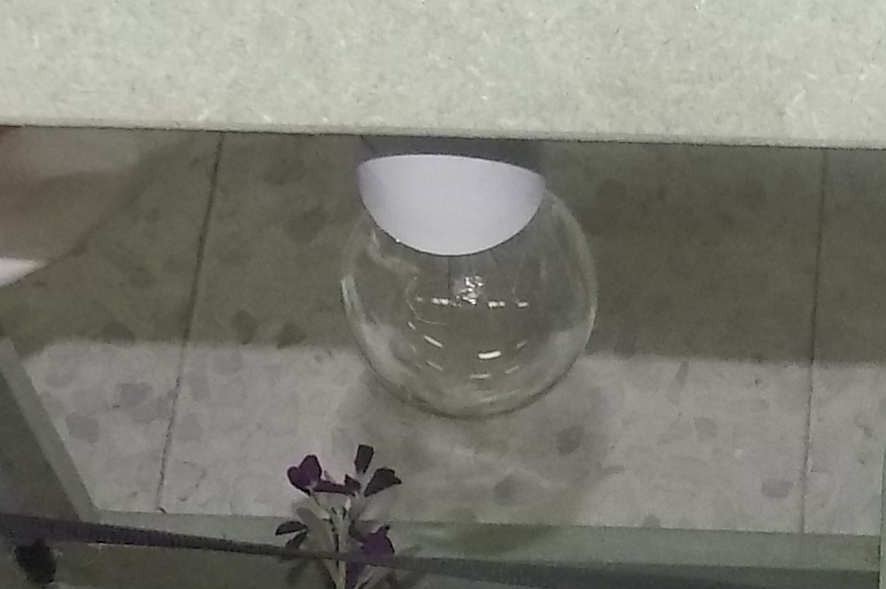
electric stove : for heating
We replaced this one with normal heating lamp for safety reasons, because of the flammable parts in the system.

Slide 18
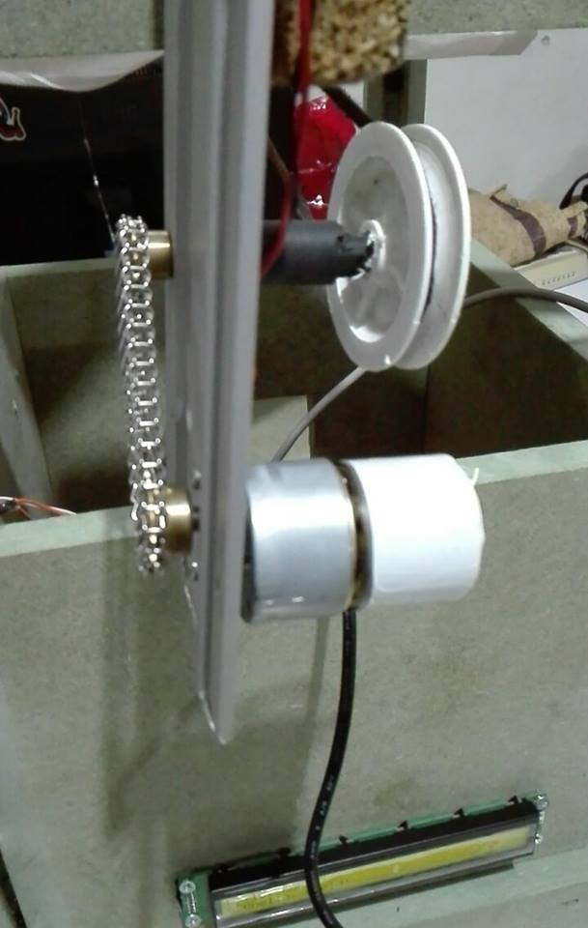
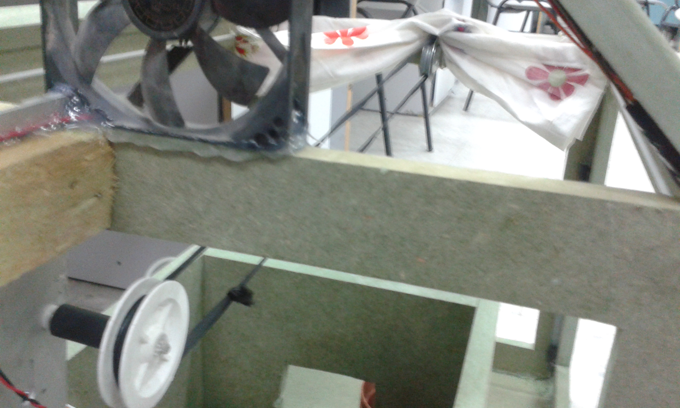
Shading cover and wheels

Slide 19
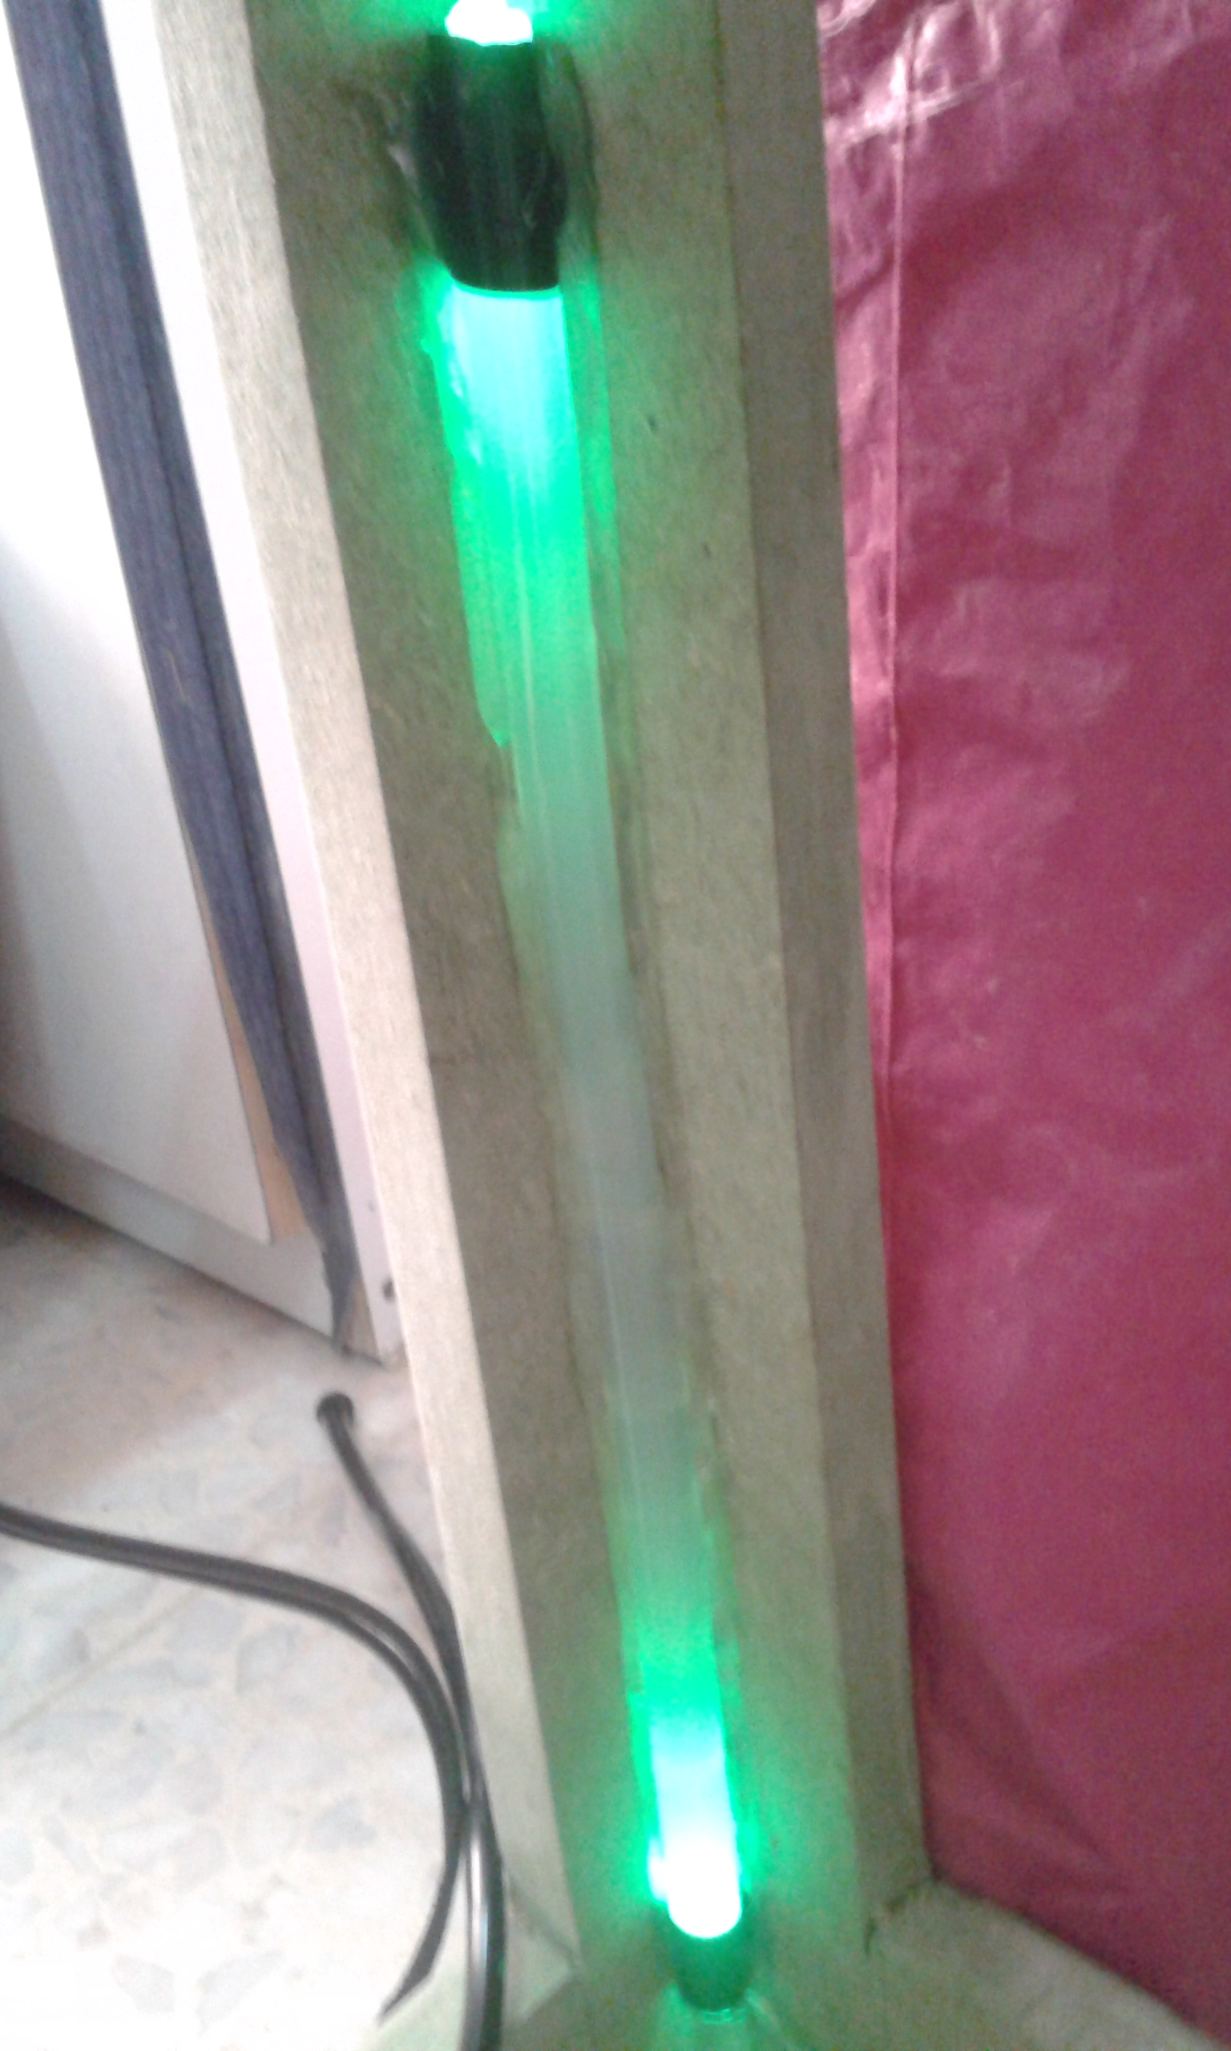
LED lights

Slide 20
Methodology

Slide 21
Two main parts
Two parts communicating remotely through the Bluetooth modules
Sensor Unit
Control Unit

Slide 22
Sensor Unit
Arduino Nano microcontroller.
Reads from the sensors :
LDR, DHT22 &Soil Moisture Sensor
multiple sensor units fairly distributed and communicating with the control unit for better readings of the environment in the greenhouse system.
Sends readings to the control unit every short period of time,

Slide 23
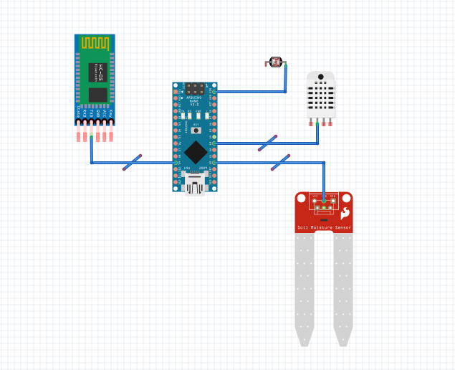
Sensor Unit

Slide 24
Control Unit
Arduino UNO microcontroller.
Receive sensors data from control units.
Connected to the heating, the fan, the shading motor, the lights and the water pump.
Controls the environment characteristics and functions of the greenhouse automatically by turning ON and OFF the greenhouse devices keeping the reading of the sensors within the given limits.
Prints the status of the system on the 40x2 LCD.
Can be forced to turn ON and OFF the devices in the greenhouse by SMS through the GSM system.
Sends SMS to the owner about the status.

Slide 25
Control Unit
For mat of the SMS to control the system is:
Device:Value;
Device refers to the device to be turned on or off, and it accepts a value of one of the following
F for Fan
L for Light
P for Pumper
H for Heater
Value refers accepts one of the following
1 to Turn ON
0 to Turn OFF
One SMS can order the system to do more than one action separated in different lines
Example:
F:0
L:1
P:1;

Slide 26
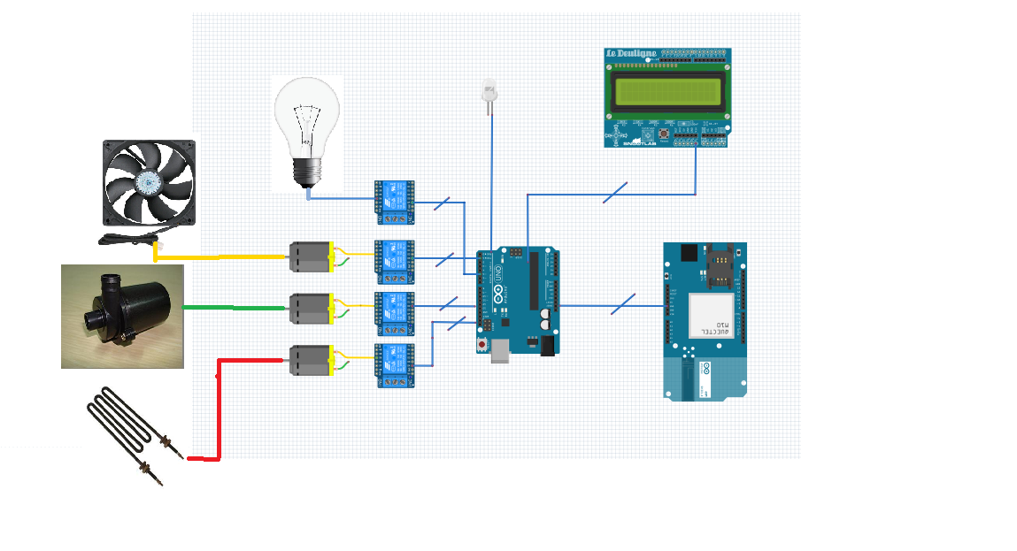
Control Unit

Slide 27
Challenges
Sensors life time: Due to exposure to weather conditions, for example soil moisture sensor. Solution: provide protection on the parts that could be covered and replace the parts that need to be replaced with time.
Bluetooth distance limitation. Solution: use long ranged transmitter receivers, like Seeedstudio 433MHz RF Long Distance Transmitter / Receiver with range of 2 km .

Slide 28
Future Work
Security and surveillance.
More advanced conditions analysis.

Slide 29
Demo
Video

