Slide 1



Slide 2
Circuit Academy
Web Platform & Mobile Application
By: Ghassan Qasrawi & Adel Qadi
Supervised by: Dr.Raed Qadi, Dr Abdallah Rashed

Slide 3
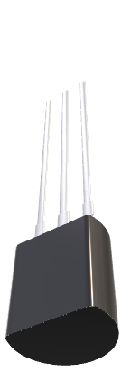

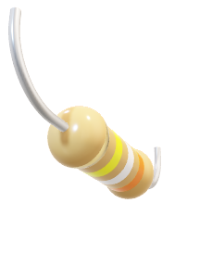
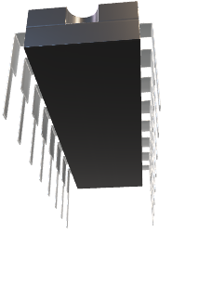
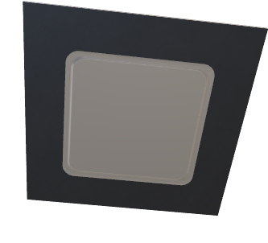
What is Circuit Academy?
CircuitAcademy is a learning web platform provided with a mobile application with the aim of supporting students and learners understand and study circuit and electronics topics easily through interactive real-time simulation, conferencing and the ability to share different learning assets through a rich community.
Circuit Academy
Web Platform & Mobile Application
By: Ghassan Qasrawi & Adel Qadi
Supervised by: Dr.Raed Qadi, Dr Abdallah Rashed

Slide 4

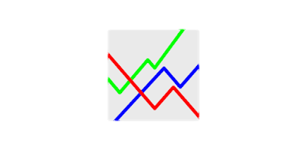







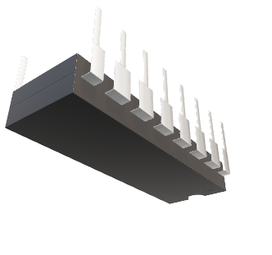
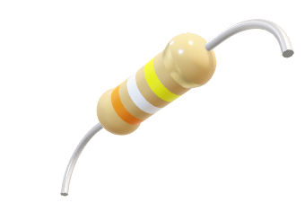
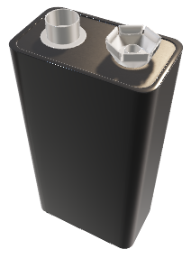

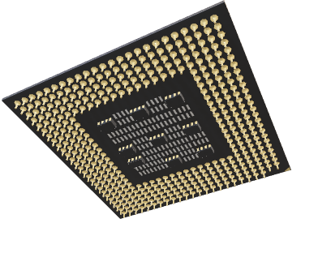
Software used
What is Circuit Academy?
CircuitAcademy is a learning web platform provided with a mobile application with the aim of supporting students and learners understand and study circuit and electronics topics easily through interactive real-time simulation, conferencing and the ability to share different learning assets through a rich community.
Circuit Academy
Web Platform & Mobile Application
By: Ghassan Qasrawi & Adel Qadi
Supervised by: Dr.Raed Qadi, Dr Abdallah Rashed
Database
Simulation
Frontend
APIs
Backend

Slide 5
Website preview
Software used
What is Circuit Academy?
Frontend
Database
Simulation
CircuitAcademy is a learning web platform provided with a mobile application with the aim of supporting students and learners understand and study circuit and electronics topics easily through interactive real-time simulation, conferencing and the ability to share different learning assets through a rich community.
Backend
APIs

Slide 6
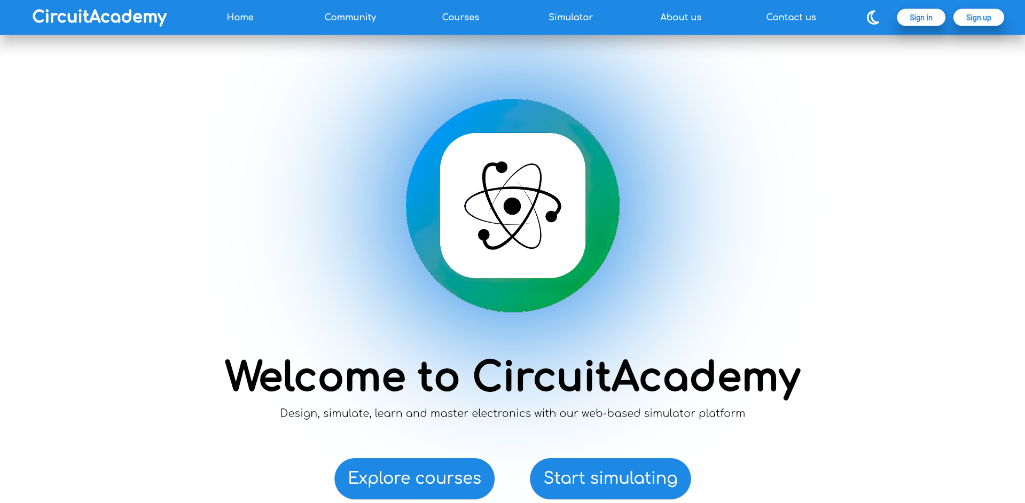
Software used
Website preview
Home Page
Database
Simulation
Frontend
APIs
Backend

Slide 7
Website preview
Home Page
Software used
Courses
Database
APIs
Simulation
Frontend
Backend

Slide 8
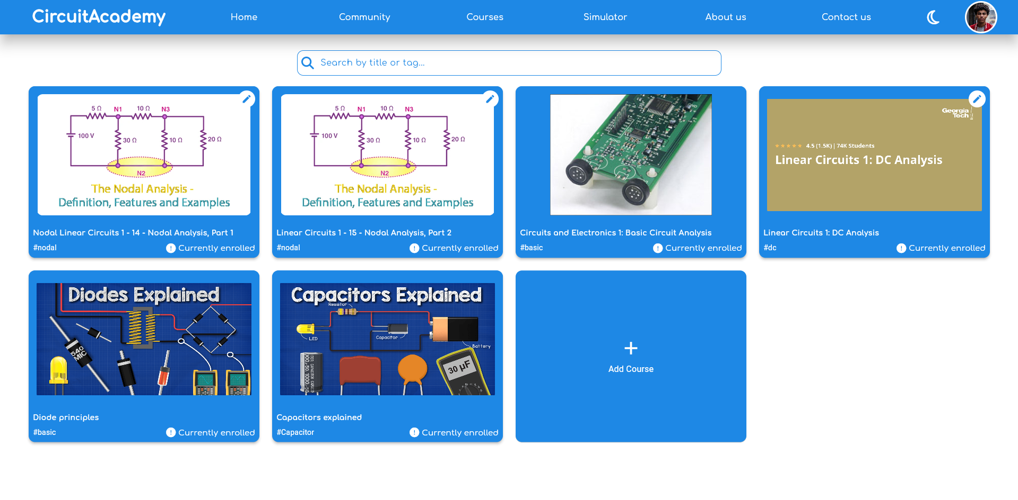
Home Page
Courses
Courses page

Slide 9
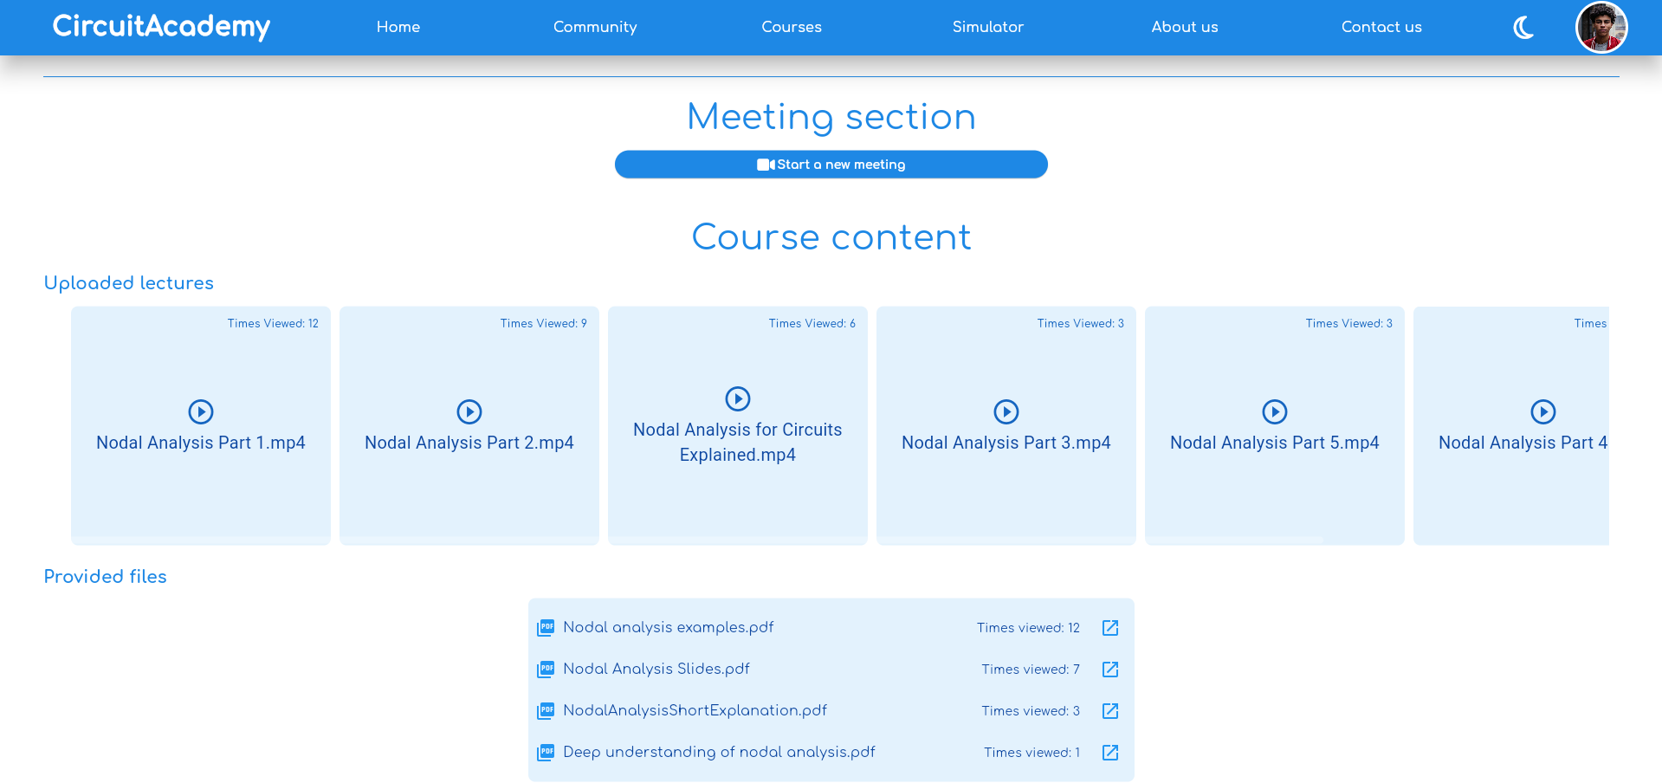
Courses
Courses page

Slide 10
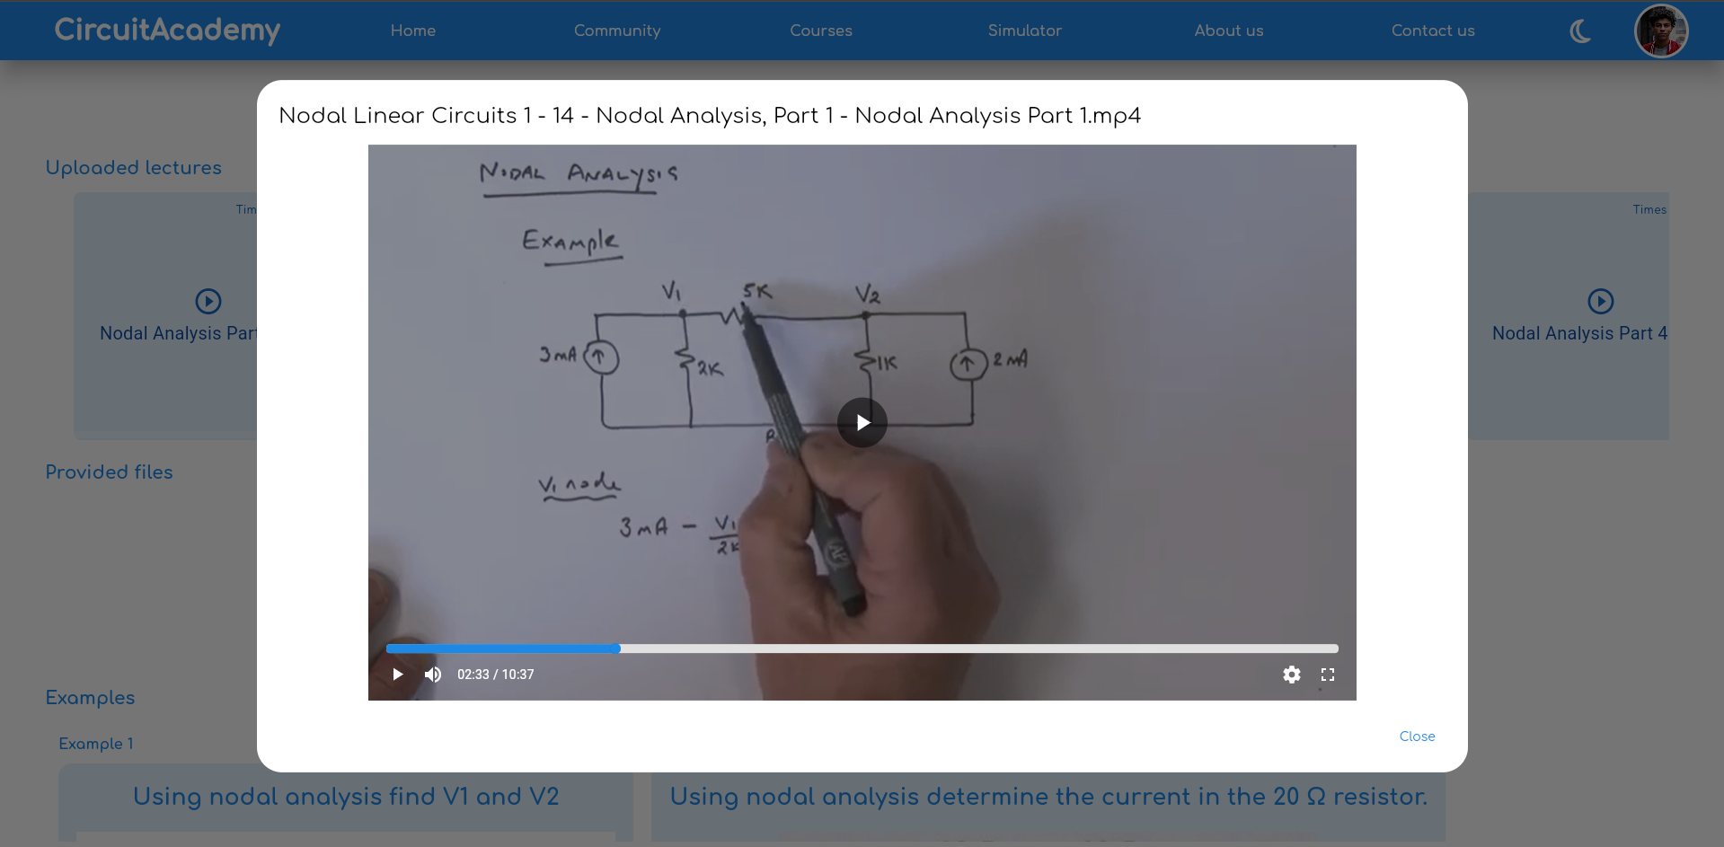
Lecture view
Courses page

Slide 11


Meeting Section
Lecture view
Courses page
Course creator view
Participant view

Slide 12
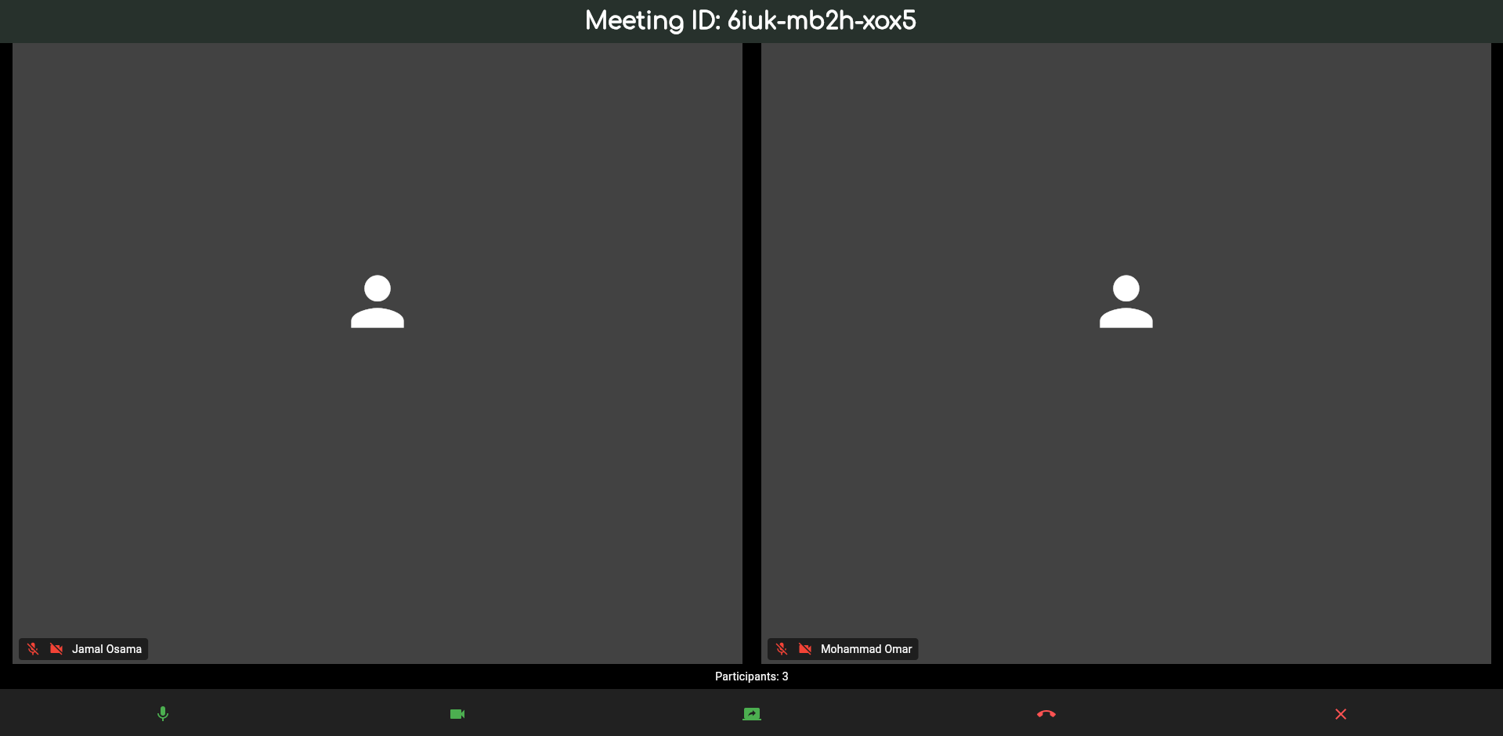
Meeting screen
Meeting Section
Lecture view
Course creator view
Participant view

Slide 13
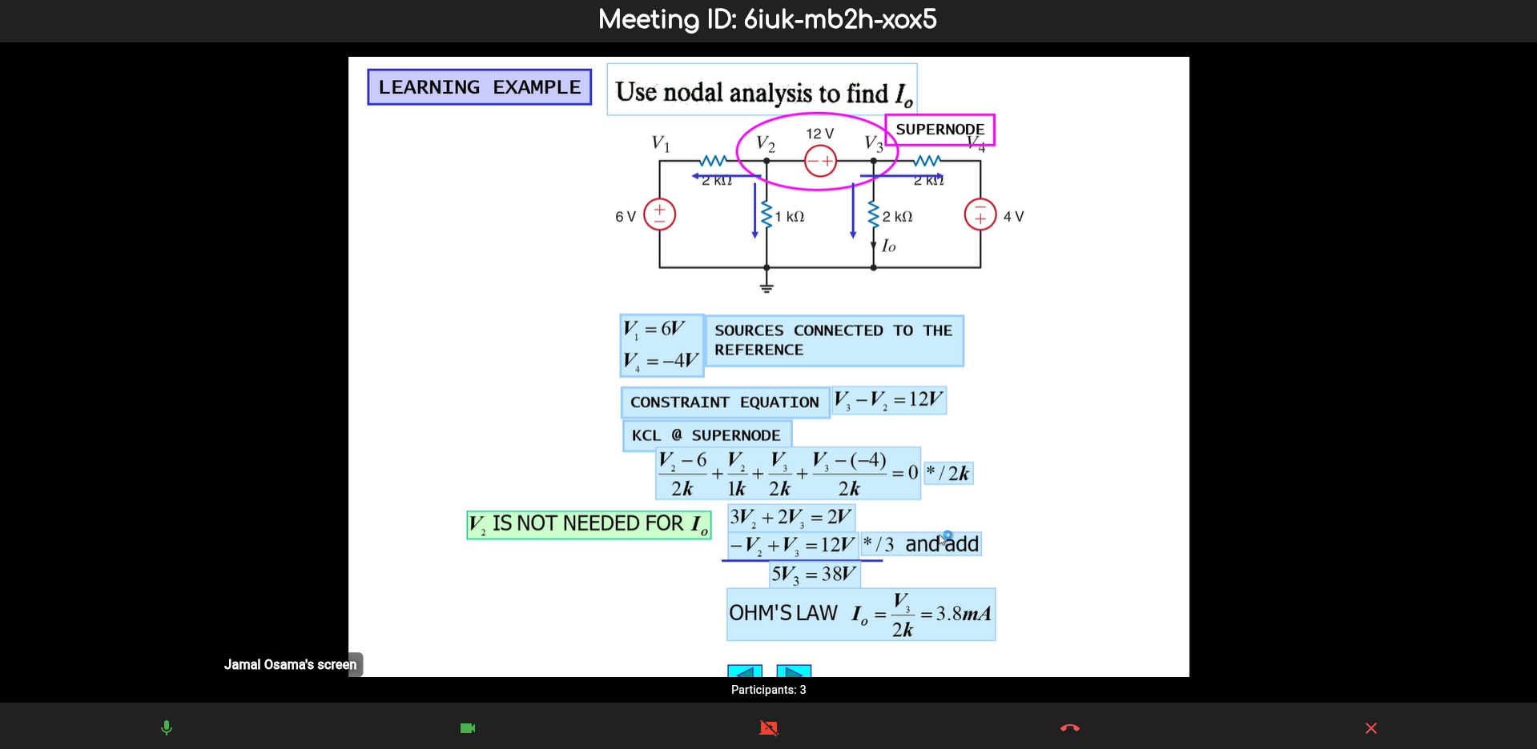
Screen sharing
Meeting screen
Meeting Section
Course creator view
Participant view

Slide 14
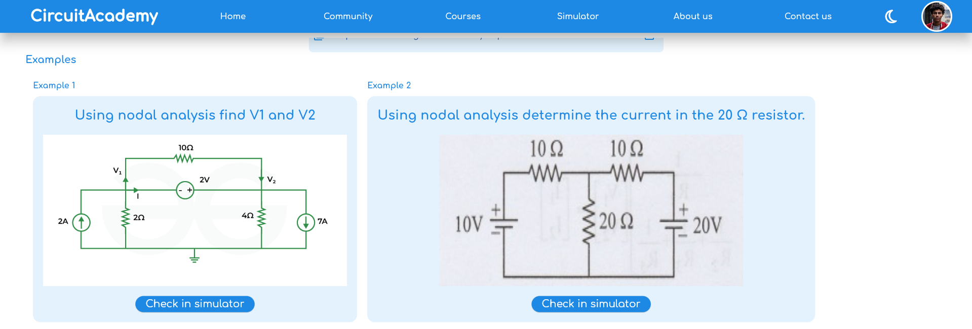
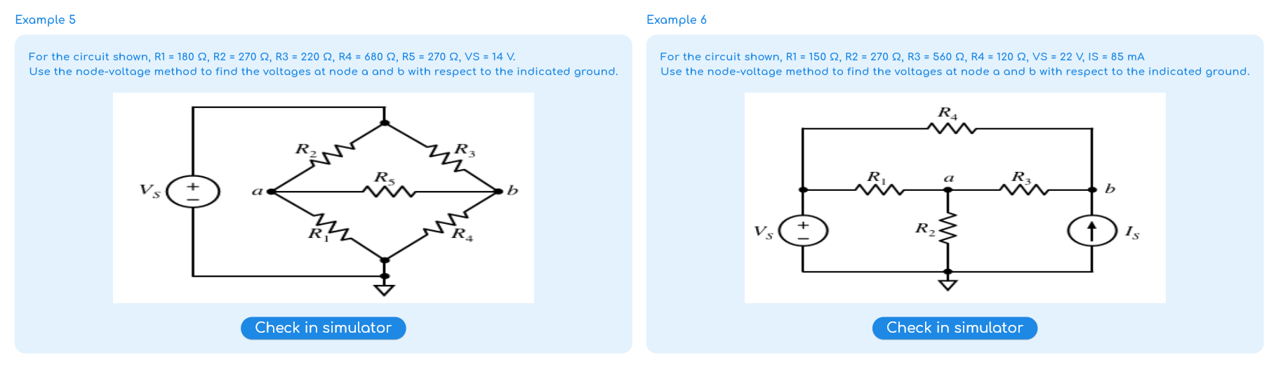
Course example
Screen sharing
Meeting screen

Slide 15
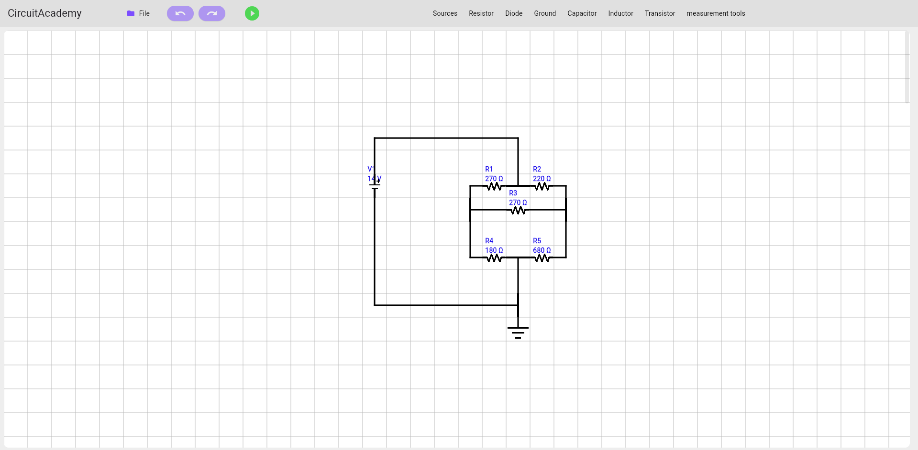
Example view
Course example
Screen sharing

Slide 16
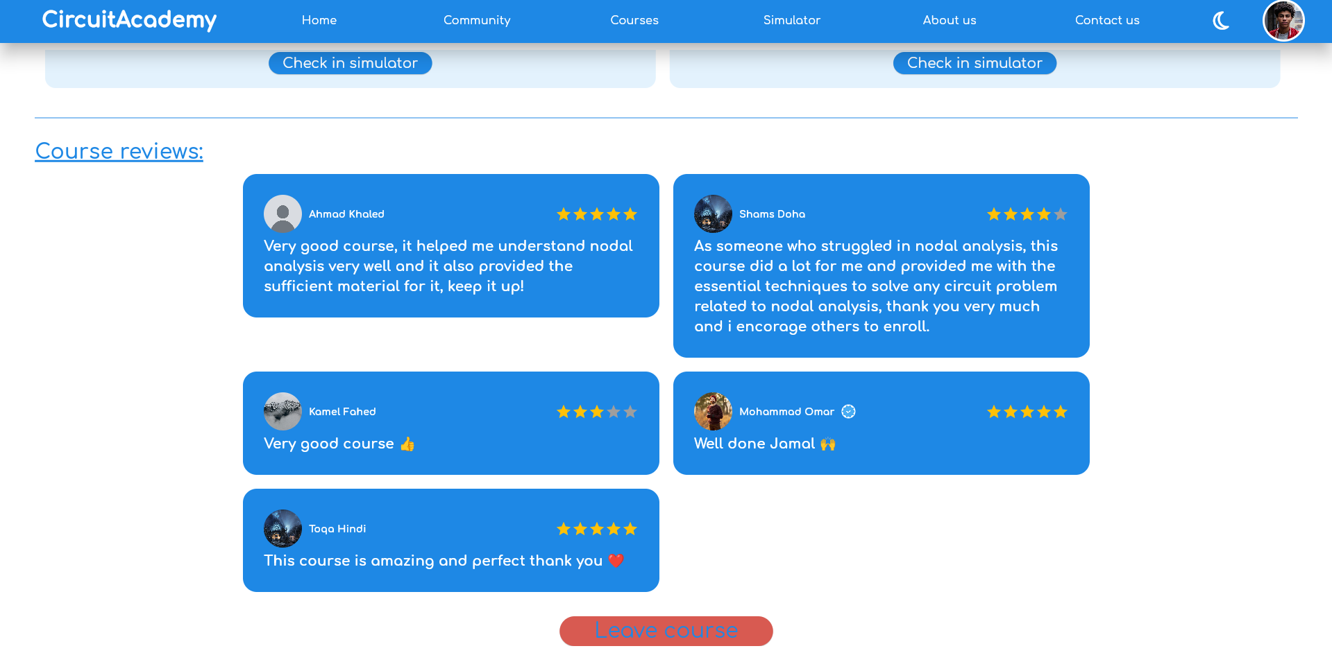
Course reviews
Example view
Course example

Slide 17
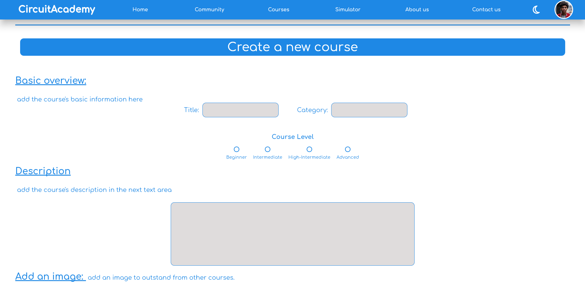
Adding courses
Course reviews
Example view

Slide 18
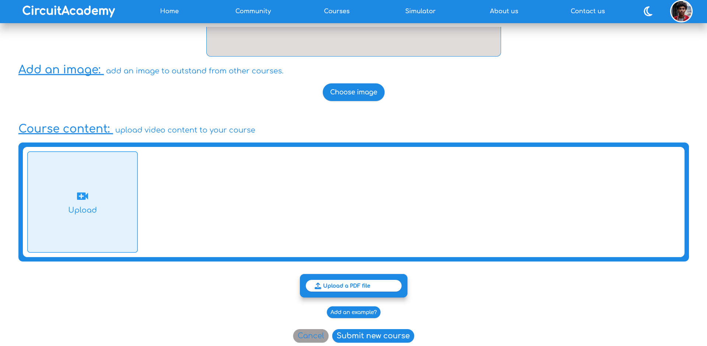
Adding courses
Course reviews

Slide 19
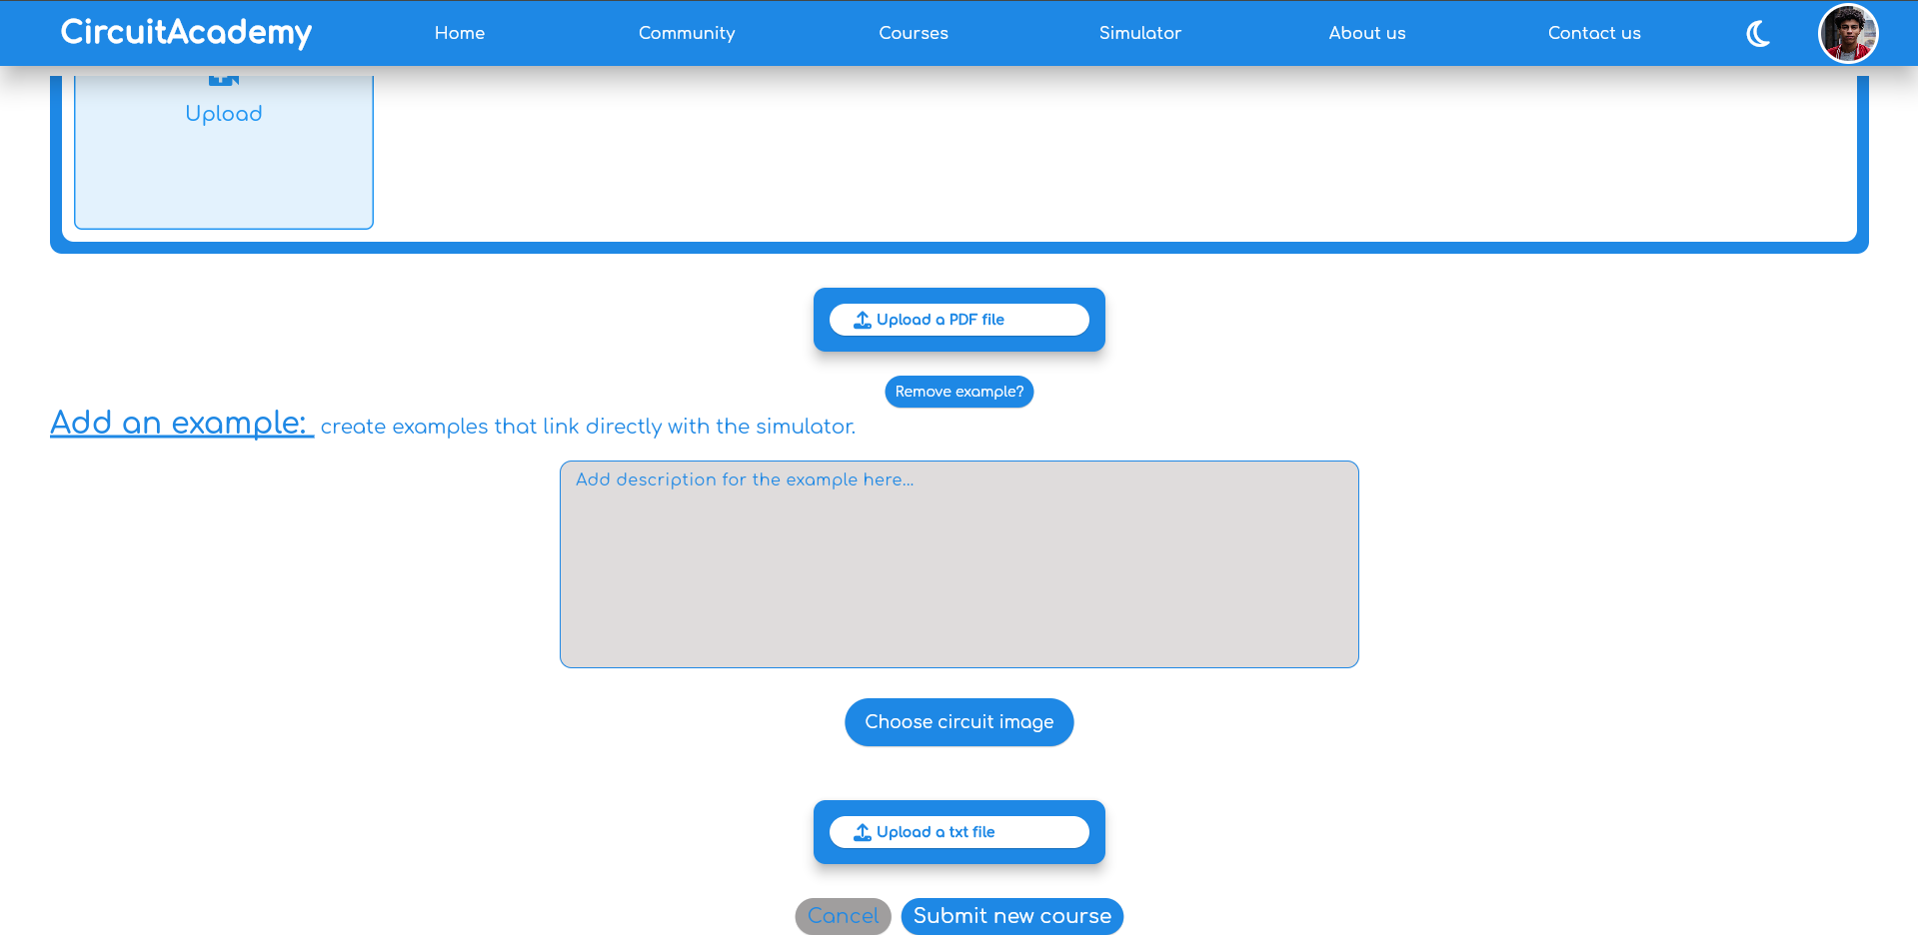
Adding courses

Slide 20
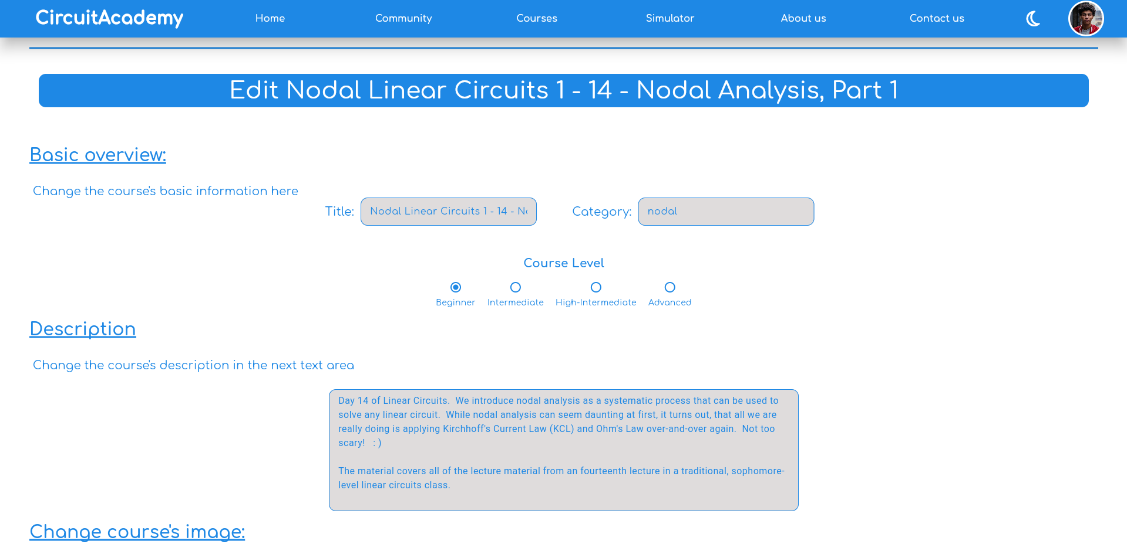
Course editing
Adding courses

Slide 21
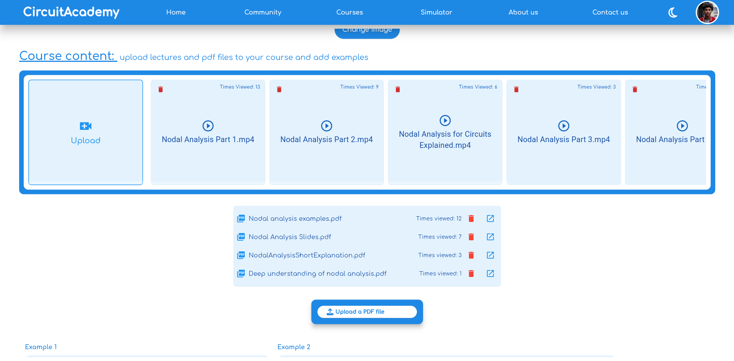
Course editing
Adding courses

Slide 22
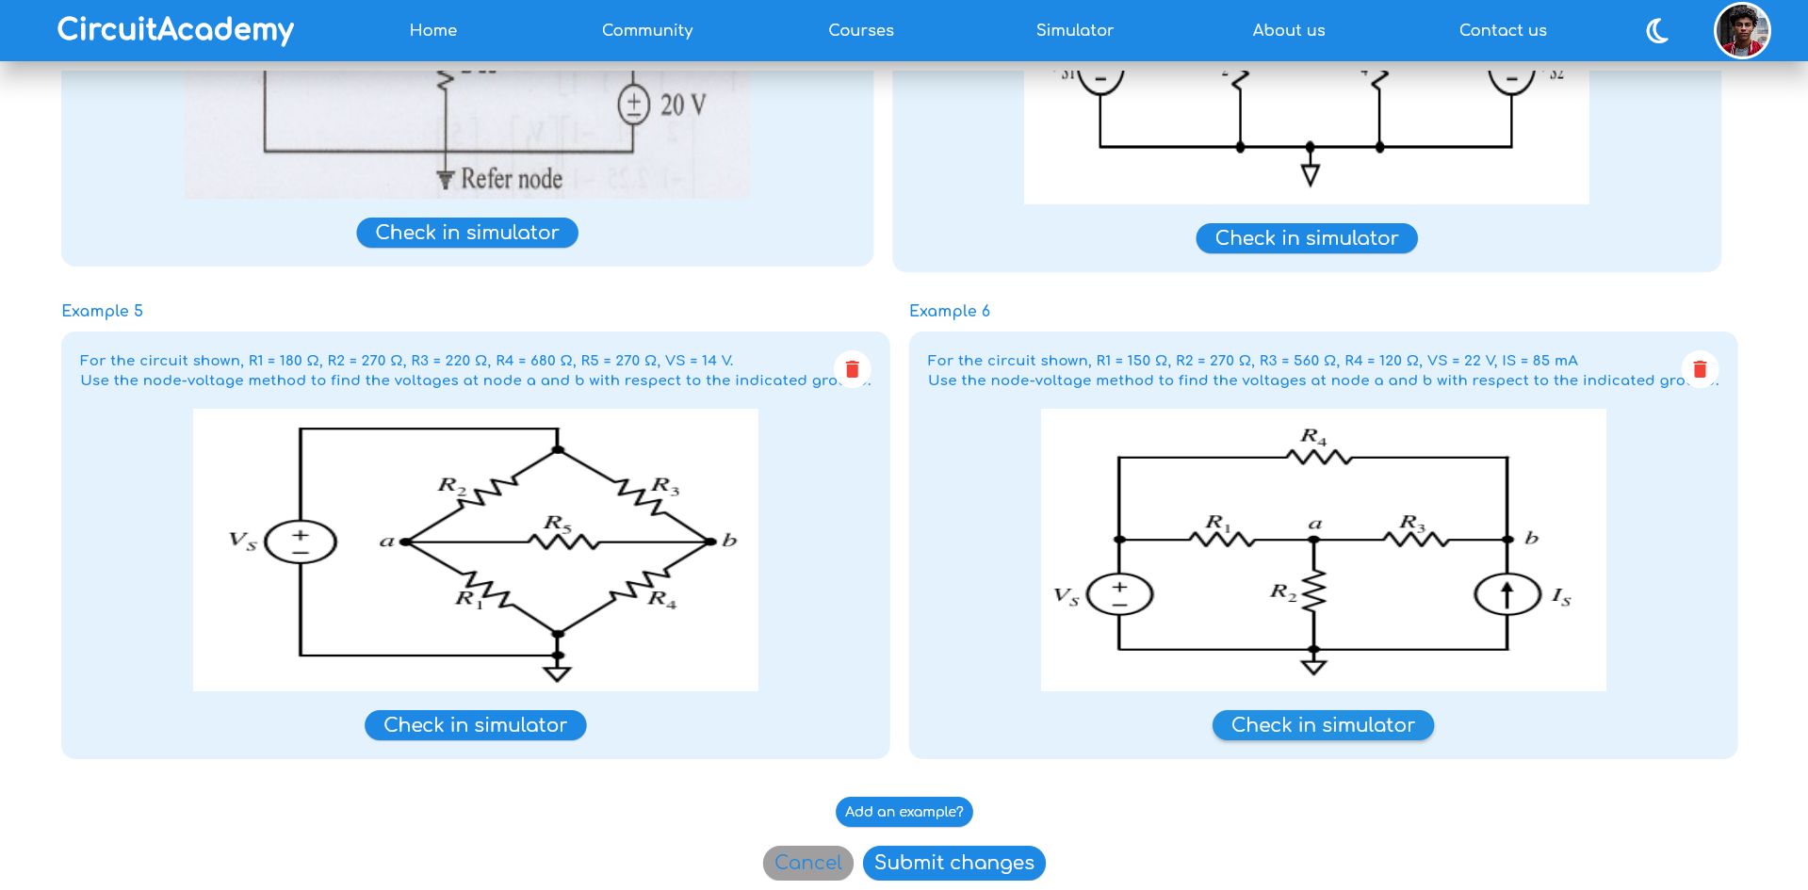
Course editing

Slide 23
Course editing
Community

Slide 24
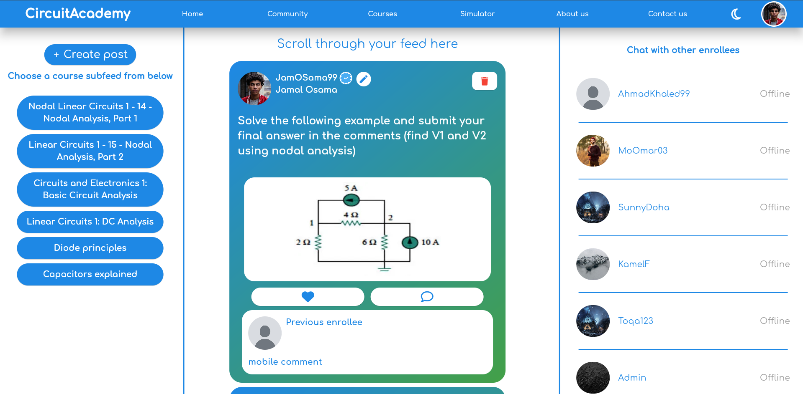
Course editing
Community
Community page

Slide 25
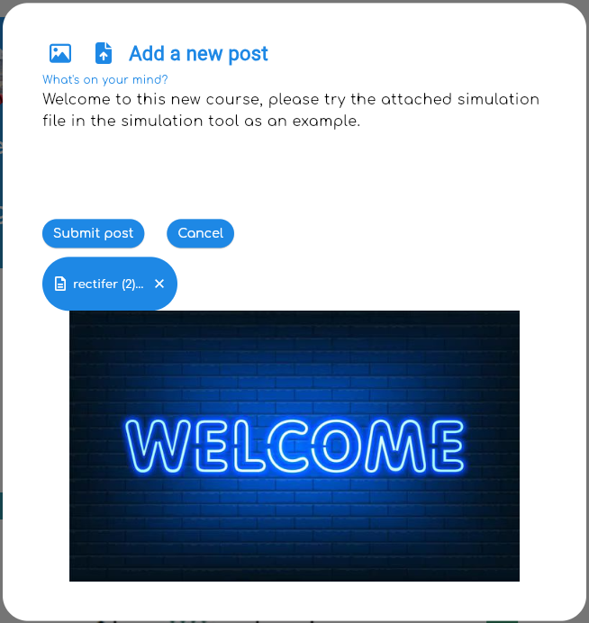

Community
Community page

Slide 26
Community page
Informational

Slide 27

Community page
Informational
About us page

Slide 28
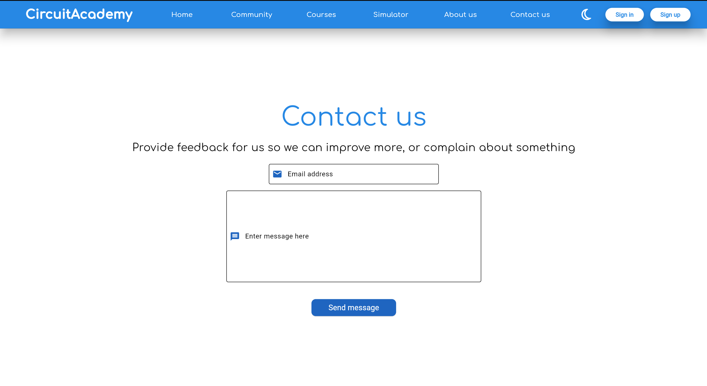
Informational
Contact us page
About us page

Slide 29
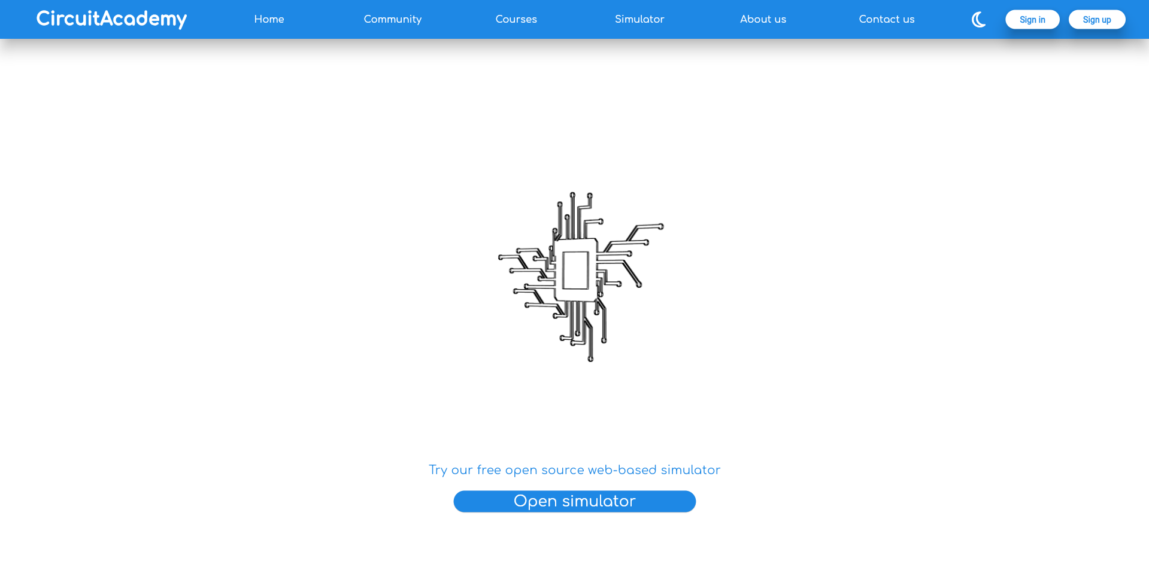
Simulator page
Contact us page
About us page

Slide 30
Simulator page
Contact us page
Profile

Slide 31
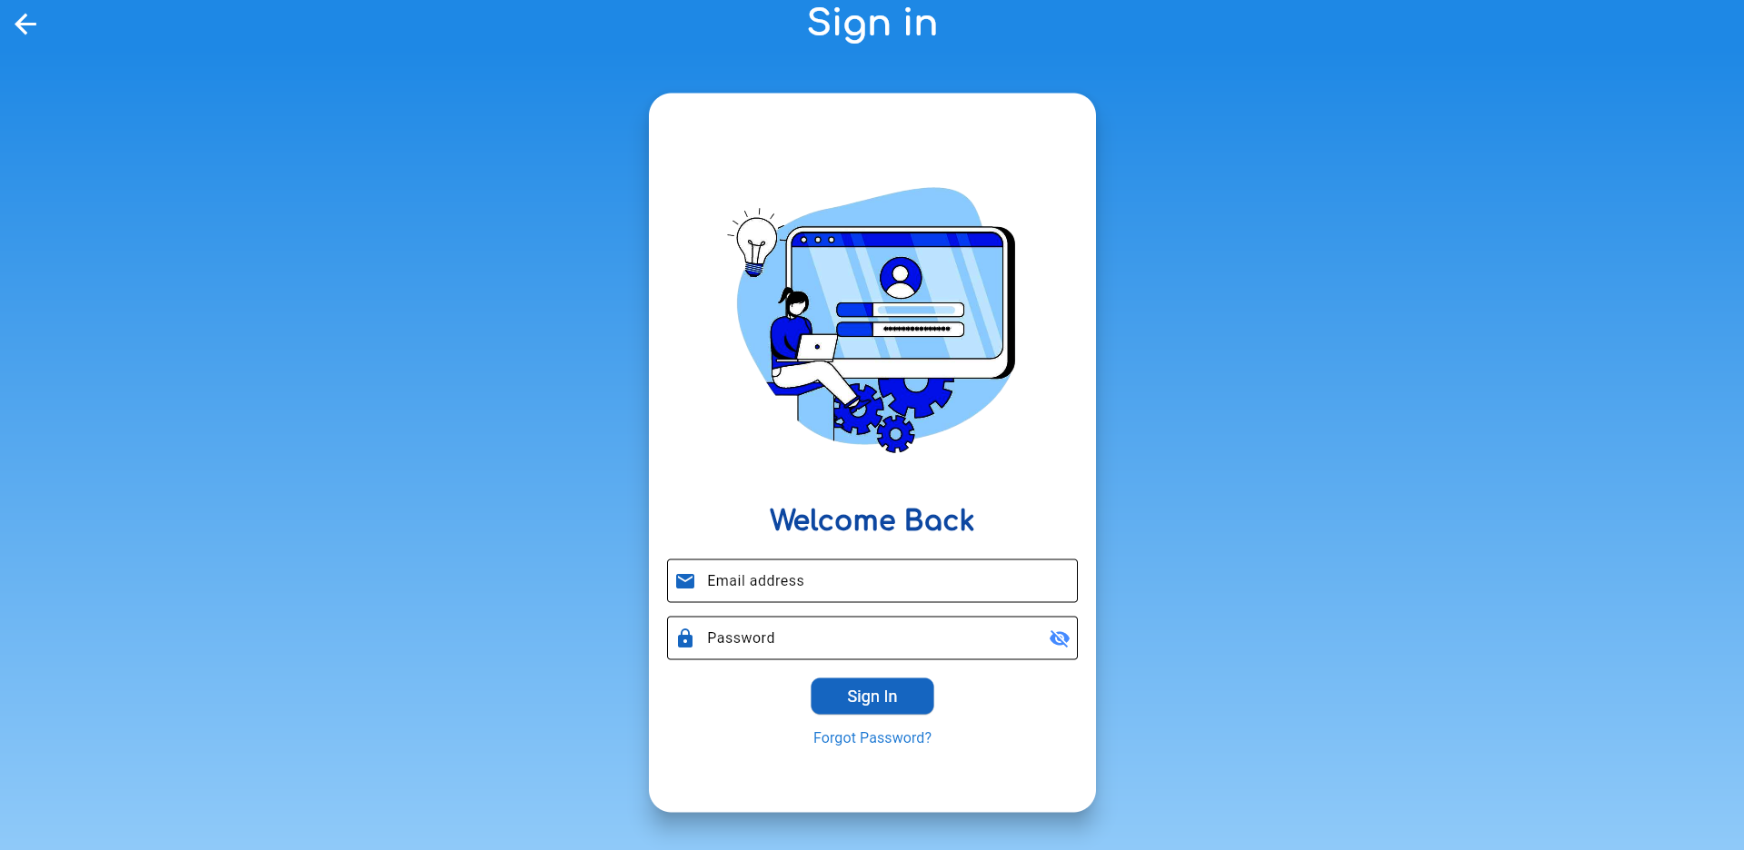
Simulator page
Light
Profile
Login page

Slide 32
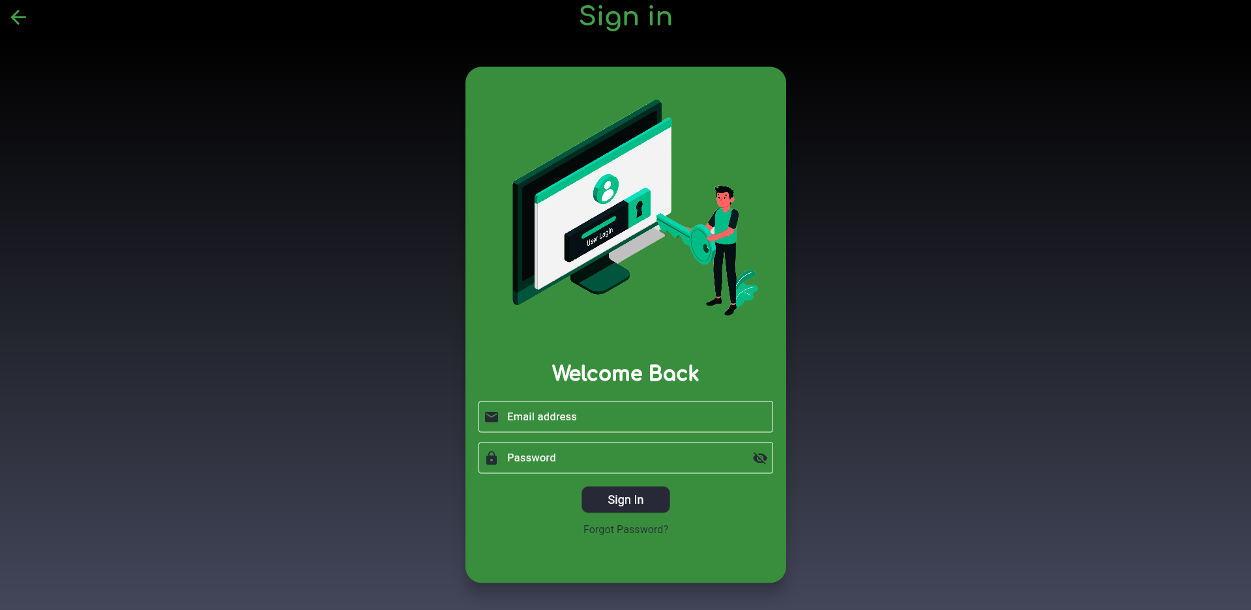
Profile
Login page
Light

Slide 33
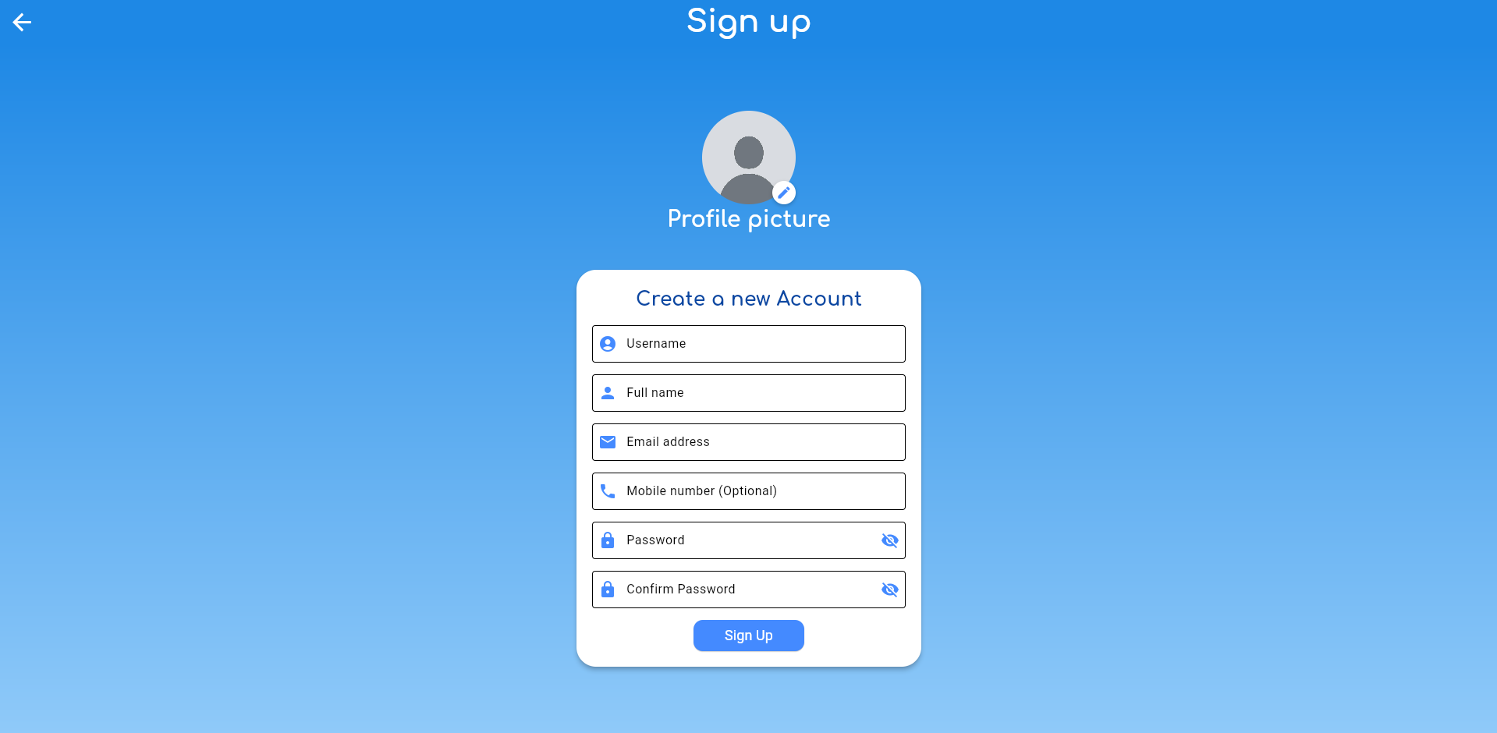
Login page
Dark
Sign up page

Slide 34
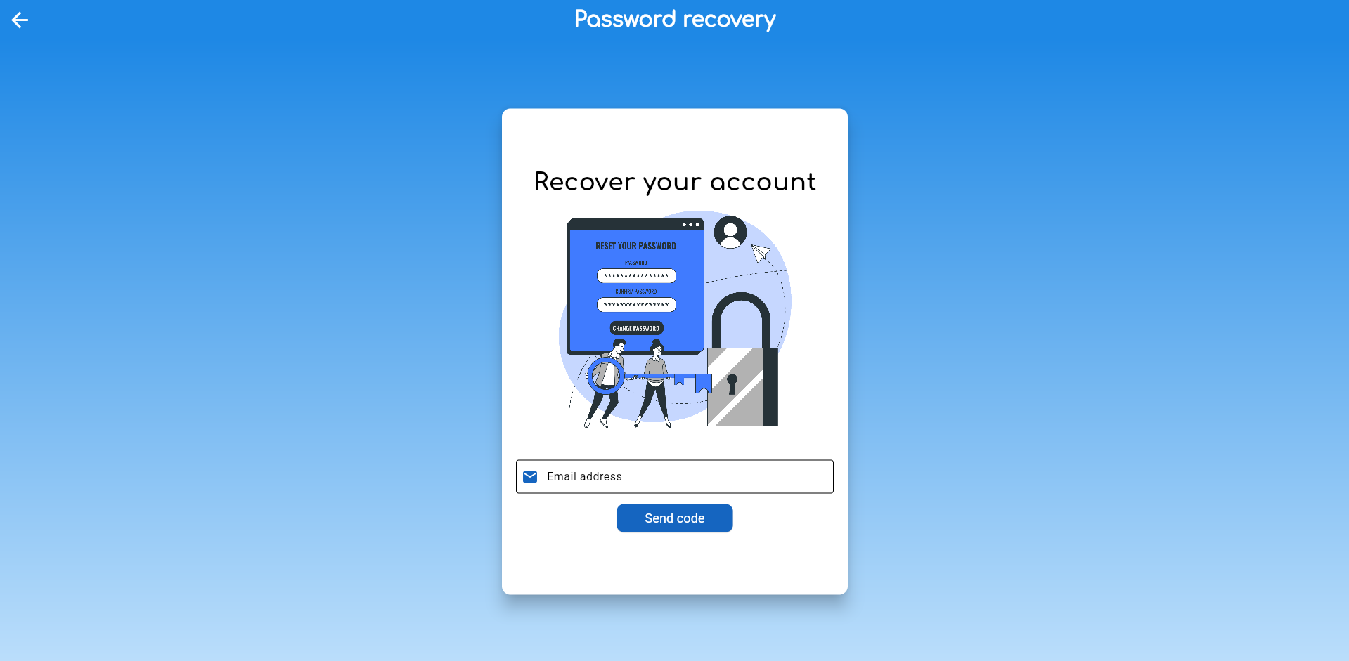
Dark
Login page
Account recovery page
Sign up page

Slide 35
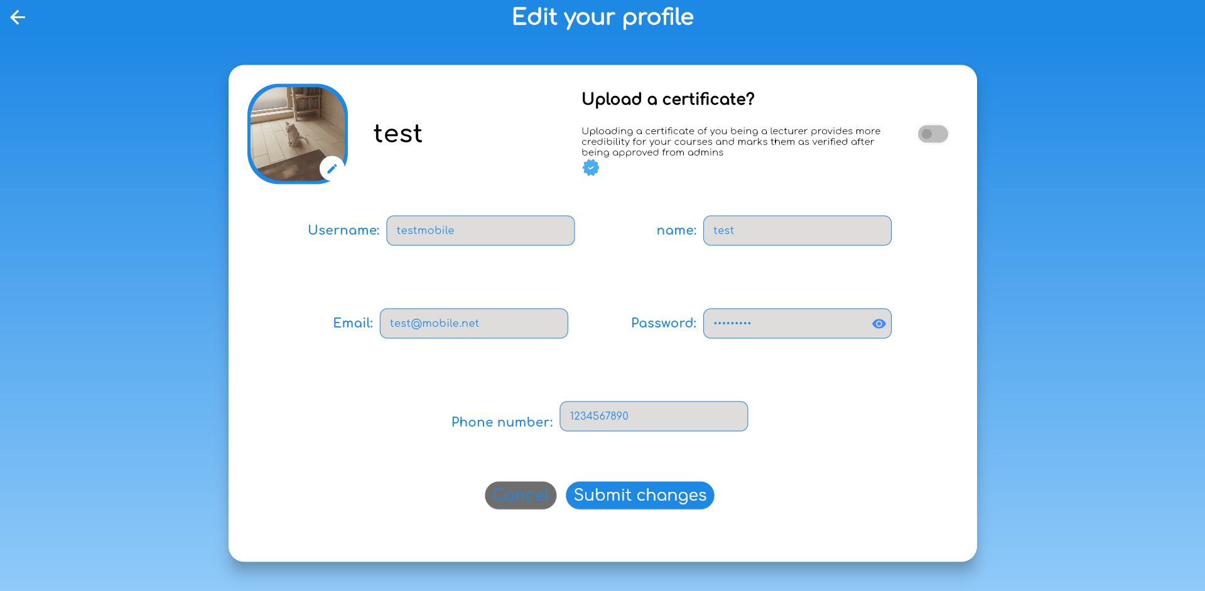
Edit profile page
Account recovery page
Sign up page

Slide 36
Edit profile page
Account recovery page
Admin

Slide 37
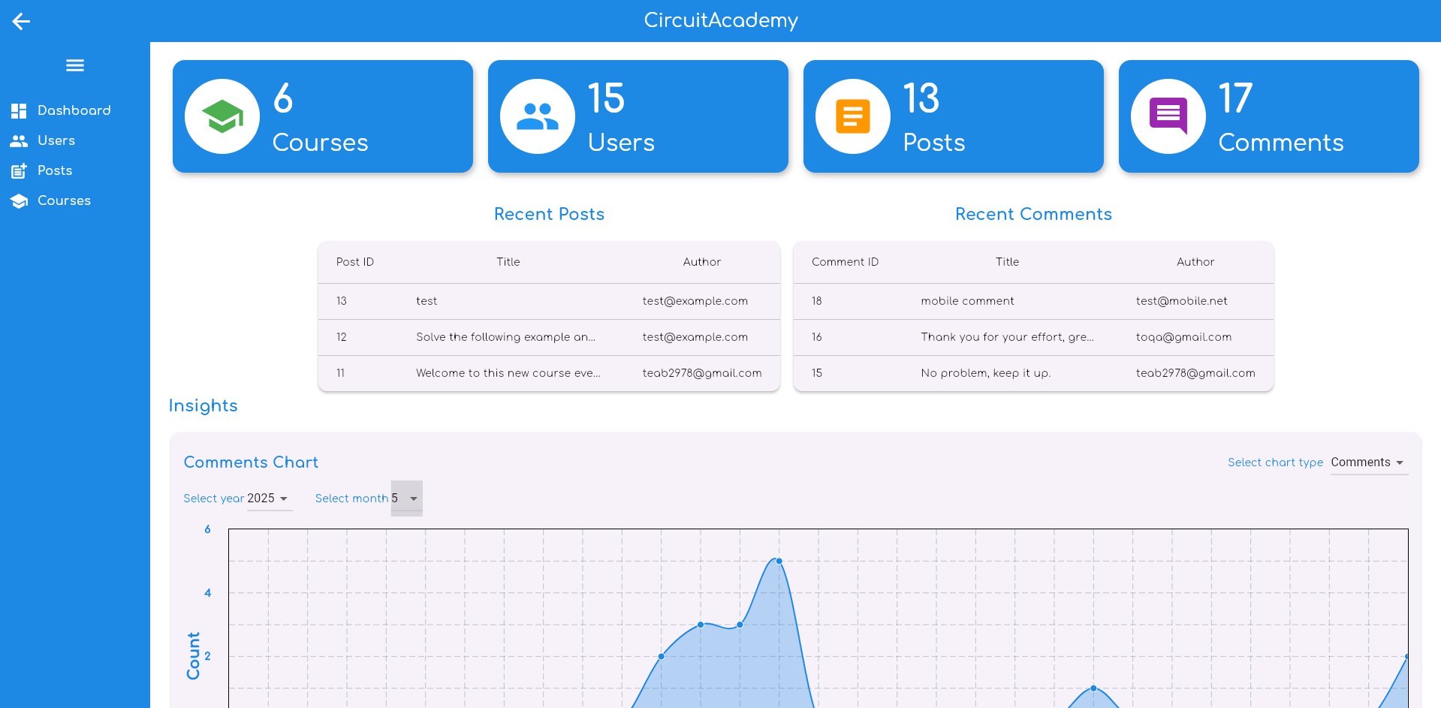
Edit profile page
Admin
Admin panel

Slide 38
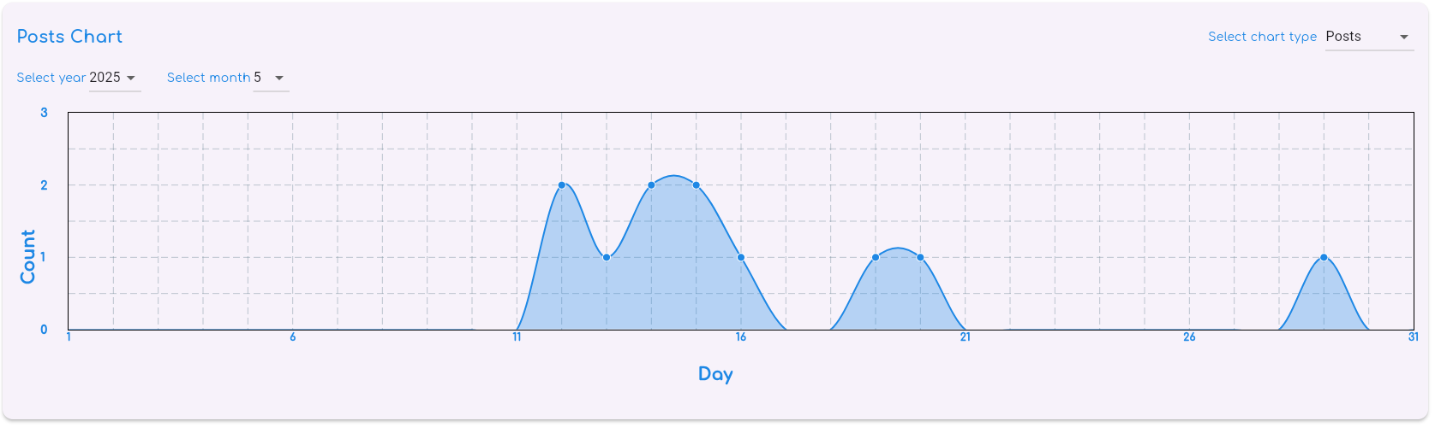
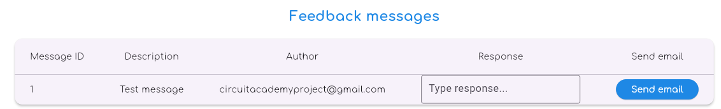
Admin
Admin panel

Slide 39
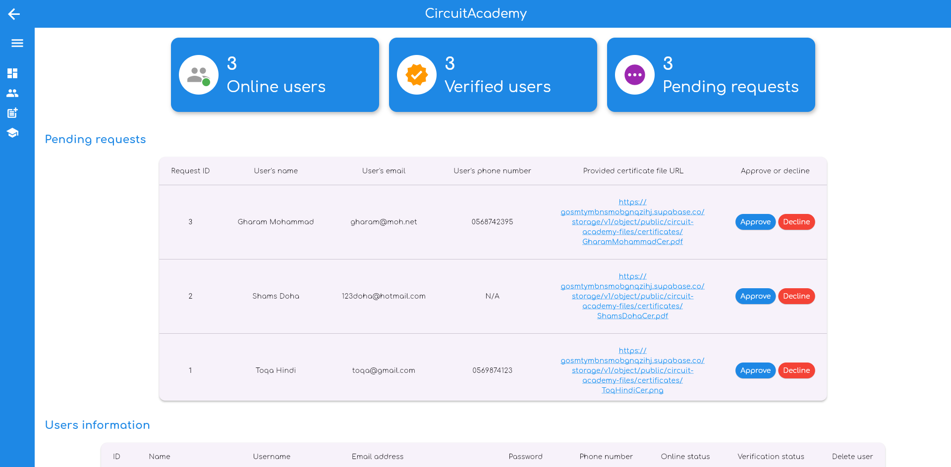
Admin panel

Slide 40
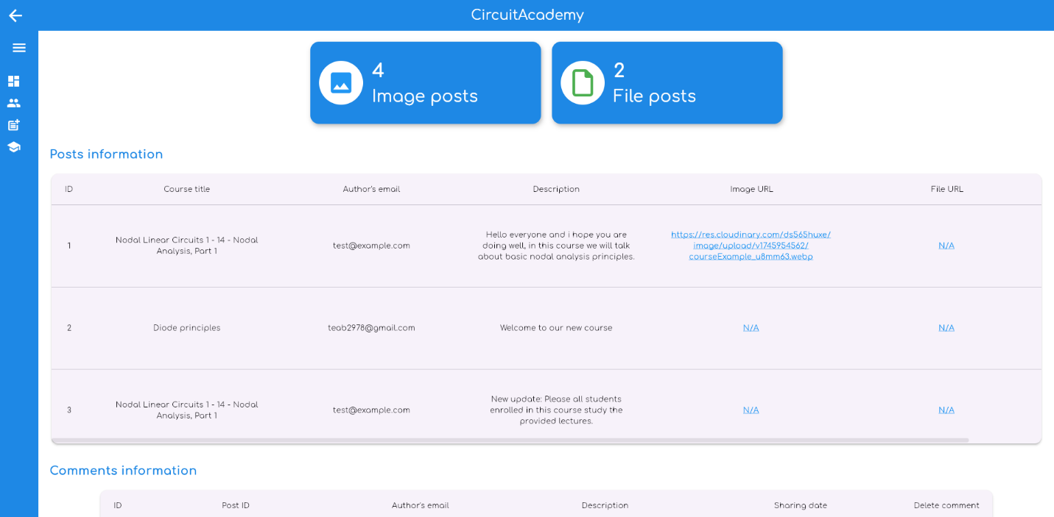
Admin panel

Slide 41
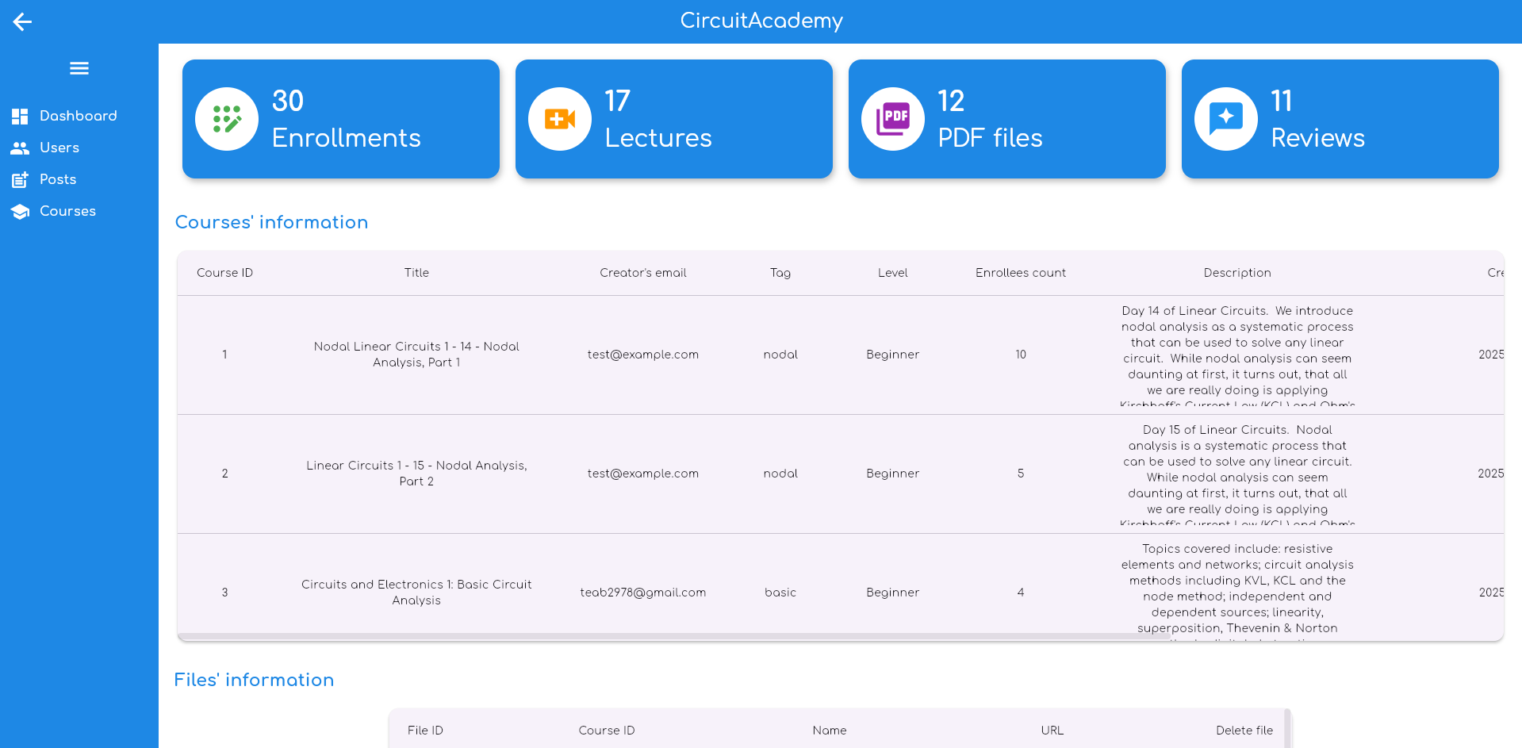
Admin panel

Slide 42

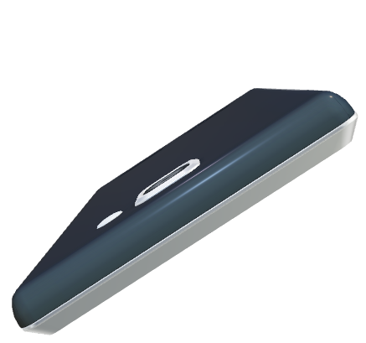

Mobile application overview
Admin panel

Slide 43

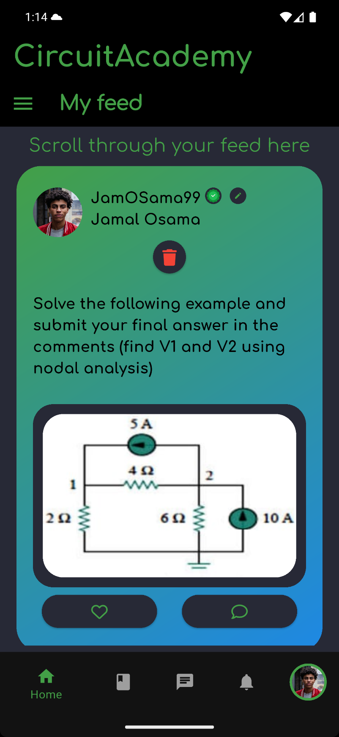
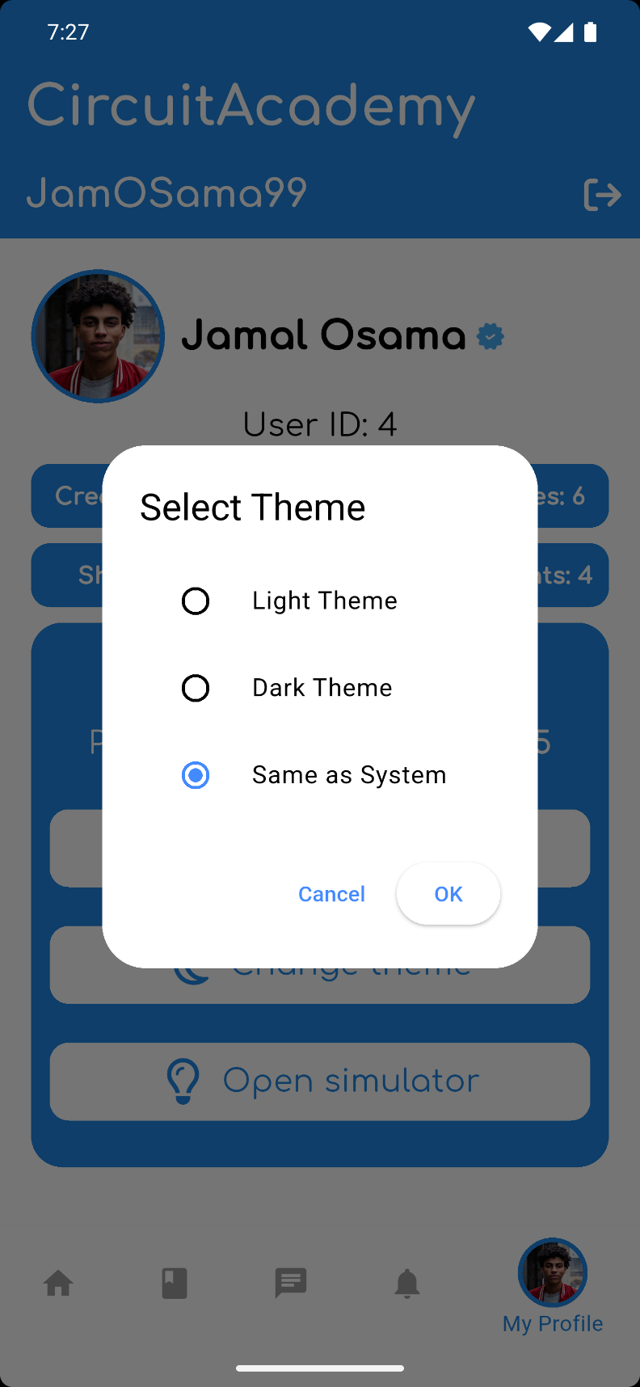



Admin panel
Mobile application overview

Slide 44

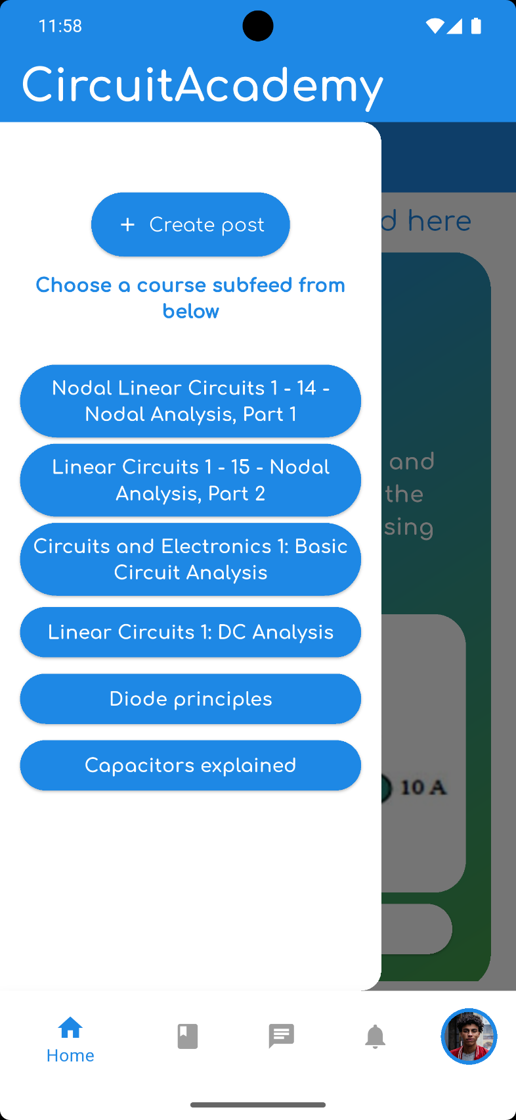
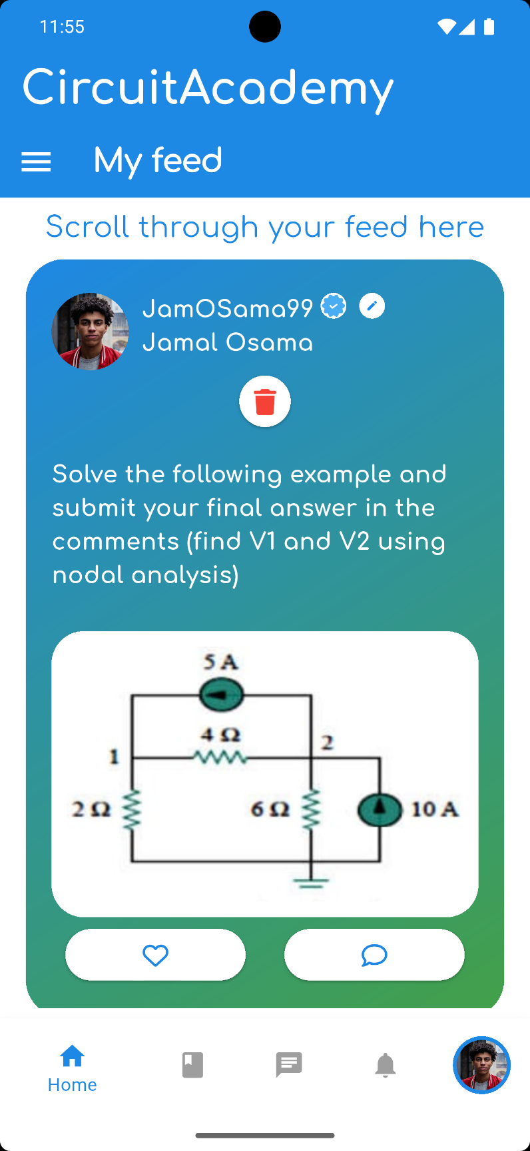

Welcome page
Mobile application overview

Slide 45
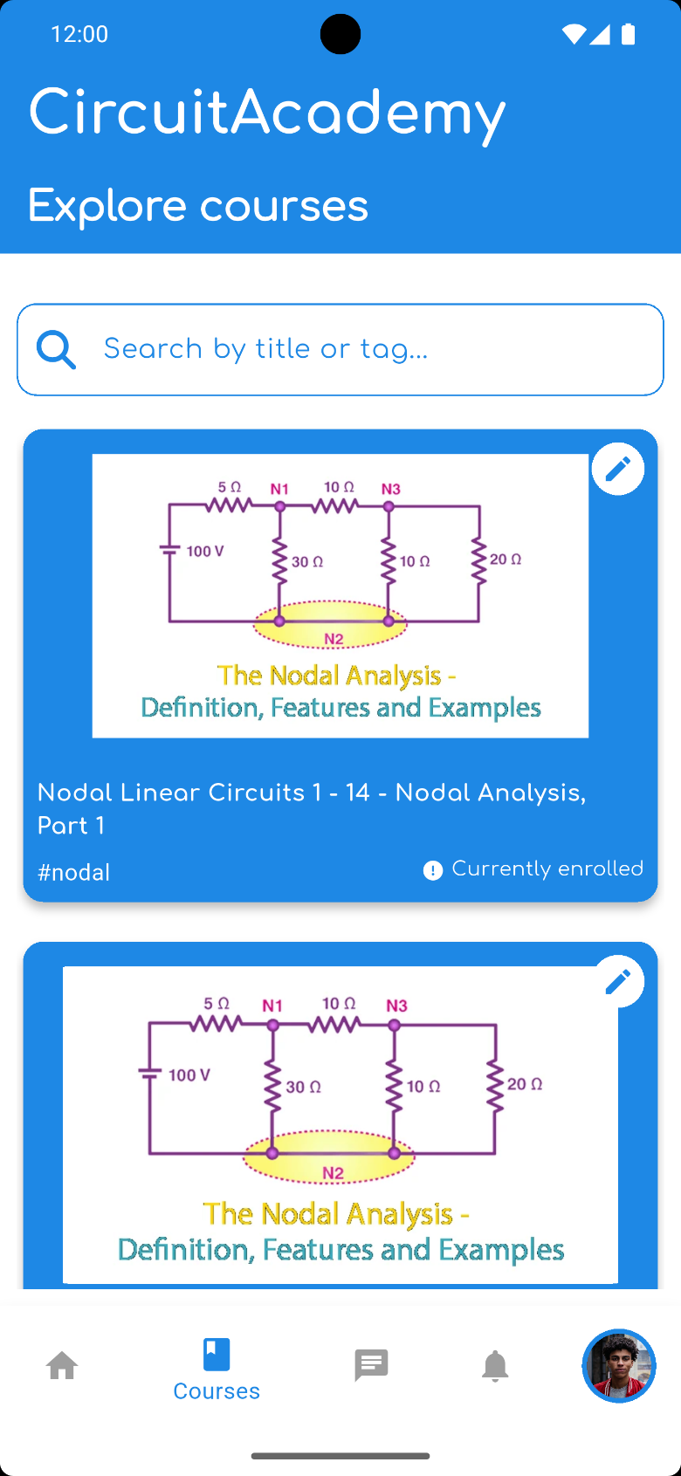
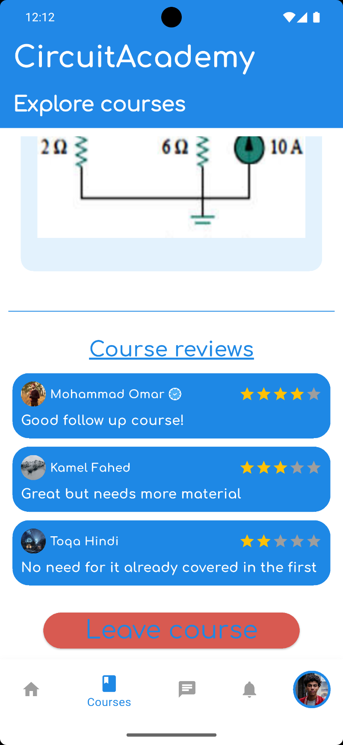
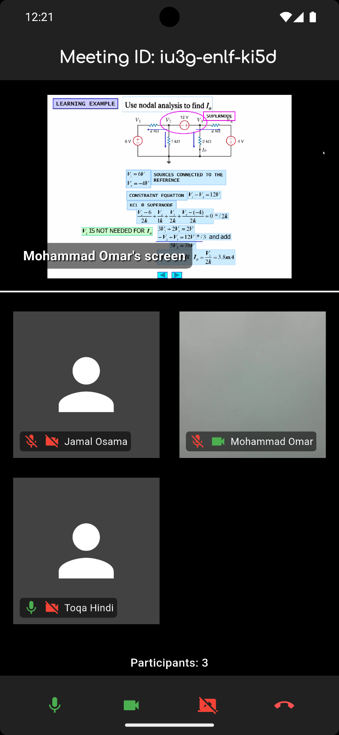
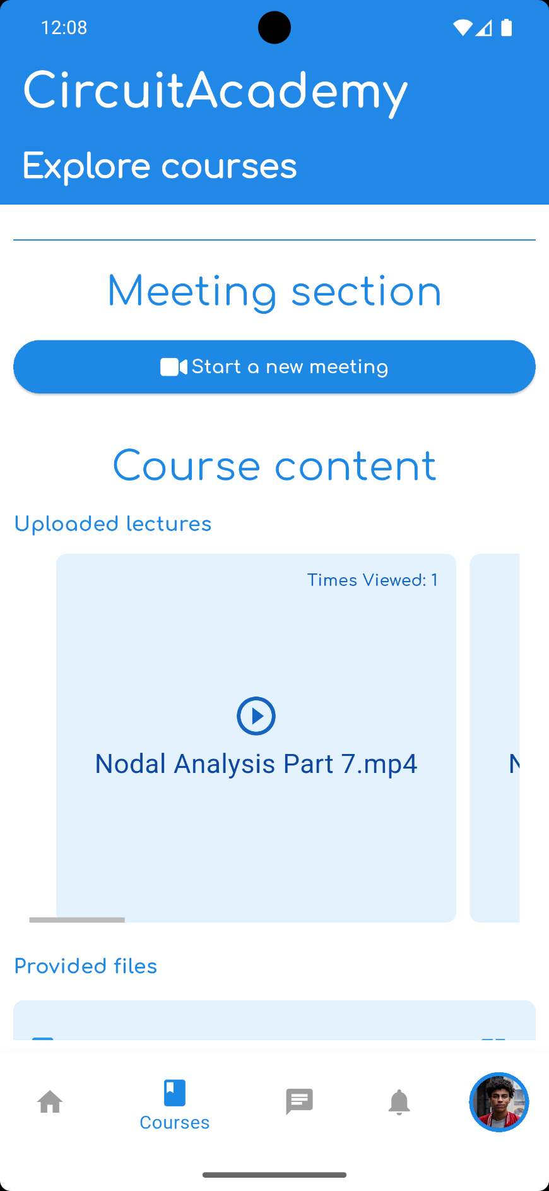

Slide 46
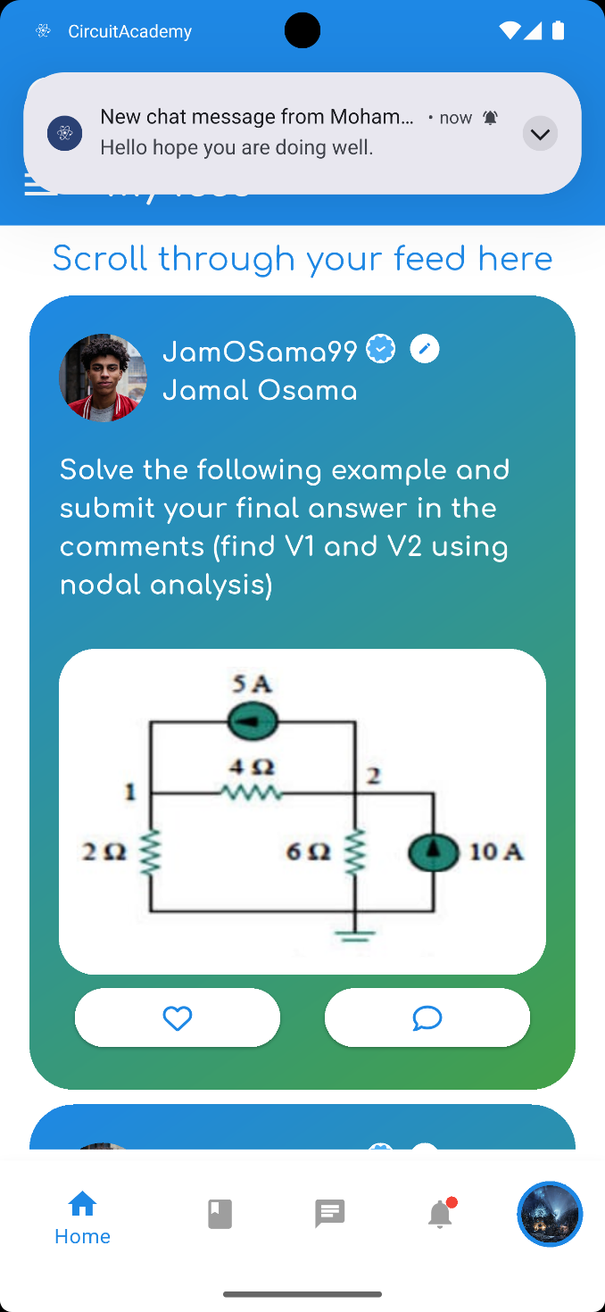




Slide 47
Circuit simulator

Slide 48

Circuit simulator
User interface
Start simulation
Drag & drop blocks
Undo/Redo
Workspace
Save/load

Slide 49












Circuit simulator
User interface
Start simulation
Drag & drop blocks
Undo/Redo
Save/load
Workspace
Available components
Ammeter
Transistor
Resistor
DC voltage source
Sinusoidal voltage source
Voltmeter
Diode
Inductor
Pulse voltage source
Oscilloscope
Ground
Capacitor
Current source

Slide 50

Available components
User interface
DC voltage source
Resistor
Transistor
Ammeter
Start simulation
Drag & drop blocks
Sinusoidal voltage source
Undo/Redo
Inductor
Diode
Voltmeter
Save/load
Pulse voltage source
Workspace
Capacitor
Ground
Oscilloscope
Current source
Drag and drop

Slide 51

Available components
Ammeter
Transistor
Resistor
DC voltage source
Sinusoidal voltage source
Voltmeter
Diode
Inductor
Pulse voltage source
Oscilloscope
Ground
Capacitor
Current source
Component editing
Drag and drop

Slide 52






Component editing
Drag and drop

Slide 53

Component editing
Component editing
Highlight

Slide 54

Component editing
Undo / Redo
Highlight

Slide 55

File save / load
Undo / Redo
Highlight

Slide 56
Simulation method
File save / load
Undo / Redo
User created circuit
Generate
netlist
Output
Identify
Nodes
Send netlist to NGspice

Slide 57

Simulation method
File save / load
User created circuit
Generate
netlist
Output
Identify
Nodes
Send netlist to NGspice

Slide 58

Simulation method
User created circuit
Identify
Nodes
Generate
netlist
Send netlist to NGspice
Output

Slide 59

Simulation method
User created circuit
Identify
Nodes
Generate
netlist
Send netlist to NGspice
Output

Slide 60
Simulation method
User created circuit
Identify
Nodes
Generate
netlist
Send netlist to NGspice
Output

Slide 61


Simulation method
User created circuit
Identify
Nodes
Generate
netlist
Send netlist to NGspice
Output
AC circuits:
DC circuits:
Output is shown as a numerical value through voltmeters or ammeters
Output is shown as a graph generated through GNUplot

Slide 62
Comparison with Multisim
Simulation method
DC circuits:
AC circuits:
User created circuit
Output is shown as a numerical value through voltmeters or ammeters
Output is shown as a graph generated through GNUplot
Identify
Nodes
Generate
netlist
Send netlist to NGspice
Output

Slide 63


Simulation method
Comparison with Multisim
Multisim
CircuitAcademy
DC circuits:
AC circuits:
User created circuit
Output is shown as a numerical value through voltmeters or ammeters
Output is shown as a graph generated through GNUplot
Identify
Nodes
Generate
netlist
Send netlist to NGspice
Output
DC circuit
DC circuit

Slide 64

Comparison with Multisim
Multisim
CircuitAcademy
CircuitAcademy
AC circuit
DC circuit
DC circuit

Slide 65

Comparison with Multisim
Multisim
CircuitAcademy
AC circuit
AC circuit
DC circuit

Slide 66

Comparison with Multisim
Multisim
CircuitAcademy
AC circuit
AC circuit
AC circuit

Slide 67
Comparison with Multisim
Multisim
CircuitAcademy
AC circuit
AC circuit
Circuit solution

Slide 68

Comparison with Multisim
Multisim
Circuit solution
AC circuit
Identify circuit type
Circuit identifier
Circuit identifier

Slide 69



Circuit solution
Identify circuit type
Circuit identifier
Formula explanation
System of equations
explanation

Slide 70
Solution explained
Formula explanation
Circuit identifier
System of equations
explanation
Matrix system explination
Matrix solution (node voltages)

Slide 71
Identify circuit type
Matrix system explination
Formula explanation
System of equations
explanation
Matrix solution (node voltages)
Formula explanation
Currents

Slide 72

Identify circuit type
Formula explanation
Matrix system explination
Currents
Matrix solution (node voltages)
AC specific explination
AC explination

Slide 73



AC specific explination
Identify circuit type
Integration and deployment
Formula explanation
We deployed the web platform using Firebase Hosting, which provided public access through a website link. The backend server was deployed using Onrender.
We also used an Atlas Mongodb server to host our database online
AC explination
Currents
View Spice netlist

Slide 74
View Spice netlist
AC specific explination
Integration and deployment
We deployed the web platform using Firebase Hosting, which provided public access through a website link. The backend server was deployed using Onrender.
We also used an Atlas Mongodb server to host our database online
AC explination

Slide 75
View Spice netlist
Future work
Integration and deployment
Include more complex components such as dependent sources.
Expand explanations for transistors and diodes.
Introduce support for basic digital components, such as AND, NAND, OR, and NOR gates.
Multi-language support.
Export circuits and circuit explanations as PDFs.
We deployed the web platform using Firebase Hosting, which provided public access through a website link. The backend server was deployed using Onrender.
We also used an Atlas Mongodb server to host our database online

Slide 76
Future work
Integration and deployment
Include more complex components such as dependent sources.
Expand explanations for transistors and diodes.
Introduce support for basic digital components, such as AND, NAND, OR, and NOR gates.
Multi-language support.
Export circuits and circuit explanations as PDFs.
We deployed the web platform using Firebase Hosting, which provided public access through a website link. The backend server was deployed using Onrender.
We also used an Atlas Mongodb server to host our database online
THANK YOU

Slide 77
Integration and deployment
We deployed the web platform using Firebase Hosting, which provided public access through a website link. The backend server was deployed using Onrender.
We also used an Atlas Mongodb server to host our database online
THANK YOU

