Slide 1

PhysioSim
by:
Akram Dweikat
Supervised by:
Dr.Samer Arandi

Slide 2
Outline…
Demo!!
How Does it work?
Obstacles Overcame.
Future work.
Problem.
Solution.
What is PhysioSim?!
What Can PhysioSim Do?!

Slide 3

Problem
Hard to Describe/Study
Physics Problems.
Lack of Dedicated
3D Physics Simulators.

Slide 4
So What Do We need?!

Slide 5
Motivation …
PhysioSim

Slide 6
What is PhysioSim?!
A platform for developing 3D physics simulations and 3D physics applications that is geared towards education.

Slide 7
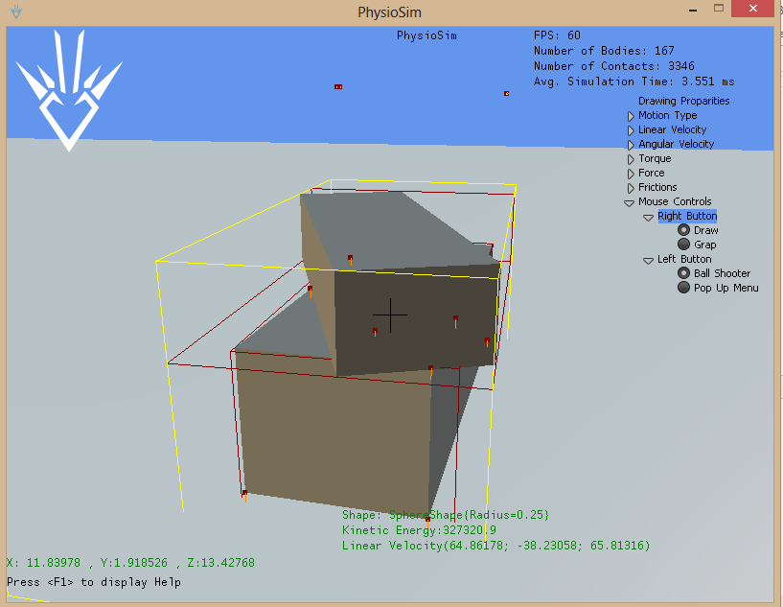
PhysioSim

Slide 8
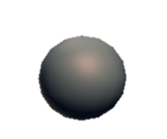

What Can PhysioSim do?
Simulate 3D movements of objects in real world.
Simulation can have up to 20,000.
Draw/ Add 3D rigid bodies dynamically.
3 types of Objects: static/dynamic/Kinematic

Slide 9
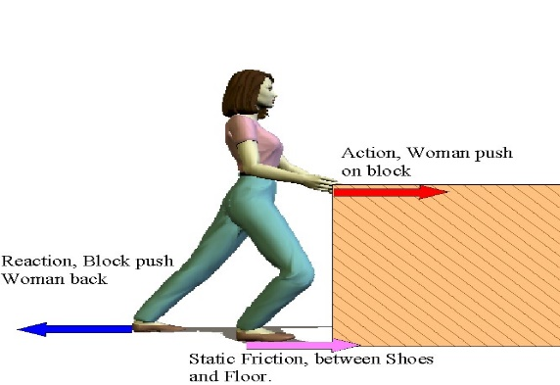
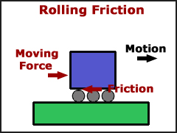
What Can PhysioSim do?
Define multiple types of friction forces.
Dynamic Friction
Static Friction

Slide 10
What Can PhysioSim do?
Restitution (Bouncing)
Mass= size * density. (Heavy /light shapes)
Apply forces/torque, control angular/linear velocities.
Use GUI
Build your application on top of it.

Slide 11
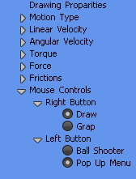
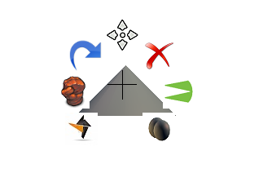
GUI Functionality
Right Menu.
define properties of Objects to be drawn.
Pup up menu. Change properties of specific object.

Slide 12


GUI Functionality
Simulation Statistics.
Rigid Body Properties.
Pointer Location.

Slide 13
It’s Demo Time!!

Slide 14
How Does It Work?
Microsoft XNA
PhysioSim
Physics Engine

Slide 15
Obstacles overcame ☺
Learning Microsoft XNA.
Majorly :GUI.
2D to 3D point.

Slide 16
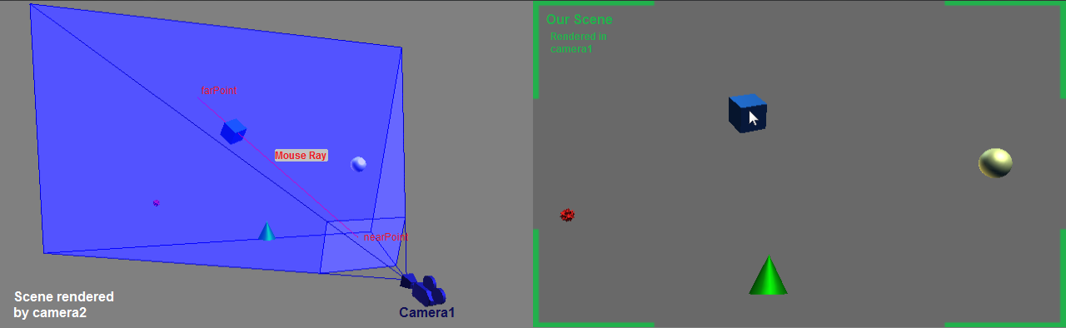
2D to 3D point Translation Problem

Slide 17
Future work
Make it more sophisticated.
Mobile Version.
Tablet version.
Cloud service.

Slide 18

Q & A time

Slide 19
Have a nice day ☺
“The Journey is more important than the destination”

