Slide 1
Vertical/rotary car parking system
Supervisor: Dr. Samer Mayaleh
Introduced by:
Ammar Bannan
Majde Zagha
Yasir Tobbileh

Slide 2
Outline
Introduction.
-Basic Component :-
* Mechanical Component.
* Electrical Component.
PLC code
Induction Motor Drive
Future work & conclusion

Slide 3
Introduction
Why we choose vertical/rotary parking ?
Why we made a new Design ?

Slide 4
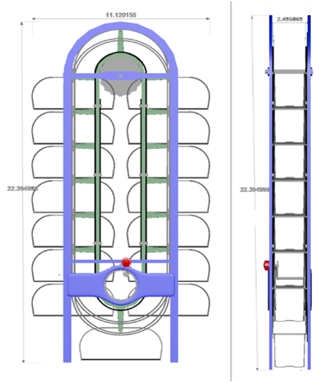
The new design

Slide 5
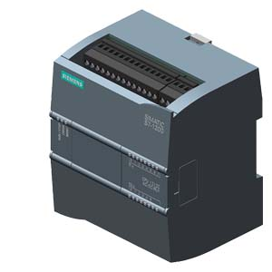
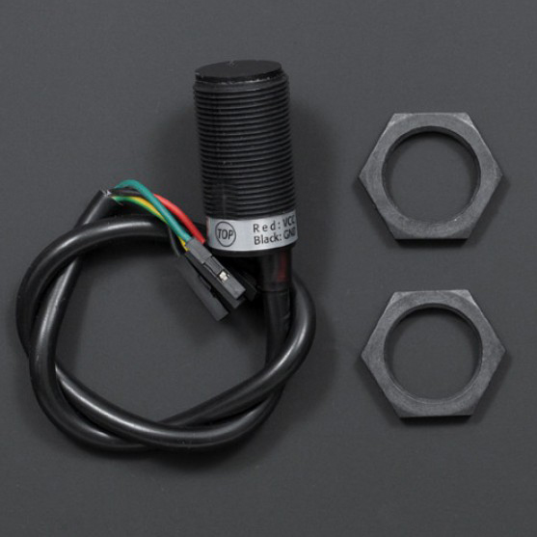
MICROCONTROLER:PLC
Type:siemens
Name:melismaticz S7-1200 (220 AC – 24 DC )
8 input , 8 output
INPUT:SENSOR
Type:IR resistive sensor
Has phase neutral and data bus

Slide 6
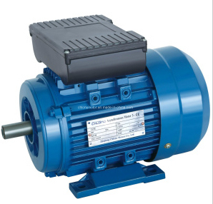
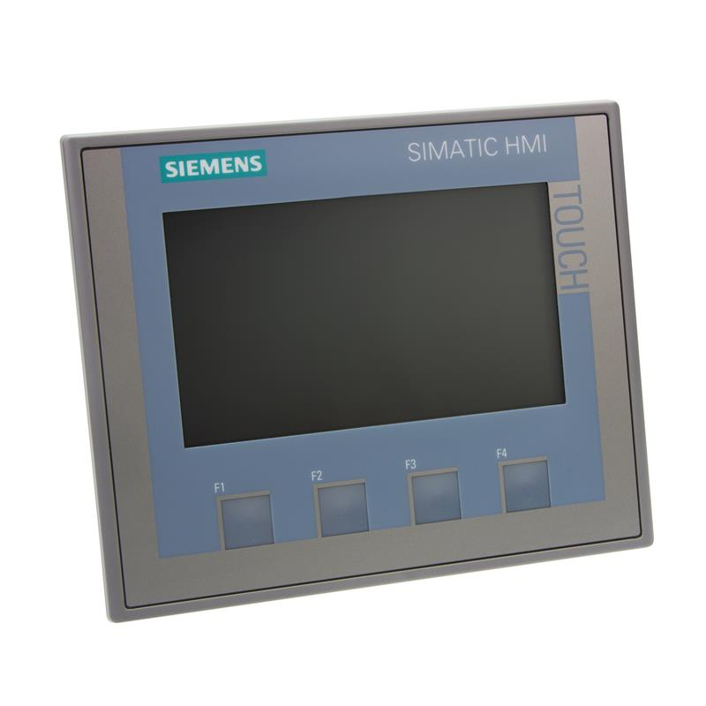
MICROCONTROLER:PLC
Output: induction motor
Two outputs one forward and one reverse
Output / Input : HMI

Slide 7
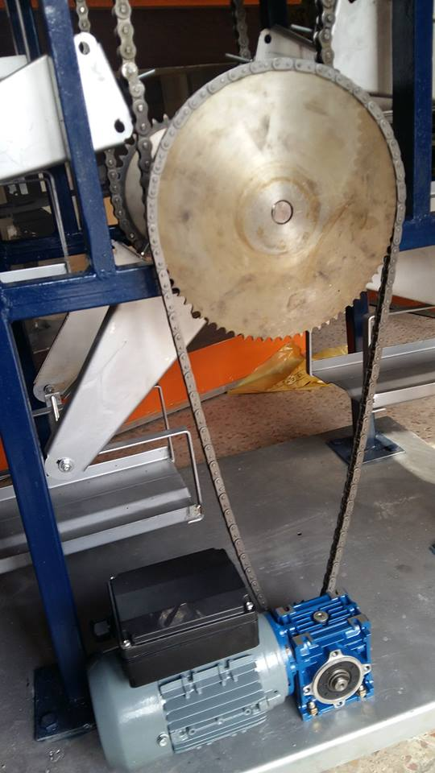
MECHANICAL ISSUE
There is two step down speed
gear box from 1450RPM to 14RPM
Mechanical gear 14RPM to 3RPM (76/16 teeth)
Standard speed is 3RPM

Slide 8
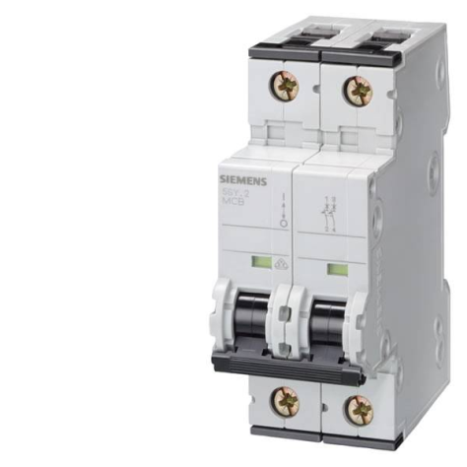
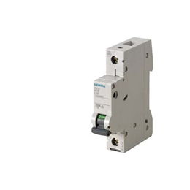
C.B (6A) Two pole
Main Protection for D.B
Protecting devices(circuit breakers)
C.B (6A) One pole
Main Protection for I.M

Slide 9
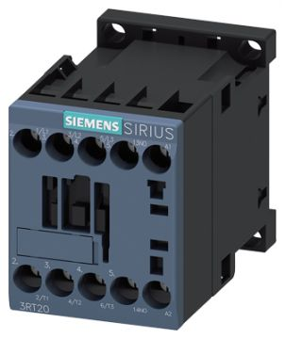
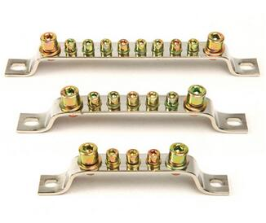
Contactor
Busbar

Slide 10
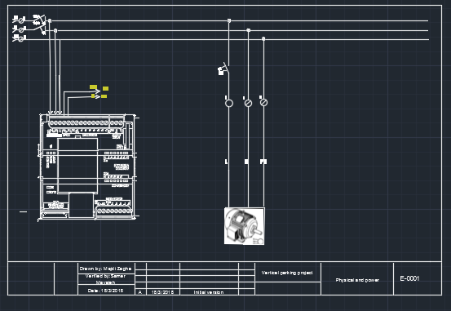
ELECTRICAL CONNECTION
Power connection(distribution board)

Slide 11
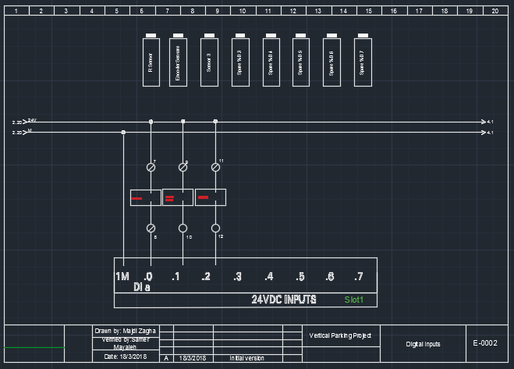
ELECTRICAL CONNECTION
Digital input connection

Slide 12
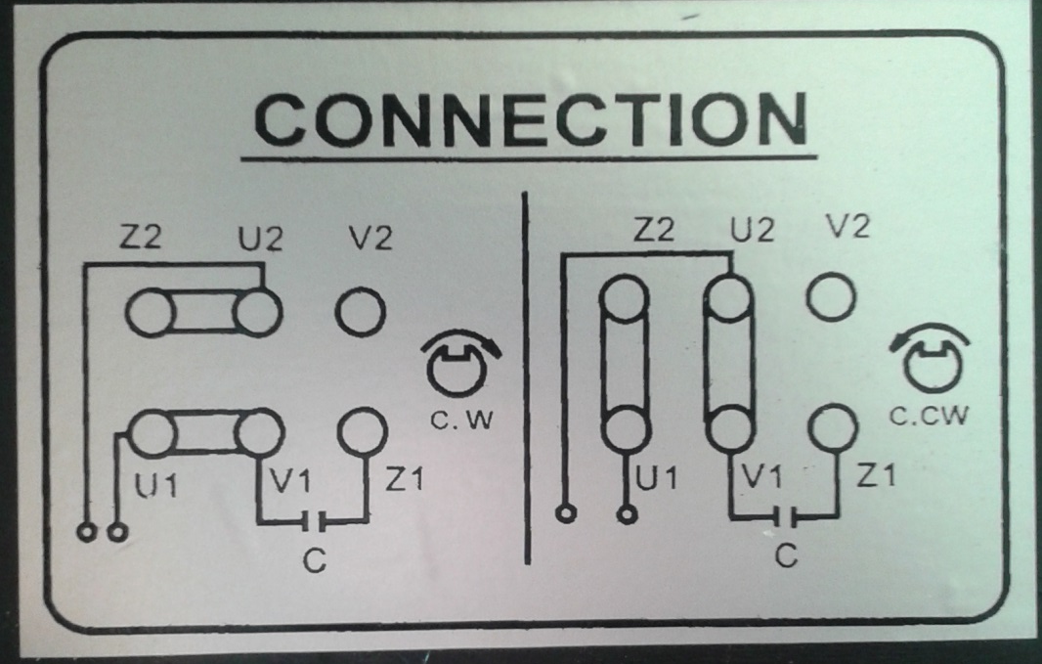
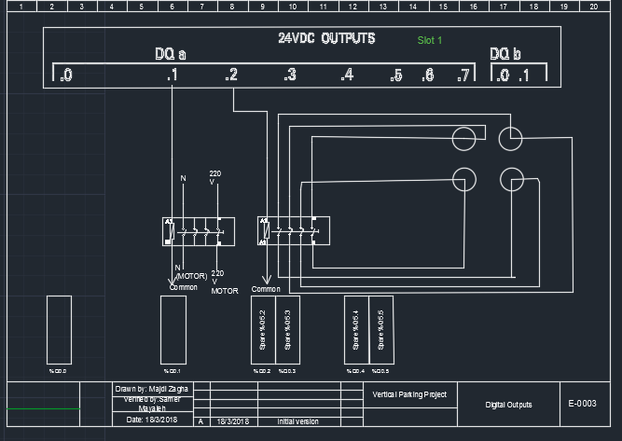
ELECTRICAL CONNECTION
Control output connection (contactors)

Slide 13
The code
The Project code is divided into Two parts in term of operation:
1. Entering Car :- In this case, the PLC makes sure that an empty car park and then make sure to read sensitive to reach the car , and finally accommodate that customer pressure on the operating button through the screen (HMI Screen ) .
2. Calling Car : - In this case, when the customer returns to take his car, press on the location of his car through the screen (HMI Screen ) , and then the PLC determines the location of the car and choose the shortest way to return the car.

Slide 14
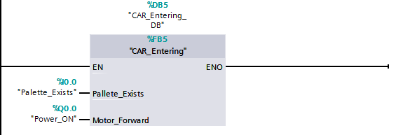
Entering Car
The first part is divided into two parts :-
1. The parking is not full.
2. Read the sensor and apply the car entry code.

Slide 15
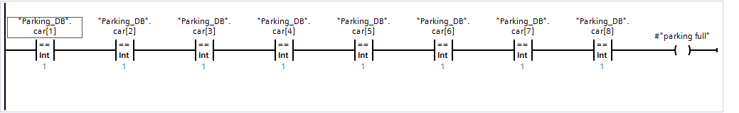
The parking is not full.

Slide 16
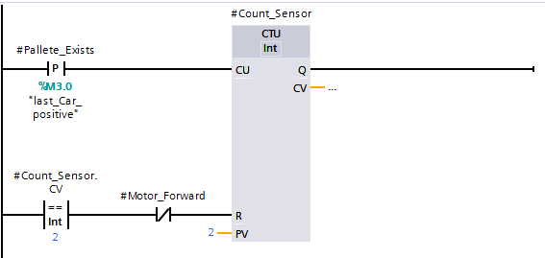
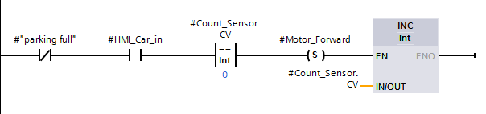
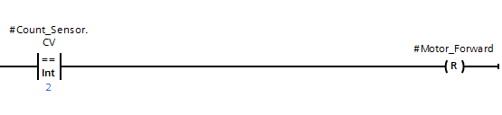
Read the sensor and apply the car entry code

Slide 17
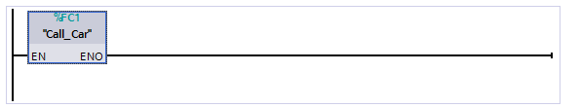
Calling Car
The calling car depends on the two blocks: -
1. The first block depends on the screen where the icon on the screen of each Pallets and the person clicking on the icon related to his car.

Slide 18
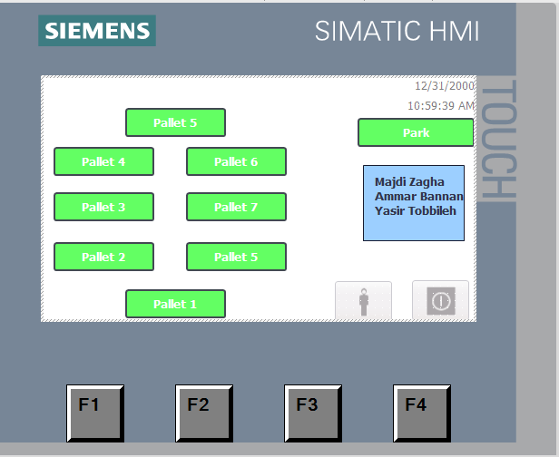
Calling Car

Slide 19
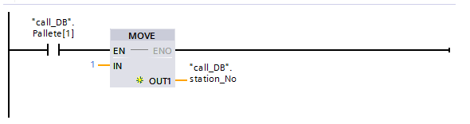
Calling Car
When the value of the Pallets becomes true we will use the Move block to determine which Pallet will move and store in "call_DB”. station_No.
Each Pallet has the same line .

Slide 20
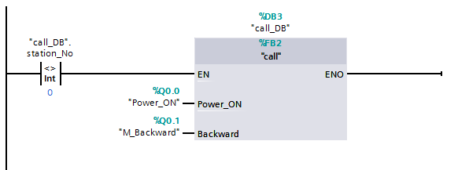
Calling Car
The second block is the one that will control and decide which Pallet will move and choose the shortest route .
This block is activated when a "call_DB".station_No is true (This means that the pallet was chosen ) .

Slide 21
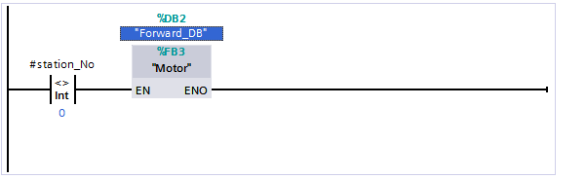
Calling Car
- When you become "call_DB”. station_No true, the "Forward_DB” is true and we used the language of Visual Basic in this block :-

Slide 22
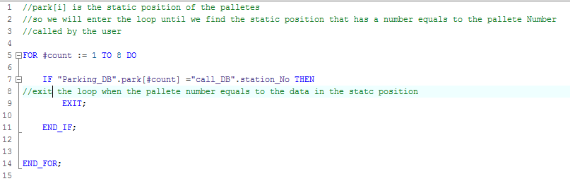

Slide 23
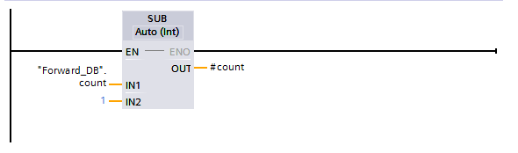
Calling Car
After the Pallet determines must be a subtraction on the value because it is possible to be at the entrance and therefore there is no need to move the motor

Slide 24
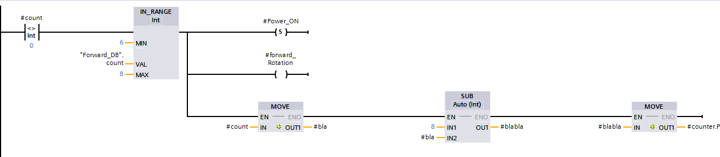
Calling Car
After that, we divided the prototype into two parts within the program so that we can determine what is the shortest way to each pallet
- First Range (forward)

Slide 25
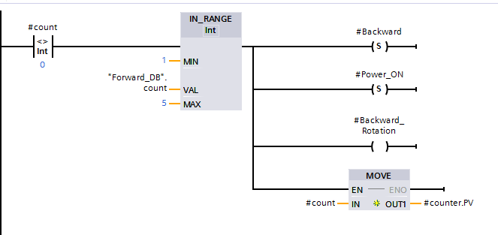
Calling Car
Second Range (Backward )

Slide 26
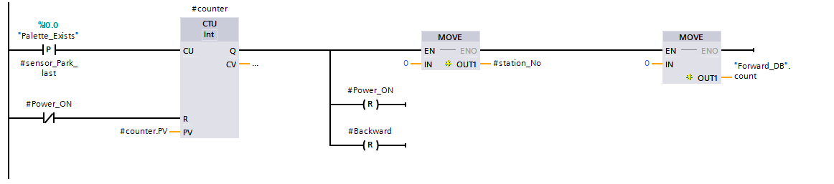

Slide 27
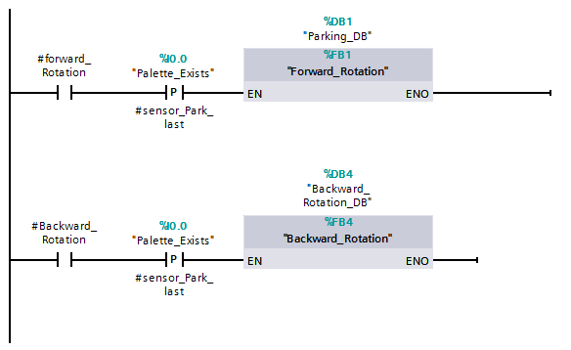
Calling Car
In the final section of the program, the prototype must be arranged after each car extraction process.

Slide 28
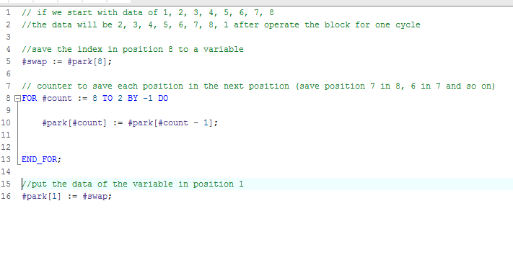
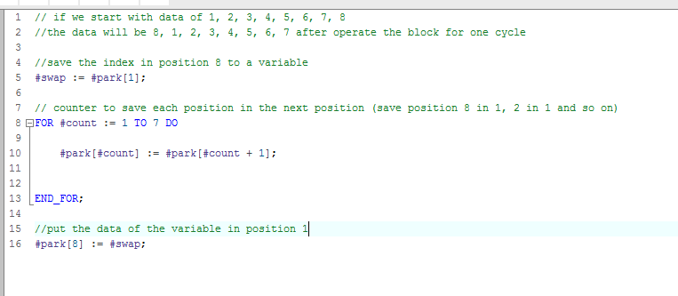
#forward_Rotation
#Backward_Rotation

Slide 29

Torque equation for equivalent motor-load system
Te-Tl = J $\frac{dw}{dt}+B∗W$
Te changes depends on the changes in Tl.
Te > Tl to let the system move.

Slide 30
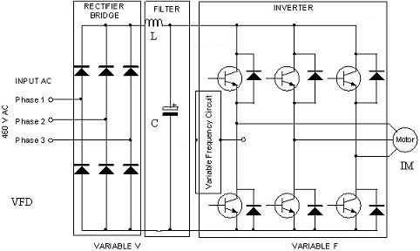
Variable frequency drive (VFD)

Slide 31
Speed control methodology
There are two basic methods to control the speed of induction motor:
1) Scalar Control.
Ignores the transient conditions.
Good only for low performance drives.
2) Vector Control or Field Orientation Control.
control of magnitude and phase based on dynamic model.
capable of observing steady state & transient motor behavior.
good for high performance drives.

Slide 32
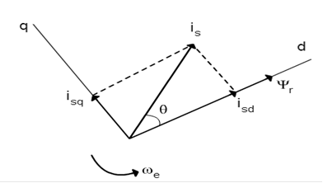
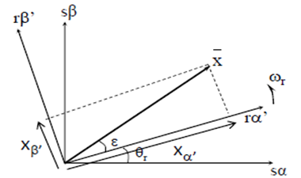
Vector Control or Field Orientation Control
Dynamic model complex due to magnetic coupling between stator phases and rotor phases
Complexity of dynamic model can be reduced by employing space vector equations
ψ_{r} lies completely on the d-axis so the system is field oriented
The stationary stator frame αβ and the rotor frame αβ’

Slide 33
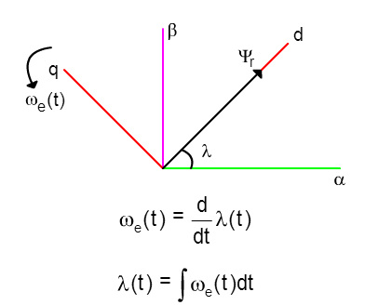
Vector control implementation
1- Direct Vector Control
Flux Angle λ obtained by measuring the machine flux
2- Indirect Vector Control
Flux Angle λ obtained from 3-phase
stator currents

Slide 34
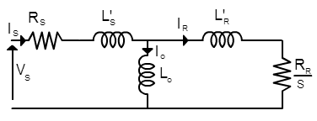
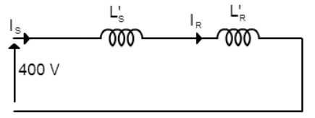
Induction Motor Speed Drive
1) Obtaining the parameters
Lo =124.58 mH , R_{R} = 0.78 Ω
σ_{S} = L'_{S} / L₀
= 0.038
σ_{R} = L'_{R} / L₀
= 0.038
σ = σ_{S} + σ_{R}
= 0.768
L_{S} = L'_{S} + L₀
=129.37 mH
L_{R} = L'_{R} + L₀
= 129.37 mH

Slide 35
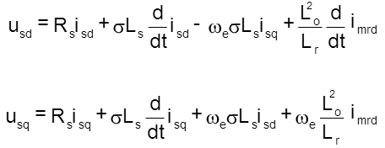
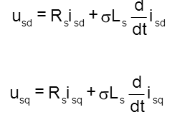
Indirect Vector Control
Stator equations

Slide 36
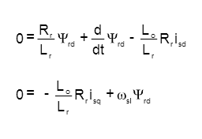
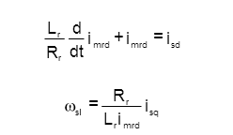
Indirect Vector Control
rotor equations
Vector control equations

Slide 37
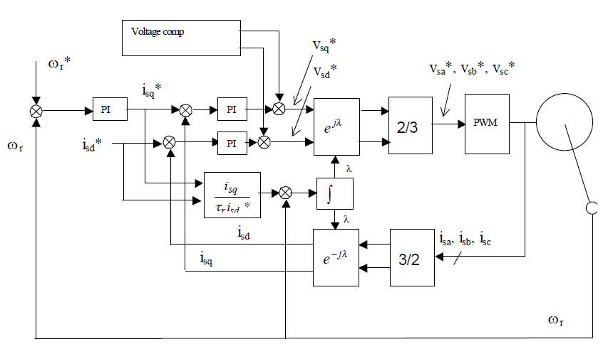
Indirect Vector Controller (without field weakening)
Dq current control and speed controller

Slide 38
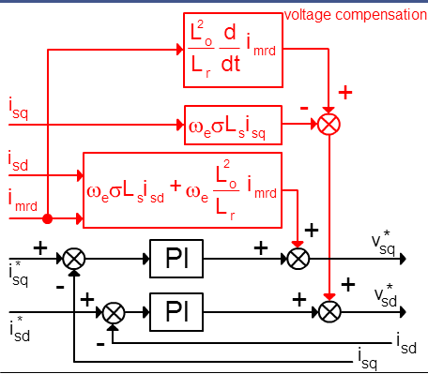
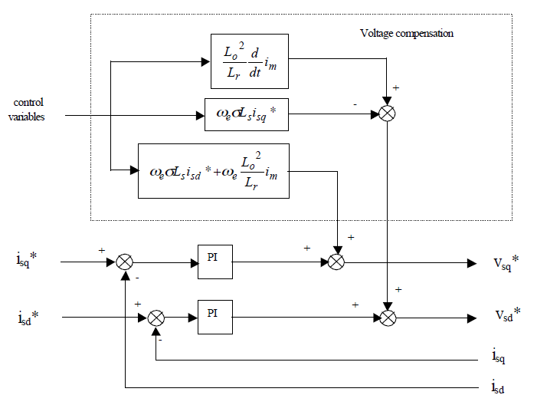
Indirect Vector Controller (without field weakening)

Slide 39
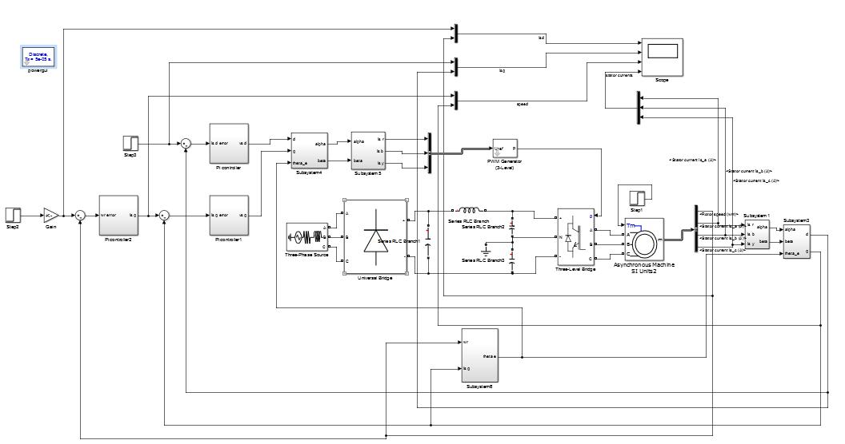
Indirect vector control Matlab simulation

Slide 40
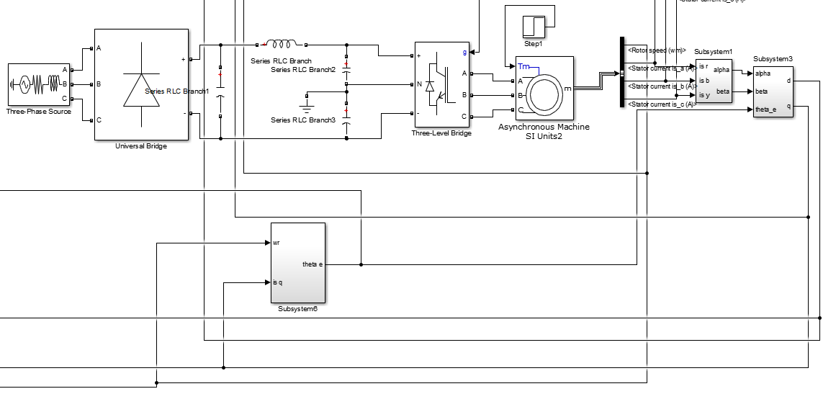
Indirect vector control Matlab simulation

Slide 41
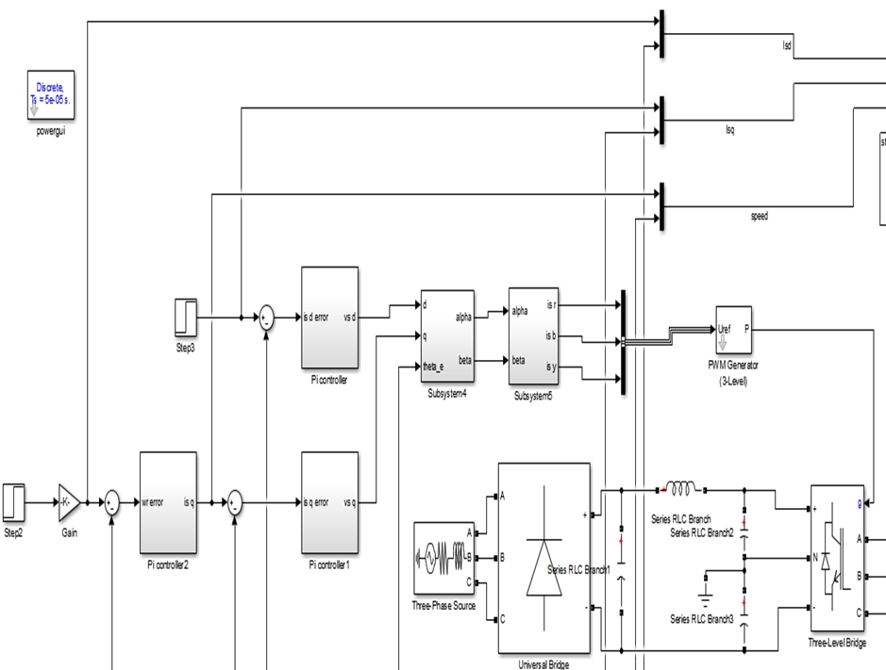
Indirect vector control Matlab simulation

Slide 42
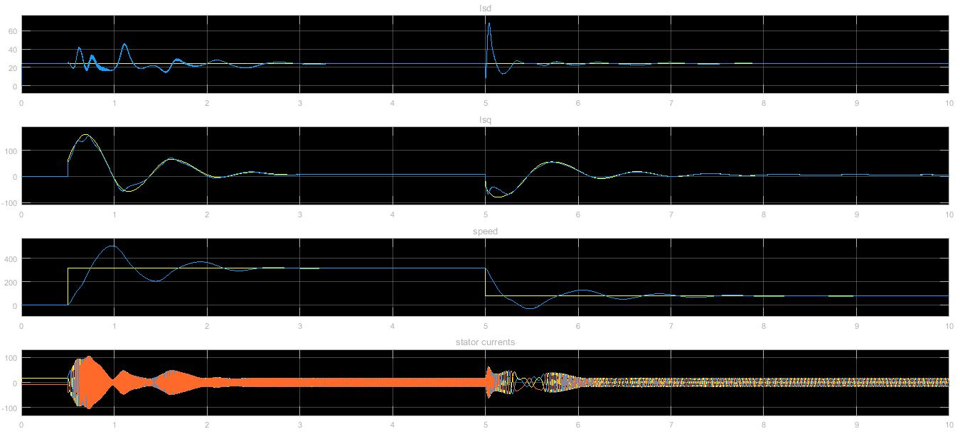
Indirect vector control Matlab simulation

Slide 43

Indirect vector control Matlab simulation

Slide 44
Future work and conclusion
The project could be improved by using a complete Supervisory Control and Data Acquisition program (SCADA)
Also GPRS can be used in order to book and reserve some pallets for specific customers.
In addition the payment for parking could be done using credit card through the HMI screen which should be connected to the internet, or by using a coin machine that starts up a timer counting for a specific time depends on the coin value.

Slide 45
Thank you

