Slide 1

College of Engineering & Information Technology
Department of Management Information Systems

Slide 2


E-commerce and E-marketing for Mamlaket Alotor
STUDENT
Shima Zaid Mohammed Tabib
Supervised DR.Kamal Irshaid

Slide 3





TABLE OF CONTENT
Introduction
03
⁰¹ Introduction
Solution
05
website
Problems
02
E- marketing
04

Slide 4


INTRODUCTION
Mamlaket Alotor
store was established in November 2017 to sell men's, women's and children's perfumes, and makeup, skin care products, body care, and hair care with high quality and competitive prices.
Palestine -Nablus -Gold Market

Slide 5

VISION
MISSION
To be the first, most successful and attractive choice in Palestine through the best prices and products in the cosmetics sector.
A unique online shopping experience through the best marketing methods

Slide 6

Problems
01
Sales decreased significantly due to the inability to visit the store due to many conditions
Little interaction on social media
02
03
Difficulty answering messages and tracking customers
04
There is no electronic payment feature, only payment upon receipt.

Slide 7

Problems
05
All auditing, registration and billing processes are paper-based
06
There are problems in tracking inventory
07
Lack of sufficient experience in marketing and eye-catching product promotion

Slide 8









SOLUTIONS
Create a website on Word Press to display all the goods in the store and the ability to purchase online.
Activate the electronic payment feature on the site.

Slide 9


SOLUTIONS
Generate sales invoices and report electronically
-Increasing interaction on social media pages through marketing and reach the largest number of customers.

Slide 10





Technology used
WordPress Social media platforms

Slide 11









Tools we used to analyze Facebook page:
Fanpage Karma Zoho Buffer
Agorapulse Facebook Insight Meta Businesses

Slide 12



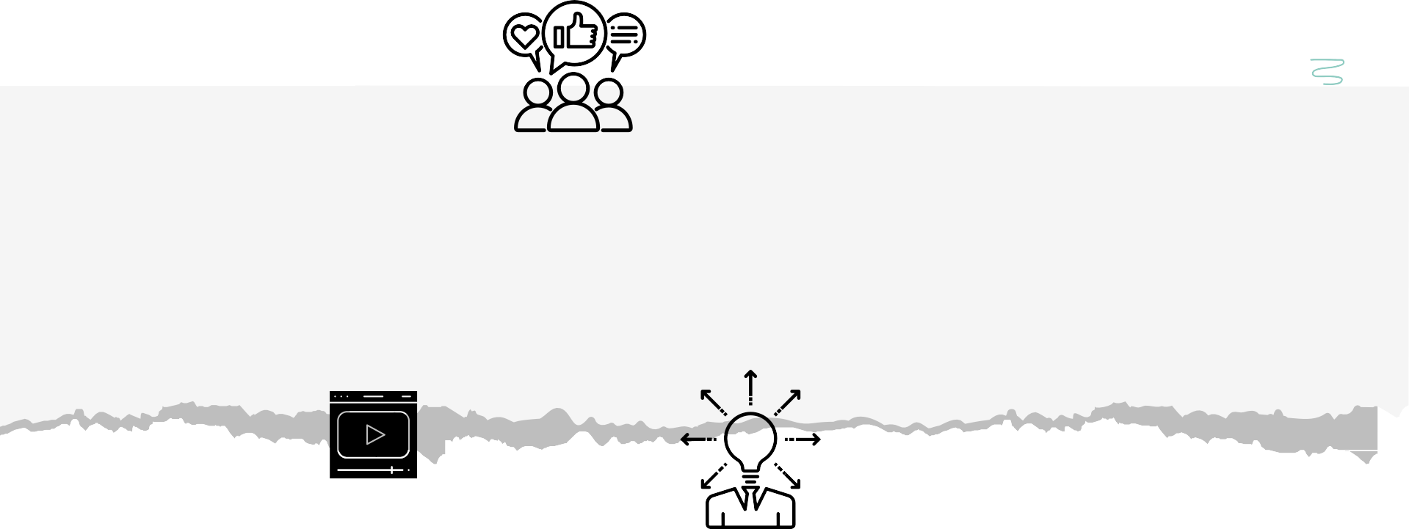

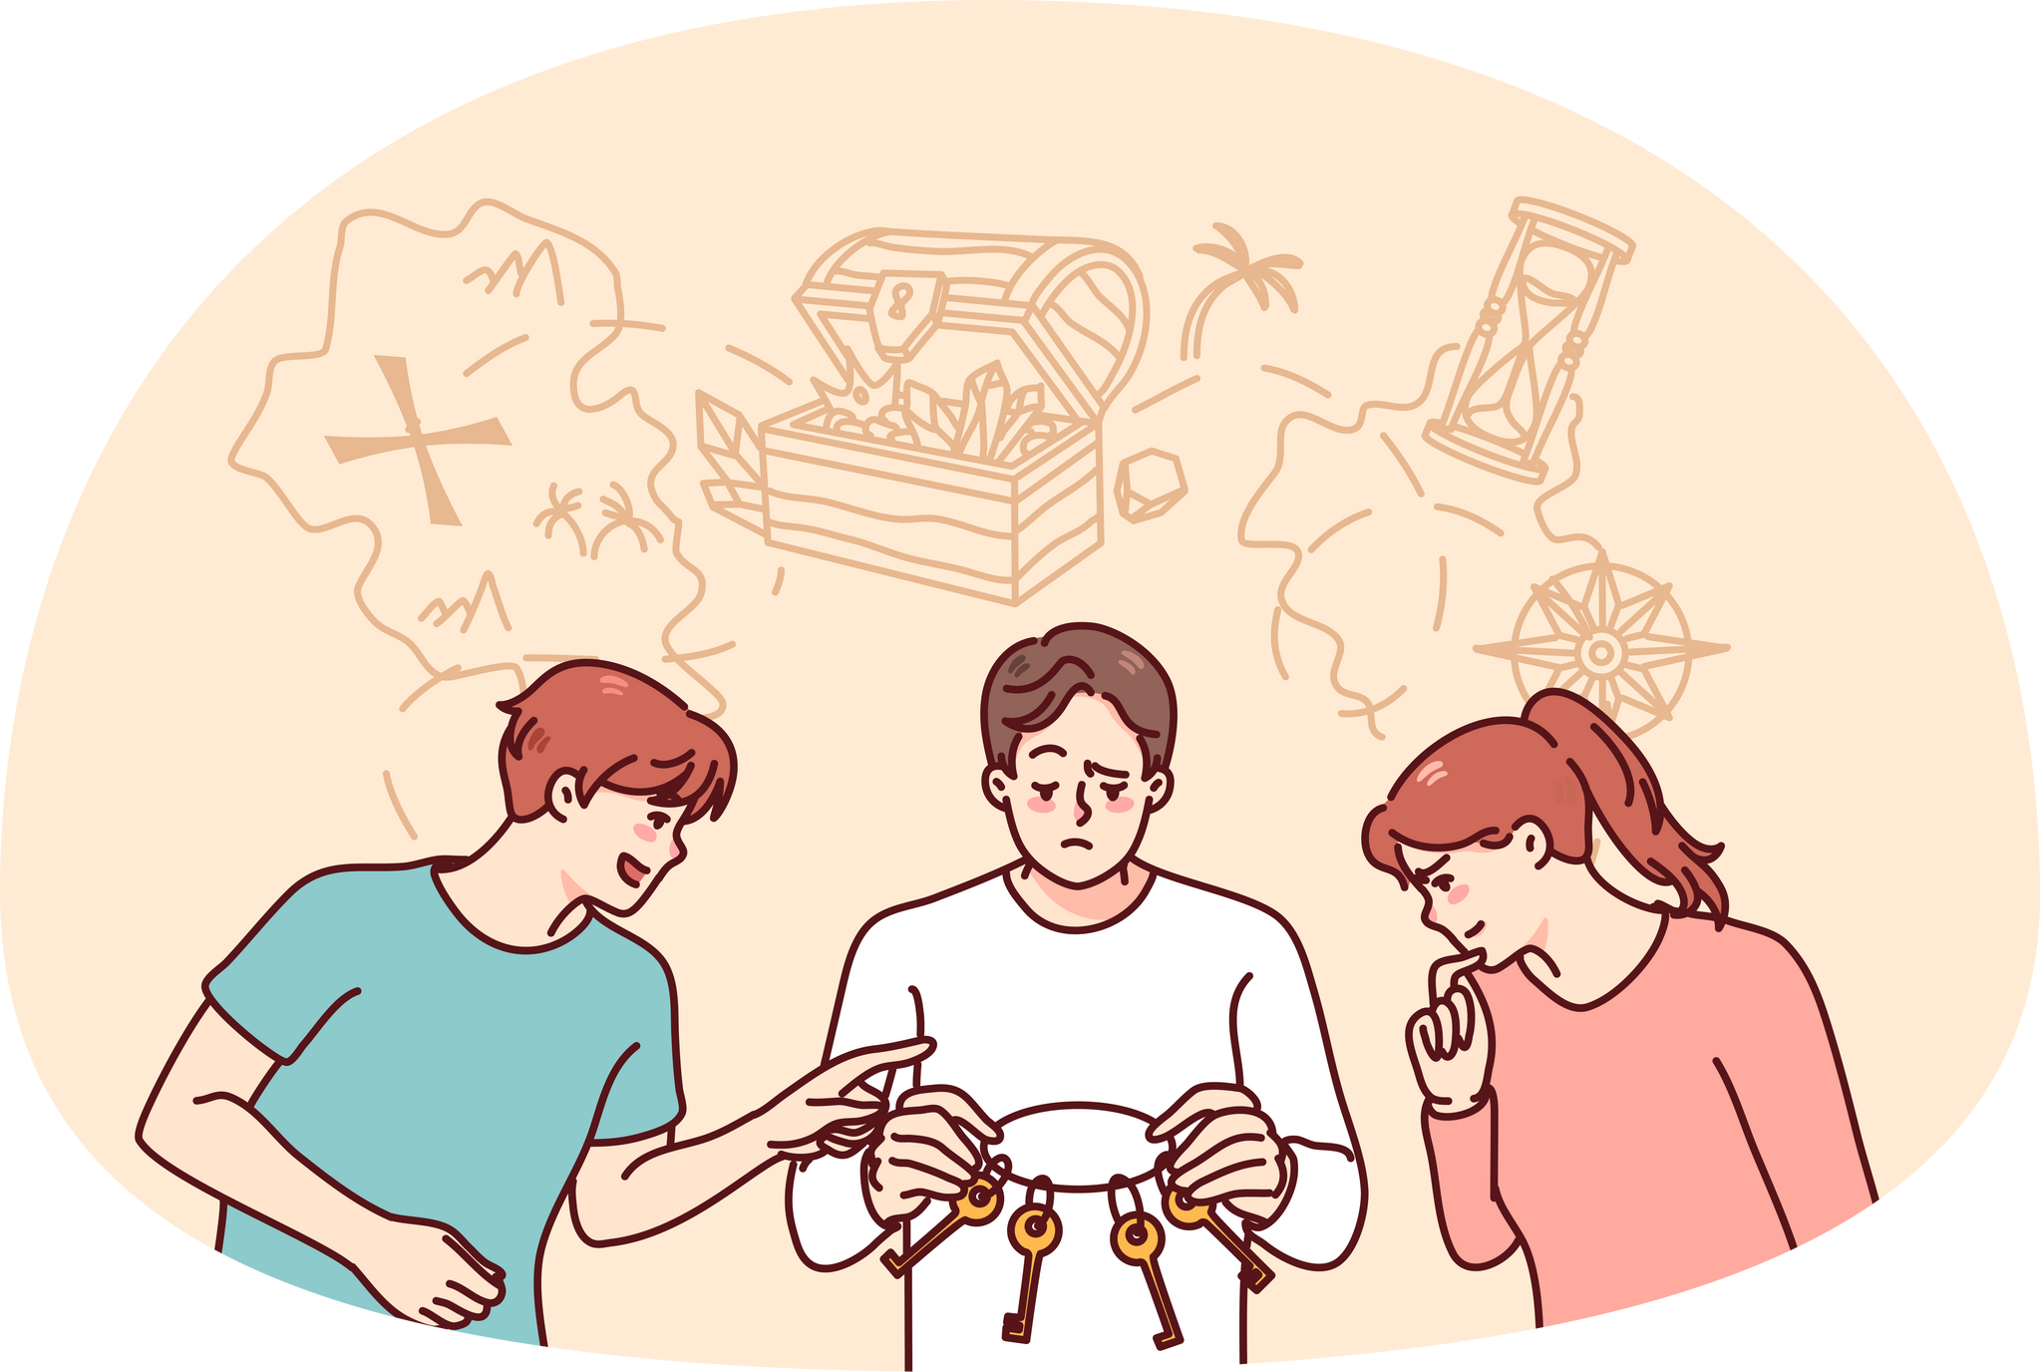
E-marketing strategies and implementation of social media:

Slide 13

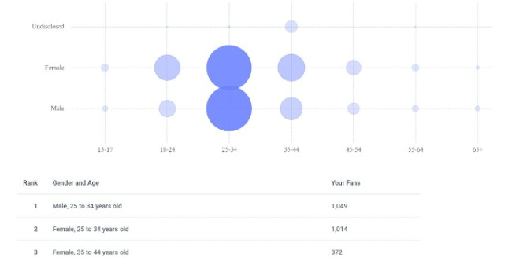
Analysing social media pages Age & Gander Analysis

Slide 14
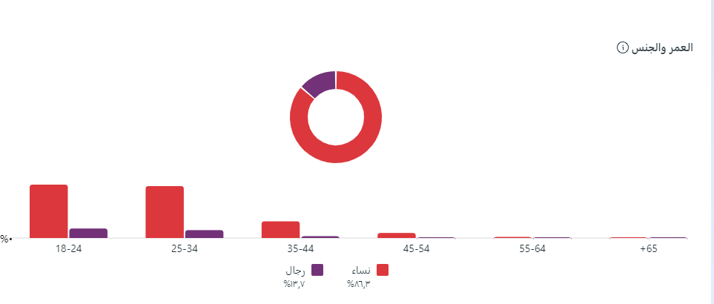
TOOL : Buffer & Meta Business suite

Slide 15
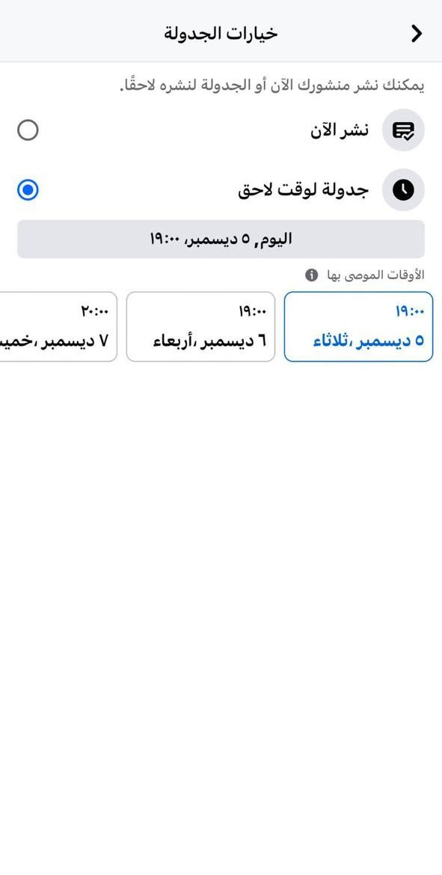
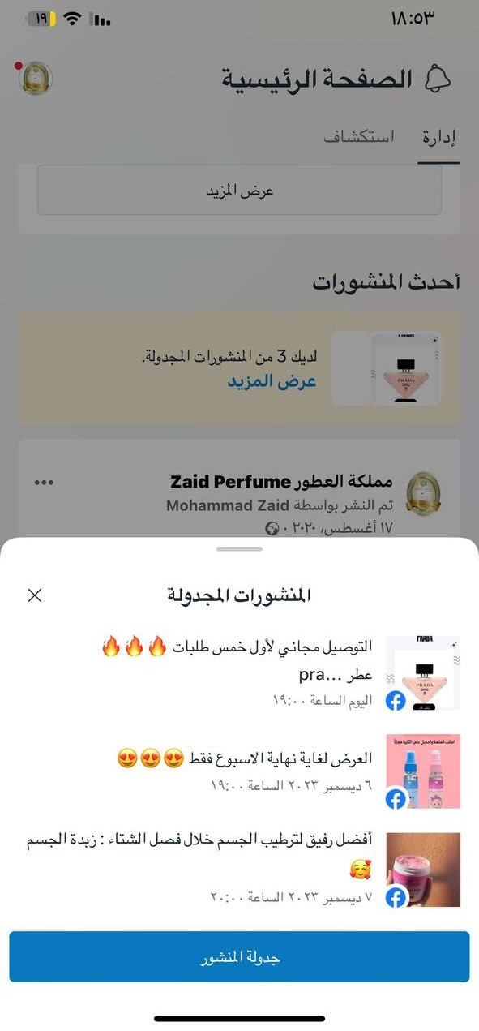
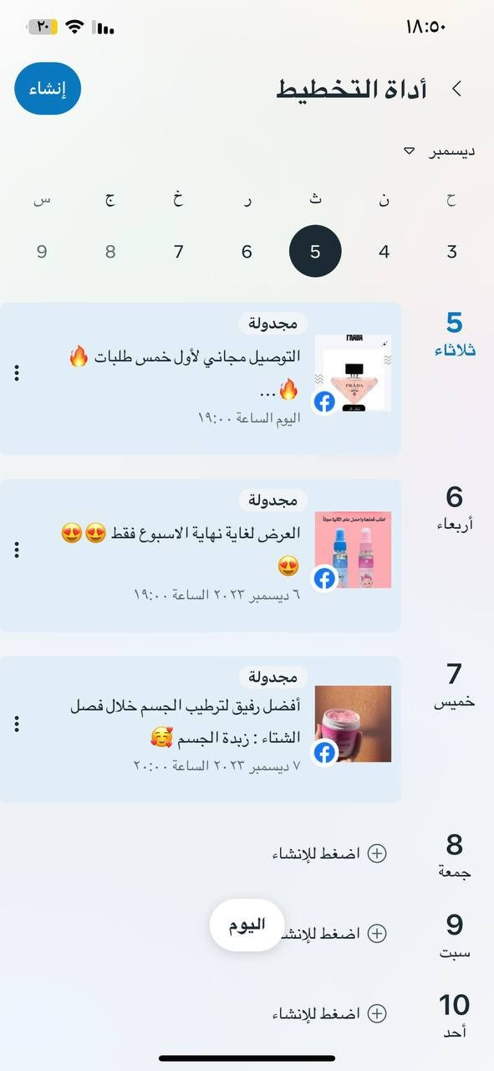

Posting scheduling

Slide 16
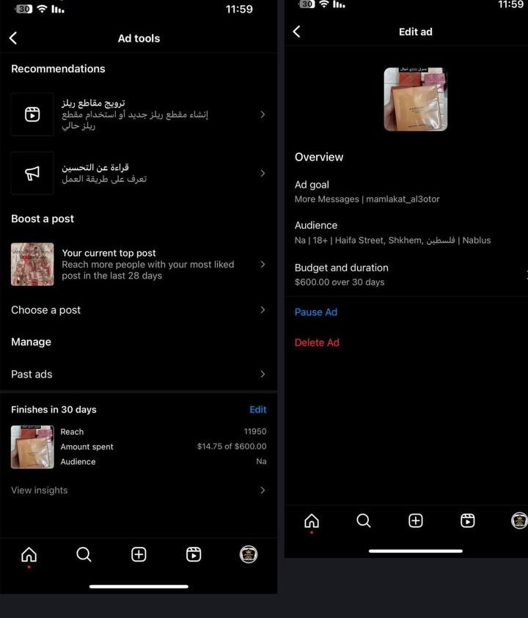

Paid Advertisements.

Slide 17
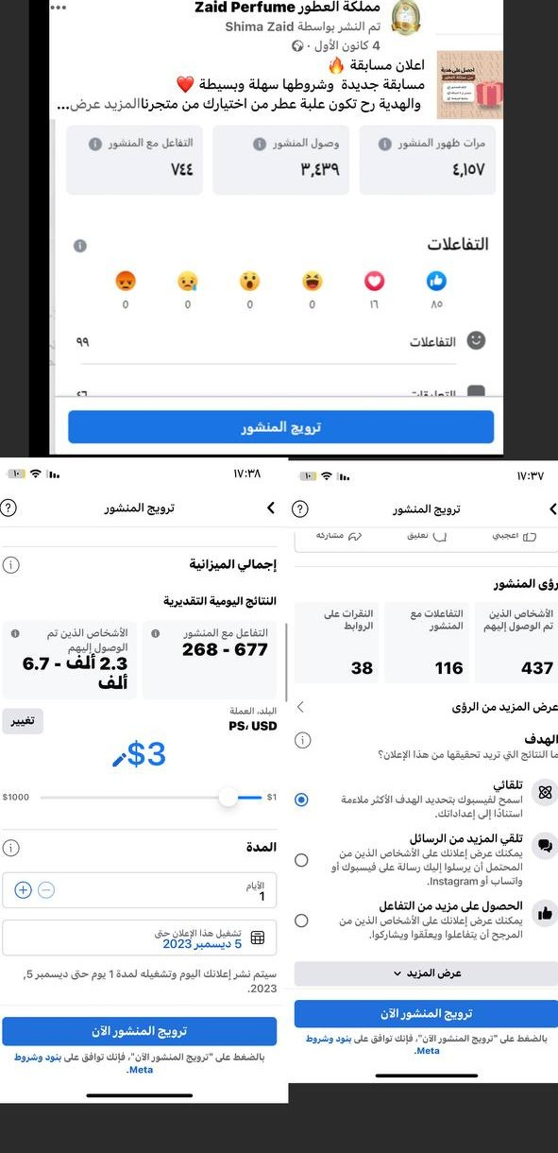


Paid Advertisements.

Slide 18
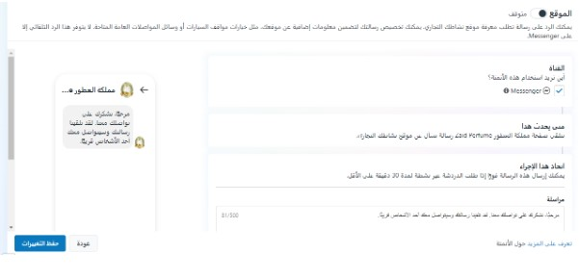

Automated reply:

Slide 19
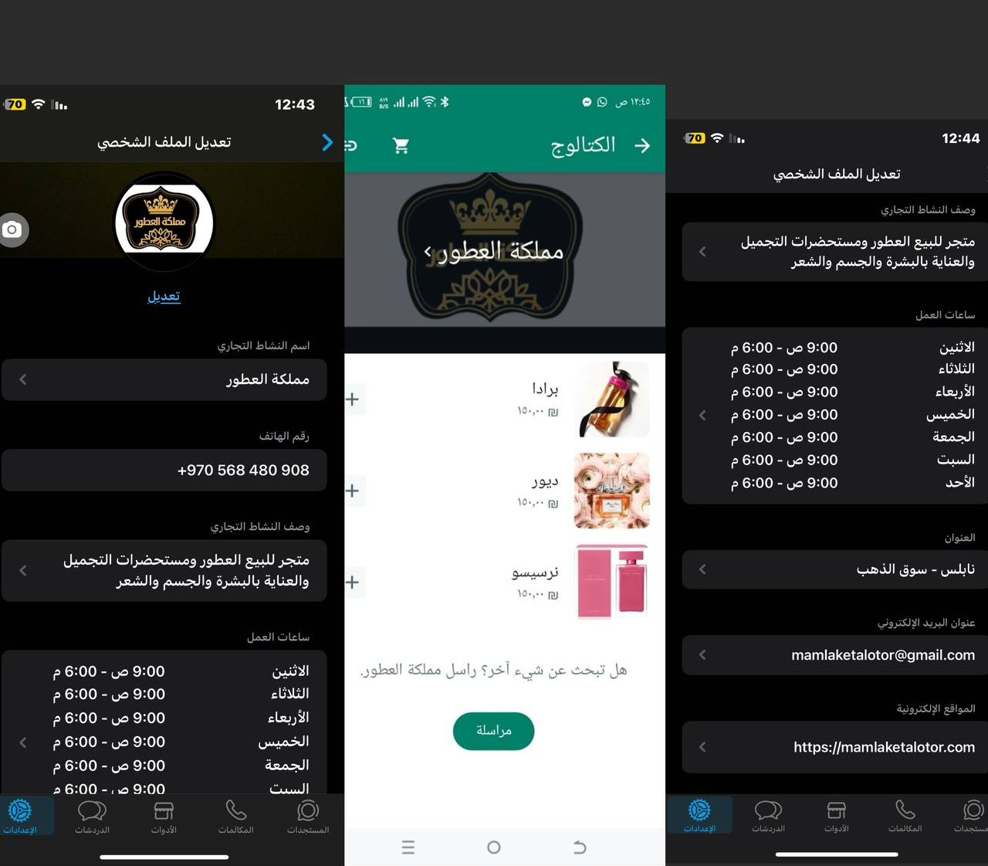

whatsapp business

Slide 20
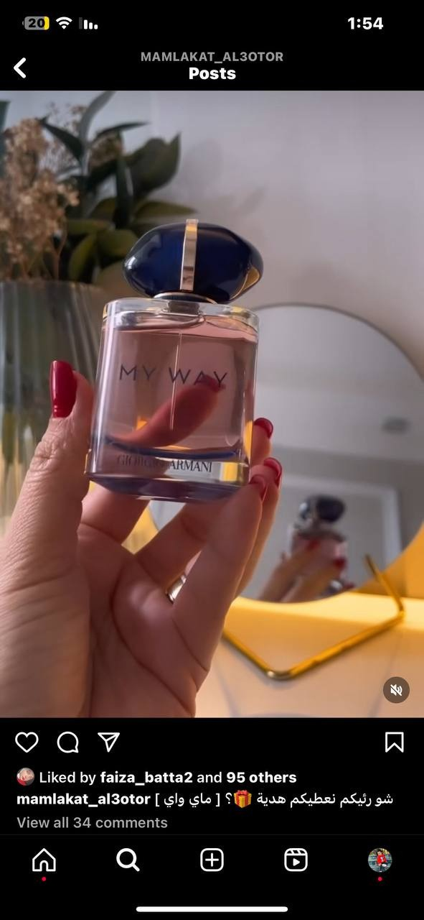
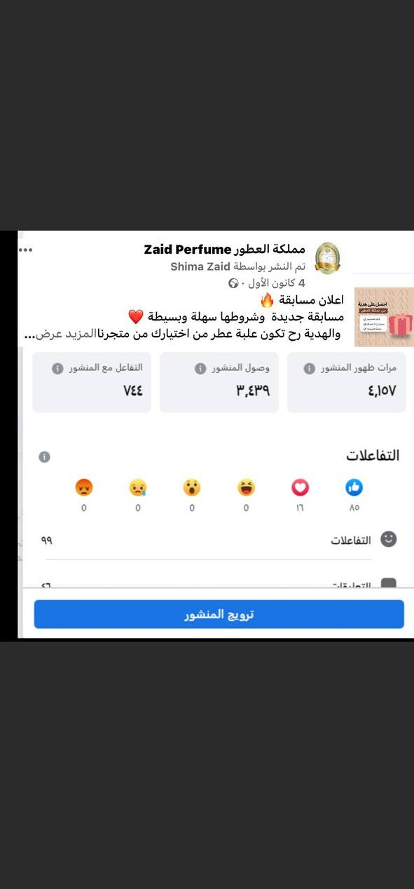


Making giveaways

Slide 21
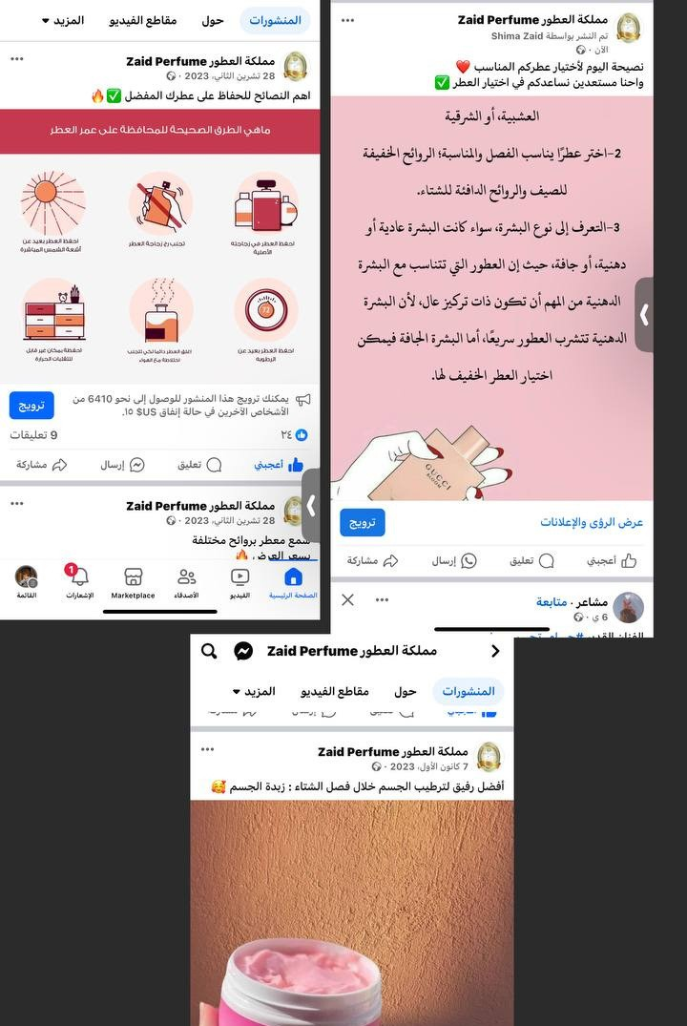

tips

Slide 22
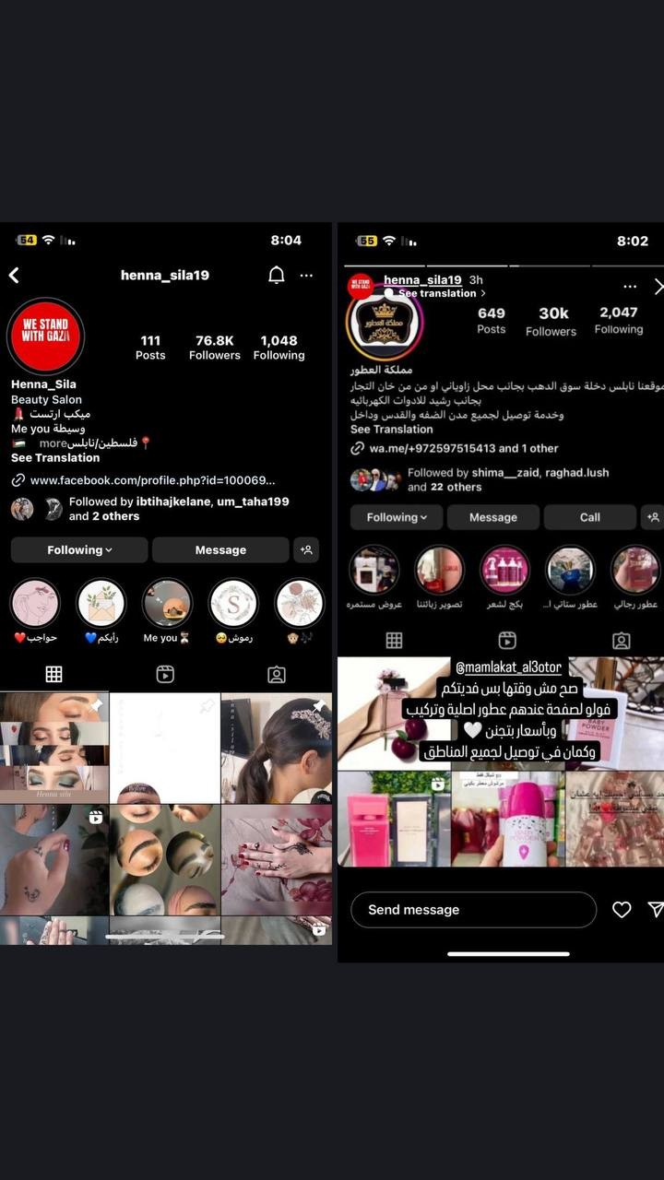
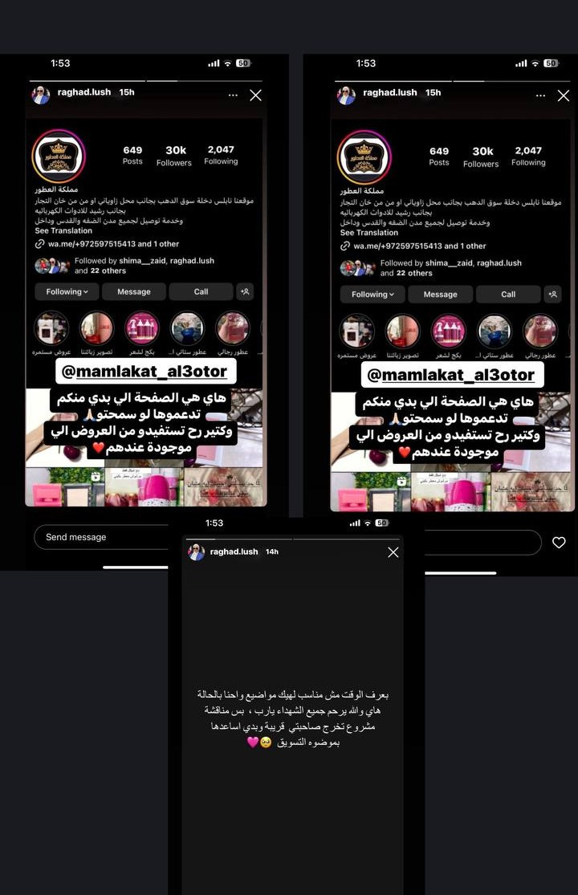
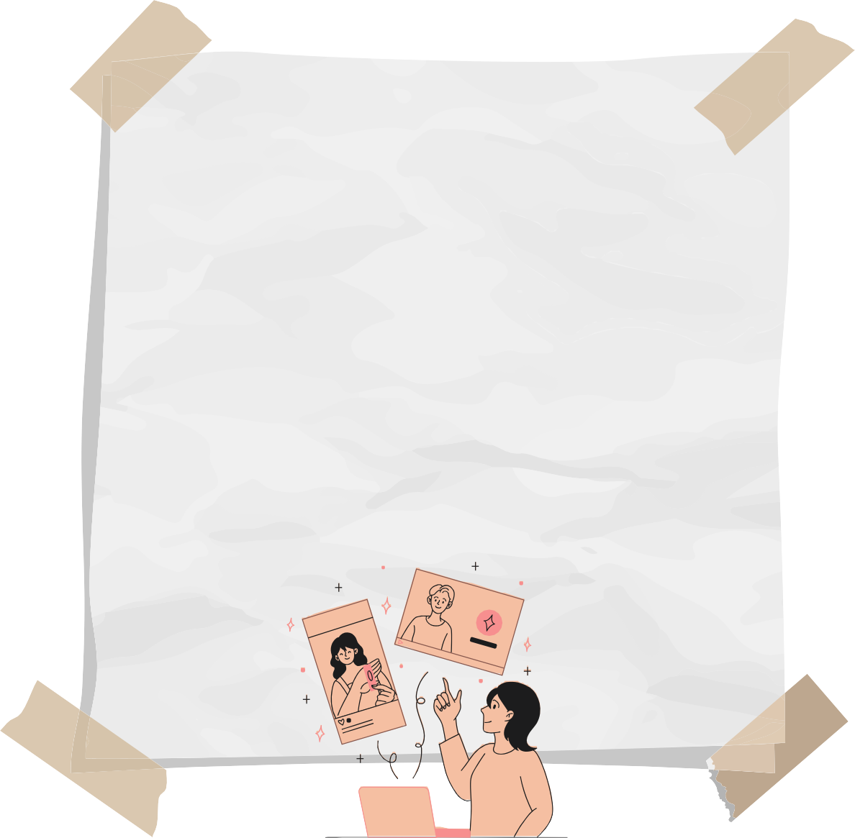
Communicate with in fluencers

Slide 23
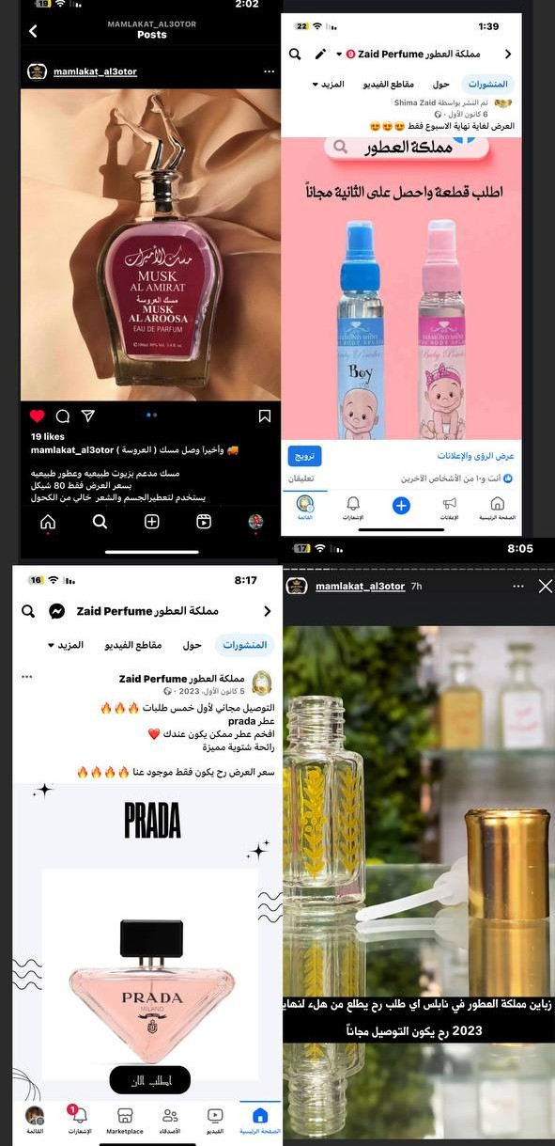
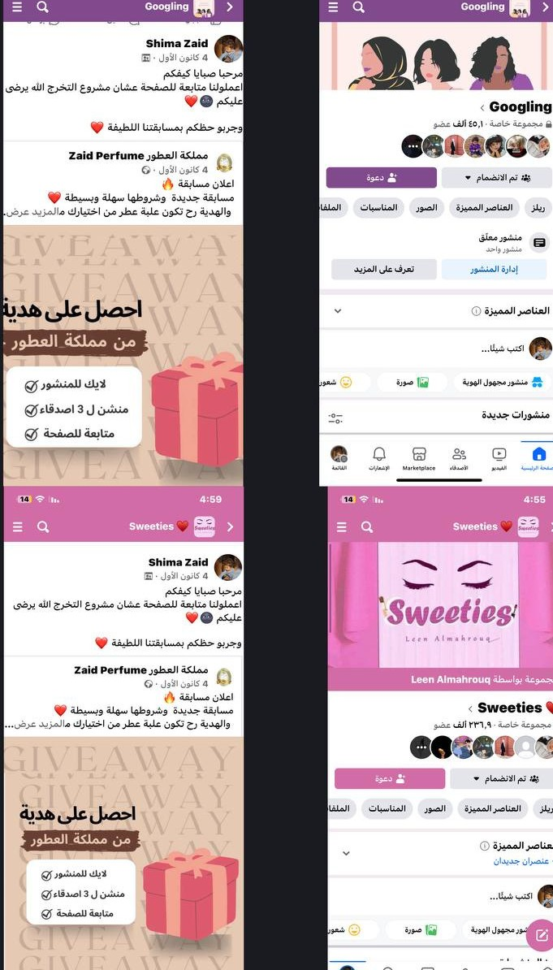

Makie offer
Post in Facebook groups

Slide 24
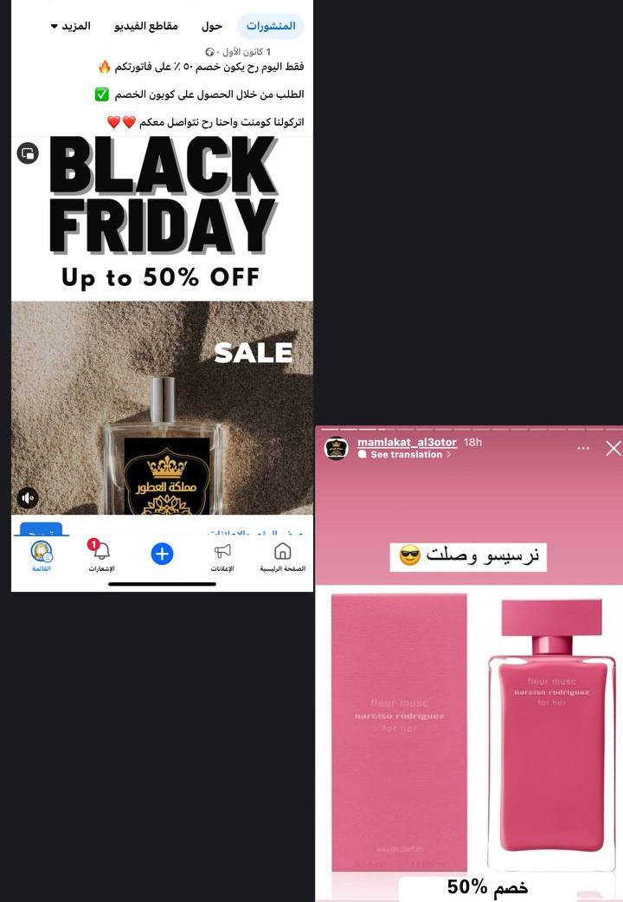


Black Friday

Slide 25
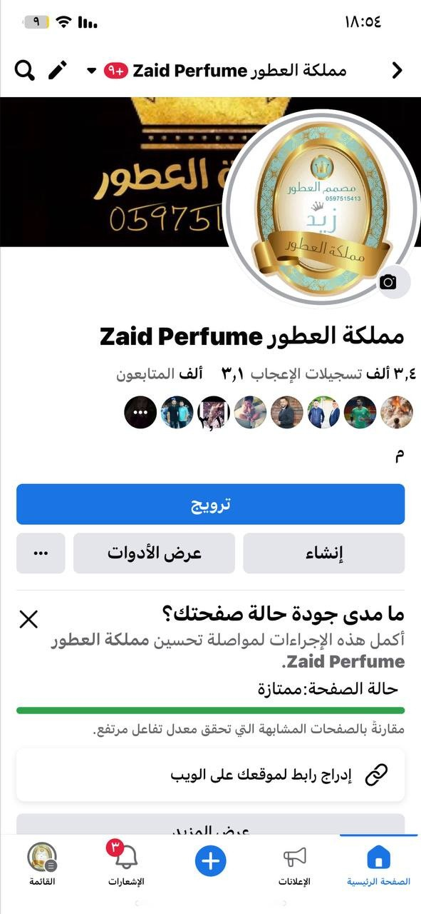
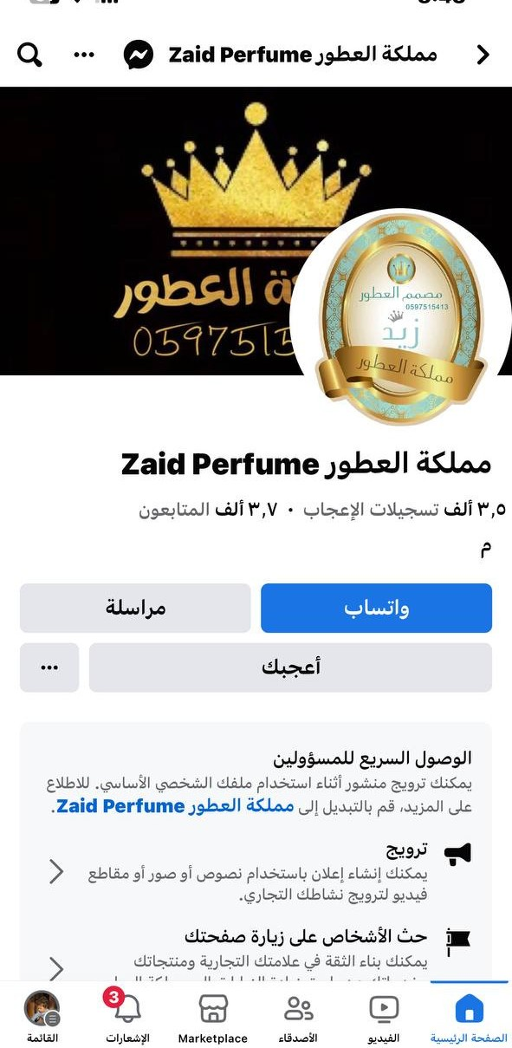
before
after

Slide 26
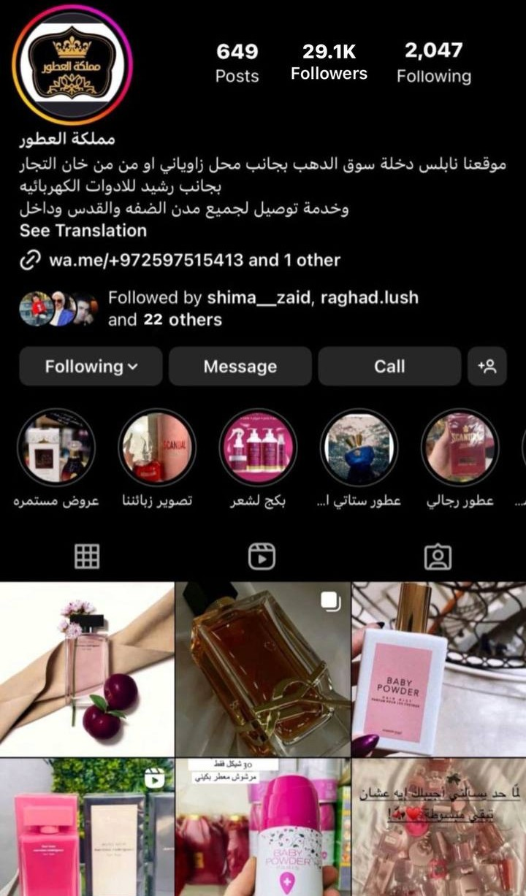
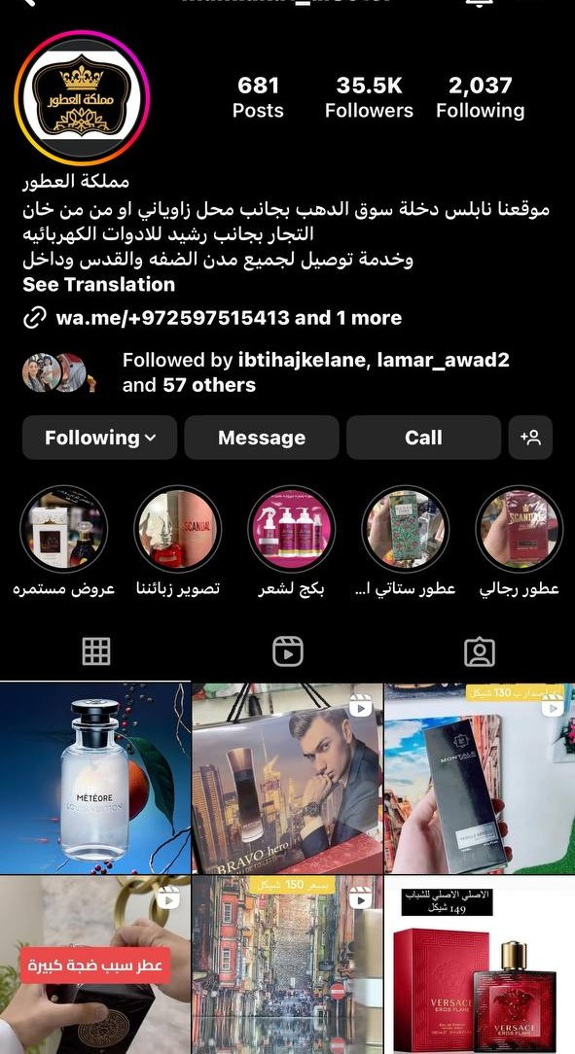
before
after

Slide 27
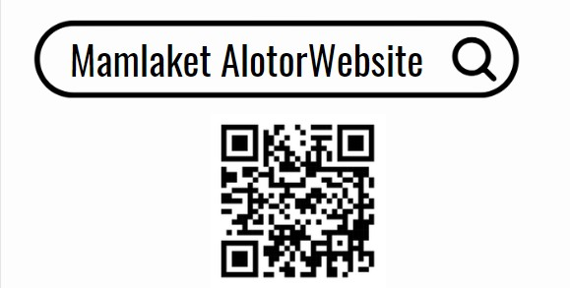

Slide 28
crm

Slide 29
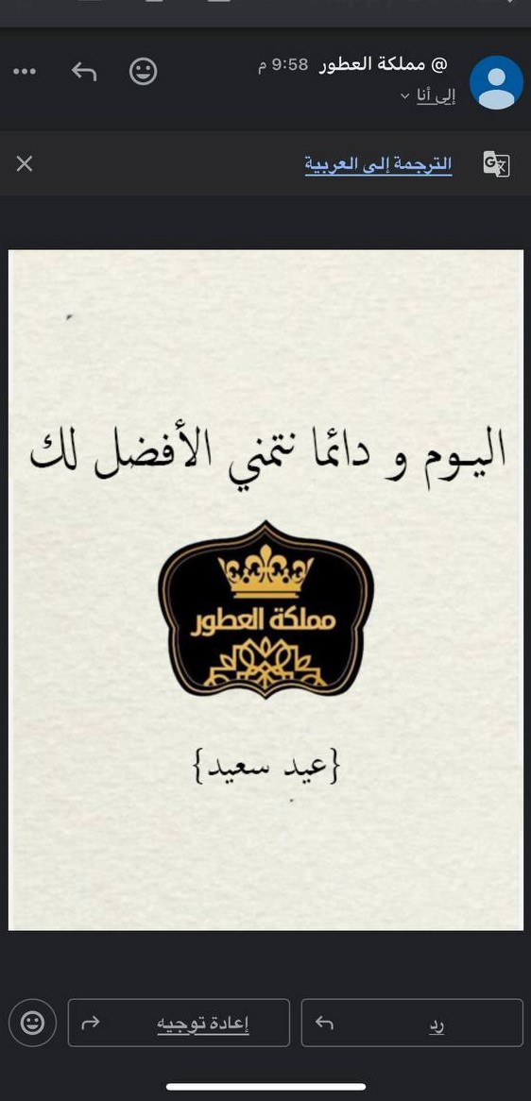
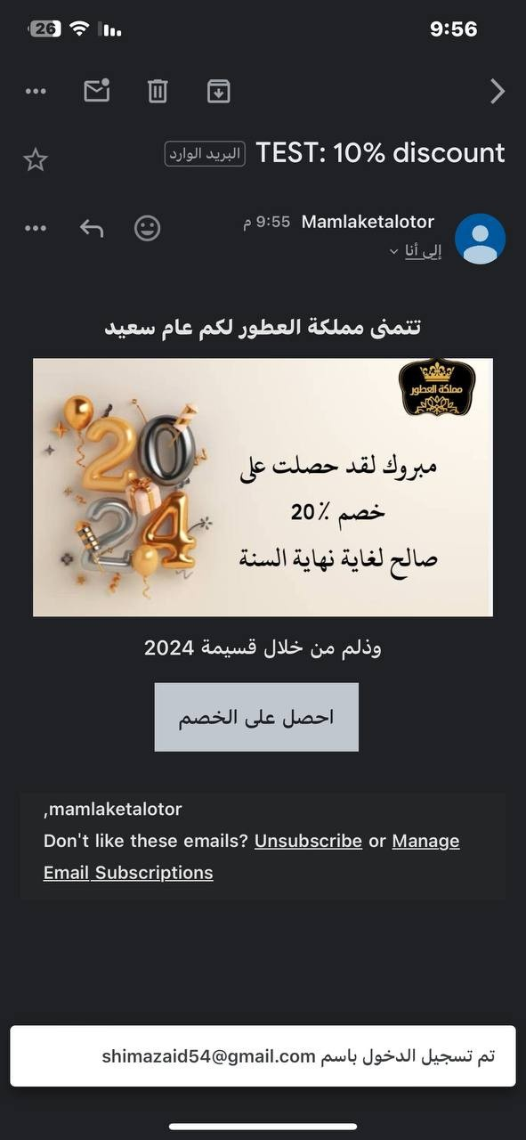
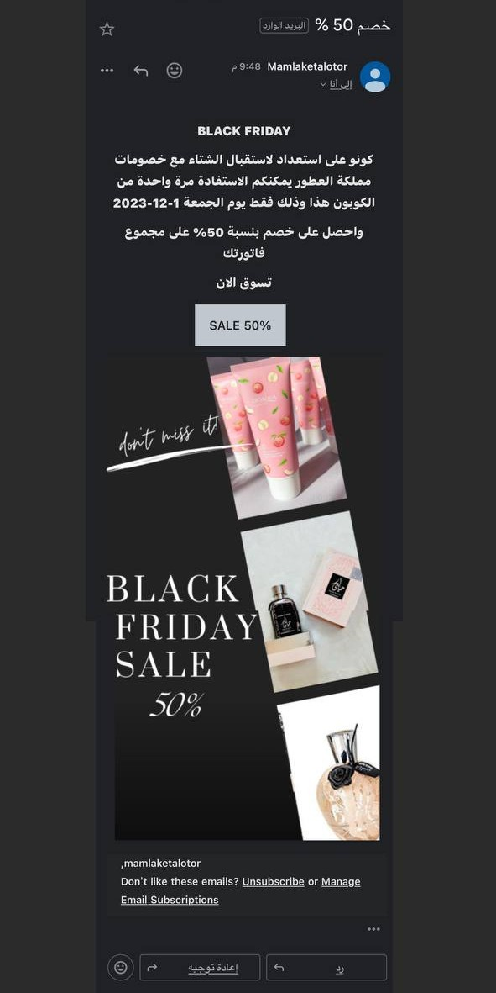

Slide 30
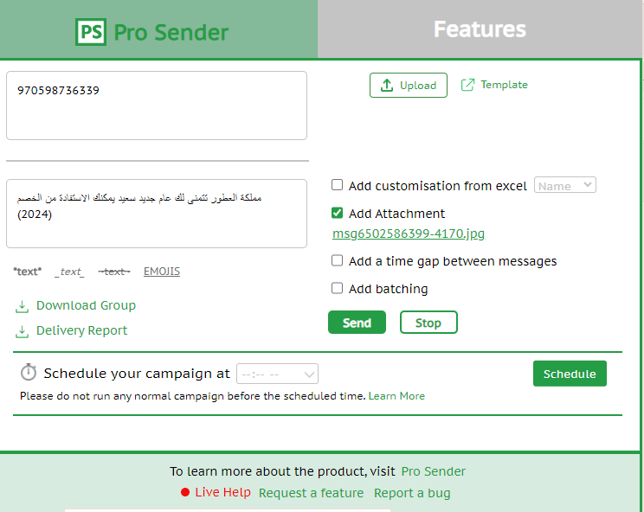
whatsapp marketing

Slide 31
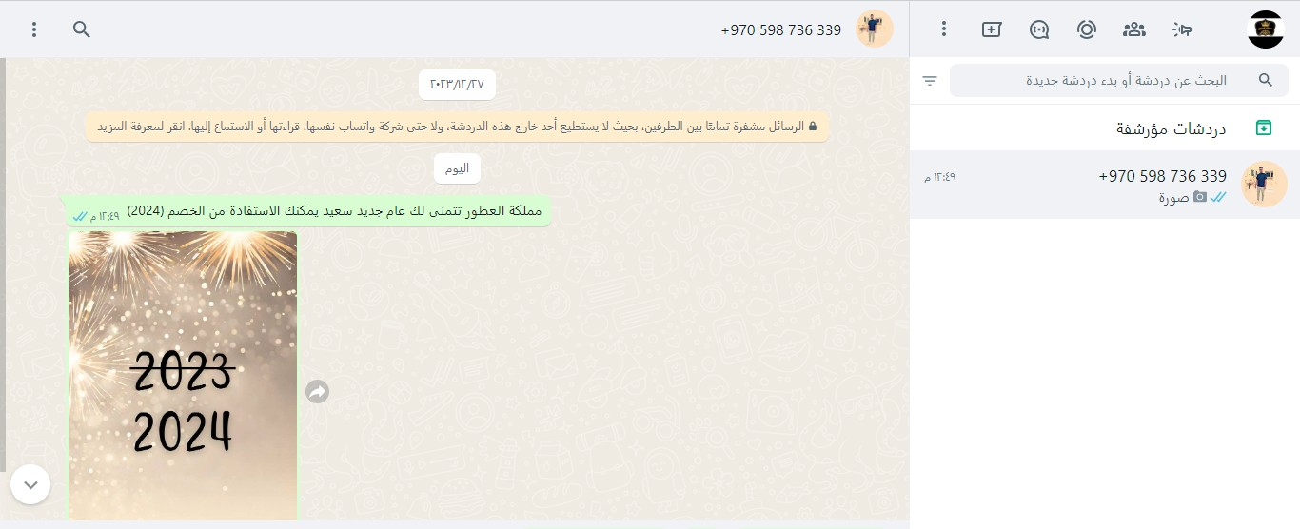

Slide 32
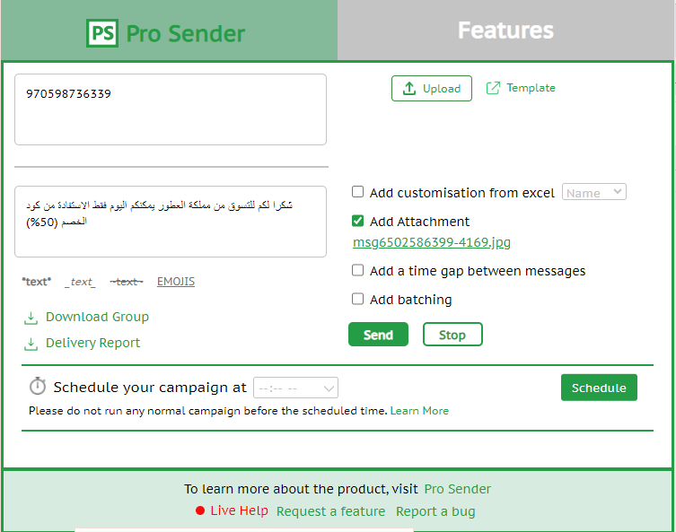

Slide 33
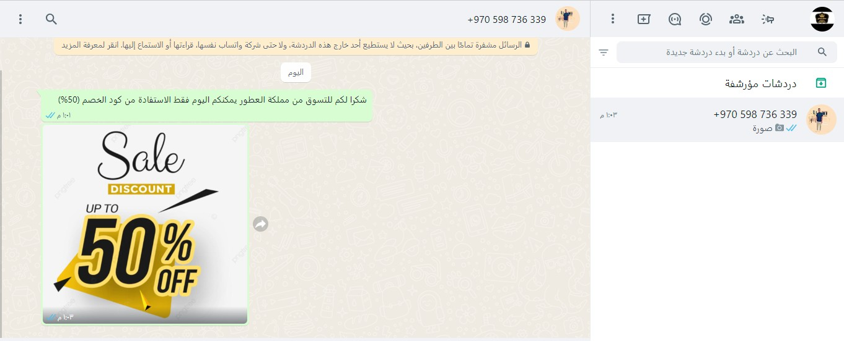

Slide 34
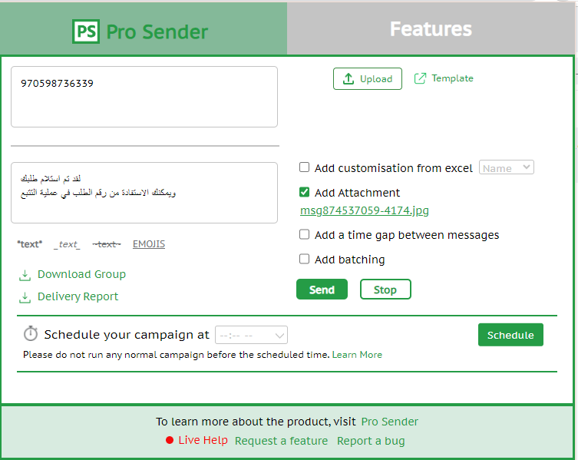

Slide 35
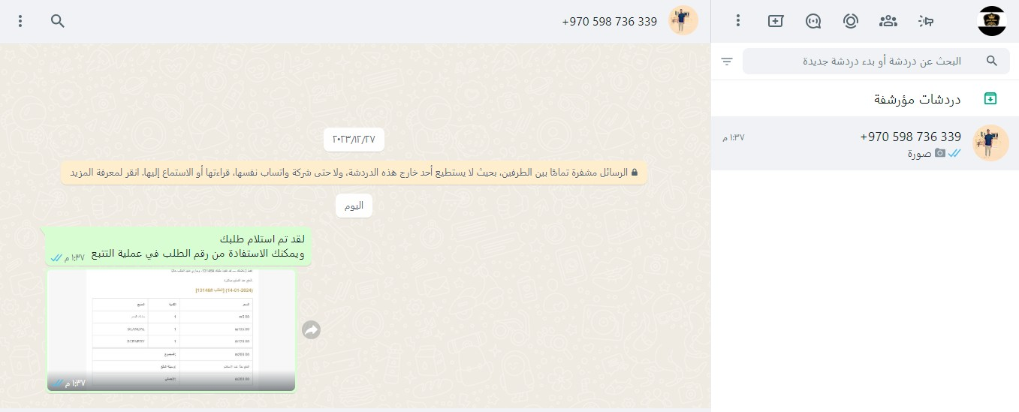

Slide 36

SEO

Slide 37
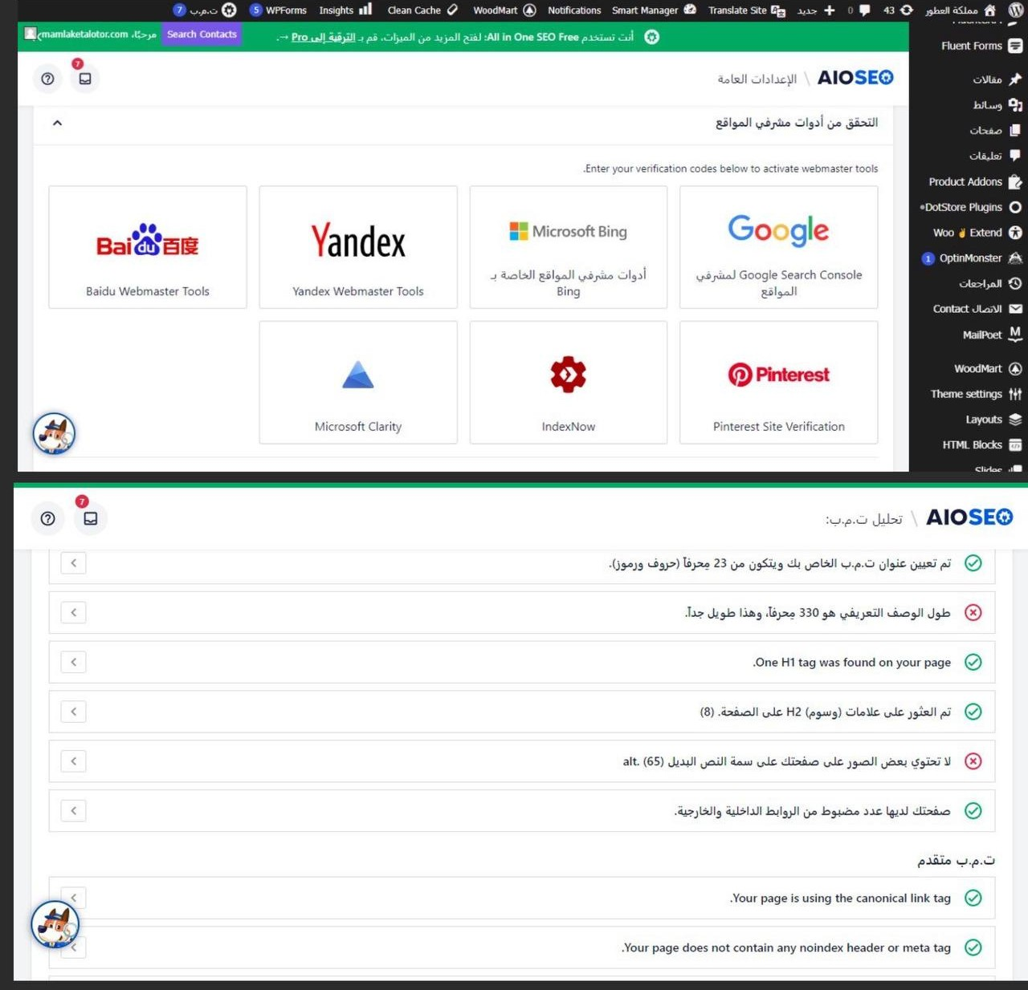

Slide 38
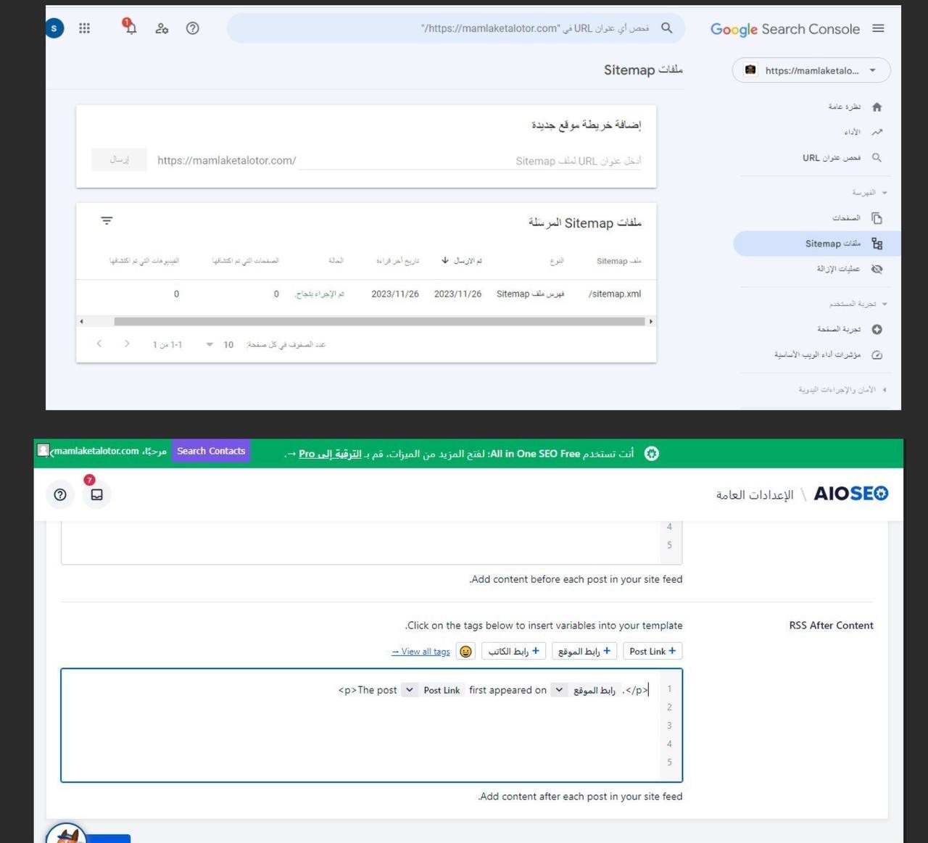

Slide 39
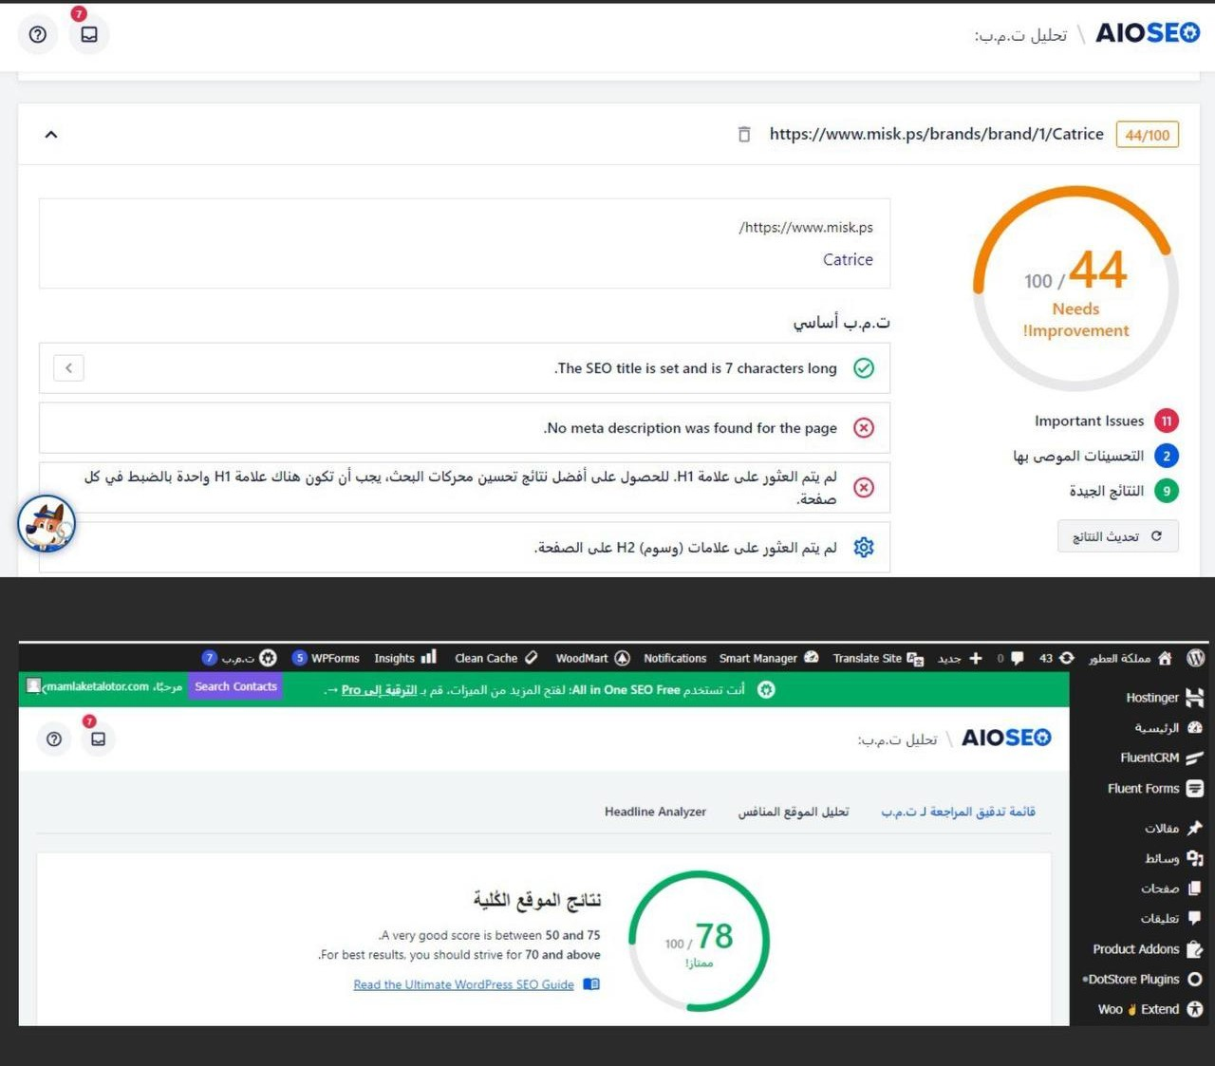

Slide 40



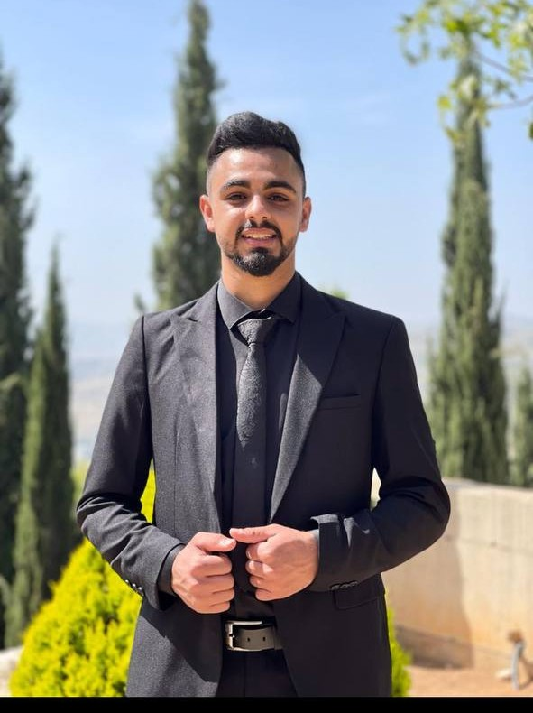
Thank you
Any questions ?
Mohammed Tabib
Shima Zaid
4

